Slide 1
ADO.NET(Activex Data Object)
Presented by:Er.Sudan Prajapati

Slide 2
Introduction
ADO.NET is a set of classes that comes with the Microsoft .NET framework to facilitate data access from managed languages.
ADO.NET has been in existence for a long time and it provides a comprehensive and complete set of libraries for data access.
The strength of ADO.NET is firstly that it lets applications access various types of data using the same methodology.
If how to use ADO.NET to access a SQL Server database is understood then the same methodology can be used to access any other type of database (like Oracle or MS Access) by just using a different set of classes
.Secondly, ADO.NET provides two models for data access: a connected model keep the connection with the database and perform data access, and another way is to get all the data in ADO.NET objects that let us perform data access on disconnected objects.

Slide 3
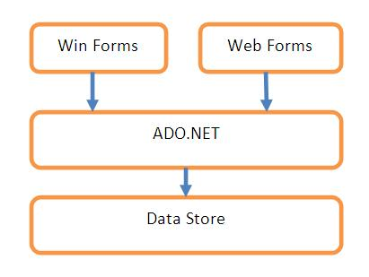
ADO.NET data access

Slide 4
The diagram shows that ADO.NET can be used with any kind of application, i.e., it can be used from a Windows Forms application, an ASP.NET application, application.
Also, the data store underneath can be any data store, SQL Server, Access, or Oracle.
It is just a matter of using the right set of classes specific to that data store and the methodology will remain the same.

Slide 5
Using the code
Let’s try to understand a few ADO.NET classes and methodologies by writing a small web application.
We will use databasesql server for understanding the various classes and methods of ADO.NET.
We will be using ADO.NET basic philosophy remains the same and can be applied with any data store.
Before jumping into the code, we will have to understand some of the important objects of ADO.NET. In a typical scenario requiring data access, we need to perform four major tasks:
Connecting to the database
Passing the request to the database, i.e., a command like select, insert, or update.
Getting back the results, i.e., rows and/or the number of rows effected.
Storing the result and displaying it to the user.

Slide 6
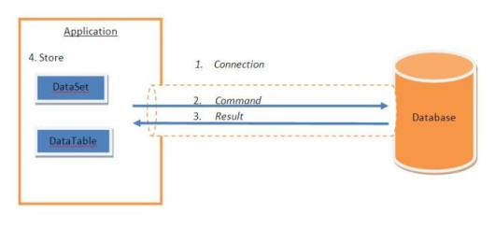

Slide 7
The Connection
The ADO.NET Connection class is used to establish a connection to the database.
The Connection class uses a ConnectionString to identify the database server location, authentication parameters, and other information to connect to the database.
This ConnectionString is typically stored in the App Config web.config.
<connectionStrings>
<add name="AsianManagement"
connectionString="Data Source=sudan;Initial Catalog=faculty;UID=asian;Password=asian;Integrated Security=True"/>
</connectionStrings>

Slide 8
Sql Connection
SqlConnection class is used to establish a connection with a database.
SqlConnection con = null;
con = new SqlConnection(ConfigurationManager.ConnectionStrings["AsianManagement"].ConnectionString);
Now we have a connection ready with database.
Whenever we want to retrieve data, we just need to open the connection, perform the operation, and close the connection.

Slide 9
Try Out
private void button1_Click(object sender, EventArgs e)
{ SqlConnection con = null;
con = new SqlConnection(ConfigurationManager.ConnectionStrings["AsianManagement"].ConnectionString);
try {
con.Open();
MessageBox.Show("Connection Open ! ");}
catch (Exception ex)
{MessageBox.Show("Can not open connection ! "); }
Finally{con.Close(); }
}

Slide 10
DataReader
A DataReader is an object that can be used to access the results sequentially from a database.
The DataReader is used to get forward only sequential results as the query executes. This is used with the Command object.
Dataset
The Dataset can be thought of as an in-memory representation of a database.
A DataSet is a disconnected data access object.
The result of the query can be stored in a Dataset.
The DataSet contains DataTables.
The DataTables contain DataRow and DataColumns. A DataSet or a DataTable can be used with a Command and a DataAdapter object to store query results.

Slide 11
DataAdapter
A DataAdapter object is used to fill a DataSet/DataTable with query results.
This can be thought of as the adapter between the connected and disconnected data models.
A Command object will be used to execute the query and a DataAdapter will use this Command object and fill the query results coming from the database into a DataSet/DataTable.

Slide 12
Try out
string connectionString = "Data Source=.;Initial Catalog=faculty;uid=asian;pwd=asian;Integrated Security=True";
string sql = "SELECT * FROM subject";
SqlConnection connection = new SqlConnection(connectionString);
SqlDataAdapter dataadapter = new SqlDataAdapter(sql, connection);
DataSet ds = new DataSet();
connection.Open();
dataadapter.Fill(ds,"f");
connection.Close();
dataGridView1.DataSource = ds;
dataGridView1.DataMember="f";
dataGridView1.ReadOnly = true;

Slide 13
Detail
SqlDataAdapter dataadapter = new SqlDataAdapter();
The DataAdapter is the one that actually executes the commands to data source.
It has a SelectCommand property accepts DbCommand object that specifies the SELECT statement used to retrieved data from the data source
DataSet ds = new DataSet();
ds.Fill(ds,"f");
After execution of the above command, a new DataTable with the name TableName will be added to the Tablesproperty oft the DataSet.
You can then access the data using the Rows property of the DataTable.

Slide 14
DataTable
private void button1_Click(object sender, EventArgs e)
{ string connectionString = "Data Source=.;Initial Catalog=faculty;uid=asian;pwd=asian;Integrated Security=True";
string sql = "SELECT * FROM subject";
SqlConnection connection = new SqlConnection(connectionString);
SqlDataAdapter dataadapter = new SqlDataAdapter(sql, connection);
connection.Open();
DataTable myTable = new DataTable("subject");
dataadapter.Fill(myTable);
dataGridView1.DataSource = myTable; }

Slide 15
The Command
Once we have the connection ready, the next step would be to tell the database about what operation we need to perform on the database.
This can be done using the Command object.
The Command Object has a property called CommandText , which contains a String value that represents the command that will be executed against the Data Source.

Slide 16
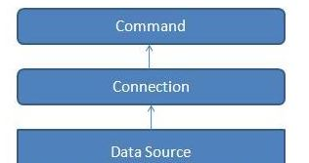

Slide 17
Important built in methods uses in the Command Object to execute the SQL statements.
C# ExecuteNonQuery
C# ExecuteReader
C# ExecuteScalar

Slide 18
Execute Reader
The ExecuteReader() in C# SqlCommand Object sends the SQL statements to the Connection Object and populate a SqlDataReader Object based on the SQL statement.
When the ExecuteReader method in SqlCommand Object execute it will instantiate a SqlClient.SqlDataReader Object.
The SqlDataReader Object is a stream-based , forward-only, read-only retrieval of query results from the Data Source, which do not update the data it contains.
The SqlDataReader cannot be created directly from code, they can created only by calling the ExecuteReader method of a C# Command Object.

Slide 19
eXAMPLE
private void button3_Click(object sender, EventArgs e) {
SqlCommand sqlCmd=new SqlCommand();
DataSet ds = new DataSet();
SqlConnection con = null;
con = new SqlConnection(ConfigurationManager.ConnectionStrings["AsianManagement"].ConnectionString);
sqlCmd.Connection = con;
sqlCmd.CommandText = "select * from subject";
try {con.Open();
SqlDataReader reader = sqlCmd.ExecuteReader();
DataTable dt = new DataTable();
dt.Load(reader);
dataGridView1.DataSource = dt;
}

Slide 20
eXAMPLE
catch (Exception ex)
{
MessageBox.Show(ex.ToString());
}
}s

