Slide 1
WINFORM
Presented by:Er.Sudan Prajapati

Slide 2
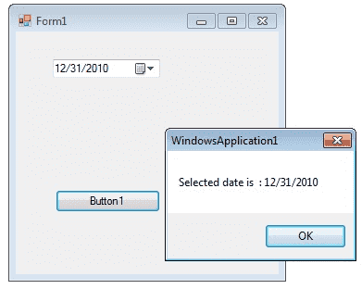
Date Time Picker Control
The DateTimePicker control allows to display and collect date and time from the user with a specified format.

Slide 3
Date Time Picker Control
The DateTimePicker control has two parts, a label that displays the selected date and a popup calendar that allows users to select a new date.
The most important property of the DateTimePicker is the Value property, which holds the selected date and time.
The control can display one of several styles, depending on its property values.
The values can be displayed in four formats, which are set by the Format property: Long, Short, Time, or Custom.

Slide 4
Date Time Picker Control
private void Form1_Load(object sender, EventArgs e)
{
dateTimePicker1.Format = DateTimePickerFormat.Short;
dateTimePicker1.Value = DateTime.Today;
}
private void button1_Click(object sender, EventArgs e)
{
DateTime iDate;
iDate = dateTimePicker1.Value;
MessageBox.Show("Selected date is " + iDate);
}

Slide 5
Adding Sound to an Application
Double Click in form and the code below
SoundPlayer simpleSound = new SoundPlayer(@"c:\Windows\Media\chimes.wav");
simpleSound.Play();

Slide 6
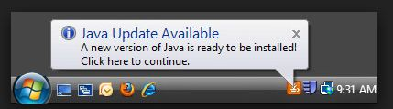
Notification Icon
In Windows there is a Taskbar with a Notification area (historically known as the system tray or status area) with icons.
Typically in the bottom-right a notification icon notifies the user of certain information.

Slide 7
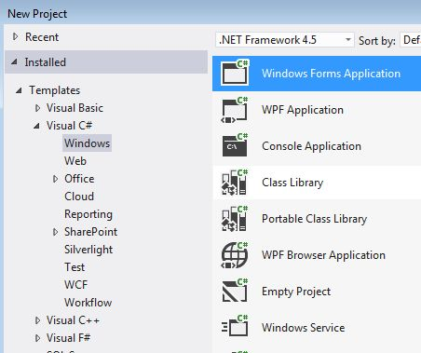
Procedure

Slide 8
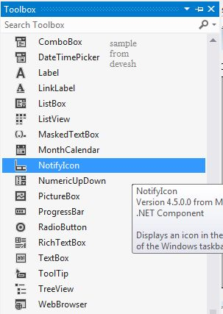

Add a Notify Icon as in the screen below:

Slide 9
Add a code below
On form Load add below
displaynotify();
Make a function displyanotify
private void displaynotify()
{ notifyIcon1.Text = "Brilliant Student of Asian";
notifyIcon1.BalloonTipTitle = "Welcome 7th Semester BIM Asian Students ";
notifyIcon1.BalloonTipText = "Click Here to see details";
notifyIcon1.ShowBalloonTip(100);
}

Slide 10
Add a code below
Click on NotifyIcon
Add the code below
private void notifyIcon1_Click(object sender, MouseEventArgs e)
{
MessageBox.Show("now i am smart in .net ");
}

Slide 11
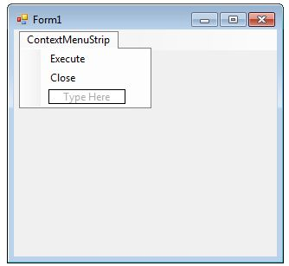
NotifyIcon with Context Menu
Add a ContextMenu using a ContextMenuStrip control from tool box.
When Application run it will be opened when right mouse click event is

Slide 12
Setting ContextMenu
Now we add the following code on the Form initialization to set ContextMenu of the NotifyIcon.
notifyIcon1.ContextMenuStrip = contextMenuStrip1;

Slide 13
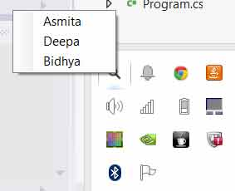
Display in following order Context Menu

Slide 14
Task
When you click asmita display msgBox Asmita is expert in .NET
When you click deepa display msgBox deepa is expert in .NET
When you click bidhya display msgBox bidhya is expert in .NET

