Slide 1
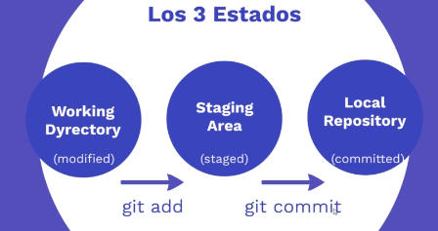
Repo remoto
push

Slide 2
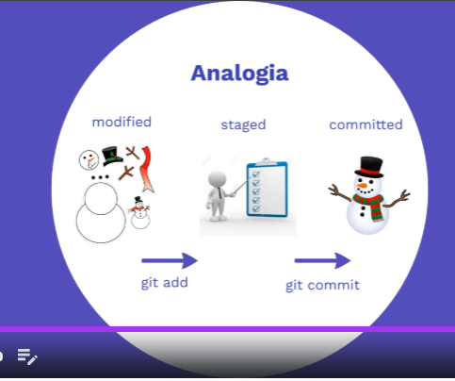
Repo remoto
push

