Slide 1
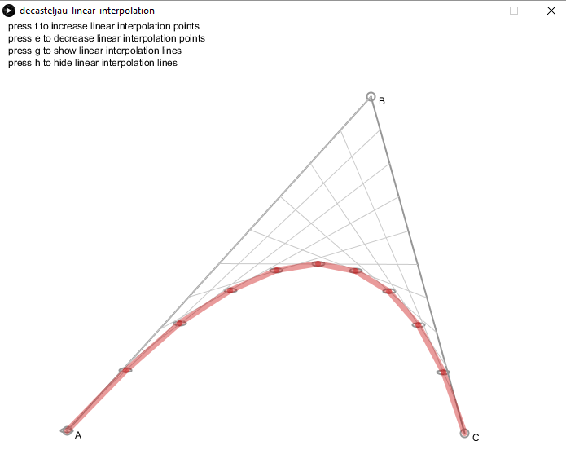
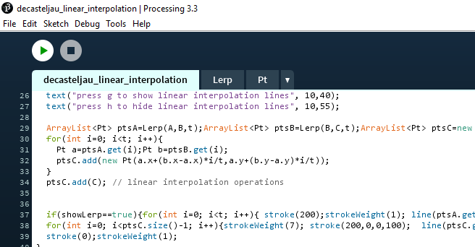
Inputs – 3 points
Linear Interpolation
curve
De Cateljau algorithm – parametric Bezier curve
Extremely high smoothness & performance

Slide 2
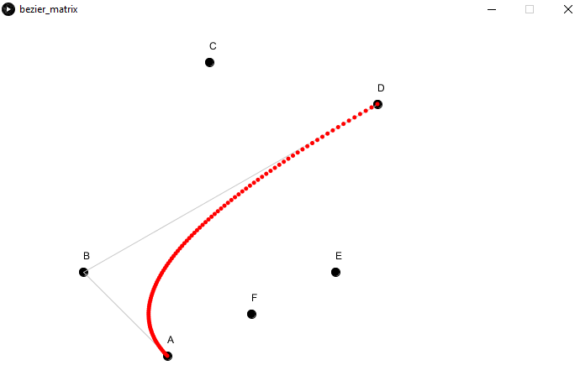
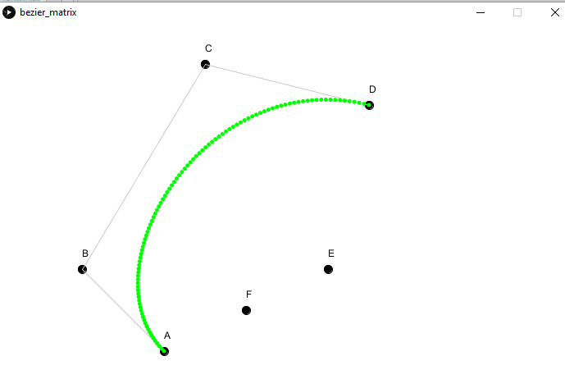
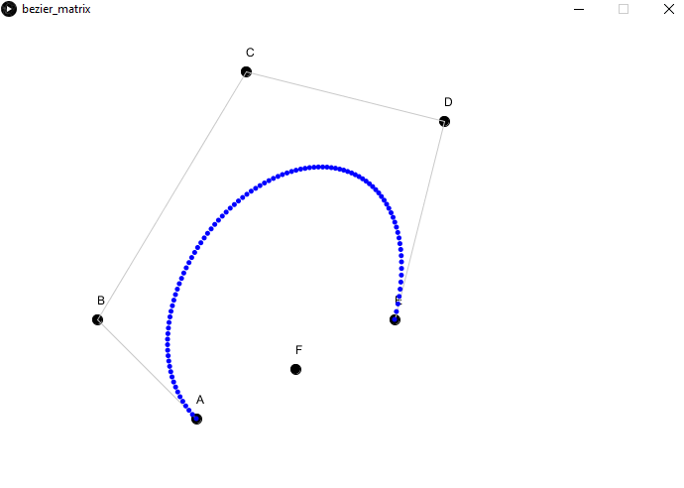
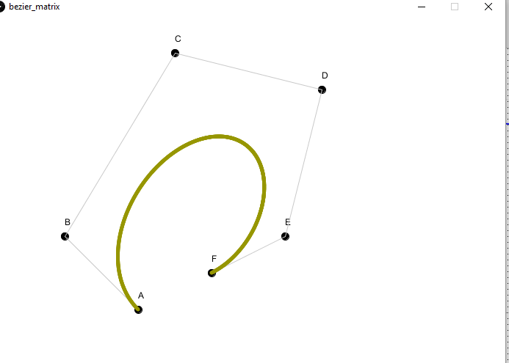
Input points : 4
Cubic Bezier curve
float x=(A.x*pow((1-t),2)) + (B.x*2*(1-t)*t) + D.x*pow(t,2);
float y=(A.y*pow((1-t),2)) + (B.y*2*(1-t)*t) + D.y*pow(t,2);
float x=(A.x*pow((1-t),3)) + (B.x*3*pow((1-t),2)*t) + (C.x*3*(1-t)*sq(t)) + D.x*pow(t,3);
float y=(A.y*pow((1-t),3)) + (B.y*3*pow((1-t),2)*t) + (C.y*3*(1-t)*sq(t)) + D.y*pow(t,3);
Input points : 3
Quadratic Bezier curve
Input points : 5
Quartic Bezier curve
float x=(A.x*pow((1-t),4)) + (B.x*4*pow((1-t),3)*t) + (C.x*6*sq(1-t)*sq(t)) + (D.x*4*(1-t)*pow(t,3)) + E.x*pow(t,4);
float y=(A.y*pow((1-t),4)) + (B.y*4*pow((1-t),3)*t) + (C.y*6*sq(1-t)*sq(t)) + (D.y*4*(1-t)*pow(t,3)) + E.y*pow(t,4);
Input points : 6
Quintic Bezier curve
float x=(A.x*pow((1-t),5)) + (B.x*5*pow((1-t),4)*t) + (C.x*10*pow((1-t),3)*sq(t)) + (D.x*10*sq(1-t)*pow(t,3)) + E.x*5*(1-t)*pow(t,4) + F.x*pow(t,5);
float y=(A.y*pow((1-t),5)) + (B.y*5*pow((1-t),4)*t) + (C.y*10*pow((1-t),3)*sq(t)) + (D.y*10*sq(1-t)*pow(t,3)) + E.y*5*(1-t)*pow(t,4) + F.y*pow(t,5);

Slide 3
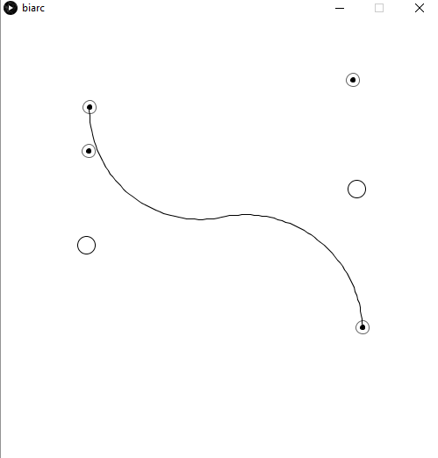
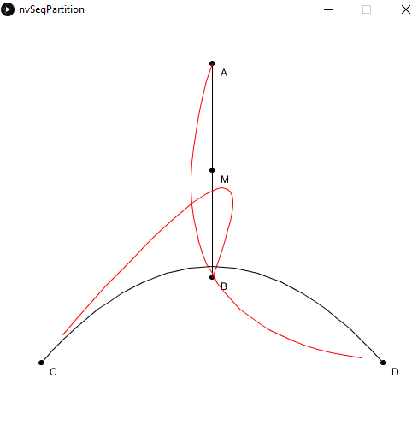
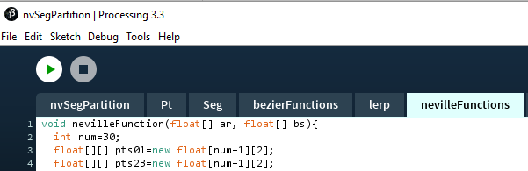
Types of curves – Biarc
biarc
Functions Separated by tab
Types of curves – Bezier, lerp, Neville

Slide 4
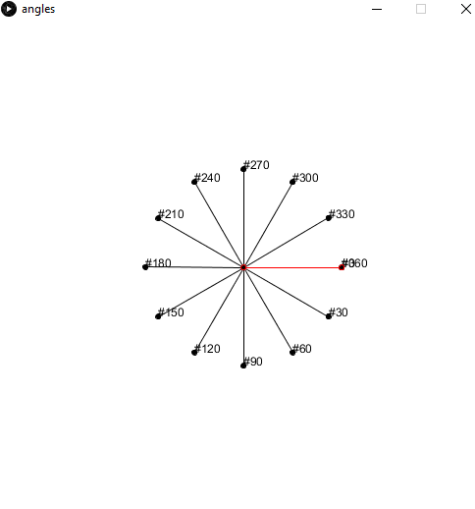
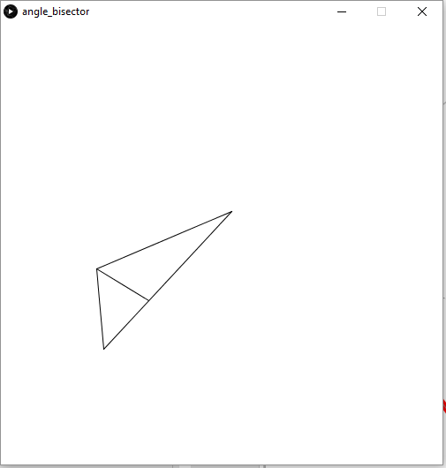
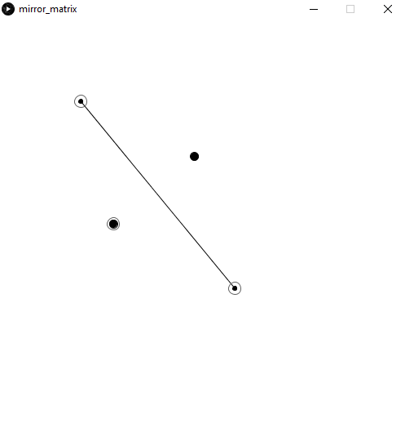
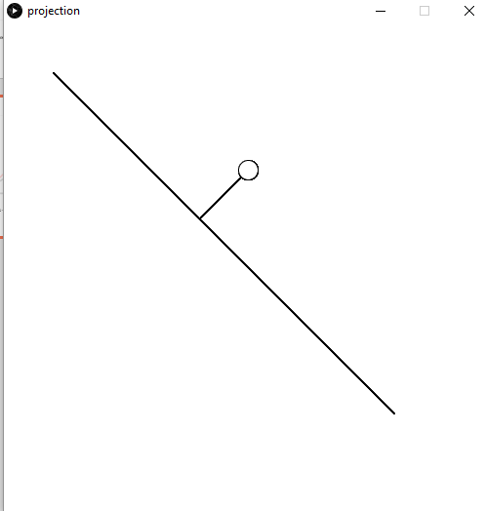
Angles
Angle_bisector
Mirror
Projection

Slide 5
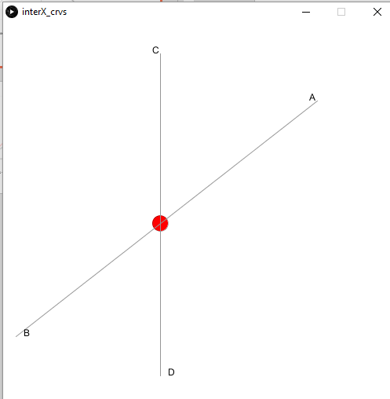
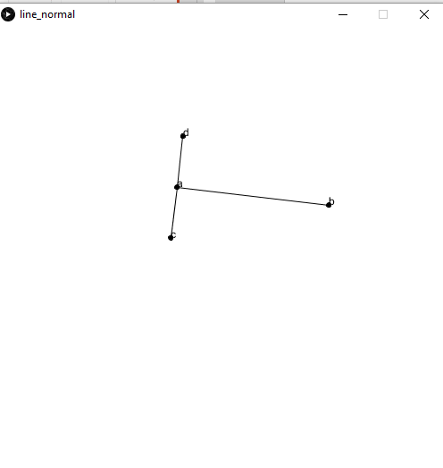
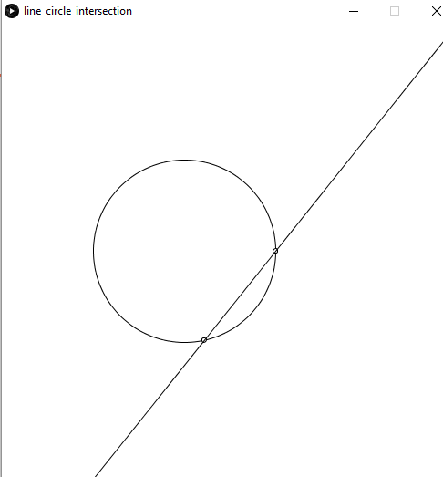
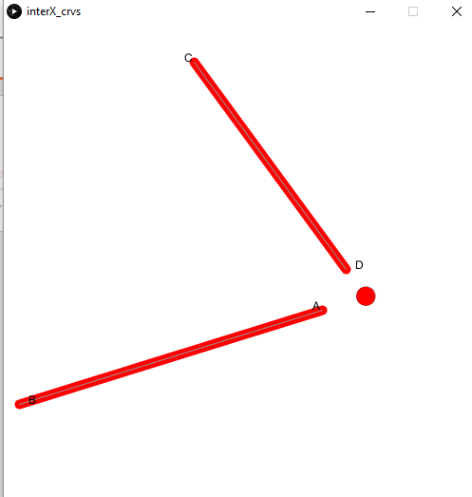
normals
Line_circle _intersection
Intersection, detect_apparent_intersection

Slide 6
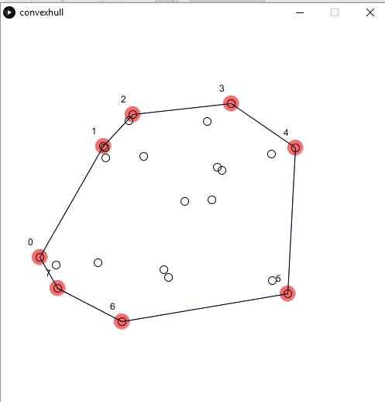
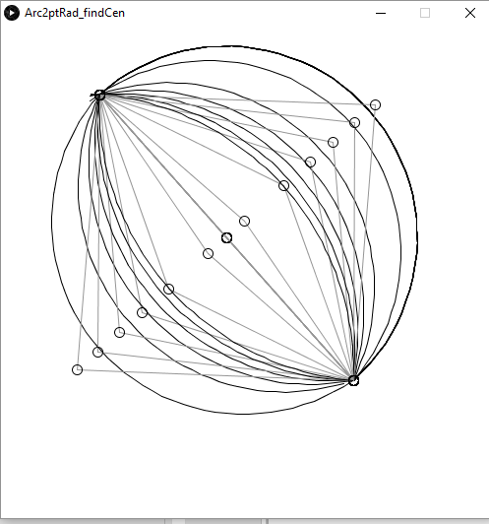
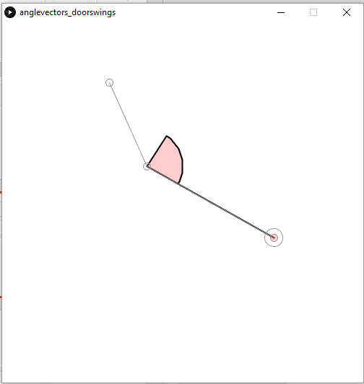
Convex hull
Arcs points normals
Intersection, arc, normal

Slide 7
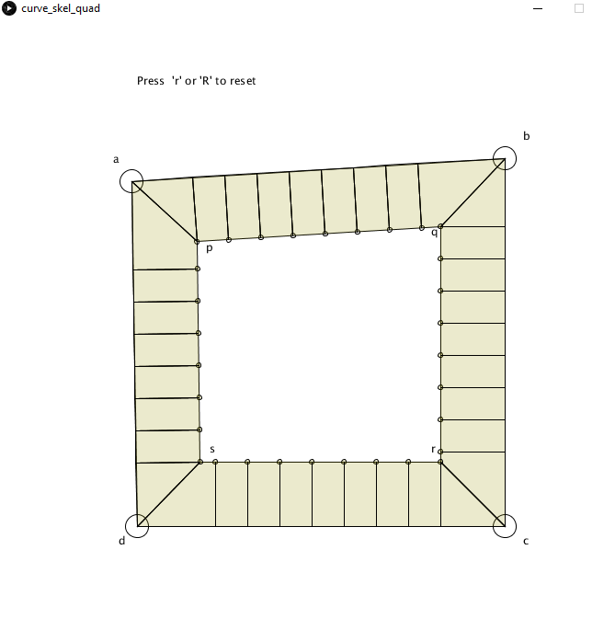
angle_bisector_subdivisions

