Slide 1
Phoenix Branch Reorganization
Territory Analysis with Revenue Metrics

Slide 2
Executive Summary
Total Active Accounts: 1,699 accounts across 4 territories
Total Active Revenue: $3,307,354.33 in annual recurring revenue
Total Lost Revenue: $14,668,592.65 from historical churn
Overall Revenue Retention: 18.4%
Best Performing Territory: East - 27.4% revenue retention, $1.1M active revenue
Strategic Focus: Improve retention in West (15.7%) & Central (17.7%) territories

Slide 3
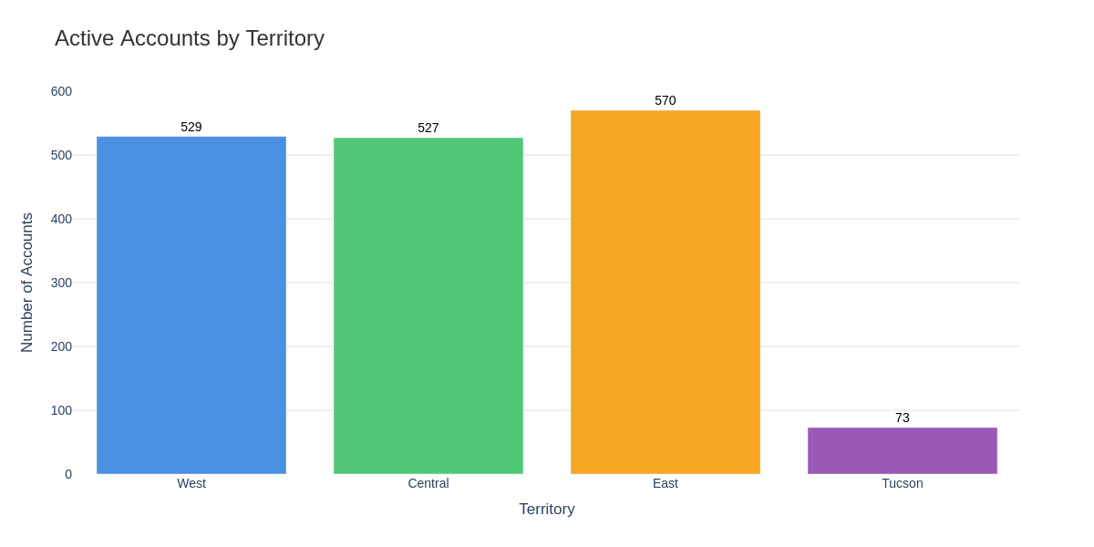
Account Distribution by Territory

Slide 4
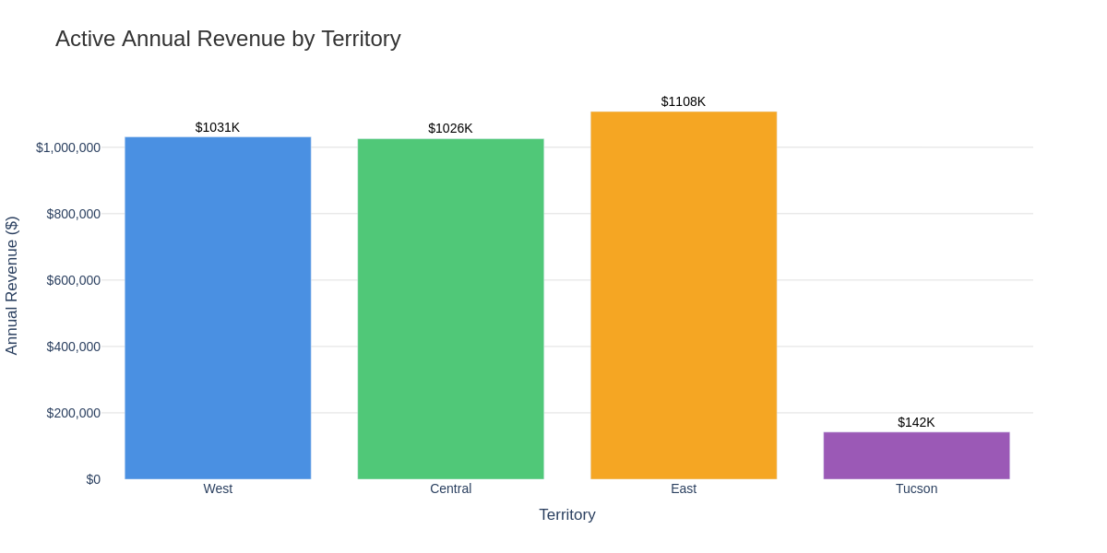
Active Annual Revenue by Territory

Slide 5
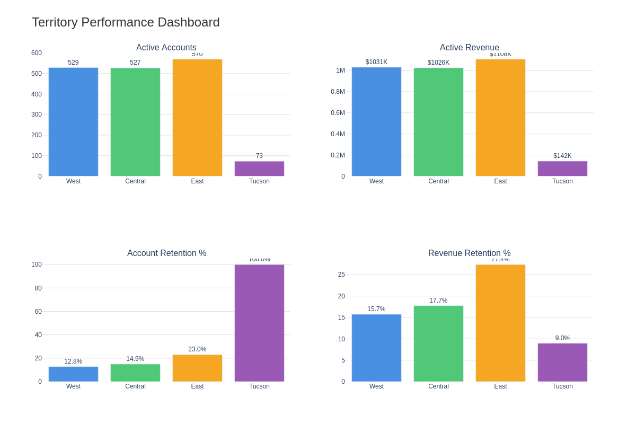
Territory Performance Dashboard

Slide 6
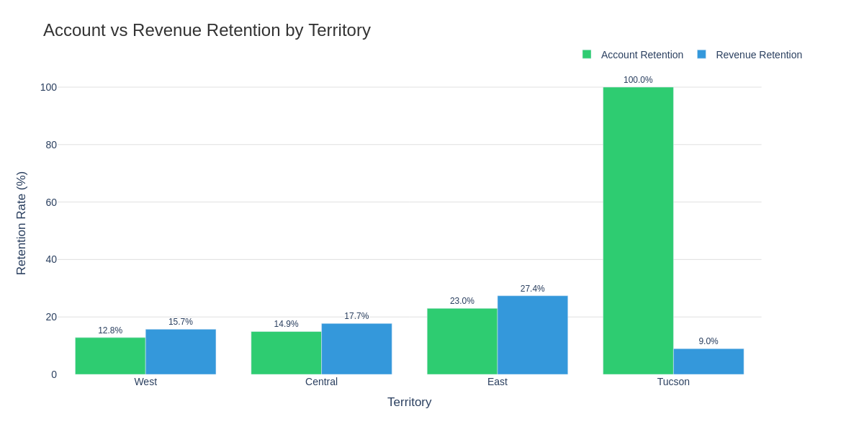
Account vs Revenue Retention Comparison

Slide 7
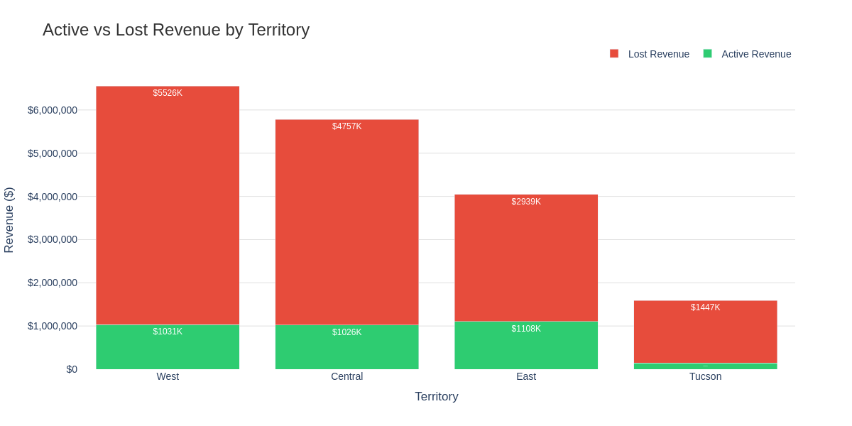
Active vs Lost Revenue by Territory

Slide 8
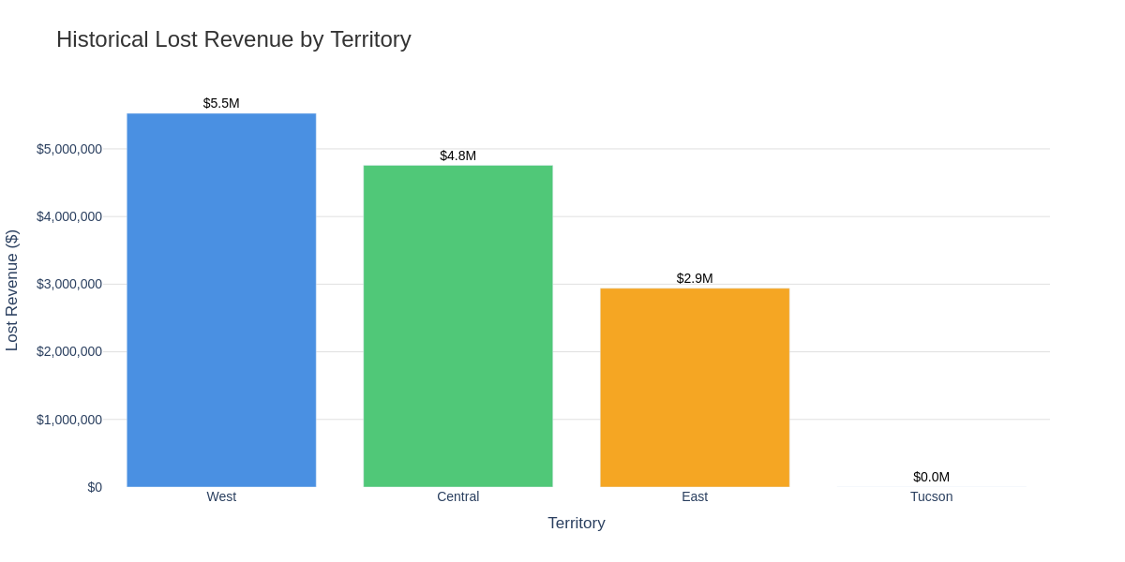
Historical Lost Revenue Analysis

Slide 9
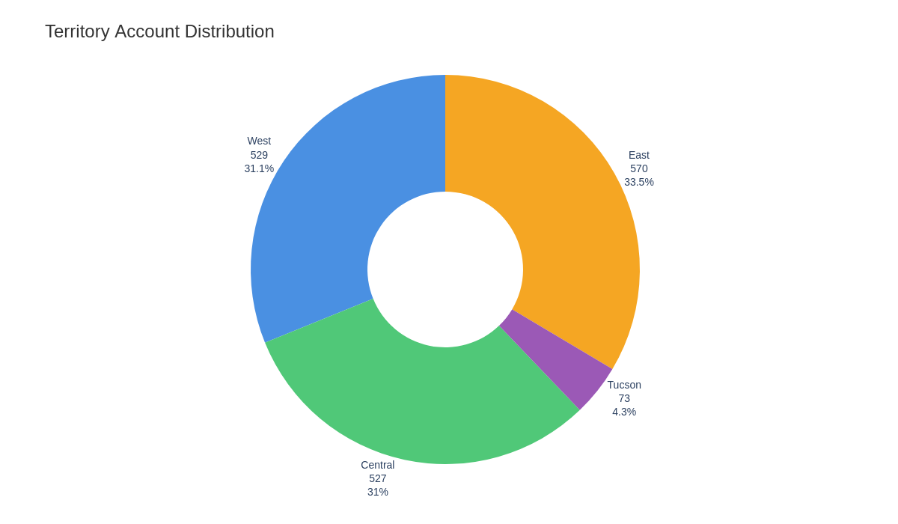
Territory Account Share

Slide 10
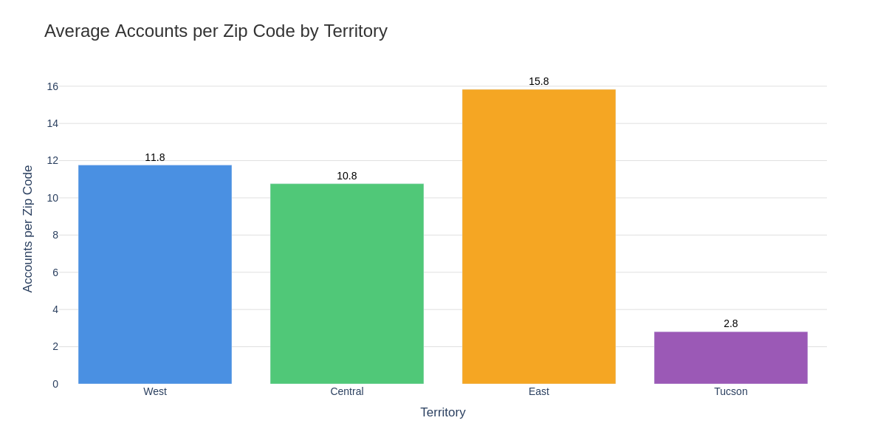
Account Density (Accounts per Zip Code)

Slide 11
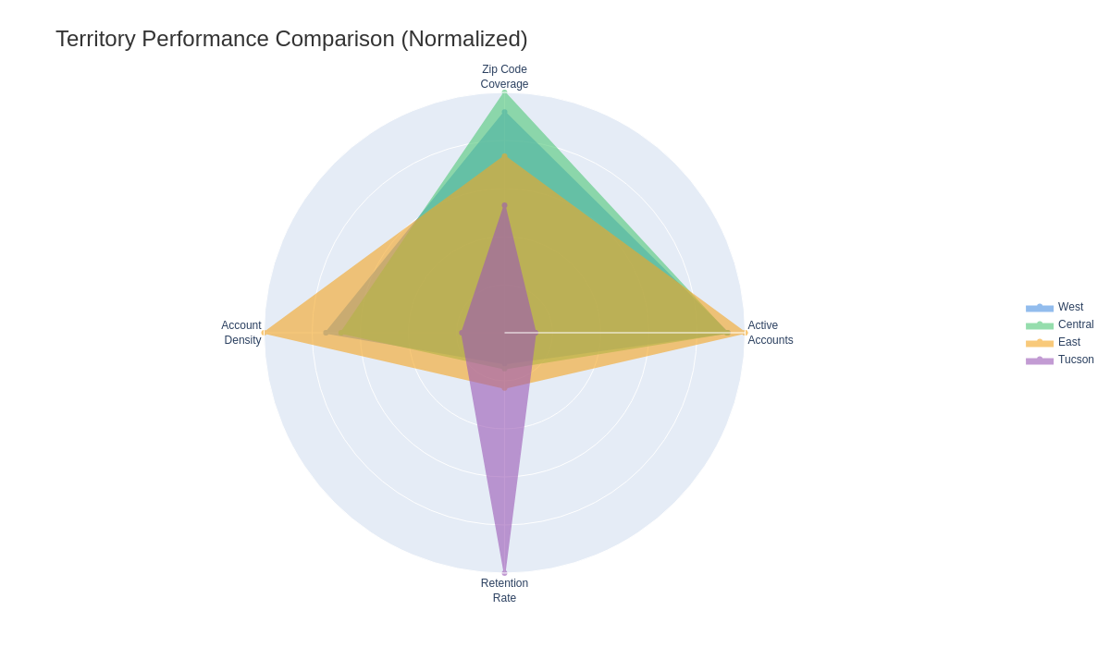
Multi-Factor Performance Comparison

Slide 12
West Territory - Detailed Metrics
Active Accounts: 529
Active Annual Revenue: $1,031,328.48
Avg Revenue per Account: $1,949.58
Zip Codes Covered: 45
Accounts per Zip: 11.8
Account Retention Rate: 12.82%
Revenue Retention Rate: 15.73%
Historical Terminated: 3,598
Lost Revenue: $5,525,709.28
Top Cities: PHOENIX (175), GLENDALE (103), PEORIA (60)

Slide 13
Central Territory - Detailed Metrics
Active Accounts: 527
Active Annual Revenue: $1,025,981.36
Avg Revenue per Account: $1,939.47
Zip Codes Covered: 49
Accounts per Zip: 10.8
Account Retention Rate: 14.94%
Revenue Retention Rate: 17.74%
Historical Terminated: 3,001
Lost Revenue: $4,756,617.26
Top Cities: SCOTTSDALE (212), PHOENIX (209), MESA (71)

Slide 14
East Territory - Detailed Metrics
Active Accounts: 570
Active Annual Revenue: $1,107,730.35
Avg Revenue per Account: $1,943.39
Zip Codes Covered: 36
Accounts per Zip: 15.8
Account Retention Rate: 22.99%
Revenue Retention Rate: 27.37%
Historical Terminated: 1,909
Lost Revenue: $2,939,262.55
Top Cities: CHANDLER (131), CASA GRANDE (104), GILBERT (104)

Slide 15
Tucson Territory - Detailed Metrics
Active Accounts: 73
Active Annual Revenue: $142,314.14
Avg Revenue per Account: $1,949.51
Zip Codes Covered: 26
Accounts per Zip: 2.8
Account Retention Rate: 100.00%
Revenue Retention Rate: 8.95%
Historical Terminated: 0
Lost Revenue: $1,447,003.56
Top Cities: TUCSON (65), MARANA (6), VAIL (2)

Slide 16
Key Insights & Recommendations
Revenue Leadership: East territory leads with $1.1M active revenue and 27% revenue retention
West Territory Challenge: Only 15.7% revenue retention, losing $5.5M - critical intervention needed
Revenue vs Account Gap: Some territories show different patterns in account vs revenue retention
Total Opportunity: $14,668,593 in lost revenue represents recovery opportunity
Action Items: Focus retention on high-value accounts; implement revenue-based KPIs

Slide 17
Financial Impact & Opportunity
Current Active Revenue: $3,307,354.33 annual recurring revenue
Historical Losses: $14,668,592.65 in churned revenue
Recovery Potential: 10% improvement in retention could recover $1.5M+ annually
West Territory Priority: Improving West retention by 5% = $275K additional revenue
ROI Focus: Retention programs typically deliver 5:1 ROI in pool service industry

Slide 18
Implementation Roadmap
1. Territory Launch (Q1 2027): Roll out new structure with revenue tracking by territory
2. High-Value Account Programs (Q1 2027): Identify and protect accounts >$2,000 annual value
3. West Territory Intervention (Q1-Q2 2027): Deploy retention team and customer success managers
4. Revenue-Based KPIs (Q2 2027): Implement monthly revenue retention tracking and alerts
5. Best Practice Replication (Q2-Q3 2027): Document and scale East territory's success model
6. Continuous Improvement (Ongoing): Quarterly reviews with revenue-focused action plans

