Slide 1
Phoenix Branch Reorganization
Territory Analysis & Performance Metrics

Slide 2
Executive Summary
Total Active Accounts: 1,699 accounts across 4 territories
Total Coverage: 156 zip codes in Phoenix and Tucson metro areas
Best Performing Territory: East - 22.99% retention rate
Highest Risk Territory: West - 12.82% retention rate, $5.5M lost revenue
Strategic Focus: Improve retention in West & Central territories

Slide 3
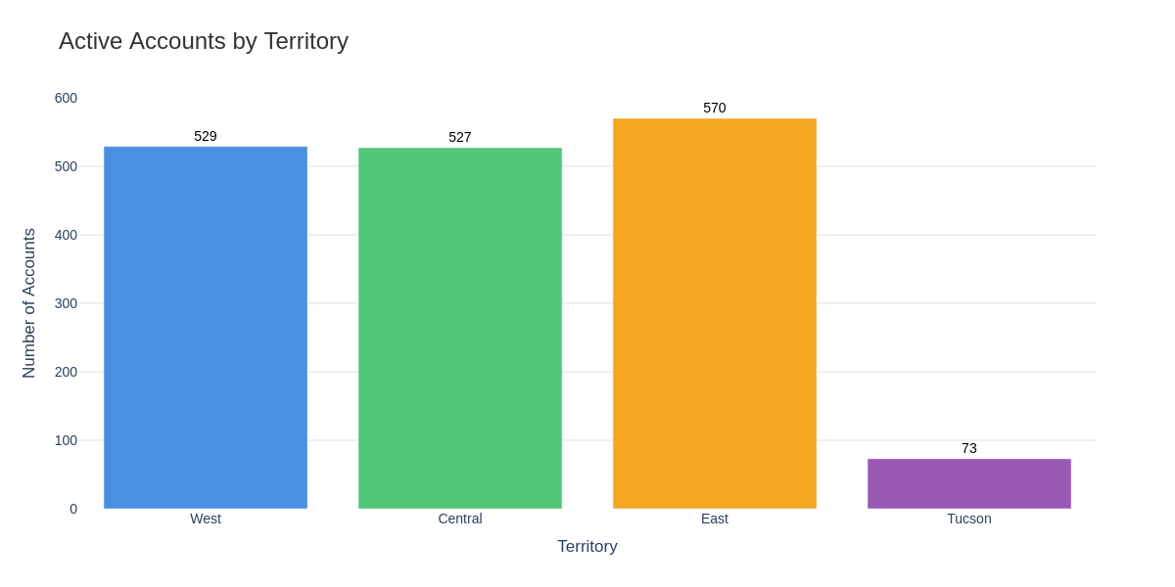
Account Distribution by Territory

Slide 4
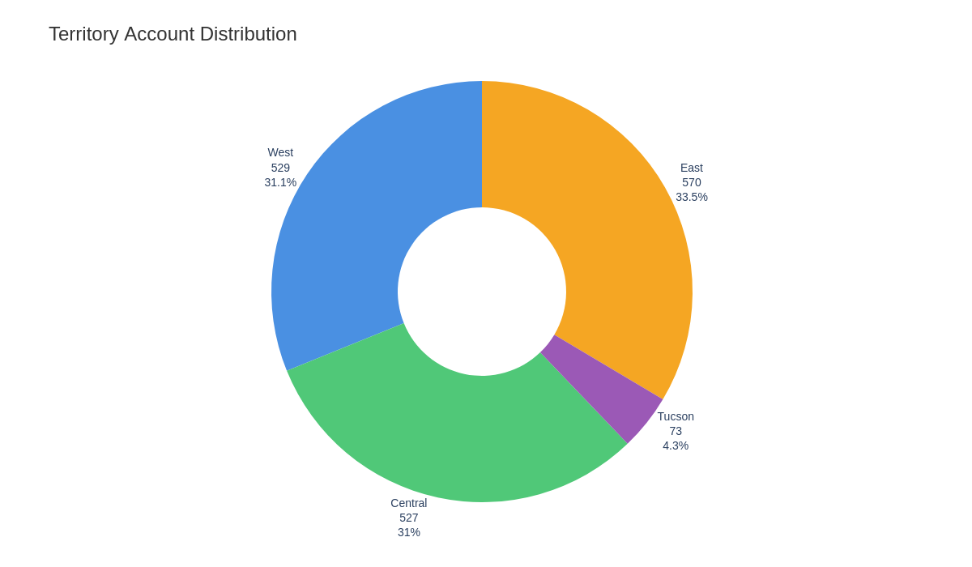
Territory Account Share

Slide 5
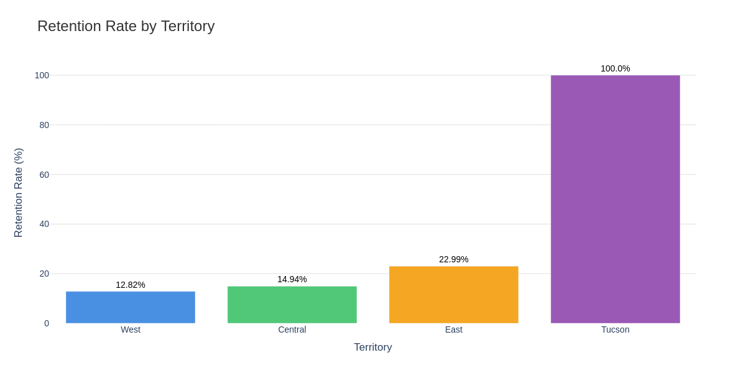
Retention Rate Comparison

Slide 6
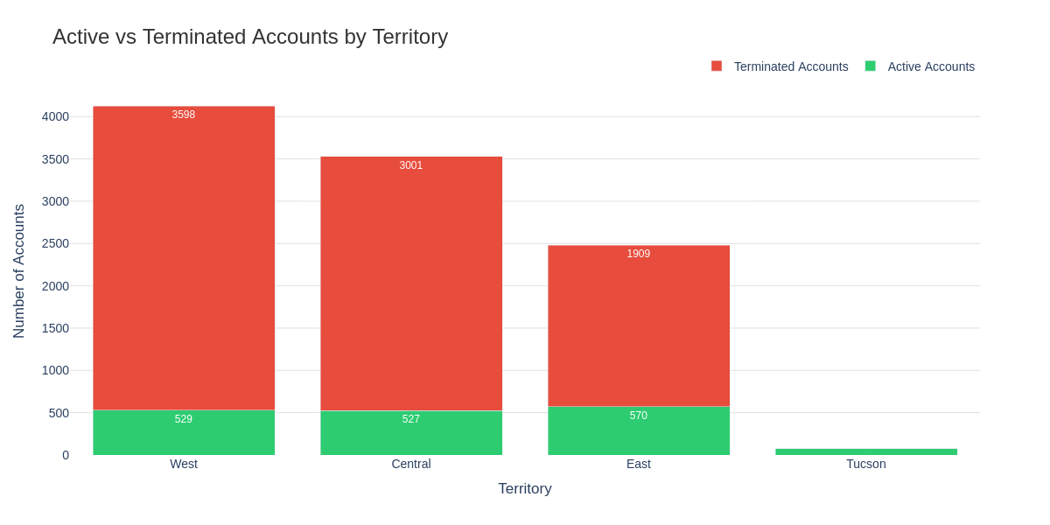
Historical Account Performance

Slide 7
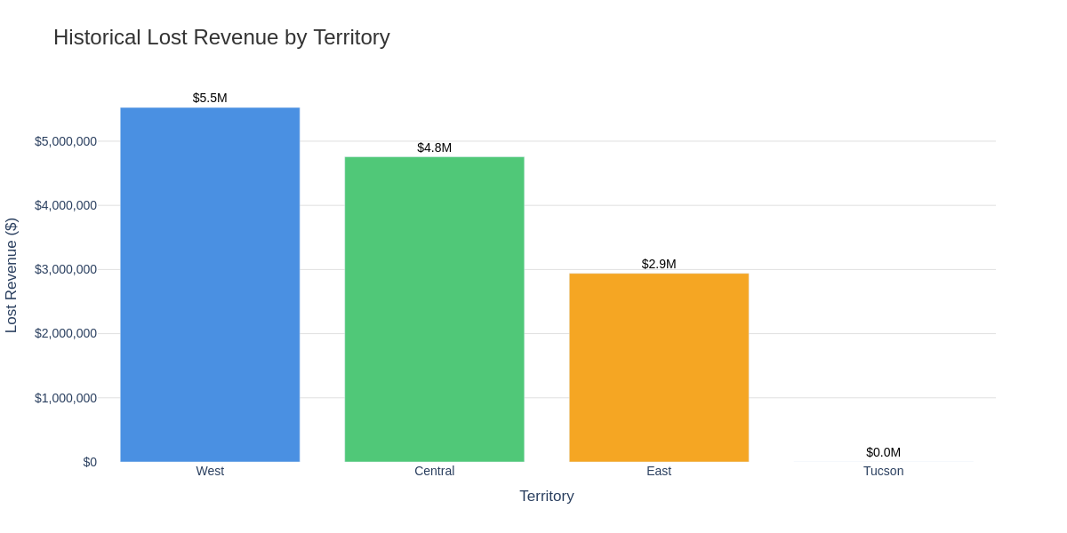
Historical Lost Revenue Analysis

Slide 8
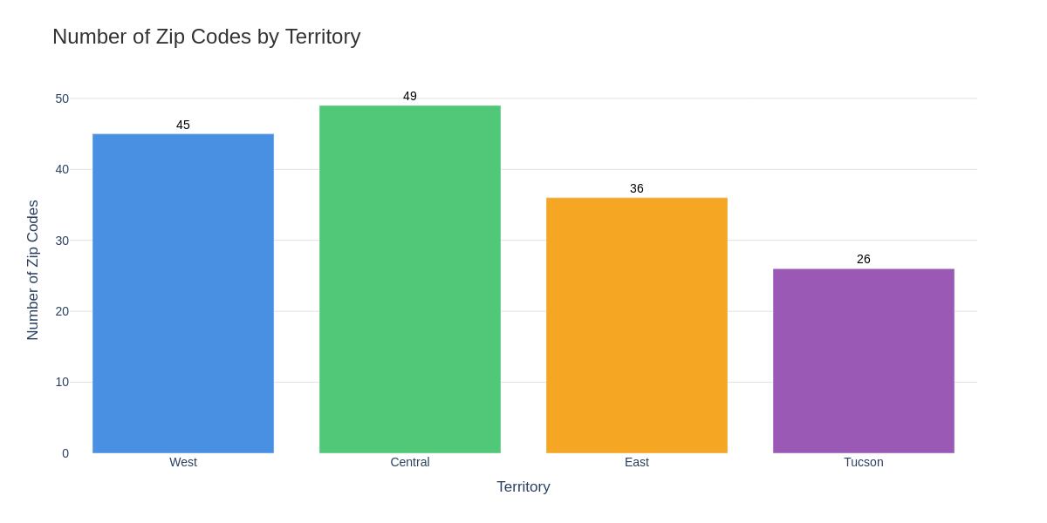
Geographic Coverage by Territory

Slide 9
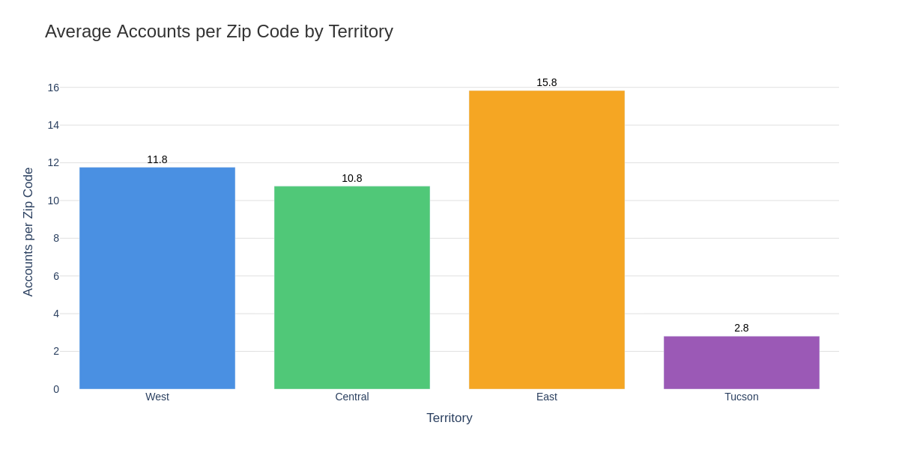
Account Density (Accounts per Zip Code)

Slide 10
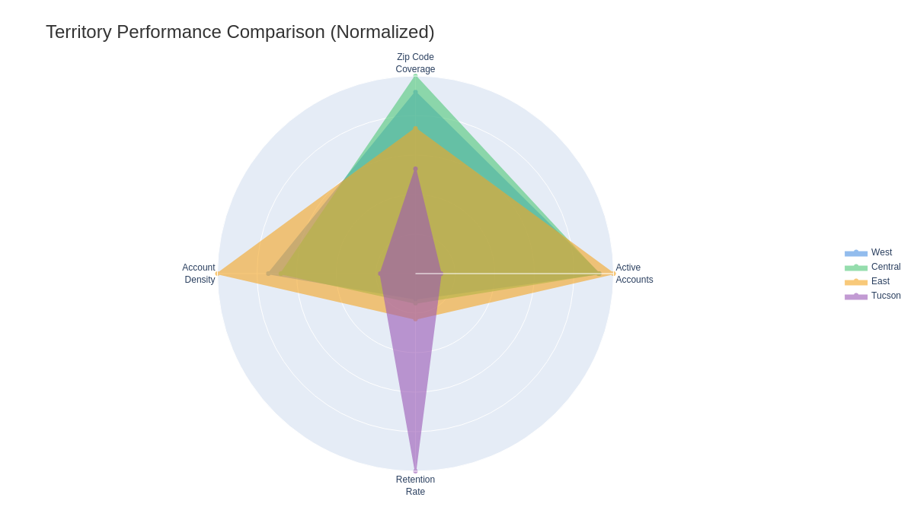
Multi-Factor Performance Comparison

Slide 11
West Territory Details
Active Accounts: 529
Zip Codes Covered: 45
Accounts per Zip: 11.8
Retention Rate: 12.82%
Historical Terminated: 3,598
Lost Revenue: $5,525,709.28
Top Cities: PHOENIX (175), GLENDALE (103), PEORIA (60)

Slide 12
Central Territory Details
Active Accounts: 527
Zip Codes Covered: 49
Accounts per Zip: 10.8
Retention Rate: 14.94%
Historical Terminated: 3,001
Lost Revenue: $4,756,617.26
Top Cities: SCOTTSDALE (212), PHOENIX (209), MESA (71)

Slide 13
East Territory Details
Active Accounts: 570
Zip Codes Covered: 36
Accounts per Zip: 15.8
Retention Rate: 22.99%
Historical Terminated: 1,909
Lost Revenue: $2,939,262.55
Top Cities: CHANDLER (131), CASA GRANDE (104), GILBERT (104)

Slide 14
Tucson Territory Details
Active Accounts: 73
Zip Codes Covered: 26
Accounts per Zip: 2.8
Retention Rate: 100.00%
Historical Terminated: 0
Lost Revenue: $0.00
Top Cities: TUCSON (65), MARANA (6), VAIL (2)

Slide 15
Key Insights & Recommendations
East Territory Success: Highest retention (23%) and density (15.8 accts/zip) - replicate best practices
West Territory Challenge: Lowest retention (12.8%) with highest churn - requires immediate attention
Central Territory: Mid-range performance (14.9%) - opportunity for improvement
Tucson Territory: New market with 100% retention - continue expansion strategy
Action Items: Focus on retention programs in West/Central; leverage East's success model

Slide 16
Implementation Roadmap
1. Territory Implementation: Roll out new territory structure Q1 2027
2. Retention Programs: Deploy targeted retention campaigns in West & Central
3. Performance Monitoring: Establish quarterly KPI reviews for each territory
4. Best Practice Sharing: Document and share East territory's success strategies
5. Resource Allocation: Align staffing and resources based on account density
6. Technology: Implement territory-specific CRM tracking and analytics

