Slide 1
Toto — Industry-Simulated AI Product Workflow
A Two-Crew CrewAI System for Hotel Booking Cancellation Prediction
Final Project — AI Development & Collaboration Course
Nir Waizman | August 2026
1

Slide 2
Agenda
● Business Background & the Problem
● The Concept — meet Toto
● High-Level Architecture (2 Crews + Flow)
● Dataset & EDA
● Crew 1 — Data Analyst (4 agents)
● Crew 2 — Data Scientist (3 agents)
● Model Results & Model Card
● Streamlit App Demo
● Tech Stack & Conclusion
2

Slide 3
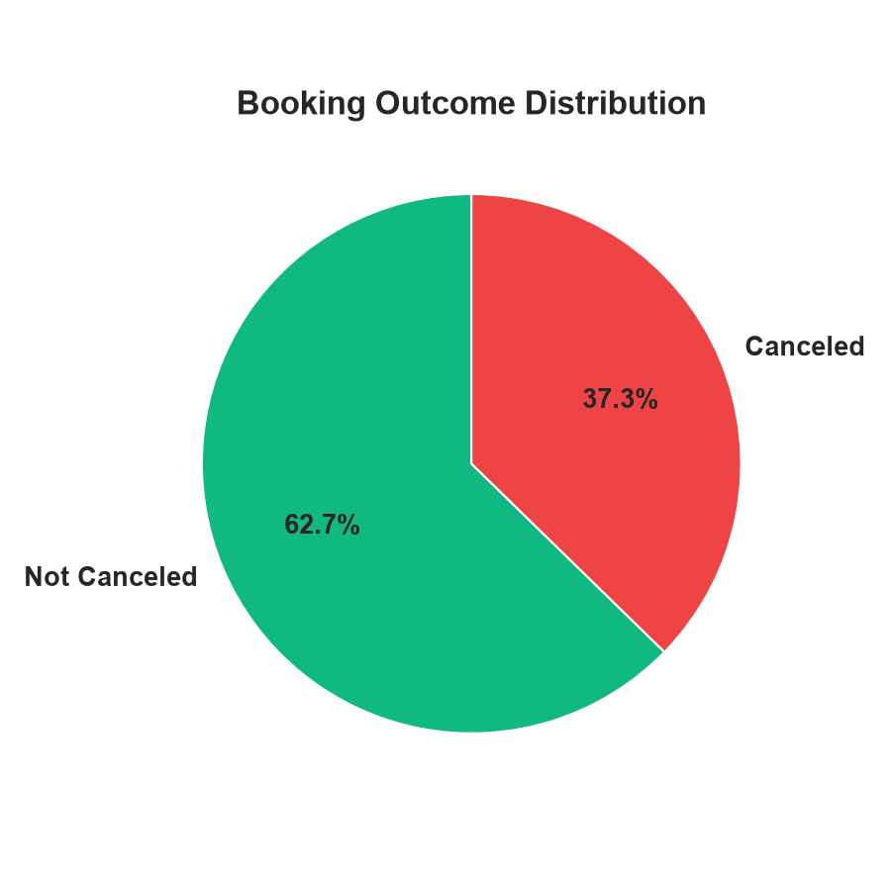
Business Background
● A hospitality group operates multiple hotels (inspired by real operations: boutique hotel in Eilat + city-center hotel in Tel Aviv).
● Booking cancellations create major revenue-management risk: unsold rooms, wasted staffing, inaccurate forecasts.
● The business needs a data-driven way to flag high-risk bookings early — before check-in — to enable smarter overbooking and deposit policy.
● Goal: build an end-to-end, reproducible AI pipeline that ingests booking data, extracts insights, and predicts cancellation risk.
119,390 real hotel bookings (Portugal, 2015–2017)
3

Slide 4
The Concept — "Toto"
● Inspired by Toto: a real, daily-operating personal AI assistant already handling legal tracking, banking, family logistics and hotel operations for its user.
● This project simulates the same philosophy at industry scale: specialized AI agents, each with one clear job, collaborating through defined handoffs.
● Crew 1 (Data Analyst) mirrors how Toto ingests raw, messy real-world information and turns it into structured, trustworthy insight.
● Crew 2 (Data Scientist) mirrors how Toto turns insight into a decision-support tool — a live prediction, not just a report.
● The CrewAI Flow enforces validation gates between crews — just like Toto never acts on unverified data.
4

Slide 5
High-Level Architecture
Crew 1 Data Analyst
• Ingestion
• Cleaning
• EDA
• Insights + Contract
Crew 2 Data Scientist
• Contract Validator
• Feature Engineer
• ML Engineer (train + eval)
CrewAI Flow
• Validation gate
• Fails gracefully on leakage / mismatch
• Auto-handoff
Output: clean_data.csv → eda_report.html → insights.md → dataset_contract.json → features.csv → model.pkl → evaluation_report.md → model_card.md
5

Slide 6
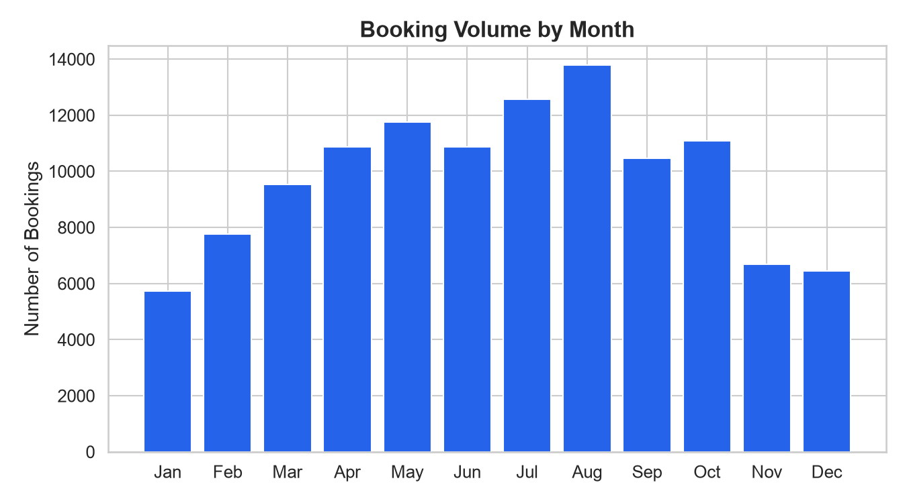
Dataset
● Hotel Booking Demand — 119,390 real hotel reservations.
● Resort Hotel + City Hotel, Portugal, 2015–2017.
● Temporal split: train on 2015–2016 (77,438 rows), test on 2017 (40,129 rows) — simulates real forecasting.
● Leakage columns explicitly excluded: reservation_status, reservation_status_date.
● 33 columns in the clean data; 25 contract-approved modeling features.
Seasonal booking volume — summer peak clearly visible
6

Slide 7
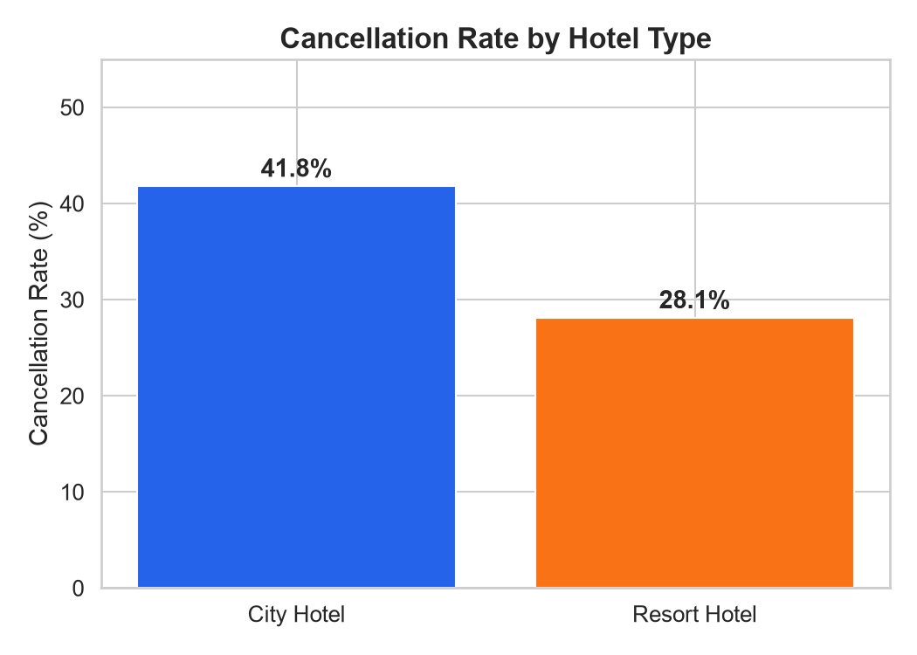
Crew 1 — Data Analyst (4 Agents)
● Data Ingestion Specialist — profiles the raw dataset, flags types and ranges.
● Data Cleaning Specialist — handles nulls, duplicates, outliers.
● EDA Analyst — generates statistics and an HTML report.
● Insights & Contract Writer — writes business insights and produces the machine-readable dataset_contract.json used to gate Crew 2.
City Hotel cancels far more often than Resort Hotel
7

Slide 8
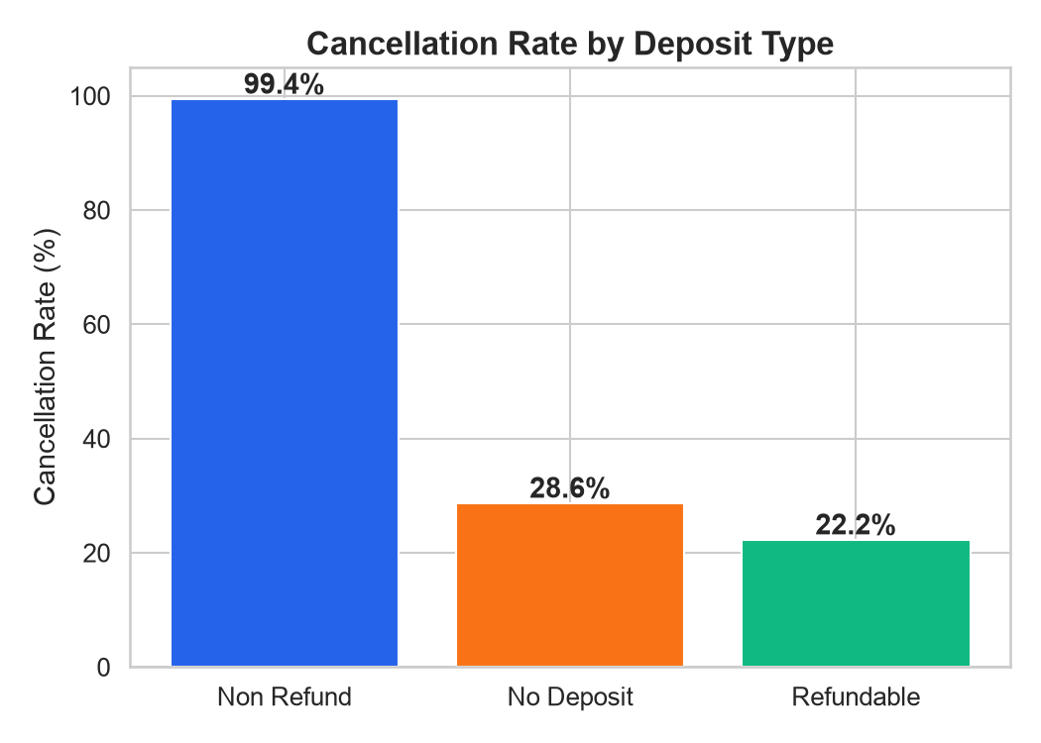
Key Business Insights
● City Hotel cancels 41.8% of bookings vs 28.1% for Resort Hotel — nearly 50% higher risk.
● Non-refundable deposits show a paradoxically high cancellation rate — a red flag worth investigating operationally.
● Longer lead time correlates strongly with higher cancellation probability.
● Recommendation: apply stricter overbooking buffers for City Hotel and long-lead-time bookings.
Cancellation rate by deposit type
8

Slide 9
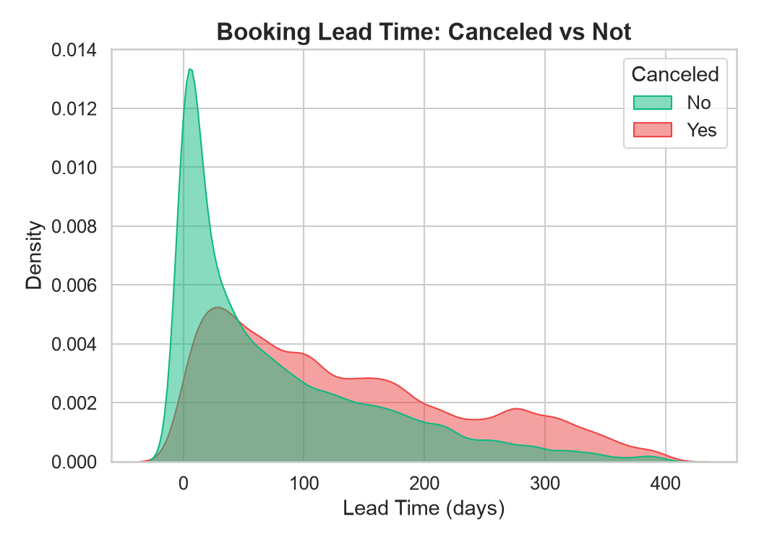
CrewAI Flow — The Handoff
● Automates Crew 1 → Crew 2 handoff — no manual file passing.
● Validation gate: confirms clean_data.csv matches dataset_contract.json before any modeling starts.
● Fails gracefully: if leakage columns are detected or the contract doesn't match, the Flow stops Crew 2 and reports why.
● This mirrors production ML pipelines, where a broken upstream contract must never silently corrupt downstream models.
Lead time distribution: canceled vs completed bookings
9

Slide 10
Crew 2 — Data Scientist (3 Agents)
● Contract Validator — confirms data matches the contract, flags any leakage columns before proceeding.
● Feature Engineer — builds the modeling feature set (features.csv) from validated clean data.
● ML Engineer — trains and evaluates candidate models, selects the best one, writes evaluation_report.md and model_card.md.
10

Slide 11
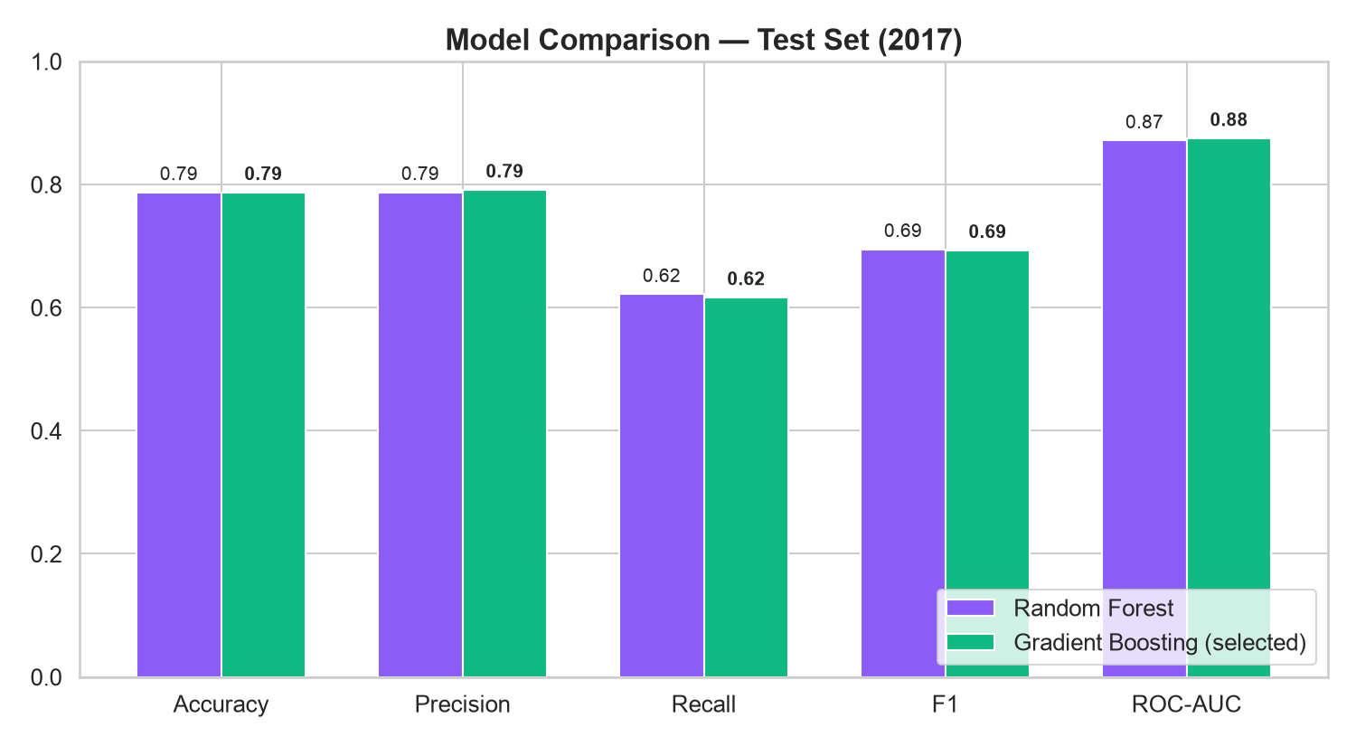
Model Results
● Compared RandomForest vs GradientBoosting.
● Temporal train/test split (2015–16 → 2017).
● GradientBoosting selected: ROC-AUC 0.875, F1 0.693.
● Edges out RandomForest on ROC-AUC (0.875 vs 0.871).
11

Slide 12
Model Card — Responsible AI
● Purpose: support overbooking / deposit-policy decisions — not to deny individual guests service.
● Model: GradientBoostingClassifier, trained on 2015–2016 bookings, tested on 2017 (temporal holdout).
● Performance: Accuracy 78.7%, Precision 79.1%, Recall 61.7%, F1 0.693, ROC-AUC 0.875.
● Known limitation: recall of ~62% means ~38% of true cancellations are missed — model should support, not replace, human judgment.
● No PII used as a feature; country and market segment are aggregate categorical fields only.
12

Slide 13
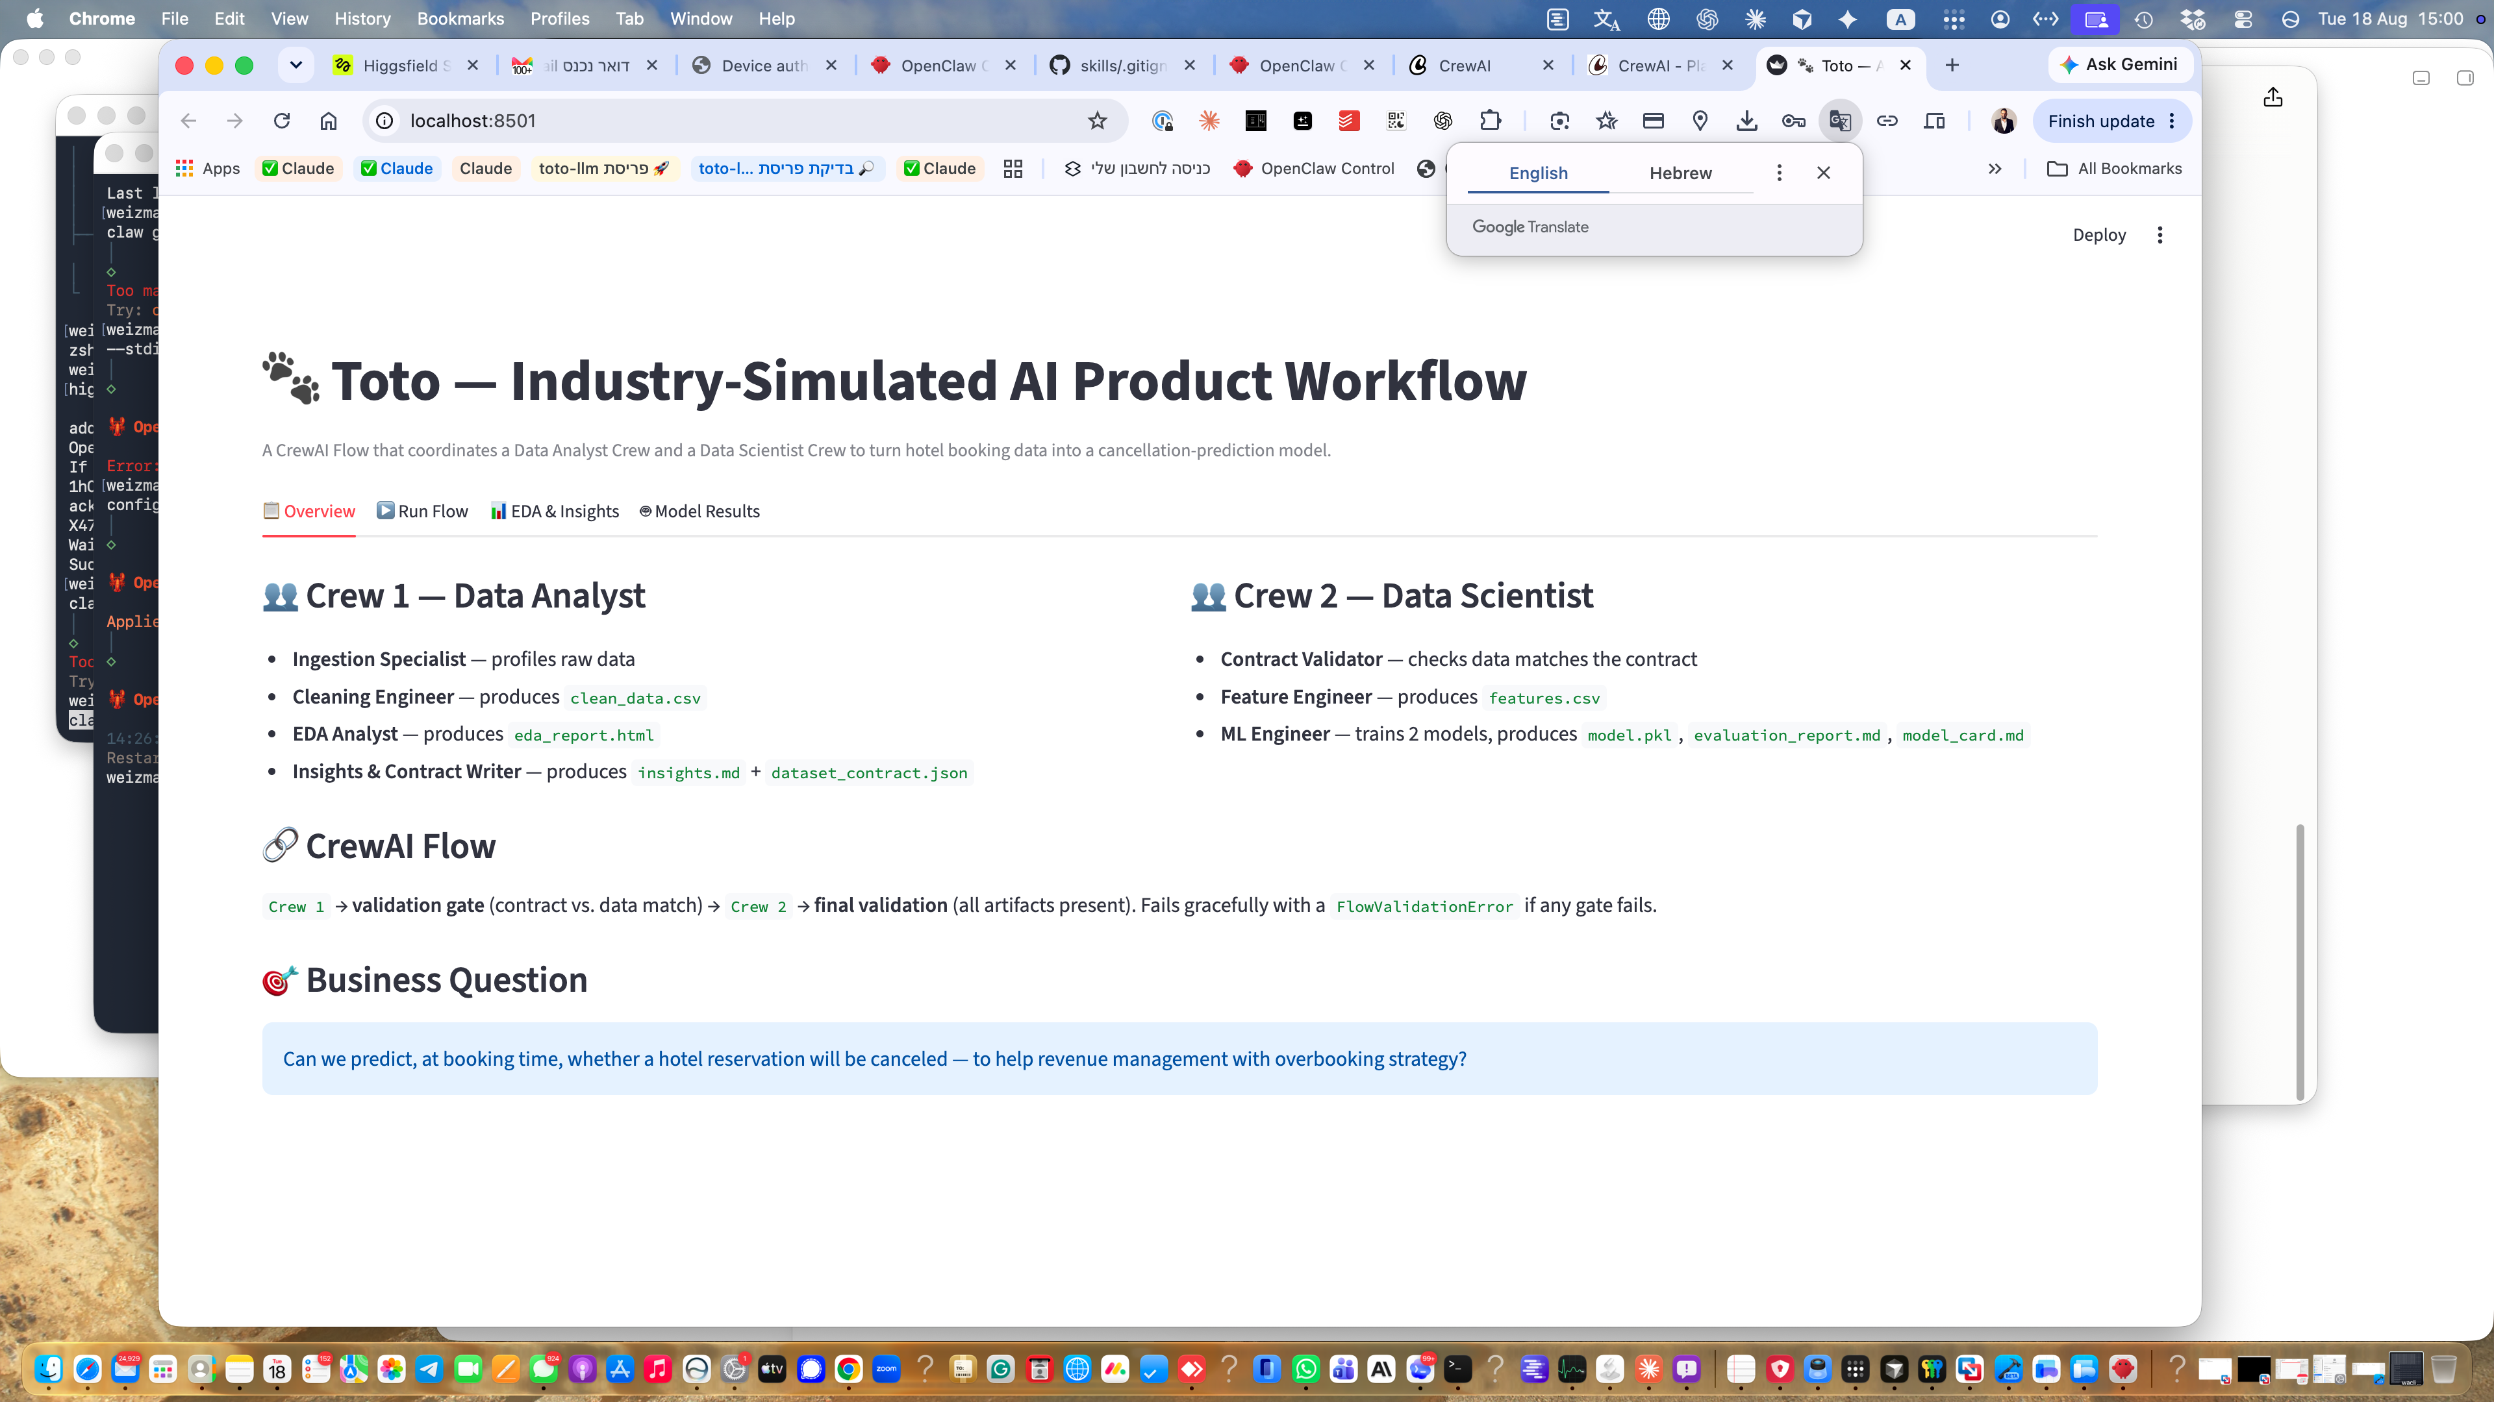
Streamlit Application
● Overview tab — explains the architecture.
● Run Flow tab — triggers the live CrewAI Flow end-to-end.
● EDA tab — interactive charts on the cleaned dataset.
● Model tab — live cancellation-risk prediction from user input.
13

Slide 14
Tech Stack & Reproducibility
● CrewAI, Python 3.12, GitHub, Streamlit.
● Pandas, Scikit-Learn, Matplotlib/Seaborn for data + modeling.
● Claude (Anthropic) as the LLM backing every agent.
● Fully reproducible: requirements.txt, .env-based secrets (excluded from Git), documented outputs contract.
● Public repo: github.com/nirwaizman/toto-final-project
14

Slide 15
Conclusion
● A working, reproducible two-crew CrewAI Flow — 7 specialized agents total.
● Solves a real hospitality problem: predicting booking cancellation risk to support revenue decisions.
● Full pipeline: raw data → validated contract → engineered features → trained model → live app.
● Same philosophy as Toto: specialized agents, verified handoffs, decision support — not blind automation.
15

