Slide 1


Traffic Prediction for Intelligent Transportation System using Machine Learning

Slide 2
Group Members
Amulya Bandi – 700730862
Alekhya Nalla – 700734522
Nirmala Yarlagadda – 700733102
Madhuri Pappu - 700735259

Slide 3
Role/Responsibilities
Collecting Resources: Nirmala Yarlagadda, Madhuri Pappu
Implementation of tasks: Alekhya Nalla, Amulya Bandi
Contributions (members/percentage)
i . Madhuri Pappu: 25%
ii. Nirmala Yarlagadda: 25%
iii. Amulya Bandi: 25%
iv. Alekhya Nalla: 25%

Slide 4
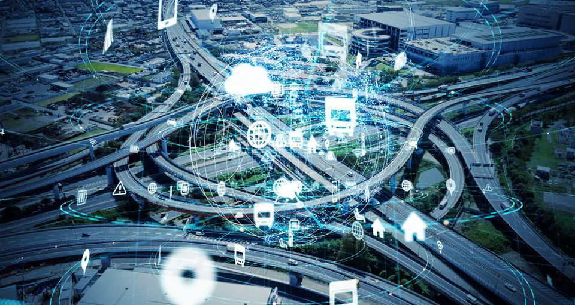
Motivation
Traffic control remains to remain a big challenge across the world, ranging from world top economy to third-world countries, it is having remained a problem due to most of the provided solutions being outweighed over time by increases in the number of vehicle user. It is a challenge to many countries and states, including those in the United States, to correlate traffic challenges with motor vehicle usage. This has led to the need for more robust traffic solutions that can consider such volatile variables.

Slide 5
Objectives
To build a machine learning application that can accurately predict traffic.
To make the application robust enough to make predictions not just for one feature, but for as many features as possible.
To build a machine application that can make predictions in real-time, with the least possible training time.

Slide 6
Related work
A time series machine learning traffic prediction application is built based on the number of vehicles on the road at any time. The application deploys dynamic time series and machine learning techniques that can with high accuracy, predict traffic flow regardless of how many vehicles are on the roads at any given time.
The application is comprised of a data preprocessing pipeline, a time series analysis pipeline, a data transformation component, a model fitting component, and a scoring component. These key features give the application the robustness to process new data in real-time and make predictions on traffic in continuous integration, and continuous deployment.

Slide 7
Problem Statement
Traffic includes everything that can affect smooth road flow, whether it entails signals, rallies, accidents, or repaired roads that lead to traffic jams. The Driver can make good use of the data if Machine Learning techniques are applied to solve the problem. Since it is cumbersome to forecast the flow of traffic due to the huge data available, it is crucial to apply machine learning and soft computing algorithms to reduce the problem's complexity. With traffic data generating exponentially in the current decades, we have transitioned to a new data concept for transportation.

Slide 8
Proposed Solution
The application uses the TensorFlow API (Application Programming Interface). The GRU (Gradient Recurrent Recurrent Unit) model is best suited for making predictions on time series data. Compared to other RNN techniques, GRU has fewer gates and relies more on hidden states for transferring memory between recurring units.

Slide 9
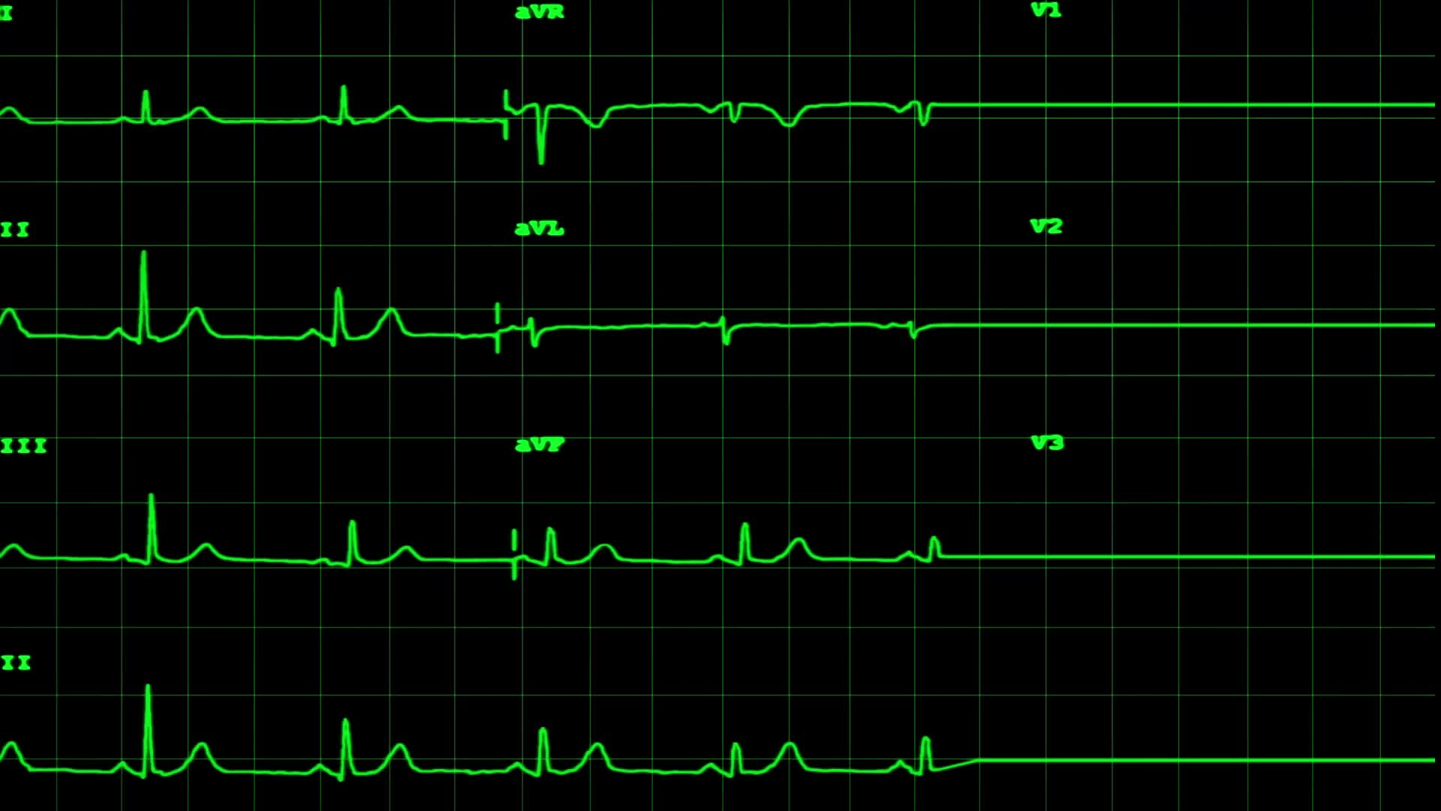
Results/Simulations
RMSE (Root Mean Squared Error) is the squared root of the mean difference between the real values and the predicted values. The lower the RMSE, the better the model's performance. The score for each of the four junctions is independent of other columns. For junction 4, only data from 2017 was provided, hence a higher RMSE score.
The model is trained on 20 epochs, and a batch size of 100. Increasing the number of epochs and the batch size can help improve the model’s scoring. This is, however, done as a tradeoff between training time and model performance.

Slide 10
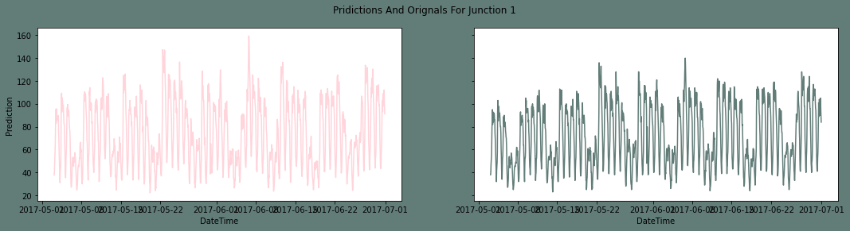
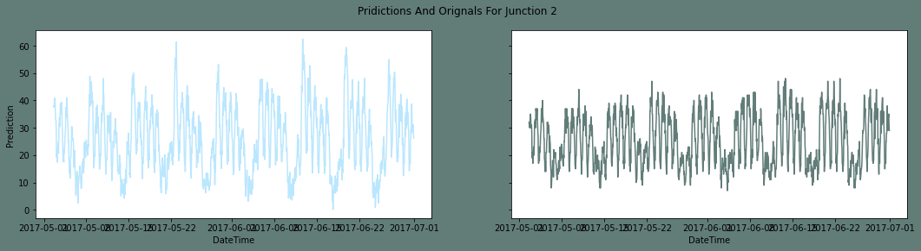
Junction 1
On this junction, the model scored 0.249. A visualization of the real values and the predicted values shows a good generalization by the model.
Junction 2
Score: 0.569

Slide 11
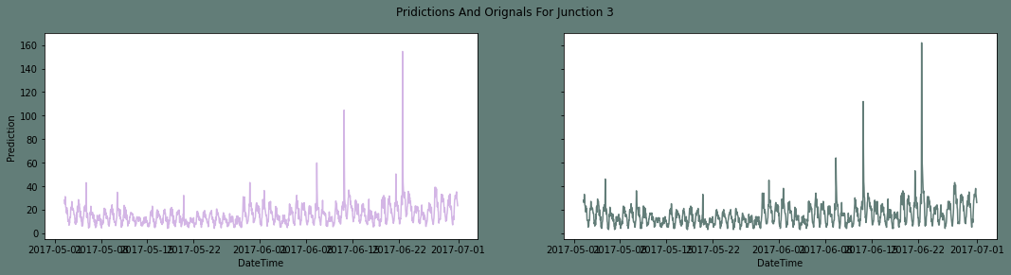
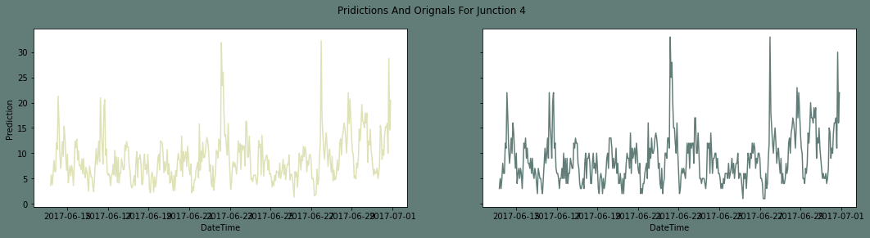
Junction 3
Score: 0.611
Junction 4
Score: 1.096

Slide 12
References
[1] G. Meena, D. Sharma, and M. Maharishi, "Traffic Prediction for Intelligent Transportation
System using Machine Learning," 2020 3rd International Conference on Emerging
Technologies in Computer Engineering: Machine Learning and Internet of Things
(ICETCE), Feb. 2020, doi: 10.1109/icetce48199.2020.9091758.
[2] A. Boukerche and J. Wang, "Machine Learning-based traffic prediction models for
Intelligent Transportation Systems," Computer Networks, vol. 181, p. 107530, Nov. 2020,
doi: 10.1016/j.comnet.2020.107530.
[3] K. Guo et al., "Optimized Graph Convolution Recurrent Neural Network for Traffic
Prediction," IEEE Transactions on Intelligent Transportation Systems, vol. 22, no. 2, pp.
1138–1149, Feb. 2021, doi: 10.1109/tits.2019.2963722.
[4] B. R. Krishna, M. H. Reddy, P. S. Vaishnavi, and S. V. Reddy, "Traffic Flow Forecast
using Time Series Analysis based on Machine Learning," 2022 6th International
Conference on Computing Methodologies and Communication (ICCMC), Mar. 2022, doi:
10.1109/iccmc53470.2022.9753812.

