Slide 1
Bluestock MF Analytics Platform
ETL, SQL, Risk Metrics, EDA, Dashboard Assets

Slide 2
Problem and Objective
Unify fragmented AMFI, NAV, SIP, AUM, transaction, and benchmark data.
Build a repeatable analytics pipeline for mutual fund selection insights.
Create dashboard-ready outputs for executive review.

Slide 3
Data Sources
10 supplied datasets covering 40 schemes and 32,778 transactions.
Live NAV fetched from mfapi.in for six selected schemes.
Benchmarks include NIFTY50, NIFTY100, midcap, smallcap, and debt indices.

Slide 4
Architecture
Python/Pandas ingestion and cleaning.
SQLite star-style schema with dimensions and fact tables.
Reports, charts, and dashboard extracts generated from processed data.

Slide 5
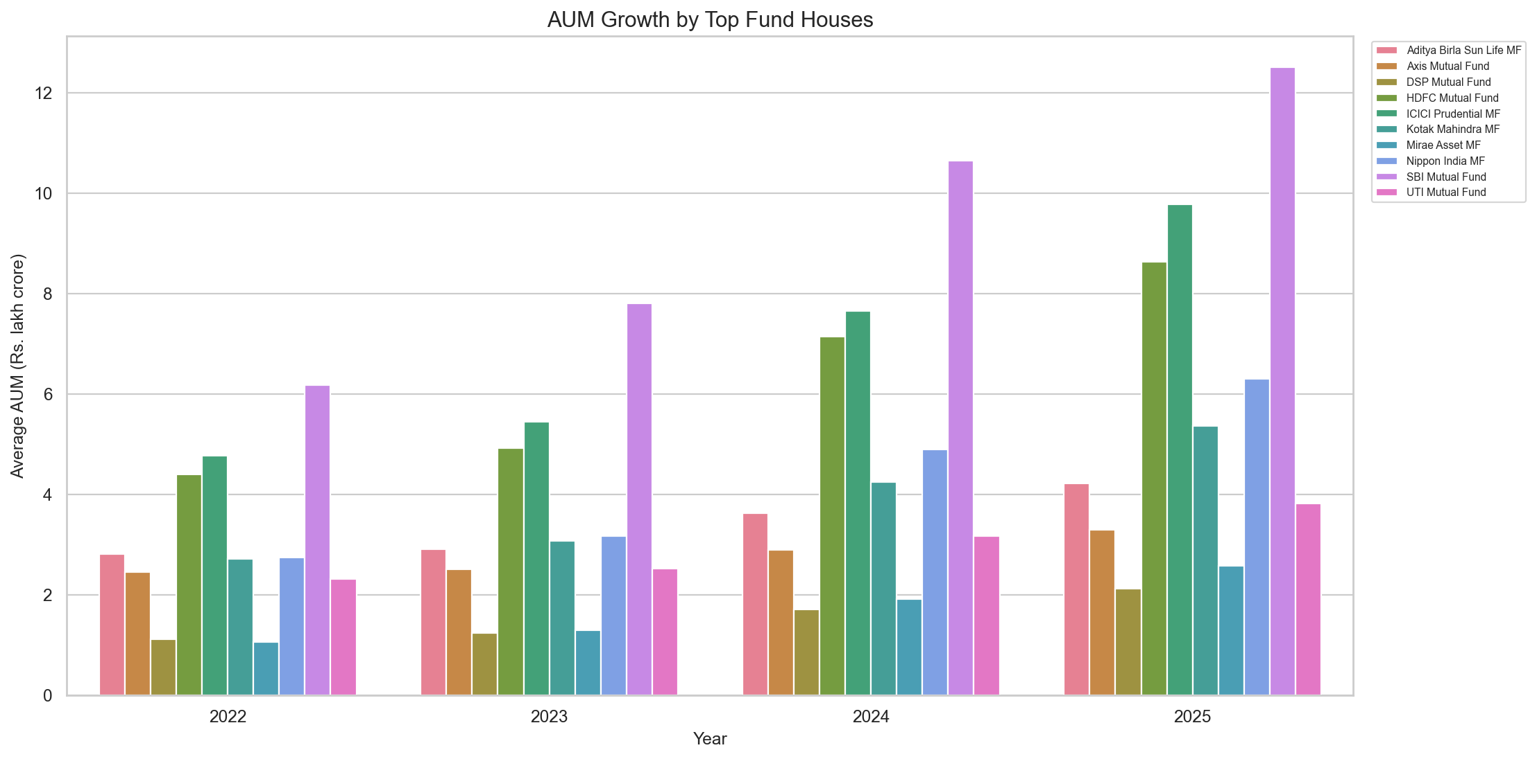
EDA: AUM by AMC

Slide 6
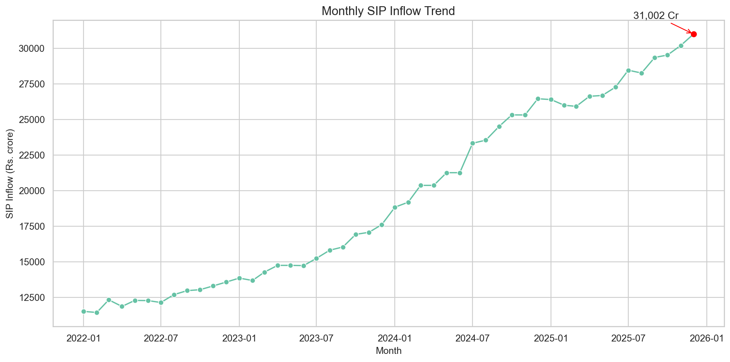
EDA: SIP Inflow Trend

Slide 7
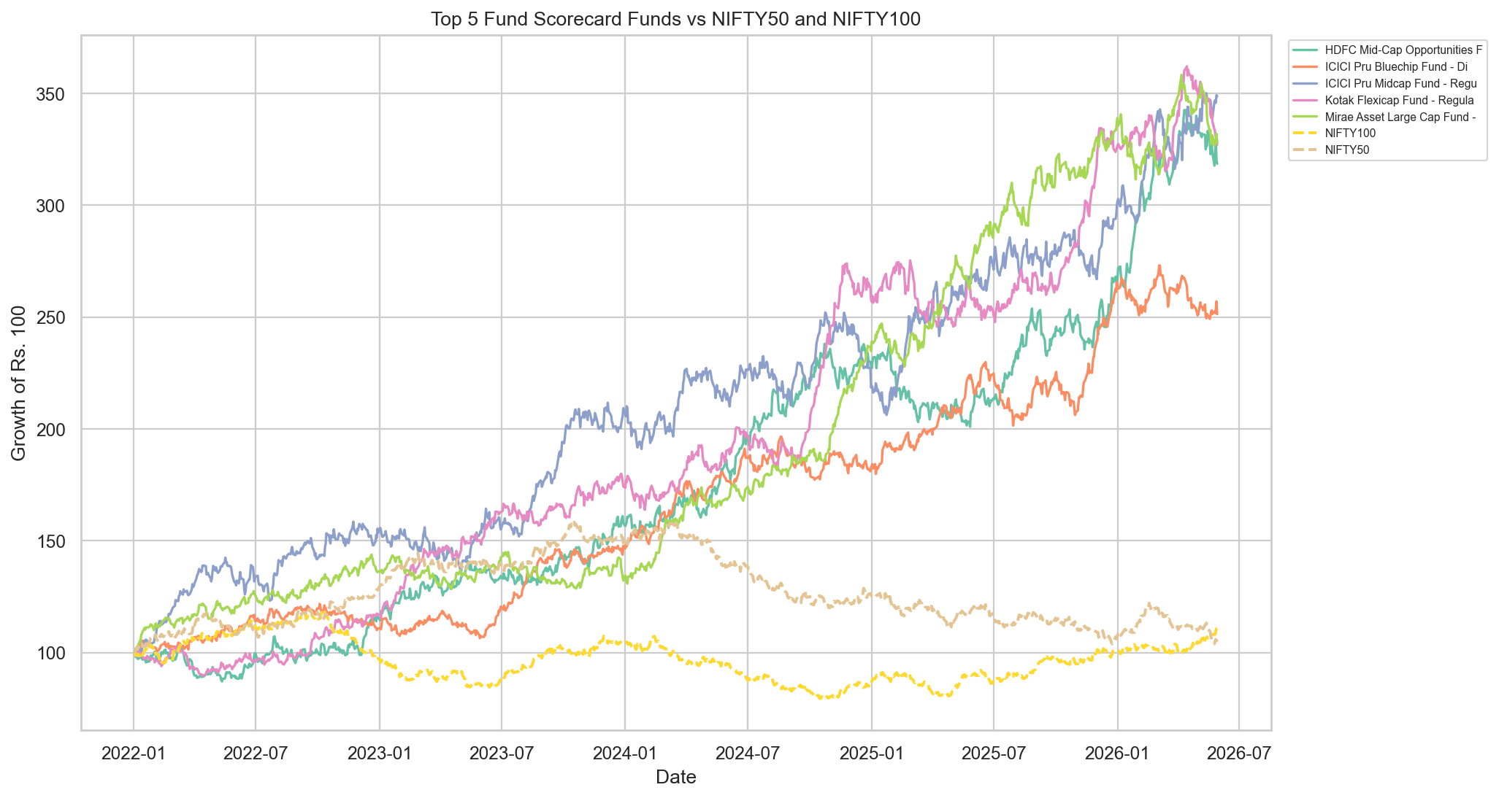
Performance: Fund vs Benchmark

Slide 8
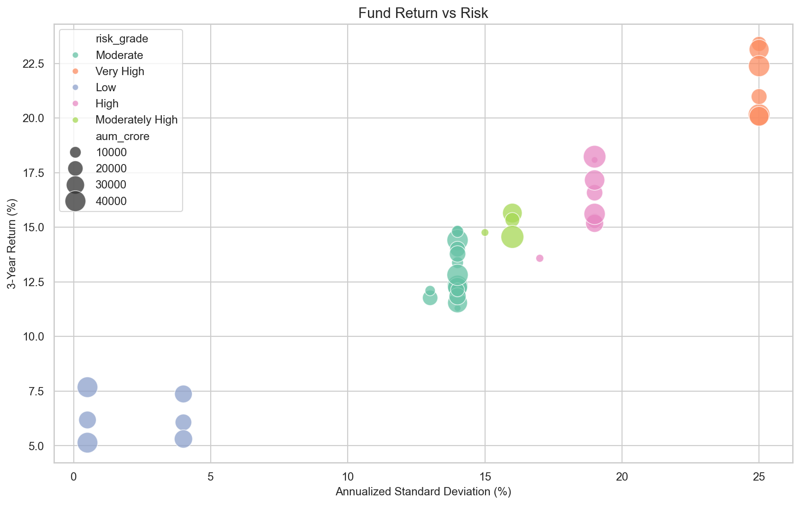
Performance: Return vs Risk

Slide 9
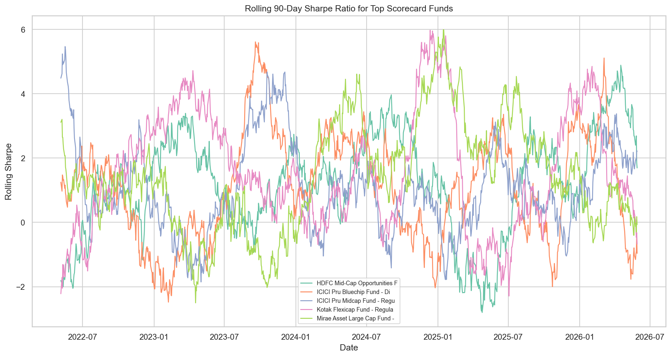
Advanced: Rolling Sharpe

Slide 10
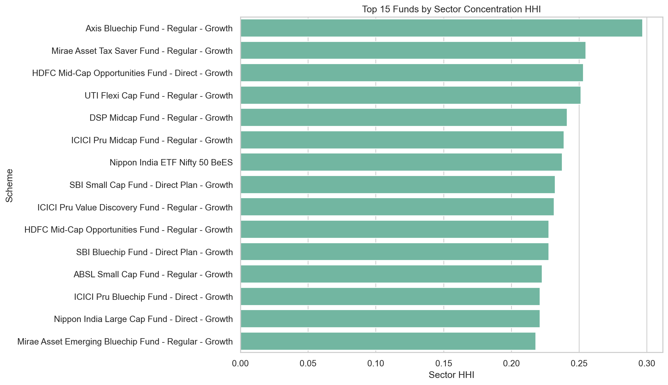
Advanced: Sector Concentration

Slide 11
Dashboard Pages
Industry Overview: AUM, SIP, folios, AMC comparison.
Fund Performance: scorecard, risk-return plot, benchmark tracking.
Investor Analytics: state, city tier, age, transaction type.
SIP and Market Trends: inflows, category heatmap, index overlay.

Slide 12
Key Takeaways
Scorecard combines return, Sharpe, alpha, expense ratio, and drawdown.
Investor analytics supports segmentation by geography and demographics.
Risk metrics help avoid judging funds only by raw returns.

