Slide 1

Garage Service Management System
Presented by Team Moon Slayers.

Slide 2

Team Moon Slayers
Arif Hosen. (ID: 251-35-187)
Nisa Hannan. (ID: 251-35-104)
Antor Biswas. (ID: 251-35-365)

Slide 3
Presenting to
Jaodun Muntasir
Lecturer
Department of Software Engineering
Faculty of Science and Information Technology
Daffodil International University

Slide 4
Overview
1
Main Menu: Central hub providing access to all system features and navigation options.
2
Add new vehicle: Allows users to register and intake new vehicles into the system with complete details.
3
Search Info: Enables quick retrieval of vehicle and customer information using various search criteria.
4
Update Info: Permits modification and editing of existing vehicle and customer records.
5
Delete: Removes outdated or erroneous vehicle and customer records from the system.
6
Service Status: Displays real-time updates on the current status of ongoing repair jobs.
7
Add Notes: Allows technicians to document observations, progress, and issues during service work.
8
Bill Count: Tracks and manages billing information and payment records for completed services.
9
Display: Shows comprehensive reports and summaries of vehicle data and service history.
10
Parts Used: Records and tracks all parts consumed during repairs for inventory and billing purposes.

Slide 5

System Goal
The goal of the Garage Service Management System is to create an efficient, reliable, and automated platform for managing all core operations of an auto repair garage. This system aims to streamline vehicle intake, track service progress, and ensure accurate logging of diagnostics, repairs, and spare parts usage. By utilizing structured record-keeping and file handling in C, it reduces manual errors and enhances data security. The system also seeks to simplify billing through automated invoice generation and maintain comprehensive service histories for future reference. Ultimately, it improves workflow efficiency, transparency, and customer satisfaction through organized and traceable service management.

Slide 6
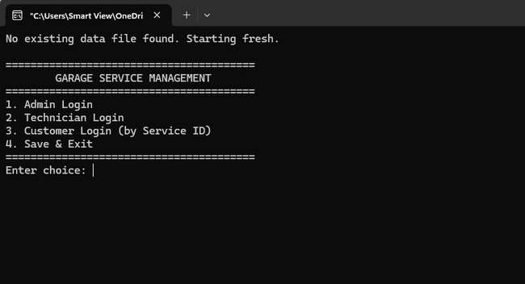
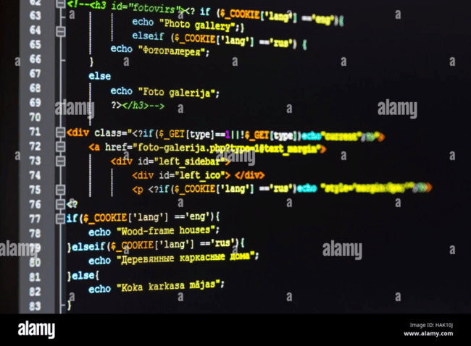
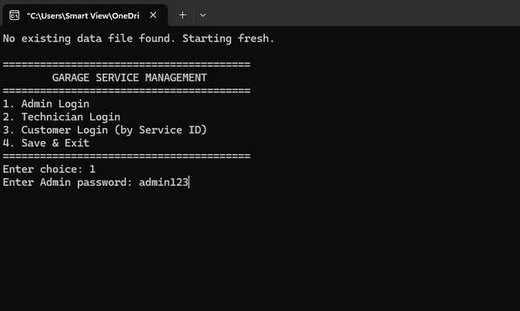
System Demonstration
The main menu of the garage service management system displays four options: Admin Login, Technician Login, Customer Login using a Service ID, and Save & Exit.
After entering choice, the system asks for the password for its safety and
protection.
After entering the admin password, the system grants access to the Admin Menu of the Garage Service Management program. It displays ten options, including adding vehicles, searching, updating, deleting records, checking service status, adding notes, generating bills, viewing data, tracking parts used, and returning to the main menu.

Slide 7
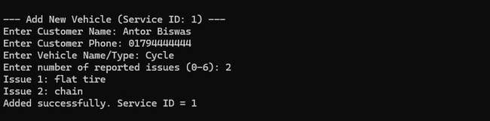
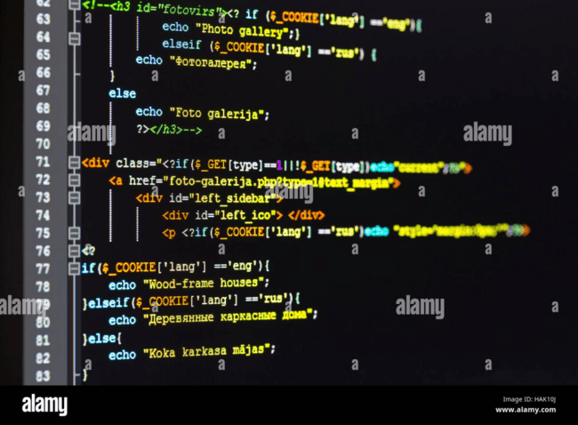
Add New Vehicle
The "Add New Vehicle" function in a Garage Service Management System allows the user to input information about a new customer & his vehicle details into the system's database.

Slide 8
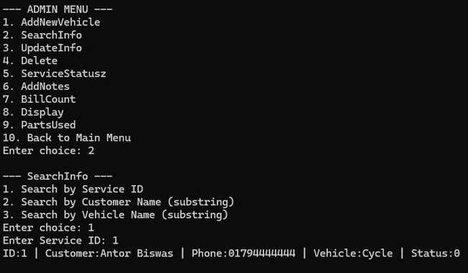
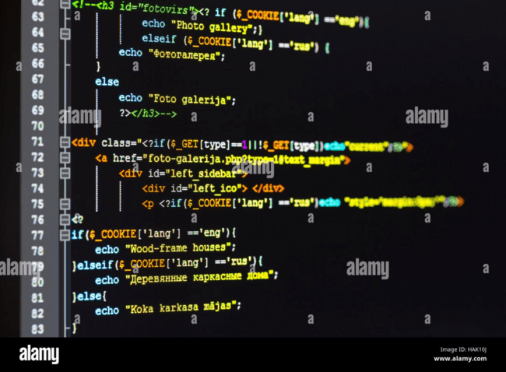
Search Info
The "Search Info" function lets the admin quickly find a vehicle/service record. It offers three search methods: by service ID, by customer name (substring match), or by vehicle name (substring match). After selecting a method and entering a query, it displays the matching record’s ID, customer, phone, vehicle, and service status.

Slide 9

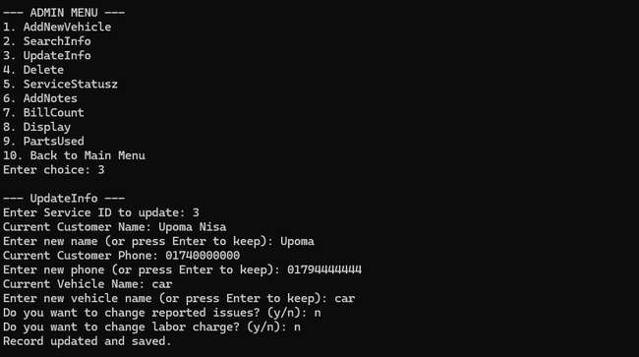
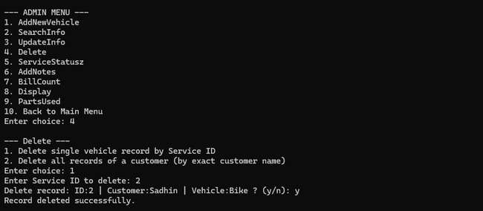
Update Info & Delete
The goal of the Garage Service Management System is to create an efficient,
reliable, and automated platform for managing all core operations of an auto
repair garage. This system aims to streamline vehicle intake, track service
progress, and ensure accurate logging of diagnostics, repairs, and spare parts
usage. By utilizing structured record-keeping and file handling in C, it reduces
manual errors and enhances data security.
The delete option removes unwanted or incorrect vehicle service records using
the unique vehicle ID. It helps keep the system clean and accurate by skipping
the selected record and rewriting the remaining data back into the file. This ensures
organized and error-free data management.

Slide 10


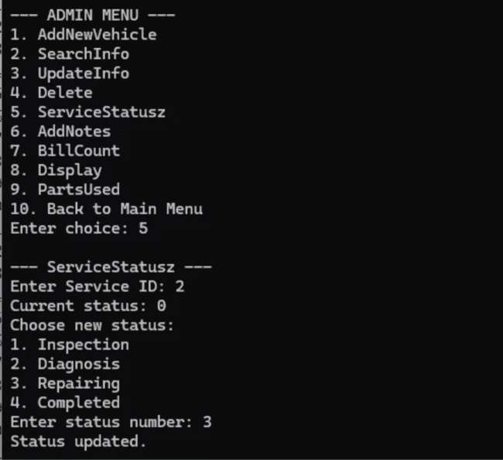
Service Status
Inspection
Diagnosis
The vehicle is being initially checked to identify visible issues or required services
The mechanic is analyzing the problem in detail to determine the exact faults.
Repairing
Completed
The identified issues are actively being fixed or parts replaced.
All service tasks are finished, and the vehicle is ready for delivery.
The Service Status function updates the progress stage of a vehicle’s service.
After entering a service ID, it shows the current
status and provides options like Inspection, Diagnosis, Repairing, or Completed.
The admin selects a new status number, and the system saves the updated service stage for that record.

Slide 11
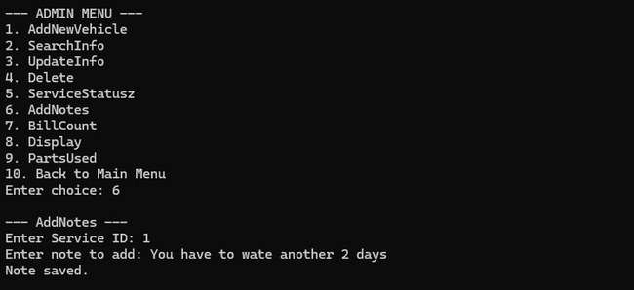
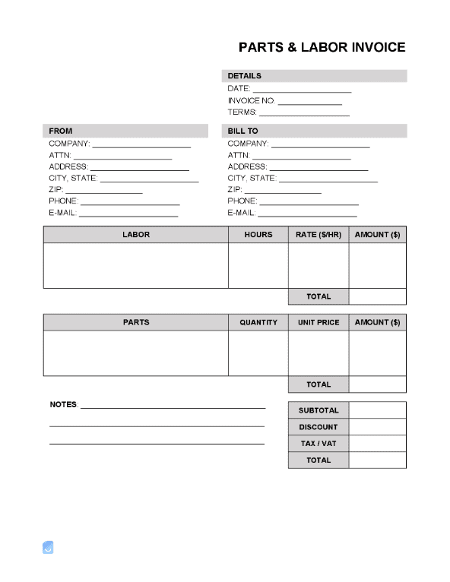
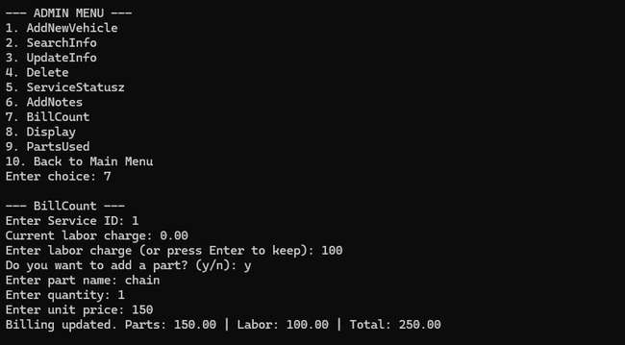
Add Note & Bill Count
The Add Notes function lets the admin record additional details about a vehicle’s service, such as observations, mechanic comments, or special instructions.
The Bill Count function calculates the total service cost for a vehicle by adding labor charges, spare parts used, and any additional fees. It provides a clear breakdown of expenses.

Slide 12
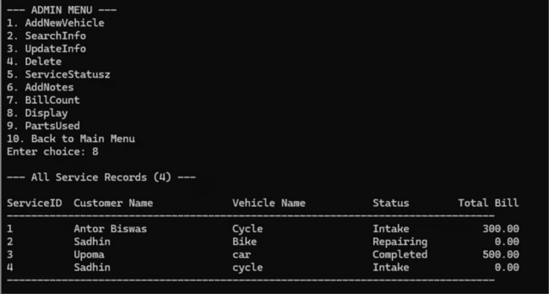
Display
The Display function shows all the service records stored in the system in a clean, table-like format. It first prints the total number of entries and then displays column headings such as ServiceID, Customer Name, Vehicle Name, Status, and Total Bill. After that, it loops through each service record and prints its details, using proper spacing or formatting to keep all columns aligned neatly. This makes it easy for the admin to quickly review every customer’s service information, check their vehicle status, and see any pending or completed bills—all in one organized view.

Slide 13
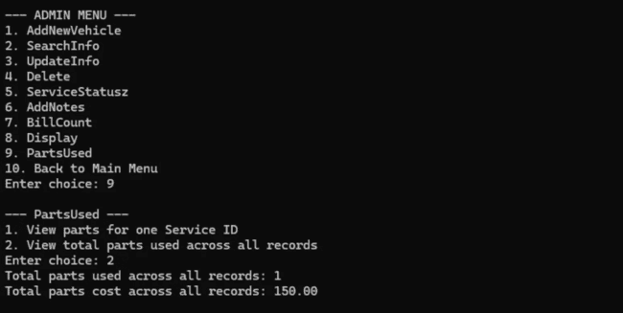
Parts Used
The Parts Used function shows information about the spare parts used during vehicle servicing. When the admin selects this option, the system gives two choices: view parts used for a single service ID or view the total parts used across all service records. In our example, option 2 was selected, so the program scanned every service entry, counted how many parts were added, and calculated the total cost of those parts. It then displayed how many parts in total were used (here, 1 part) and the total amount spent on them (150.00).

Slide 14

Thank You
Team Moon Slayers

