Slide 1

Predicting Students' Grades Based on Study Hours
By : Ni Kadek Nia Saraswati.

Slide 2

About Me
Hello, nice to meet you all…
I am an informatics engineering student at the Indonesian Institute of Business and Technology.

Slide 3
Project Overview
The aim
This project aims to build a machine learning model that accurately predicts students' grades based on their study hours.
The problem to be solved
To assist students and teachers in monitoring learning progress and predicting students' future grades.
Expected impact
This model can help students study more effectively and efficiently, while also aiding teachers in providing more targeted guidance to students.

Slide 4

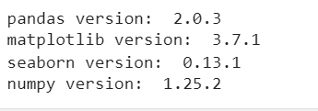

Tools and version libraries
Tool : Google Colab
Programming language: Python
Libraries Version :

Slide 5


Insights and analytics

Slide 6
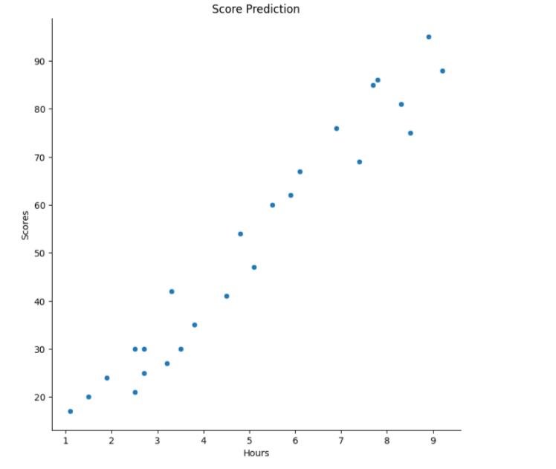
Visualization and Insight
Insight: The scatter plot shows a positive correlation between study hours and scores. This means that as the number of study hours increases for students, their scores are likely to increase as well.
Recomendation: Encourage students to increase the amount of time they spend studying, which can help improve their chances of achieving even better scores.

Slide 7
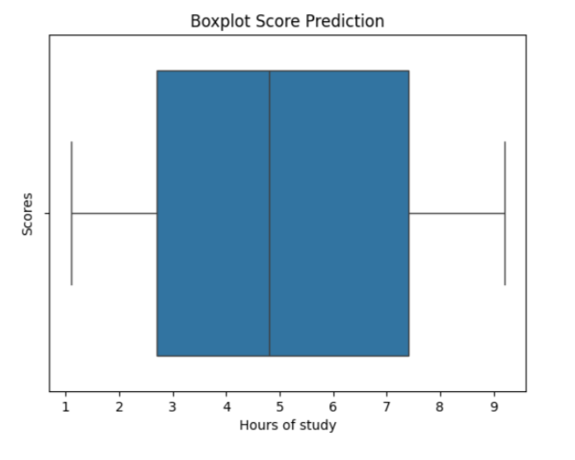
Visualization and Insight
Insight: The adjacent box plot consists of an X-axis and a Y-axis. The X-axis represents the number of study hours of students, divided into several categories (e.g., 1-2 hours, 2-4 hours, 4-7 hours, and 7-9 hours). Meanwhile, the Y-axis shows the number of students achieving specific scores. Thus, students who studied for 4-7 hours obtained the highest scores, whereas those who studied for 1-2 hours obtained the lowest scores.
Recomendation: Students are advised to study for a minimum of 4 hours per day, and to enhance the quality of their studying by practicing solving problems, among other methods.

Slide 8


Results of the Comparison between Linear Regression and Decision Tree Models from the Used Dataset

Slide 9
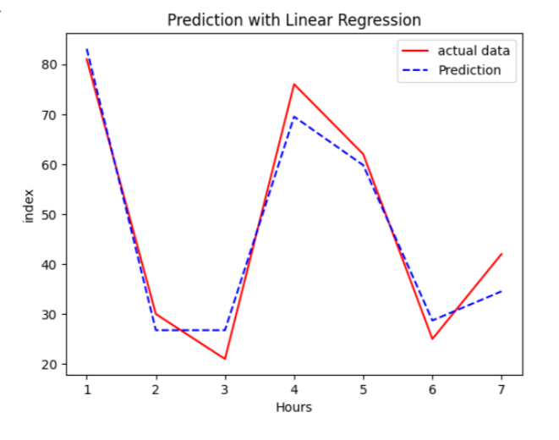
Linear Regression Model
The R-squared value for linear regression is 0.9553509219739938, indicating approximately 95% accuracy of the model.

Slide 10
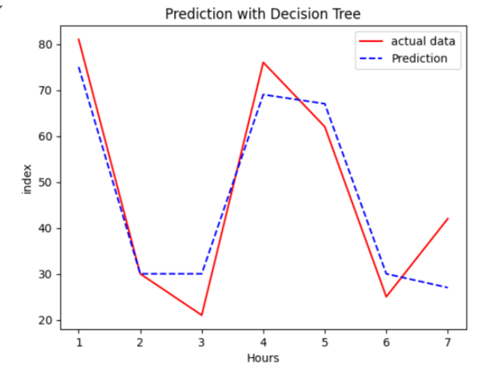
Decision Tree Model
The R-squared value for the Decision Tree model is 0.8803859268443893, meaning approximately 88% accuracy for this model.

Slide 11
Recommended Model Selection
Therefore, based on the two models evaluated, it is recommended to use the Linear Regression model, as it has a higher accuracy rate of 95% compared to the Decision Tree model.

Slide 12



Thanks!
If you have any questions or suggestions,
find me at:

