Slide 1

Business Intelligence
SCHOOL OF COMPUTER TECHNOLOGIES

Slide 2
Chapter 3
Seeking the Source – The Source of Business Intelligence

Slide 3
Transactional Data
The bulk of the business intelligence for most organizations comes from the data they already have:
Transactional data is the information stored to track the interactions, or business transactions, carried out by an organization

Slide 4
OLTP
Online transational processing systems record business interactions as they happen. They support the day-to-day operations of an organization.

Slide 5
Why we don’t use OLTP as source of BI
Small Transactions vs huge Aggregates
Interfering with Business Operations
Archiving
Separate sources in OLTP

Slide 6
Data Mart
A data mart is a body of historical data in an electronic repository that does not participate in the daily operations of the organization. Instead, this data is used to create business intelligence. The data in the data mart usually applies to a specific area of the organization.
Data Mart vs Data Warehouse

Slide 7
Data Mart
A data mart is a body of historical data in an electronic repository that does not participate in the daily operations of the organization. Instead, this data is used to create business intelligence. The data in the data mart usually applies to a specific area of the organization.
Data Mart vs Data Warehouse

Slide 8
History of Data Warehousing
Bill Inmon - Father of Data Warehousing
Devised the term “Data Warehouse” in 1991
Defined a model to support “Single Version of Truth”
Ralph Kimball – Father of Business Intelligence
Concept of Data Marts, Start schema and Snowflake data structure
Developed techniques behind analytical tools in dimensional modelling
Data Warehousing Toolkit

Slide 9
Features of a Data Mart
De-normalized
No Real-Time Data
Consolidation and Cleansing
Data Cleansing removes inconsistencies and errors from transactional data so it has the consistency necessary for use in a data mart
Transactional data is the information stored to track the interactions, or business transactions, carried out by an organization

Slide 10
ETL
The Extract, Transform and Load process extracts from one or more OLTP system, performs any required data cleansing to transform data into a consistent format, and loads the cleansed data by inserting it into the Data Mart.
A data mart is a body of historical data in an electronic repository that does not participate in the daily operations of the organization. Instead, this data is used to create business intelligence. The data in the data mart usually applies to a specific area of the organization.

Slide 11
Data Mart Structure
Measure – a numeric quantity expressing some aspect of the organization’s performance. The information represented by this quantity is used to support or elevate the decision making and performance of the organization. A measure can also be called a Fact.

Slide 12
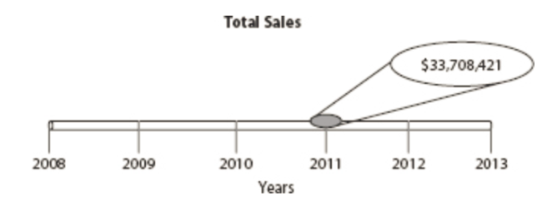
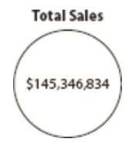
Data Mart Structure
Dimension : a categorization used to spread out an aggregate measure to reveal its constituent parts.
Example:
Total Sales vs Total Sales by time vs Total Sales by time by Product type by sales region

Slide 13
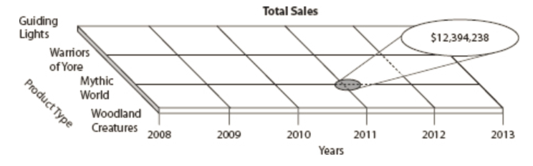
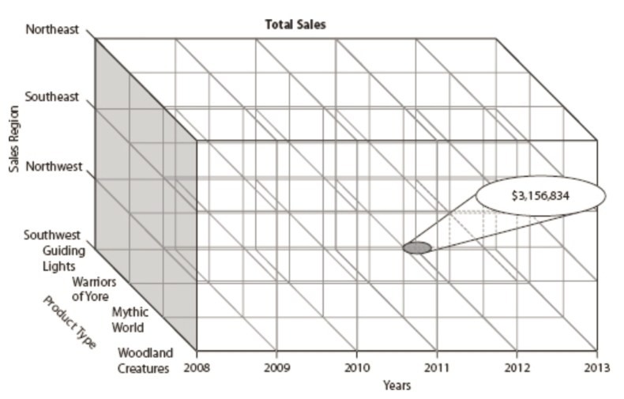
Data Mart Structure
Dimension - Example continued.

Slide 14
Data Mart Structure
Star Schema:
A relational database schema used to hold measures and dimensions in a data mart. The measures are stored in a fact table, and dimensions are stored in dimension tables.

Slide 15
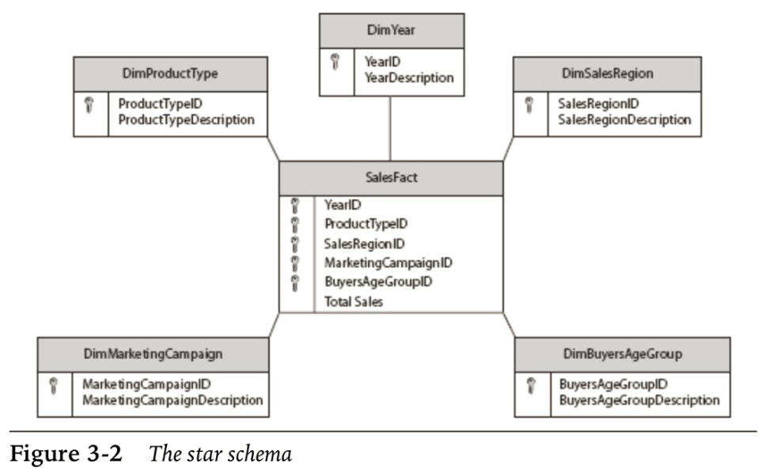
Data Mart Structure
Star Schema:

Slide 16
Data Mart Structure
Attribute:
An attribute is a n additional piece of information pertaining(относящиеся) to a dimension member that is not the unique identifier or the description of the member.

Slide 17
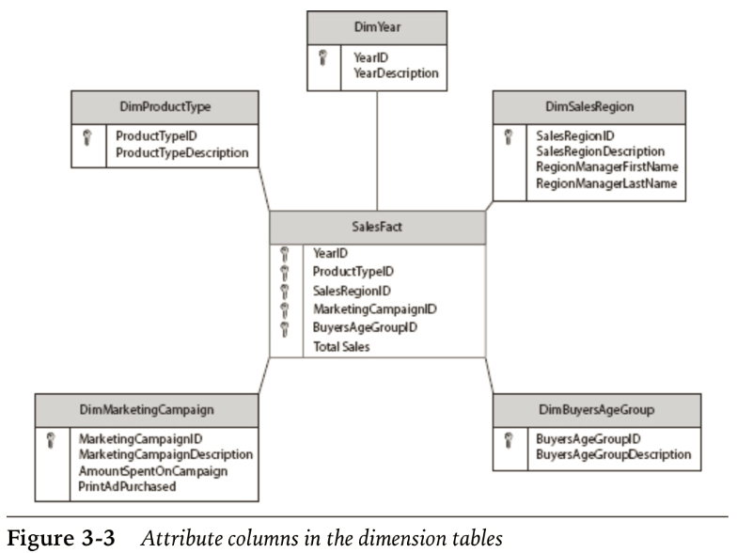
Data Mart Structure
Attribute:

Slide 18
Data Mart Structure
Hierarchy:
A hierarchy is a structure made up of two or more levels within a dimension.

Slide 19
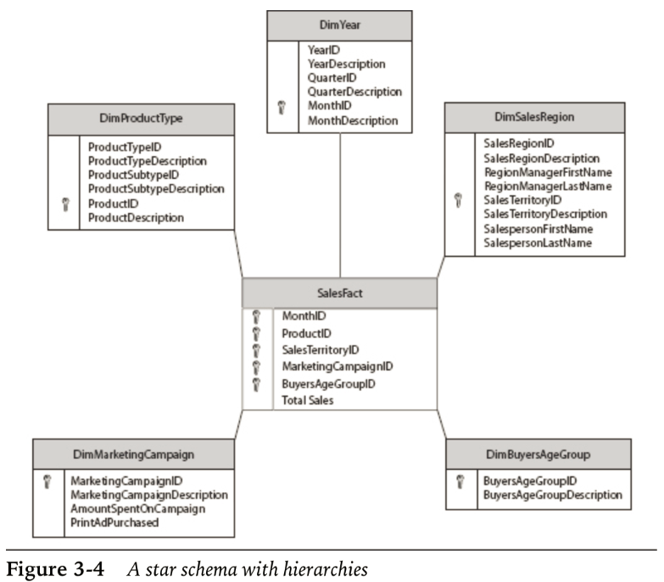
Data Mart Structure
Hierarchy:

Slide 20
Data Mart Structure
Snowflake Schema:
Main usage : Normalizing Hierarchies

Slide 21
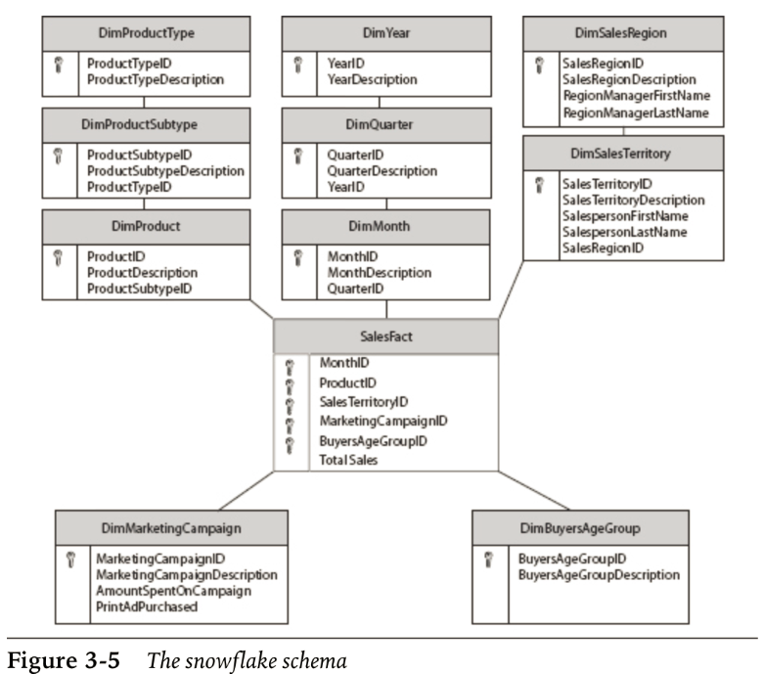
Data Mart Structure
Snowflake Schema:

