Slide 1

Business Intelligence
SCHOOL OF COMPUTER TECHNOLOGIES

Slide 2
Chapter 4
Two, Two, Two Models in One – The BI Semantic Model

Slide 3
OLAP
Online Analytical Processing Systems enable users to quickly and easily retrieve information from data, usually in a data mart, for analysis. OLAP systems present data using measures, dimensions, hierarchies and cubes.
A data mart is a body of historical data in an electronic repository that does not participate in the daily operations of the organization. Instead, this data is used to create business intelligence. The data in the data mart usually applies to a specific area of the organization.

Slide 4
BISM
To facilitate interactive data explorations, SSAS creates a model of underlying data. The BI Semantic Model can be either
Multidimensional or
Tabular Model

Slide 5
Cube
A Cube is a structure that contains a value for one or more measures for each unique combination of the members of all it’s dimensions. These are detail, or leaf-level, values. The cube also contains aggregated values formed by the dimension hierarchies or when one or more of the dimensions is left out of the hierarchy.

Slide 6
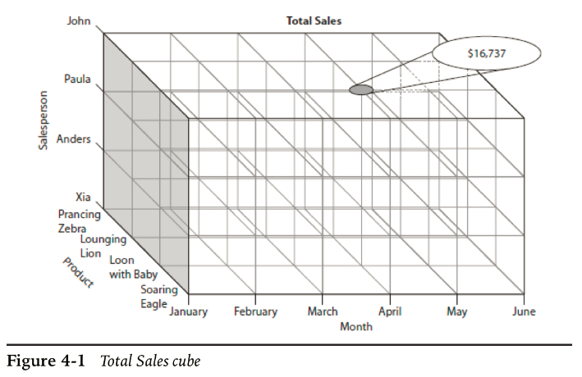
Cube

Slide 7
Aggregation
An aggregation is a value formed by combining values from a given dimension or set of dimensions to create a single value. This is often done by adding the values together using the sum aggregate, but other aggregation calculations can also be used.

Slide 8
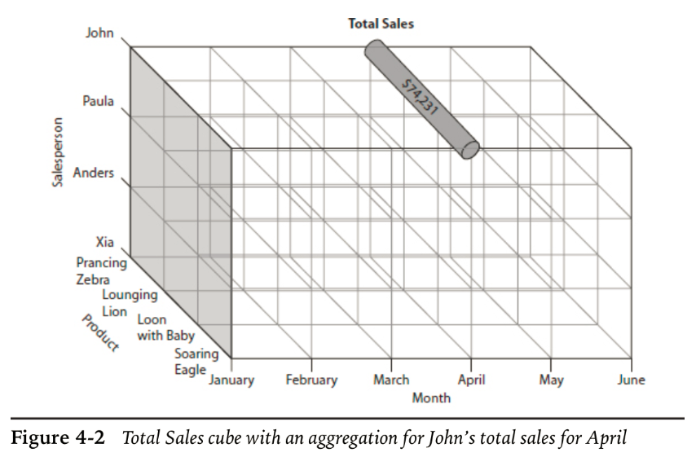
Aggregation

Slide 9
Multi-Dimensional Database
A multidimensional database is structured around measures, dimensions, hierarchies and cubes rather than tables, rows, columns, and relations.

Slide 10
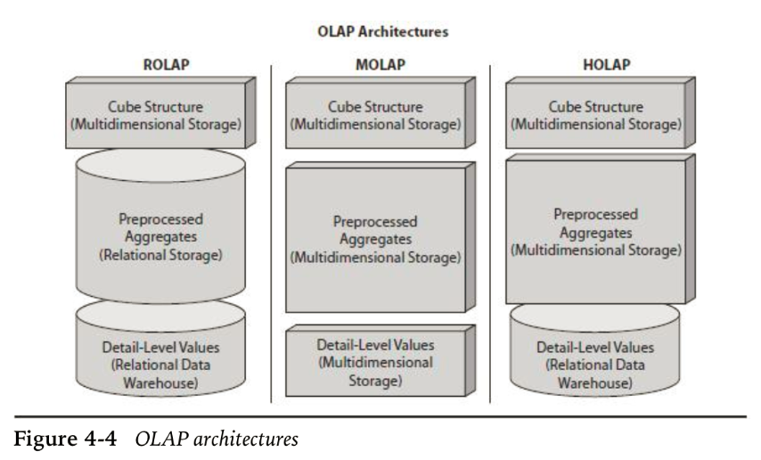
OLAP Architecture

Slide 11
Parts of multidimensional Model Implementation
Data Source: a connection
Data Source View: how we look at data from cube perspective
Pre-processed aggregates stored in Proactive Cache
XML Definitions

Slide 12
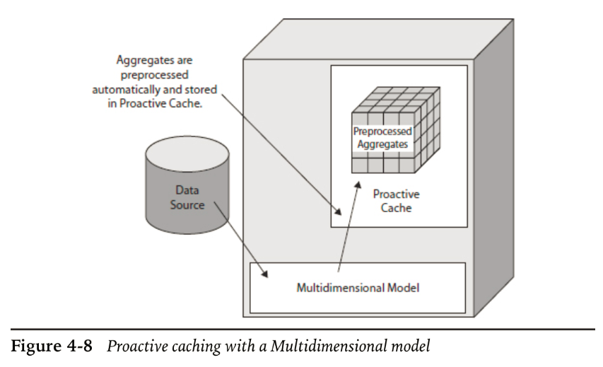
Proactive cache

Slide 13
Tabular Model
Available since 2012 version
Less complex
Less features
No measure, dimension attribute or hierarchy
Related tables with fields just as in Relational databases

Slide 14
Tabular Model Architecture
Cached Mode
Direct Query Mode

Slide 15
Chapter 5
First Steps – Beginning the Development of Business Intelligence

Slide 16
Querying the OLAD system
MDX
Multidimensional expression language provides the programming language for BISM multidimensional navigation.

Slide 17
Querying the OLAD system
DMX
Data Mining Expression language provides the commands to easily setup and analyze data mining structures.

Slide 18
Querying the OLAD system
XMLA
XML for analytical services is an open, XML-based standard protocol for interacting with Microsoft SQL Server 2012 Analysis Services data over a Hypertext Transfer Protocol (HTTP) connection, such as an intranet or the Internet. XMLA uses the Simple Object Access Protocol (SOAP) – Being an open standard, XMLA is used by other vendors OLAP tools as well.

