Slide 1

Business Intelligence
SCHOOL OF COMPUTER TECHNOLOGIES

Slide 2
Chapter 6
Building Foundations – Creating Data Marts

Slide 3
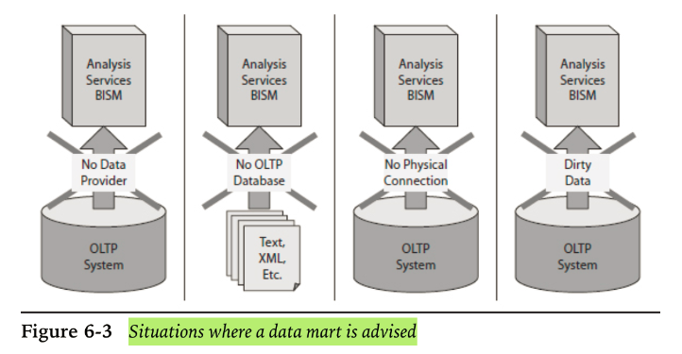
Why we need Data Marts

Slide 4
Data Mart Structure
Measures
Monetary Amounts
Counts
Time Periods - # of minutes or hours, etc.
In design we need measure name, it’s source, Data type(Money, Integer, Decimal) and formula/aggregation function

Slide 5
Data Mart Structure
Dimensions
in design we need dimension name, source, data type of the dimension’s key and name of parent dimension

Slide 6
Data Mart Structure
Attributes
In Design we need Attribute name, Source, Data type and Name of it’s dimension the attribute applies

Slide 7
MaxMin Manufacturing Data Mart
Business Need:
VP of production wants to analyze the statistics available from the manufacturing automation system. He would like an interactive analysis tool.
Because Manufacturing Automation System doesn’t have a Database, a data mart needs to be created.

Slide 8
MaxMin Manufacturing Data Mart
Business process:
Machines handle the following steps:
Filling a mold with raw material
Aiding the hardening of material
Removal of mold when hardening is complete
Computerized paining
Curing the paint

Slide 9
MaxMin Manufacturing Data Mart
Interview result with VP:
Number of accepted/rejected products by batch, by product, by machine, by day
Elapsed time for molding and hardening by product, by machine, by day
Product rolls up into product sub-type which rolls up to Product type.

Slide 10
MaxMin Manufacturing Data Mart
Interview result with VP:
Machine rolls up into machine type, which rolls up into material
Machine also rolls up into plant, which rolls up into country
Day rolls up into Month, Quarter, Year
We also need Machine manufacturer and purchase date of the machine

Slide 11
MaxMin Manufacturing Data Mart
Data Source – csv flat file:
Product
Batch number of the raw material
Machine number
Operator employee number
Start and end of manufacture date and time ( when the batch run begins and ends)
Reject flag

Slide 12
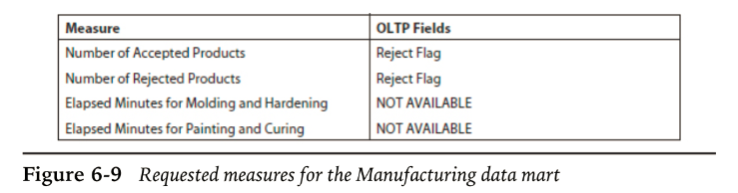
MaxMin Manufacturing Data Mart
Steps:
1- prepare a list of requested measures
2- determine if the OLTP fields are available

Slide 13
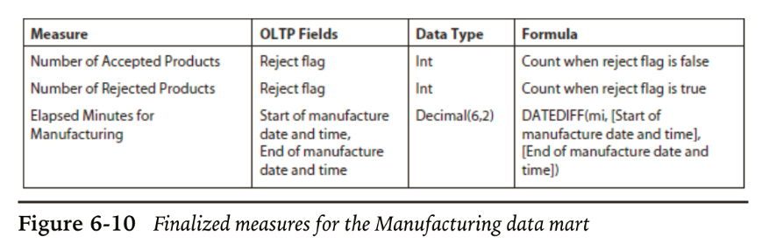
MaxMin Manufacturing Data Mart
Steps:
3- resolve and finalize the list

Slide 14
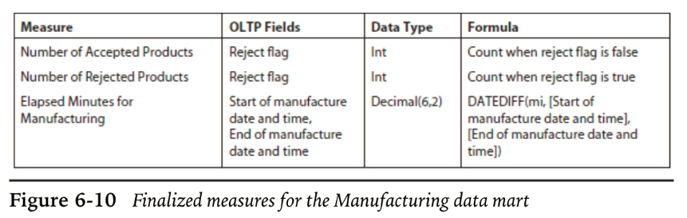
MaxMin Manufacturing Data Mart

Slide 15
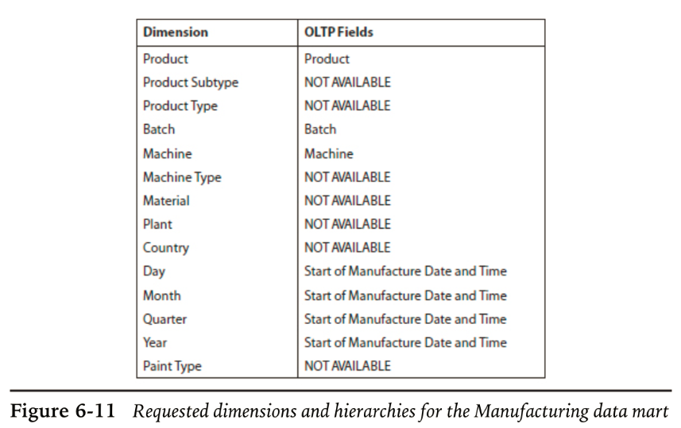
MaxMin Manufacturing Data Mart

Slide 16
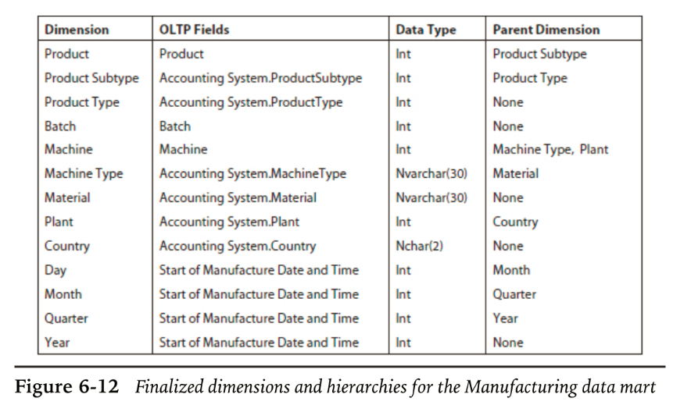
MaxMin Manufacturing Data Mart

Slide 17
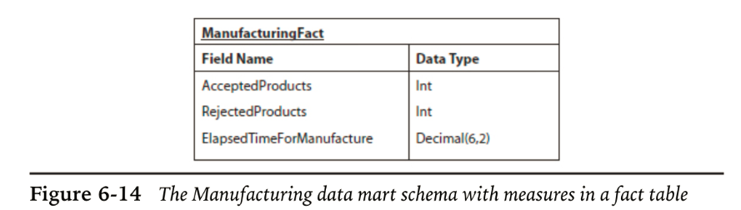
MaxMin Manufacturing Data Mart

Slide 18
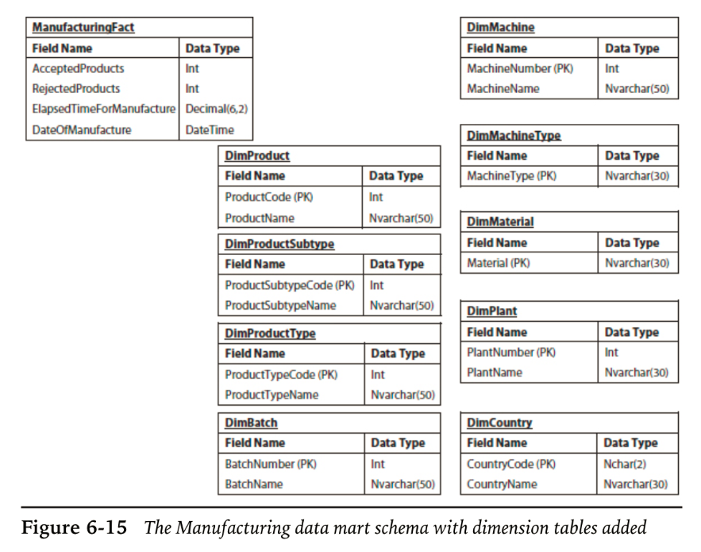
MaxMin Manufacturing Data Mart

Slide 19
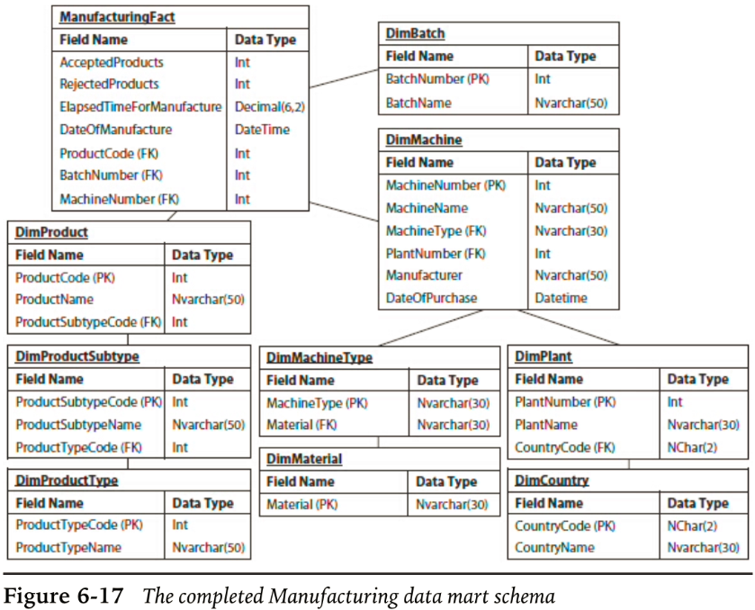
MaxMin Manufacturing Data Mart

Slide 20
MaxMin Manufacturing Data Mart
Creating the Data Mart – in class assignment

Slide 21
Chapter 7
Transformers – Integration Services Structure and Component

Slide 22
Package structure
Control Flow
Data Flow
Parameters
Event Handler
Package Explorer

Slide 23
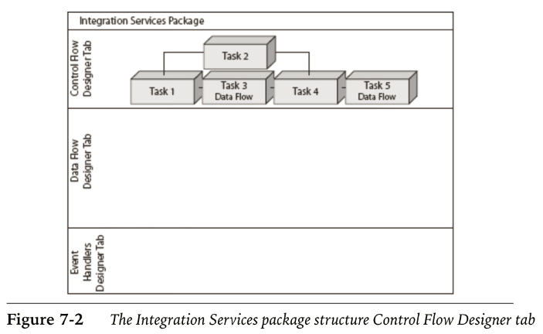
Package structure

Slide 24
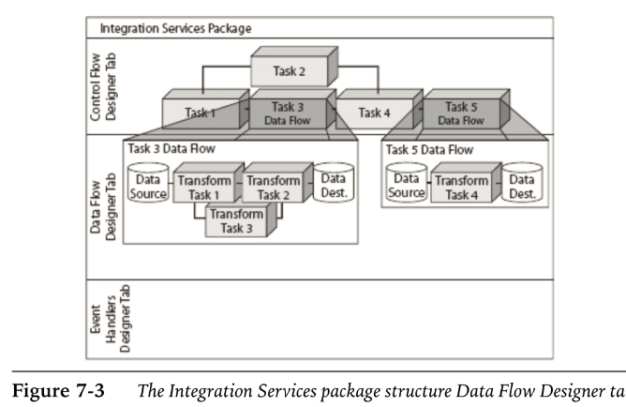
Package structure

Slide 25
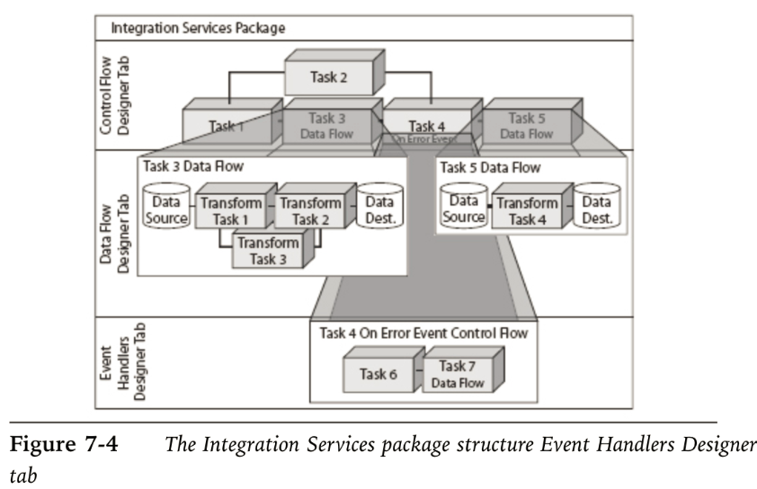
Package structure

Slide 26
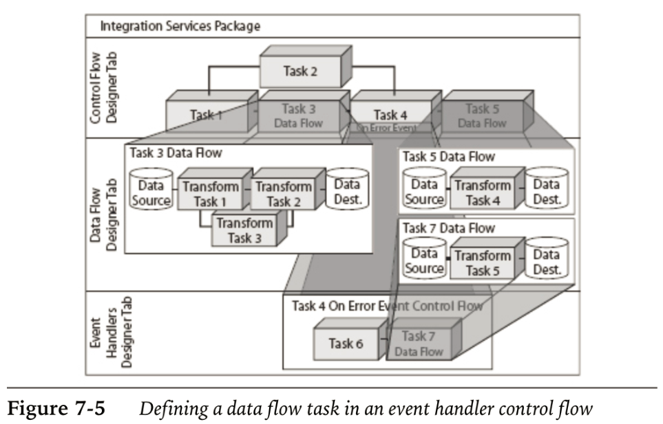
Package structure

Slide 27
Package structure
Connection managers
Precedence Arrows – error handling
Data Flow:
Data Source, Data Transformation and data destination
Control flow containers:
For Loop Container
Foreach Loop Container
Sequence Container

Slide 28
Package structure
Control Flow items
Analysis Services Execute DDL Task
Analysis Services Processing Task
Bulk Insert Task
CDC Control Task
Data Flow Task
Data Mining Task
Data Profiling task

Slide 29
Package structure
Control Flow items
Execute SQL Task
Execute Process Task
Execute Package Task
Expression Task
File System Task
FTP Task
Message Queue Task
Script Task

Slide 30
Package structure
Control Flow items
Send Mail Task
Web Service Task
WMI Data Reader Task
WMI Event Watcher Task
XML Task

Slide 31
Package structure
Control Flow items
Maintenance Plan Tasks
Back up Database Task
Check Database Integrity Task
Execute SQL Server Agent Job Task
Execute T-SQL Statement Task
History Cleanup Task
Maintenance Cleanup Task

Slide 32
Package structure
Control Flow items
Maintenance Plan Tasks
Notify Operator Task
Rebuild Index Task
Reorganize Index Task
Shrink Database Task
Update Statistics Task
Custom Task

Slide 33
Package structure
Data Flow Items
Data Flow Sources
Data Flow Destinations
Data Flow Transformations

Slide 34
Package structure
Data Flow Items
Data Flow Transformations
Aggregate
Audit
Cache Transform
CDC Splitter
Character Map
Conditional Split

Slide 35
Package structure
Data Flow Items
Data Flow Transformations
Copy Column
Data Conversion
Data Mining Query
Derived Column
DQS Cleansing
Export Column

Slide 36
Package structure
Data Flow Items
Data Flow Transformations
Fuzzy Grouping
Fuzzy Lookup
Import Column
Lookup
Merge
Merge Join

Slide 37
Package structure
Data Flow Items
Multicast
OLE DB Command
Percentage Sampling
Pivot
Row Count
Row Sampling
Script Componenet

Slide 38
Package structure
Data Flow Items
Slowly Changing Dimension
Term Extraction
Term Lookup
Union All
Unpivot

