Slide 1
Comp3035-Systems Analysis Instructor: Abid Rana

Slide 2
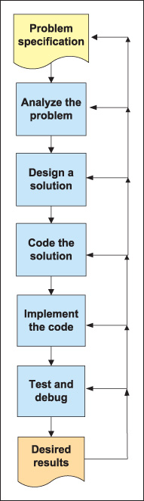
WHY do we need Systems Analysis
C# Programming Form Problem Analysis to Program Design

Slide 3
Information System
information system: an integrated set of components (hardware and software) for collecting, storing, and processing data. It delivers information (and knowledge) to support business processes. {Encyclopedia Britannica}
What is an Information System?

Slide 4
Systems Analysis and Design SAD
Techniques and approaches to develop computer based information systems more efficiently and effectively.
The life cycle of any information system consists of four phases: Planning, Analysis, Design, Implementation.
Different approaches or METHODOLOGIES have been developed for SAD.

Slide 5
Why do we need a formal process?
The doghouse analogy..
Abnormally high failure rate for IT Projects {Most famous study reported a 42% failure rate..Standish Group in 1996.
A 2011 study by project management consulting company, PM Solutions reports 37% failure rate.
What is a failure?
Projects are late {Time}
over budget {cost}
fewer features than planned {scope}
The Triple Constraint

Slide 6
Top Five Reasons for IT Project Failure
5.Risks: Unidentified or assumed, not managed.
4.Planning: Based on insufficient data, missing items, insufficient details, poor estimates.
3.Schedules: Too tight, unrealistic, overly optimistic.
2.Resources: Lack of resources, resource conflicts, turnover of key resources, poor planning.
1.Requirements: Unclear, lack of agreement, lack of priority, contradictory, ambiguous, imprecise.
The System Analyst is the key person

Slide 7
Systems Development Life Cycle (SDLC)
Planning
Analysis
Design
Implementation

Slide 8
The SDLC Process
The process consists of four phases
Each phase consists of a series of steps
Each phase is documented (deliverables)
Phases are executed sequentially, incrementally, iteratively or in some other pattern

Slide 9
Questions to be Answered
Planning phase
Why should we build this system?
What value does it provide?
How long will it take to build?
Analysis phase
Who will use it?
What should the system do for us?
Where & when will it be used?
Design phase
How should we build it?

Slide 10
SDLC: The Planning Phase
Project Initiation
Develop/receive a system request
Conduct a feasibility analysis
Technical feasibility
Economic feasibility
Organizational feasibility
Project Management
Develop the work plan
Staff the project
Monitor & control the project

Slide 11
SDLC: The Analysis Phase
Develop an analysis strategy
Model the current system
Formulate the new system
Gather the requirements
Develop a system concept
Create a business model to represent:
Business data
Business processes
Develop a system proposal

Slide 12
SDLC: The Design Phase
Develop a design strategy
Design architecture and interfaces
Develop databases and file specifications
Develop the program design to specify:
What programs to write
What each program will do

Slide 13
SDLC: The Implementation Phase
Construct the system
Build it (write the programming code)
Test it
Install system
Train the users
Support the system (maintenance)

Slide 14
SDLC: Methodologies
Methodology: a formalized approach to implementing the SDLC
Categories
Process oriented
Data centered
Object-oriented
Structured
Rapid action development
Agile development

Slide 15
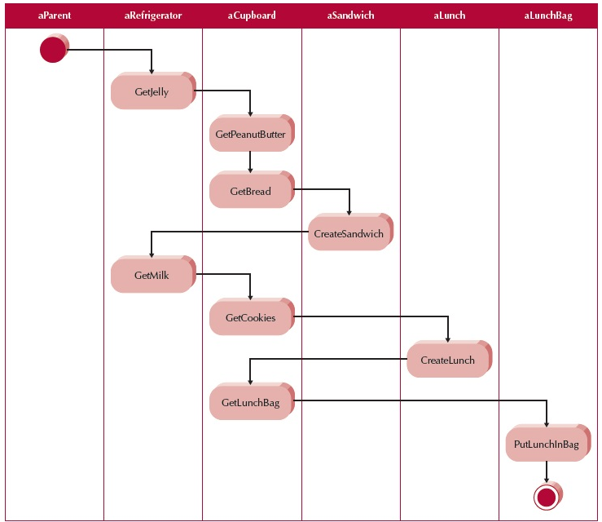

Slide 16
Classes of Methodologies
Structured Development
Waterfall Development
Parallel Development
Rapid Application Development
Phased
Prototyping
Agile Development
eXtreme Programming
SCRUM

Slide 17
Process-centered vs. Data-centered Methodologies.
Process-centered methodologies emphasize process models as the core of the system concept.
Example: Process-centered methodologies would focus first on defining the processes (e.g., assemble sandwich ingredients).
Data-centered methodologies emphasize data models as the core of the system concept.
Example: Data centered methodologies would focus first on defining the contents of the storage areas (e.g., refrigerator) and how the contents were organized.

Slide 18
Structured-design methodologies
Structured design methodologies are usually fairly formal, step-by-step approaches to systems development. The project moves through the phases in a systematic way. The emphasis in most of these methodologies is development of paper-based specifications for the new system prior to implementation.
The Waterfall Approach
Parallel Development

Slide 19
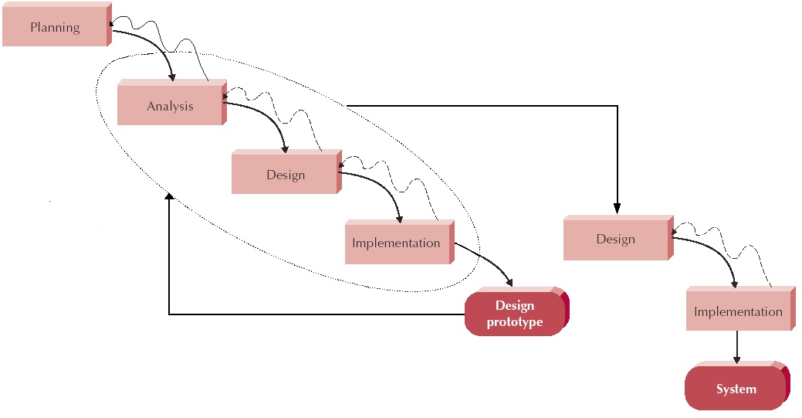
The Waterfall Methodology

Slide 20
Parallel Development :Instead of doing sequential design and implementation perform a general design for the whole system and then divide the project into a series of distinct subprojects that can be designed and implemented in parallel.
Once all subprojects are complete, there is a final integration of the separate pieces, and the system is delivered.
attempt to address the problem of long delays between the analysis phase and the delivery of the system

Slide 21
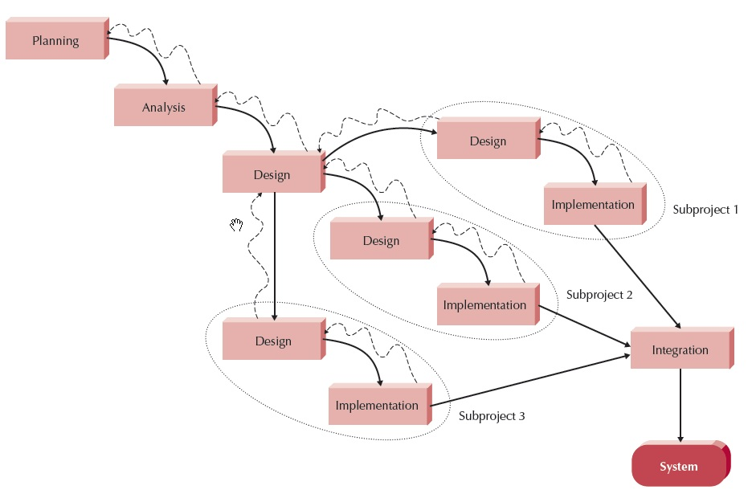
Parallel Development

Slide 22
Rapid Application Development(RAD) –based Mythologies: tend to emphasize quick creation of a limited-capability version (prototype) of the system or a model of the system.
These methodologies focus on refining this preliminary system or model rather than trying to fully describe it on paper prior to implementation.
attempt to address both weaknesses of structured design methodologies by adjusting the SDLC phases to get some part of the system developed quickly and into the hands of the users. In this way, the users can better understand the system and suggest revisions that bring the system closer to what is needed
Prototyping and Phased Development

Slide 23
Phased Development methodology breaks the overall system into a series of versions that are developed sequentially.
The most important and fundamental requirements are bundled into the first version of the system. The analysis phase then leads into design and implementation, but only with the set of requirements identified for version 1
Once version 1 is implemented, work begins on version 2. Additional analysis is performed based on the previously identified requirements and combined with new ideas and issues that arose from the users’ experience with version 1. Version 2 then is designed and implemented, and work immediately begins on the next version

Slide 24
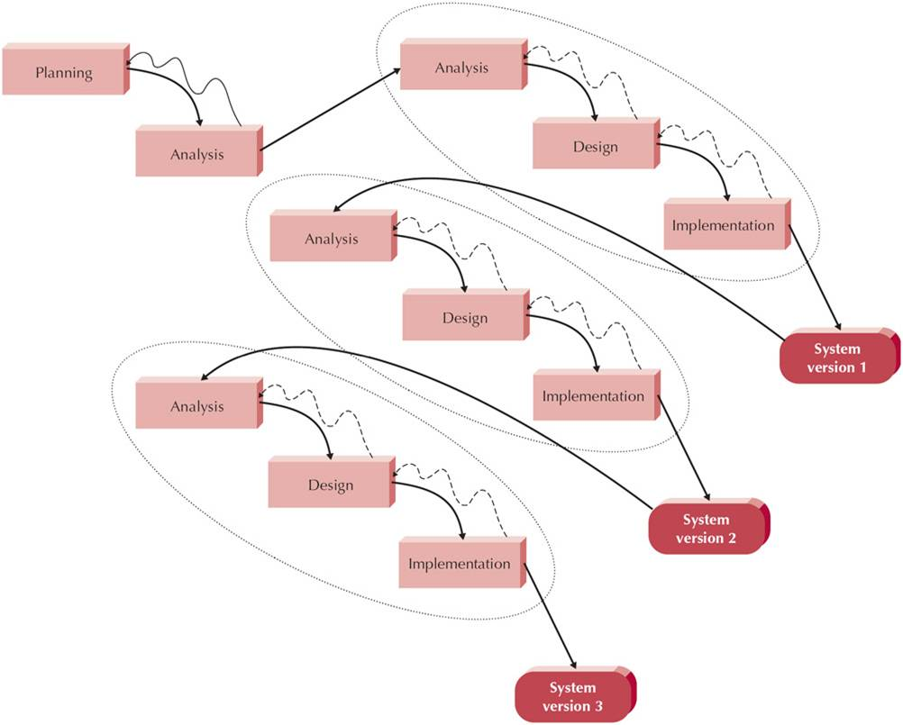
Phased Development methodology

Slide 25
Prototyping: performs the analysis, design, and implementation phases concurrently, and all three phases are performed repeatedly in a cycle until the system is completed.
With these methodologies, the basics of analysis and design are performed, and work immediately begins on a system prototype, a “quick-and-dirty” program that provides a minimal amount of features
The key advantage of a prototyping-based methodology is that it very quickly provides a system for the users to interact with, even if it is not ready for widespread organizational usage.

Slide 26
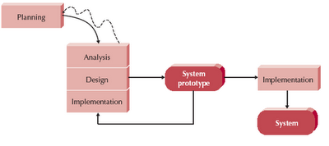
Prototyping

Slide 27
Throwaway Prototyping: consists of relatively thorough analysis phase is used to gather requirements.
However, many of the features suggested by the users may be not well understood, and there may be challenging technical issues to be solved. Each of these issues is examined by analyzing, designing, and building a design prototype.
A design prototype is not a working system; it is a product that represents a part of the system that needs additional refinement and it only contains enough detail to enable users to understand the issues under consideration.

Slide 28
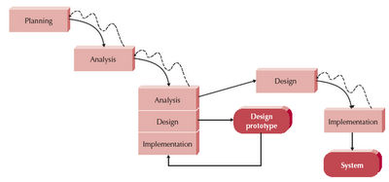
Throwaway Prototyping

Slide 29
Agile Development programming-centric methodologies that focus on streamlining the SDLC by eliminating much of the modeling and documentation overhead, most of the time is spent on simple, iterative application development.
Extreme Programming (XP)
Scrum
Dynamic Systems Development Method (DSDM).

Slide 30
Extreme Programming (XP) project typically begins with user stories that describe what the system requirements.
Then, programmers code in small, simple modules and test to meet those needs. Users are required to be available to clear up questions and issues as they arise.
XP projects deliver results sooner than even the RAD approaches, and they rarely get bogged down in gathering requirements for the system.

Slide 31
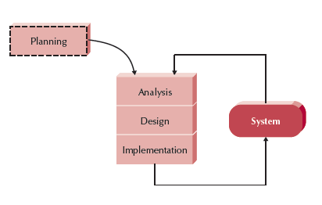
Extreme Programming (XP)

Slide 32
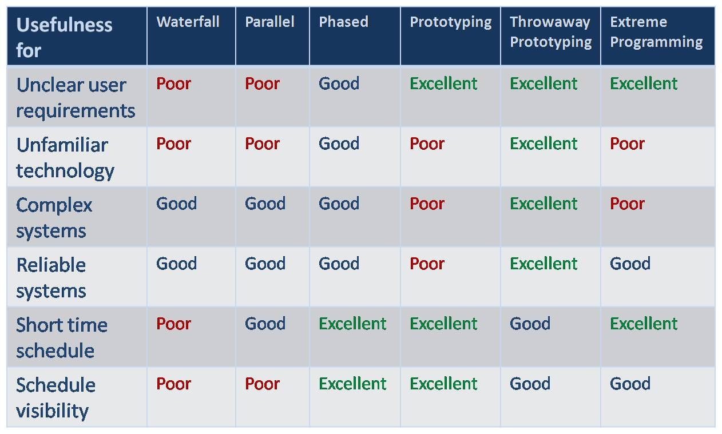
Which Methodology to Use?

Slide 33
The Systems Analyst: Skills
Agents of change
Identify ways to improve the organization
Motivate & train others
Skills needed:
Technical: must understand the technology
Business: must know the business processes
Analytical: must be able to solve problems
Communications: technical & non-technical audiences
Interpersonal: leadership & management
Ethics: deal fairly and protect confidential information

Slide 34
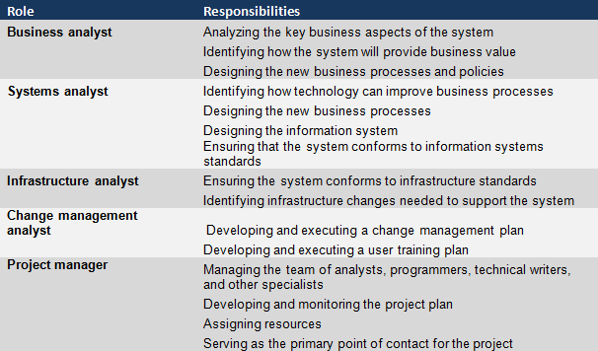
The Systems Analyst: Roles

Slide 35
Object-Oriented Systems Analysis & Design
Attempts to balance data and process
Utilizes the Unified Modeling Language (UML) and the Unified Process
Characteristics of OOAD:
Use-case Driven
Architecture Centric
Iterative and Incremental

Slide 36
Characteristics of Object-Oriented Systems
Classes & Objects
Object (instance): instantiation of a class
Attributes: information that describes the class
State: describes its values and relationships at a point in time
Methods & Messages
Methods: the behavior of a class
Messages: information sent to an object to trigger a method (procedure call)

Slide 37
Characteristics of Object-Oriented Systems (cont.)
Encapsulation & information hiding
Encapsulation: combination of process & data
Information hiding: functionality is hidden
Inheritance
General classes are created (superclasses)
Subclasses can inherit data and methods from a superclass

Slide 38
Characteristics of Object-Oriented Systems (cont.)
Polymorphism & dynamic binding
Polymorphism: the same message can have different meanings
Dynamic binding: type of object is not determined until run-time
Contrast with static binding

Slide 39
Object-Oriented Systems Analysis & Design
Use-case driven
Use-cases define the behavior of a system
Each use-case focuses on one business process
Architecture centric
Functional (external) view: focuses on the user’s perspective
Static (structural) view: focuses on attributes, methods, classes & relationships
Dynamic (behavioral) view: focuses on messages between classes and resulting behaviors

Slide 40
Object-Oriented Systems Analysis & Design (cont.)
Iterative & incremental
Undergoes continuous testing & refinement
The analyst understands the system better over time
Benefits of OOSAD
Break a complex system into smaller, more manageable modules
Work on modules individually
See the system more realistically—as the users do

Slide 41
The Unified Process
A specific methodology that maps out when and how to use the various UML techniques for object-oriented analysis and design
A two-dimensional process consisting of phases and workflows
Phases are time periods in development
Workflows are the tasks that occur in each phase
Activities in both phases & workflows will overlap

Slide 42
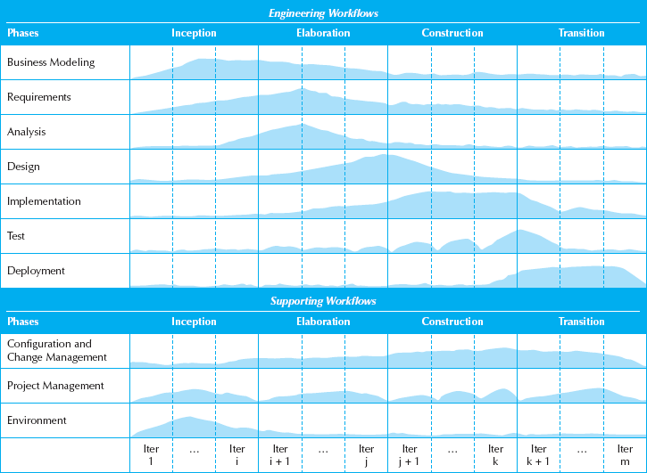
The Unified Process

Slide 43
Unified Process Phases
Inception
Feasibility analyses performed
Workflows vary but focus is on business modeling & requirements gathering
Elaboration
Heavy focus on analysis & design
Other workflows may be included
Construction: Focus on programming (implementation)
Transition--Focus on testing & deployment

Slide 44
Engineering Workflows
Business modeling
Requirements
Analysis
Design
Implementation
Testing
Deployment

Slide 45
Supporting Workflows
Project management
Configuration and change management
Environment
Operations and support*
Infrastructure management*
* Part of the enhanced unified process

Slide 46
Extensions to the Unified Process
The Unified Process does not include:
Staffing
Budgeting
Contract management
Maintenance
Operations
Support
Cross- or inter-project issues

Slide 47
Extensions to the Unified Process (cont.)
Add a Production Phase to address issues after the product has been deployed
New Workflows:
Operations & Support
Infrastructure management
Modifications to existing workflows:
Test workflow
Deployment workflow
Environment workflow
Project Management workflow
Configuration & change management workflow

Slide 48
Unified Modeling Language
Provides a common vocabulary of object-oriented terms and diagramming techniques rich enough to model any systems development project from analysis through implementation
Version 2.0 has 14 diagrams in 2 major groups:
Structure diagrams
Behavior diagrams

Slide 49
UML Behavior Diagrams
Depict the dynamic relationships among the instances or objects that represent the business information system
Activity
Sequence
Communication
Interaction overview
Timing
Behavior state machine
Protocol state machine,
Use-case diagrams

Slide 50
UML Structure Diagrams
Represent the data and static relationships in an information system
Class
Object
Package
Deployment
Component
Composite structure

Slide 51
Summary
All systems development projects follow essentially the same process, called the system development life cycle (SDLC)
System development methodologies are formalized approaches to implementing SDLCs
The systems analyst needs a variety of skills and plays a number of different roles
Object-oriented systems differ from traditional systems

Slide 52
Summary
Object-Oriented Systems Analysis and Design (OOSAD) uses a use-case-driven, architecture-centric, iterative, and incremental information systems development approach
The Unified Process is a two-dimensional systems development process described with a set of phases and workflows
The Unified Modeling Language, or UML, is a standard set of diagramming techniques

