Slide 1
Chapter 1:
Introduction to Systems
Analysis and Design

Slide 2
Learning Objectives
Systems development life cycle
  Identify the four phases
  How it came about
  Methodology alternatives
Team roles & skill sets
Object-oriented systems characteristics
Object-oriented systems analysis & design
The Unified Process & its extensions
The Unified Modeling Language (UML)

Slide 3
Introduction
Why do we need a formal process?
  Failures occur (too) often
  Creating systems is not intuitive
  Projects are late, over budget or delivered with fewer features than planned
The System Analyst is the key person
  Designs a system to add value
  Must understand the business processes
  Job is rewarding, yet challenging
  Requires specific skill sets

Slide 4
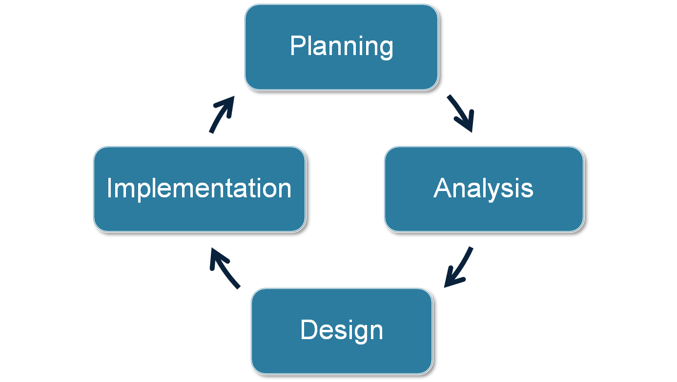
Systems Development
Life Cycle (SDLC)

Slide 5
The SDLC Process
The process consists of four phases
Each phase consists of a series of steps
Each phase is documented (deliverables)
Phases are executed sequentially, incrementally, iteratively or in some other pattern

Slide 6
Questions to be Answered
Planning phase
  Why should we build this system?
  What value does it provide?
  How long will it take to build?
Analysis phase
  Who will use it?
  What should the system do for us?
  Where & when will it be used?
Design phase
  How should we build it?

Slide 7
SDLC: The Planning Phase
Project Initiation
  Develop/receive a system request
  Conduct a feasibility analysis
    Technical feasibility
    Economic feasibility
    Organizational feasibility
Project Management
  Develop the work plan
  Staff the project
  Monitor & control the project

Slide 8
SDLC: The Analysis Phase
Develop an analysis strategy
  Model the current system
  Formulate the new system
Gather the requirements
  Develop a system concept
  Create a business model to represent:
    Business data
    Business processes
Develop a system proposal

Slide 9
SDLC: The Design Phase
Develop a design strategy
Design architecture and interfaces
Develop databases and file specifications
Develop the program design to specify:
  What programs to write
  What each program will do

Slide 10
SDLC: The Implementation Phase
Construct the system
  Build it (write the programming code)
  Test it
Install system
  Train the users
Support the system (maintenance)

Slide 11
SDLC: Methodologies
Methodology: a formalized approach to implementing the SDLC
Categories
  Process oriented
  Data centered
  Object-oriented
  Structured
  Rapid action development
  Agile development

Slide 12
Classes of Methodologies
Structured Development
  Waterfall Development
  Parallel Development
Rapid Application Development
  Phased
  Prototyping
Agile Development
  eXtreme Programming
  SCRUM

Slide 13
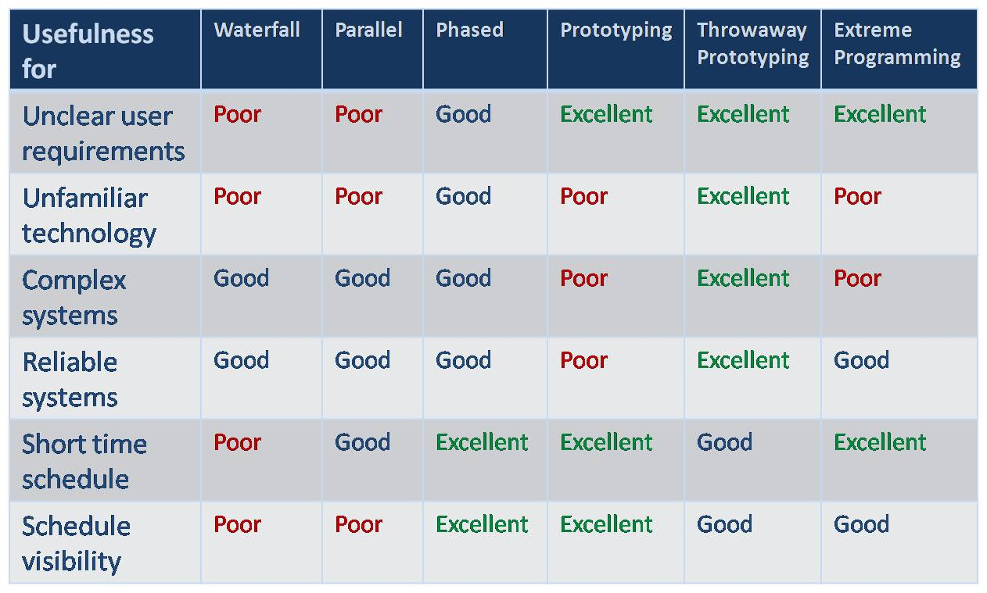
Which Methodology to Use?

Slide 14
The Systems Analyst: Skills
Agents of change
  Identify ways to improve the organization
  Motivate & train others
Skills needed:
  Technical: must understand the technology
  Business: must know the business processes
  Analytical: must be able to solve problems
  Communications: technical & non-technical audiences
  Interpersonal: leadership & management
  Ethics: deal fairly and protect confidential information

Slide 15
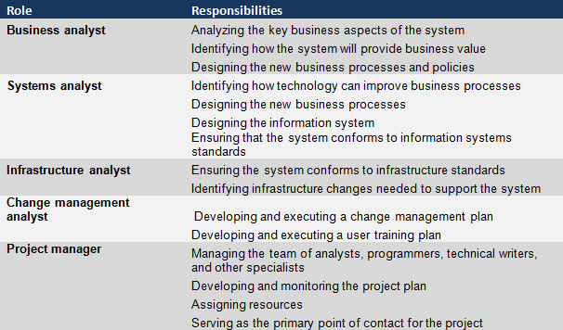
The Systems Analyst: Roles

Slide 16
Object-Oriented
Systems Analysis & Design
Attempts to balance data and process
Utilizes the Unified Modeling Language (UML) and the Unified Process
Characteristics of OOAD:
  Use-case Driven
  Architecture Centric
  Iterative and Incremental

Slide 17
Characteristics of Object-Oriented Systems
Classes & Objects
  Object (instance): instantiation of a class
  Attributes: information that describes the class
  State: describes its values and relationships at a point in time
Methods & Messages
  Methods: the behavior of a class
  Messages: information sent to an object to trigger a method (procedure call)

Slide 18
Characteristics of Object-Oriented Systems (cont.)
Encapsulation & information hiding
  Encapsulation: combination of process & data
  Information hiding: functionality is hidden
Inheritance
  General classes are created (superclasses)
  Subclasses can inherit data and methods from a superclass

Slide 19
Characteristics of Object-Oriented Systems (cont.)
Polymorphism & dynamic binding
  Polymorphism: the same message can have different meanings
  Dynamic binding: type of object is not determined until run-time
  Contrast with static binding

Slide 20
Object-Oriented Systems Analysis & Design
Use-case driven
  Use-cases define the behavior of a system
  Each use-case focuses on one business process
Architecture centric
  Functional (external) view: focuses on the user’s perspective
  Static (structural) view: focuses on attributes, methods, classes & relationships
  Dynamic (behavioral) view: focuses on messages between classes and resulting behaviors

Slide 21
Object-Oriented Systems Analysis & Design (cont.)
Iterative & incremental
  Undergoes continuous testing & refinement
  The analyst understands the system better over time
Benefits of OOSAD
  Break a complex system into smaller, more manageable modules
  Work on modules individually
  See the system more realistically—as the users do

Slide 22
The Unified Process
A specific methodology that maps out when and how to use the various UML techniques for object-oriented analysis and design
A two-dimensional process consisting of phases and workflows
  Phases are time periods in development
  Workflows are the tasks that occur in each phase
  Activities in both phases & workflows will overlap

Slide 23
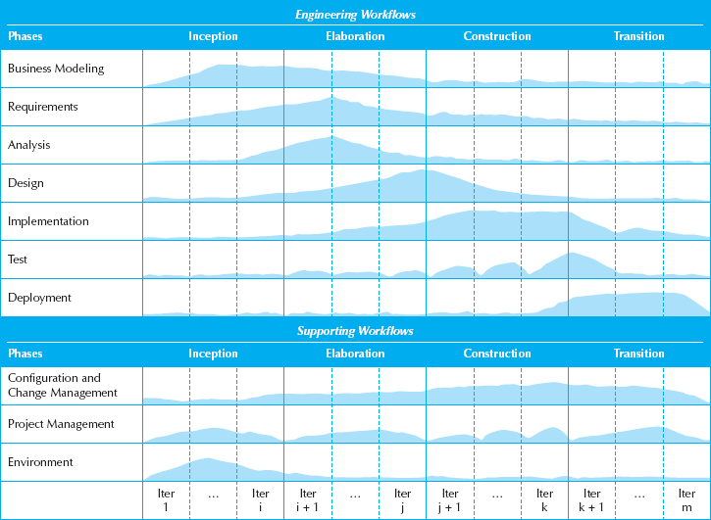
The Unified Process

Slide 24
Unified Process Phases
Inception
  Feasibility analyses performed
  Workflows vary but focus is on business modeling & requirements gathering
Elaboration
  Heavy focus on analysis & design
  Other workflows may be included
Construction: Focus on programming (implementation)
Transition--Focus on testing & deployment

Slide 25
Engineering Workflows
Business modeling
Requirements
Analysis
Design
Implementation
Testing
Deployment

Slide 26
Supporting Workflows
Project management
Configuration and change management
Environment
Operations and support*
Infrastructure management*
* Part of the enhanced unified process

Slide 27
Extensions to the Unified Process
The Unified Process does not include:
  Staffing
  Budgeting
  Contract management
  Maintenance
  Operations
  Support
  Cross- or inter-project issues

Slide 28
Extensions to the Unified Process (cont.)
Add a Production Phase to address issues after the product has been deployed
New Workflows:
  Operations & Support
  Infrastructure management
Modifications to existing workflows:
  Test workflow
  Deployment workflow
  Environment workflow
  Project Management workflow
  Configuration & change management workflow

Slide 29
Unified Modeling Language
Provides a common vocabulary of object-oriented terms and diagramming techniques rich enough to model any systems development project from analysis through implementation
Version 2.0 has 14 diagrams in 2 major groups:
  Structure diagrams
  Behavior diagrams

Slide 30
UML Structure Diagrams
Represent the data and static relationships in an information system
  Class
  Object
  Package
  Deployment
  Component
  Composite structure

Slide 31
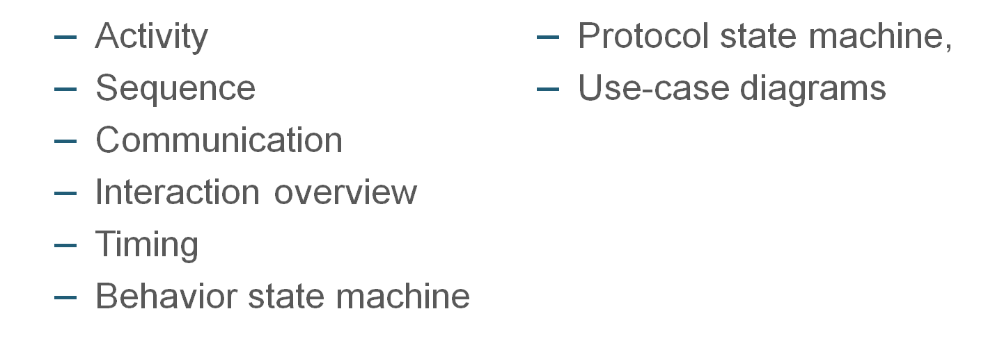
UML Behavior Diagrams
Depict the dynamic relationships among the instances or objects that represent the business information system

Slide 32
Summary
All systems development projects follow essentially the same process, called the system development life cycle (SDLC)
System development methodologies are formalized approaches to implementing SDLCs
The systems analyst needs a variety of skills and plays a number of different roles
Object-oriented systems differ from traditional systems

Slide 33
Summary
Object-Oriented Systems Analysis and Design (OOSAD) uses a use-case-driven, architecture-centric, iterative, and incremental information systems development approach
The Unified Process is a two-dimensional systems development process described with a set of phases and workflows
The Unified Modeling Language, or UML, is a standard set of diagramming techniques

