Slide 1

Classification of readmittance rate using Diabetes Dataset
By
Nisah Ahmed
Jiahui Ren
Samson
Rahul

Slide 2
Introduction
10 years of treatment/clinical care data at 130 US Hospitals (from 1999-2008)
Project Statement:
  Determine the factors (age, race, gender) and the medications which we can study to reduce the rise of diabetic patients focusing on Readmittance Rate of Patients.
  Our aim will be to obtain a higher precision and F1-Score in our confusion matrix on supervised Machine Learning Classifiers.

Slide 3
Hypothesis

Slide 4
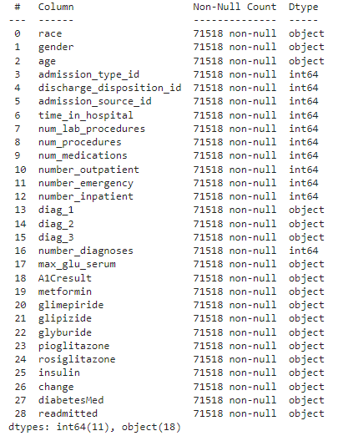
Data Description
Features: 0 to 27
Target/Output: Readmitted (28)

