Slide 1

Classification of readmittance rate using Diabetes Dataset
By
Nisah Ahmed
Jiahui Ren
Samson
Rahul

Slide 2
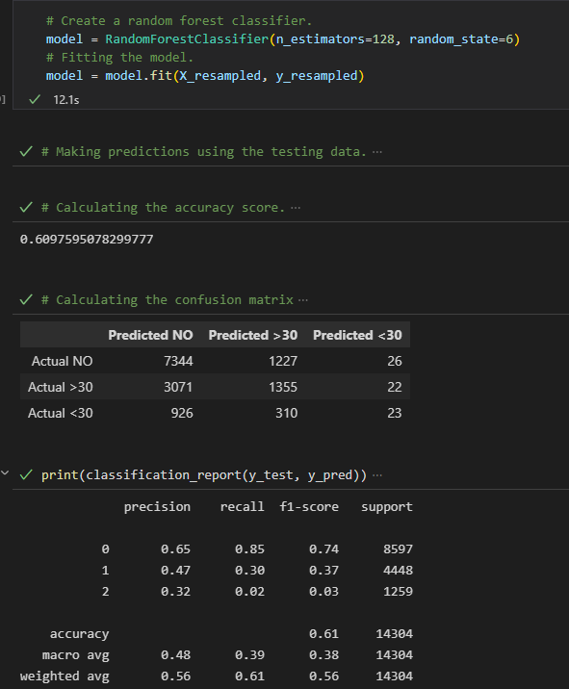
Random Forest Classifier – Attempt 1
Over Sampling and data scaling used.
Total Datapoints – 71518 X 30
The accuracy achieved is 60.98%

Slide 3
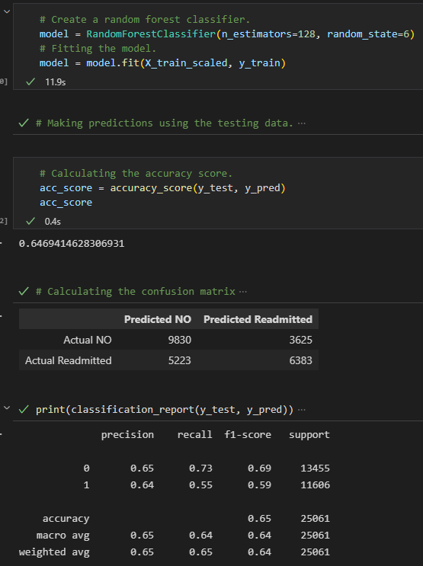
Random Forest Classifier – Attempt 2
The result column was changed from 3 outputs to 2.
Returning patients were not removed as per the initial ETL.
Total Datapoints – 100244 X 30
Accuracy achieved was 64.69%

Slide 4
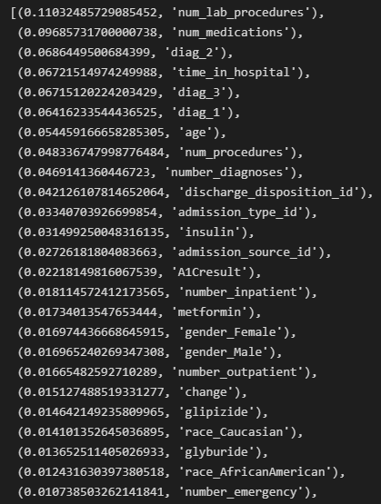
Feature Importance
Usefulness of features in predicting the results - ranked

Slide 5
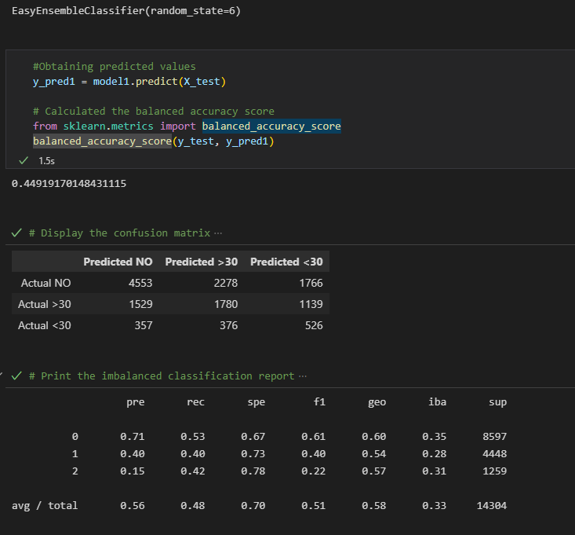
Easy Ensemble Classifier – Attempt 1
Over Sampling and data scaling used.
Total Datapoints – 71518 X 30
Accuracy achieved was 44.92%

Slide 6
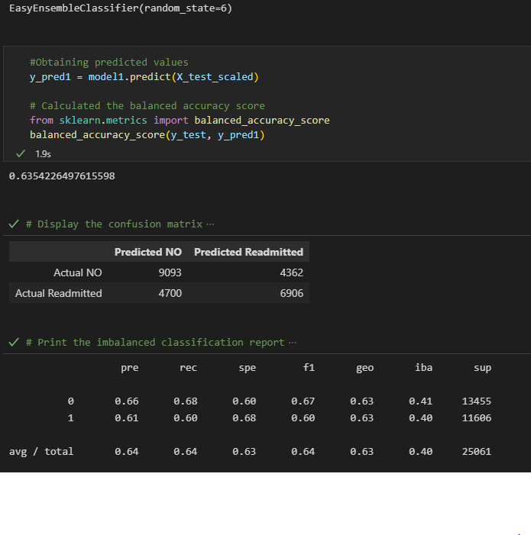
Easy Ensemble Classifier – Attempt 2
The result column was changed from 3 outputs to 2.
Returning patients were not removed as per the initial ETL.
Total Datapoints – 100244 X 30
Accuracy achieved was 63.54%

Slide 7
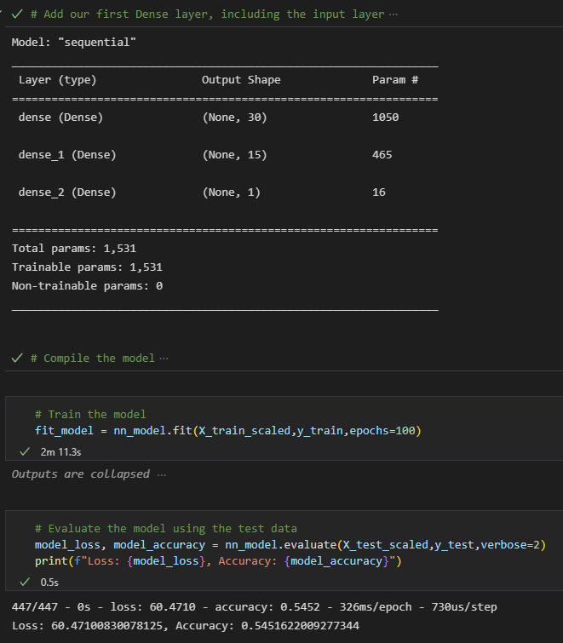
ANN Classifier – Attempt 1
2 layers used
100 epochs
Activation - RELU
Accuracy achieved was 54.52%

Slide 8
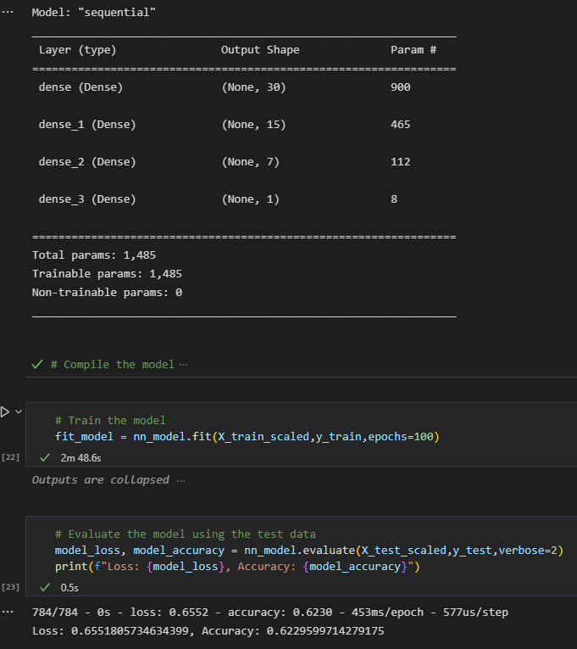
ANN Classifier – Attempt 2
3 layers used
100 epochs
Activation – tanh
The result column was changed from 3 outputs to 2.
Returning patients were not removed as per the initial ETL.
Total Datapoints – 100244 X 30
Accuracy achieved was 62.3%

