Slide 1
Pozitive/Negative Detection from Text
Course:SENG461
Group Members: Hayrunnisa İlgün, Fatma Nur Kodak
Date:24.12.2025

Slide 2
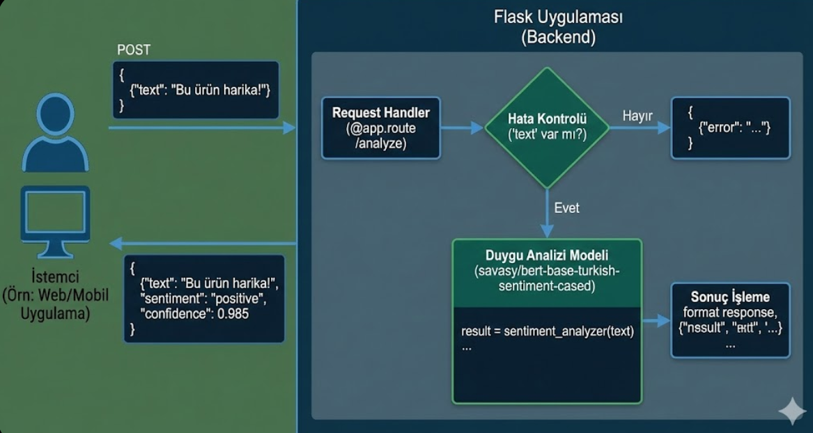
Frontend–Backend Interaction (Workflow)
Backend Architecture
The backend of the application is developed using Flask, a lightweight Python web framework. It is responsible for handling client requests, processing input data, and returning sentiment analysis results in a structured format.
When the application starts, a pre-trained BERT-based sentiment analysis model is loaded once using the Transformers library. Loading the model at startup improves performance by avoiding repeated initialization for each request.
The backend exposes a RESTful POST endpoint that receives user input in JSON format. The request must include a text field containing the text to be analyzed. If the required data is missing, the backend returns an appropriate error response.
After receiving valid input, the text is passed to the sentiment analysis pipeline. The model processes the text and predicts the sentiment label along with a confidence score. These results are then formatted into a JSON response and sent back to the client.
This backend architecture ensures efficient request handling, modular design, and scalable sentiment analysis functionality.

Slide 3
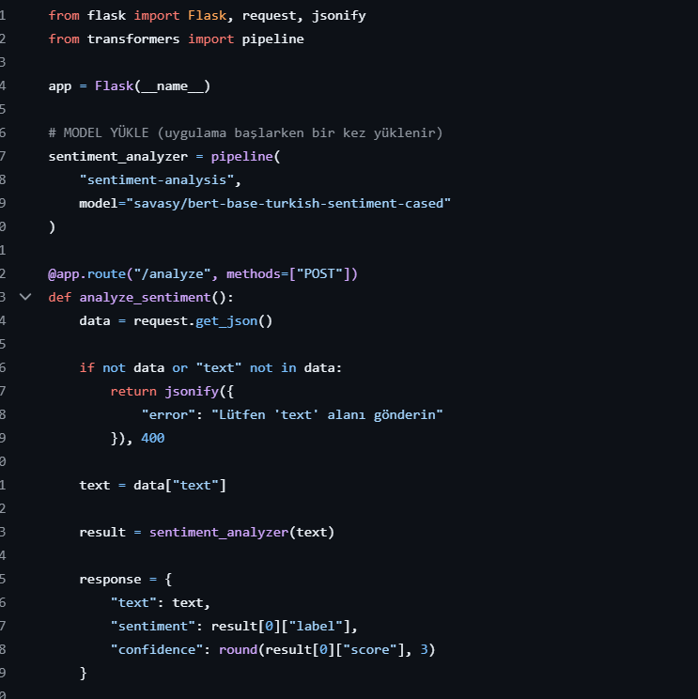
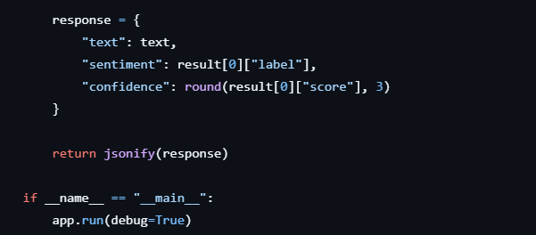
Backend Architecture
The backend of the application is developed using Flask, a lightweight Python web framework. It is responsible for handling client requests, processing input data, and returning sentiment analysis results in a structured format.
When the application starts, a pre-trained BERT-based sentiment analysis model is loaded once using the Transformers library. Loading the model at startup improves performance by avoiding repeated initialization for each request.
The backend exposes a RESTful POST endpoint that receives user input in JSON format. The request must include a text field containing the text to be analyzed. If the required data is missing, the backend returns an appropriate error response.
After receiving valid input, the text is passed to the sentiment analysis pipeline. The model processes the text and predicts the sentiment label along with a confidence score. These results are then formatted into a JSON response and sent back to the client.

Slide 4
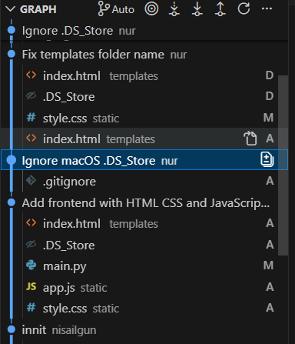
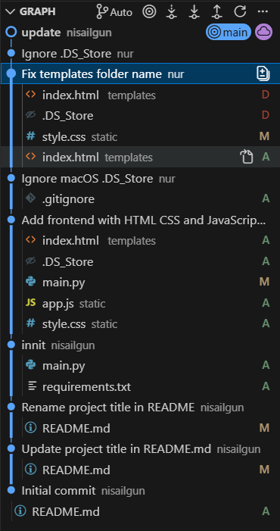
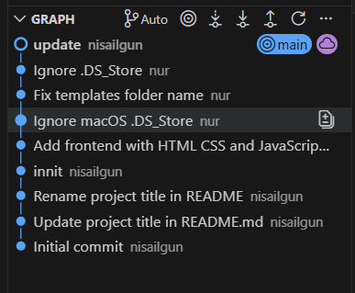
Git history / commit

Slide 5
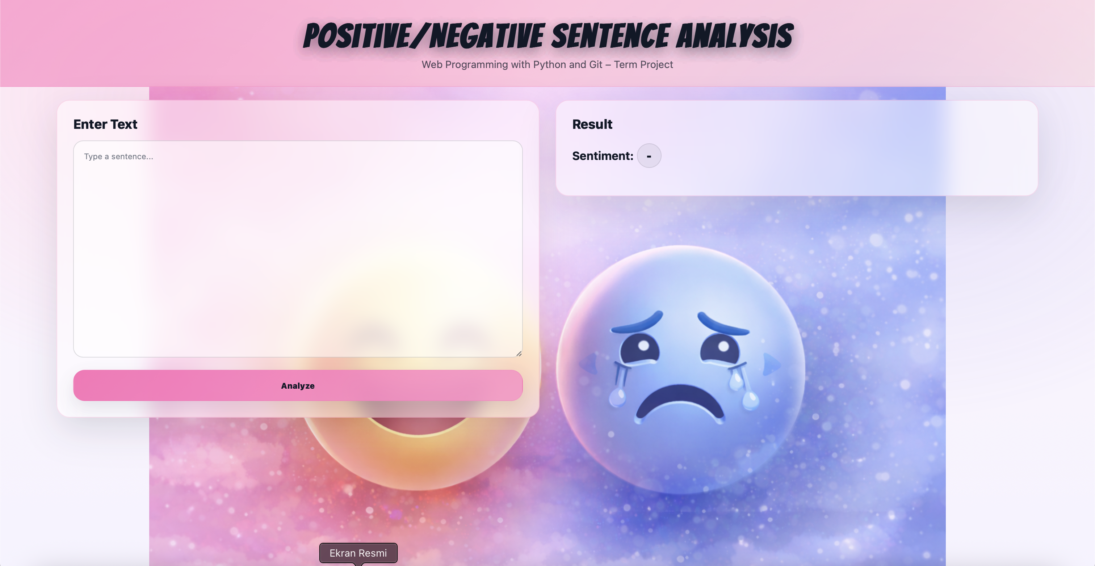
Sentiment Analysis Web Application
This interface represents a Positive/Negative Sentence Analysis web application. The user enters a sentence into the input area on the left, and the system analyzes the emotional polarity of the text using a sentiment analysis model.
The result is displayed on the right side with a clear sentiment label (Positive or Negative) and a corresponding visual emoji, providing immediate and intuitive feedback. The soft pastel color palette and transparent cards enhance readability while keeping the focus on user interaction and results.

Slide 6
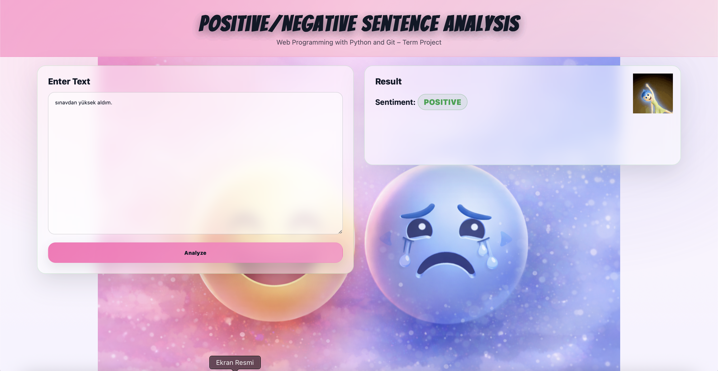
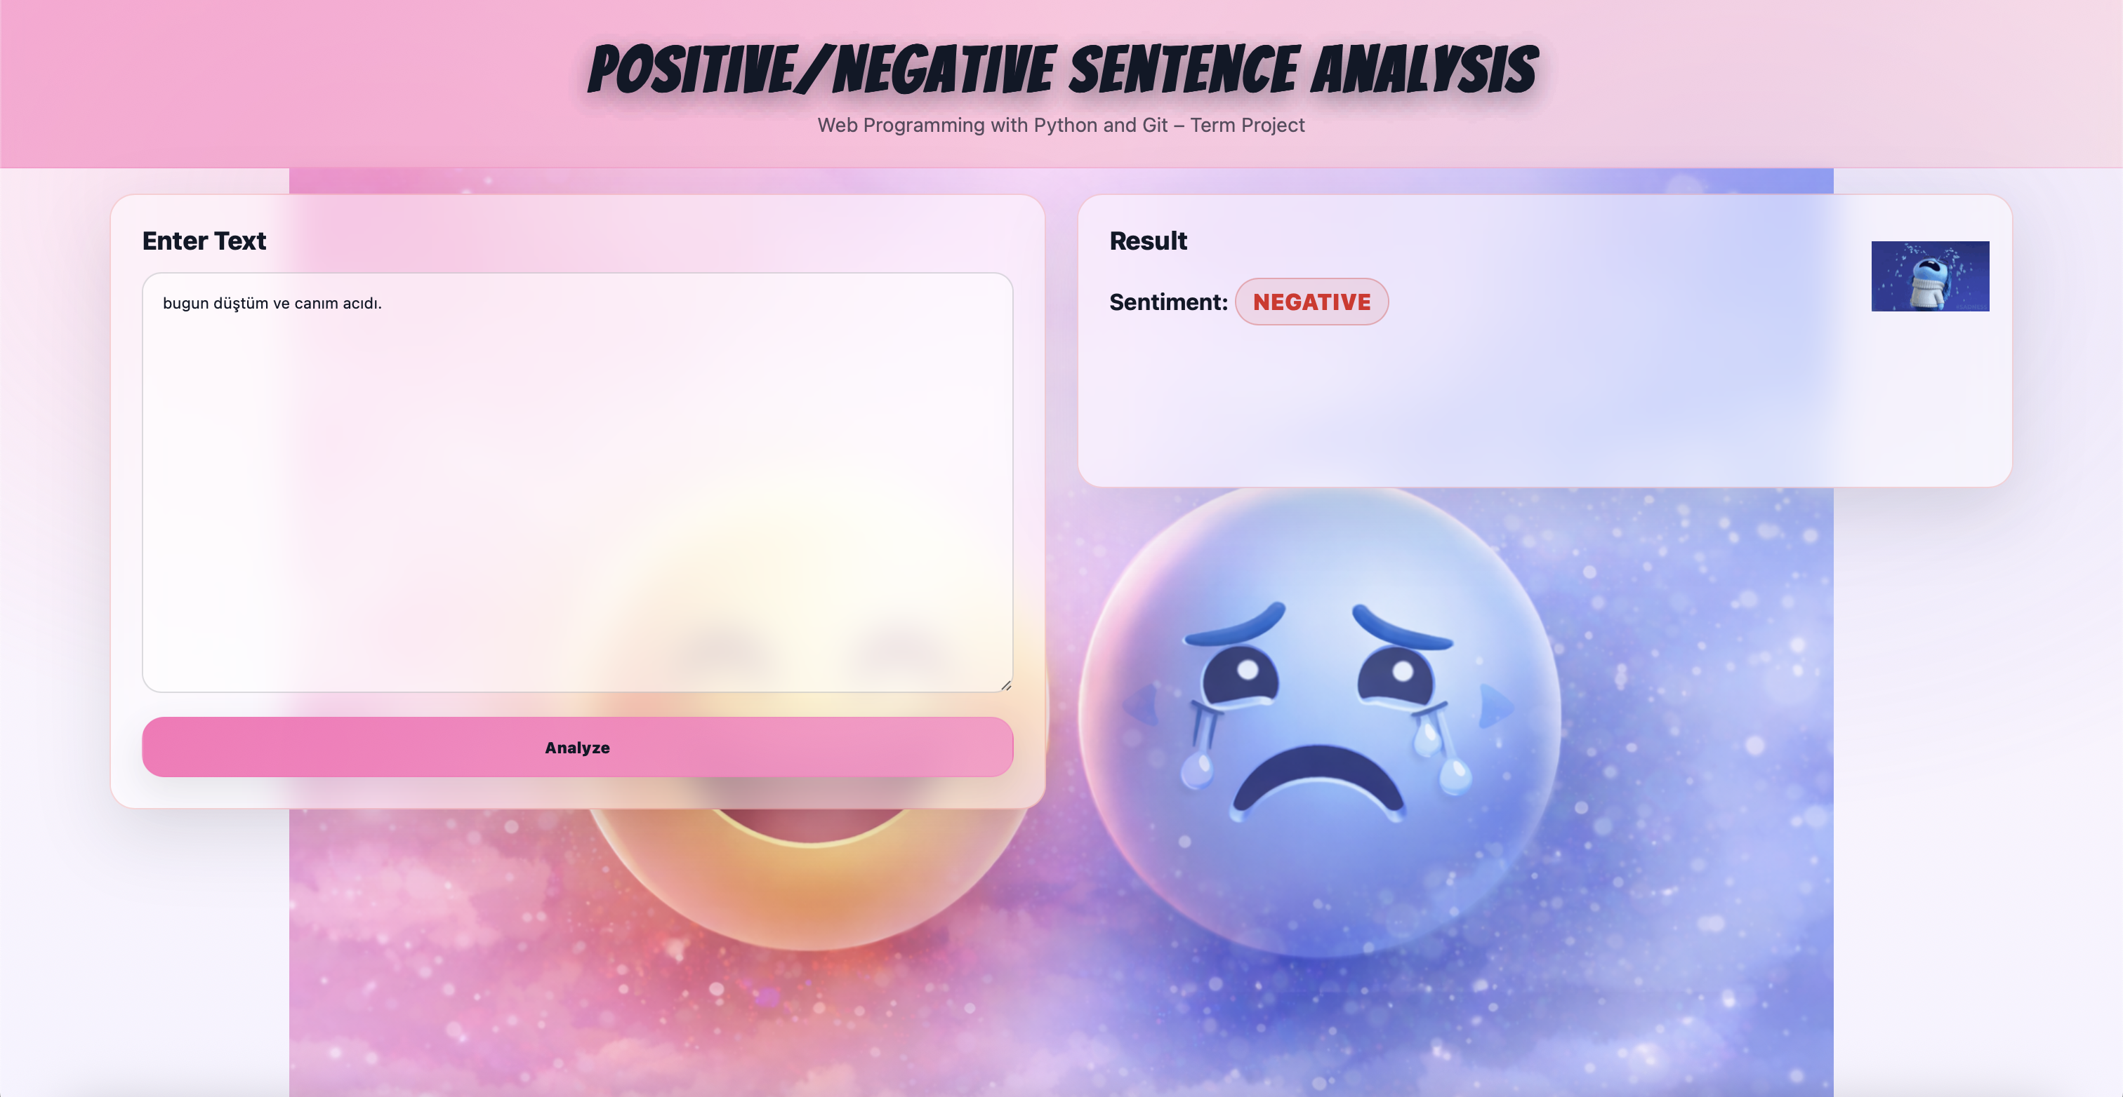

Slide 7
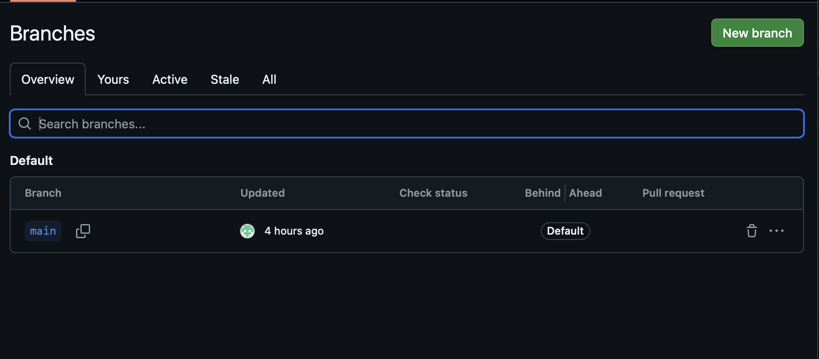
Git Branching & Version Control Workflow

