Slide 1



KONGU ENGINEERING COLLEGE
PERUNDURAI ERODE-638060
DEPARTMENT OF COMPUTER APPLICATION
DIGITAL PLATFORM FOR AGRO CENTER
Team Members :
Nisanth G(24MCR074)
Preteka A T(24MCR079)
Varshini T (24MCR123)
Team Guide:
Mrs.M.Sindhu MCA.,
Team number: 30

Slide 2
PROJECT OVERVIEW
The project as focuses on developing a professional web application for a Agricultural needs.
The main objective of this project is to improve the customer experience of the Agricultural needs using a web application.
This web application streamlines the purchasing process, ensuring security and efficiency.
During online payments, customers receive a One-Time Password (OTP) via SMS, providing an additional layer of security to safeguard transactions.
This feature not only protects sensitive information but also builds trust between the platform and its users.
Once the order is successfully placed, customers receive a confirmation message through WhatsApp, ensuring they are promptly informed about their purchase status.
This integration of SMS and WhatsApp notifications enhances user engagement

Slide 3
EXISTING SYSTEM
A user interface has been developed for both the admin and user modules.
The admin module allows administrators to add new products and manage existing products and orders.
In the user module, customers can view all available products along with their prices and descriptions. When customers wish to purchase a product, they can add it to their shopping cart. All data is stored in a Firebase database.

Slide 4
PROPOSED SYSTEM
The total cost of a purchase is determined by adding the product cost to the shipping cost. When a customer decides to buy a product using the online payment method, they must enter their valid payment information, including their contact number. This step is crucial for processing the transaction securely.
After the customer submits their details, they will receive a One-Time Password (OTP) via SMS or email. This OTP serves as a verification tool to confirm the customer's identity and validate the order. Customers must enter the OTP within a specified time frame to proceed with the purchase.

Slide 5
TECHNOLOGIES USED
FRONT-END
BACK-END
REACT JS
HTML
CSS
JAVASCRIPT
FIREBASE
NODE JS

Slide 6
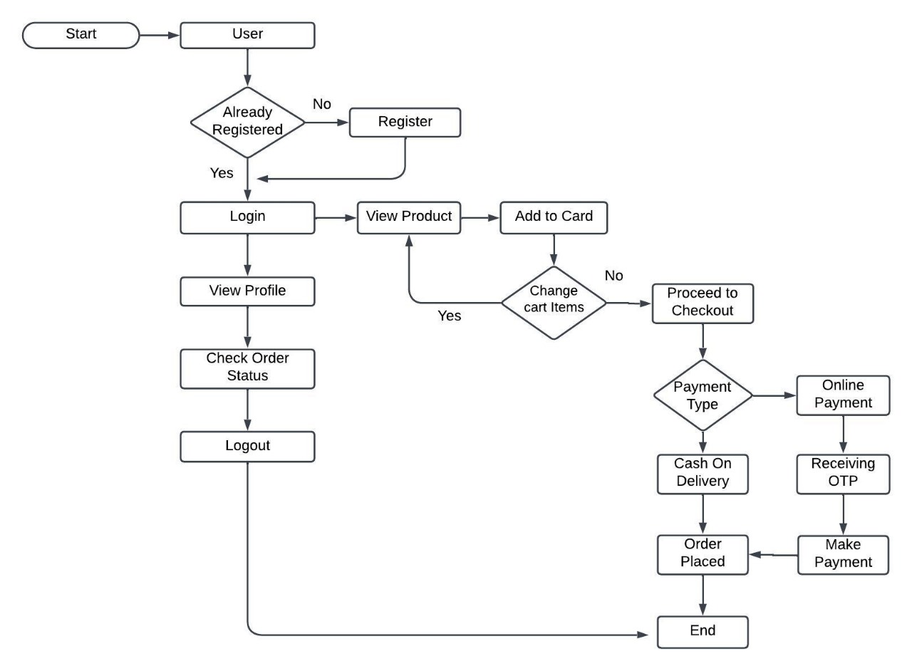
USER SYSTEM FLOW DIAGRAM

Slide 7
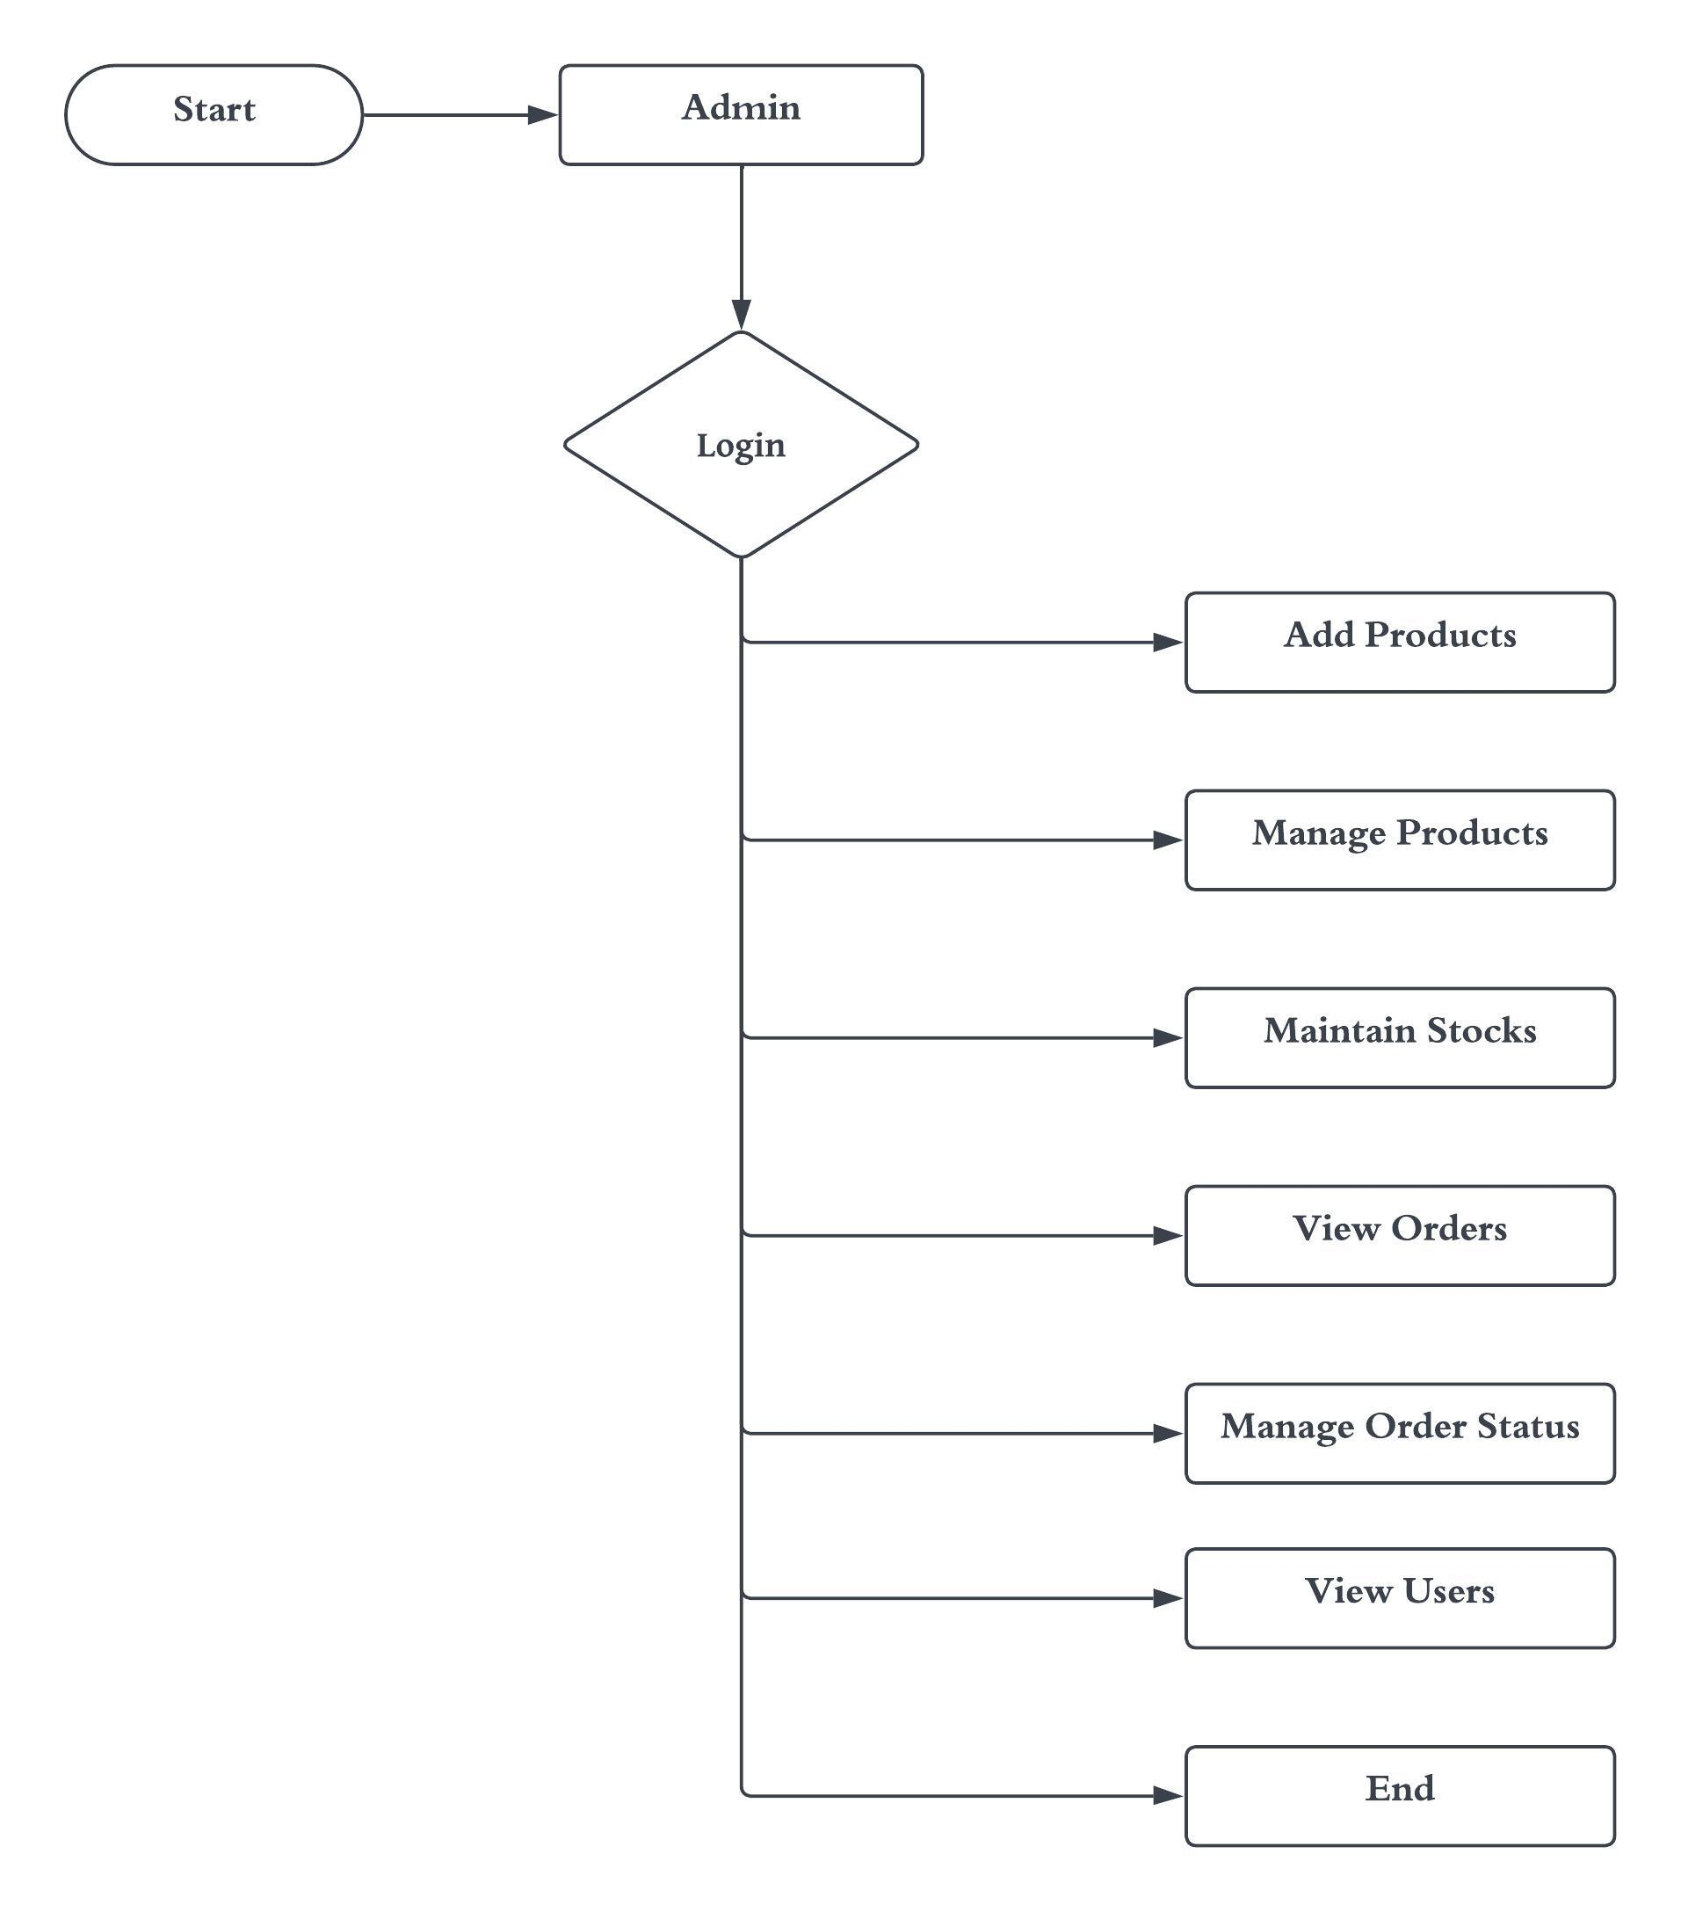
ADMIN SYSTEM FLOW DIAGRAM

Slide 8
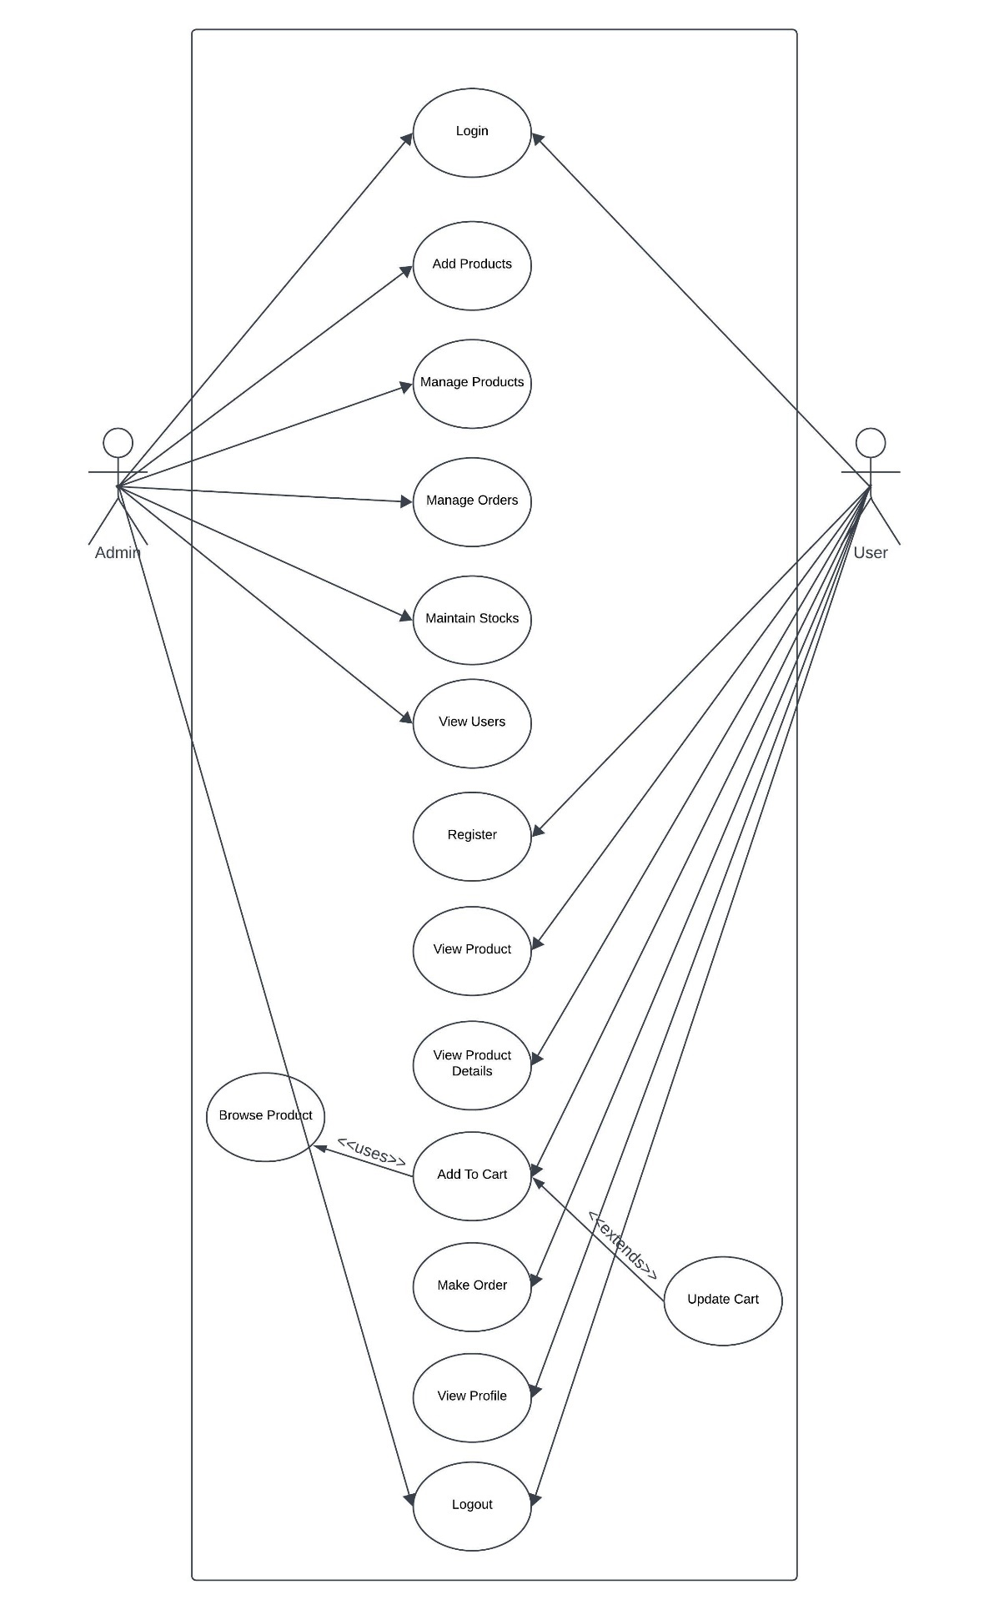
USE CASE DIAGRAM

Slide 9
MODULE DESCRIPTION
HOME MODULE:
The Home module is the entry point of the online platform, featuring an interactive landing page that highlights the agro center's offerings.
It includes a navigation bar for easy access to sections like Products, About Us, Account, and Cart.
The module showcases dynamic content, including promotions, featured products, and ongoing sales or events.
Its responsive design ensures an optimal viewing experience across devices, providing a user-friendly introduction to the platform.

Slide 10
PRODUCT MODULE:
The Product Module is the core of the online platform, featuring an organized and visually appealing product catalog. Each listing includes images, descriptions, prices, expiration dates, and availability.
It offers a diverse range of trusted brands like Roundup, Barrier, and Biomycin, ensuring high-quality options for users.
The module also includes an intuitive shopping cart system for seamless online transactions. Overall, it enhances user confidence in the store's offerings.

Slide 11
AUTHENTICATION MODULE:
The Authentication Module is the secure gateway for user interaction with the online platform, managing identities and access.
It offers a seamless registration process for account creation and a secure login mechanism with password hashing and encryption.
Users can customize their profiles and recover passwords through account settings.
The module also includes multi-factor authentication and session management to enhance security.
Overall, it provides a user-friendly experience while ensuring peace of mind.

Slide 12
CECKOUT MODULE:
The Checkout Module is the final phase of the online shopping journey, streamlining the process from product selection to order completion.
It features a user-friendly interface for reviewing items, entering shipping details, and selecting secure payment options.
The module includes address validation and error-checking to ensure accurate user inputs, along with detailed order summaries for confirmation.
Its responsive design guarantees a seamless experience across devices. Overall, it aims to provide a secure and efficient conclusion to transactions on the platform..

Slide 13
ADMIN MODULE:
The Admin Module is the central hub for platform administrators, providing essential tools for managing the online agro center.
Administrators can add, edit, and manage products to maintain an up-to-date inventory. Integrated order management allows tracking and updating order statuses in real-time.
User management features provide an overview of customer details.
Advanced analytics and reporting tools offer insights into sales trends and customer behavior, enabling data-driven decision-making to optimize operations and enhance satisfaction.

Slide 14
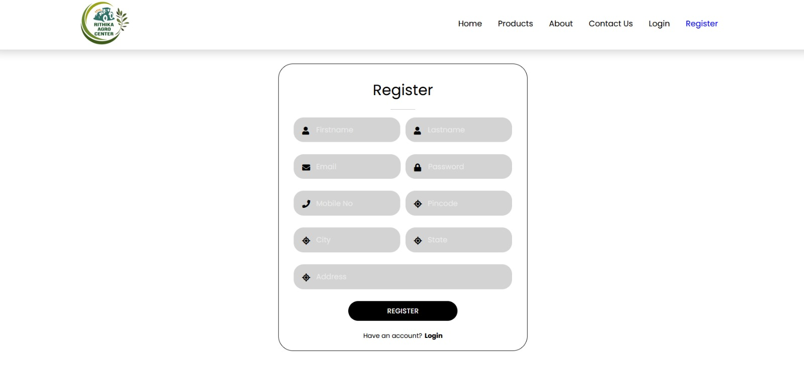
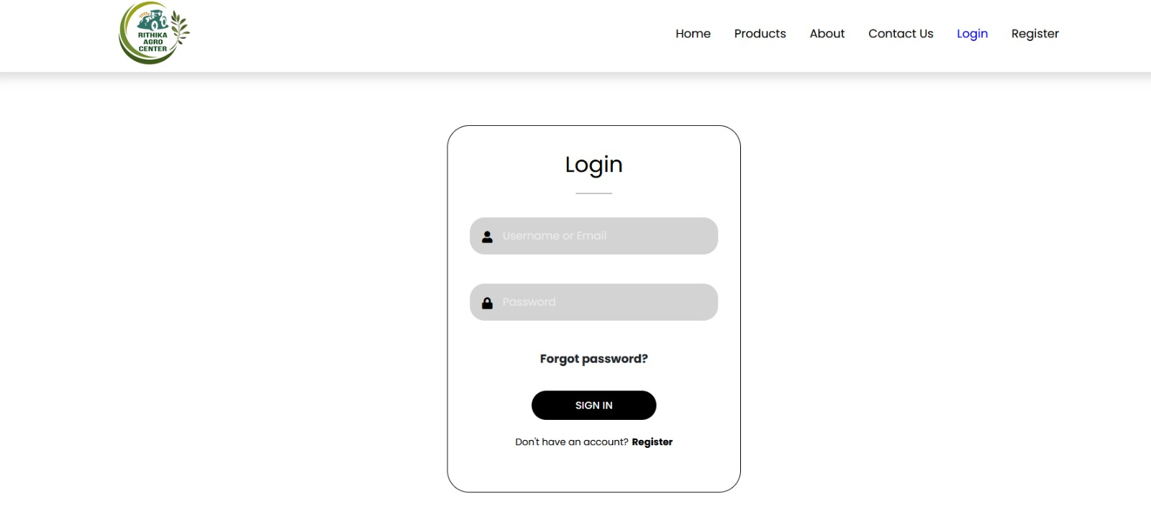
SCREEN SHOTS
User Registration Page
User Login Page

Slide 15
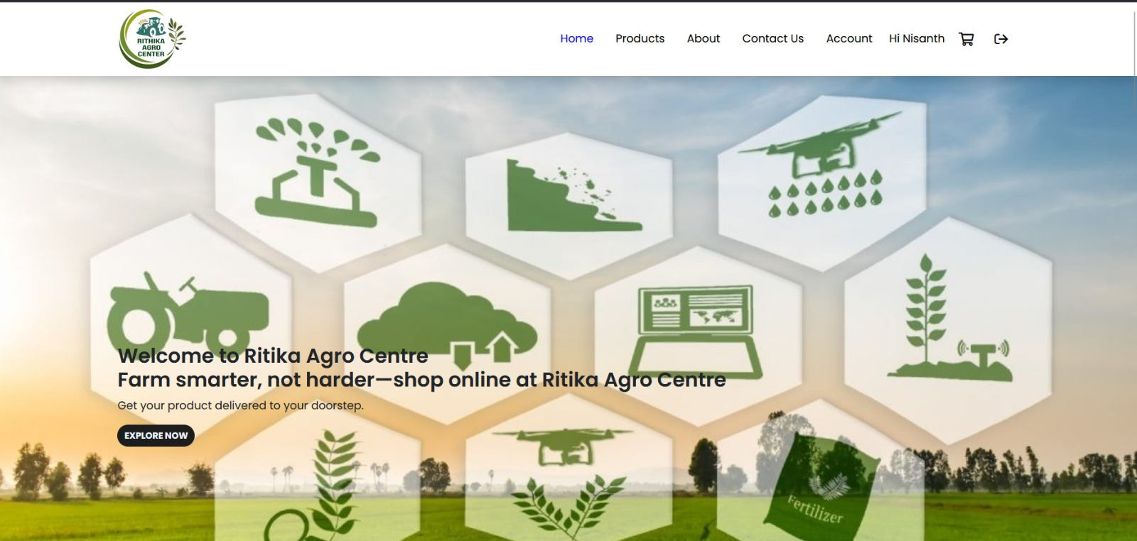
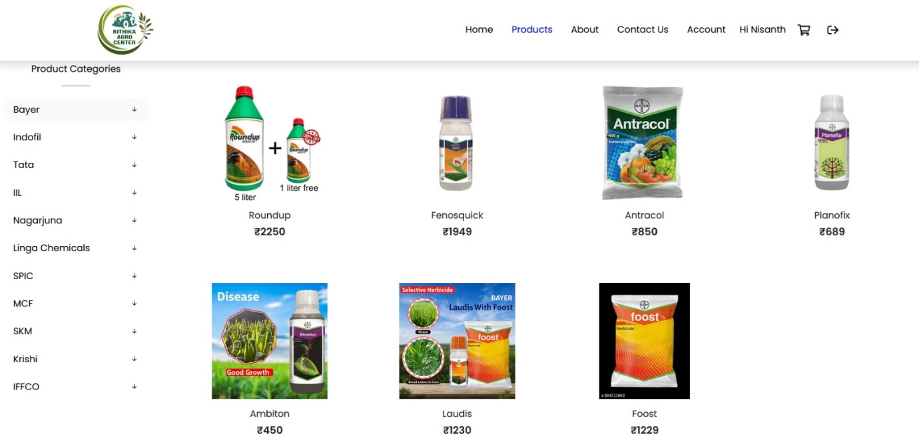
Home Page
Products Page

Slide 16
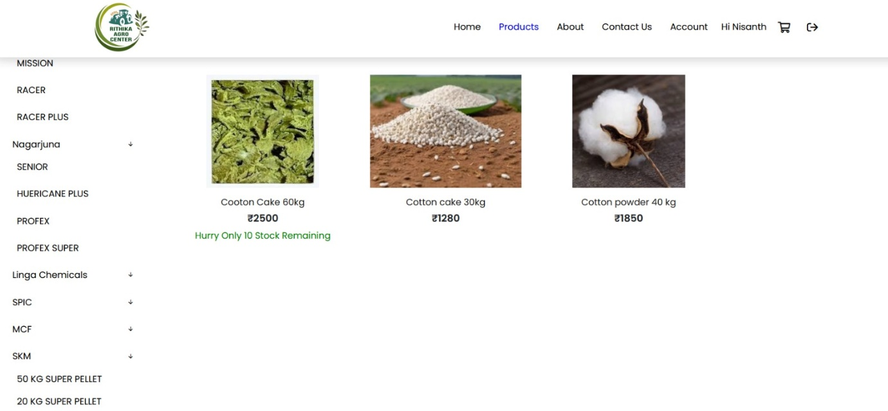
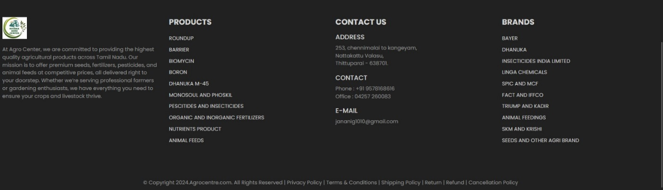
Product Page(Stock)
About Page

Slide 17
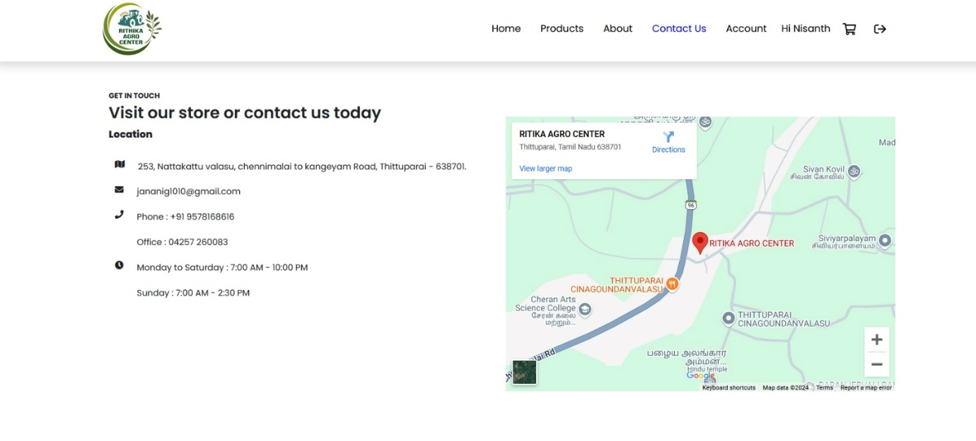
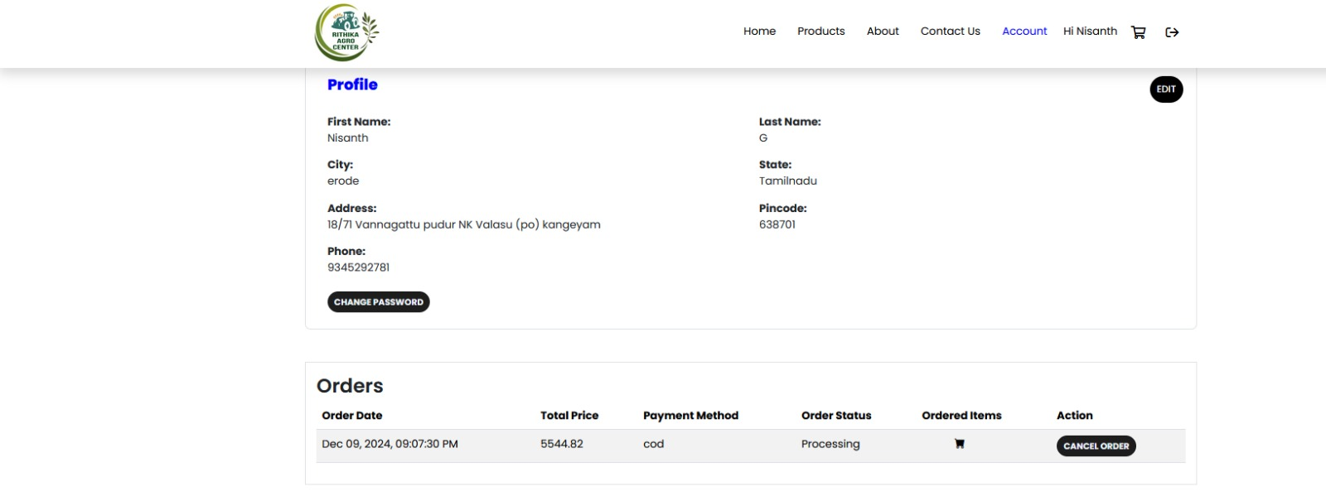
Contact Page
Profile Page

Slide 18
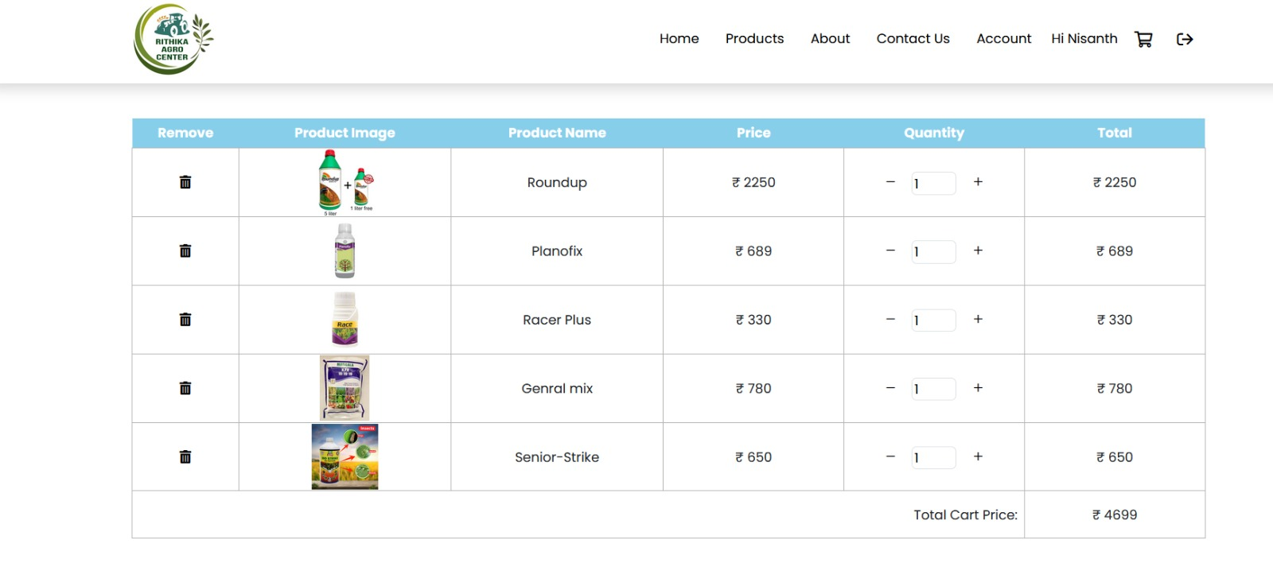
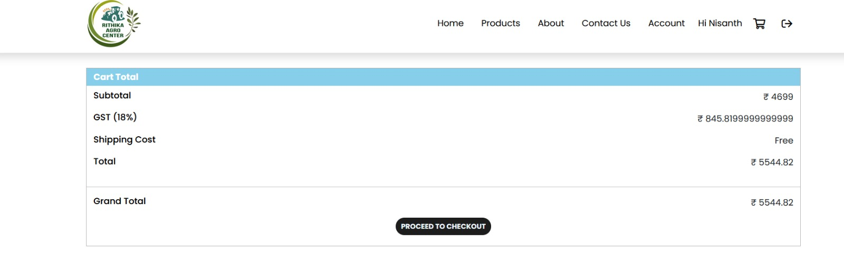
Cart Page
Order Page

Slide 19
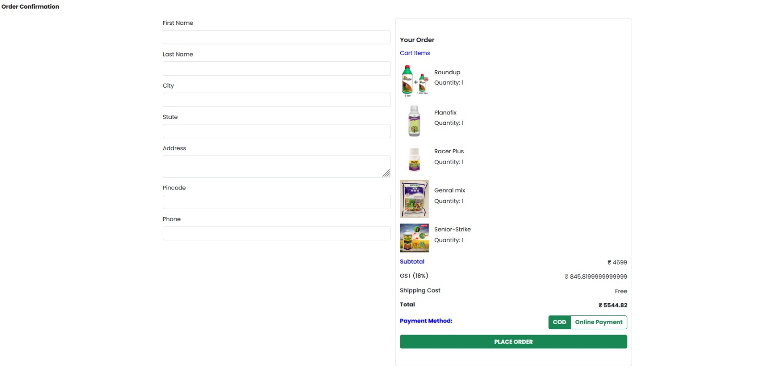

Slide 20
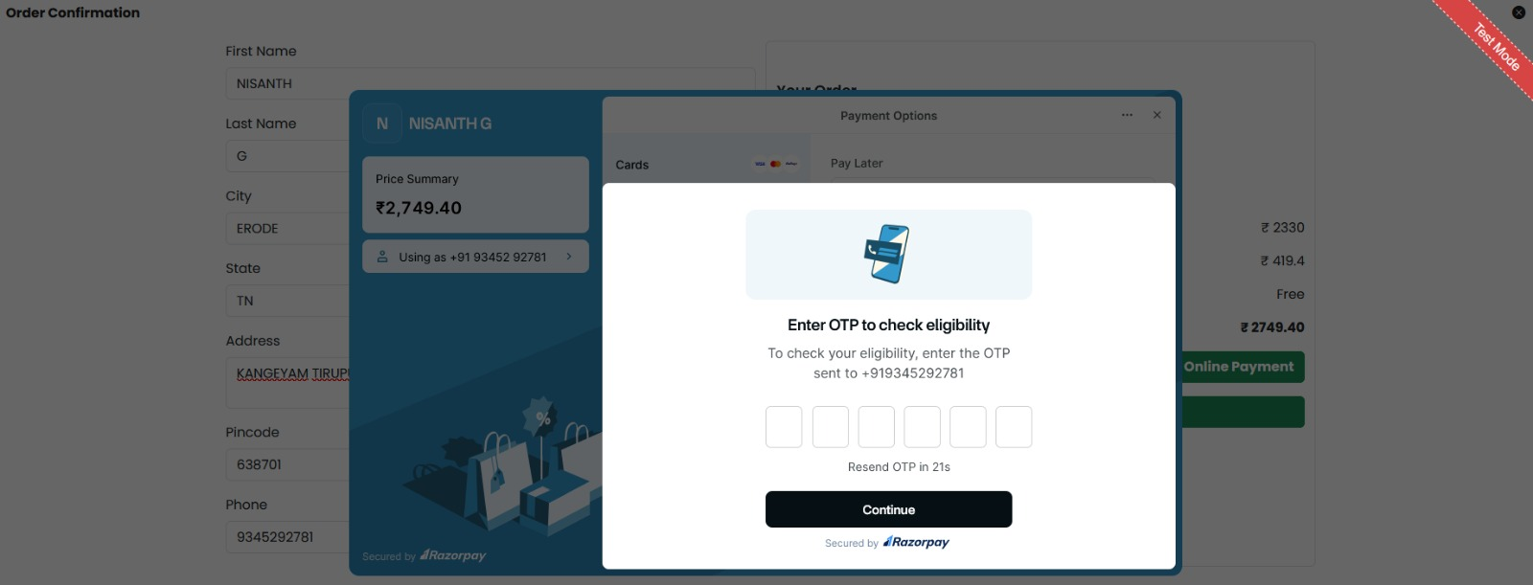
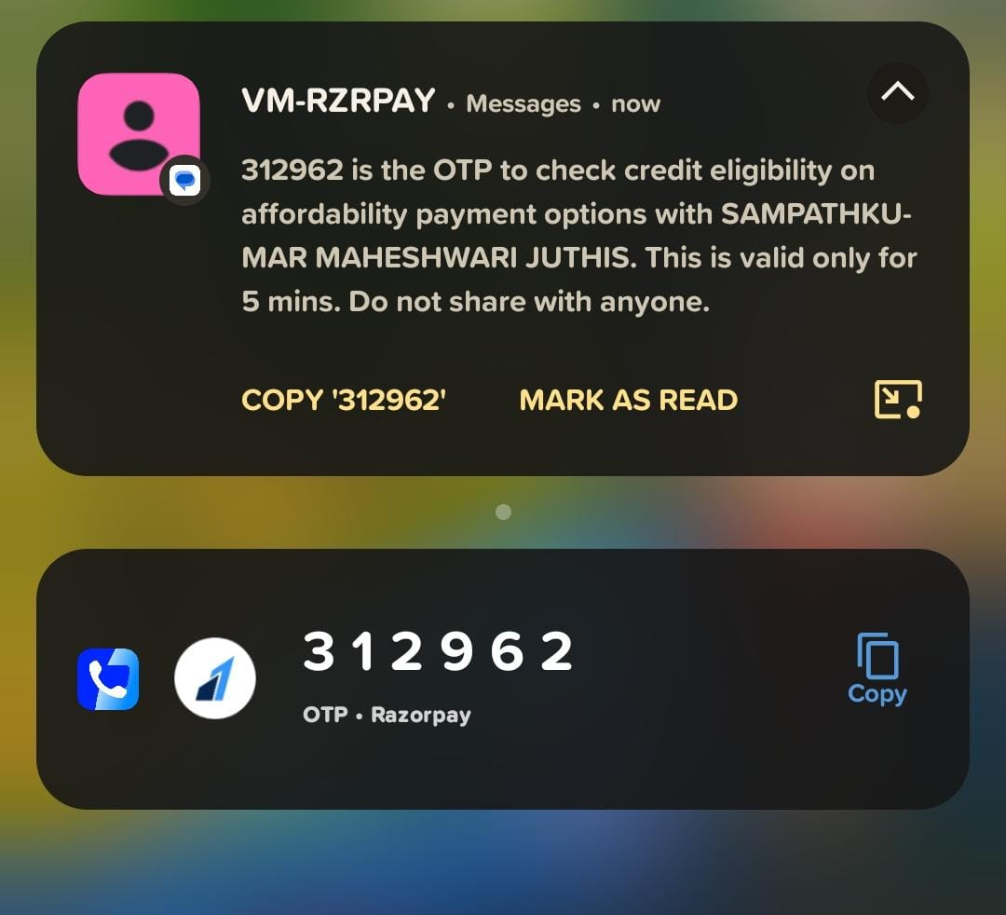
OTP Verification Page

Slide 21
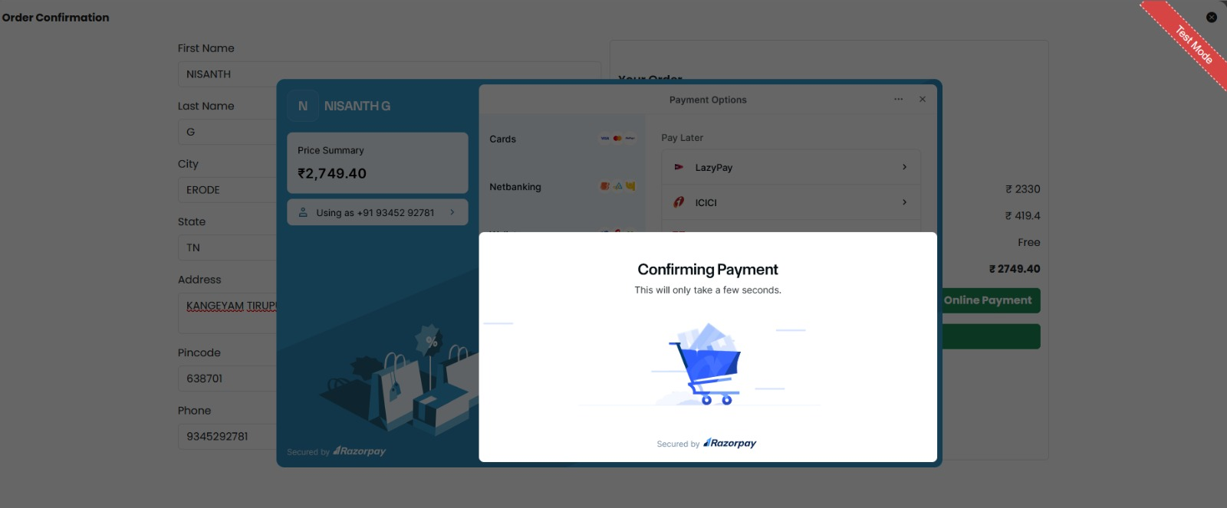
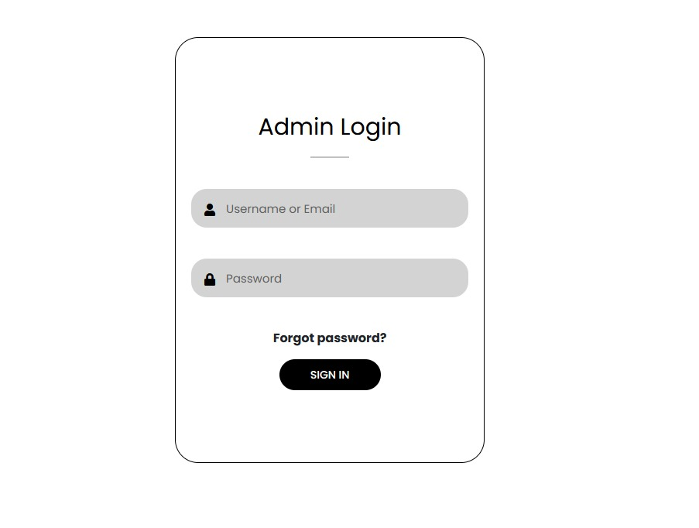
Payment Confirmation for Order Page
Admin Login

Slide 22
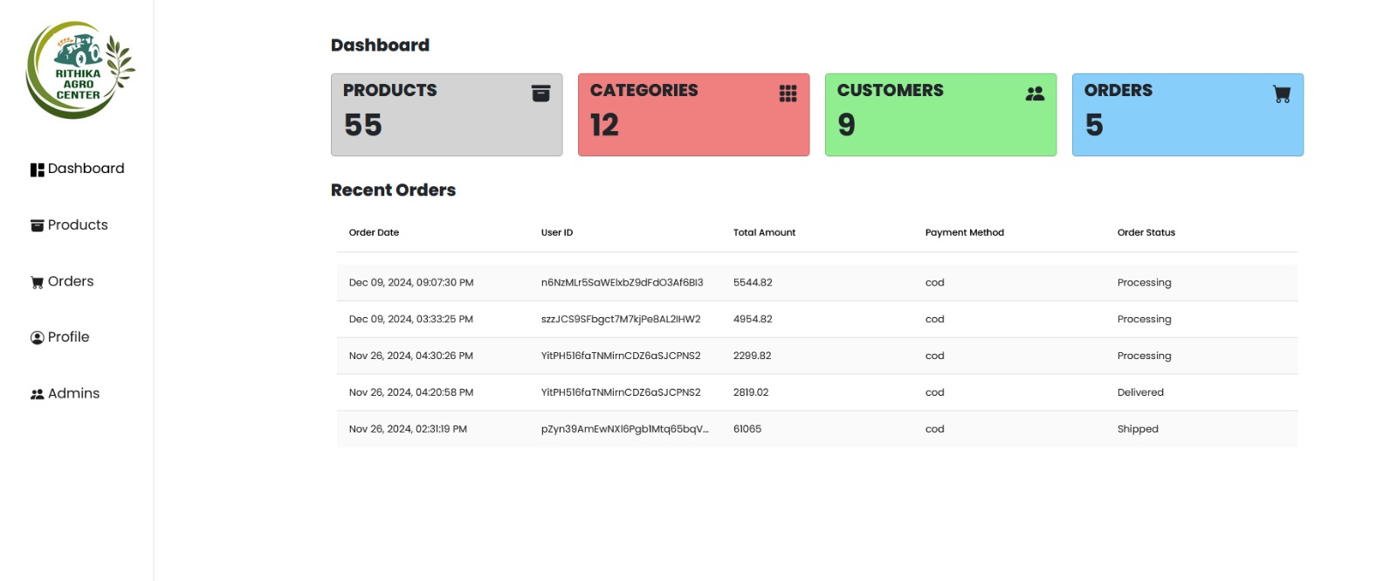
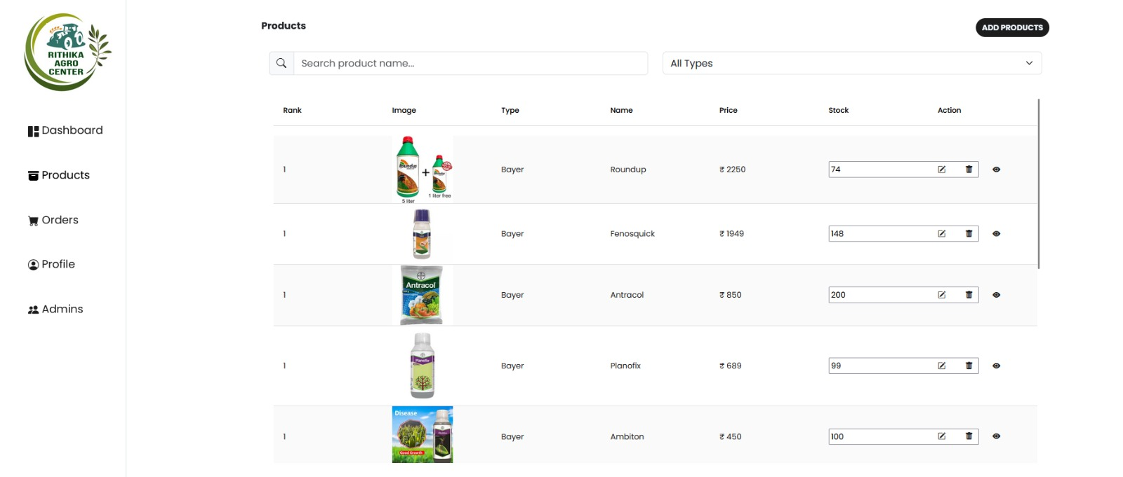
Admin Dashboard Page
Admin Product Page

Slide 23
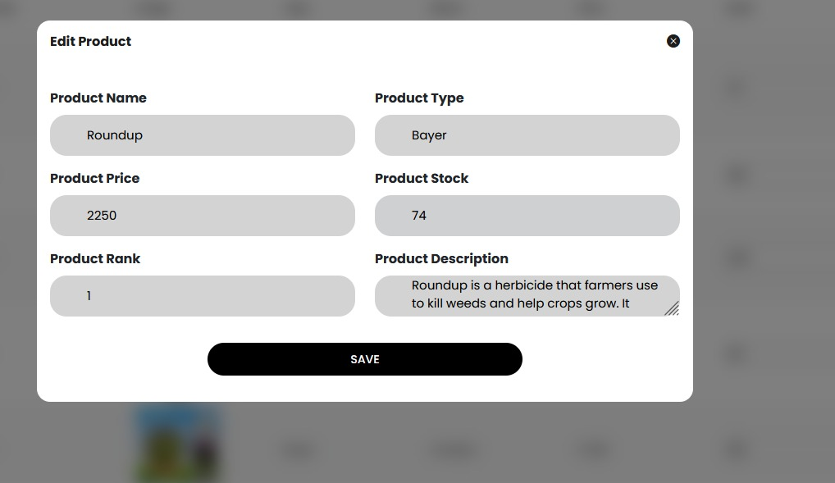
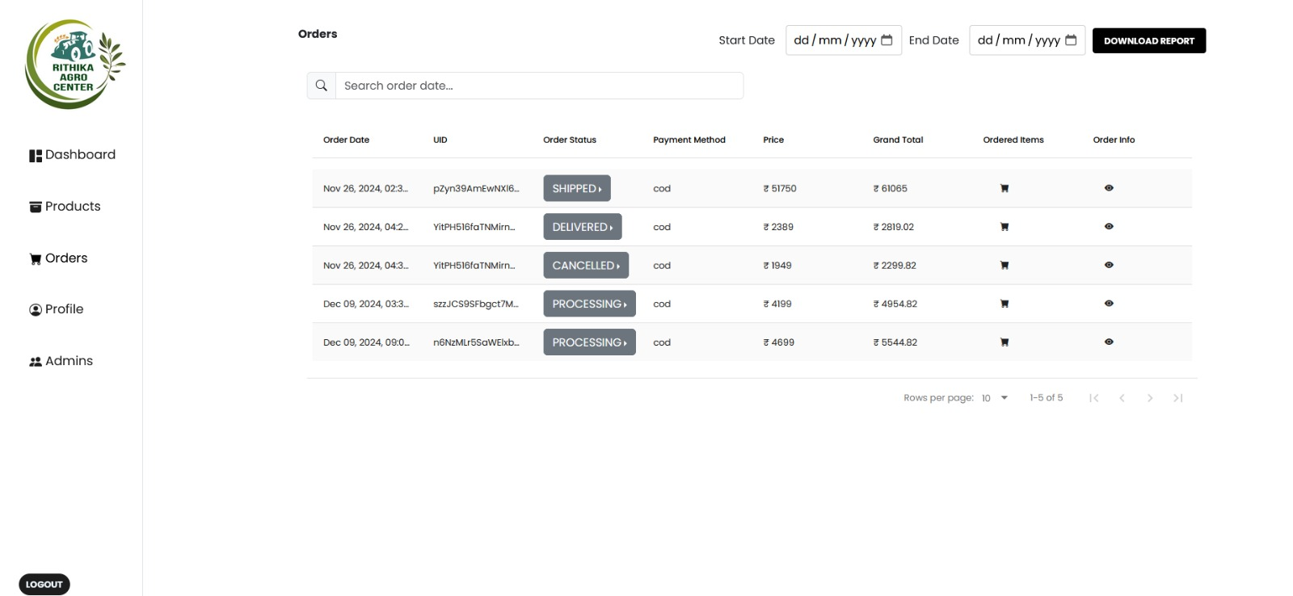
Adding Product in Admin Panel
Order Detail Page

Slide 24
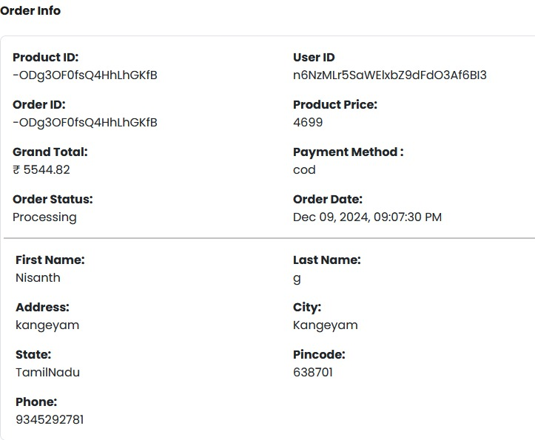
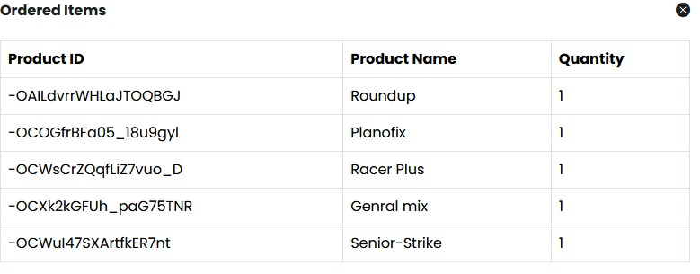

Slide 25
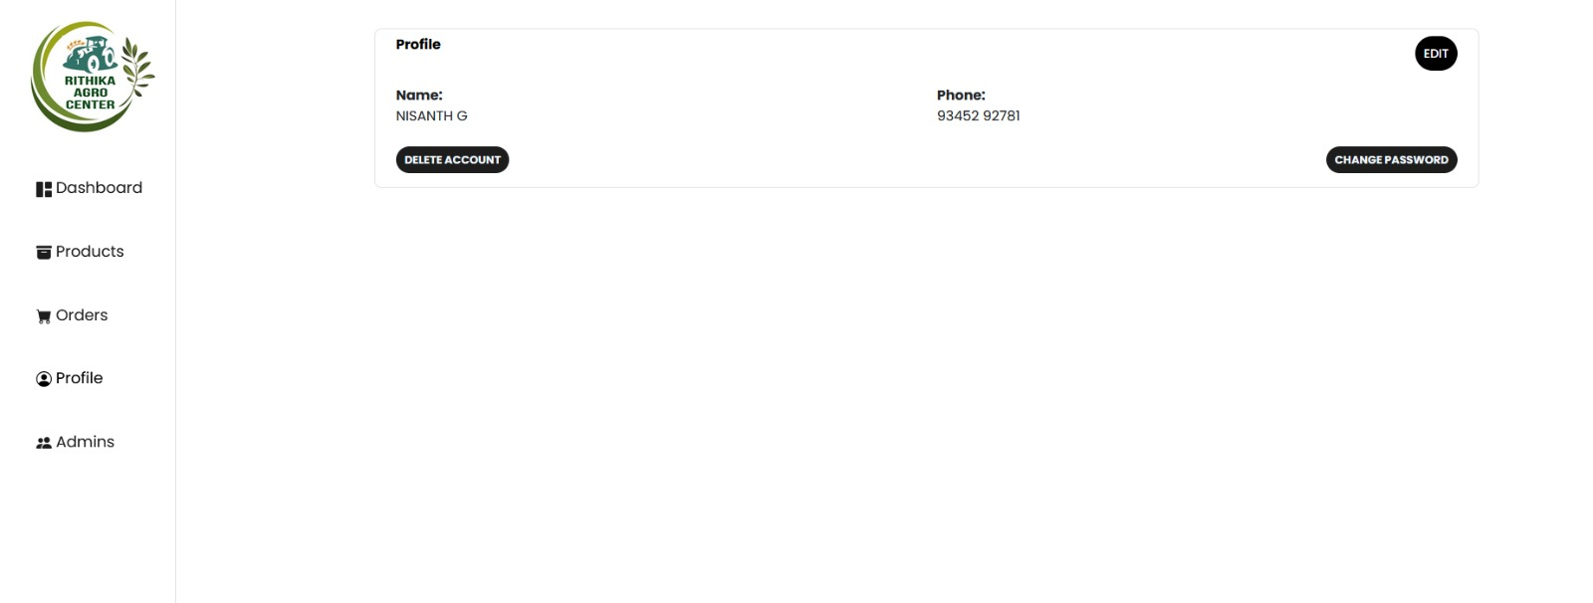
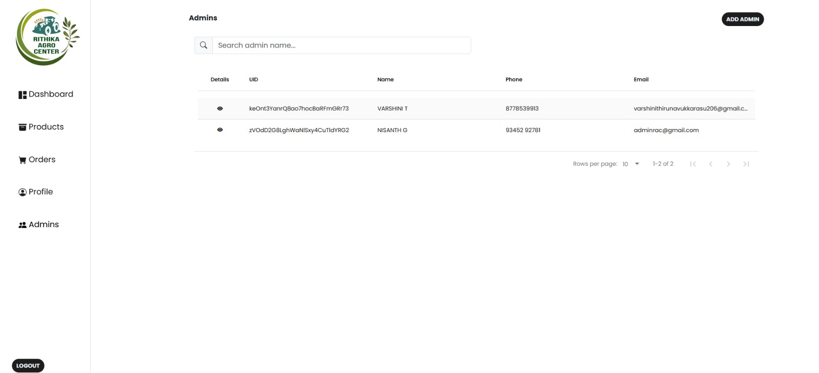
Admin Profile Page
User Login Info Page

Slide 26
CONCLUSSION
User-Friendly Shopping for Farmers: The Agro Center's digital platform makes it easy for farmers and others in agriculture to shop online. It has a simple design, secure payment options,
and quick purchasing processes.
Learning and Personalized Help: The platform includes learning materials and customized tools to help users understand their choices better, making shopping smarter and building trust.
Ready the Future: As farming and technology change, the platform will keep improving to
stay updated, ensuring it meets the needs of farmers now and in the future.

Slide 27


