Slide 1



KONGU ENGINEERING COLLEGE
PERUNDURAI ERODE-638060
DEPARTMENT OF COMPUTER APPLICATIONS
Unmasking Hair Loss Through a Fusion of Human Lifestyle Data Using Machine Learning Algorithms
Team Members :
Nisanth G(24MCR074)
Preteka A T(24MCR079)
Varshini T (24MCR123)
Team Guide:
Ms.M.Sindhu MCA.,
Team number: 30

Slide 2
ABSTRACT
Hair loss is a prevalent problem that is impacted by genetics, lifestyle, and medical factors.
Prediction accuracy is decreased by traditional studies' frequent reliance on small datasets.
To determine the main causes of hair loss, this study combines real-time data with machine learning algorithms like Random Forest, Decision Tree, XGBoost, Extra Trees, and Ensemble approaches.
To improve feature selection and model performance, we use Generative Adversarial Networks (GANs) for augmentation and SMOTE for data balance.
Our method facilitates early detection, increases predictive accuracy, and permits tailored therapy suggestions.
This study offers practical advice that enables people to properly manage the health of their hair.

Slide 3
EXISTING SYSTEM
This research proposes an ensemble machine learning approach for predicting hair fall, combining multiple algorithms to improve prediction accuracy, precision, and recall.
By analyzing genetic, lifestyle, and environmental factors, ensemble models outperform individual algorithms in identifying both hair fall and non-hair fall instances.
The algorithms with the accuracy by Decision Tree 0.85 , Random Forest 0.89, SVM 0.87, Logistic Regression 0.82, Proposed Ensemble Method 0.90.
The approach mitigates the limitations of individual models, offering a more robust and accurate prediction framework.
These findings highlight the potential of ensemble models in early detection and prevention of hair loss, benefiting researchers, practitioners, and individuals focused on hair health.

Slide 4
LITERATURE REVIEW
Title | Authors | Year of Publication | Objective | Evaluation Metrics | Algorithm | Results
An Effective Approach Using Machine Learning for Fall Prediction | Vinora, P. U. Maheswari, R. N. Deborah, E. Ajitha, A. Srinivasan, and G. Sivakarthi | 2023 | The aim of this research is to create an ensemble machine learning approach for predicting hair loss, enhancing accuracy, precision, and recall by integrating multiple algorithms to facilitate early detection and prevention. | Accuracy, precision, recall,F1 Score. | Scaled Conjugate Gradient, Bayesian Regularization, Levenberg-Marquardt, BFGS Quasi-Newton Backpropagation, Resilient Backpropagation, Conjugate Gradient Backpropagation, Conjugate Gradient Backpropagation With Polak-Ribiére Updates, One-Step Secant Backpropagation, Gradient Descent | In this study, we explored various machine learning algorithms and proposed an ensemble approach for predicting hair loss.
Enhancing Hairfall Prediction: A Comparative Analysis of Individual Algorithms and An Ensemble Method | Chennu Naga Venkata Sai , E. Archana, Bandi Vivek , Batini Dhanwanth , Viknesh K S | 2023 | The objective of this research is to develop an ensemble machine learning approach for predicting hair fall, improving accuracy, precision, and recall by combining multiple algorithms to enhance early detection and prevention. | Accuracy, precision, recall,F1 Score. | Decision Tree Random Forest , SVM , Logistic Regression , Proposed Ensemble Method. | In this study, we investigated the use of different machine learning algorithms and proposed an ensemble approach for predicting hair loss.

Slide 5
Title | Authors | Year of Publication | Objective | Evaluation Metrics | Algorithm | Results
Enhanced Hair Disease Classification Using Deep Learning, | D. Banerjee, V. Kukreja, D. Bordoloi, and A. Choudhary | 2023 | This study developed a machine-learning model for classifying hair conditions, achieving an overall accuracy of 88.53% with strong precision, recall, and F1-Scores. Evaluated on 8,550 photos, the model effectively detected various conditions, highlighting its reliability in hair illness classification. | Accuracy | Ensemble methods | Achieved an overall accuracy of 88.53% in classifying various hair conditions.
“Survey-based Machine learning approaches to diagnosis of hair fall disorder in Bangladeshi Community | F. Khatun, M. R. Ajmain, S. A. Khushbu, N. J. Ria, and S. R. H. Noori | 2022 | This research survey investigates the causes of hair loss, focusing on factors like genetics, dandruff, allergies, and stress. Using machine learning algorithms such as SVM, Logistic Regression, and XGBoost, the study aims to analyze survey data for accuracy. Results show that XGBoost achieved the highest performance, with an accuracy of 92.62%. | Accuracy, precision, recall,F1 Score. | XGBoost (along with SVM, Logistic Regression, Naive Bayes, Decision Tree, Random Forest, K-nearest Neighbor) | XGBoost demonstrated the best performance with an accuracy of 92.62%.

Slide 6
Title | Authors | Year of Publication | Objective | Evaluation Metrics | Algorithm | Results
A Machine Learning Framework for Hair Type Categorization to Optimize the Hair Removal Algorithm in Dermoscopy Images | G. S. Ioannidis et al., | 2023 | This study presents a machine learning framework for classifying hair types in dermatoscopy images, achieving 80% accuracy and 79.8% AUC using an SVM classifier. It also identifies an optimal kernel size of 20x20 for the black-hat hair removal algorithm, ensuring high image quality for subsequent deep learning applications in skin disease classification. | Accuracy | Support Vector Machine (SVM) | Achieved 80% accuracy and 79.8% AUC in hair type classification.
Machine Learning Approach for Hairstyle Recommendation | H. Weerasinghe and D. Vidanagama | 2020 | This paper presents a machine learning framework for recommending suitable hairstyles based on face shape classification, achieving 91% accuracy in face shape detection and 83% accuracy in hairstyle recommendations using the Naïve Bayes algorithm. The model utilizes 5,000 trained images and allows users to share recommendations with beauticians via "The Beauty Quest" Salon network. | Accuracy, precision, recall,F1 Score. | Naïve Bayes | 91% accuracy for face shape classification and 83% accuracy for hairstyle recommendations.

Slide 7
Title | Authors | Year of Publication | Objective | Evaluation Metrics | Algorithm | Results
An Enhanced Stress based Hairfall Detection and Prevention using KNN and Machine Learning Techniques | L. Srinivasan, Jeevika, R. K. Navina and S. Priyadharshini | 2023 | This study highlights the impact of stress on hair loss, particularly among IT sector employees, and emphasizes the importance of early stress detection to mitigate mental health issues. It suggests that machine learning algorithms, particularly KNN, can effectively predict stress levels and diagnose related conditions. | Accuracy, precision, recall,F1 Score. | KNN | KNN demonstrated superior outcomes in stress prediction, though specific results were not detailed.
Implementing Machine Learning Techniques for Hair Health Prediction in Follicle Futures | P. Duraisamy, V. Vidhya, T. Preetha, and V. Niranjani | 2024 | This study evaluates various machine learning algorithms for predicting hair health, finding that the random forest algorithm achieved an impressive 94.6% accuracy. It highlights the importance of factors like genetics, diet, and stress in hair health management and suggests future improvements in data integration and user-friendly tools. | Accuracy | Random Forest | Random forest achieved 94.6% accuracy in forecasting hair health. Bookmark messageCopy message

Slide 8
Title | Authors | Year of Publication | Objective | Evaluation Metrics | Algorithm | Results
Role and Mechanisms of Phytochemicals in Hair Growth and Health | P. Kesika, B. S.Sivamaruthi, S. Thangaleela, M. Bharathi, and C. Chaiyasut | 2023 | This review discusses the role of phytochemicals in promoting hair health and managing hair loss, highlighting their potential as natural remedies compared to synthetic treatments. It emphasizes the need for further research to substantiate the efficacy of phytochemicals in hair care and their mechanisms of action. | hair loss; alopecia; phytochemicals; hair health; hair growth stimulation | Decision Tree | Phytochemicals are identified as promising candidates for developing treatments for hair problems, with a call for more scientific studies to validate their effectiveness.
Development of Tea Seed Oil Nanostructured Lipid Carriers and In Vitro Studies on Their Applications in Inducing Human Hair Growth | P. Riangjanapatee et al., | 2022 | This study developed tea seed oil-loaded nanostructured lipid carriers (NLC) to enhance hair growth while minimizing the oily texture of direct oil application, with NLC-C showing superior stability, non-toxicity, and a 78.8% reduction in serum firmness. The formulation demonstrated improved diffusion efficiency and a significant entrapment efficiency of 96.26%, making it a promising alternative for stimulating hair growth. | tea seed oil; nanostructured lipid carriers; human follicle dermal papilla; natural ingredient; spreadability; texture analysis; hair serum | NLC | NLC-C demonstrated effective hair growth stimulation and reduced the greasy feeling associated with traditional tea seed oil application.

Slide 9
Title | Authors | Year of Publication | Objective | Evaluation Metrics | Algorithm | Results
Prediction of Alopecia Areata using Machine Learning Techniques | S. Aditya, S. Sidhu, and M. Kanchana | 2022 | This study explores machine learning for diagnosing alopecia areata (AA) using a dataset of over 1,500 images, achieving classification accuracies of 85% for SVM, 78% for KNN, 88% for Random Forest, 80% for Gaussian Naive Bayes, and 92% for CNN, demonstrating CNN's effectiveness in this context. | Accuracy | SVM, KNN, Random Forest, Gaussian Naive Bayes, CNN | CNN achieved the highest accuracy of 92% in classifying alopecia areata.
Deep Learning-based Convolutional Neural Network Model for Hair Diseases Detection | S. Srivastav, K. Guleria, and S. Sharma | 2023 | This study addresses the impact of chemical hair treatments on health and proposes a convolutional neural network (CNN) model for early detection of hair diseases using a dataset from Kaggle. The model achieved a peak accuracy of 95% at epoch 85 with the Adam optimizer, while the SGD optimizer reached a maximum accuracy of 89% at epoch 50, outperforming existing models. | Accuracy, precision, recall,F1 Score. | CNN | The CNN model demonstrated superior performance in detecting hair diseases compared to existing models.

Slide 10
Title | Authors | Year of Publication | Objective | Evaluation Metrics | Algorithm | Results
An Effective Optimization-Based Convolutional Neural Network for Effective Hair and Scalp Detection System | V. Khan and K. Subramaniam | 2023 | This study introduces a Cat Swarm-based Convolutional Neural System (CS-CNS) for automating hair follicle segmentation and status classification, employing Adaptive Wiener Filter for preprocessing and Hexagonal Scale Invariant Feature Transform for feature extraction. The model's effectiveness is validated using metrics like accuracy, precision, recall, F1-score, and error rate. | Accuracy, Precision, Recall, F1-Score, Error Rate | CatSwarm-based Convolutional Neural System (CS-CNS) | The CS-CNS model's performance is validated against other models, demonstrating its effectiveness in hair follicle status classification.
Explainable Machine Learning on Classification of Healthy and Unhealthy Hair | W. Y. Chow, W. W. Heng, N. A. Abdul-Kadir, and H. Nadaraj | 2022 | This study employs a Convolutional Neural Network to classify hair with and without scalp diseases using online image datasets, achieving an accuracy of 96.63%. While standard performance metrics like accuracy, precision, and recall were obtained, the LIME technique revealed that high classification accuracy does not necessarily indicate practical applicability of the model. | Accuracy, precision, recall,F1 Score. | CNN | Achieved 96.63% accuracy, but LIME interpretation indicated potential issues with model applicability. Bookmark message

Slide 11
Title | Authors | Year of Publication | Objective | Evaluation Metrics | Algorithm | Results
An Empirical Study on Hair Strength Classification using CNN and Random Forest Ensembles | Yashu, V. Kukreja, P. Srivastava, and A. Garg | 2024 | This study introduces a hybrid CNN-Random Forest model for categorizing hair strength, achieving 76.77% accuracy and effective classification supported by precision, recall, and F1-scores. The model features two convolutional layers followed by pooling, flattening, and Random Forest classification, with opportunities for improvement through parameter refinement and expanded datasets. | Accuracy | Hybrid CNN-Random Forest | Achieved 76.77% accuracy in classifying hair strength, with implications for cosmetics, healthcare, and hair care management.
Estimating hair density with XGBoost | Y. Wang, M. Hsu, M. Y. Wang, and J. Lin, | 2024 | Hair density estimation is crucial in dermatology and trichology; however, manual counting is time-consuming and error-prone. Although automated approaches have been developed using image processing, neural networks, and deep learning, creating a robust and widely applicable method remains challenging. This study explored the use of XGBoost to estimate hair density with the aim of developing a more accurate and versatile approach. | Accuracy, precision, recall,F1 Score. | XGBoost model | The XGBoost model outperformed previous methods, achieving 89.5% accuracy on the training set and 95.3% accuracy on the test set. This surpassed the results of Kim et al. (52.4%), Urban et al. (79.6%), and Sacha et al. (88.2%) for the test set.

Slide 12
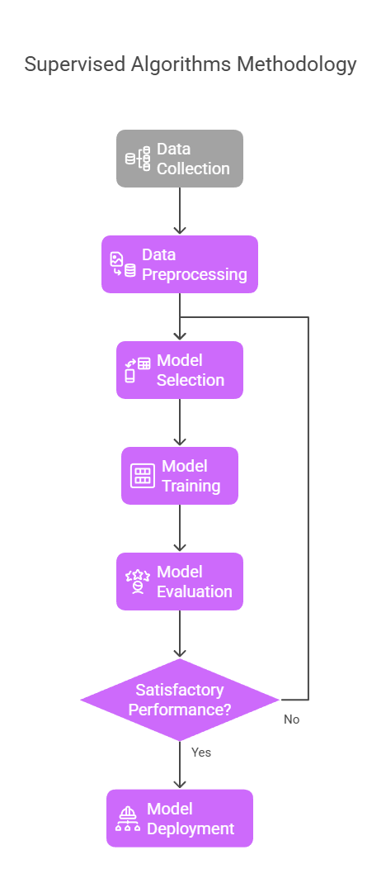
MACHINE LEARNING
Machine Learning (ML) is a part of Artificial Intelligence (AI) that allows computers to learn from data and improve their performance over time without being explicitly programmed.
It uses algorithms to analyze data, find patterns, and make decisions or predictions.
There are different types of Machine Learning, and one of the most popular is Supervised Learning.
In Supervised Learning, the machine learns from labeled data — meaning the input data comes with the correct output (answers).
The algorithm uses this data to learn the relationship between inputs and outputs, so it can predict outcomes for new, unseen data.
Examples:
Predicting house prices based on features like size, location, and number of rooms.
Classifying emails as 'spam' or 'not spam'.

Slide 13
DATA SET DESCRIPTION
S.NO | FEATURE | DESCRIPTION | VALUES
1 | Age Group | Your age range. | 18-25,26-35,36-45,46-60,above 60
2 | Gender | Male or female. | Female,Male,Others
3 | Family History of Hair Loss | Any relatives with hair loss | Yes,No
4 | Type of Hair Loss in Family | Pattern or type of their hair loss. | Male,Female pattern baldness
5 | Ethnicity | Your ethnic background. | Asian,African,Caucasian,Other
6 | Do you Smoke | Do you smoke | Yes,No
7 | Alcohol Frequently | Drink alcohol often | Yes,No
8 | Heat Styling Tools | Use curling or straightening tools | Daily,Few times a week,Rarly,Never
9 | Dye or Bleach your Hair | Color or bleach your hair | Yes,No
10 | High levels of Stress Regularly | High stress levels | Yes,No
11 | Dandruff or an Itchy Scalp | Dandruff or itchy scalp | Yes,No
12 | Excessive Hair Shedding while Washing or Combing | Lose lots of hair when washing/combing | Yes,No
13 | What is your Hair Type | Hair type | Straight,Wavy,Curly,Coily
14 | How often do you Wash your Hair | wash your hair | Daily,Every other day,Twice a week,Once a week

Slide 14
15 | Hair Care Products containing Harsh Chemicals | Products | Yes,No
16 | Balanced Diet Rich in Protein,Vitamins and Iron | Diet follow | Yes,No
17 | Hair Growth Supplements | Take hair growth supplements | Yes,No
18 | Drink enough Water daily | Drink enough water daily | Yes,No
19 | Rapid Weight Loss Recently | Lost weight quickly recently | Yes,No
20 | Follow Vegetarian or Vegan diet | Follow a plant-based diet | Yes,No
21 | Diagnosed with a Hormonal Imbalance | Diagnosed imbalance like thyroid | Yes,No
22 | Chemotherapy or Radiation Therapy | Had chemo or radiation | Yes,No
23 | Do you have an Autoimmune Disease | Have an autoimmune disease | Yes,No
24 | Are you Taking any Medications known to Cause Hair Loss | On meds that cause hair loss | Yes,No
25 | How Severe do you Consider your Hair Loss? | How bad is your hair loss | 0-No hair loss,1-Mild hair loss,2-Moderate hair loss,3-severe hair loss
Data set link:
https://docs.google.com/spreadsheets/d/1sXnelmgFrSBPOKuVww6nDyTd8bNEXdaaC3qELtBnJ1U/edit?usp=sharing

Slide 15
PROPOSED SYSTEM
The purpose of this study is to improve the accuracy of hair loss prediction by exploring different machine learning algorithms and evaluating their performance.
The system focuses on predicting and analyzing hair fall problems using real-time lifestyle data collected from individuals.
The dataset contains 940 records with various personal and lifestyle-related factors that may affect hair health.
To achieve accurate predictions, the proposed system uses multiple machine learning algorithms such as:
Random Forest
Decision Tree
XGBoost
Extra Trees
Ensemble Method

Slide 16
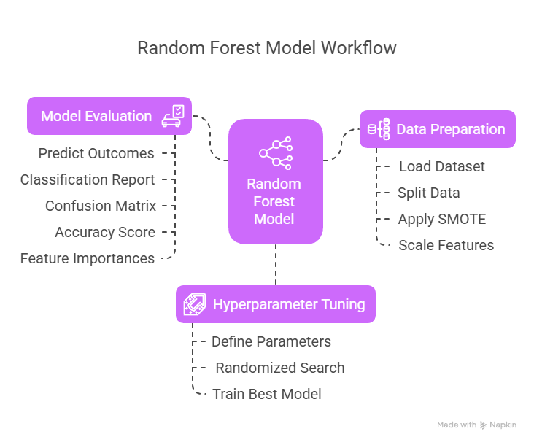
RANDOM FOREST
Random Forest is an ensemble learning method that constructs multiple decision trees.
It is used for both classification and regression tasks.
Random Forest improves prediction accuracy by averaging the results of individual trees.
The goal of Random Forest is to enhance generalization and reduce overfitting by combining multiple decision trees.

Slide 17
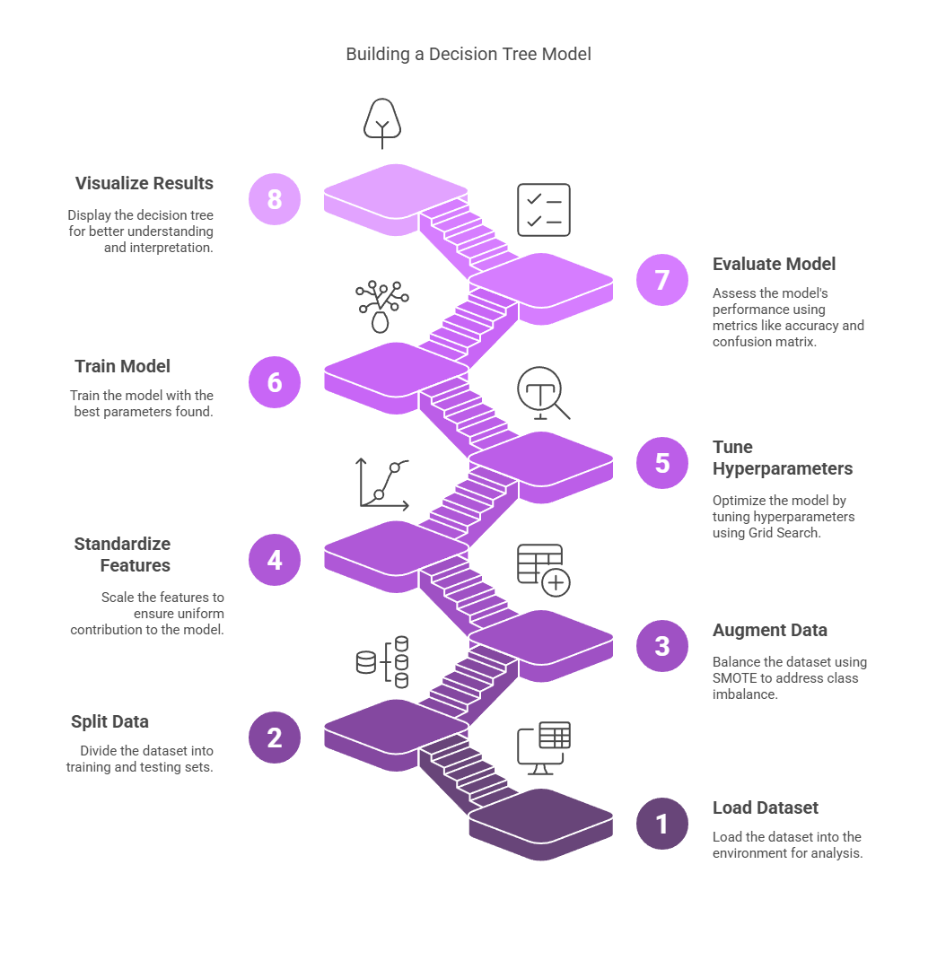
Decision Tree:
A decision tree is a non-parametric supervised learning algorithm
which is utilized for both classification and regression tasks.
It can be very useful for solving decision-related problems.
The goal of decision tree learning is to create a model that predicts the value of the output variable based on input variable

Slide 18
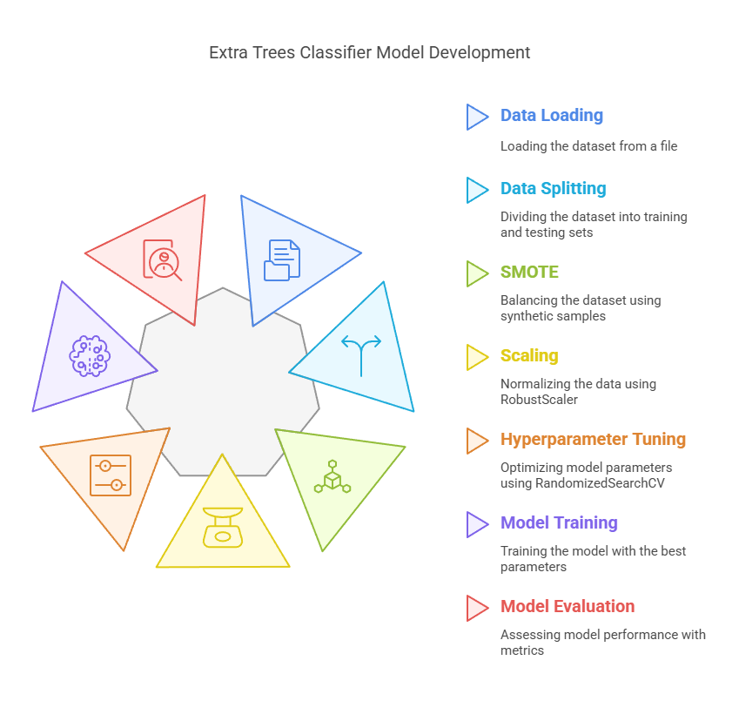
Extra Trees
Extra Trees is an ensemble algorithm that builds multiple decision trees with random splits, making it faster and less prone to overfitting than other tree-based models.
It handles both classification and regression tasks, offers better generalization, and is efficient with large datasets

Slide 19
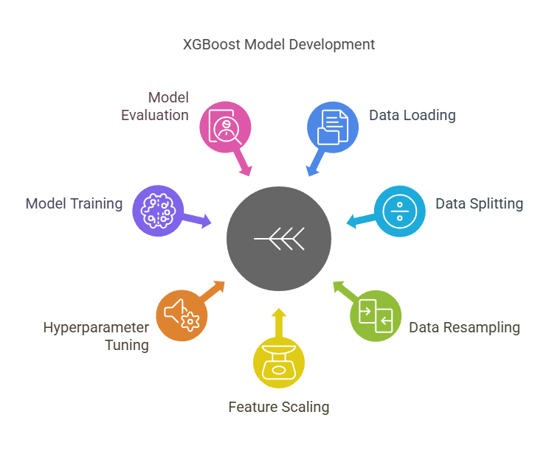
XGBoost
It is known for its speed and efficiency, making it suitable for large datasets.
XGBoost can automatically handle missing data without requiring imputation.
The algorithm incorporates L1 and L2 regularization, which helps prevent overfitting.
It supports parallelization, which speeds up training, especially with large datasets.
XGBoost can handle both linear and non-linear relationships in the data, making it versatile for various tasks.

Slide 20
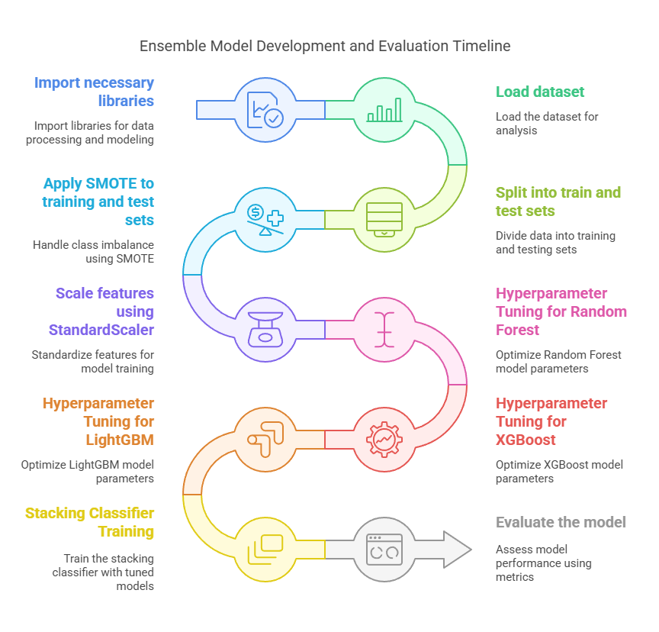
Ensemble Model-1(LG,XG,RF)
Ensemble methods combine multiple models to improve accuracy, robustness, and generalization by reducing bias and variance.
The data is split into training and testing sets, and class imbalance is
handled using SMOTE.
Features are scaled for better model performance.
Hyperparameter tuning is done for Random Forest, XGBoost, and
LightGBM models to improve accuracy.
Hyperparameter tuning is done for Random Forest, XGBoost, and LightGBM models to improve accuracy.

Slide 21
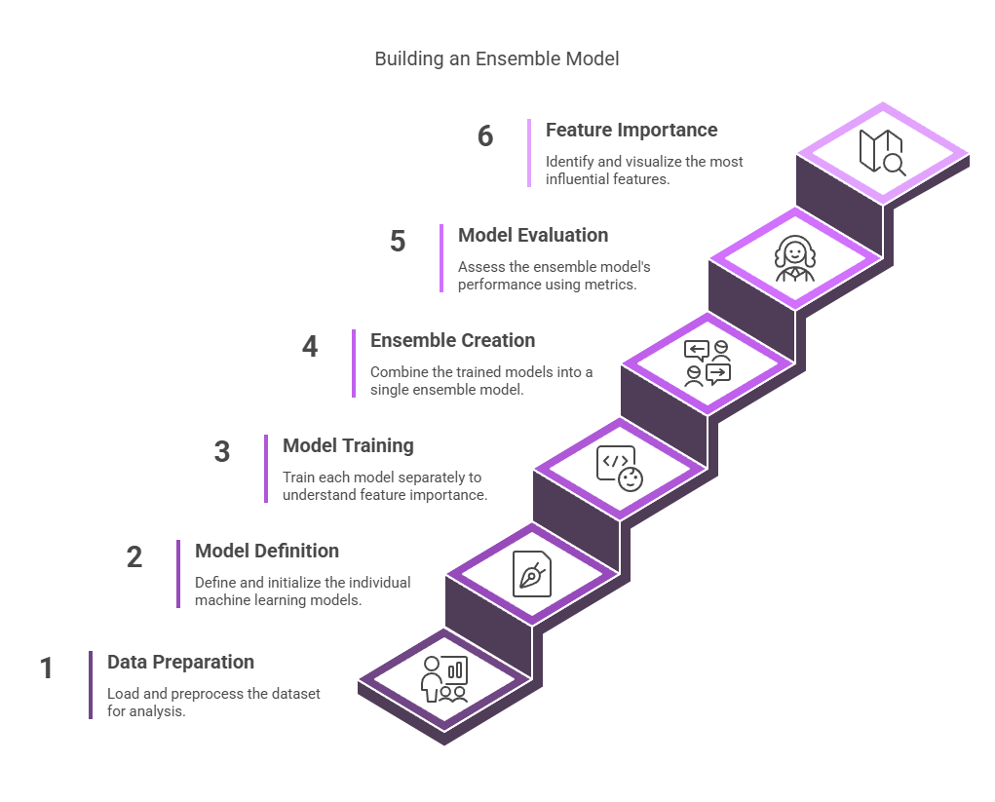
Ensemble Model-2(RF,KNN,GB)
The proposed ensemble combines Random Forest, K-Nearest Neighbors (KNN), and Gradient Boosting to improve hair loss prediction accuracy.
It leverages the strengths of different algorithms: Random Forest for stability, KNN for simplicity, and Gradient Boosting for handling complex patterns.
By combining these models, the system delivers more reliable and consistent predictions than using individual algorithms alone.

Slide 22
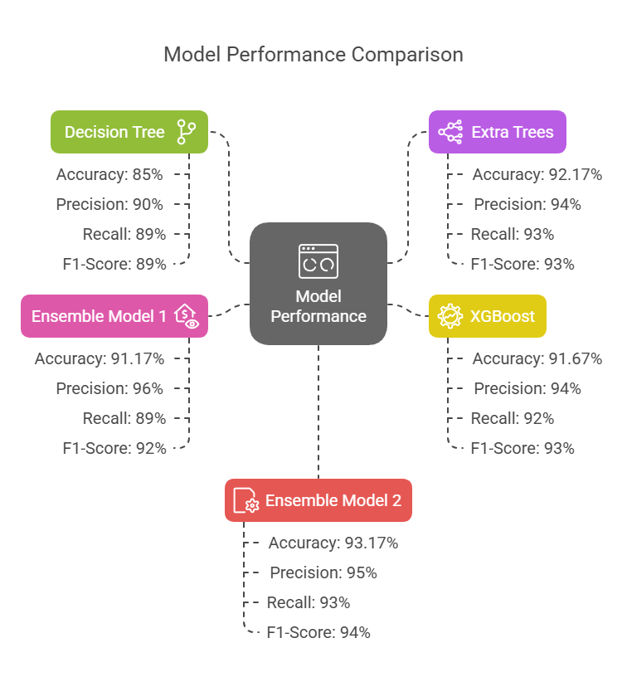
RESULT
Among all the models, Ensemble Model 2 (XGBoost + Logistic Regression + Random Forest) gave the best performance with higher Precision, Recall, and F1-Score values.
It outperformed both individual models and Ensemble Model 1, making it the most accurate for predicting hair loss.

Slide 23
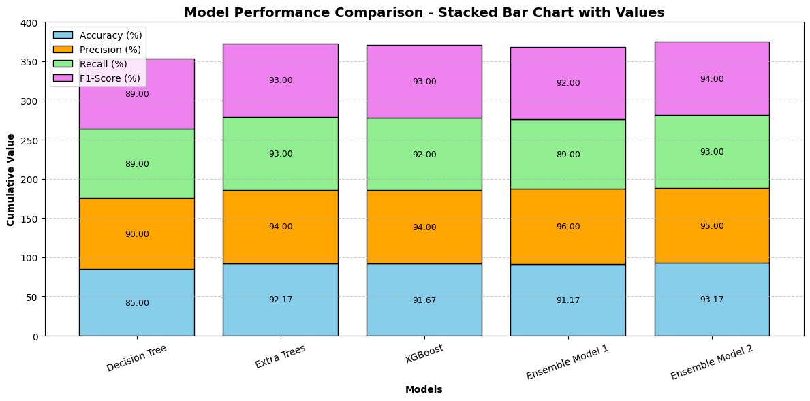
CONCLUSION
The results clearly indicate that ensemble learning techniques outperform individual machine learning models in predicting hair loss.
Among them, Ensemble Model 2 produced the most reliable and balanced results across all evaluation metrics, making it the most suitable choice for this prediction task.
This demonstrates that combining diverse algorithms helps capture complex patterns in human lifestyle data, leading to improved prediction accuracy and model robustness.

Slide 24
REFERENCE
[1] A. Vinora, P. U. Maheswari, R. N. Deborah, E. Ajitha, A. Srinivasan, and G. Sivakarthi, “An Effective Approach Using Machine Learning for Fall Prediction,” in 2023.
[2] Chennu Naga Venkata Sai, E. Archana, Bandi Vivek, Batini Dhanwanth, Viknesh K S, “Enhancing Hairfall Prediction: A Comparative Analysis of Individual Algorithms and An Ensemble Method,” in 2023.
[3] D. Banerjee, V. Kukreja, D. Bordoloi, and A. Choudhary, “Enhanced Hair Disease Classification Using Deep Learning,” in 2024.
[4] F. Khatun, M. R. Ajmain, S. A. Khushbu, N. J. Ria, and S. R. H. Noori, “Survey-based Machine learning approaches to diagnosis of hair fall disorder in Bangladeshi Community,” 109/ICCCNT54827.2022.9984226, in 2022.
[5] G. S. Ioannidis et al., “A Machine Learning Framework for Hair Type Categorization to Optimize the Hair Removal Algorithm in Dermoscopy Images,” in 2023.
[6] H. Weerasinghe and D. Vidanagama, “Machine Learning Approach for Hairstyle Recommendation,” in 2020 5th International Conference on Information Technology Research (ICITR), Moratuwa, Sri Lanka: IEEE, Dec. 2020.
[7] L. Srinivasan, A. Jeevika, R. K. Navina, and S. Priyadharshini, “An Enhanced Stress-based Hairfall Detection and Prevention using KNN and Machine Learning Techniques,” in 2023.
[8] P. Duraisamy, V. Vidhya, T. Preetha, and V. Niranjani, “Implementing Machine Learning Techniques for Hair Health Prediction in Follicle Futures,” in 2024.

Slide 25
[9] P. Kesika, B. S. Sivamaruthi, S. Thangaleela, M. Bharathi, and C. Chaiyasut, “Role and Mechanisms of Phytochemicals in Hair Growth and Health,” Pharmaceuticals, vol. 16, no. 2, p. 206, Jan. 2023.
[10] P. Riangjanapatee et al., “Development of Tea Seed Oil Nanostructured Lipid Carriers and In Vitro Studies on Their Applications in Inducing Human Hair Growth,” Pharmaceutics, vol. 14, no. 5, p. 984, May 2022.
[11] S. Aditya, S. Sidhu, and M. Kanchana, “Prediction of Alopecia Areata using Machine Learning Techniques,” in 2022 IEEE International Conference on Data Science and Information System (ICDSIS), Hassan, India: IEEE, Jul. 2022.
[12] S. Srivastav, K. Guleria, and S. Sharma, “Deep Learning-based Convolutional Neural Network Model for Hair Diseases Detection,” in 2023 3rd International Conference on Smart Generation Computing, Communication and Networking (SMART GENCON), Bangalore, India: IEEE, Dec. 2023.
[13] V. Khan and K. Subramaniam, “An Effective Optimization-Based Convolutional Neural Network for Effective Hair and Scalp Detection System,” in 2023.
[14] W. Y. Chow, W. W. Heng, N. A. Abdul-Kadir, and H. Nadaraj, “Explainable Machine Learning on Classification of Healthy and Unhealthy Hair,” in 2022.
[15] Yashu, V. Kukreja, P. Srivastava, and A. Garg, “An Empirical Study on Hair Strength Classification using CNN and Random Forest Ensembles,” in 2024.
[16] Y. Wang, M. Hsu, M. Y. Wang, and J. Lin, “Estimating hair density with XGBOOST,” Int. J. Cosmet. Sci., p. ics.13030, Nov. 2024.

Slide 26


