Slide 1
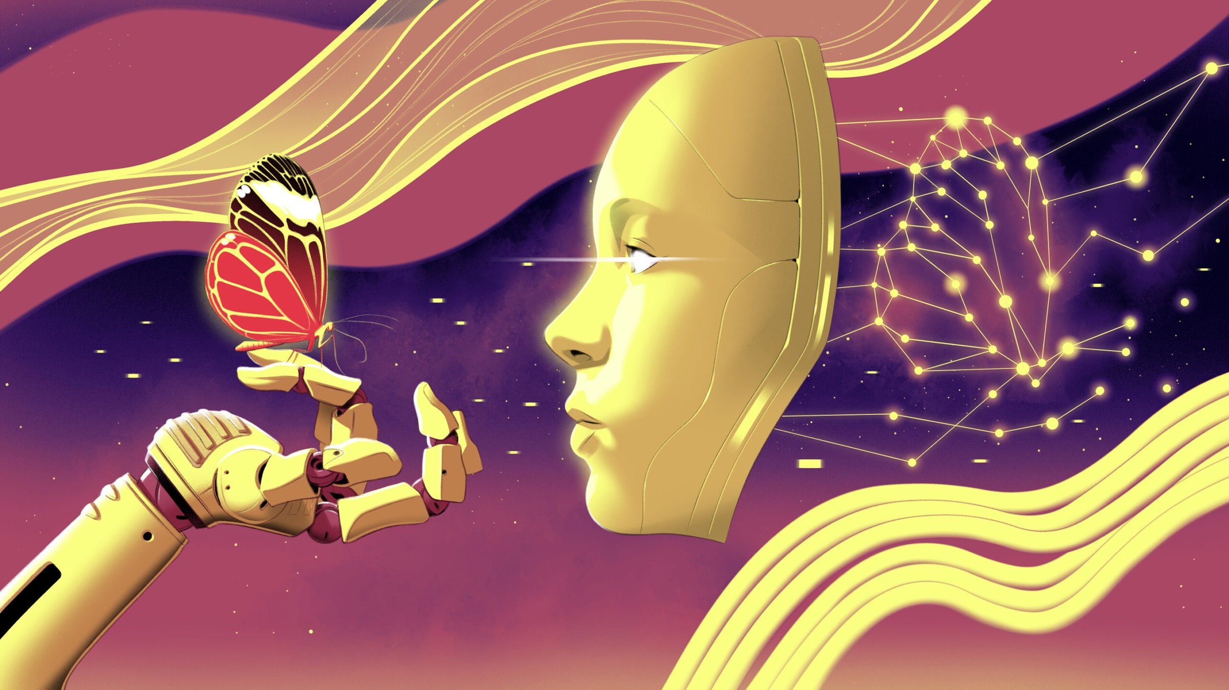
Self-Taught AI & the Human Brain
Self-supervised learning of Neural Networks

Slide 2
Then vs Now: Training AI
Supervised Learning
Self-Supervised Learning
Training method: Relied heavily on labeled data.
Data preparation: Required significant human effort to label vast amounts of data with specific categories (e.g., "tabby cat," "grass").
Learning process: Networks might learn superficial patterns.
Example: Recognizing cows based solely on the presence of grass, not the actual features of the cow.
Training method: Utilizes data without predefined labels in various forms.
Data preparation: Less human intervention needed.
Learning process: Focuses on identifying inherent patterns, relationships and features within the data itself.
Example: Analyzing an image, the model might learn to recognize edges, shapes, and textures.

Slide 3
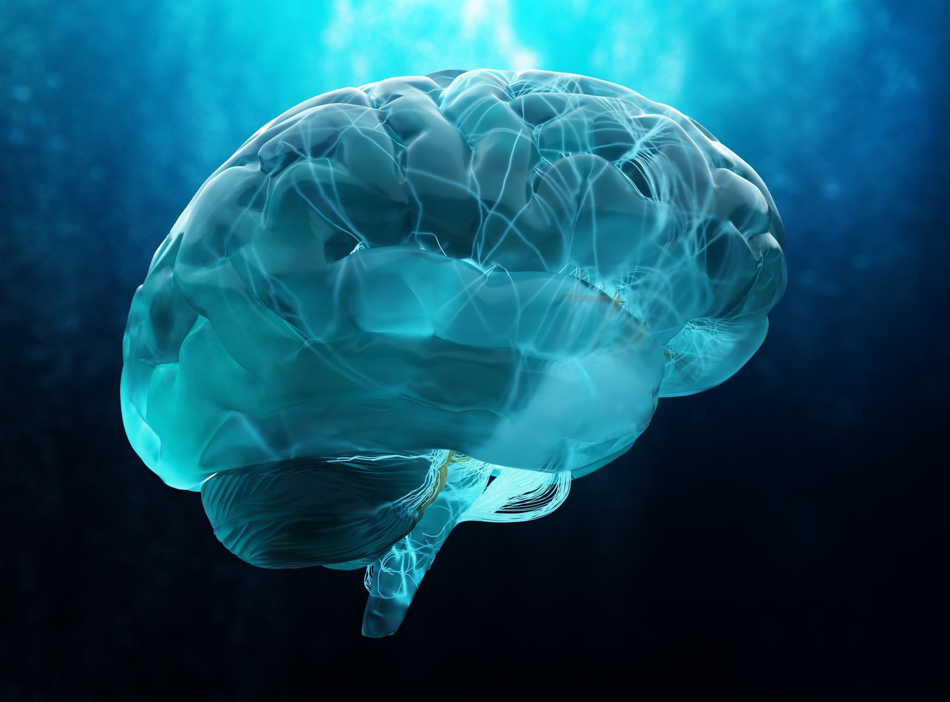
Recent Developments in Self-Supervised Learning
Successful areas: Achieves impressive results in language models & and recently also in image recognition models
Mimicking brain function: Recent models show similar processing patterns to mammalian brains in vision & hearing.
Potential benefits: Unveiling how the brain learns from sensory information.

Slide 4
How did we get here?
Network classifies images
Incorrect clusters trigger weight adjustments
Repeated with multiple training images
  First Attempts of Neural Networks:
  Success of AlexNet in image classification (2010)
  Initial models of the primate visual system using similar neural networks by neuroscientists.
  Intriguing Findings:
  Monkey and artificial neuron activity showed surprising correspondence when viewing the same images.
  Similar models were developed for hearing and odor detection.
Learning Process

Slide 5
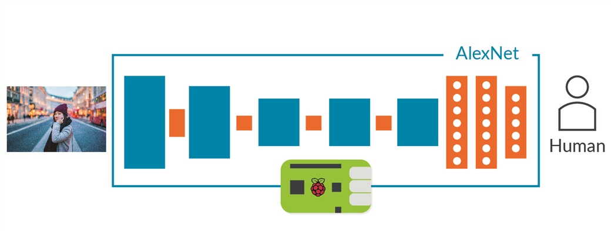
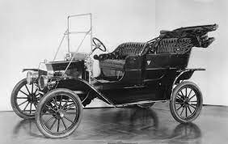



Hitting a Wall :
Car vs. Leopard (2017)
In an experiment made in University of Tübingen, neural network failed to recognize a car with a leopard print overlay. It classified the original image as a car but considered the modified image a leopard.
Network prioritized texture (pattern) over the underlying object's shape, showing its limited ability to grasp the true nature of the world.

Slide 6

Self-Supervised Learning
Self-supervised learning eliminates the need for human-labeled data to avoid these mishaps.
Algorithms exploit the inherent structure within the data itself. They essentially create gaps in the data and ask the neural network to fill in the blanks.

Slide 7



Current Usages
A large language model algorithm that predict the next word in a sentence. Fed with data available on the internet, this model the syntactic structure of the language, demonstrating impressive linguistic ability—all without external labels or supervision.
Masked auto-encoders algorithm that hide parts of images by analyzing the visible portions to reconstruct the entire image. Key information from the visible areas is compressed into mathematical descriptions, including details like object shape. These descriptions are then used to recreate the full image, allowing the model to grasp underlying visual features and relationships.

Slide 8

Self-Supervised Brains
Brain learning may involve self-supervised mechanisms. This is shown by distinct pathways for object recognition and movement in the human visual system.
Researchers developed an AI model mirroring this structure. One pathway focuses on image processing, while the other predicts sequences.
The AI's responses to video stimuli paralleled those of real mouse brains, hinting at a potential connection between self-supervised learning and brain structure.

Slide 9
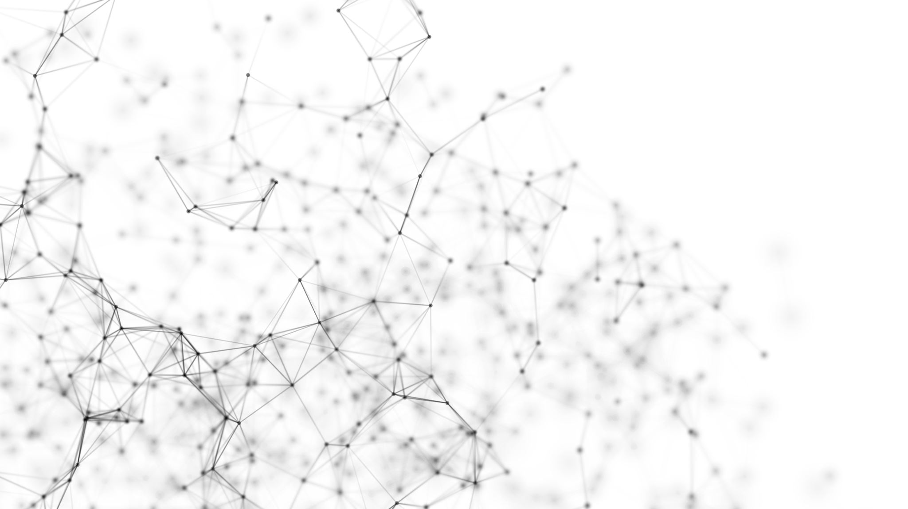
Uncured Pathologies in SSL
Certain recognized neuroscientists expressed a doubt self-supervised learning.
A lab in MIT created "metamers," confusing to humans but not AI. This suggests that the representations that form in the neural network’s deeper layers, even with self-supervised learning, don’t match the representations in our brains.
Notes:
For example, Wav2Vec 2.0 predicts sound too briefly. For some, brain understanding needs more. Feedback connections aren't replicated in models.

Slide 10
What’s next?
Next projects includes training highly recurrent networks with self-supervised learning and match artificial neuron activity to real neurons.
If similarities hold, it suggests brains need self-supervised learning. This might indicate limited intelligent information processing ways.
Finding systematic similarities between vastly different systems might suggest that perhaps there are not that many ways to process information in an intelligent fashion.

