Slide 1
Exploratory Data Analysis on BSEE Well Data
Group 9
Team Manager: Nisarg Shah
Members: Omkar Koli, Praveen Kumar G, Parva Shah, Nithin Lingala
Course: Data Science
Group: 9

Slide 2
Work Allocation
Nisarg Shah – Data scraping
Nithin - EDA
Praveen – EDA and Data wrangling
Omkar – Data Visualization
Parva –Data mining

Slide 3
Data Scraping: Methodology
Group 9
• Source: Bureau of Safety and Environmental Enforcement (BSEE).
• Challenge: The website is a dynamic ASP.NET application (not static HTML).
• Solution: Built a custom class-based Python scraper.
• Tech Stack: Selenium (automation) & BeautifulSoup (parsing).
• Optimization: Programmatically set page size to 200 to reduce load times.

Slide 4
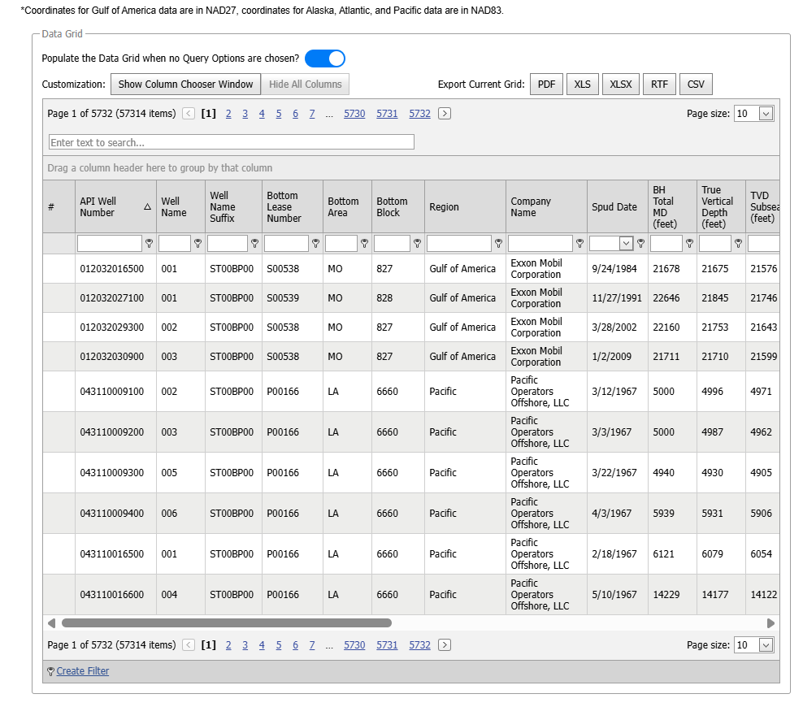
Screenshot of Data on website

Slide 5
Data Scraping: Results
Group 9
Volume: Successfully scraped ~20,000 well records.
Reduced scraping time from 2hours to 12 minute by optimizing python script.
Dimensions: Extracted data across 24 distinct columns.
Key Features: API Well Number, Company Name, Spud Date, Status Code.
Outcome: Transformed unstructured web content into a structured CSV.

Slide 6
Basic Data Exploration – Overview
• 20,000 well records across 27 variables
• Mix of numeric, categorical, and date features
• Includes depths, geographic coordinates, company info
• Suitable for analysis, modeling, and spatial evaluation

Slide 7
Numerical Feature Summary
• Water Depth averages ~150 ft (shallow-water dominant)
• RKB centered around 90 ft → consistent rig elevation
• Lat/Long tightly clustered → Gulf of America focus
• Skewness detected in Water Depth due to deepwater wells

Slide 8
Categorical Variable Insights
• Region: Gulf of America ~92%, Pacific ~8%
• Major operators: Apache, Chevron, Talos
• Well Type dominated by Development wells (Type D)
• Status Code: Mostly Plugged & Abandoned (PA)

Slide 9
Missing Values Summary
• KOP column had 73% missing → removed
• Small gaps in numeric fields (<1%) → median imputation
• Missing dates represent ongoing well operations
• Latitude/longitude missing in ~1% of wells

Slide 10
Outlier Analysis
• High Water Depth values → legitimate deepwater wells
• RKB shows minimal deviation
• Coordinate outliers rare due to regional clustering
• Outliers retained as operationally meaningful

Slide 11
EDA: Data Wrangling
Group 9
Removed empty column # (100% missing).
Replaced placeholder values "*****" with proper NaN.
Converted key depth columns (BH Total MD, TVD, True Vertical Depth) to numeric.
Converted drilling dates (Spud Date, Total Depth Date, Status Date) to datetime.
Standardized text fields (Region, Company Name, Status Codes) for consistency.
Ensured the dataset is clean, structured, and ready for transformation.

Slide 12
EDA: Data Wrangling
Group 9
Dropped KOP column → 73% missing, no analytical value.
Median imputation for small gaps in numeric fields:
Water Depth
RKB
BH Total MD
True Vertical Depth
TVD Subsea
Kept missing dates & coordinates:
Represent wells still drilling / pending updates.
Carry real operational meaning (not errors).

Slide 13
EDA: Data Wrangling
Group 9
Transformations
Rounded coordinates to 4 decimals for uniform precision.
Cleaned and standardized all categorical variables.
New Features Created
Drilling Duration (days)
→ Total Depth Date − Spud Date
Depth Difference
→ MD − TVD (identifies directional drilling)
Deepwater Flag
→ True for Water Depth > 1000 ft

Slide 14
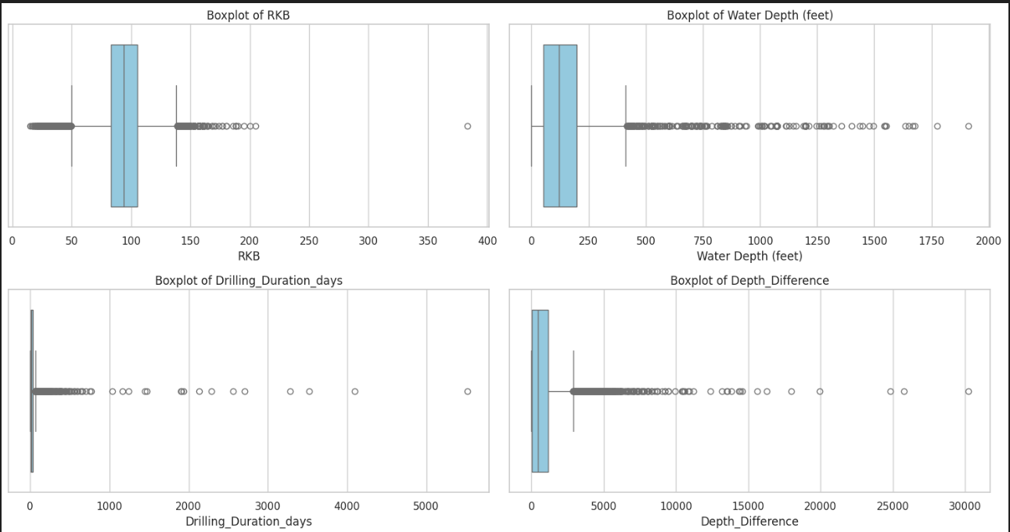
EDA: Data Wrangling
Group 9

Slide 15
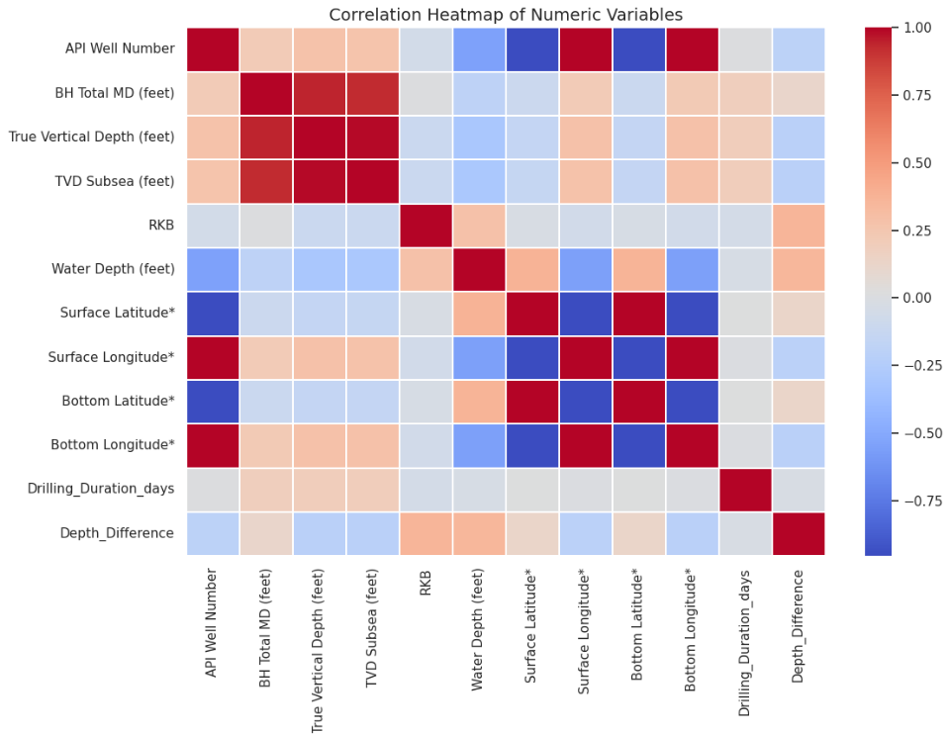
EDA: Data Wrangling
Group 9

Slide 16
EDA SUMMARY
Group 9
Correlation Insights
Depth-related variables highly correlated (r > 0.93).
Surface & bottom coordinates nearly identical → mostly vertical wells.
Drilling Duration & Water Depth weakly correlated → independent operational factors.
Outlier Analysis
Outliers in Water Depth, Drilling Duration, Depth Difference → valid, not errors.
Represent deepwater wells, long drilling campaigns, and directional drilling.
Overall Conclusion
Dataset is now clean, consistent, and enriched.
Ready for advanced visualization and modeling.
Engineered features provide deeper operational insights.

Slide 17
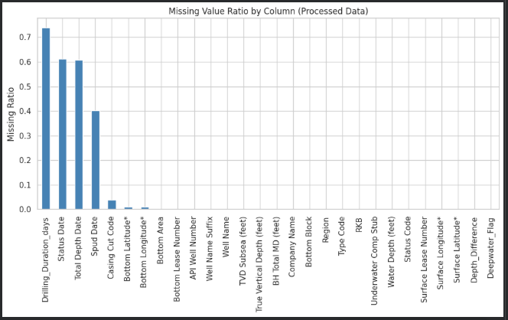
Data Visualization Framework
Group 9
Used processed dataset (df_viz = df_Gas_Oil.copy())
Visuals created after cleaning, transformations, and feature engineering
Focused on depth behavior, drilling patterns, regional distribution
Combined univariate, bivariate, and multivariate visualizations

Slide 18
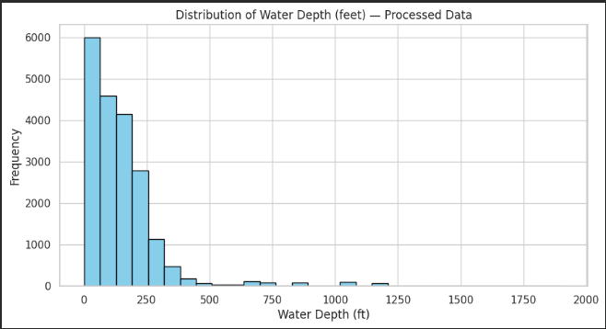
Data Visualization: Univariate Visualizations
Group 9
Water Depth Distribution: Majority of wells in shallow–mid-depth waters
Measured Depth (MD): Most wells drilled between 8,000–12,000 feet
Multi-peaked MD distribution → different drilling programs
Reveals environmental and operational character of wells

Slide 19
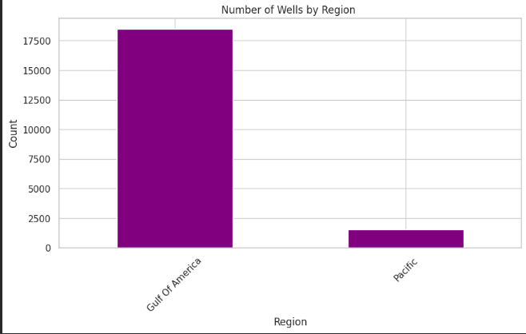
Regional Activity Visualization
Gulf of Mexico is the dominant offshore region
Pacific region contributes a minor share
Regional distribution aligns with U.S. offshore drilling reality

Slide 20
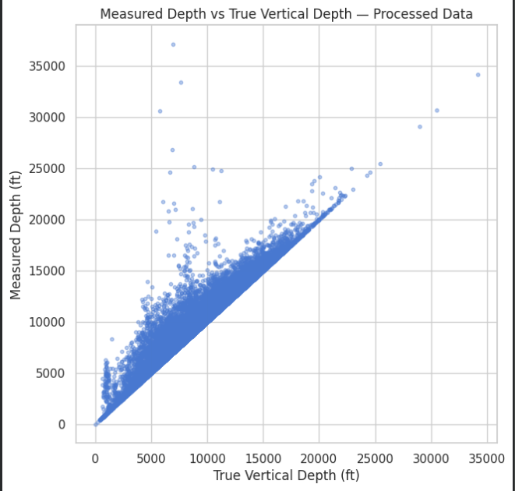
Bivariate Visualizations
MD vs TVD Scatter Plot:
Points along the diagonal → mostly vertical wells
Points above diagonal → directional/drift wells
Shows drilling behavior and well geometry

Slide 21
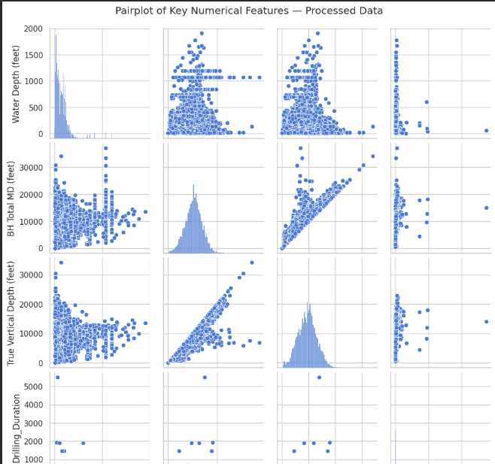
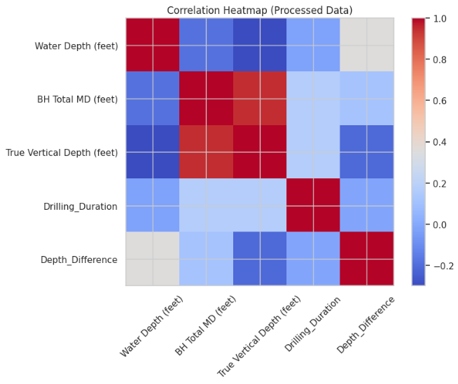
Multivariate Insights
Correlation Heatmap of key features
Strong correlation between MD & TVD
Weak correlation between Drilling Duration & depth variables
Pairplot shows consistent relationships among depth metrics

Slide 22

Key Takeaways from Visualization
Depth-related features define well geometry and drilling style
Shallow-water drilling dominates offshore activity
Directional wells appear as deviations in MD vs TVD plot
Regional dominance of Gulf of Mexico confirmed visually
Engineered features provide deeper context on drilling operations

Slide 23
Data Mining: Pattern Discovery
Group 9
• Correlation: Strong positive link between 'BH Total MD' and 'True Vertical Depth'.
• Geospatial Mining: Average Water Depth varies significantly by Region.
• Anomaly Detection: Identified the deepest well as a specific outlier.

Slide 24
Data Mining: Strategic Takeaways
Group 9
• Lifecycle Narrative: Traced typical well life from Spudding to Abandonment.
• Tech Advancement: Increasing well depths over time indicates better tech.
• Operational Landscape: Distinct clusters of Active vs. Legacy wells.
• Decision Support: Predict maintenance needs based on well age/depth.

Slide 25
Thank You

