Slide 1

Advance computing concept
Professor: Dr.Mahdi Firoozjaei

Slide 2
Outline
Introduction
Concepts
Demo
Conclusion

Slide 3
1. Introduction

Slide 4

What is a web search engine ?
A searching software.
Gets the information through online searches.
using keywords or a phrase.
Delivers the information to the user.

Slide 5
Working of search engine
User
Web Crawler
Indexing
Sorting
Display Result

Slide 6


Slide 7
2.Concepts

Slide 8
Problem statement
For this project, we have to design and implement a web search engine in Java using the below features:
Algorithm to find patterns using regular expressions
Algorithm for translation of HTML to text data
Algorithm to rand web pages using sorting
Data Structures like heaps, hashtable, large dictionaries, and many other
Algorithms for finding keywords using string matching
Algorithms to analyze frequencies of words using hash tables or search trees
Using large datasets and other files.

Slide 9
Features
Web Crawler: Parth Patel – 110071969
Searching Word & Sorting: Nisarg Shihora - 110089546

Slide 10
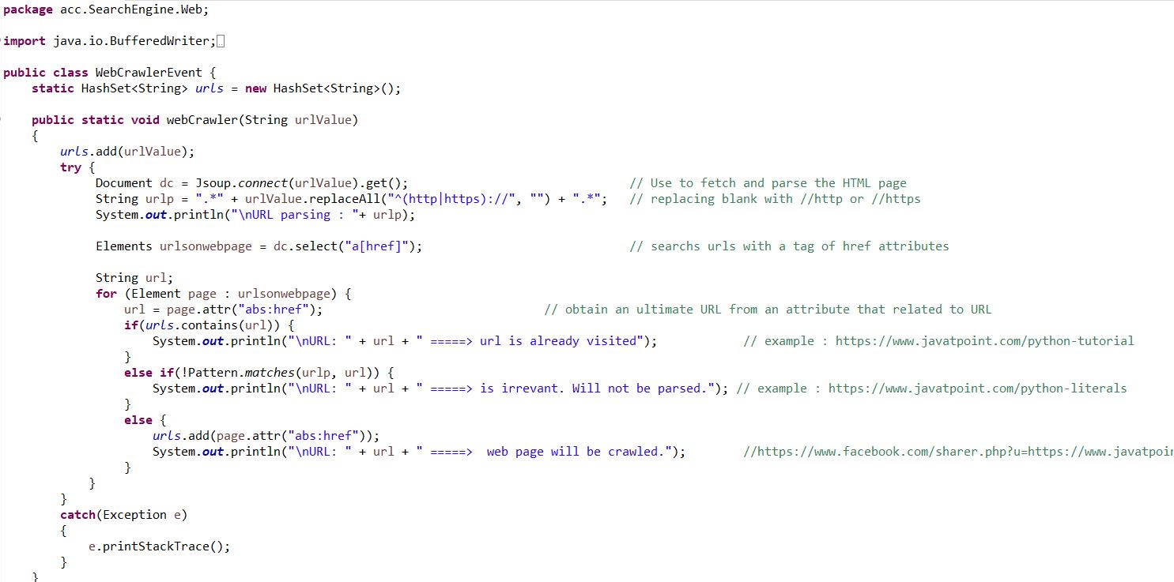
Crawler
A web crawler is responsible for searching web pages on the user request for certain keywords or phrases.
It is also responsible for scraping and parsing HTML from URL.
We have used Jsoup for web scraping and Java regular expression for

Slide 11
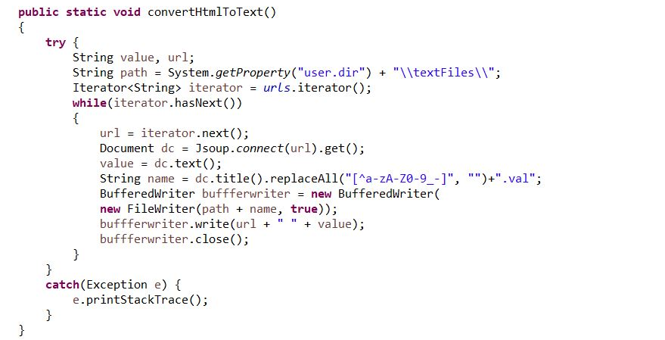

Slide 12
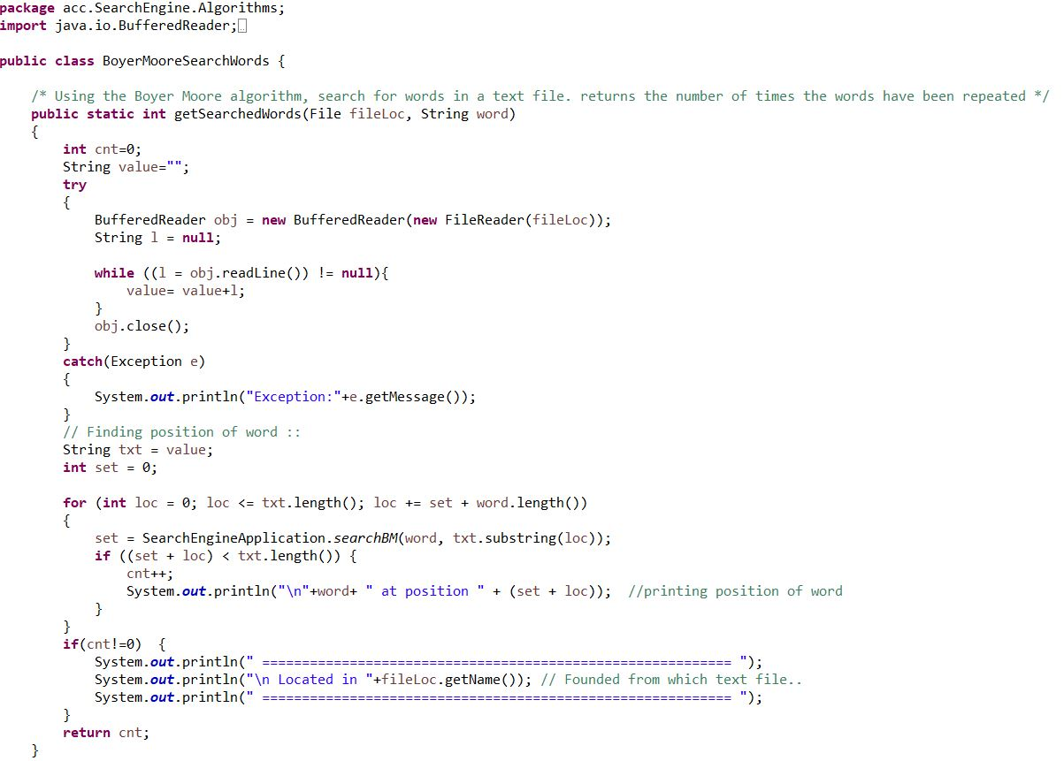
Searching Keywords using boyer-moore algorithm
Using the algorithm the string or phrases can be broken down in order to perform a keyword search.
It will display the position and number of times the word has appeared.
It will the store the destination of the URL as well.

Slide 13
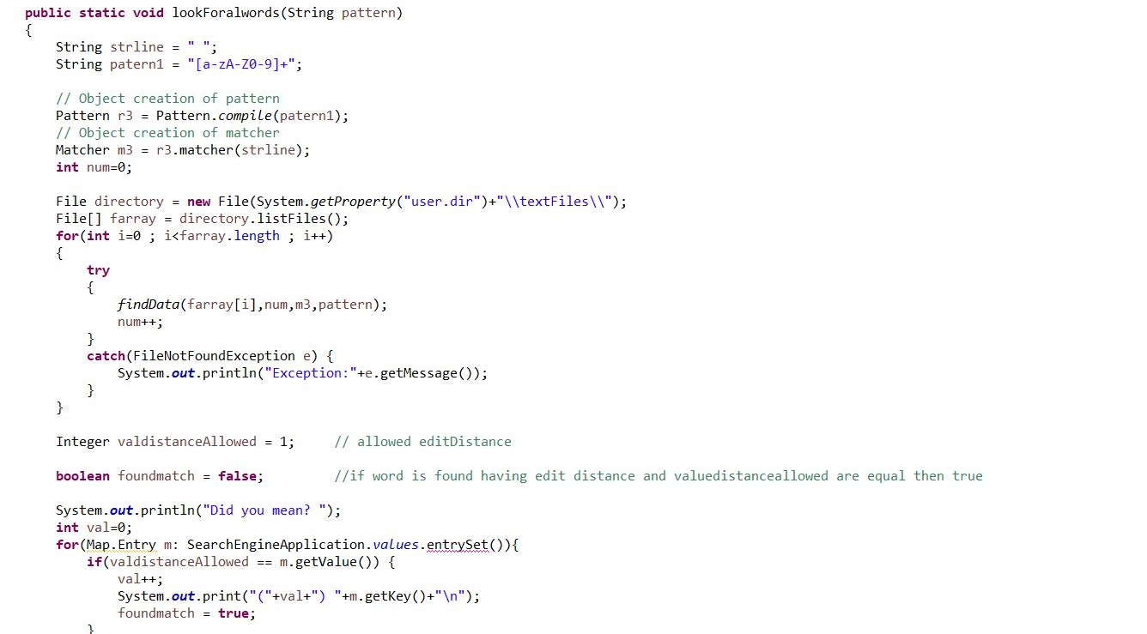

Slide 14
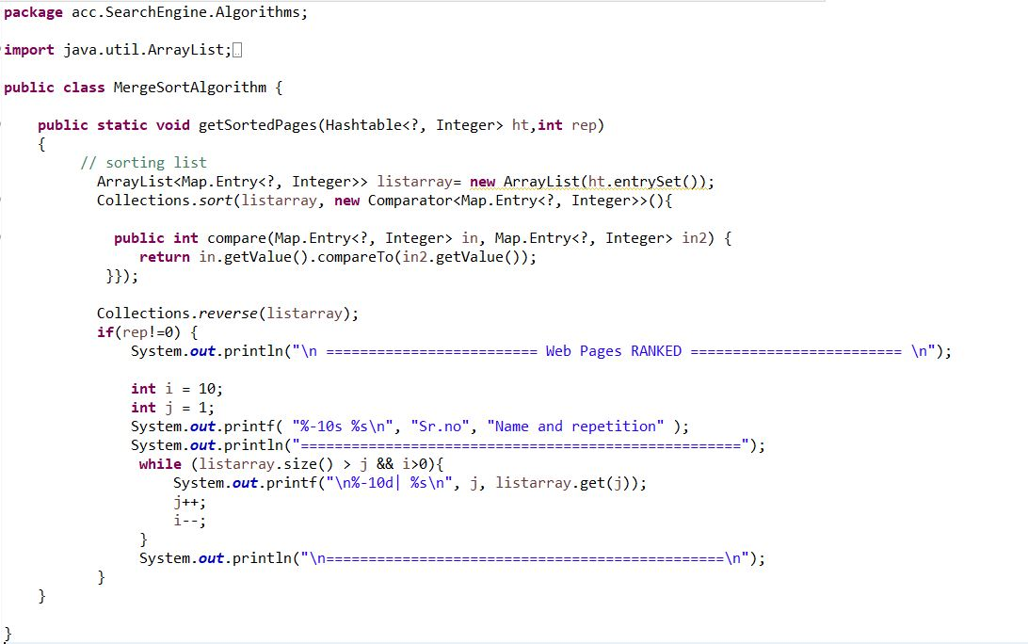
Sorting web pages using merge sort
Changes the order of result i.e., displays it in accordance to relevance.
The ordering is done from the most relevant to the least relevant search.

Slide 15
3.demo

Slide 16

Future scope
Web-based and mobile-based android applications for the search engine.
Add more URLs so that the user has a vast variety of data to search from.
Include Graphical User Interface to enhance the user experience.

Slide 17
4.Conclusion

Slide 18
We have successfully developed a web search engine for our final project using JAVA as the programming language and Eclipse IDE as the platform for programming.
Under the guidance of our faculties Dr Mahdi Firoozjaei and Bahareh Rahmatikargar, we learned different concepts throughout the course including sorting, hash tables and many more. From this project, we were able to apply and develop a system that depends on different data structures and algorithms learned through the term.

Slide 19
Thank you DR. MAHDI fIROOZJAEI & BAHAREH RAHAMATIKARGAR

