Slide 1
Warehouse Storage Optimisation
Dhruvil Dave AU1841003
Harvish Jariwala AU1841050
Dhatri Kapuriya AU1841129
Nisarg Thoriya AU1841142
Notes:
Good evening sir, the problem we are trying to solve is warehouse storage optimisation

Slide 2
Introduction
In any product based corporations the most important thing is warehouse storage optimisation. Optimisation increases efficiency facilitates proper coordination and maintains good control. When Warehouse Space Optimisation, the first thing is finding a suitable location. When choosing a location, planners should know which bin or container is empty and whether it could fit the dimensions of the product.
Most of the mega corporations uses robots to place their products into the right place. But the commands are driven manually. This can be replaced by machine learning techniques and machines/robots can decide themselves the optimal location for product.
Notes:
Optimization is one the domain where machine learning can be applied, as machine learning can scaled for very large problems. Multi-national companies are replacing humans with robots, as they maximize resource utilization.The main purpose of warehouse is to store as much products as we can. With Optimisation we can achieve higher efficiency and propere coordination. With optimization of warehouses we can maintain good control of supply chain. When we think of warehouse space optimization, the first thing come to our mind is to find suitable location for the incoming products. When planners are choosing the location to store in warehouse, they should know exaclty which bins are empty and which bin would be perfect so that we can achive optimization

Slide 3
Problem Statement
As a part of warehouse Storage optimisation, our main problem lies in finding the suitable bin or container for the incoming product and to place in a manner which would possibly accommodate more products in the given area.
“Model is said to learn from experience E with respect to some class of tasks T and performance measure P, if its performance at tasks in T, as measured by P, improves with experience E.”
T : classify which bin the product will be placed into
E : current state of bins (vacancy measure)
P : Classification accuracy, whether the product is placed in correct bin or not
Notes:
For optimization, our main problem lies in finding the suitable bin where we can store the incoming product and we should store the product in a manner which would possibly accommodate more products in the warehouse and we shall leave smallest possible empty space.
As Tom Mitchell in his book Machine Learning provides a short formalism that stats “ model is said to learn from experience E with respect to some class of tasks T and performance measure P. if its performance at tasks in T ,as measured by P, improves with experience E” . We have used this formalism as a template and tried to define E,T and P for our problem statement, Here Task T will be “classification of which bin should we select to placing the product “ can be considered as Tasks T , then “current state of bins or how much vacancy is available in bins “can be considered as Experience E, and “accuracy of whether the product is placed in correct bin “ can be considered as Performance Measure M for our problem statement

Slide 4
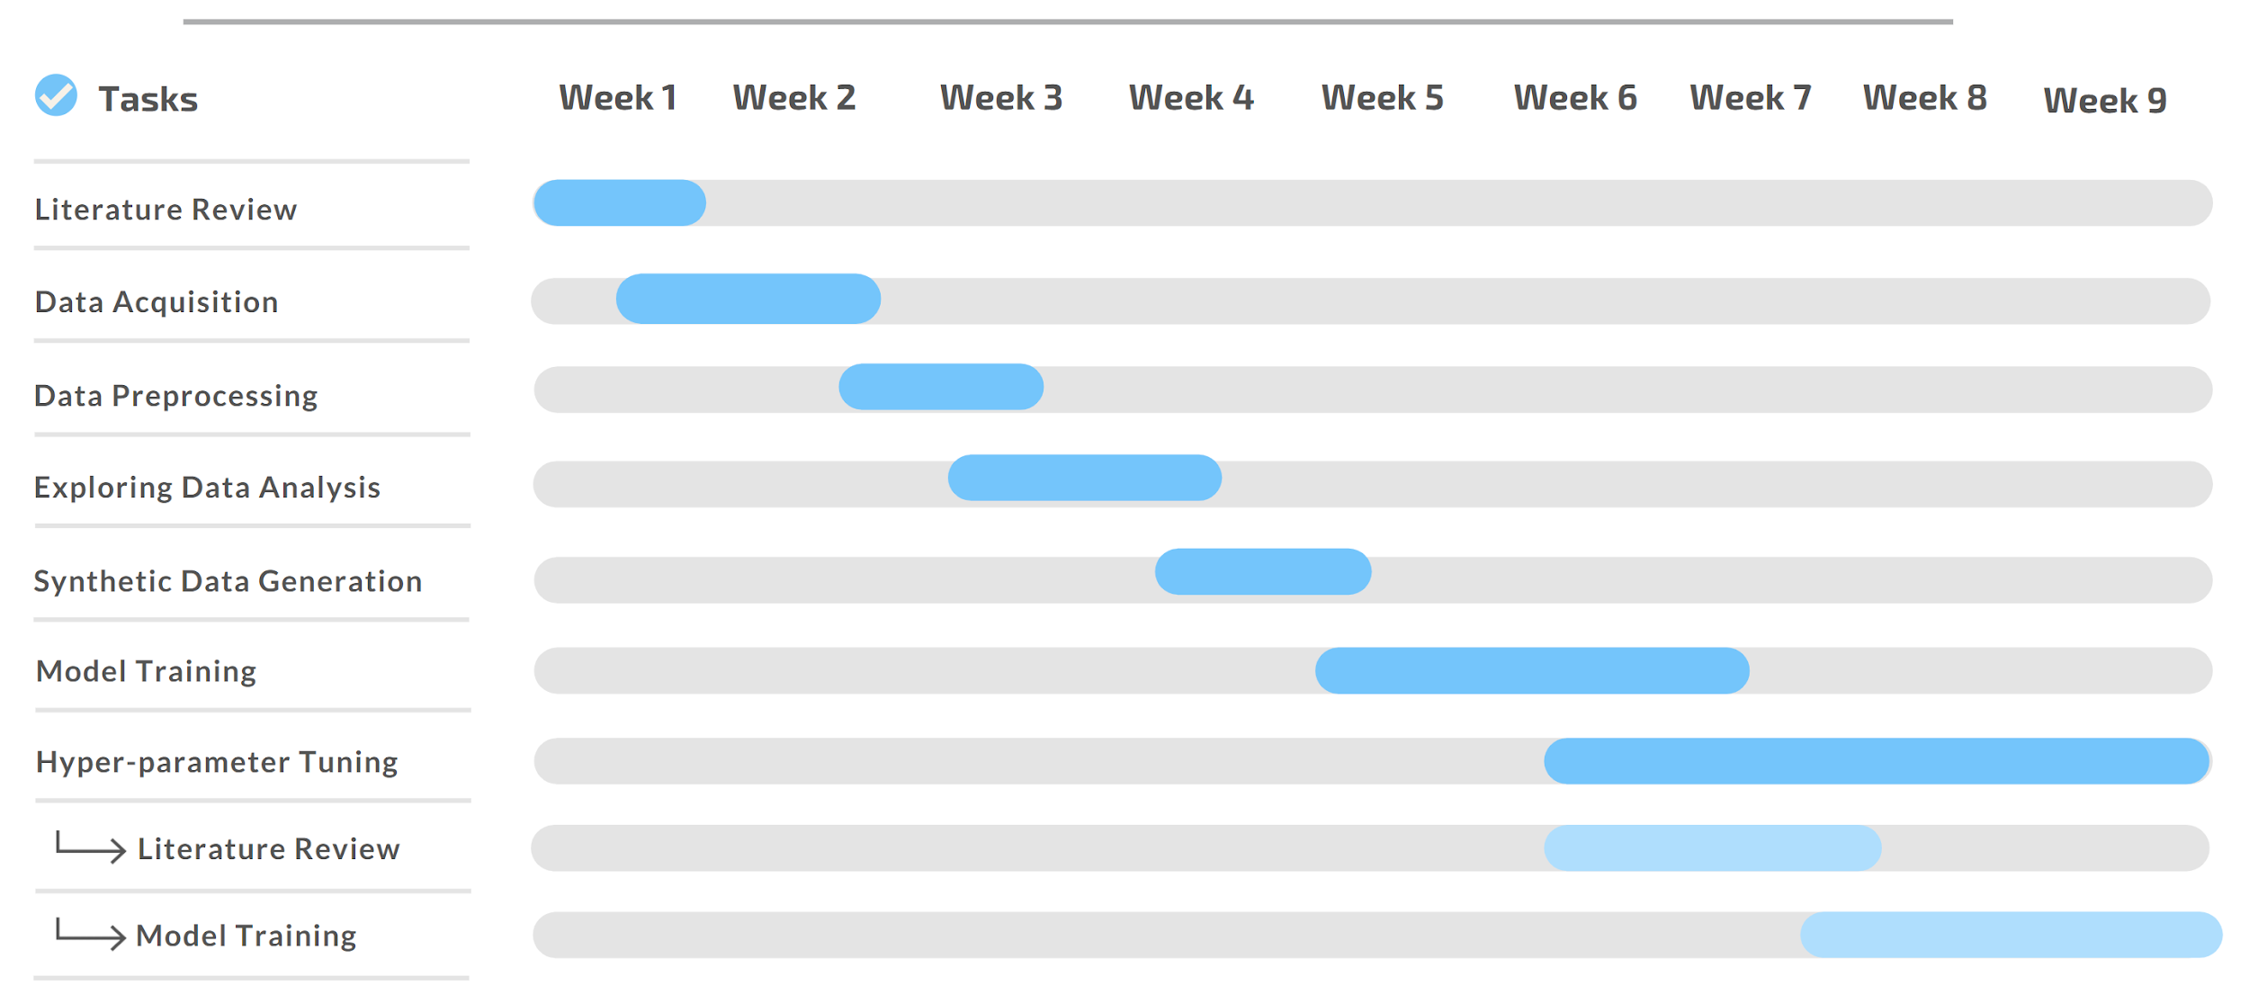
GANTT Chart

Slide 5
Existing body of work
Nvidia’s deep learning based approach
In 2013, Nvidia came up with OCaPi (Optimal Cart Pick) algorithm to solve this special case of travelling salesman problem
However, this algorithm was too slow. So they used a Neural network OCaPi Travel Time Estimator which allowed the users to reduce travel time by 11%
Predicting Warehouse Storage
This is done by Michael Li at MIT.
He has employed many different machine learning methods, including Linear Regression, Gradient Boosted Trees, and (fully-connected) neural networks. For the final chosen neural network model.
Notes:
The first paper we’d like to discus was on Nvidia’s post on deep learning based approach by Calvin Seward and colleagues
There are two problems in warehouse: picker routing problem and order batching problem
Picker routing problem: If there’s a person who wants to get to various points inside the warehouse, our goal is to find an optimal solution or a path for the person which is the most efficient. This is a special case of travelling salesman problem. To solve this, they created the okapi algorithm. This algorithm was linear in terms of number of isles but it was still slow for the next problem which is
Order Batching problem: A lot of people have ordered a bunch of different things, and there are multiple items placed across different places.
So they tried to develop a neural network based Okapi algorithm and they observed significant performance improvement from seconds to milliseconds.
Another study was done by Michael Li in MIT. He tried to predict how long a shipment would stay in the warehouse using different methods which are listed in front of you. He had a relatively smaller dataset and managed to get decent results. Infact, he predicted he could provide savings of 10 million dollars. However much details of this project are not available.

Slide 6
Our Approach
Data Acquisition
Data preprocessing
01
02
Our first step was data acquisition, we obtained the data from Amazon Bin Images Dataset
The images were labelled with metadata containing the details and description of the products that each bin had
We had to extract the metadata from this dataset 5.3 lakh images i.e. bins
After we obtained this dataset, we converted it into usable form i.e. we extracted the metadata from the images
These were converted into a single JSON with various product attributes.
As we were not going to use Deep neural networks we dropped the images
Notes:
So after an ice breaking session and couple of brainstorming sessions and we found out this dataset on
amazon S3. this dataset was basically a collection of images of bins in any particular warehouse of amazon.
these images were captured by robots as part of normal Amazon Fulfillment Center
operations. Along with the images, there were also metadata
provided for each particular image in “JSON” format. So our
first task was to download the entire dataset that was hosted
over Amazon S3 Bucket. This was a very huge file about 30GB so we had to use docker loaded with Amazon CLI.
After getting the entire data we studied the images and the metadata file attached with each of them.
These data files consisted of information like ASIN (Amazon Standard Identification Number), quantity,
weight, length, height and width for each product. Since we
were not going to use any of the deep learning techniques, we
decided to drop the images entirely from our dataset and here
we were left with almost 530,000 JSON files to be cleaned
and preprocessed.
Now our aim was to tabularise the json data as classical machine learning requires tabularised dataset
and also find some metric for our dataset which
could help us solve the problem of placing products into bins optimally. We tried taking surface area of each
bin by figuring out from the products stored in them, as bin dimensions are unknown. But this did
not result into a fairer solution as any product could have a larger surface area
but its volume could be lower and hence can be occupied.
Finally we came up with a volume metric. this was basically used to measure
the empty space left in each bin. As bin dimensions are unknown, we assumed that the all bins are of same size
and we got the bin size by calculating the maximum volume stored by a bini i.e. we
added the volumes of all products in each bin and found MAX out of it
This implies that the size of bins must be less than or equal to the MAX volume.

Slide 7
Our Approach
Synthetic Data generation
Model Fitting
03
04
Based on the Amazon Bin Images Dataset, we created our generalised synthetic data.
This synthetic data had 15000 rows and 200 bins and every sample introduced a product into one of the bins.
We extended this data from 15000 samples to 1 million samples using CTGAN
After the data was tidy and in usable form, we applied Machine Learning models onto it.
We fitted models like Decision Tree, Random Forest and K-Nearest Neighbors onto this data set

Slide 8
Our Approach (After Midsem)
Hyperparameter tuning - AutoML
Hyperparameter Tuning - Manual Methods
05
06
AutoML libraries automate the process of model training and hyperparameter tuning.
We used H2O.ai AutoML library to tune the models for our dataset and figure out the best approach.
Manual Parameter tuning was done initially on a RandomForestClassifier to understand and observe the process of parameter tuning.
Changing the number of estimators was the clear way to change the effect of model on our dataset.

Slide 9
Final Results: Optuna
Random Forest Classifier
k-Nearest Neighbors
XGBoost Classifier
- We trained a RFC model in Optuna with 100 trials
- N_estimators ranged from 2 to 20
- Max_depth ranged from 1 to 32
- k-Nearest Neighbors had 25 trials because of speed limitations
- N_neighbors ranged from 2 to 20
- Leaf size was set from 10 to 400
- XGBoost could be ran for 100 trails as it ran using GPU
- N_estimators ranged from 0 to 1000
- Learning rate from 0.005 to 0.5 loguniformly

Slide 10
Final Result: AutoML
Method | AUC
StackedEnsemble_AllModels | 0.8896
StackedEnsemble_BestOfFamily | 0.849501
XGBoost_2 | 0.88528
XGBoost_1 | 0.888208
GBM_4 | 0.848131
XGBoost_3 | 0.846808
GBM_3 | 0.846387
GBM_2 | 0.844955
GBM_1 | 0.84195
XRT_1 | 0.835325
DRF_1 | 0.824493

Slide 11
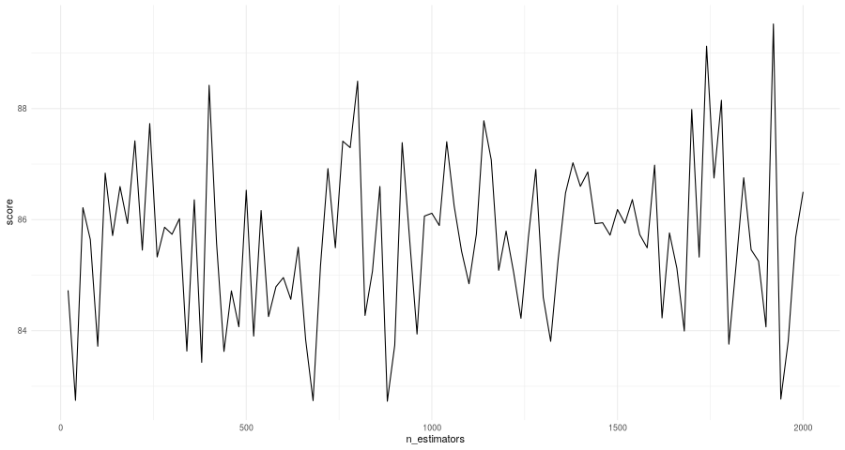
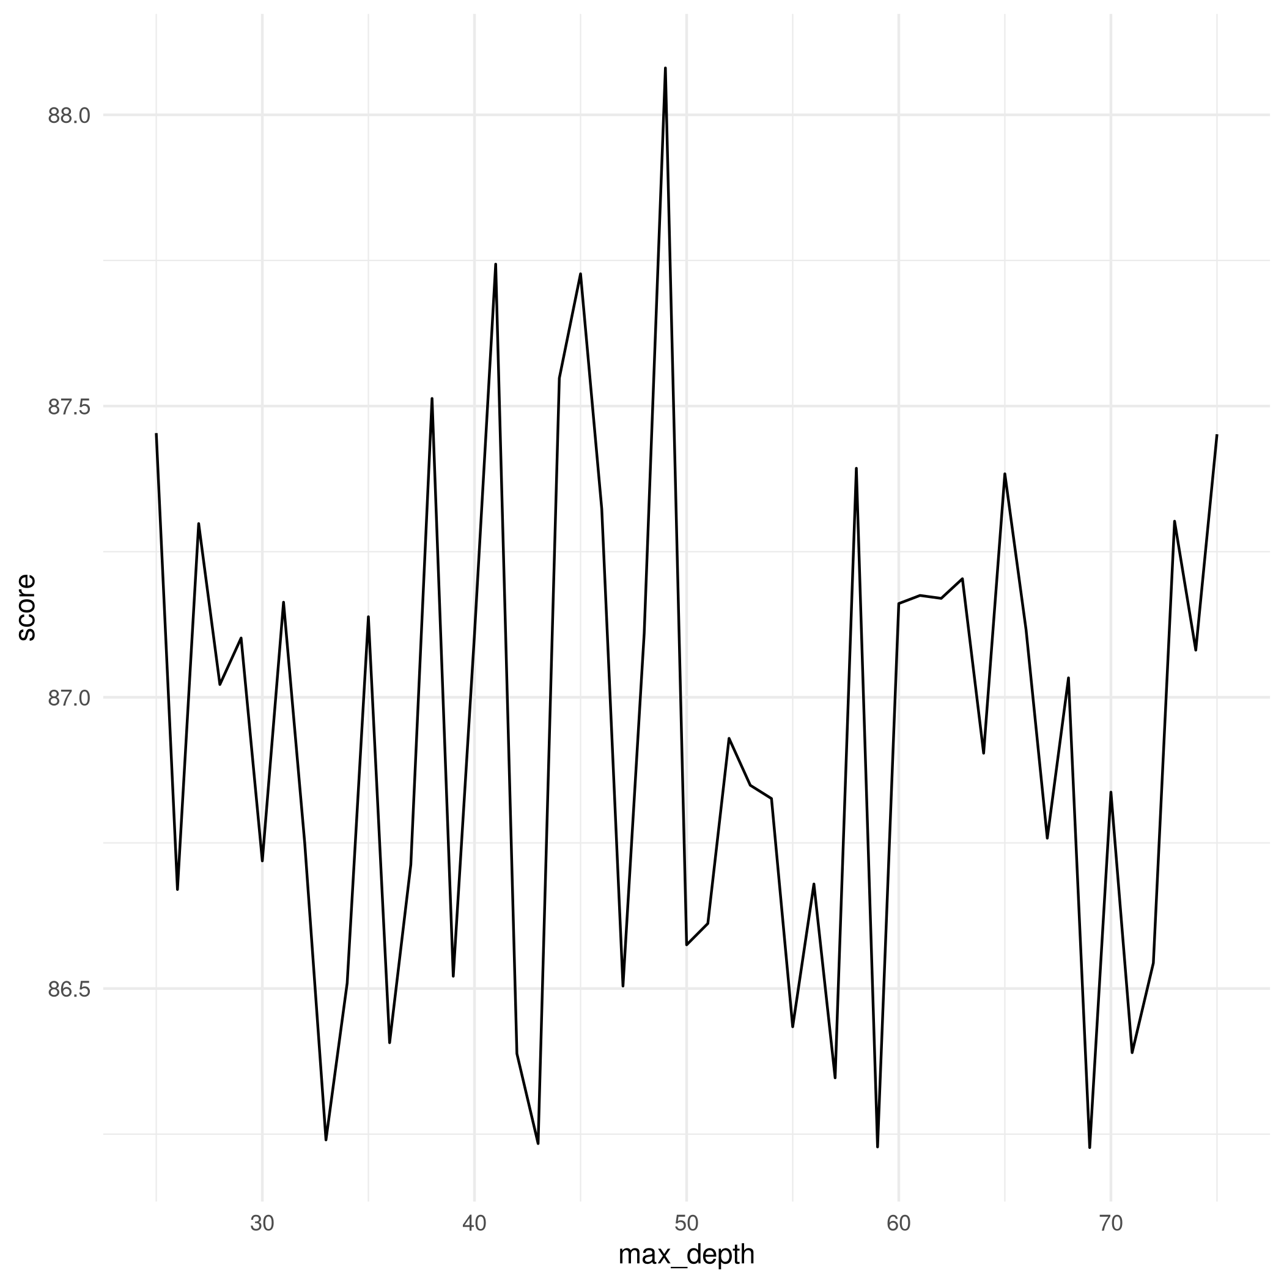
Final Result - Random Forest
Fine tuning n_estimators
Fine tuning max_depth

Slide 12
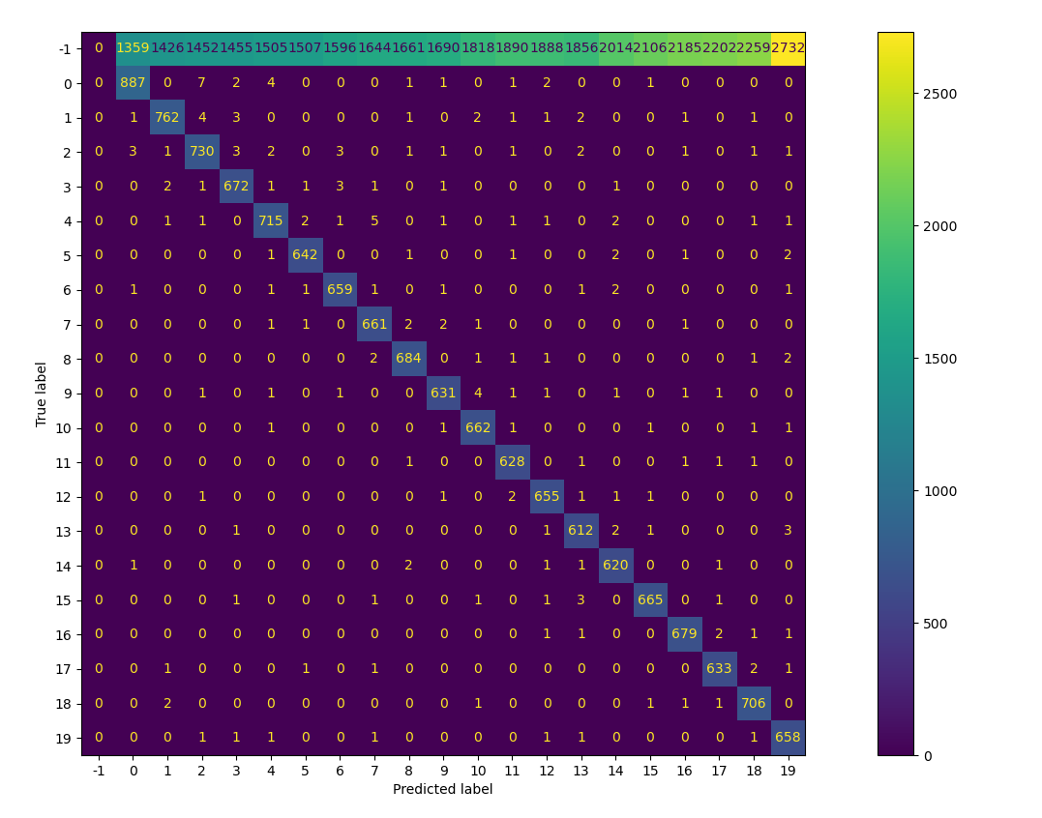
Final Result - RFC Confusion matrix

Slide 13
Conclusion
This project was an entirely different approach to the problem of solving the warehouse storage spaces optimization. This field is generally dominated by deep learning methods and classical machine learning methods are completely overlooked.
Through this project we understood the look of using a classical machine learning classifier to approach a complex problem like this with a very high number of classes in output. We tried and learnt various methods of the entire machine learning operations pipeline starting from data fetching, preprocessing, cleaning, feature engineering, modelling, exploratory data analysis, hyperparameter tuning and generating reproducible outputs.
In this process, we got to explore the various new libraries available that can highly speed this processes up on a GPU or a TPU and this learning will be very much helpful in our future endeavours as well. We aim to use this knowledge even further in any machine learning problems we encounter.

Slide 14
Role of each group member in project
 | Report Making | Data Cleaning | EDA | Modelling | Hyper parameter Tuning
Dhruvil Dave
Dhatri Kapuriya
Harvish Jariwala
Nisarg Thoriya

Slide 15
References
https://scikit-learn.org/stable/auto_examples/classification/plot_classifier_comparison.html
https://mlli.mit.edu/projects/machine-learning/predicting-warehouse-storage
https://machinelearningmastery.com/how-to-define-your-machine-learning-problem/
https://developer.nvidia.com/blog/optimizing-warehouse-operations-machine-learning-gpus/
https://en.wikipedia.org/wiki/Multiclass_classification
https://docs.h2o.ai/h2o/latest-stable/h2o-docs/automl.html
https://optuna.org/
https://automl.github.io/auto-sklearn/master/

