Slide 1
Object Recognition Using Geometric Hashing
CS773C Machine Intelligence Advanced Applications
Spring 2008: Object Recognition

Slide 2
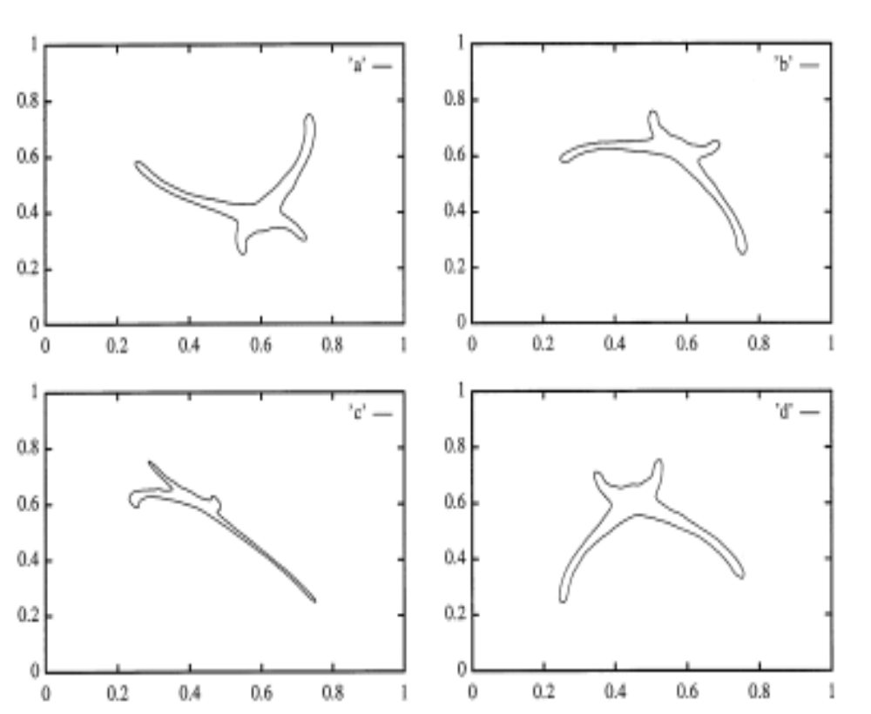
Affine Transformation
Under the assumption that objects are “flat” and the camera is not very close to the objects, different 2D views of a 3D object can be related by an affine transformation

Slide 3

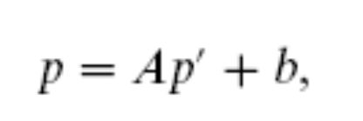
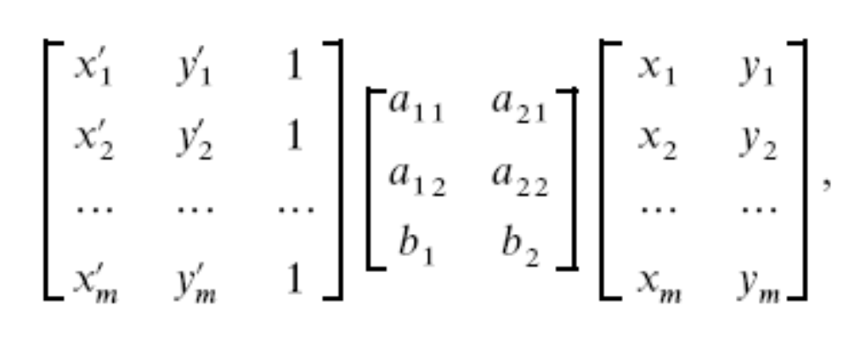
Affine Transformation (cont’d)
Models translation, rotation, scaling and shearing
or
Six unknowns
Need at least six
equations to solve for
the unknowns!

Slide 4
Affine Transformation
Need to find at least three correspondences to solve for the affine transformation
p₂
p’₃
p₁
p’₂
p₃
p’₁

Slide 5
Geometric Hashing
Models are represented in a redundant affine invariant way and stored in a table (off-line).
Hashing is used for organizing and searching the table.

Slide 6
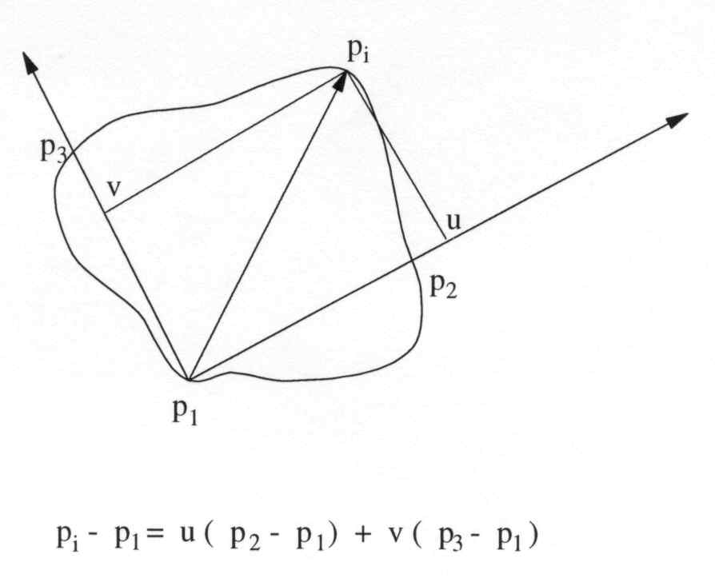
Affine Invariants
Each triplet of non-collinear model points forms a basis of a coordinate system that is invariant under affine transformations.
Represent model points in an affine invariant way by rewriting them in terms of this coordinate system.
(u,v) are affine invariant!

Slide 7
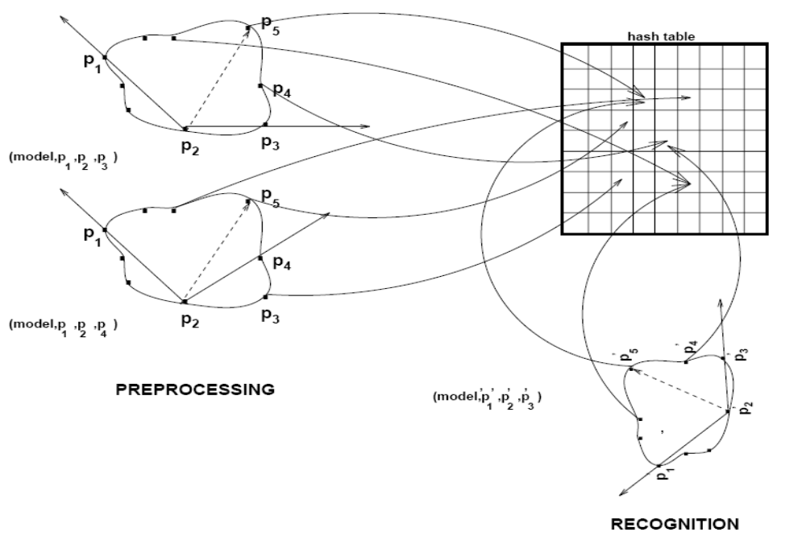
Preprocessing and Recognition

Slide 8
Preprocessing Step
For each model do:
(1) Extract model's point features.
(2) For each ordered set of three, non-collinear, points (p₁, p₂, p₃)
  (a) Compute the coordinates (u,v) of the remaining features in the coordinate frame defined by the model basis (p₁, p₂, p₃)
  (b) After a proper quantization, use the computed coordinates (u,v) as an index to a two dimensional hash table, and record in the corresponding hash table bin the information (model, (p₁, p₂, p₃))
  Hash Function: h(Q(u), Q(v)) →

Slide 9
Preprocessing and Recognition

Slide 10
Recognition Step
(1) Extract the image point features
(2) Choose an arbitrary ordered pair (p’₁, p’₂, p’₃)
(3) Compute the coordinates (u’,v’), of the remaining feature points in the coordinate frame defined by the image basis (p’₁, p’₂, p’₃)
(4) After quantization, use the computed coordinates as an index to the hash table. For every entry (model, (p₁, p₂, p₃)) found in the corresponding bin, cast a vote.

Slide 11
Recognition Step (cont’d)
(5) Histogram all the hash table entries that received one or more votes. Determine those entries that received more than a certain number of votes -- each such entry corresponds to a potential match (hypothesis generation).
(6) For each potential match, consider all the model-image feature pairs which voted for a particular entry, and recover the affine transformation A that results in the best least-squares match between all the corresponding feature points.

Slide 12
Recognition Step (cont’d)
(7) Map the model onto the image using the computed transform and compare the model edges with the image edges (verification step).
(8) If the verification fails for all the models computed in step (5), go back to step (2) and repeat the procedure using a different image basis.

Slide 13
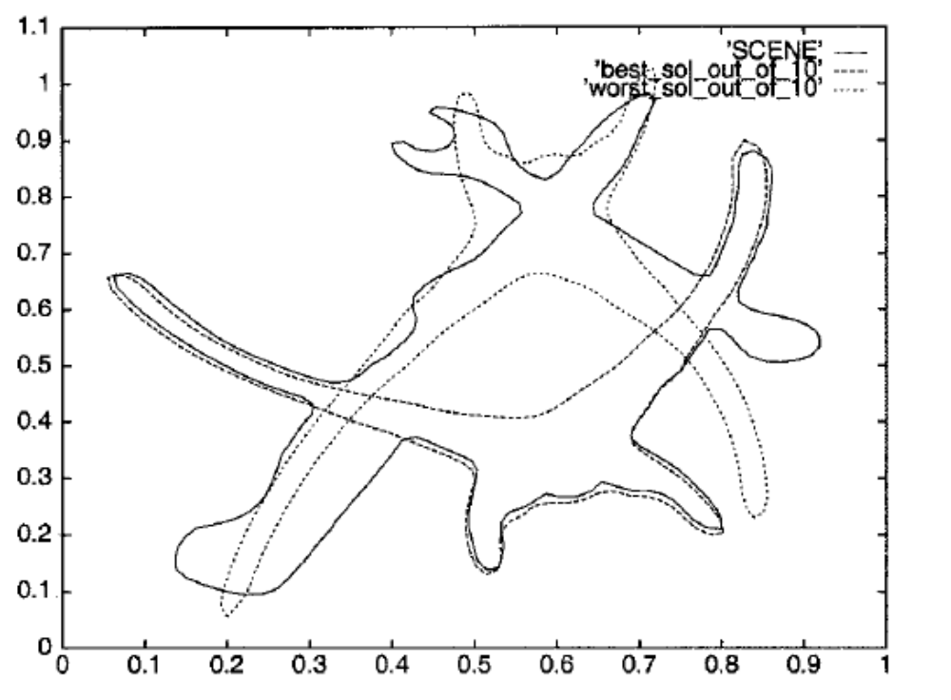
Recognition Example
Bad hypothesis
Good hypothesis

Slide 14
Complexity
Preprocessing Step:
O(Mm⁴)
Recognition Step:
worst case: O(i⁴Mm⁴)
(M: #models, m: #model points, i: #scene points)

Slide 15
3D Geometric Hashing
(Lamdan & Wolfson, "Geometric hashing: a general and efficient model-based recognition system", Inter. Conf. on Computer Vision, 1988, pp. 238-249).
Looking for 4 point correspondences between the 3-D model and the 2-D image (3D hash table).
Four non-coplanar points define a 3-D affine basis;
the coordinates of any 3-D point can be computed in this coordinate frame.
During recognition, we vote for all the bins lying on a given line in the 3D hash-table.

Slide 16
Comments on Geometric Hashing
For the algorithm to be successful, it suffices to select an image basis triplet which belongs to some model.
The goal of the voting scheme is to reduce the number of hypotheses that must verified (filtering).
In the case where model points are missing from the image (i.e., due to occlusions), recognition is still possible as long as there is a sufficient number of points hashing into the correct hash table bins.

Slide 17
Unstable basis triplets
(Costa, Haralick, and Shapiro "Optimal affine invariant point matching", 6th Israel Conf. on AI, 1990, pp. 35-61)
“Skinny” triangles lead to instabilities in the computation of the affine transformation parameters.
Avoid “skinny” triangles using an “area” criterion.

Slide 18
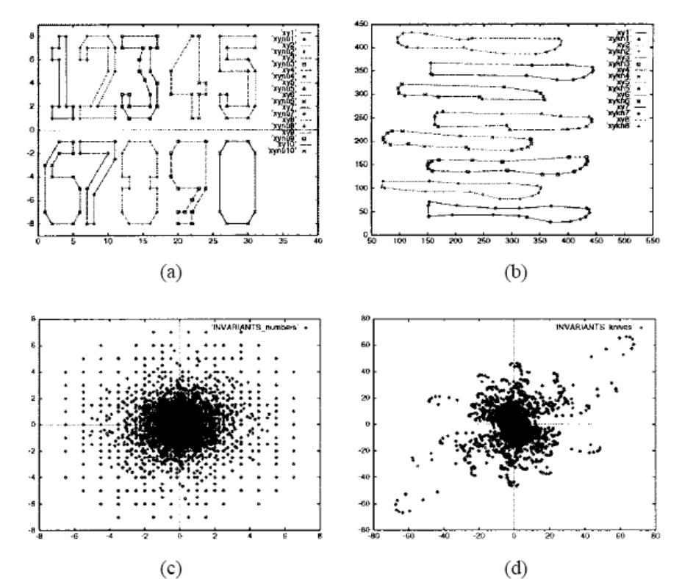
Non-uniform Distribution of Invariants
The distribution of invariants might be non-uniform.

Slide 19
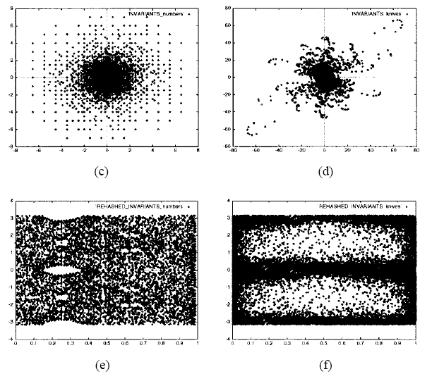
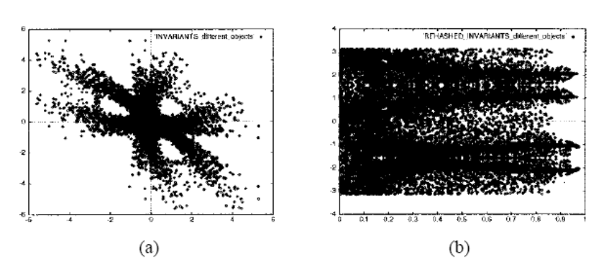
Rehashing
(I. Rigoutsos and R. Hummel, “Several Results on Affine Invariant Geometric Hashing, 8th Israeli Conf on Artificial Intell. And Comp. Vision, 1991)
Map the distribution of invariants to a uniform distribution.
Need to make assumptions about the distribution of invariants.
(assuming similarity transformations)
(assuming affine transformations)

Slide 20
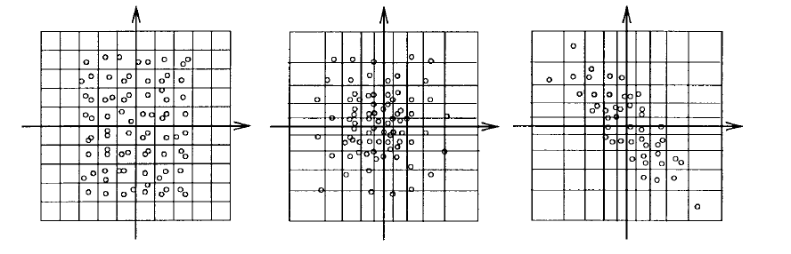
“Learn” good geometric hash functions
(G. Bebis et al., "Using Self-Organizing Maps to Learn Geometric Hashing Functions for Model-Based Object Recognition" , IEEE Transactions on Neural Networks Vol 9, No. 3, pp. 560-570, 1998).
Make the size of the bins proportional to the density of the data.
Learning is based on the “Kohonen” neural network.

Slide 21
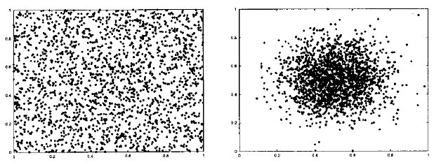
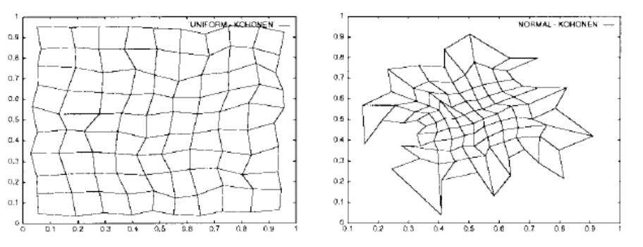
“Learn” good geometric hash functions (cont’d)
Think of the grid as an “elastic” net that deforms based on the density of the data.
data distributions
deformed grid

Slide 22
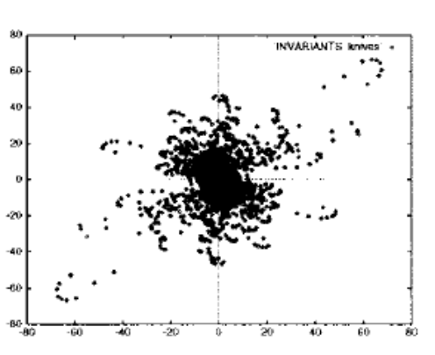
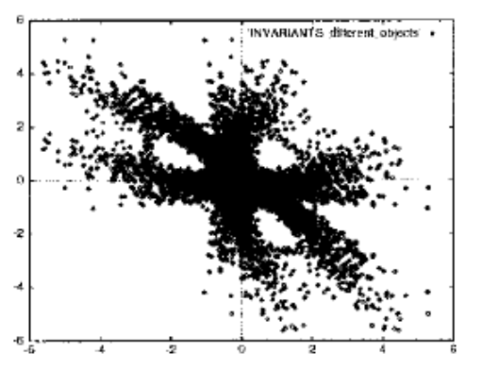
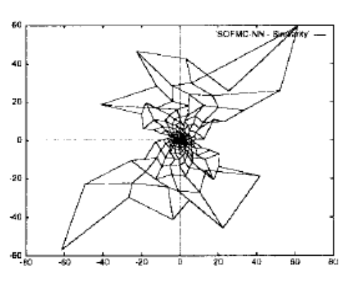
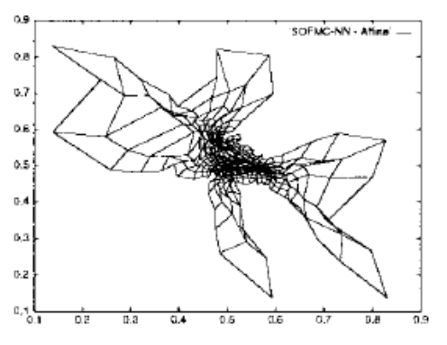
“Learn” good geometric hash functions (cont’d)
data distributions
deformed grid

Slide 23
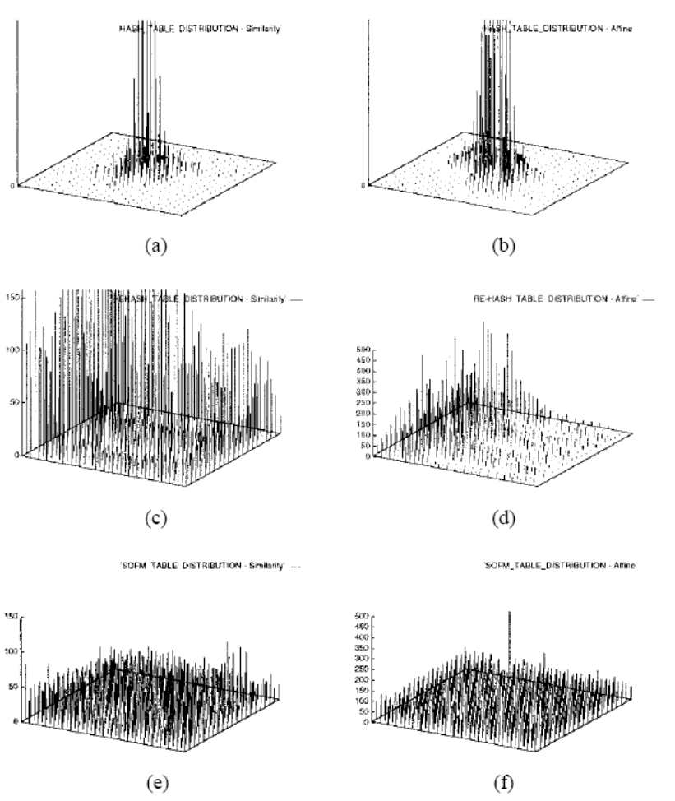
“Learn” good geometric hash functions (cont’d)
Similarity
Affine
Original
Rehashing
Learning

Slide 24
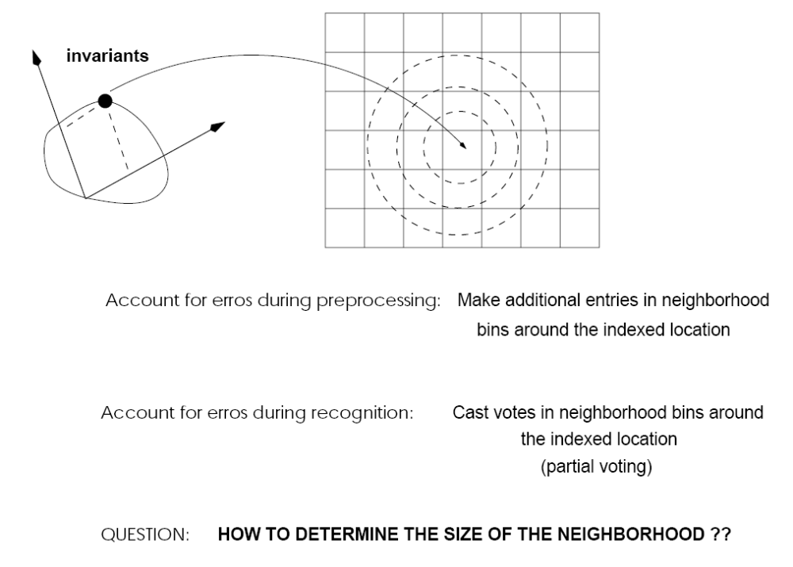
Noise
(Grimson & Huttenlocher "On the sensitivity of Geometric hashing", 1990)
(Lamdan & Wolfson "On the error analysis of Geometric hashing", 1991)
The performance of Geometric hashing degrades rapidly for cluttered scenes or in the presence of moderate sensor noise (3-5 pixels).
Possible solutions:
Make additional entries during
preprocessing (increases
storage).
Cast additional votes during
recognition (increases time)

Slide 25
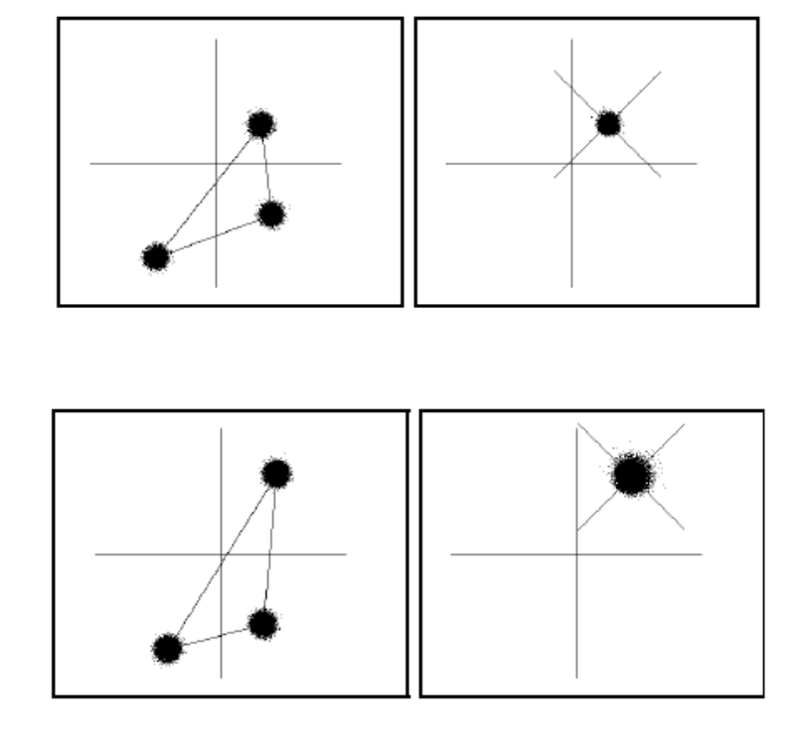
Neighborhood Size
(Rigoutsos and Hummel, 1995)
Size, shape and orientation
of the regions that need to
be accessed in the affine
space depend on the selected
basis triplet as well as on the
computed hash locations.
The larger the separation of the two basis points, the smaller the spread
in the space of invariants.
Adaptive weight voting
Feature Space
(Gaussian noise)
Space of Invariants

Slide 26
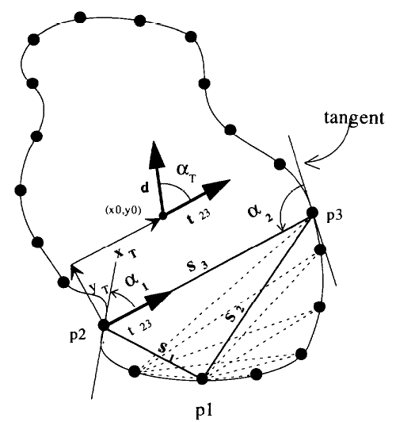
Index Selectivity
Recognition accuracy could be improved by increasing index selectivity.
  e.g., using higher-dimensional indices
  A. Califano and R. Mohan, “Multidimensional Indexing for Recognizing Visual Shapes”, IEEE Transactions on Pattern Analysis and Machine Intelligence, vol. 16 , no. 4, pp. 373 – 392, 1994

