Slide 1
Data Analytics
(CS61061)
Lecture #2
Data Categorization
Dr. Debasis Samanta
Professor
Department of Computer Science & Engineering

Slide 2

Quote of the day..
The simple things are also the most extraordinary things, and only the wise can see them.
  Be minute to everything around you. The world is a great teacher!
            PAULO COELHO Brazillian author.

Slide 3
We are going to learn…
Data in data analytics
NOIR topology
Nominal scale of measurement
Ordinal scale of measurent
Interval scale of measurement
Ratio scale of measurement
Data model for high-dimensional data

Slide 4
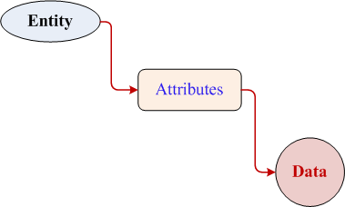
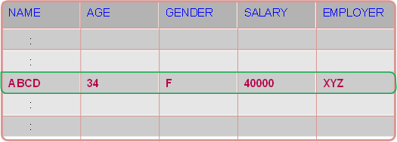
Data in Data Analytics
Entity: A particular thing is called entity or object.
Attribute. An attribute is a measurable or observable property of an entity.
Data. A measurement of an attribute is called data.
Note
  Data defines an entity.
  Computer can manage all type of data (e.g., text, numeric, image, audio, video, etc.).

Slide 5

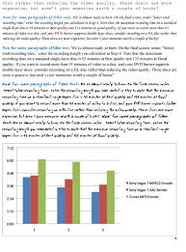
Data representation
How a document (e.g., text) can be represented?

Slide 6

Data representation
How an image can be represented?

Slide 7

Data representation
How a video can be represented?

Slide 8

Data representation
How the streaming data from an artificial earth satellite can be represented?

Slide 9
Data in Data Analytics
  In general, there are many types of data that can be used to measure the properties of an entity.
  A good understanding of data scales (also called scales of measurement) is important.
  Depending the scales of measurement, different techniques are followed to derive hitherto unknown knowledge in the form of
    patterns, associations, anomalies or similarities from a volume of data.

Slide 10
NOIR
Classification of scales of Measurement

Slide 11
NOIR classification
  The mostly recommended scales of measurement are
  N: Nominal
  O: Ordinal
  I: Interval
  R: Ratio
  The NOIR scale is the fundamental building block on which the extended data types are built.

Slide 12
NOIR Classification
Nominal
Ordinal
Interval
Ratio
Binary
Alphabetical Ordered
Ternary
Others
Symmetric
Asymmetric
Numerically Ordered
Literally Ordered
Discrete
Continuous
Categorical (Qualitative)
Numeric (Quantitative)

Slide 13
Nominal scale
  Definition
  A variable that takes a value among a set of mutually exclusive codes that have no logical order is known as a nominal variable.
  Examples
Gender Used letters or numbers
{ M, F} or { 1, 0 }
Blood groups Used string
{A , B , AB , O }
Rhesus (Rh) factors Used symbols
{+ , - }
Country code ??
????

Slide 14
Nominal scale: Properties
Note
The nominal scale is used to label data categorization using a consistent naming convention.
The labels can be numbers, letters, strings, enumerated constants or other keyboard symbols.
Nominal data thus makes “category” of a set of data.
The number of categories should be two (binary) or more (ternary, etc.), but countably finite.

Slide 15
Nominal scale: Properties
Note
A nominal data may be numerical in form, but the numerical values have no mathematical interpretation.
  For example, 10 prisoners are 100, 101, … 110, but; 100 + 110 = 210 is meaningless. They are simply labels.
Two labels may be identical ( = ) or dissimilar ( ≠ ).
These labels do not have any ordering among themselves.
  For example, we cannot say blood group B is better or worse than group A.
Labels (from two different attributes) can be combined to give another nominal variable.
  For example, blood group with Rh factor ( A+ , A- , AB+, etc.)

Slide 16
Binary scale of nominal data
Definition
A nominal variable with exactly two mutually exclusive categories that have no logical order is known as binary variable
Examples
Switch: {ON, OFF}
Attendance: {True, False}
Entry: {Yes, No}
etc.
Note
A Binary variable is a special case of a nominal variable that takes only two possible values.

Slide 17
Symmetric and Asymmetric Binary Scale
Different binary variables may have unequal importance.
If two choices of a binary variable have equal importance, then it is called symmetric binary variable.
  Example: Gender = {male, female}
// usually of equal probability.
If the two choices of a binary variable have unequal importance, it is called asymmetric binary variable.
  Example: Food preference = {V, NV}

Slide 18
Operations on Nominal variables
Summary statistics applicable to nominal data is mode.
Arithmetic (+,-,*and/) and logical operations (<,>,≠, etc.) are not permitted.
The allowed operations are : accessing (read, check, etc.) and re-coding (into another non-overlapping symbol set, that is, one-to-one mapping), etc.
Nominal data can be visualized using line charts, bar charts or pie charts, etc.
Two or more nominal variables can be combined to generate other nominal variable.
  Example: Gender (M,F) × Marital status (S, M, D, W)

Slide 19
Ordinal scale
Definition
Ordered nominal data are known as ordinal data and the variable that generates it is called ordinal variable.
  Example:
  Shirt size = { S, M, L, XL, XXL}
Note
The values assumed by an ordinal variable can be ordered among themselves as each pair of values can be compared literally or using relational operators ( < , ≤ , > , ≥ ).

Slide 20
Operation on Ordinal data
Usually relational operators can be used on ordinal data.
Summary measures mode and median can be used on ordinal data.
Ordinal data can be ranked (numerically, alphabetically, etc.) Hence, we can find any of the percentiles measures of ordinal data.
Calculations based on order are permitted (such as count, min, max, etc.).
Spearman’s R can be used as a measure of the strength of association between two sets of ordinal data.
Numerical variable can be transformed into ordinal variable, but with a loss of information.
  For example, Age [1, … 100] = [young, middle-aged, old]

Slide 21
Interval scale
Definition
It allows to measure the interval between two measures.
Interval scale data are like ordinal data, in that they can be placed in a meaningful order. In addition, they have meaningful intervals between them.
Example 1:
S, M, L, being in ordinal scale, we cannot say that interval between S and M is same as that of between M and L , etc. Whereas, on the Celsius scale (which is an interval scale of measurement), the difference between 100ºC and 90ºC is the same as the difference between 50ºC and 40ºC.
Note that in interval scale of measurement, a zero-value does not mean that there is nothing!

Slide 22
Interval scale: Properties
Examples
  Latitude, longitude, temperature (in Celsius/Fahrenheit scale), calendar dates, etc.
Properties
Interval data are with well-defined interval.
Interval data are measured on a numeric scale (with +ve, 0 (zero), and –ve values).
Interval data may have a zero point on origin. However, the origin does not imply a true absence of the measured characteristics.
  For example, the temperature outside is 0ºC. Here, 0ºC does not indicate a complete absence of heat; it is a value of a temperature.

Slide 23
Operations on Interval data
We can add to or from interval data.
  For example: date1 + x-days = date2
Subtraction can also be performed.
  For example: current date – date of birth = age
Negation (changing the sign) and multiplication by a constant are permitted.
All operations on ordinal data defined are also valid here.
Linear (e.g. cx + d ) or Affine transformations are permissible.
Other one-to-one non-linear transformation (e.g., log, exp, sin, etc.) can also be applied.

Slide 24
Operation on Interval data
Note
Interval data can be transformed to nominal or ordinal scale, but with a loss of information.
Interval data can be graphed using histogram, frequency polygon, etc.
The statistical estimation like mean, median, and mode can be calculated.

Slide 25
Ratio scale
Definition
Interval data with a clear definition of “zero” are called ratio data.
  Examples:
  Temperature in Kelvin scale, intensity of earth-quake on Richter scale, sound intensity in Decibel, cost of an article in Rupees, population of a country, weight of a body, age of a tree, height of a building, etc.
Note
The data with ratio scale of measurement are the mostly used data in data science.
In ratio scale, both differences between data values and ratios (of non-zero) data pairs are meaningful.
100ºC is not twice as hot as 50ºC. On the other hand, 100 Kg is twice heavy as 50 Kg.
Temperature in Kelvin scale is a ratio scale of measurement. Here, 0ºK means an absolute temperature and also we can say that 20ºK is as twice as 10ºK.

Slide 26
Ratio scale: Properties
Properties
All ratio data are interval data but the reverse is not true.
Ratio scale, as mentioned earlier has an absolute zero characteristic. It has orders and equally distanced value between units. The zero point characteristic makes it relevant or meaningful to say, “one object has twice the length of the other” or “is twice as long”.
Ratio scale doesn’t have a negative number, unlike interval scale because of the absolute zero or zero point characteristic.
To measure any object on a this scale, researchers must first see if the object meets all the criteria for interval scale plus has an absolute zero characteristic.

Slide 27
Operation on Ratio data
All arithmetic operations on interval data are applicable to ratio data.
In addition, multiplication, division, etc. are allowed.
Mean, median and mode are the permissible statistical operations.
Any linear transformation of the form ( ax + b )/c are known.

Slide 28
Properties of data
  Following FOUR properties (operations) of data are pertinent.
# | Property | Operation | Type
1. | Distinctiveness | = and ≠ | Categorical (Qualitative)
2. | Order | < , ≤ , > , ≥
3. | Addition | + and - | Numerical (Quantitative)
4. | Multiplication | * and /

Slide 29
NOIR summary
Nominal (with distinctiveness property only)
Ordinal (with distinctive and order property only)
Interval (with additive property + property of Ordinal data)
Ratio (with multiplicative property + property of Interval data)
  Further, nominal and ordinal are collectively referred to as categorical or qualitative data. Whereas, interval and ratio data are collectively referred to as quantitative or numeric data.

Slide 30
Data Cube
Multidimensional Data Modeling

Slide 31
Concept of data cube
A multidimensional data model views data in the form of a cube.
A data cube is characterized with two things
  Dimension: the perspective or entities with respect to which an organization wants to keep record.
  Fact: The actual values in the record
Example.
Rainfall data of Metrological Department
  Time (Year, Season, Month, Week, Day, etc.)
  Location (Country, Region, State, etc.)

Slide 32
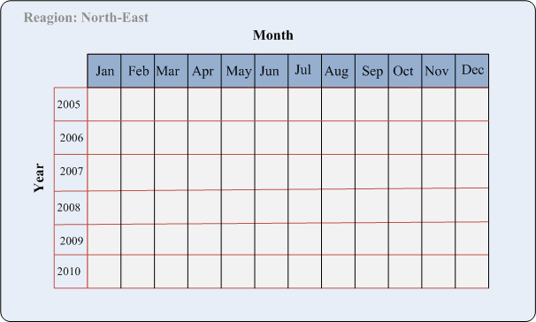
2-D view of rainfall data
In this 2-D representation, the rainfall for “North-East” region are shown with respect to different months for a period of years

Slide 33
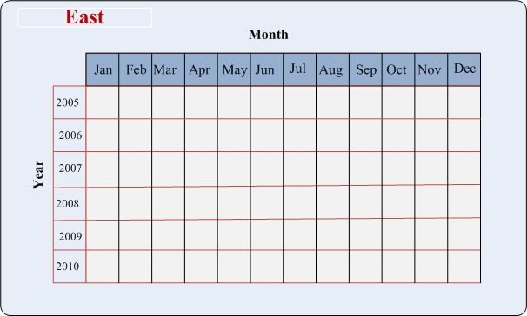

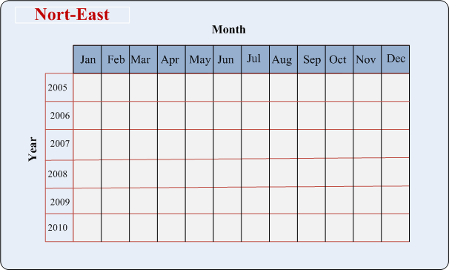
3-D view of rainfall data
Suppose, we want to represent data according to times (Year, Month) as well as regions of a country say East, West, North, North-East, etc.
A 2-D view of 3-D rainfall data

Slide 34
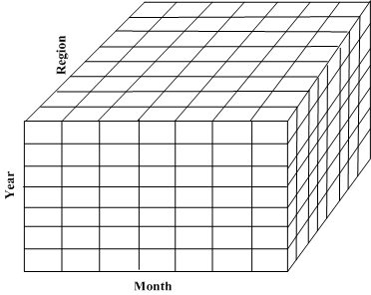
3-D view of rainfall data
Data cube: This enables us a 3-D view of the rainfall data

Slide 35
3-D view of rainfall data
India
China
Russia
Pakistan
Data cube: This enables us a 3-D view of the rainfall data for a continent say?

Slide 36
3-D view of rainfall data
What is the data cube representation of rainfall data of the entire world?

Slide 37
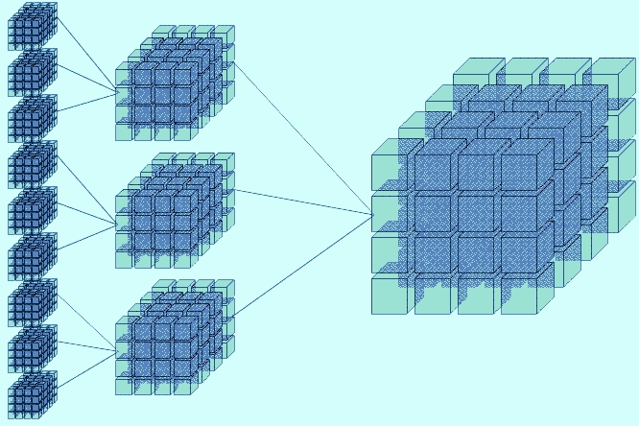
Data cube aggregation
ROLL UP
DRILL DOWN
37

Slide 38
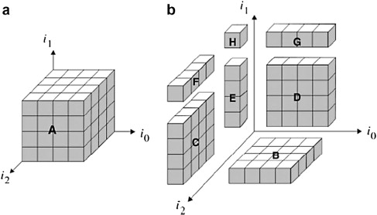
Data cube segregation
BASE CUBOID
SLICE
38

Slide 39
Reference
The detail material related to this lecture can be found in
  Data Mining: Concepts and Techniques (3rd Edn.) by Jiawei Han, Michelline Kamber and Jian Pei, Morgan Kaufmann (2014).

Slide 40
Any question?

Slide 41
Questions of the day…
Consider an image as an entity.
  What are the attributes you should think to represent an image?
  Categorize each attribute according to the NOIR data classification.
  Suppose, two images are given. Give an idea to check if two images are identical or not.
How you can convert a data of interval type to ordinal type? Give an example. What are the issues of such transformation? Whether the reverse is possible or not? Justify you answer.

Slide 42
Questions of the day…
What are the different properties used to categorize the data according to NOIR data categorization?
Given an entity say “STUDENT” with the following attributes. Identify the NOIR category to which each of them belongs.
Scholarship amount | Name | RollNo | DoB | Aaadhar No. | Gender | Mobiloe No. | Email Id

Slide 43
Questions of the day…
Give the concept of data cube to represent hyper-dimensional data? Also, explain with suitable diagrams the following.
    Roll up
    Drill down
    Slice
Using the concept of data cube, how YouTube can archive videos of all type?
Give FOUR differences between data of types “interval” and “ratio-scale”

Slide 44




Questions of the day…
What are the different types of data you can think to judiciously represent an entity like the following?

