Slide 1
Data Analytics
(CS61061)
Lecture #3
Descriptive Statistics
Dr. Debasis Samanta
Professor
Department of Computer Science & Engineering

Slide 2

Quote of the day..
Change your thoughts and you change your world.
          Norman Vincent Peale, American - Clergyman

Slide 3
Today’s discussion includes…
Introduction
Data summarization
  Measurement of location
    Mean, median, mode, midrange, etc.
  Measure of dispersion
    Range, Variance, Standard Deviation, etc.
  Other measures
    MAD, AAD, Percentile, IQR, etc.
Graphical summarization
  Box plot

Slide 4
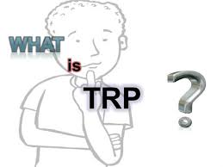
TRP: An example
Television rating point (TRP) is a tool provided
to judge which programs are viewed the most.
  This gives us an index of the choice of the people
  and also the popularity of a particular channel.
For calculation purpose, a device is attached to the TV sets in few thousand viewers’ houses in different geographic and demographic sectors.
  The device is called as People's Meter. It reads the time and the program that a viewer watches on a particular day for a certain period.
An average is taken, for example, for a 30-days period.
The above further can be augmented with a personal interview survey (PIS), which becomes the basis for many studies/decision making.
Essentially, we are to analyze data for TRP estimation.

Slide 5
Defining Data
A set of data is a collection of observed values representing one or more characteristics of some objects or units.
Definition 3.1: Data
  Example: For TRP, data collection consist of the following attributes.
    Age: A viewer’s age in years
    Sex: A viewer’s gender coded 1 for male and 0 for female
    Happy: A viewer’s general happiness
            NH for not too happy
            PH for pretty happy
            VH for very happy
    TVHours: The average number of hours a respondent watched TV during a day

Slide 6
Defining Data
Viewer# | Age | Sex | Happy | TVHours
… | … | … | … | …
… | … | … | … | …
55 | 34 | F | VH | 5
… | … | … | … | …
  Note:
    A data set is composed of information from a set of units.
    Information from a unit is known as an observation.
    An observation consists of one or more pieces of information about a unit; these are called variables.

Slide 7
Defining Population
A population is a data set representing the entire entities of interest.
Definition 3.2: Population
  Example: All TV viewers in the country/world.
  Note:
    All people in the country/world is not a population.
    For different survey, the population set may be completely different.
    For statistical learning, it is important to define the population that we intend to study very carefully.

Slide 8
Defining Sample
A sample is a data set consisting of a population.
Definition 3.3: Sample
  Example: All students studying in Class XII is a sample, whereas those students belong to a given school is population.
  Note:
    Normally a sample is obtained in such a way as to be representative of the population.

Slide 9
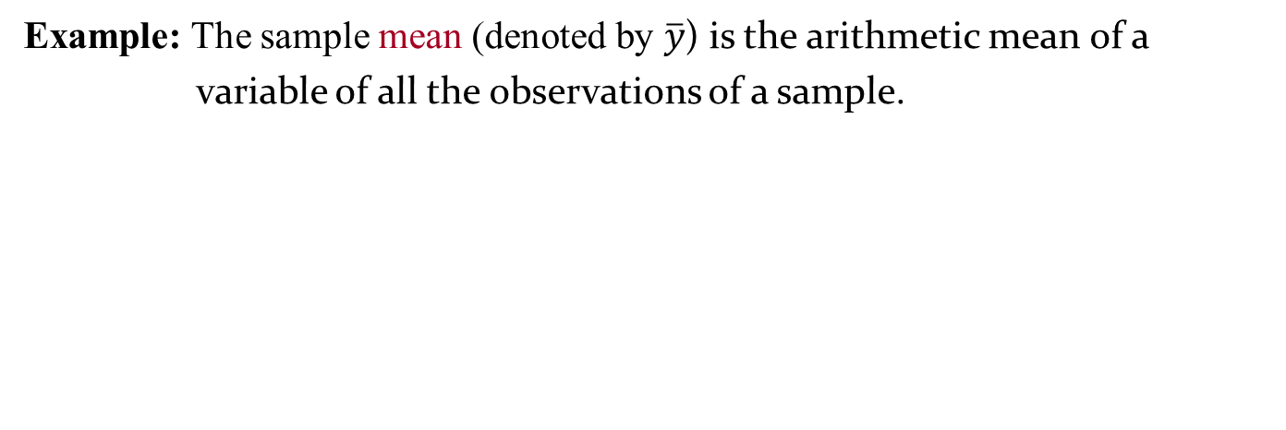
Defining Statistics
A statistics is a quantity calculated from data that describes a particular characteristics of a sample.
Definition 3.4: Statistics
  Example: The sample mean (denoted by $\overline{y}$) is the arithmetic mean of a
  variable of all the observations of a sample.

Slide 10
Defining Statistical Inference
Statistical inference is the process of using sample statistics to make decisions about population.
Definition 3.5: Statistical inference
  Example: In the context of TRP
    Overall frequency of the various levels of happiness.
    Is there a relationship between the age of a viewers and his/her general happiness?
    Is there a relationship between the age of the viewer and the number of TV hours watched?

Slide 11
Data Summarization
  To identify the typical characteristics of data (i.e., to have an overall picture).
  To identify which data should be treated as noise or outliers.
  The data summarization techniques can be classified into two broad categories:
      Measures of location
      Measures of dispersion

Slide 12
Measurement of location
  It is also alternatively called as measuring the central tendency.
    A function of the sample values that summarizes the location information into a single number is known as a measure of location.
  The most popular measures of location are
        Mean
        Median
        Mode
        Midrange
  These can be measured in three ways
      Distributive measure
      Algebraic measure
      Holistic measure

Slide 13
Distributive measure
  It is a measure (i.e., function) that can be computed for a given data set by partitioning the data into smaller subsets, computing the measure for each subset, and then merging the results in order to arrive at the measure’s value for the original (i.e., entire) data set.
  Example
    sum(), count()

Slide 14
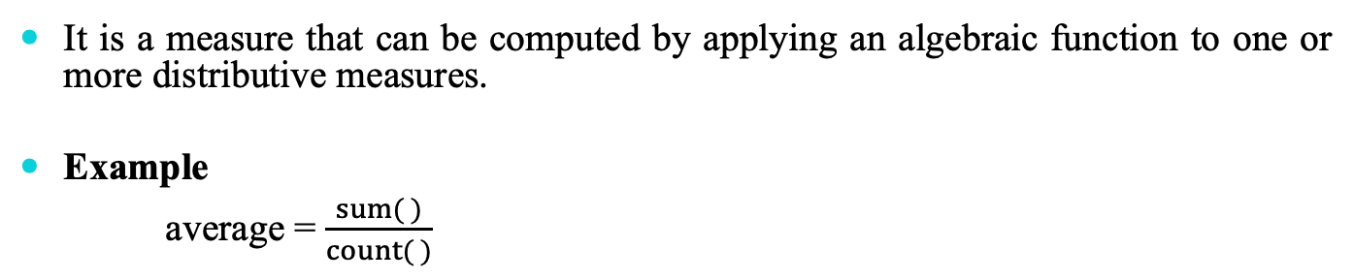
Algebraic measure
  It is a measure that can be computed by applying an algebraic function to one or more distributive measures.
  Example
    average = $\frac{sum( )}{count( )}$

Slide 15
Holistic measure
  It is a measure that must be computed on the entire data set as a whole.
  Example
    Calculating median
    What about mode?

Slide 16
Arithmetic Mean

Slide 17
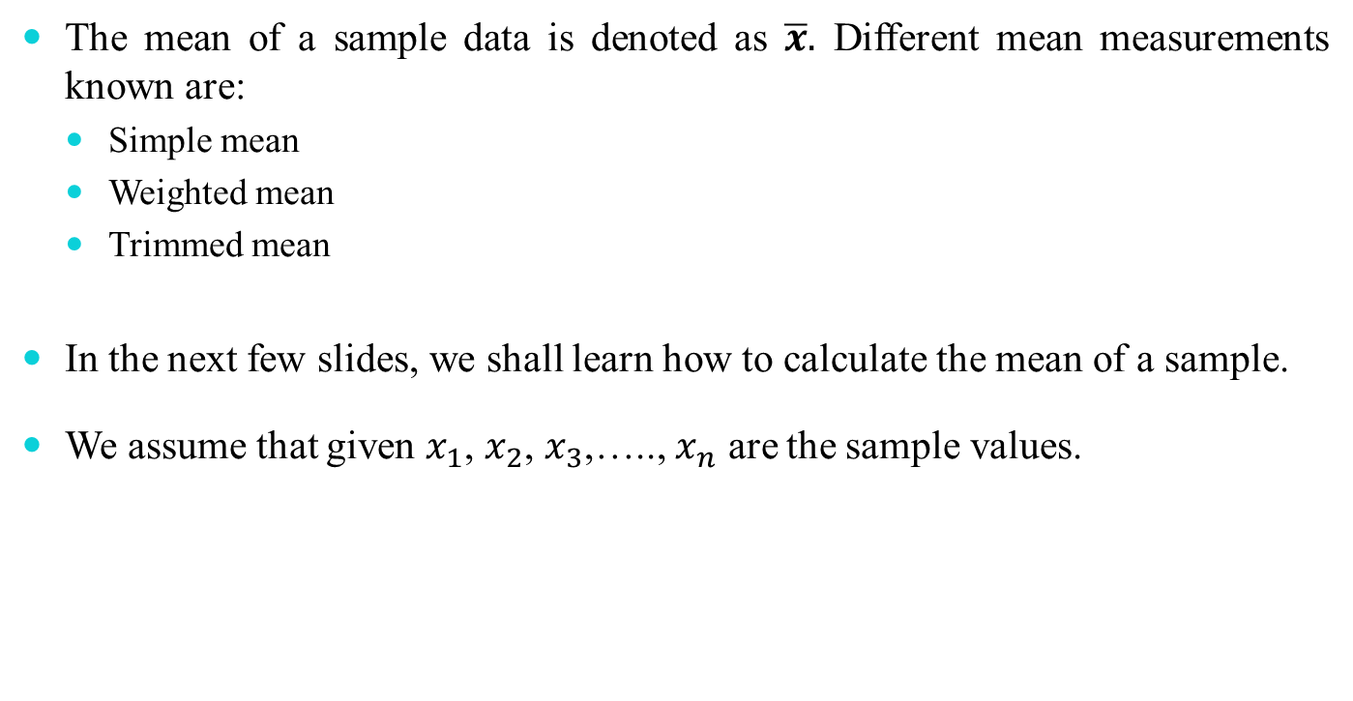
Mean of a sample
  The mean of a sample data is denoted as $\overline{x}.$ Different mean measurements known are:
    Simple mean
    Weighted mean
    Trimmed mean
  In the next few slides, we shall learn how to calculate the mean of a sample.
  We assume that given $x_{1}$, $x_{2}$, $x_{3}$,….., $x_{n}$ are the sample values.

Slide 18
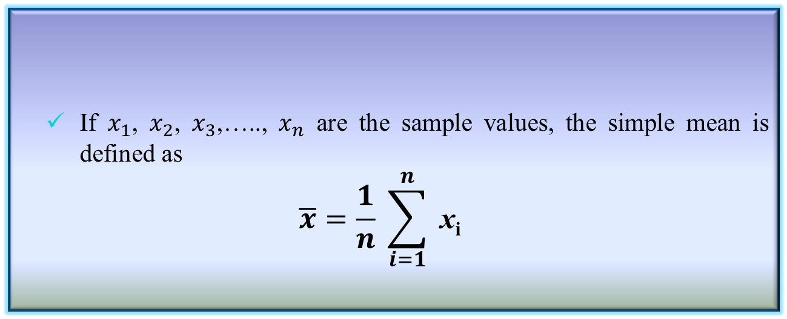
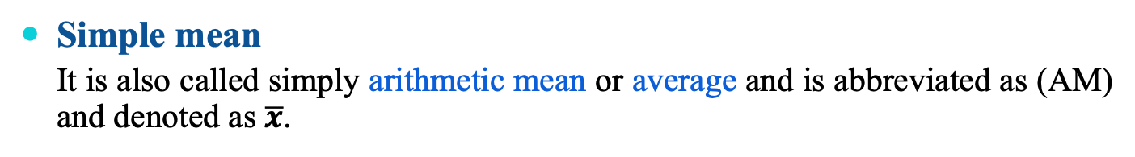
Simple mean of a sample
  Simple mean
    It is also called simply arithmetic mean or average and is abbreviated as (AM) and denoted as $\overline{x}$.
    If $x_{1}$, $x_{2}$, $x_{3}$,….., $x_{n}$ are the sample values, the simple mean is defined as
    $$\overline{x}=\frac{1}{n} \sum_{i=1}^{n}{ \text{x}\text{i}}$$
Definition 3.6: Simple mean

Slide 19
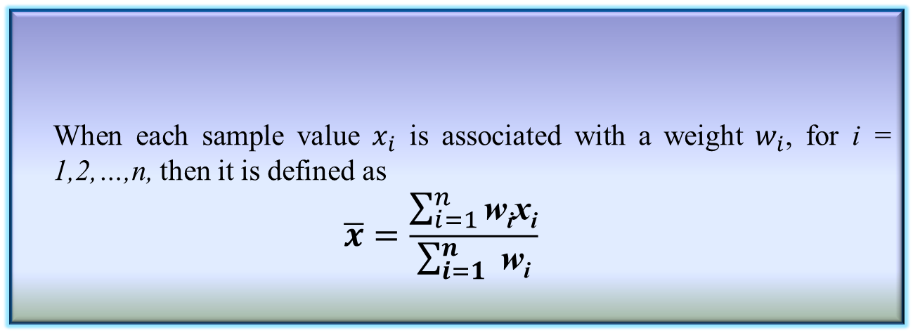
Weighted mean of a sample
  Weighted mean
    It is also called weighted arithmetic mean or weighted average.
    When each sample value $x_{i}$ is associated with a weight $w_{i}$, for i = 1,2,…,n, then it is defined as
    $$\overline{x}=\frac{\sum_{i=1}^{n}{\text{w}\text{i}\text{x}\text{i}}}{\sum_{i=1}^{n}{ \text{w}\text{i}}}$$
Definition 3.7: Weighted mean
  Note
    When all weights are equal, the weighted mean reduces to simple mean.

Slide 20
Trimmed mean of a sample
  Trimmed Mean
    If there are extreme values (also called outlier) in a sample, then the mean is influenced greatly by those values. To offset the effect caused by those extreme values, we can use the concept of trimmed mean
    Trimmed mean is defined as the mean obtained after chopping off values at the high and low extremes.
Definition 3.8: Trimmed mean

Slide 21
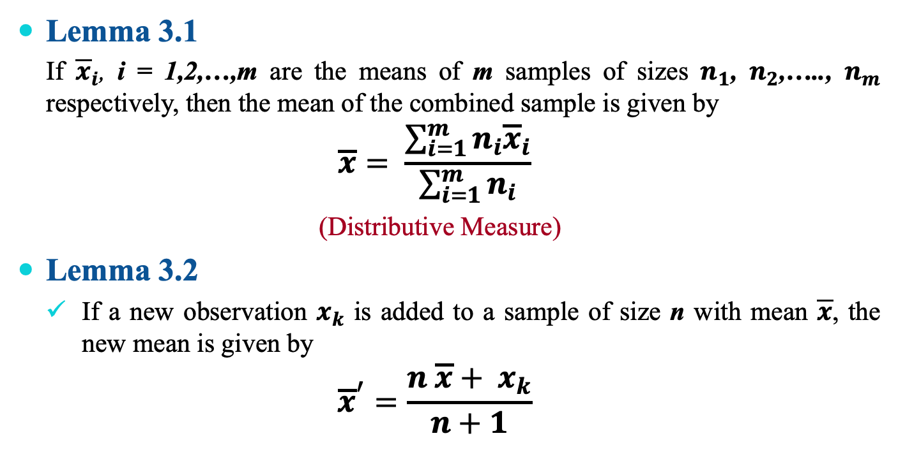
Properties of mean
  Lemma 3.1
    If ${\overline{x}}_{i}$, i = 1,2,…,m are the means of m samples of sizes $n_{1}$, $n_{2}$,….., $n_{m}$ respectively, then the mean of the combined sample is given by
    $$\overline{x}= \frac{\sum_{i=1}^{m}{n_{i}{\overline{x}}_{i}}}{\sum_{i=1}^{m}{n_{i}}}$$
    (Distributive Measure)
  Lemma 3.2
    If a new observation $x_{k}$ is added to a sample of size n with mean $\overline{x}$, the new mean is given by
    $${\overline{x}}^{′}=\frac{n \overline{x}+ x_{k}}{n+1}$$

Slide 22
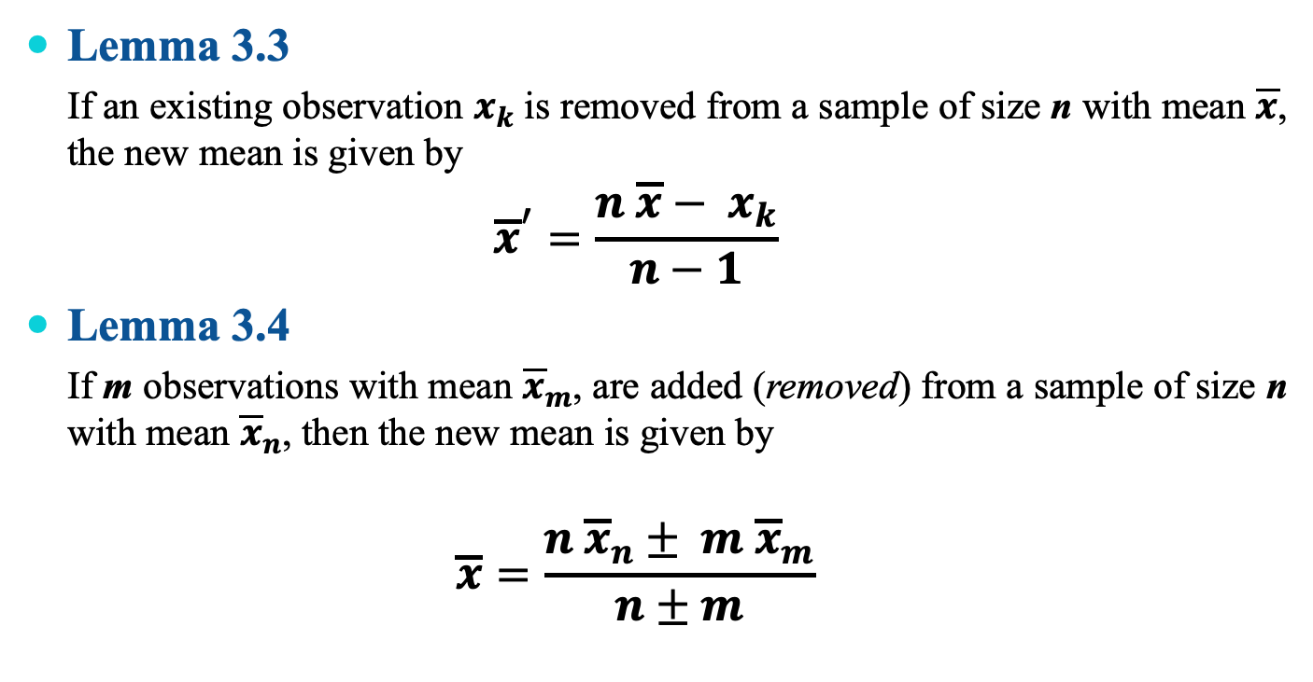
Properties of mean
  Lemma 3.3
    If an existing observation $x_{k}$ is removed from a sample of size n with mean $\overline{x}$, the new mean is given by
    $${\overline{x}}^{′}=\frac{n \overline{x}− x_{k}}{n−1}$$
  Lemma 3.4
    If m observations with mean ${\overline{x}}_{m}$, are added (removed) from a sample of size n with mean ${\overline{x}}_{n}$, then the new mean is given by
    $$\overline{x}=\frac{n {\overline{x}}_{n}± m {\overline{x}}_{m}}{n±m}$$

Slide 23
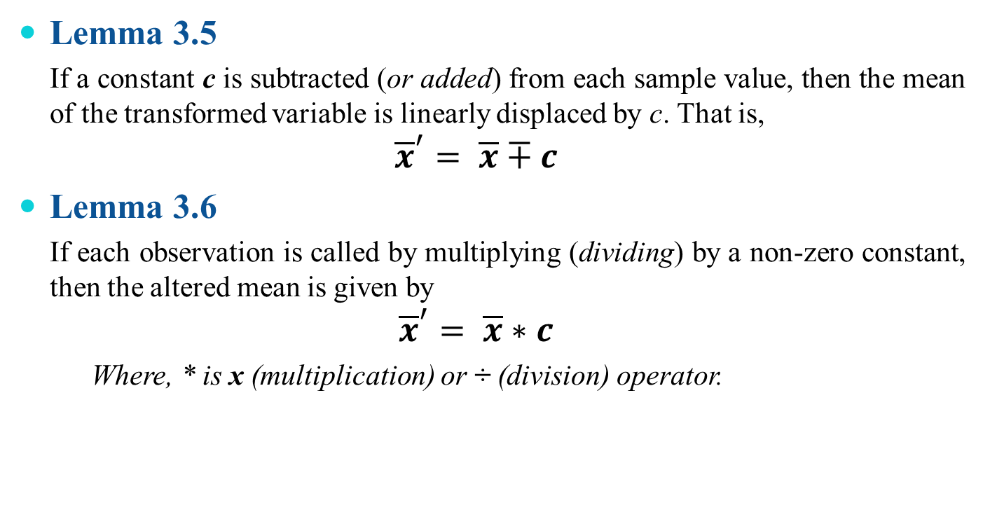
Properties of mean
  Lemma 3.5
    If a constant c is subtracted (or added) from each sample value, then the mean of the transformed variable is linearly displaced by c. That is,
    $${\overline{x}}^{′}= \overline{x}∓c$$
  Lemma 3.6
    If each observation is called by multiplying (dividing) by a non-zero constant, then the altered mean is given by
    $${\overline{x}}^{′}= \overline{x}∗c$$
    Where, * is x (multiplication) or ÷ (division) operator.

Slide 24
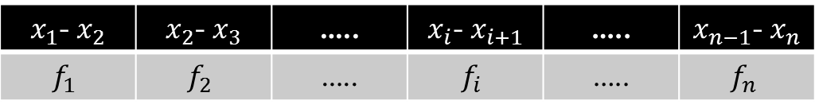
Mean with grouped data
    Sometimes data is given in the form of classes and frequency for each class.
    Class →
    Frequency →
$x_{1}$- $x_{2}$ | $x_{2}$- $x_{3}$ | ….. | $x_{i}$- $x_{i+1}$ | ….. | $x_{n−1}$- $x_{n}$
$$f_{1}$$ | $$f_{2}$$ | ….. | $$f_{i}$$ | ….. | $$f_{n}$$
  There three methods to calculate the mean of such a grouped data.
    Direct method
    Assumed mean method
    Step deviation method

Slide 25
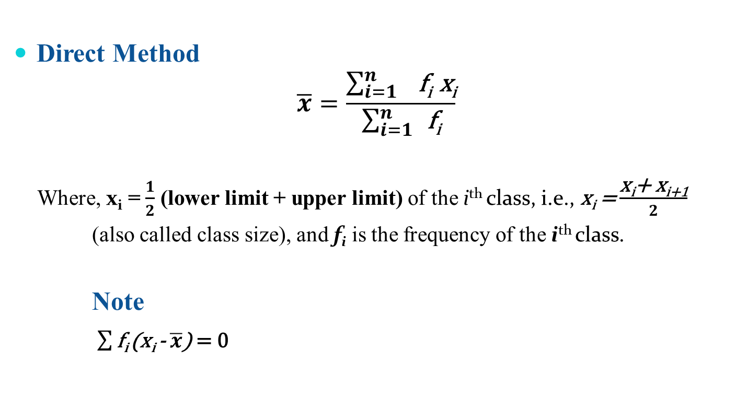
Direct method
    Direct Method
    $$\overline{x}=\frac{\sum_{i=1 }^{n}{\text{f}\text{i} \text{x}\text{i}}}{\sum_{i=1}^{n}{ }\text{f}\text{i}}$$
      Where, $\text{x}\text{i}$ = $\frac{1}{2}$ (lower limit + upper limit) of the i^{th} class, i.e., $\text{x}\text{i}$ = $\frac{\text{x}\text{i}\text{+ }\text{x}\text{i}\text{+1}}{2}$
      (also called class size), and $\text{f}\text{i}$ is the frequency of the i^{th} class.
      Note
      $\sum{\text{f}\text{i} }$($\text{x}\text{i}$ - $\overline{x}$) = 0

Slide 26
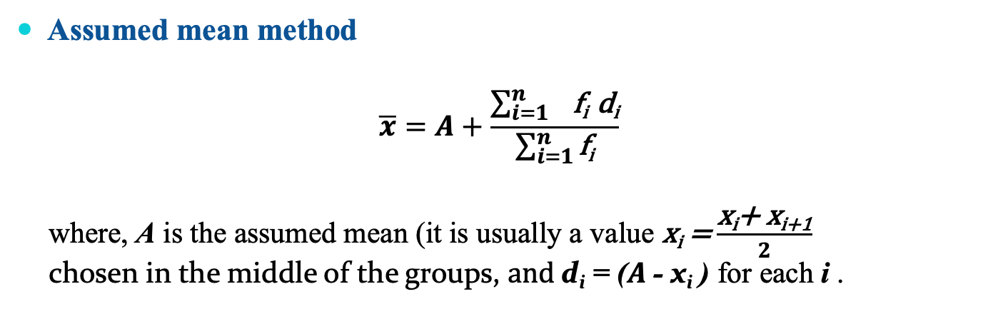
Assumed mean method
    Assumed mean method
    $$\overline{x}=A+\frac{\sum_{i=1 }^{n}{\text{f}\text{i} \text{d}\text{i}}}{\sum_{i=1}^{n}{\text{f}\text{i}}}$$
      where, A is the assumed mean (it is usually a value $\text{x}\text{i}$ = $\frac{\text{x}\text{i}\text{+ }\text{x}\text{i}\text{+1}}{2}$
      chosen in the middle of the groups, $and \text{d}\text{i}$ = ($A$- $\text{x}\text{i}$ ) for each i .

Slide 27
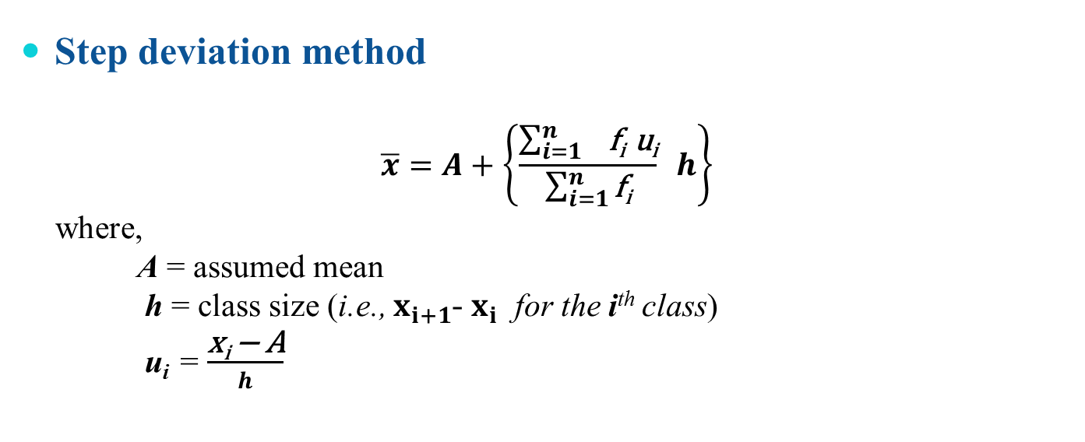
Step deviation method
    Step deviation method
    $$\overline{x}=A+\left\{\frac{\sum_{i=1 }^{n}{\text{f}\text{i} \text{u}\text{i}}}{\sum_{i=1}^{n}{\text{f}\text{i}}} h\right\}$$
      where,
      A = assumed mean
      h = class size (i.e., $x_{i+1}$- $x_{i}$ for the i^{th} class)
      u_{i} = $\frac{\text{x}\text{i} \text{−} \text{A}}{h}$

Slide 28
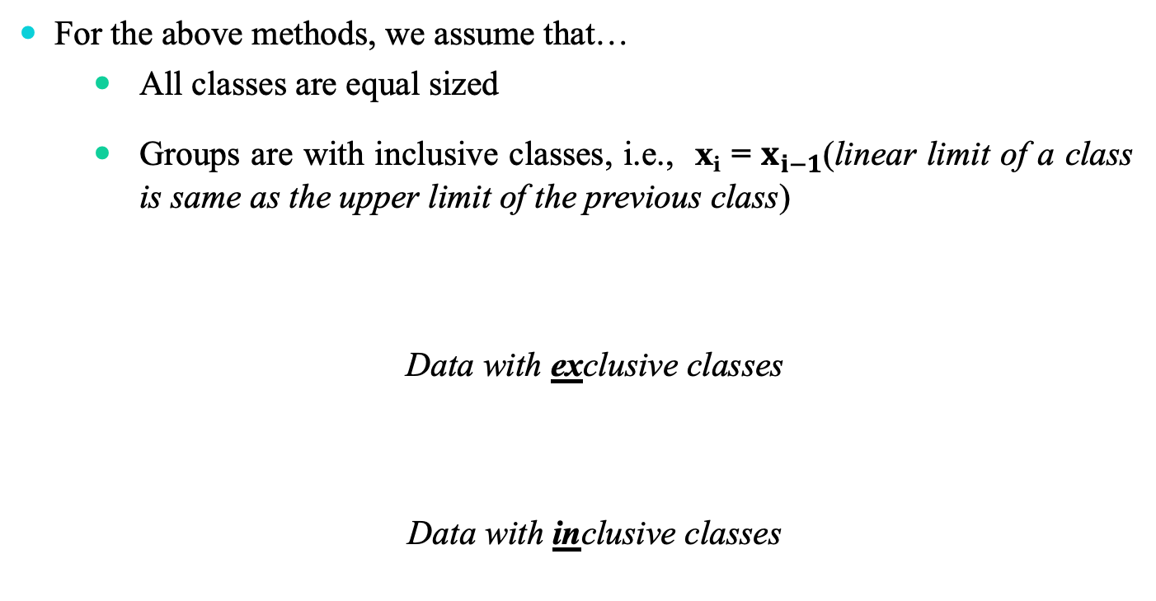
Mean for a group of data
    For the above methods, we assume that…
        All classes are equal sized
        Groups are with inclusive classes, i.e., $\text{x}\text{i}$ = $x_{i−1}$(linear limit of a class is same as the upper limit of the previous class)
      Data with exclusive classes
      Data with inclusive classes
10 - 19 | 20 - 29 | 30 - 39 | $$\text{4}\text{0 − }\text{4}\text{9}$$
9.5 – 19.5 | 19.5 – 29.5 | 29.5 – 39.5 | $$\text{39}\text{.5 – }\text{4}\text{9.5}$$

Slide 29
Ogive: Graphical method to find mean
    Ogive (pronounced as O-Jive) is a cumulative frequency polygon graph.
        When cumulative frequencies are plotted against the upper (lower) class limit, the plot resembles one side of an Arabesque or ogival architecture, hence the name.
        There are two types of Ogive plots
          Less-than (upper class versus cumulative frequency)
          More than (lower class versus cumulative frequency)
    Example:
    Suppose, there is a data relating the marks obtained by 200 students in an examination
    444, 412, 478, 467, 432, 450, 410, 465, 435, 454, 479, …….
    (Further, suppose it is observed that the minimum and maximum marks are 410, 479, respectively.)

Slide 30
Ogive: Cumulative frequency table
    444, 412, 478, 467, 432, 450, 410, 465, 435, 454, 479, …….
    Step 1: Draw a cumulative frequency table
Marks | Conversion into exclusive series | No. of students | Cumulative Frequency
(x) |  | (f) | (C.M)
410-419 | 409.5-419.5 | 14 | 14
420-429 | 419.5-429.5 | 20 | 34
430-439 | 429.5-439.5 | 42 | 76
440-449 | 439.5-449.5 | 54 | 130
450-459 | 449.5-459.5 | 45 | 175
460-469 | 459.5-469.5 | 18 | 193
470-479 | 469.5-479.5 | 7 | 200

Slide 31
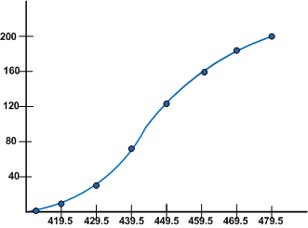
Ogive: Graphical method to find mean
Marks | Conversion into exclusive series | No. of students | Cumulative Frequency
(x) |  | (f) | (C.M)
410-419 | 409.5-419.5 | 14 | 14
420-429 | 419.5-429.5 | 20 | 34
430-439 | 429.5-439.5 | 42 | 76
440-449 | 439.5-449.5 | 54 | 130
450-459 | 449.5-459.5 | 45 | 175
460-469 | 459.5-469.5 | 18 | 193
470-479 | 469.5-479.5 | 7 | 200
    Step 2: Less-than Ogive graph
Upper class | Cumulative Frequency
Less than 419.5 | 14
Less than 429.5 | 34
Less than 439.5 | 76
Less than 449.5 | 130
Less than 459.5 | 175
Less than 469.5 | 193
Less than 479.5 | 200

Slide 32
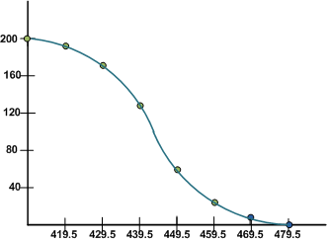
Ogive: Graphical method to find mean
Marks | Conversion into exclusive series | No. of students | Cumulative Frequency
(x) |  | (f) | (C.M)
410-419 | 409.5-419.5 | 14 | 14
420-429 | 419.5-429.5 | 20 | 34
430-439 | 429.5-439.5 | 42 | 76
440-449 | 439.5-449.5 | 54 | 130
450-459 | 449.5-459.5 | 45 | 175
460-469 | 459.5-469.5 | 18 | 193
470-479 | 469.5-479.5 | 7 | 200
    Step 3: More-than Ogive graph
Lower class | Cumulative Frequency
More than 409.5 | 200
More than 419.5 | 186
More than 429.5 | 166
More than 439.5 | 124
More than 449.5 | 70
More than 459.5 | 25
More than 469.5 | 7

Slide 33
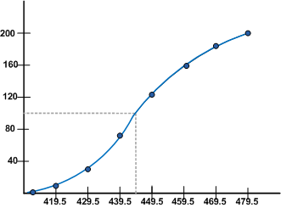

Information from Ogive
    Mean from Less-than Ogive
    Mean from More-than Ogive
    A % C freq of .65 for the third class 439.5.....449.5 means that 65% of all scores are found in this class or below.

Slide 34
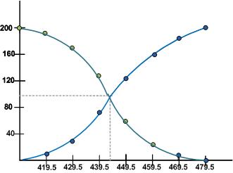
Information from Ogive
Less-than and more-than Ogive approach
A cross point of two Ogive plots gives the mean of the sample

Slide 35
Some other measures of mean
    There are three mean measures of location:
        Arithmetic Mean (AM)
        Geometric mean (GM)
        Harmonic mean (HM)
        These three means are called Pythagorean means

Slide 36
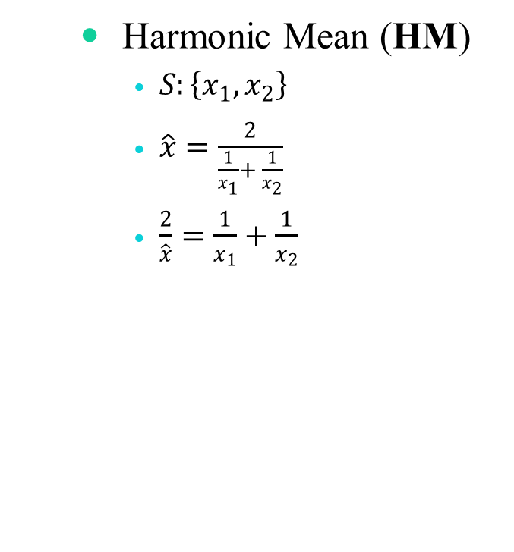
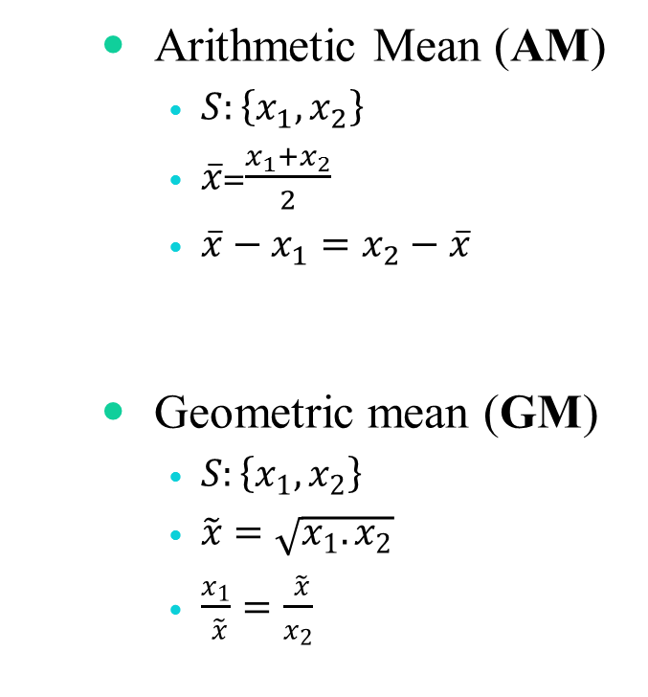
Some other measures of mean
        Arithmetic Mean (AM)
      $S:\left\{x_{1},x_{2}\right\}$
      $\overline{x}$=$\frac{x_{1}+x_{2}}{2}$
      $\overline{x}−x_{1}=x_{2}−\overline{x}$
        Geometric mean (GM)
      $S:\left\{x_{1},x_{2}\right\}$
      $\tilde{x}=\sqrt{x_{1}.x_{2}}$
      $\frac{x_{1}}{ \tilde{x}}=\frac{ \tilde{x}}{x_{2}}$
        Harmonic Mean (HM)
      $S:\left\{x_{1},x_{2}\right\}$
      $\hat{x}=\frac{2}{\frac{1}{x_{1}}+ \frac{1}{x_{2}}}$
      $\frac{2}{\hat{x}}=\frac{1}{x_{1}}+\frac{1}{x_{2}}$

Slide 37
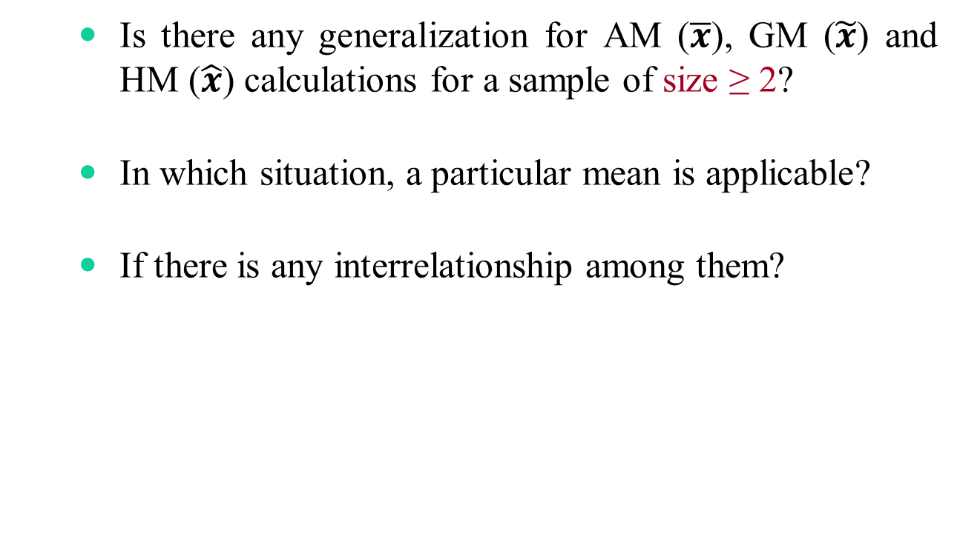
???
        Is there any generalization for AM ($\overline{x}$), GM ($\tilde{x}$) and HM ($\hat{x}$) calculations for a sample of size ≥ 2?
        In which situation, a particular mean is applicable?
        If there is any interrelationship among them?

Slide 38
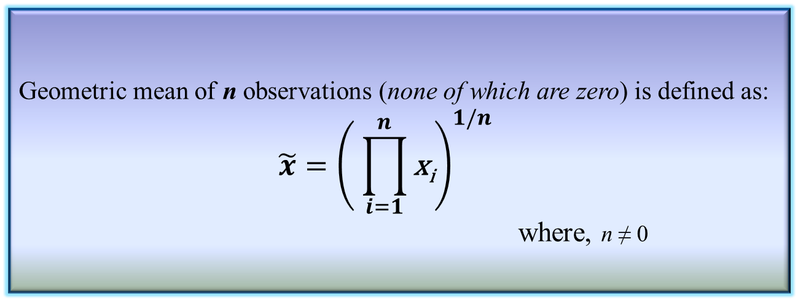
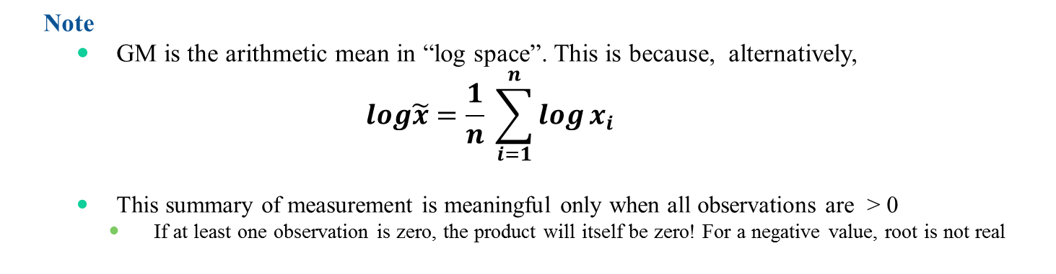
Geometric mean
    Geometric mean of n observations (none of which are zero) is defined as:
      $$\tilde{x}={\left( \prod_{i=1}^{n}{\text{x}\text{i}}\right)}^{1/n}$$
      where, n ≠ 0
Definition 3.9: Geometric mean
      Note
        GM is the arithmetic mean in “log space”. This is because, alternatively,
        $$log\tilde{x}=\frac{1}{n} \sum_{i=1}^{n}{\log{x_{i}} }$$
        This summary of measurement is meaningful only when all observations are > 0
          If at least one observation is zero, the product will itself be zero! For a negative value, root is not real

Slide 39
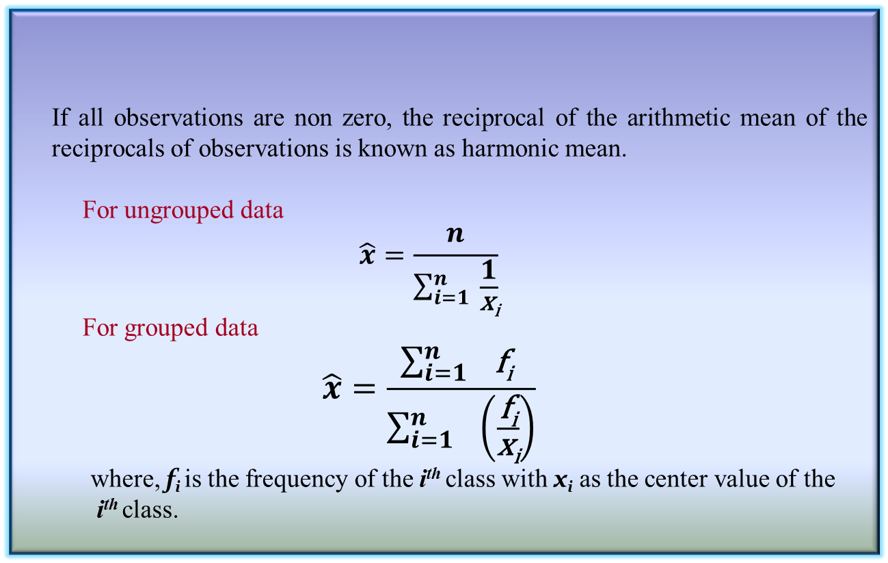
Harmonic mean
      If all observations are non zero, the reciprocal of the arithmetic mean of the reciprocals of observations is known as harmonic mean.
        For ungrouped data
      $$\hat{x}=\frac{n}{\sum_{i=1}^{n}{ \frac{1}{\text{x}\text{i}}}}$$
        For grouped data
      $$\hat{x}=\frac{\sum_{i=1 }^{n}{\text{f}\text{i} }}{\sum_{i=1}^{n}{ }\left(\frac{\text{f}\text{i}}{\text{x}\text{i}}\right)}$$
      where, $\text{f}\text{i}$is the frequency of the i^{th} class with $\text{x}\text{i}$ as the center value of the
      i^{th} class.
Definition 3.10: Harmonic mean

Slide 40
Usefulness of different means

Slide 41
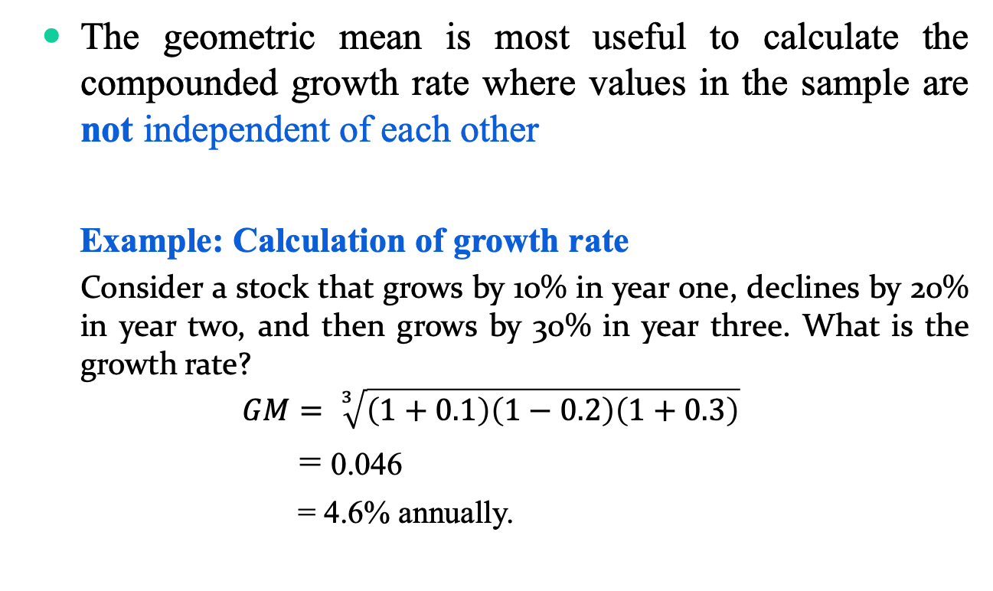
Applications of GM
        The geometric mean is most useful to calculate the compounded growth rate where values in the sample are not independent of each other
        Example: Calculation of growth rate
      Consider a stock that grows by 10% in year one, declines by 20% in year two, and then grows by 30% in year three. What is the growth rate?
      $$GM= \sqrt[3]{\left(1+0.1\right)\left(1−0.2\right)\left(1+0.3\right)}$$
      = 0.046
      = 4.6% annually.

Slide 42
Applications of GM
        Other some applications:
          if values tend to make large fluctuations.
          when the values that are multiplied together are exponential value
            the statistical rates of human population growth in consecutive 10 or 20 years, etc.
Why Geometric Mean is “geometric”?

Slide 43
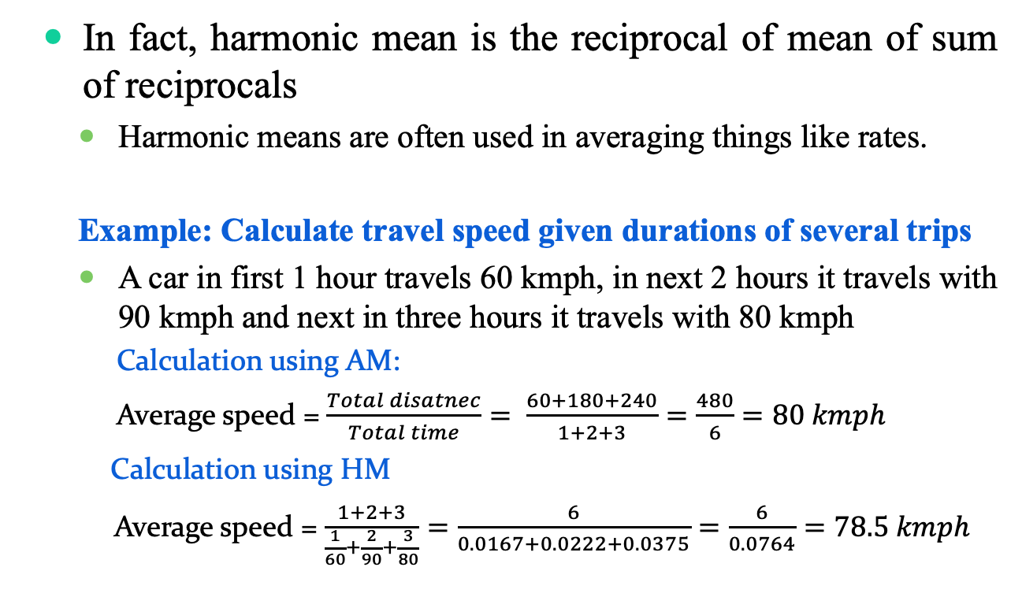
Applications of HM
        In fact, harmonic mean is the reciprocal of mean of sum of reciprocals
          Harmonic means are often used in averaging things like rates.
          Example: Calculate travel speed given durations of several trips
          A car in first 1 hour travels 60 kmph, in next 2 hours it travels with 90 kmph and next in three hours it travels with 80 kmph
Calculation using AM:
Average speed = $\frac{Total disatnec}{Total time}= \frac{60+180+240}{1+2+3}=\frac{480}{6}=80 kmph$
          Calculation using HM
          Average speed = $\frac{1+2+3}{\frac{1}{60}+\frac{2}{90}+\frac{3}{80}}=\frac{6}{0.0167+0.0222+0.0375}=\frac{6}{0.0764}=78.5 kmph$

Slide 44
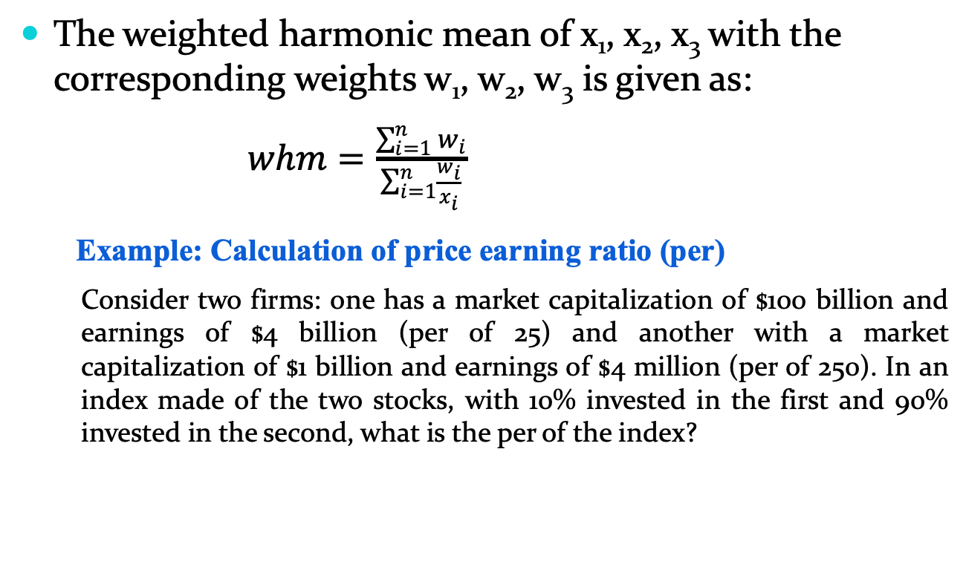
Applications of weighted HM
The weighted harmonic mean of x₁, x₂, x₃ with the corresponding weights w₁, w₂, w₃ is given as:
$whm=\frac{\sum_{i=1}^{n}{w_{i}}}{\sum_{i=1}^{n}{\frac{w_{i}}{x_{i}}}}$
Example: Calculation of price earning ratio (per)
          Consider two firms: one has a market capitalization of $100 billion and earnings of $4 billion (per of 25) and another with a market capitalization of $1 billion and earnings of $4 million (per of 250). In an index made of the two stocks, with 10% invested in the first and 90% invested in the second, what is the per of the index?

Slide 45
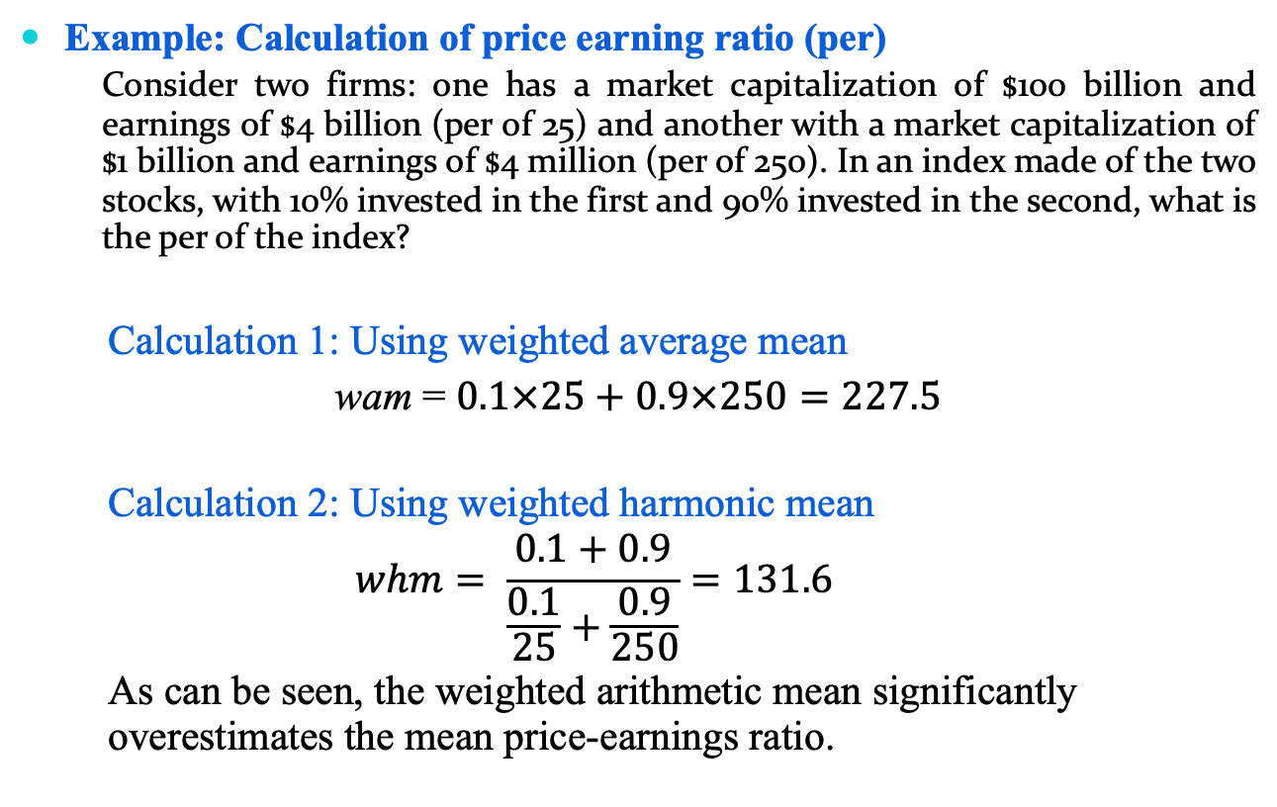
Applications of weighted HM
Example: Calculation of price earning ratio (per)
          Consider two firms: one has a market capitalization of $100 billion and earnings of $4 billion (per of 25) and another with a market capitalization of $1 billion and earnings of $4 million (per of 250). In an index made of the two stocks, with 10% invested in the first and 90% invested in the second, what is the per of the index?
Calculation 1: Using weighted average mean
wam = $0.1×25+0.9×250=227.5$
Calculation 2: Using weighted harmonic mean
$$whm= \frac{0.1+0.9}{\frac{0.1}{25}+\frac{0.9}{250}}=131.6$$
As can be seen, the weighted arithmetic mean significantly overestimates the mean price-earnings ratio.

Slide 46
Other way of using means

Slide 47
Different mean calculations
    Let us consider a sample which considers two things
        Observation
        Range
    Example: Rainfall data
        Here, rainfall is the observation and day is the range for each element in the sample
        Here, we are to measure the mean “rate of rainfall” as the measure of location
Rainfall (in mm) | r₁ | r₂ | … | r_{n}
Days (in number) | d₁ | d₂ | … | d_{n}

Slide 48
Different mean calculations
    Case 1: Range remains same for each observation
    Example: Having data about amount of rainfall per week, say.
Rainfall (in mm) | 35 | 18 | … | 22
Days (in number) | 7 | 7 | … | 7

Slide 49
Significant of different mean calculations
    Case 2: Ranges are different, but observation remains same
    Example: Same amount of rainfall in different number of days, say.
Rainfall (in mm) | 50 | 50 | … | 50
Days (in number) | 1 | 4 | … | 7

Slide 50
Different mean calculations
    Case 3: Ranges are different, as well as the observations
    Example: Different amount of rainfall in different number of days, say.
Rainfall (in mm) | 21 | 34 | … | 18
Days (in number) | 5 | 3 | … | 7

Slide 51

Rule of thumbs for means
    AM: When the range remains same for each observation
      Example: Case 1
Rainfall (in mm) | 35 | 18 | … | 22
Days (in number) | 7 | 7 | … | 7
$$\overline{x}=\frac{1}{n}\sum_{1}^{n}{x_{i}}$$

Slide 52


Rule of thumbs for means
    HM: When the range is different but each observation is same
      Example: Case 2
Rainfall (in mm) | 50 | 50 | … | 50
Days (in number) | 1 | 4 | … | 7
$$\tilde{x}=\frac{n}{\sum_{1}^{n}{\frac{1}{x_{i}}}}$$
$$x_{i}=\frac{r_{i}}{d_{i}}$$
Here,

Slide 53

Rule of thumbs for means
    GM: When the ranges are different as well as the observations
      Example: Case 3
Rainfall (in mm) | 21 | 34 | … | 18
Days (in number) | 5 | 3 | … | 7
$$\hat{x}={\left(\prod_{1}^{n}{x_{i}}\right)}^{\frac{1}{n}}$$
$$x_{i}=r_{i}×d_{i}$$
where

Slide 54
Key takeaways
    The important things to recognize is that all three means are simply the arithmetic means in disguise!
    Each mean follows the “additive structure”.
      Suppose, we are given some abstract quantities {x₁, x₂, …, x_{n}}
      Each of the three means can be obtained with the following steps
        Transform each x_{i} into some y_{i}
        Taking the arithmetic mean of all y_{i}’s
        Transforming back the to the original scale of measurement

Slide 55
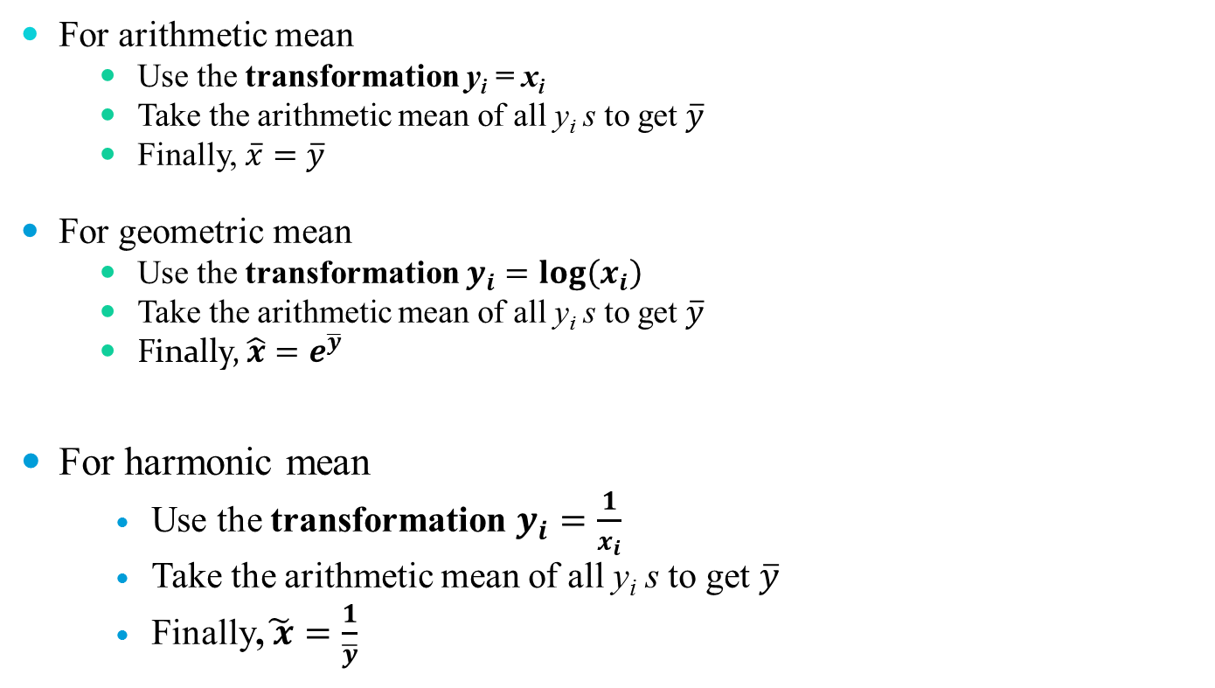
Key takeaways
    For arithmetic mean
        Use the transformation y_{i} = x_{i}
        Take the arithmetic mean of all y_{i} s to get $\overline{y}$
        Finally, $\overline{x}=\overline{y}$
    For geometric mean
        Use the transformation $y_{i}=log\left(x_{i}\right)$
        Take the arithmetic mean of all y_{i} s to get $\overline{y}$
        Finally, $\hat{x}=e^{\overline{y}}$
    For harmonic mean
    Use the transformation $y_{i}=\frac{1}{x_{i}}$
    Take the arithmetic mean of all y_{i} s to get $\overline{y}$
    Finally,$\tilde{ x}=\frac{1}{\overline{y}}$

Slide 56
Key takeaways
    All mean calculations are applicable to a set of data in a sample.
    In general, you can observe that
    If your sample contains all values which are same (i.e., invariant), then
    Apply AM, to find summary mean when data are in a normalized, GM to find growth rate and HM to find the summary mean when data are not normalized.
    AM ≥ GM ≥ HM
    AM = GM = HM

Slide 57
Median calculation

Slide 58
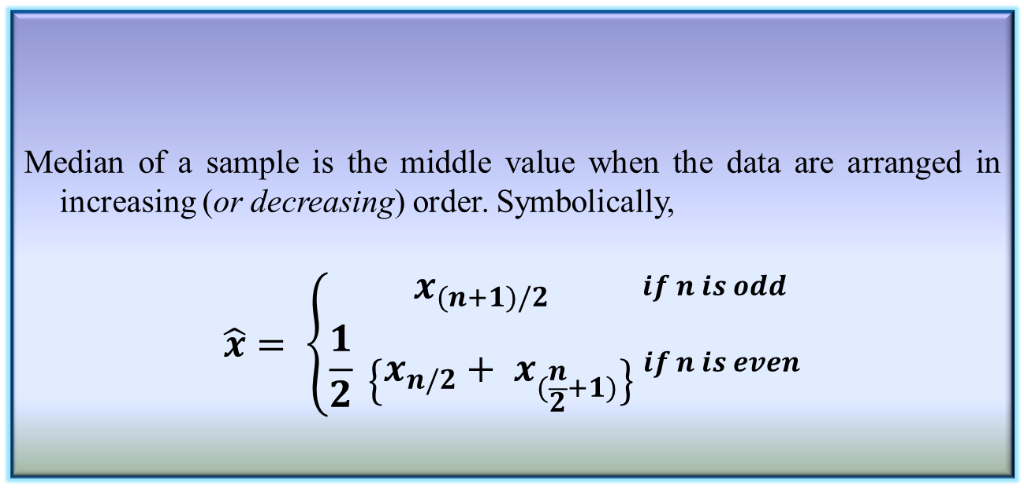
Median of a sample
  Median of a sample is the middle value when the data are arranged in increasing (or decreasing) order. Symbolically,
    $$\hat{x}= \left\{\begin{aligned}x_{(n+1)/2} \\ \frac{1}{2} \left\{x_{n/2}+ x_{(\frac{n}{2}+1)}\right\}\end{aligned}\right. _{if n is even}^{\begin{aligned}if n is odd \\ \\ \end{aligned}}$$
Definition 3.12: Median of a sample

Slide 59
Calculating median from a set of samples
    Consider the case of three sets of data:
      Set 1: x₁₁, x₁₂, x₁₃, …, x_{1m}
      Set 2: x₂₁, x₂₂, x₂₃, …, x_{2n}
      Set 3: x₃₁, x₃₂, x₃₃, …, x_{3p}
What is median?
Calculate in a memory-constrained computing environment.
Distributive/ algebraic/ holistic approach?

Slide 60
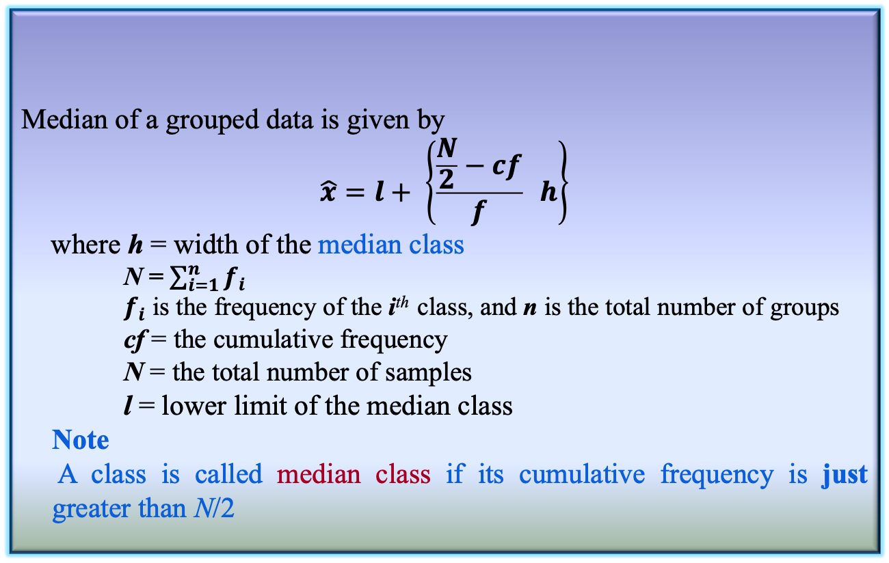
Median of a sample
  Median of a grouped data is given by
    $$\hat{x}=l+ \left\{\frac{\frac{N}{2}−cf}{f} h\right\}$$
    where h = width of the median class
      N = $\sum_{i=1}^{n}{f_{i}}$
      $f_{i}$ is the frequency of the i^{th} class, and n is the total number of groups
      cf = the cumulative frequency
      N = the total number of samples
    l = lower limit of the median class
    Note
    A class is called median class if its cumulative frequency is just greater than N/2
Definition 3.12: Median of a grouped data

Slide 61
Mode calculation

Slide 62
Mode of a sample
  Mode is defined as the observation which occurs most frequently.
  For example, number of wickets obtained by bowler in 10 test matches are as follows.
  1 2 0 3 2 4 1 1 2 2
  In other words, the above data can be represented as:-
  Clearly, the mode here is “2”.
 | 0 | 1 | 2 | 3 | 4
# of matches | 1 | 3 | 4 | 1 | 1

Slide 63
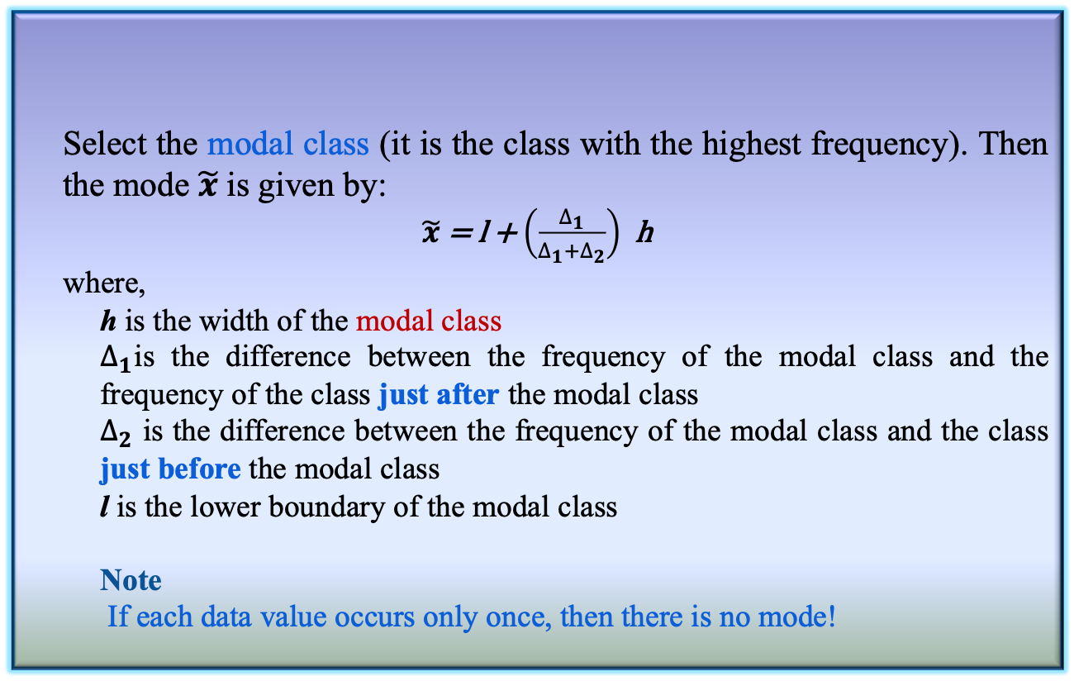
Mode of a grouped data
    Select the modal class (it is the class with the highest frequency). Then the mode $\tilde{x}$ is given by:
  $\tilde{x}$ = l + $\left(\frac{∆_{1}}{∆_{1}+∆_{2}}\right)$ h
    where,
      h is the width of the modal class
      $∆_{1}$is the difference between the frequency of the modal class and the frequency of the class just after the modal class
      $∆_{2}$ is the difference between the frequency of the modal class and the class just before the modal class
      l is the lower boundary of the modal class
      Note
      If each data value occurs only once, then there is no mode!
Definition 3.13: Mode of a grouped data

Slide 64
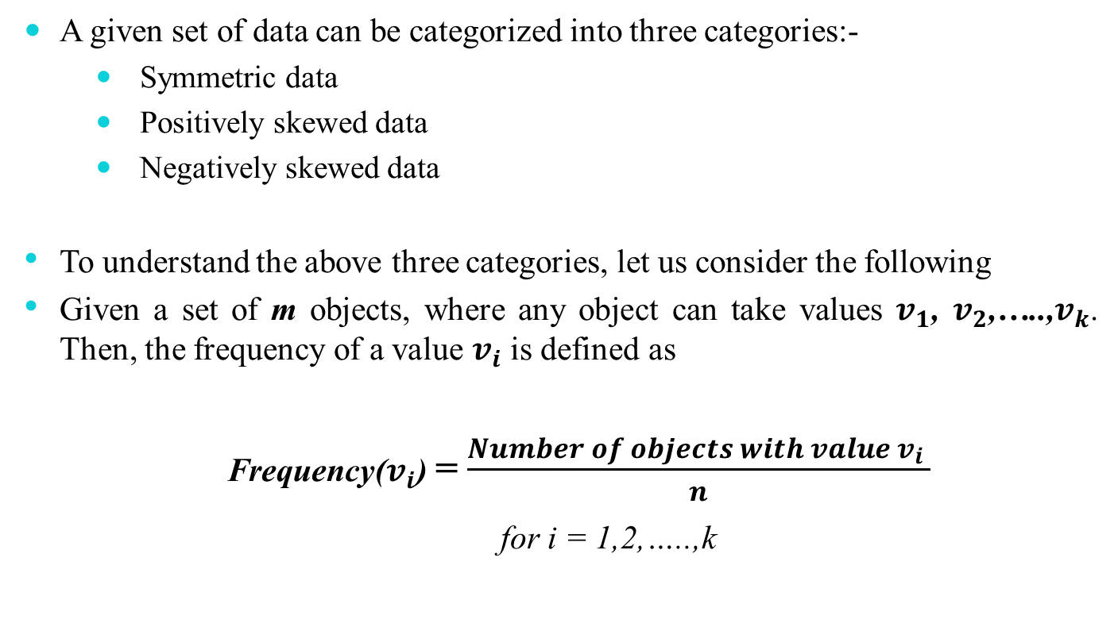
Relation between mean, median and mode
  A given set of data can be categorized into three categories:-
      Symmetric data
      Positively skewed data
      Negatively skewed data
    To understand the above three categories, let us consider the following
    Given a set of m objects, where any object can take values $v_{1}$, $v_{2}$,…..,$v_{k}$. Then, the frequency of a value $v_{i}$ is defined as
    Frequency($v_{i}$) = $\frac{Number of objects with value{ v}_{i} }{n}$
  for i = 1,2,…..,k

Slide 65
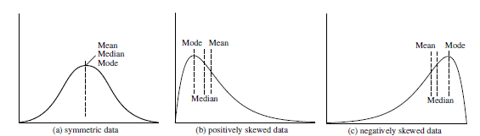
Symmetric data
  For symmetric data, all mean, median and mode lie at the same point

Slide 66
Positively skewed data
  Here, mode occurs at a value smaller than the median

Slide 67
Negatively skewed data
  Here, mode occurs at a value greater than the median

Slide 68
Empirical Relation!
  How to measure the skewness of data?
  Following is an empirical relation, valid for moderately skewed data
  Mean – Mode = 3 * (Mean – Median)
Skewness = 3 * (mean–median) / standard deviation

Slide 69
Midrange
  It is the trimmed mean of a range of values at the middle in a sample data set.
  Steps for calculating midrange
    A percentage ‘p’ between 0 and 100 is specified.
    The top and bottom of (p/2)% of the data is thrown out.
    The mean is then calculated in the normal way.
  Thus, the median is trimmed mean with p = 100% while the arithmetic mean corresponds to p = 0%
  Note
  Trimmed mean is a special case of Midrange

Slide 70
Measure of dispersion

Slide 71
Measures of dispersion
  Location measure are far too insufficient to understand data.
  Another set of commonly used summary statistics for continuous data are those that measure the dispersion.
  A dispersion measures the extent of spread of observations in a sample.
  Some important measures of dispersion are:
      Range
      Variance and Standard Deviation
      Mean Absolute Deviation (MAD)
      Absolute Average Deviation (AAD)
      Interquartile Range (IQR)

Slide 72
Measures of dispersion
  Example
  Suppose, two samples of fruit juice bottles from two companies A and B. The unit in each bottle is measured in litre.
  Both samples have same mean. However, the bottles from company A with more uniform content than company B.
  We say that the dispersion (or variability) of the observation from the average is less for A than sample B.
    The variability in a sample should display how the observation spread out from the average
    In buying juice, customer should feel more confident to buy it from A than B
Sample A | 0.97 | 1.00 | 0.94 | 1.03 | 1.06
Sample B | 1.06 | 1.01 | 0.88 | 0.91 | 1.14

Slide 73
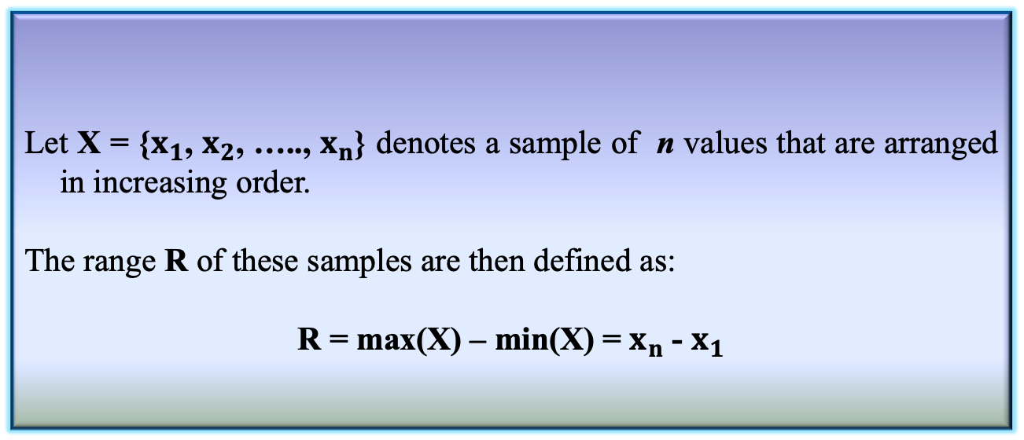
Range of a sample
Definition 3.14: Range of a sample
  Let X = {$x_{1}$, $x_{2}$, ….., $x_{n}$} denotes a sample of n values that are arranged in increasing order.
  The range R of these samples are then defined as:
  R = max(X) – min(X) = $x_{n}$ - $x_{1}$
  Range identifies the maximum spread, it can be misleading if most of the values are concentrated in a narrow band of values, but there are also a relatively small number of more extreme values.
  The variance is another measure of dispersion to deal with such a situation.

Slide 74
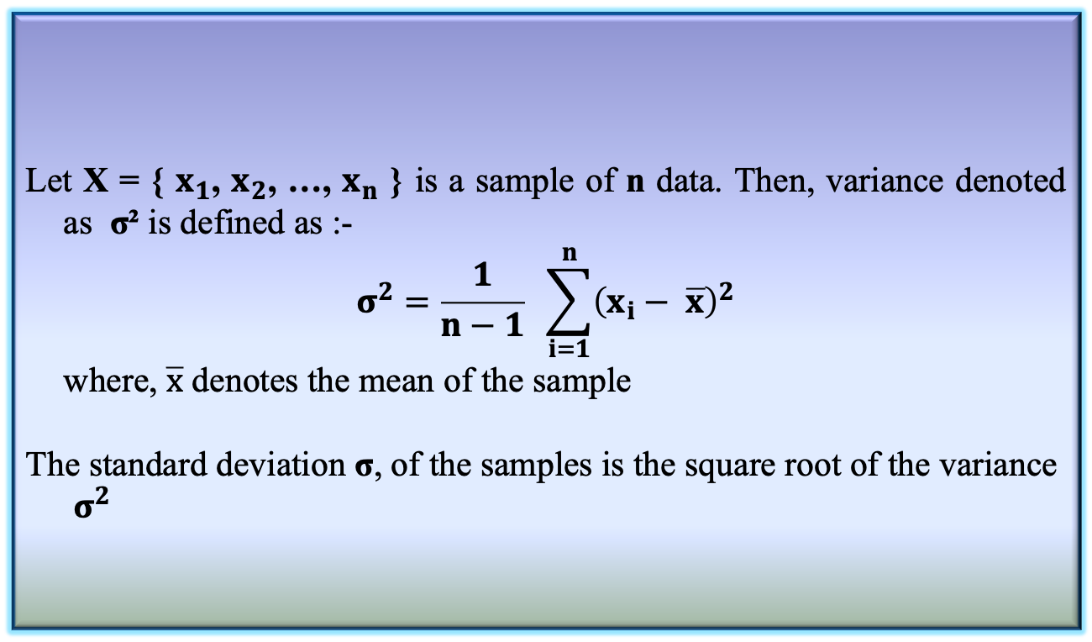
Variance and Standard Deviation
  Let X = { $x_{1}$, $x_{2}$, …, $x_{n}$ } is a sample of n data. Then, variance denoted as σ² is defined as :-
  $$σ^{2}=\frac{1}{n−1} \sum_{i=1}^{n}{{\left(x_{i}− \overline{x}\right)}^{2}}$$
    where, $\overline{x}$ denotes the mean of the sample
  The standard deviation σ, of the samples is the square root of the variance $σ^{2}$
Definition 3.15: Variance and Standard Deviation

Slide 75
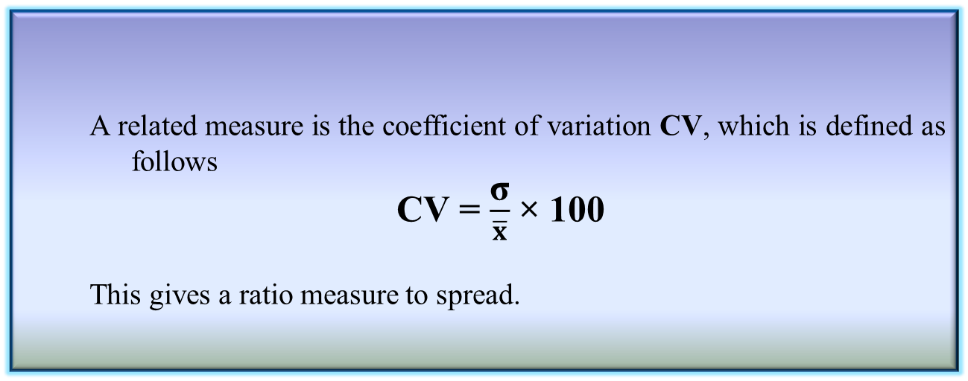
Coefficient variation
  Basic properties
      σ measures spread about mean and should be chosen only when the mean is chosen as the measure of central tendency
      σ = 0 only when there is no spread, that is, when all observations have the same value, otherwise σ > 0
      A related measure is the coefficient of variation CV, which is defined as follows
    CV = $\frac{\text{σ}}{\overline{x}}$ × 100
      This gives a ratio measure to spread.
Definition 3.16: Coefficient of variation

Slide 76
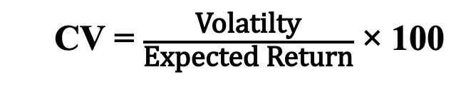
Coefficient variation
  Significance of CV
      It is a statistical measure of the dispersion of data points in a data series around the mean
      CV = p% implies that standard deviation is p% to that of the mean of a sample.
    Example:
      Suppose, there are three series of data representing amount of returns that investors receives from three farms F1, F2 and F3 in a year.
      CV(F1), CV(F2), CV(F3) indicate volatilities/ risks in comparison of return expected from investment
    CV = $\frac{\text{Volatilty}}{\text{Expected} \text{Return}}$ × 100

Slide 77
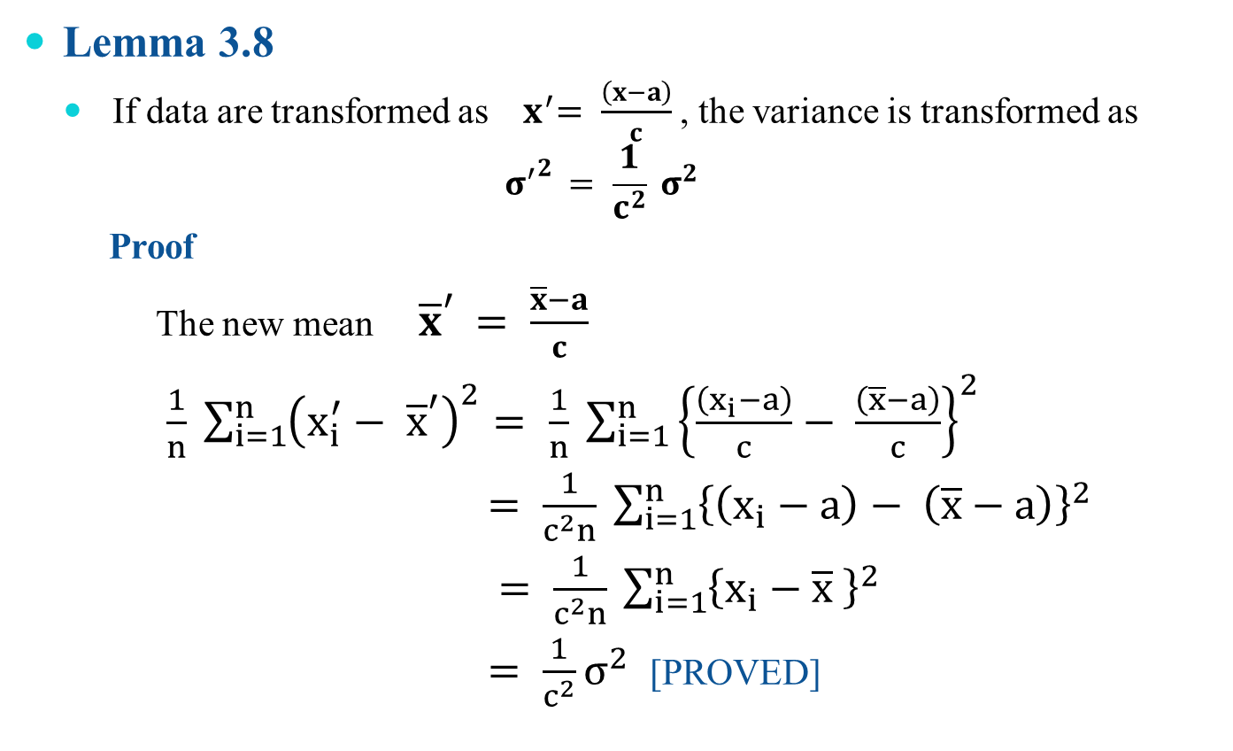
Variance and Standard Deviation
  Lemma 3.8
    If data are transformed as ${ x}^{′}= \frac{\left(x−a\right)}{c}$ , the variance is transformed as
    $${σ^{′}}^{2 }= \frac{1}{c^{2}} σ^{2}$$
    Proof
      The new mean ${\overline{x}}^{′ }= \frac{\overline{x}−a}{c}$
$\frac{1}{n} \sum_{i=1}^{n}{{\left(x_{i}^{′}− {\overline{x}}^{′}\right)}^{2}= \frac{1}{n}} \sum_{i=1}^{n}{{\left\{\frac{\left(x_{i}−a\right)}{c}− \frac{\left(\overline{x}−a\right)}{c}\right\}}^{2}}$
$= \frac{1}{c^{2}n} \sum_{i=1}^{n}{{\left\{\left(x_{i}−a\right)− \left(\overline{x}−a\right)\right\}}^{2}}$
$= \frac{1}{c^{2}n} \sum_{i=1}^{n}{{\left\{x_{i}−\overline{x} \right\}}^{2}}$
$= \frac{1}{c^{2}}σ^{2}$ [PROVED]

Slide 78
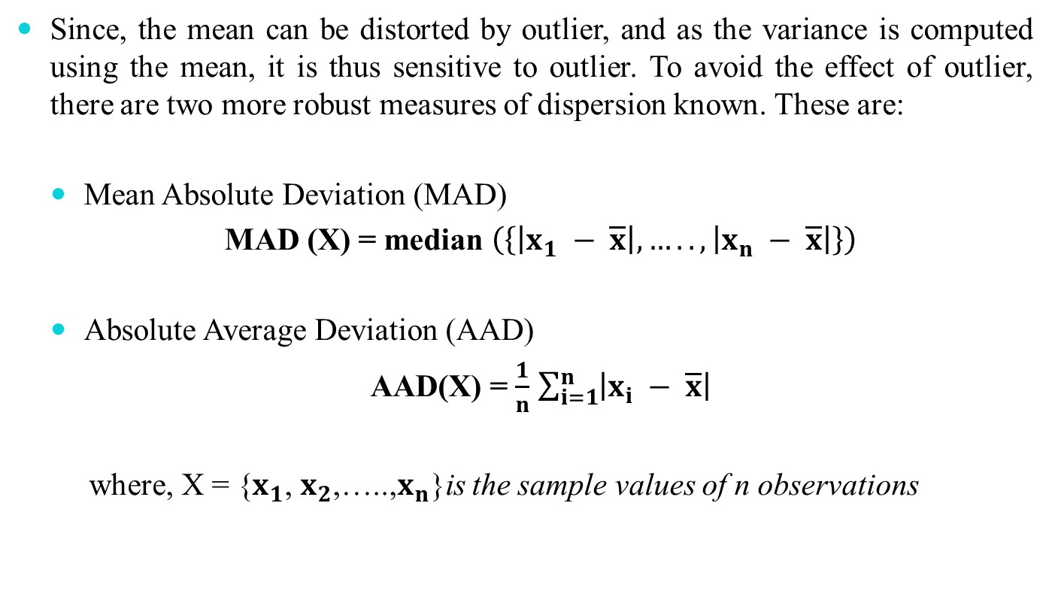
Mean Absolute Deviation (MAD)
  Since, the mean can be distorted by outlier, and as the variance is computed using the mean, it is thus sensitive to outlier. To avoid the effect of outlier, there are two more robust measures of dispersion known. These are:
    Mean Absolute Deviation (MAD)
    MAD (X) = median $\left(\left\{\left|x_{1} − \overline{x}\right|,…..,\left|x_{n} − \overline{x}\right|\right\}\right)$
    Absolute Average Deviation (AAD)
    AAD(X) = $\frac{1}{n}$ $\sum_{i=1}^{n}{\left|x_{i} − \overline{x}\right|}$
      where, X = {$x_{1}$, $x_{2}$,…..,$x_{n}$}is the sample values of n observations

Slide 79
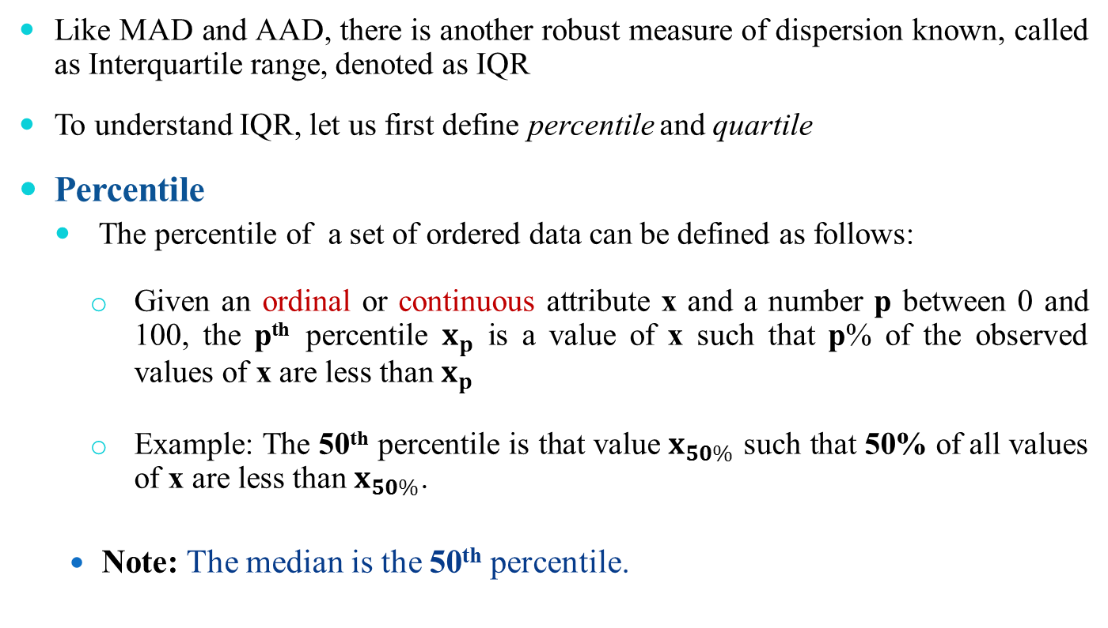
Interquartile Range
  Like MAD and AAD, there is another robust measure of dispersion known, called as Interquartile range, denoted as IQR
  To understand IQR, let us first define percentile and quartile
  Percentile
    The percentile of a set of ordered data can be defined as follows:
      Given an ordinal or continuous attribute x and a number p between 0 and 100, the p^{th} percentile $x_{p}$ is a value of x such that p% of the observed values of x are less than $x_{p}$
      Example: The 50th percentile is that value $x_{50\%}$ such that 50% of all values of x are less than $x_{50\%}$.
  Note: The median is the 50th percentile.

Slide 80
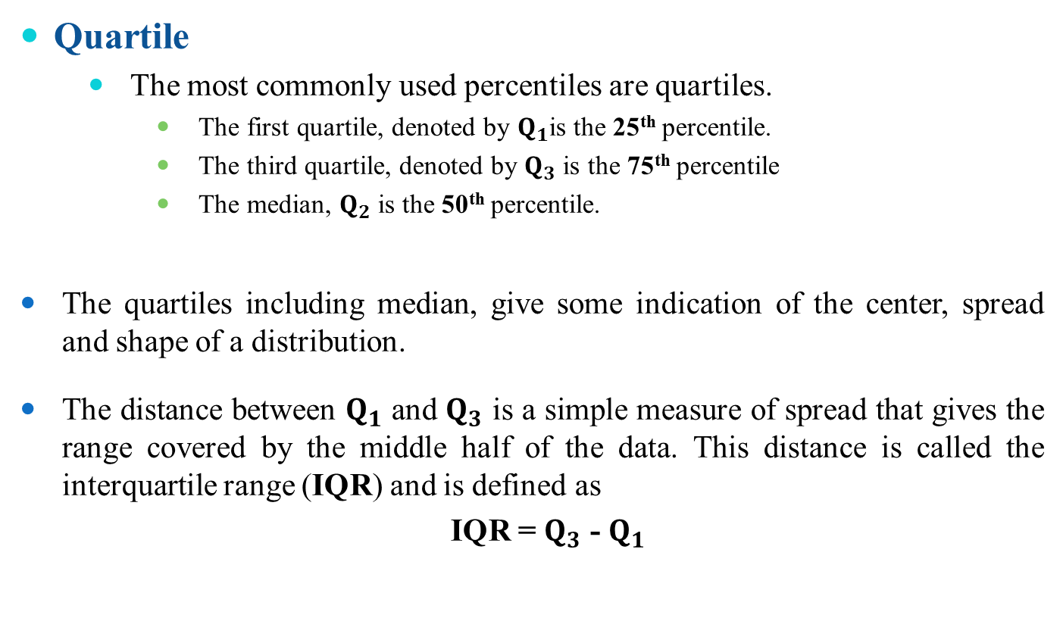
Interquartile Range
  Quartile
      The most commonly used percentiles are quartiles.
          The first quartile, denoted by $Q_{1}$is the 25th percentile.
          The third quartile, denoted by $Q_{3}$ is the 75th percentile
          The median, $Q_{2}$ is the 50th percentile.
  The quartiles including median, give some indication of the center, spread and shape of a distribution.
  The distance between $Q_{1}$ and $Q_{3}$ is a simple measure of spread that gives the range covered by the middle half of the data. This distance is called the interquartile range (IQR) and is defined as
    IQR = $Q_{3}$ - $Q_{1}$

Slide 81
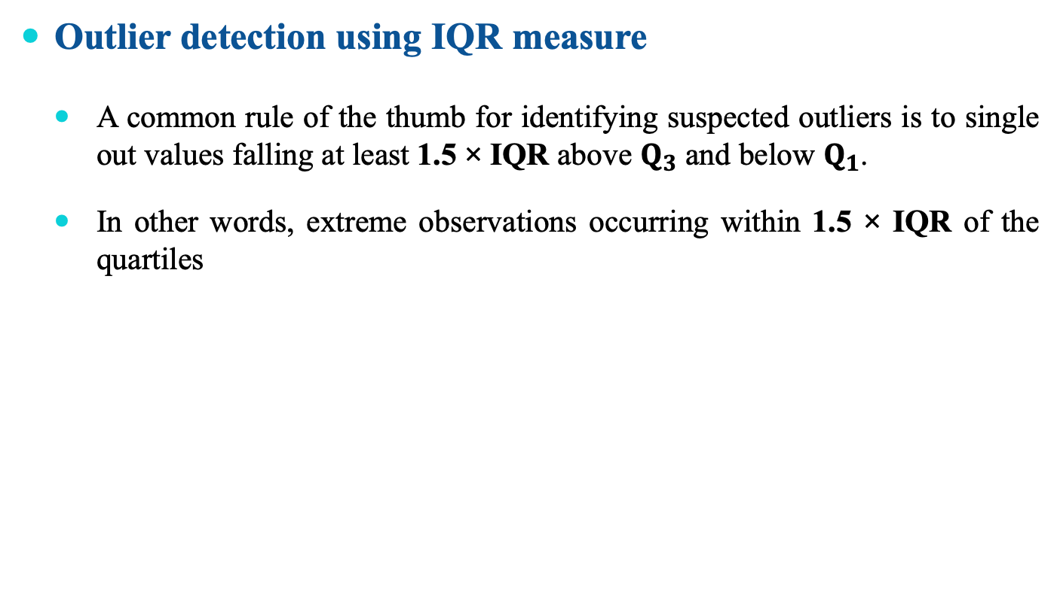
Application of IQR
  Outlier detection using IQR measure
  A common rule of the thumb for identifying suspected outliers is to single out values falling at least 1.5 × IQR above $Q_{3}$ and below $Q_{1}$.
  In other words, extreme observations occurring within 1.5 × IQR of the quartiles

Slide 82
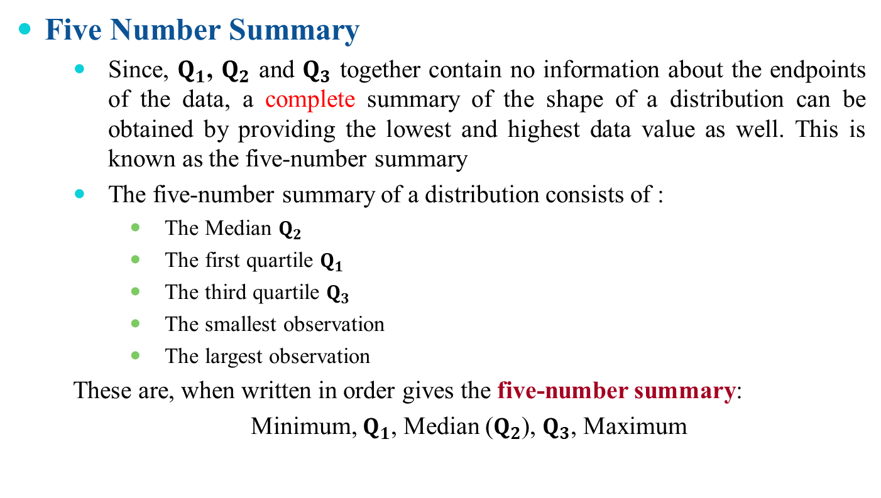
Application of IQR
  Five Number Summary
      Since, $Q_{1}$, $Q_{2}$ and $Q_{3}$ together contain no information about the endpoints of the data, a complete summary of the shape of a distribution can be obtained by providing the lowest and highest data value as well. This is known as the five-number summary
      The five-number summary of a distribution consists of :
          The Median $Q_{2}$
          The first quartile $Q_{1}$
          The third quartile $Q_{3}$
          The smallest observation
          The largest observation
      These are, when written in order gives the five-number summary:
      Minimum, $Q_{1}$, Median ($Q_{2}$), $Q_{3}$, Maximum

Slide 83
Box plot
  Graphical view of Five number summary

Slide 84
Reference
The detail material related to this lecture can be found in
  Probability and Statistics for Enginneers and Scientists (8th Ed.) by Ronald E. Walpol, Sharon L. Myers, Keying Ye (Pearson), 2013 .

Slide 85
Any question?

Slide 86
Questions of the day…
Which of the following central tendency measurements allows distributive, algebraic and holistic measure?
  mean
  median
  Mode
  Which measure may be faster than other? Why?
Give three situations where AM, GM, and HM are the right measures of central tendency?

Slide 87
Questions of the day…
Given a sample of data, how to decide whether it is
  Symmetric?
  Skew-symmetric (positive or negative)?
  Uniformly increasing (or decreasing)?
  In-variate?
How the box-plots will look for the following types of samples?
  a) Symmetric b) Positively skew-symmetric
  c) Negatively skew-symmetric d) in-variate

Slide 88
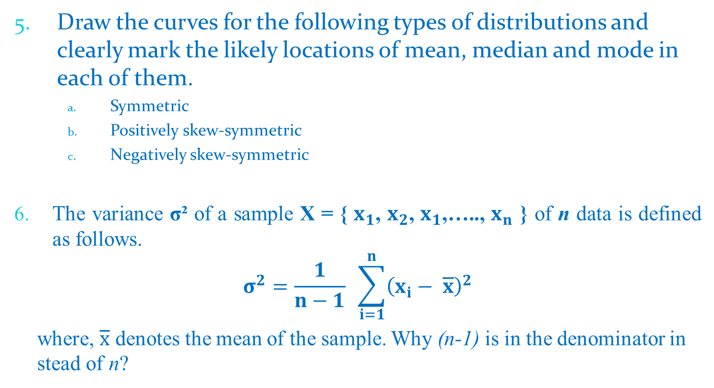
Questions of the day…
Draw the curves for the following types of distributions and clearly mark the likely locations of mean, median and mode in each of them.
    Symmetric
    Positively skew-symmetric
    Negatively skew-symmetric
  The variance σ² of a sample X = { $x_{1}$, $x_{2}$, $x_{1}$,….., $x_{n}$ } of n data is defined as follows.
  $$σ^{2}=\frac{1}{n−1} \sum_{i=1}^{n}{{\left(x_{i}− \overline{x}\right)}^{2}}$$
    where, $\overline{x}$ denotes the mean of the sample. Why (n-1) is in the denominator in stead of n?

Slide 89
Questions of the day…
What are the degree of freedoms in each of the following cases?
    A sample with a single data.
    A sample with n data.
    A sample of tabular data with n rows and m columns.
Calculate the Coefficient of variation (CV) for the following sample data.
(a) 10, -5, 20, 15, -5, 25, 30, 35, -25, 25
(b)
x | 10 | 20 | 30 | 40 | 50
f(x) | 0.2 | 0.4 | 0.1 | 0.2 | 0.1

