Slide 1
Data Analytics
(CS61061)
Tutorial # 1
Data categorization, Descriptive statistics, Probability distributions, Sampling distributions

Slide 2
Objective Type Questions

Slide 3
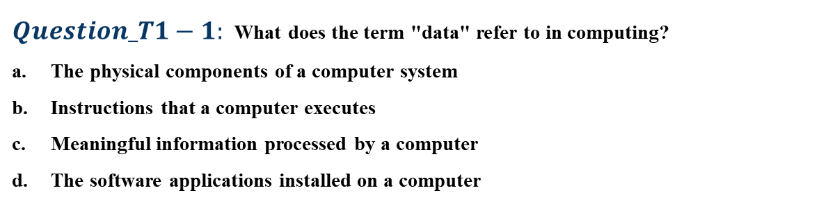
Objective type questions
$Question_T1−1:$What does the term "data" refer to in computing?
The physical components of a computer system
Instructions that a computer executes
Meaningful information processed by a computer
The software applications installed on a computer

Slide 4
Objective type questions
$Question_T1−1:$What does the term "data" refer to in computing?
The physical components of a computer system
Instructions that a computer executes
Meaningful information processed by a computer
The software applications installed on a computer

Slide 5
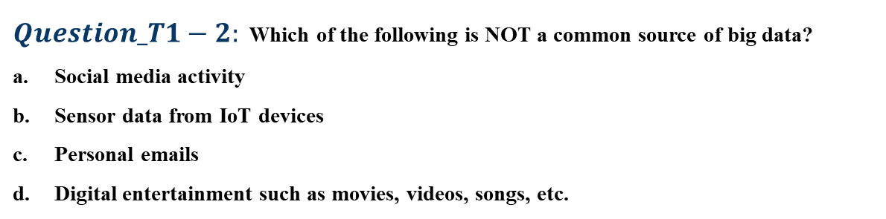
Objective type questions
$Question_T1−2:$ Which of the following is NOT a common source of big data?
Social media activity
Sensor data from IoT devices
Personal emails
Digital entertainment such as movies, videos, songs, etc.

Slide 6
Objective type questions
$Question_T1−2:$ Which of the following is NOT a common source of big data?
Social media activity
Sensor data from IoT devices
Personal emails
Digital entertainment such as movies, videos, songs, etc.

Slide 7
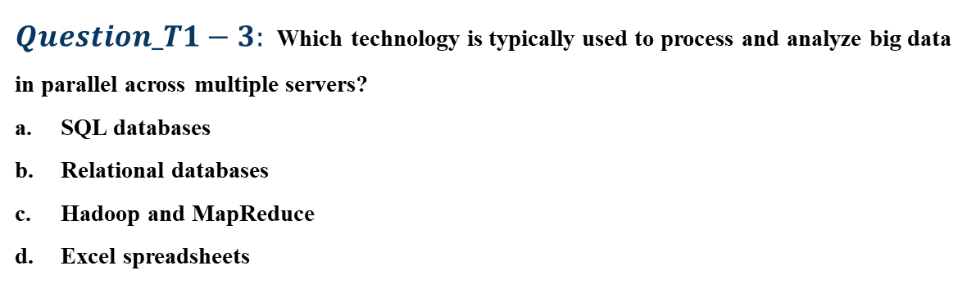
Objective type questions
$Question_T1−3:$Which technology is typically used to process and analyze big data in parallel across multiple servers?
SQL databases
Relational databases
Hadoop and MapReduce
Excel spreadsheets

Slide 8
Objective type questions
$Question_T1−3:$Which technology is typically used to process and analyze big data in parallel across multiple servers?
SQL databases
Relational databases
Hadoop and MapReduce
Excel spreadsheets

Slide 9
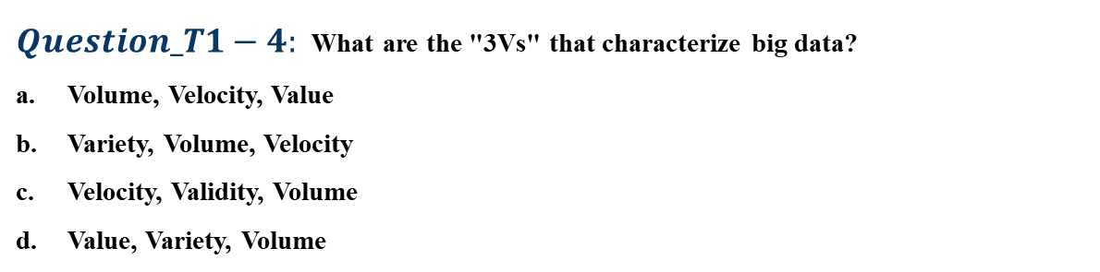
Objective type questions
$Question_T1−4:$What are the "3Vs" that characterize big data?
Volume, Velocity, Value
Variety, Volume, Velocity
Velocity, Validity, Volume
Value, Variety, Volume

Slide 10
Objective type questions
$Question_T1−4:$What are the "3Vs" that characterize big data?
Volume, Velocity, Value
Variety, Volume, Velocity
Velocity, Validity, Volume
Value, Variety, Volume

Slide 11
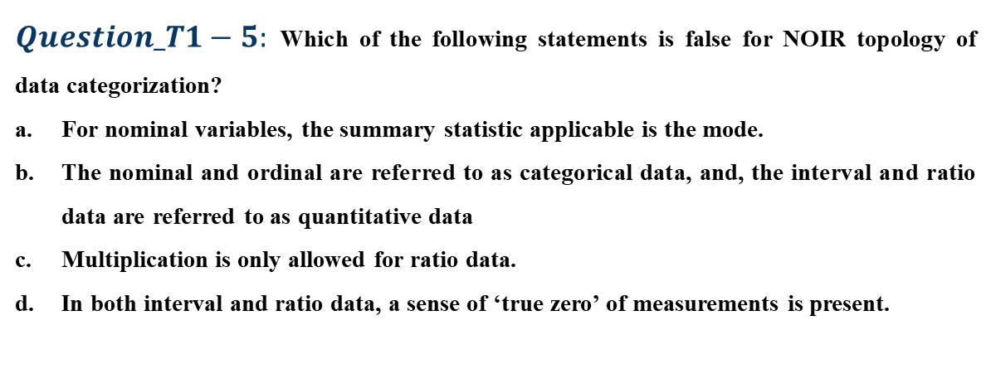
Objective type questions
$Question_T1−5:$Which of the following statements is false for NOIR topology of data categorization?
For nominal variables, the summary statistic applicable is the mode.
The nominal and ordinal are referred to as categorical data, and, the interval and ratio data are referred to as quantitative data
Multiplication is only allowed for ratio data.
In both interval and ratio data, a sense of ‘true zero’ of measurements is present.

Slide 12

Objective type questions
$Question_T1−5:$Which of the following statements is false for NOIR topology of data categorization?
For nominal variables, the summary statistic applicable is the mode.
The nominal and ordinal are referred to as categorical data, and, the interval and ratio data are referred to as quantitative data.
Multiplication is only allowed for ratio data.
In both interval and ratio data, a sense of ‘true zero’ of measurements is present.

Slide 13
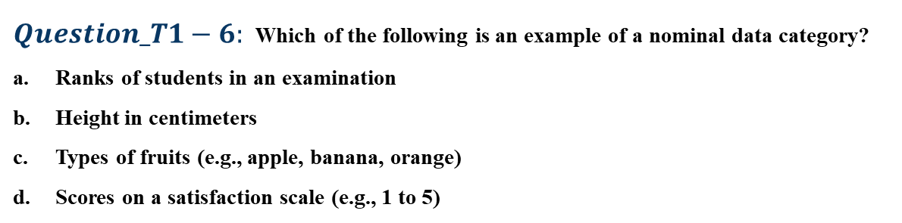
Objective type questions
$Question_T1−6:$Which of the following is an example of a nominal data category?
Ranks of students in an examination
Height in centimeters
Types of fruits (e.g., apple, banana, orange)
Scores on a satisfaction scale (e.g., 1 to 5)

Slide 14
Objective type questions
$Question_T1−6:$Which of the following is an example of a nominal data category?
Ranks of students in an examination
Height in centimeters
Types of fruits (e.g., apple, banana, orange)
Scores on a satisfaction scale (e.g., 1 to 5)

Slide 15
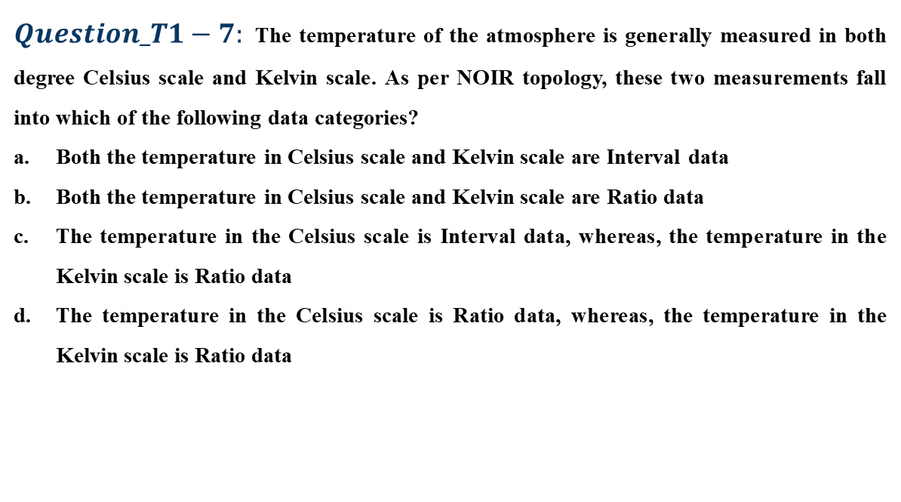
Objective type questions
$Question_T1−7:$The temperature of the atmosphere is generally measured in both degree Celsius scale and Kelvin scale. As per NOIR topology, these two measurements fall into which of the following data categories?
Both the temperature in Celsius scale and Kelvin scale are Interval data
Both the temperature in Celsius scale and Kelvin scale are Ratio data
The temperature in the Celsius scale is Interval data, whereas, the temperature in the Kelvin scale is Ratio data
The temperature in the Celsius scale is Ratio data, whereas, the temperature in the Kelvin scale is Ratio data

Slide 16
Objective type questions
$Question_T1−7:$The temperature of the atmosphere is generally measured in both degree Celsius scale and Kelvin scale. As per NOIR topology, these two measurements fall into which of the following data categories?
Both the temperature in Celsius scale and Kelvin scale are Interval data
Both the temperature in Celsius scale and Kelvin scale are Ratio data
The temperature in the Celsius scale is Interval data, whereas, the temperature in the Kelvin scale is Ratio data
The temperature in the Celsius scale is Ratio data, whereas, the temperature in the Kelvin scale is Ratio data

Slide 17
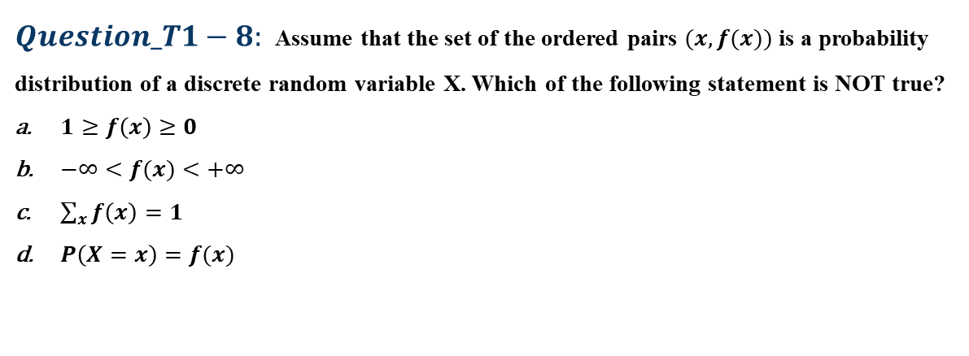
Objective type questions
$Question_T1−8:$Assume that the set of the ordered pairs $(x, f(x))$is a probability distribution of a discrete random variable X. Which of the following statement is NOT true?
$1≥f\left(x\right)≥0$
$−∞<f(x)<+∞$
$\sum_{x}{f\left(x\right)=1}$
$P\left(X=x\right)=f(x)$

Slide 18
Objective type questions
$Question_T1−8:$Assume that the set of the ordered pairs $(x, f(x))$is a probability distribution of a discrete random variable X. Which of the following statement is NOT true?
$1≥f\left(x\right)≥0$
$−∞<f(x)<+∞$
$\sum_{x}{f\left(x\right)=1}$
$P\left(X=x\right)=f(x)$

Slide 19
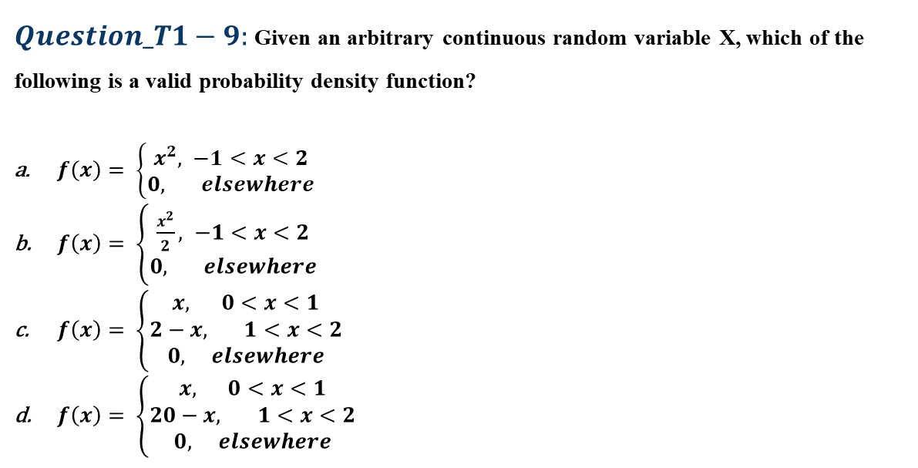
Objective type questions
$Question_T1−9:$ Given an arbitrary continuous random variable X, which of the following is a valid probability density function?
$f\left(x\right)= \left\{\begin{aligned}x^{2}, −1<x<2 \\ 0, elsewhere\end{aligned}\right.$
$f\left(x\right)= \left\{\begin{aligned}\frac{x^{2}}{2}, −1<x<2 \\ 0, elsewhere\end{aligned}\right.$
$f\left(x\right)= \left\{\begin{aligned}x, 0<x<1 \\ 2−x, 1<x<2 \\ 0, elsewhere\end{aligned}\right.$
$f\left(x\right)= \left\{\begin{aligned}x, 0<x<1 \\ 20−x, 1<x<2 \\ 0, elsewhere\end{aligned}\right.$

Slide 20
Objective type questions
$Question_T1−9:$ Given an arbitrary continuous random variable X, which of the following is a valid probability density function?
$f\left(x\right)= \left\{\begin{aligned}x^{2}, −1<x<2 \\ 0, elsewhere\end{aligned}\right.$
$f\left(x\right)= \left\{\begin{aligned}\frac{x^{2}}{2}, −1<x<2 \\ 0, elsewhere\end{aligned}\right.$
$f\left(x\right)= \left\{\begin{aligned}x, 0<x<1 \\ 2−x, 1<x<2 \\ 0, elsewhere\end{aligned}\right.$
$f\left(x\right)= \left\{\begin{aligned}x, 0<x<1 \\ 20−x, 1<x<2 \\ 0, elsewhere\end{aligned}\right.$

Slide 21
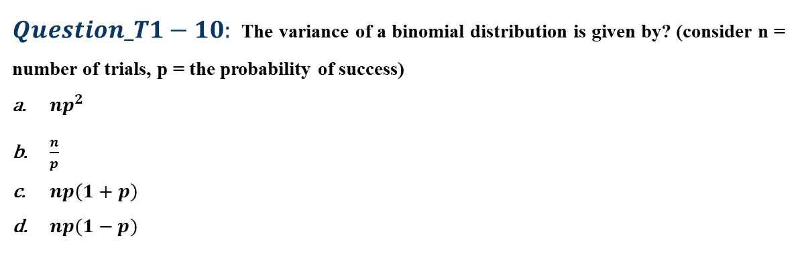
Objective type questions
$Question_T1−10:$The variance of a binomial distribution is given by? (consider n = number of trials, p = the probability of success)
$np^{2}$
$\frac{n}{p}$
$np\left(1+p\right)$
$np(1−p)$

Slide 22
Objective type questions
$Question_T1−10:$The variance of a binomial distribution is given by? (consider n = number of trials, p = the probability of success)
$np^{2}$
$\frac{n}{p}$
$np\left(1+p\right)$
$np(1−p)$

Slide 23
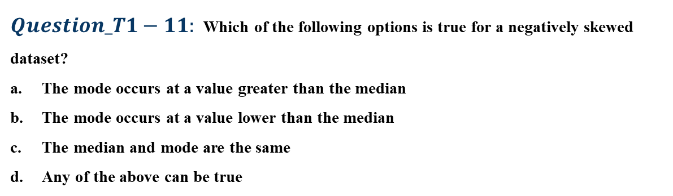
Objective type questions
$Question_T1−11:$Which of the following options is true for a negatively skewed dataset?
The mode occurs at a value greater than the median
The mode occurs at a value lower than the median
The median and mode are the same
Any of the above can be true

Slide 24
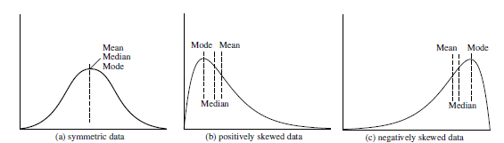
Objective type questions
$Question_T1−11:$Which of the following options is true for a negatively skewed dataset?
The mode occurs at a value greater than the median
The mode occurs at a value lower than the median
The median and mode are the same
Any of the above can be true

Slide 25
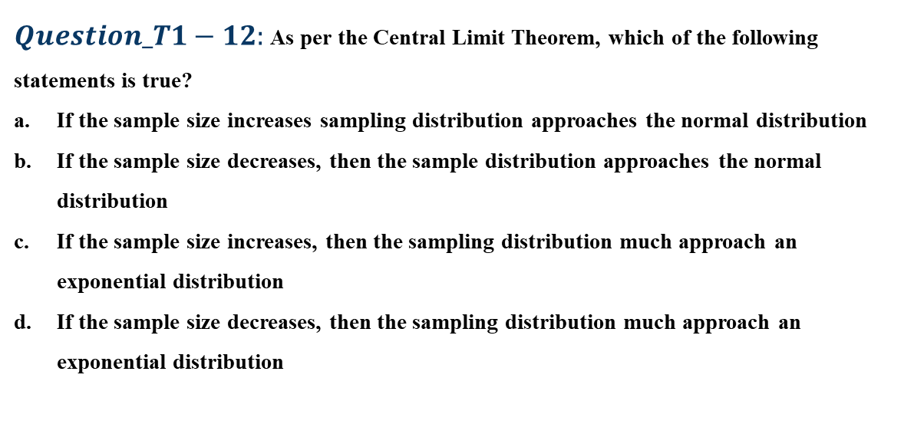
Objective type questions
$Question_T1−12:$ As per the Central Limit Theorem, which of the following statements is true?
If the sample size increases sampling distribution approaches the normal distribution
If the sample size decreases, then the sample distribution approaches the normal distribution
If the sample size increases, then the sampling distribution much approach an exponential distribution
If the sample size decreases, then the sampling distribution much approach an exponential distribution

Slide 26
Objective type questions
$Question_T1−12:$ As per the Central Limit Theorem, which of the following statements is true?
If the sample size increases sampling distribution approaches the normal distribution
If the sample size decreases, then the sample distribution approaches the normal distribution
If the sample size increases, then the sampling distribution much approach an exponential distribution
If the sample size decreases, then the sampling distribution much approach an exponential distribution
Hint: The central limit theorem states that the sampling distribution will approach normal distribution, with the increase in sample size. A sample size of more than 30 can be considered as large enough for this assumption.

Slide 27
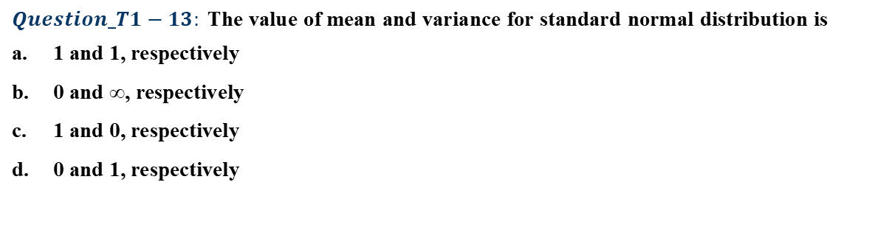
Objective type questions
$$Question_T1−13: \text{The} \text{value} \text{of} \text{mean} \text{and} \text{variance} \text{for} \text{standard} \text{normal} \text{distribution} \text{is}$$
$\text{1 }\text{and}\text{ 1, }\text{respectively}$
$\text{0 }\text{and}\text{ ∞, }\text{respectively}$
$\text{1 }\text{and}\text{ 0, }\text{respectively}$
$\text{0 }\text{and}\text{ 1, }\text{respectively}$

Slide 28

Objective type questions
$$Question_T1−13: \text{The} \text{value} \text{of} \text{mean} \text{and} \text{variance} \text{for} \text{standard} \text{normal} \text{distribution} \text{is}$$
$\text{1 }\text{and}\text{ 1, }\text{respectively}$
$\text{0 }\text{and}\text{ ∞, }\text{respectively}$
$\text{1 }\text{and}\text{ 0, }\text{respectively}$
$\text{0 }\text{and}\text{ 1, }\text{respectively}$

Slide 29
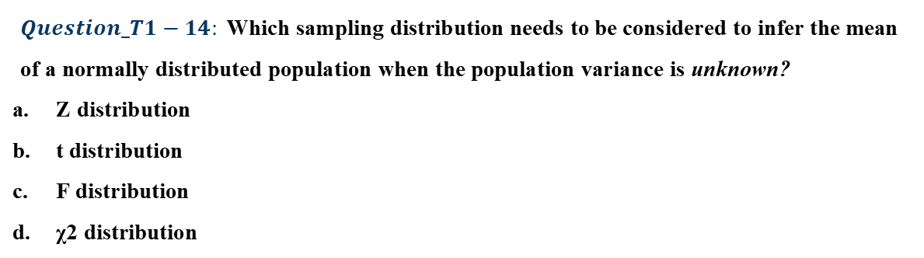
Objective type questions
$$Question_T1−14: \text{Which} \text{sampling} \text{distribution} \text{needs} \text{to} \text{be} \text{considered} \text{to} \text{infer} \text{the} \text{mean} \text{of} \text{a} \text{normally} \text{distributed} \text{population} \text{when} \text{the} \text{population} \text{variance} \text{is} \text{unknown}\text{?}$$
$\text{Z} \text{distribution}$
$\text{t} \text{distribution}$
$\text{F} \text{distribution}$
$\text{χ}\text{2 }\text{distribution}$

Slide 30
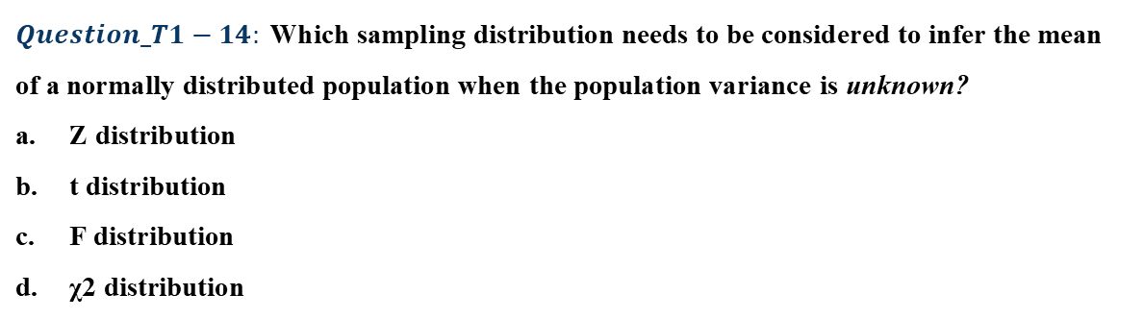
Objective type questions
$$Question_T1−14: \text{Which} \text{sampling} \text{distribution} \text{needs} \text{to} \text{be} \text{considered} \text{to} \text{infer} \text{the} \text{mean} \text{of} \text{a} \text{normally} \text{distributed} \text{population} \text{when} \text{the} \text{population} \text{variance} \text{is} \text{unknown}\text{?}$$
$\text{Z} \text{distribution}$
$\text{t} \text{distribution}$
$\text{F} \text{distribution}$
$\text{χ}\text{2 }\text{distribution}$

Slide 31
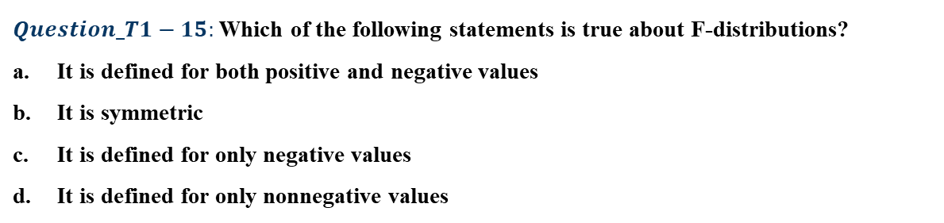
Objective type questions
$Question_T1−15:$Which of the following statements is true about F-distributions?
It is defined for both positive and negative values
It is symmetric
It is defined for only negative values
It is defined for only nonnegative values

Slide 32
Objective type questions
$Question_T1−15:$Which of the following statements is true about F-distributions?
It is defined for both positive and negative values
It is symmetric
It is defined for only negative values
It is defined for only nonnegative values

Slide 33
Numerical Type Problems

Slide 34
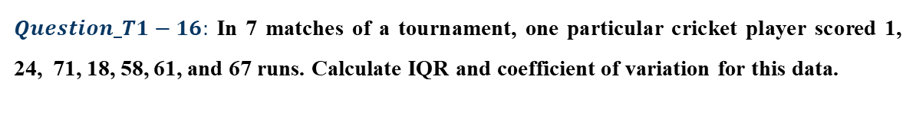
Numerical type problems
$Question_T1−16:$ In 7 matches of a tournament, one particular cricket player scored 1, 24, 71, 18, 58, 61, and 67 runs. Calculate IQR and coefficient of variation for this data.

Slide 35
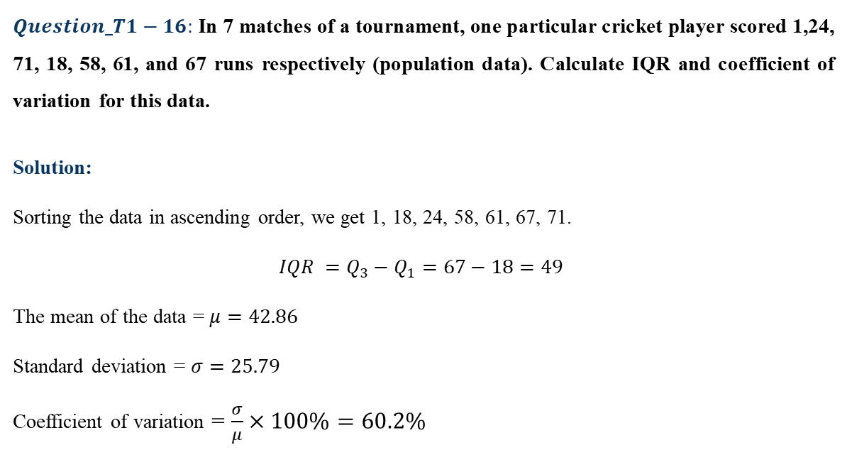
Numerical type problems
$Question_T1−16:$ In 7 matches of a tournament, one particular cricket player scored 1,24, 71, 18, 58, 61, and 67 runs respectively (population data). Calculate IQR and coefficient of variation for this data.
Solution:
Sorting the data in ascending order, we get 1, 18, 24, 58, 61, 67, 71.
$$IQR =Q_{3}−Q_{1}=67−18=49$$
The mean of the data = $μ=42.86$
Standard deviation = $σ=25.79$
Coefficient of variation = $\frac{σ}{μ}×100\%=60.2\%$

Slide 36
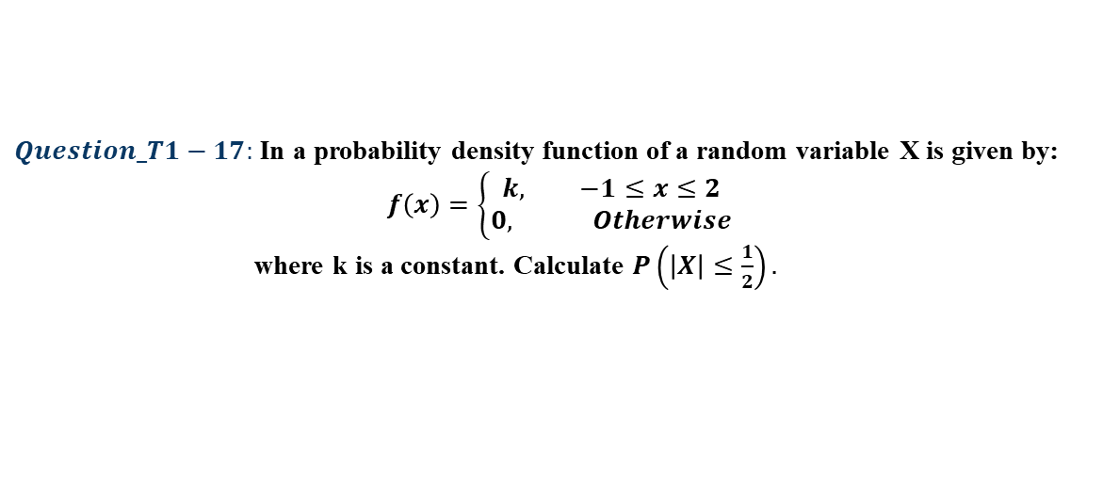
Numerical type problems
$Question_T1−17:$ In a probability density function of a random variable X is given by:
$$f\left(x\right)=\left\{\begin{aligned}k, −1≤x≤2 \\ 0, Otherwise\end{aligned}\right.$$
where k is a constant. Calculate $P\left(\left|X\right|≤\frac{1}{2}\right).$

Slide 37
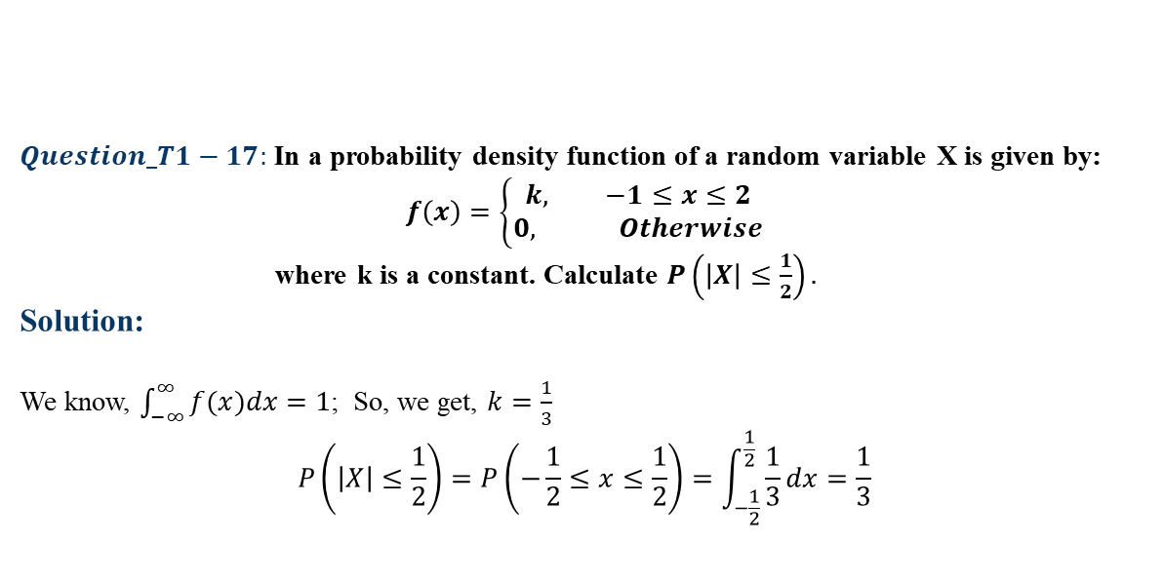
Numerical type problems
$Question_T1−17:$ In a probability density function of a random variable X is given by:
$$f\left(x\right)=\left\{\begin{aligned}k, −1≤x≤2 \\ 0, Otherwise\end{aligned}\right.$$
where k is a constant. Calculate $P\left(\left|X\right|≤\frac{1}{2}\right).$
Solution:
We know, $\int_{−∞}^{∞}{f(x)dx}=1$; So, we get, $k=\frac{1}{3}$
$$P\left(\left|X\right|≤\frac{1}{2}\right)=P\left(−\frac{1}{2}≤x≤\frac{1}{2}\right)=\int_{−\frac{1}{2}}^{\frac{1}{2}}{\frac{1}{3}dx}=\frac{1}{3}$$

Slide 38
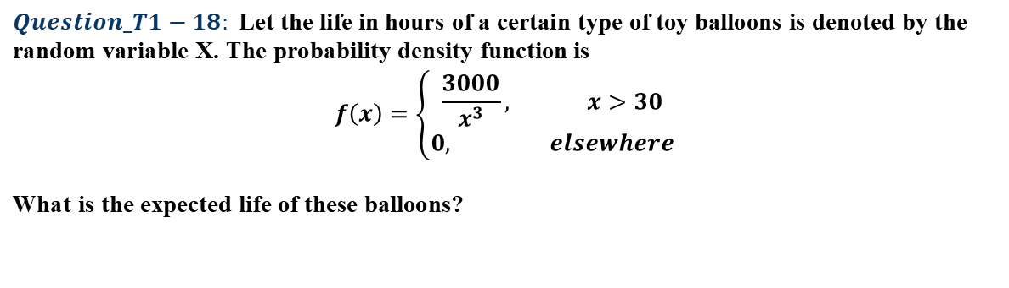
Numerical type problems
$$Question_T1−18: \text{Let} \text{the} \text{life} \text{in} \text{hours} \text{of} \text{a} \text{certain} \text{type} \text{of} \text{toy} \text{balloons} \text{is} \text{denoted} \text{by} \text{the} \text{random} \text{variable} \text{X}\text{. }\text{The} \text{probability} \text{density} \text{function} \text{is}$$
$$f\left(x\right)=\left\{\begin{aligned}\frac{3000}{x^{3}}, x>30 \\ 0, elsewhere\end{aligned}\right.$$
$$\text{What} \text{is} \text{the} \text{expected} \text{life} \text{of} \text{these} \text{balloons}\text{?}$$

Slide 39
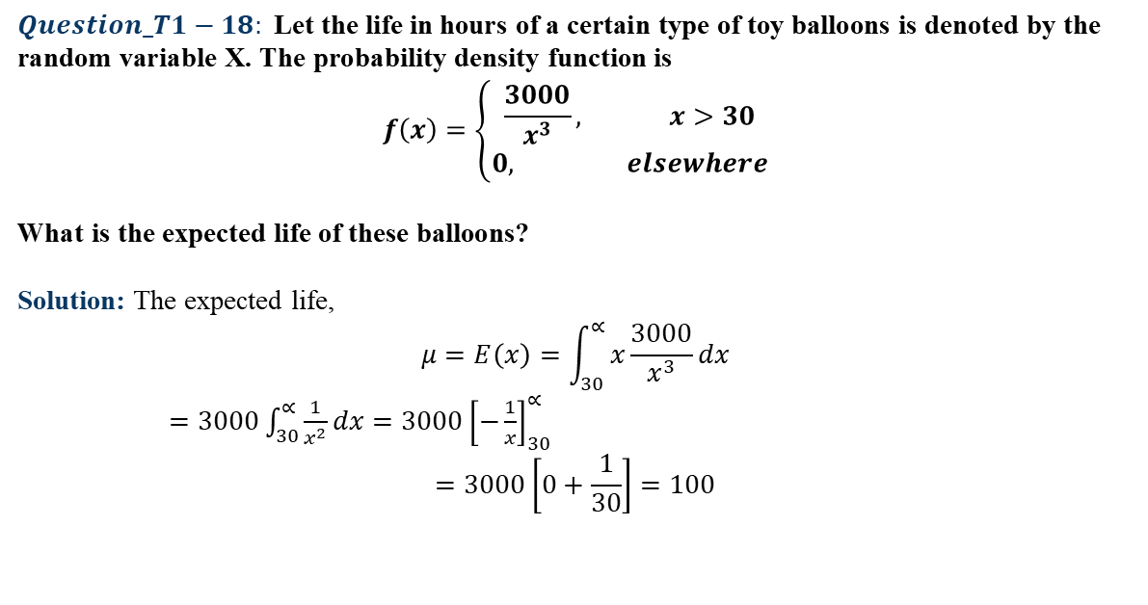
Numerical type problems
$$Question_T1−18: \text{Let} \text{the} \text{life} \text{in} \text{hours} \text{of} \text{a} \text{certain} \text{type} \text{of} \text{toy} \text{balloons} \text{is} \text{denoted} \text{by} \text{the} \text{random} \text{variable} \text{X}\text{. }\text{The} \text{probability} \text{density} \text{function} \text{is}$$
$$f\left(x\right)=\left\{\begin{aligned}\frac{3000}{x^{3}}, x>30 \\ 0, elsewhere\end{aligned}\right.$$
$$\text{What} \text{is} \text{the} \text{expected} \text{life} \text{of} \text{these} \text{balloons}\text{?}$$
Solution: The expected life,
$$μ=E\left(x\right)=\int_{30}^{∝}{x\frac{3000}{x^{3}}dx}$$
$=3000\int_{30}^{∝}{\frac{1}{x^{2}}dx}=3000{\left[−\frac{1}{x}\right]}_{30}^{∝}$
$$=3000\left[0+\frac{1}{30}\right]=100$$

Slide 40
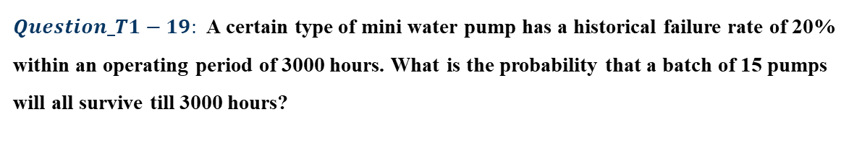
Numerical type problems
$Question_T1−19:$A certain type of mini water pump has a historical failure rate of 20% within an operating period of 3000 hours. What is the probability that a batch of 15 pumps will all survive till 3000 hours?

Slide 41
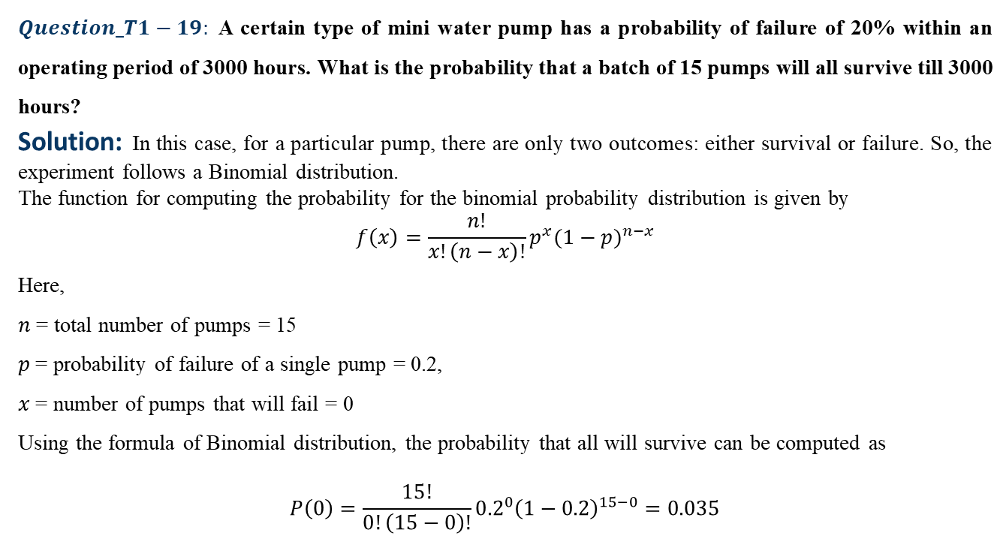
Numerical type problems
$Question_T1−19:$A certain type of mini water pump has a probability of failure of 20% within an operating period of 3000 hours. What is the probability that a batch of 15 pumps will all survive till 3000 hours?
Solution: In this case, for a particular pump, there are only two outcomes: either survival or failure. So, the experiment follows a Binomial distribution.
The function for computing the probability for the binomial probability distribution is given by
$$f\left(x\right)=\frac{n!}{x!\left(n−x\right)!}p^{x}{(1−p)}^{n−x}$$
Here,
𝑛 = total number of pumps = 15
𝑝 = probability of failure of a single pump = 0.2,
𝑥 = number of pumps that will fail = 0
Using the formula of Binomial distribution, the probability that all will survive can be computed as
$$P\left(0\right)=\frac{15!}{0!\left(15−0\right)!}{0.2}^{0}{\left(1−0.2\right)}^{15−0}=0.035$$

Slide 42
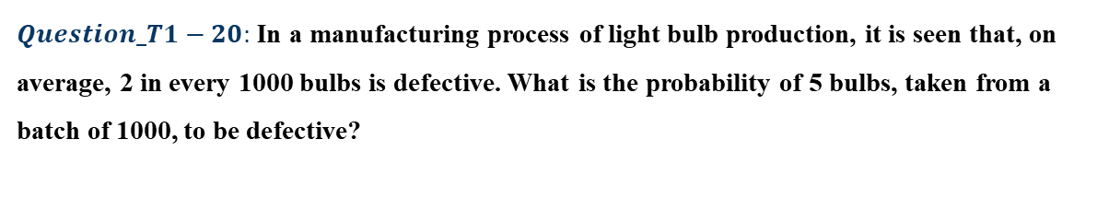
Numerical type problems
$Question_T1−20:$ In a manufacturing process of light bulb production, it is seen that, on average, 2 in every 1000 bulbs is defective. What is the probability of 5 bulbs, taken from a batch of 1000, to be defective?

Slide 43
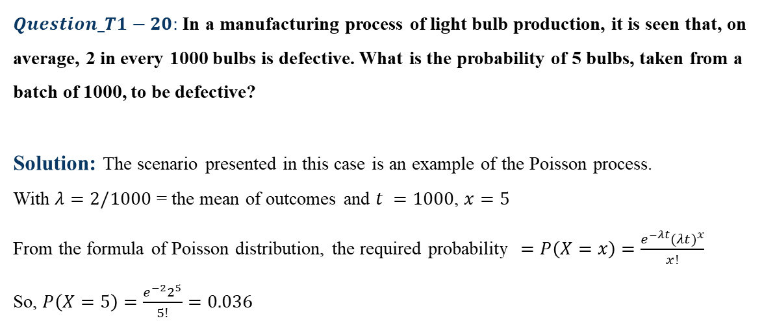
Numerical type problems
$Question_T1−20:$ In a manufacturing process of light bulb production, it is seen that, on average, 2 in every 1000 bulbs is defective. What is the probability of 5 bulbs, taken from a batch of 1000, to be defective?
Solution: The scenario presented in this case is an example of the Poisson process.
With $λ=2/1000$ = the mean of outcomes and $t =1000$, $x=5$
From the formula of Poisson distribution, the required probability $=P\left(X=x\right)=\frac{e^{−λt}{(λt)}^{x}}{x!}$
So, $P\left(X=5\right)=\frac{e^{−2}2^{5}}{5!}=0.036$

Slide 44
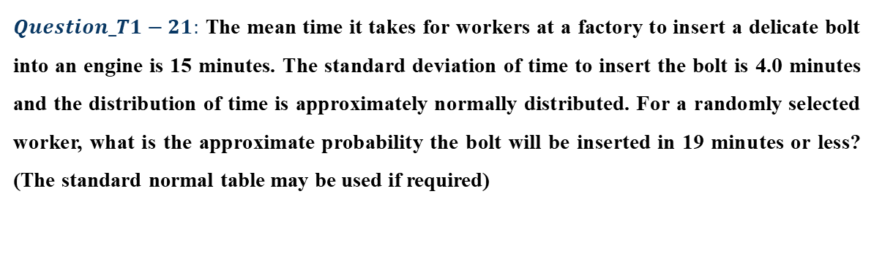
Numerical type problems
$Question_T1−21:$ The mean time it takes for workers at a factory to insert a delicate bolt into an engine is 15 minutes. The standard deviation of time to insert the bolt is 4.0 minutes and the distribution of time is approximately normally distributed. For a randomly selected worker, what is the approximate probability the bolt will be inserted in 19 minutes or less? (The standard normal table may be used if required)

Slide 45
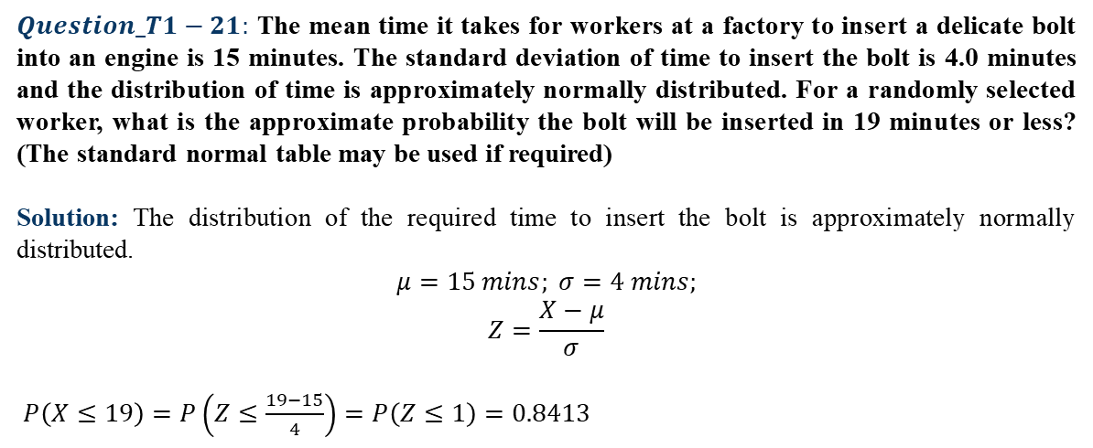
Numerical type problems
$Question_T1−21:$ The mean time it takes for workers at a factory to insert a delicate bolt into an engine is 15 minutes. The standard deviation of time to insert the bolt is 4.0 minutes and the distribution of time is approximately normally distributed. For a randomly selected worker, what is the approximate probability the bolt will be inserted in 19 minutes or less? (The standard normal table may be used if required)
Solution: The distribution of the required time to insert the bolt is approximately normally distributed.
$$μ=15 mins; σ=4 mins;$$
$$Z=\frac{X−μ}{σ}$$
$P\left(X≤19\right)=P\left(Z≤\frac{19−15}{4}\right)=P\left(Z≤1\right)=0.8413$

Slide 46
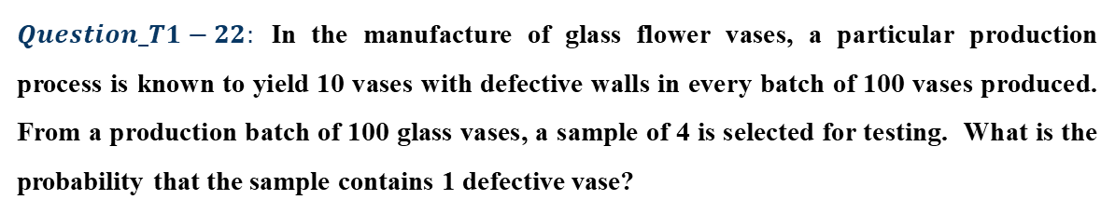
Numerical type problems
$Question_T1−22:$ In the manufacture of glass flower vases, a particular production process is known to yield 10 vases with defective walls in every batch of 100 vases produced. From a production batch of 100 glass vases, a sample of 4 is selected for testing. What is the probability that the sample contains 1 defective vase?

Slide 47
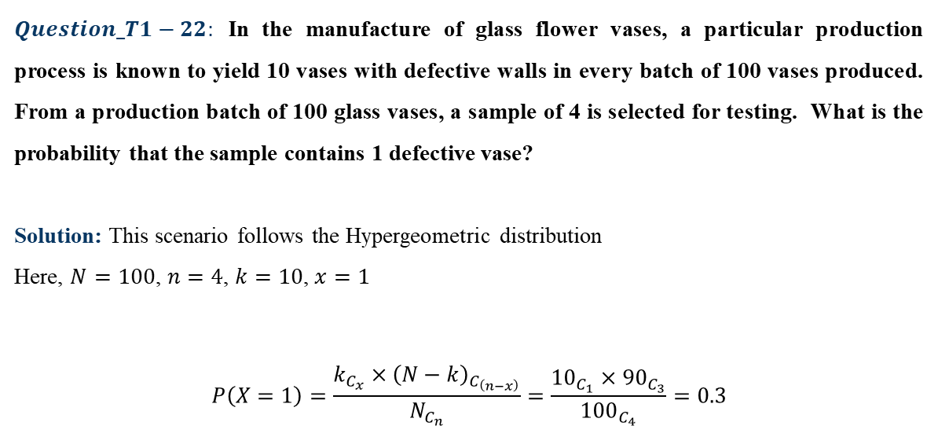
Numerical type problems
$Question_T1−22:$ In the manufacture of glass flower vases, a particular production process is known to yield 10 vases with defective walls in every batch of 100 vases produced. From a production batch of 100 glass vases, a sample of 4 is selected for testing. What is the probability that the sample contains 1 defective vase?
Solution: This scenario follows the Hypergeometric distribution
Here, $N=100$, $n=4$, $k=10$, $x=1$
$$P\left(X=1\right)=\frac{k_{C_{x}}×{\left(N−k\right)}_{C_{\left(n−x\right)}}}{N_{C_{n}}}=\frac{{10}_{C_{1}}×{90}_{C_{3}}}{{100}_{C_{4}}}=0.3$$

Slide 48
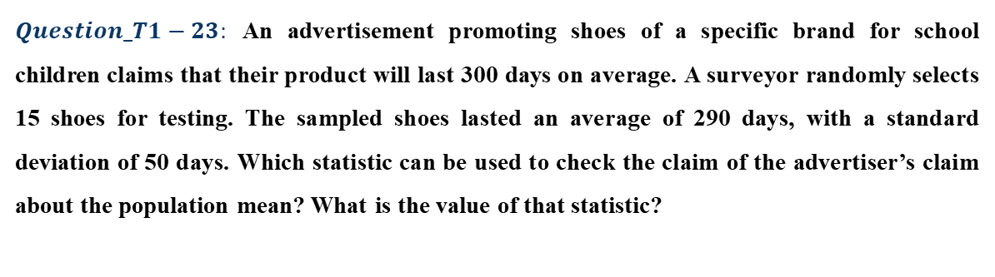
Numerical type problems
$Question_T1−23:$ An advertisement promoting shoes of a specific brand for school children claims that their product will last 300 days on average. A surveyor randomly selects 15 shoes for testing. The sampled shoes lasted an average of 290 days, with a standard deviation of 50 days. Which statistic can be used to check the claim of the advertiser’s claim about the population mean? What is the value of that statistic?

Slide 49
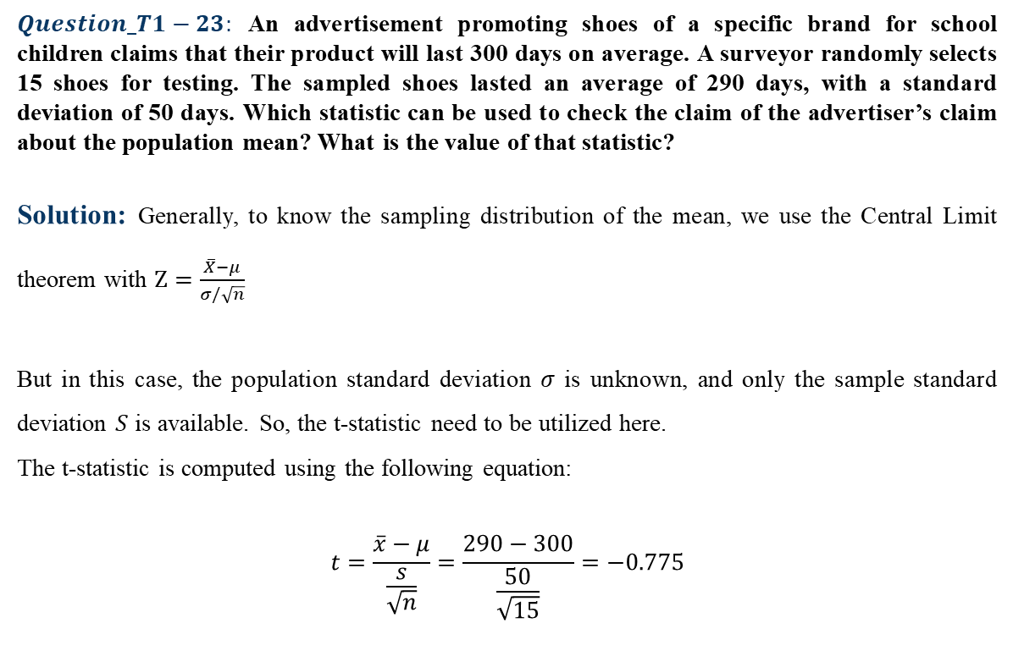
Numerical type problems
$Question_T1−23:$ An advertisement promoting shoes of a specific brand for school children claims that their product will last 300 days on average. A surveyor randomly selects 15 shoes for testing. The sampled shoes lasted an average of 290 days, with a standard deviation of 50 days. Which statistic can be used to check the claim of the advertiser’s claim about the population mean? What is the value of that statistic?
Solution: Generally, to know the sampling distribution of the mean, we use the Central Limit theorem with $Z=\frac{\overline{X}−μ}{σ/\sqrt{n}}$
But in this case, the population standard deviation $σ$ is unknown, and only the sample standard deviation $S$ is available. So, the t-statistic need to be utilized here.
The t-statistic is computed using the following equation:
$$t=\frac{\overline{x}−μ}{\frac{s}{\sqrt{n}}}=\frac{290−300}{\frac{50}{\sqrt{15}}}=−0.775$$

Slide 50
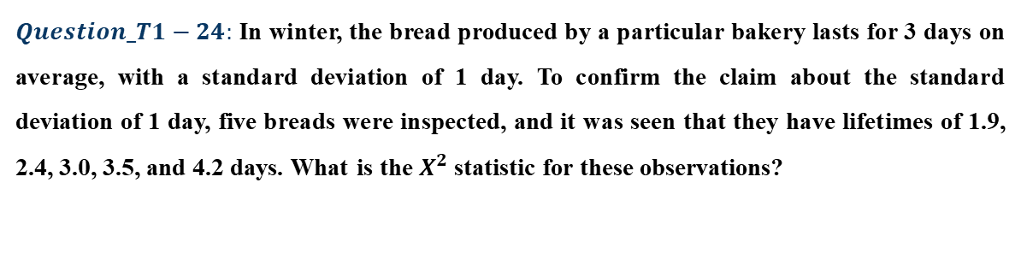
Numerical type problems
$Question_T1−24:$ In winter, the bread produced by a particular bakery lasts for 3 days on average, with a standard deviation of 1 day. To confirm the claim about the standard deviation of 1 day, five breads were inspected, and it was seen that they have lifetimes of 1.9, 2.4, 3.0, 3.5, and 4.2 days. What is the $X^{2}$ statistic for these observations?

Slide 51
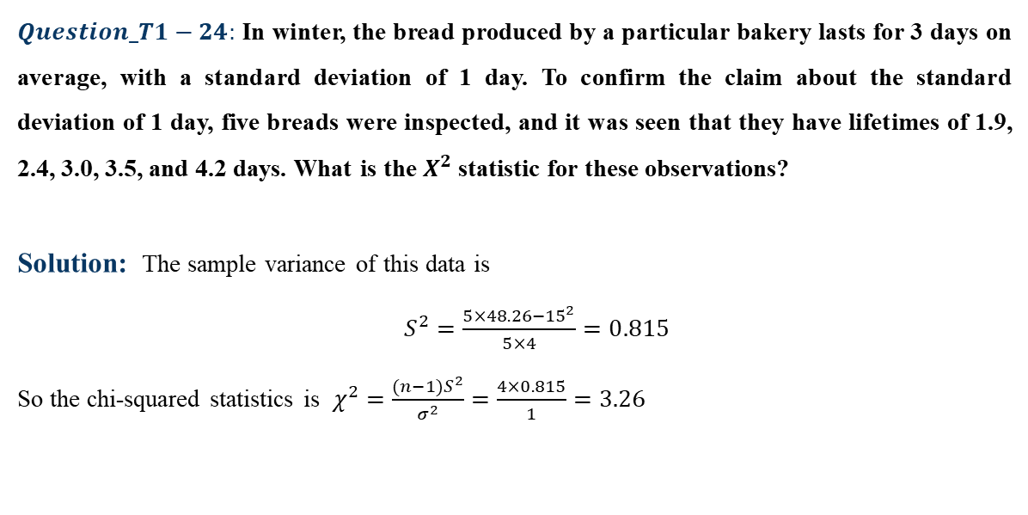
Numerical type problems
$Question_T1−24:$ In winter, the bread produced by a particular bakery lasts for 3 days on average, with a standard deviation of 1 day. To confirm the claim about the standard deviation of 1 day, five breads were inspected, and it was seen that they have lifetimes of 1.9, 2.4, 3.0, 3.5, and 4.2 days. What is the $X^{2}$ statistic for these observations?
Solution: The sample variance of this data is
$S^{2}=\frac{5×48.26−{15}^{2}}{5×4}=0.815$
So the chi-squared statistics is $χ^{2}=\frac{(n−1)S^{2}}{σ^{2}}=\frac{4×0.815}{1}=3.26$

Slide 52

Numerical type problems
$Question_T1−25:$ The below table shows the Population Standard Deviation (SD) and Sample Standard Deviation for sugar price in kg in Kolkata and Dhaka. We want to compare the sample variances of these two distributions. What statistics should we use? What is the value of that statistic considering the sugar price in Kolkata in the numerator?
 | Population SD | Sample SD
Kolkata | 30 | 35
Dhaka | 50 | 45

Slide 53
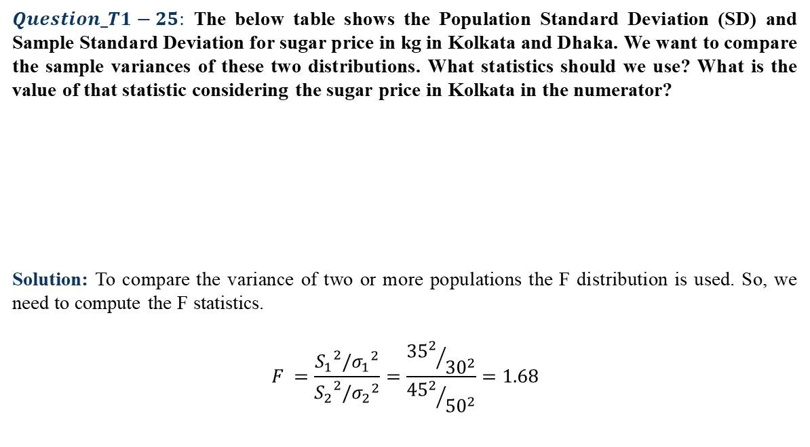
Numerical type problems
$Question_T1−25:$ The below table shows the Population Standard Deviation (SD) and Sample Standard Deviation for sugar price in kg in Kolkata and Dhaka. We want to compare the sample variances of these two distributions. What statistics should we use? What is the value of that statistic considering the sugar price in Kolkata in the numerator?
Solution: To compare the variance of two or more populations the F distribution is used. So, we need to compute the F statistics.
$$F =\frac{{S_{1}}^{2}/{σ_{1}}^{2}}{{S_{2}}^{2}/{σ_{2}}^{2}}=\frac{{{35}^{2}}/{{30}^{2}}}{{{45}^{2}}/{{50}^{2}}}=1.68$$
 | Population SD | Sample SD
Kolkata | 30 | 35
Dhaka | 50 | 45

Slide 54
Thank You!!

