Slide 1
Tutorial-II
Data Analytics
(CS61061)
Topic : Statistical Learning

Slide 2
Objective Type Problems

Slide 3
Question 1: Which of the following statements is true about the power of a test?
The power of a test is equal to (1-β) (Here, β = Probability of accepting null hypothesis, given that the null hypothesis is false)
The power of a test is equal to (1- α) (Here, α= Probability of rejecting null hypothesis, given that null hypothesis is true)
The power of a test is equal to α
The power of a test is equal to β

Slide 4
Question 1: Which of the following statements is true about the power of a test?
The power of a test is equal to (1-β) (Here, β = Probability of accepting null hypothesis, given that the null hypothesis is false)
The power of a test is equal to (1- α) (Here, α= Probability of rejecting
null hypothesis, given that null hypothesis is true)
c. The power of a test is equal to α
d. The power of a test is equal to β
Detailed Explanation: The power of a test is the probability of correctly rejecting the null hypothesis when it is false. It is equal to (1-β)

Slide 5
Question 2: In which of the below cases of hypothesis testing, a Type II error does occur?
When we reject a null hypothesis that is actually true in the population (Reject H₀, given that H₀ is true)
When we reject a null hypothesis that is actually false in the population (Reject H₀, given that H₀ is false)
When we fail to reject a null hypothesis that is actually true in the population (Accept H₀, given that H₀ is true)
When we fail to reject a null hypothesis that is actually true in the population (Accept H₀, given that H₀ is false)

Slide 6
Question 2: In which of the below cases of hypothesis testing, a Type II error does occur?
When we reject a null hypothesis that is actually true in the population (Reject H₀, given that H₀ is true)
When we reject a null hypothesis that is actually false in the population (Reject H₀, given that H₀ is false)
When we fail to reject a null hypothesis that is actually true in the population (Accept H₀, given that H₀ is true)
When we fail to reject a null hypothesis that is actually true in the population (Accept H₀, given that H₀ is false)
Explanation: A type II error (false-negative) occurs if the investigator fails to reject a null hypothesis that is actually false in the population.

Slide 7
Question 3 : In a hypothesis testing, a certain population parameter μ is compared with a specific value 0f 100. A set of null (H0) and alternate hypothesis (H1) is given below. Which of the following indicates a two-tailed test?
H₀ :μ=100 H₁:μ>100
H₀:μ=100 H₁:μ<100
H₀:μ=100 H₁:μ≠100
None of the above

Slide 8
Question 3 : In a hypothesis testing, a certain population parameter μ is compared with a specific value of 100. A set of null (H₀) and alternate hypothesis (H₁) is given below. Which of the following indicates a two-tailed test?
H₀ :μ=100 H₁:μ>100
H₀:μ=100 H₁:μ<100
H₀:μ=100 H₁:μ≠100
None of the above
Explanation: An alternative hypothesis that specifies that the parameter can lie on either side of the value specified by H_0 is called a two-sided (or two-tailed) test.
Example.
H₀ : μ=100 and H₁:μ≠100
Again, a statistical test in which the alternative hypothesis specifies that the population parameter lies entirely above or below the value specified in H₀ is called a one-sided (or one-tailed) test.

Slide 9
Question 4: A t-test is a significance test that assesses
  a. The means of two independent groups
  b. The medians of two dependent groups
  c. The modes of two independent variables
  d. The standard deviation of three independent variables

Slide 10
Question 4: A t-test is a significance test that assesses
  a. The means of two independent groups
  b. The medians of two dependent groups
  c. The modes of two independent variables
  d. The standard deviation of three independent variables
Explanation: A t-test is a statistical test used to compare the means of two independent groups. It is used to determine if there is a significant difference between the means of the two groups, indicating that there is a real effect or relationship. The t-test calculates a t-value, which is then compared to a critical value to determine if the difference between the means is statistically significant.

Slide 11
Question 5. Statistical significance or the probability of finding statistical significance is also known as
  a. Degrees of freedom (df)
  b. p-value
  c. Standard deviation (sd)
  d. A constant source of frustration!

Slide 12
Question 5. Statistical significance or the probability of finding statistical significance is also known as
  a. Degrees of freedom (df)
  b. p-value
  c. Standard deviation (sd)
  d. Quartile deviation
Explanation: Statistical significance or the probability of finding statistical significance is commonly referred to as the p-value. The p-value is a measure of the strength of evidence against the null hypothesis and indicates the likelihood of obtaining the observed results by chance alone. It is used in hypothesis testing to determine whether the results of a study are statistically significant or not.

Slide 13
Question 6.Consider a hypothesis H₀ = 5 against H1 > 5. The test is?
One tailed test
Two tailed test
It does not come under hypothesis test
Not valid hypothesis as they violate the exclusive and exhaustive property.

Slide 14
Question 6. Consider a hypothesis H₀ = 5 against H₁ > 5. The test is?
One tailed test
Two tailed test
It does not come under hypothesis test
Not valid hypothesis as they violate the exclusive and exhaustive property.
Explanation: In the given example since H₁ lies above the Ho that is the Null Hypothesis the test is referred as a one tailed test.

Slide 15
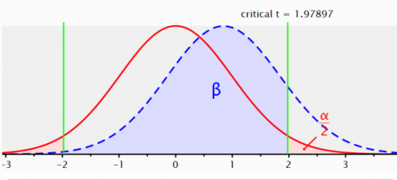
Question 7. What is used when we want to know whether the difference between a sample mean and the population mean is large enough to be statistically significant?
  a. One-Sample z-test
  b. F test
  c. Line test
  d. Litmus test

Slide 16
Question 7. What is used when we want to know whether the difference between a sample mean and the population mean is large enough to be statistically significant?
  a. One-Sample z-test
  b. F test
  c. Line test
  d. Litmus test
Explanation:
The one-sample z-test is used when we want to determine if the difference between a sample mean and the population mean is statistically significant. This test calculates the z-score, which measures how many standard deviations the sample mean is away from the population mean. By comparing the calculated z-score to a critical value, we can determine if the difference is large enough to be statistically significant.

Slide 17
Question 8: Which of the following statements is false about power curve?
The power of the test increases and approaches unity as the true mean gets further from the null hypothesis value.
b. As the true value of the population parameter approaches that of the null hypothesis, the power approaches. (Probability of rejecting null hypothesis, given that null hypothesis is true)
c. Decreasing increases the power
d. Increasing the sample size increases the power.

Slide 18
Question 8: Which of the following statements is false about power curve?
The power of the test increases and approaches unity as the true mean gets further from the null hypothesis value.
b. As the true value of the population parameter approaches that of the null hypothesis, the power approaches. (Probability of rejecting null hypothesis, given that null hypothesis is true)
c. Decreasing increases the power
d. Increasing the sample size increases the power.
Explanation:
In reality, as the true value of the population parameter approaches that of the null hypothesis, the power decreases. This means that if the true effect size is small (close to the null hypothesis value), it becomes harder to detect a significant difference, leading to lower power.

Slide 19
Question 9: An online retailer incorrectly concludes that a new website design increases the conversion rate, when in reality, it does not. What type of error is committed if the null hypothesis (H₀) is that the new design has no effect on the conversion rate?
  Type 1 error (False positive).
  Type 2 error (False negative).
  Correct decision.
  No error.

Slide 20
Question 9: An online retailer incorrectly concludes that a new website design increases the conversion rate, when in reality, it does not. What type of error is committed if the null hypothesis (H₀) is that the new design has no effect on the conversion rate?
  Type-I error (False positive).
  Type-II error (False negative).
  Correct decision.
  No error.
Explanation:
A Type-I error, also known as a false positive, occurs when the null hypothesis (H0) is wrongly rejected when it is actually true. In this scenario, the quality control department has incorrectly concluded that the bulbs meet the required standards (rejecting H0) when, in reality, the bulbs do not meet the standards. This is a situation of making an incorrect positive decision.

Slide 21
Question 10: Standard normal distribution has the following properties
a. µ=0 and σ =1
b. µ=1 and σ =1
c. µ=1 and σ =0
d. µ=1 and σ =1

Slide 22
Question 10: Standard normal distribution has the following properties
a. µ=0 and σ =1
b. µ=1 and σ =1
c. µ=1 and σ =0
d. µ=1 and σ =1
Explanation: The standard normal distribution is a special case of the normal distribution where the mean (µ) is 0 and the standard deviation (σ) is 1.
In a standard normal distribution:
µ (mean) is 0: This means that the center of the distribution is at 0. In other words, the average value is 0.
σ (standard deviation) is 1: This indicates the spread or dispersion of the data points. In a standard normal distribution, the spread is such that 68% of the data falls within 1 standard deviation of the mean, 95% within 2 standard deviations, and 99.7% within 3 standard deviations.

Slide 23
Subjective Type Problems

Slide 24
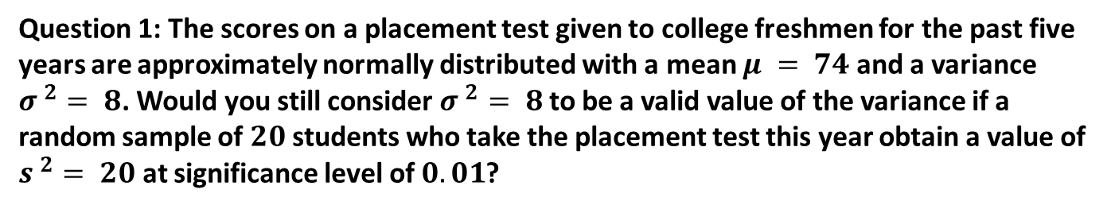

Slide 25
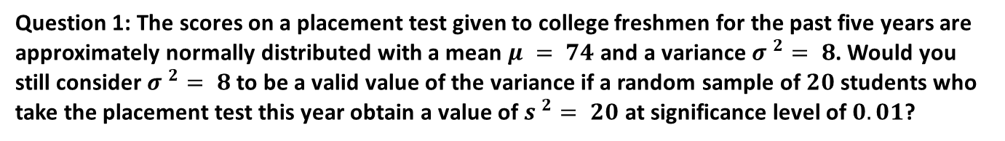
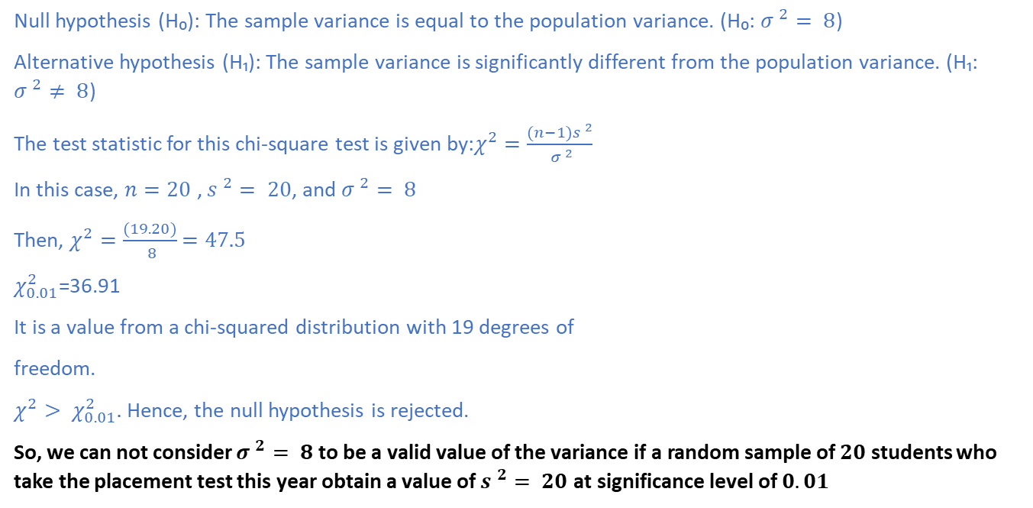
Solution:

Slide 26
Question 2: A factory produces electronic components with a mean lifespan of 8000 hours and a standard deviation of 500 hours. If random samples of size 64 are selected from the production, what is the probability that the average lifespan of the sample will be more than 8100 hours?

Slide 27
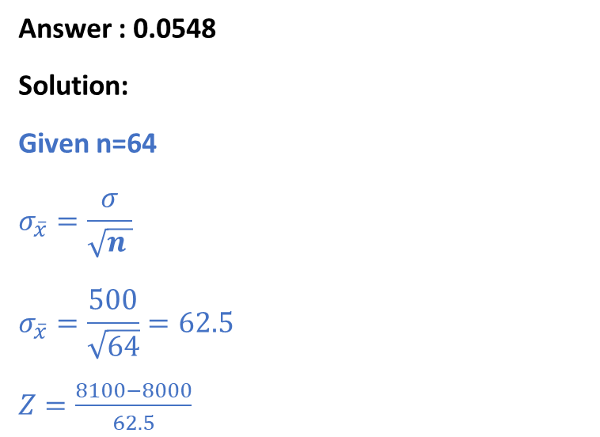
Question 2: A factory produces electronic components with a mean lifespan of 8000 hours and a standard deviation of 500 hours. If random samples of size 64 are selected from the production, what is the probability that the average lifespan of the sample will be more than 8100 hours?
P(Z >1.6) = 1- P(Z<1.6) =1-0.9452 =0.0548

Slide 28
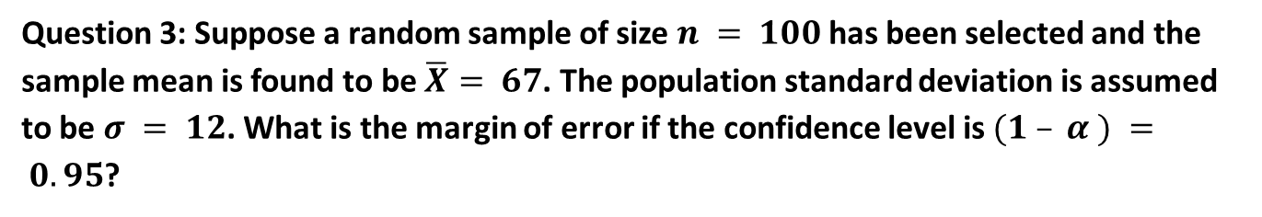

Slide 29
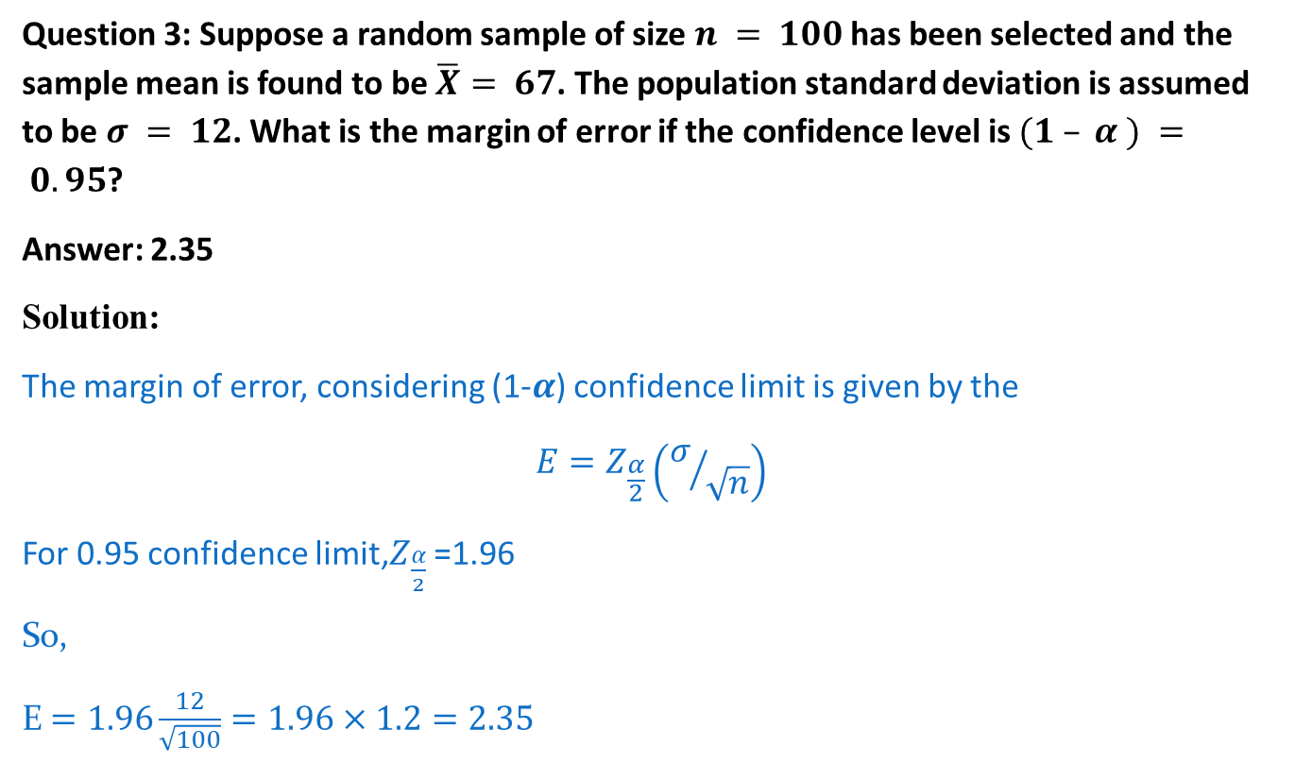

Slide 30
Question 4: A manufacturing firm claims that the batteries used in their electronic games will last an average of 30 hours. To maintain this average, 16 batteries are tested each month. If the computed t-value falls between −t_{0.025} and t_{0.025}, the firm is satisfied with its claim. What conclusion should the firm draw from a sample that has a mean of 27.5 hours and a standard deviation of 5 hours? What is the test statistic value for this hypothesis testing?

Slide 31
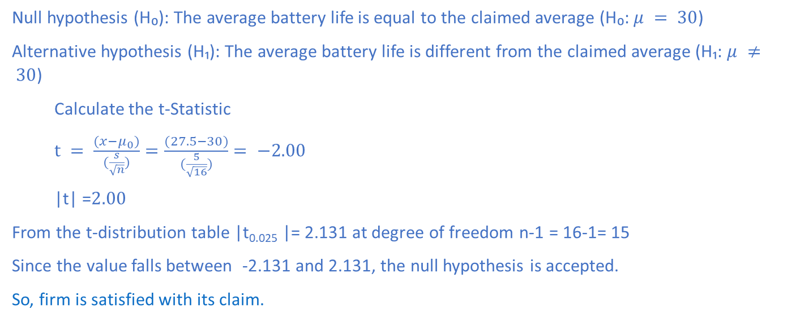
Question 4: A manufacturing firm claims that the batteries used in their electronic games will last an average of 30 hours. To maintain this average, 16 batteries are tested each month. If the computed t-value falls between −t_{0.025} and t_{0.025}, the firm is satisfied with its claim. What conclusion should the firm draw from a sample that has a mean of 27.5 hours and a standard deviation of 5 hours? What is the test statistic value for this hypothesis testing?
Answer: firm is satisfied with its claim.
Solution:

Slide 32
Question 5: The average number of acres burned by forest and range fires in a large New Mexico county is 4,300 acres per year, with a standard deviation of 750 acres. The distribution of the number of acres burned is normal. What is the probability that between 2,500 and 4,200 acres will be burned in any given year?

Slide 33
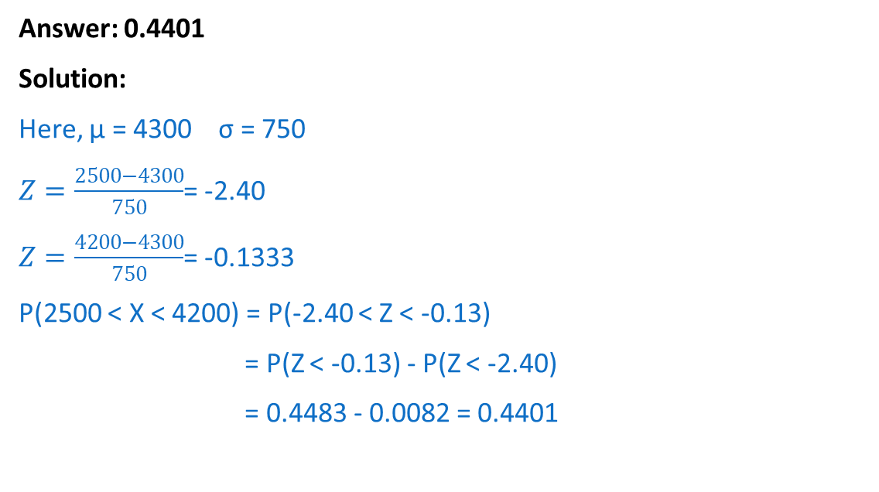
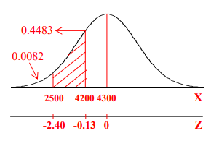
Question 5: The average number of acres burned by forest and range fires in a large New Mexico county is 4,300 acres per year, with a standard deviation of 750 acres. The distribution of the number of acres burned is normal. What is the probability that between 2,500 and 4,200 acres will be burned in any given year?

