Slide 1

Course Name: Hardware Security
Faculty Name: Prof Debdeep Mukhopadhyay
Department : Computer Science and Engineering
Topic
Lecture 02: Introduction to Hardware Security (Part 2)

Slide 2

Concepts Covered:
Root of Trust and TPM
Hardware Attacks
Side Channels and Trust in Hardware
A Hardware Design Flow

Slide 3



Hardware Root-of-Trust (RoT)
Secure Boot: In a trusted boot, a hardware based root of trust initiates the chain of trust by measuring the initial BIOS code.
Measurement here means computing a cryptographic hash function over the software’s binary, as well as any inputs, libraries, or configuration files used.
The BIOS then measures and executes the bootloader, and the bootloader in turn then measures and executes the operating system.
It will halt the system if any attempt is made to execute a program that is not in the approved list (L*).
If $m1∉L^{∗}, Halt$
If $m2∉L^{∗}, Halt$
Trusted Boot: L=⌀
Prog P1,
Conf C1
Execute
Execute
Prog P2,
Conf C2
System
(Hardware)
System
(P1,C1)
Measure m1
Measure m2
Append: L←L||m1
Append: L←L||m2
References: Bryan Parno, et. al., Bootstrapping Trust in Modern Computers, Springer

Slide 4
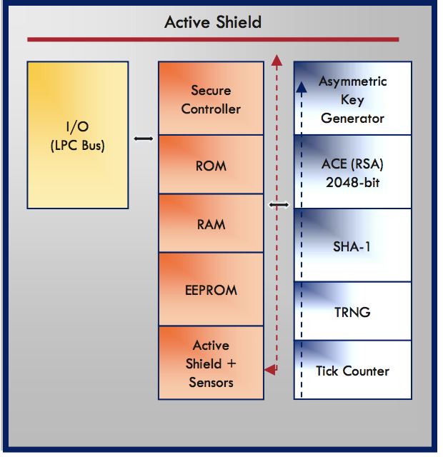
Trusted Platform Modules (TPM)
Definition: "A Trusted Platform is a computing platform that has a trusted component, probably in the form of built-in hardware, which it uses to create a foundation of trust for software processes.”-S. Pearson.
I/O: Low Pin Count Bus (LPC)
Secure Controller: Controls internal TPM execution flow and verifies commands
EEPROM: Stores TPM Keys [Endorsement Keys (EK), Storage Root Key (SRK)], Other data like Owner Authorization Data, EK Certificate
The EK and SRK never leaves the IC boundary.
References: http://www.cs.unh.edu/~it666/reading_list/Hardware/tpm_fundamentals.pdf

Slide 5
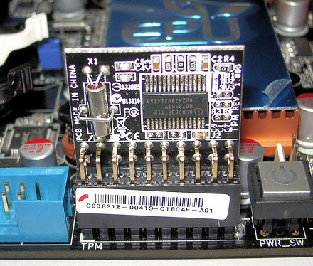
TPM Cryptographic Hardware
Trusted Platform Module installed on a motherboard
Asymmetric Key Generation: RSA Key Generator, Supports 1024-2048 bits
RSA Encryption Engine: RSA operations
SHA-1 engine: Hashing to measure integrity stored in Platform Configuration Registers (PCR). PCR←hash(PCR||hash(newcode)).
Random Noise Generator: True random generator to be used for cryptographic operations
Tick Counter: Provides an audit trail of TPM commands
Security Features: Active Shield, Voltage fluctuation detectors, high frequency sensors, Reset filters, etc.
References: http://www.cs.unh.edu/~it666/reading_list/Hardware/tpm_fundamentals.pdf

Slide 6
TPM 2.0
TPM 2.0 is not backward compatible.: RSA Key Generator, Supports 1024-2048 bits
Specification requires SHA-1 and SHA-256
Elliptic Curve Cryptosystems (NIST P-256, Barreto-Naehrig 256-bit curves)
128-bit AES encryption
Many other algorithms are also defined.
References: https://en.wikipedia.org/wiki/Trusted_Platform_Module#TPM_1.2_vs_TPM_2.0

Slide 7
Hardware Attacks on TPMs
In 2010, researchers presented an attack against TPM in Black Hat Conference
Extract secrets from a single TPM by inserting a probe and spying on the internal bus of an Infineon SLE 66 CL PC.
In 2015, reports on Differential Power Analysis (DPA) were reported to extract the secret keys.
References: https://en.wikipedia.org/wiki/Trusted_Platform_Module#TPM_1.2_vs_TPM_2.0

Slide 8
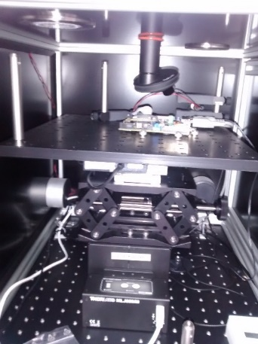
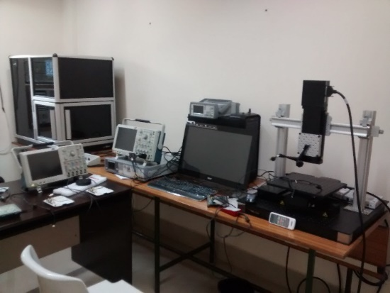
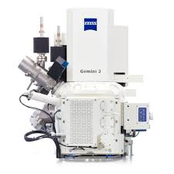
Hardware Attacks
Side Channel Attacks: Monitoring of analog signals, like time, power, Electro-magnetics, sound, etc.
Fault Attacks: Physical perturbation of Vcc, clock, temperature, UV light, X-Rays, Laser
Invasive Attacks: Probe data, modify circuit!
Modern Focused Ion Beam (FIB) machines can create test points and modify the chip structure from the rear side thus overcoming sophisticated top metal mesh protections and sensors
Expensive but feasible!
References: http://www.cs.unh.edu/~it666/reading_list/Hardware/tpm_fundamentals.pdf

Slide 9
Hardware Security bridges the gap between Theory and Practice
Message
E
D
Message
Communication
Channel
K_{a}
K_{b}
leaked
Information
Alice
Bob
Side Channels in the real world
Through which a cryptographic module leaks information to its environment unintentionally
Mallory
Cryptographic Theory has limitations.
There is an absence of theory for the reality!
Even mathematically strong ciphers leak in the real world!

Slide 10
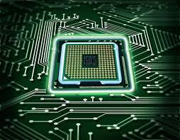
Hardware Security Design Goals
Performance:
Speed, Clock Frequency, Latency
Fast Arithmetic
Security:
Side Channel Attacks, Fault Attacks
Lightweight Countermeasures
Cost:
Area, Power, Energy

Slide 11
Hardware Design Flow on FPGAs
What is an FPGA?
Field Programmable Gate Arrays.
Array of logic cells connected via routing channels.
Special I/O cells.
Logic cells are mainly lookup tables (LUT) with associated registers.

Slide 12
Application of FPGAs
Prototyping:
Ensemble of Gate arrays used to emulate a circuit before manufacturing
Faster and more accurate simulation
Less cost Production:
Very less time to market
Better performance of modern FPGAs
Reconfigurable Computing:
Same hardware used to configure on the fly
Partial Reconfiguration also possible!
Special Purpose Computing Platform:
Dedicated to solve one problem
Can be attached to general purpose computers

Slide 13
A Classic Example of DES Cracker
In 1998, a custom hardware attack was mounted against the Data Encryption Standard :
$250,000 to build and decrypted DES cipher in 56 hours
In 2006, COPACOBANA (Cost-Optimized PArallel COde Breaker) was built:
Consists of commercially available, reconfigurable integrated circuits.
$10,000 and decrypts DES cipher in around 6.4 days
Cost decrease by roughly a factor of 25
Adjusting for inflation over 8 years yields an even higher improvement of about 30x.
Since 2007, SciEngines GmbH, a spin-off company of the two project partners of COPACOBANA has enhanced and developed successors of COPACOBANA.
In 2008 their COPACOBANA RIVYERA reduced the time to break DES to the current record of less than one day, using 128 Spartan-3 5000's
[Source: http://en.wikipedia.org/wiki/Custom_hardware_attack]

Slide 14
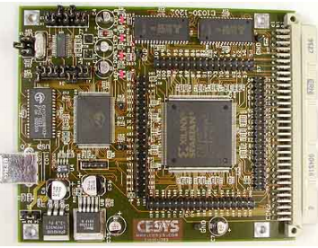
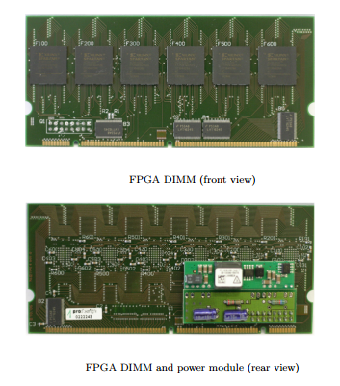
COPACOBANA Components
References: http://www.copacobana.org/paper/copacobana_gettingstarted.pdf

Slide 15
FPGA Architecture
I/O Block:
Located around the periphery of the core of the chip
Programmable Connectivity to the chip
Logic Blocks:
Configurable Logic Blocks (CLBs)
Surrounded by routing logic
Connected by switch blocks, or connections blocks
Switch Block: Connects wires in adjacent channels through programmable switches
Connection Block: Connects the wire segments around CLBs to its inputs and outputs also through programmable switches

Slide 16
Components of the CLB
LUT (Look Up Table) for implementing any function with k-inputs (k is 4 or 6)
Combinational Logic
Flip-flops/
Latches
(Sequential
Logic)

Slide 17





Design Flow
Design Entry in schematic, ABEL, VHDL, and/or Verilog. Vendors include Synopsys, Aldec (Xilinx Foundation), Mentor, Cadence, Viewlogic, and 35 others.
1
Implementation includes Placement & Routing and bitstream generation using Xilinx’s M1 Technology. Also, analyze timing, view layout, and more.
2
M1 Technology
Download directly to the Xilinx
hardware device(s) with
unlimited reconfigurations* !!
3
XC4000
XC4000
XC4000
*XC9500 has 10,000 write/erase cycles

Slide 18
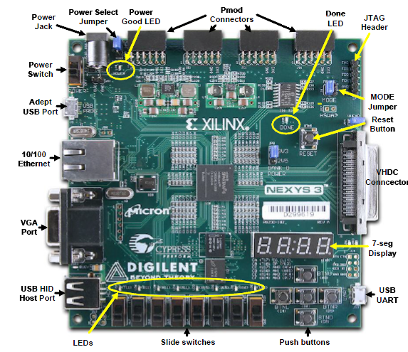
Nexys-III Board (A Sample Hardware Board)
FPGA
Source: www.digilent.com

Slide 19
A Simple Design Problem
Design a 2 bit adder:
Input : ‘a’ and ‘b’
Output: s = a + b

Slide 20
Design Files
module adder(a, b, s);
input [1:0] a, b;
output [2:0] s;
assign s = a + b;
endmodule

Slide 21
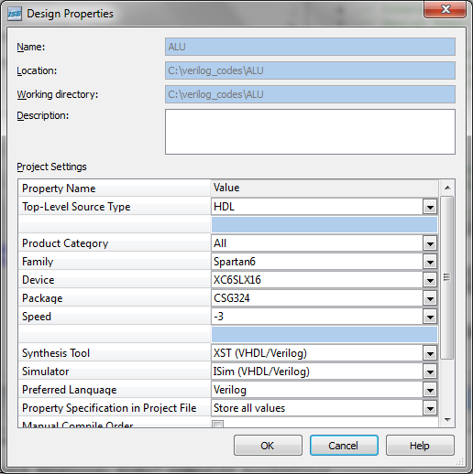
The Xilinx Design Environment
Device
Specifications
For the Nexys-III
Board

Slide 22
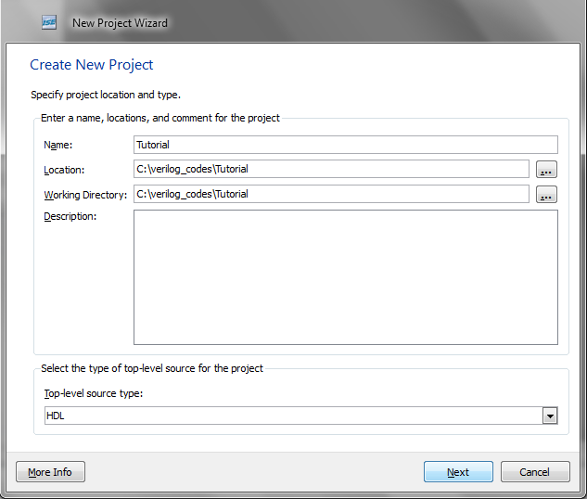
New Project Wizard

Slide 23
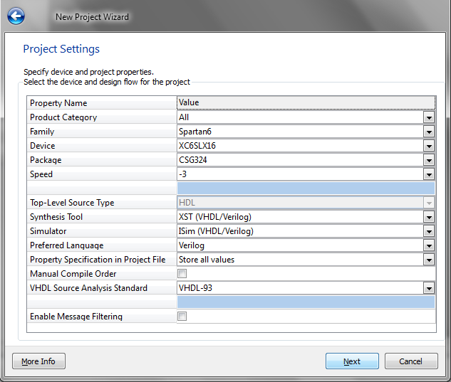
Device Settings
Device
Specifications
For the Nexys-III
Board

Slide 24
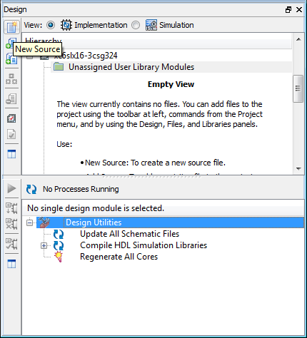
Click New Source

Slide 25
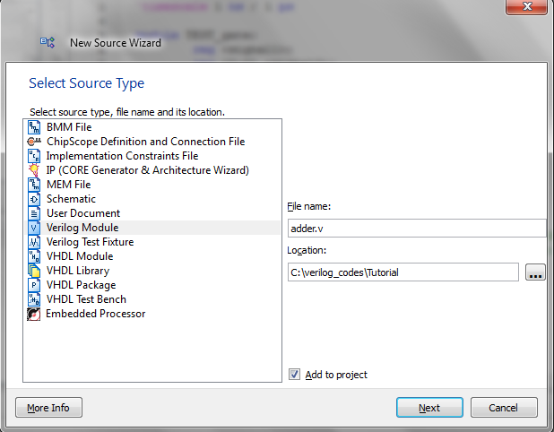
Create a Verilog File ‘adder.v’
Click
‘Next’->’Next’

Slide 26
‘adder.v’
module adder(a, b, s);
input [1:0] a, b;
output [2:0] s;
assign s = a + b;
endmodule

Slide 27
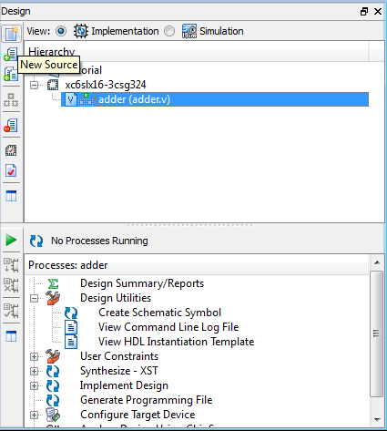
Writing Test Bench
Add the top module as ‘adder’

Slide 28
File ‘testadder.v’
module testadder;
// Inputs
reg [1:0] a;
reg [1:0] b;
// Outputs
wire [2:0] s;
// Instantiate the Unit Under Test
// (UUT)
adder uut (
.a(a),
.b(b),
.s(s));
initial begin
// Initialize Inputs
a = 0;
b = 0;
// Wait 100 ns for global
//reset to finish
#100;
// Add stimulus here
a = 2'b01;
b = 2'b11;
#1
a = 2'b11;
b = 2'b11;
end
endmodule

Slide 29
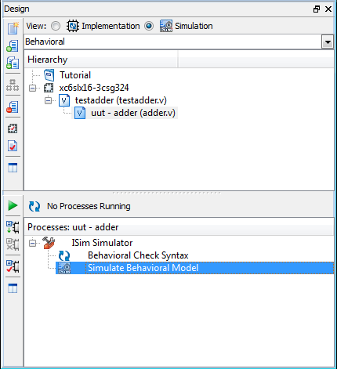
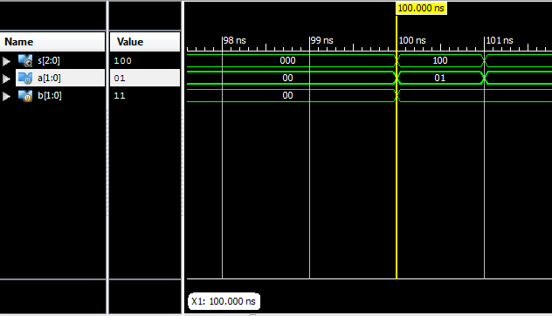
Simulated Behavioral Model

Slide 30
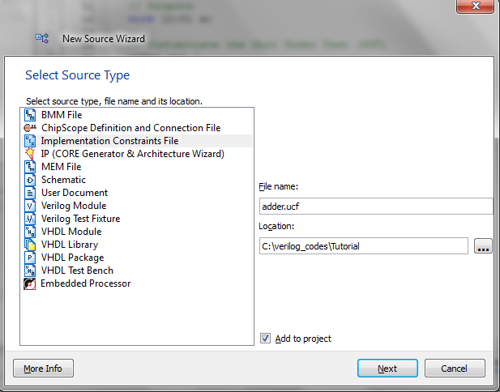
Adding User Constraint File (UCF) for Synthesis
NET "a[0]" LOC = T10;
NET "a[1]" LOC = T9;
NET "b[0]" LOC = V9;
NET "b[1]" LOC = M8;
NET "s[0]" LOC = U16;
NET "s[1]" LOC = V16;
NET "s[2]" LOC = U15;
(SEE THE NEXYS-III BOARD FOR
DESCRIPTIONS)
Go to Implement and Press
Synthesize-XST (Xilinx Synthesis
Technology)

Slide 31
Steps of Design Automation
RTL Design: Description of the design in a HDL (Hardware Design Language):
Data/Control Paths, Module description, integration, testing.
RTL Elaboration: Inferring of data-path to be realized by special components internal to the FPGA. The control path gets elaborated to finite state machines (FSM), or Boolean equations.
Architecture Independent Optimization: Data-path optimized by techniques like constant propagation, strength reduction, expression optimizations. Control paths are optimized by FSM encoding, state minimizations.

Slide 32
Steps of Design Automation
Mapping: Various elements of the design are optimally assigned to FPGA resources. Data-path elements get inferred to adders, multipliers, memory elements. Control-path are realized in the FPGA logic block. The optimizations depend on the FPGA fabric, the LUT structures, etc.
Placement: Decides the physical locations and inter-connections of each logic block.
Placement Driven Optimizations: In order to reduce the inter-connects, the initial placement is updated.
Routing: The CLBs and the wires are interconnected using restricted programmable switches.
Bit-Stream Generation: Final Step! It takes the routed design as input, and produces the bit stream to program the logic and inter-connects (every thing is a switch which can be programmed)

Slide 33
Open Adept tool from Digilent
Connect the Nexys-III board to the USB
Look for the USB Prog port in the board (AND NOT THE UART)
Click Initialize Chain
Should show the device XC6SLX16
Select the bit file: adder.bit and Program the FPGA
Check with the switch inputs, and see the result on the three LEDs (correspond with the UCF File)

Slide 34

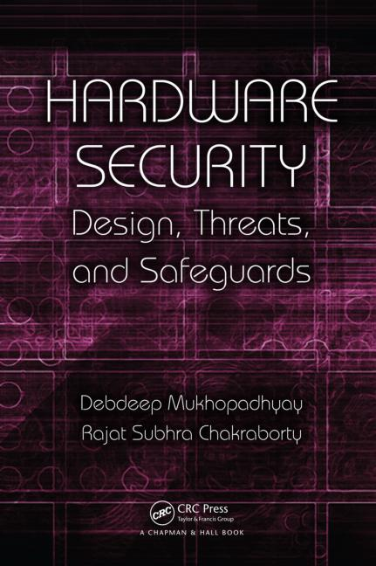
References:
Debdeep Mukhopadhyay and Rajat Subhra Chakraborty, Hardware Security: Design, Threats and Safeguards, CRC Press

Slide 35

Conclusion:
TPM a hardware security co-processor to work as a root of trust
Hardware Attacks are still possible in the form of side channel attacks
FPGAs provide a reconfigurable platform for hardware design
FPGA design flow takes the RTL description to the final prototype in the form of bit-files

Slide 36


