Slide 1
Big Data Processing
Jiaul Paik
IIT Kharagpur
Lecture 7

Slide 2
Multithreaded Programming

Slide 3
What is a thread?
A thread is a single sequential flow of control within a program
OR
A sequence of commands/instructions within a program

Slide 4
What is a thread?
thread
Program/process

Slide 5
What is a thread?
Thread 1
Thread 2
Program/process

Slide 6
Why Multithreading?
Better, more modular way of solving a problem
Processing computation in parallel by dividing tasks
Separate computation from I/O

Slide 7
Shared Memory Multiprocessors
Shared Memory
Shared bus
CPU
CPU
. . . .
CPU
CPU
Input/output

Slide 8
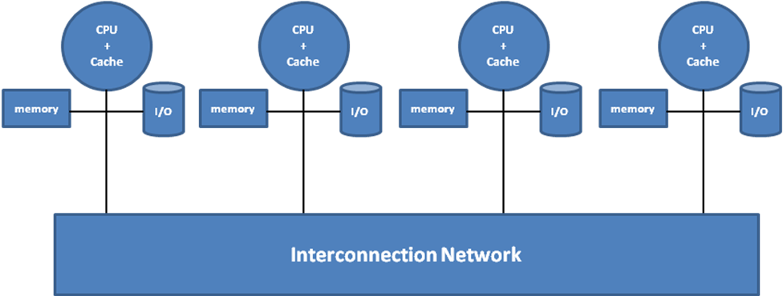
Distributed Memory Systems

Slide 9
Why Multithreading?
Example 1:
Customer transaction database files are coming from two sources with date, name and amount (in two separate files). Find total amount spent by each person.
Sequential programming
Multithreading
ReadFromFile(filename1)
SortByName()
P = AddAmountBasedOnName()
ReadFromFile(filename2)
SortByName()
Q = AddAmountBasedOnName()
AddData(P,Q)
ReadFromFile(filename1)
SortByName()
P = AddAmountBasedOnName()
ReadFromFile(filename2)
SortByName()
Q = AddAmountBasedOnName()
AddData(P,Q)

Slide 10
Why Multithreading?
Example 2:
Sort a large set of integers in ascending order
Sequential programming
Quicksort(S)

Slide 11
Why Multithreading?
Example 2:
Sort a large set of integers in ascending order
Multithreading
Quicksort(S)
Quicksort(S)
Quicksort(S)
Quicksort(S)
Quicksort(S)
Quicksort(S)
k-way merge

Slide 12
Programming support for threads
Threads as a programming abstraction.
Want to
dynamically create threads
communicate among threads
synchronize activities of threads
terminate threads
Typically a library provides these desired functionalities

Slide 13
Thread creation and termination
A thread executes some portion of a program
Like a program it has an entry point
When a thread is created this entry point is the address of some function

Slide 14
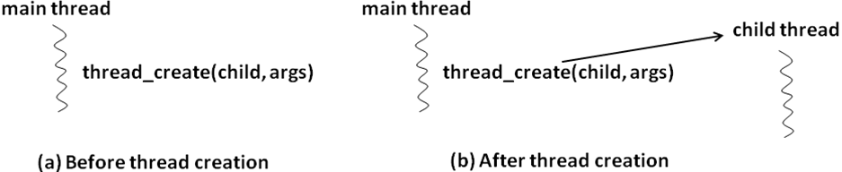
Thread creation and termination
tid_t thread_create (args)

Slide 15
Thread creation and termination
Thread automatically terminates when it exits the top-level procedure that it started in.
Library may also provide an explicit call for terminating a thread in same process:
thread_terminate (tid);
Where tid is the system-supplied identifier of the thread we wish to terminate.

Slide 16
Communication among threads
Threads share the same address space
sharing memory is simple
Shared variables can be visible to multiple threads

Slide 17
Data race
A condition where
multiple concurrent threads are simultaneously trying to access a shared variable
and at least one threads trying to update the shared variable
int var = 0; // shared variable
Thread 1 Thread 2
while (var == 0) { .
/* do nothing */ .
} .
if (var == 0) var = 1;
.
.

Slide 18
Data race
int count = 0; // shared variable
Thread 1 (T1) Thread 2 (T2) Thread 3 (T3) Thread 4 (T4)
. . .
. . .
count++; count++; count++; printf(count)
. . . .
. . . .
What will it print?

Slide 19
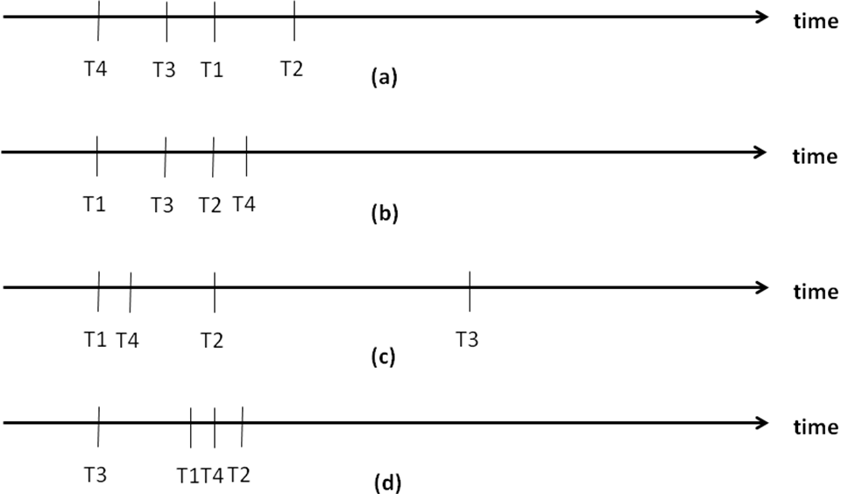
Data race
Depends on the sequence of execution!

Slide 20
Data race
Sequential Programming
Deterministic
Parallel Programming
Within a thread execution is sequential
Order of execution of threads determined by a thread scheduler
Non-deterministic
Results may vary

Slide 21
Synchronization among threads
Critical Sections
Sections of code in different threads which access the same shared variable are called
Need to avoid any two critical sections from being active at the same time
If one is in a critical section it must exclude the others
Thus this is called Mutual Exclusion
Variables used for this purpose are called mutex variables

Slide 22
Synchronization among threads
In practice
mutex_lock_type mylock;
Calls to acquire and release a particular lock:
thread_mutex_lock (mylock);
thread_mutex_unlock(mylock);
Only one thread at a time may lock the mutex!

Slide 23
Synchronization among threads
T1
T2
T3
T4
Critical section
Critical section
Critical section
Critical section
T1 is active and executing code inside its critical section.
T2 is active and executing code outside its critical section.
T3 is active and executing code outside its critical section.
T4 is blocked and waiting to get into its critical section.

Slide 24
Example Thread functions
thread_create (arguments):
creates a new thread that starts execution in top-level procedure with supplied args
thread_terminate (arguments):
terminates thread with id given by tid.
thread_mutex_lock (arguments):
when thread returns it has mylock; calling thread blocks if the lock is in use currently by some other thread.
thread_mutex_trylock (arguments):
Request for lock, it returns success if thread gets mylock;
thread_mutex_unlock(arguments):
For releasing lock
thread_join (arguments):
calling thread blocks until thread given by peer thread terminates.

Slide 25
Summary of threaded programming concepts
Terminology | Description
Top level procedure | The starting point for execution of a thread of a parallel program
Deterministic execution | Every run of a given program results in the same output for a given set of inputs. The execution model presented to a sequential program has this property.
Non-deterministic execution | Different runs of the same program for the same set of inputs could result in different outputs. The execution model presented to a parallel program has this property.
Data race | Multiple threads of the same program are simultaneously accessing a shared variable without any synchronization, with at least one of the accesses being a write to the variable.
Mutual exclusion | Signifies a requirement to ensure that threads of the same program execute serially. This requirement needs to be satisfied to avoid data races
Critical section | A region of a program wherein the activities of the threads are serialized to ensure mutual exclusion.
Blocked | Signifies the state of a thread in which it is simply waiting in a queue for some condition to be satisfied to make it runnable.

Slide 26
Summary of threaded programming concepts
Terminology | Description
Busy waiting | Signifies the state of a thread in which it is continuously checking for a condition to be satisfied before it can proceed further in its execution.
Deadlock | One or more threads of the same program are blocked awaiting a condition that will never be satisfied.
Livelock | One or more threads of the same program are busy-waiting for a condition that will never be satisfied.

Slide 27
pthreads library calls summary
int pthread_mutex_init(pthread_mutex_t *mutex,
const pthread_mutex-attr_t *mutexattr);
int pthread_cond_init(pthread_cond_t *cond,
pthread_condattr_t *cond_attr);
int pthread_create(pthread_t *thread, pthread_attr_t *attr, void *(*start_routine)(void *), void *arg);
int pthread_kill(pthread_t thread, int signo);
int pthread_join(pthread_t th, void **thread_return);
pthread_t pthread_self(void);
int pthread_mutex_lock(pthread_mutex_t *mutex);
int pthread_mutex_unlock(pthread_mutex_t *mutex);
int pthread_cond_wait(pthread_cond_t *cond,
pthread_mutex_t *mutex);
int pthread_cond_signal(pthread_cond_t *cond);
int pthread_cond_broadcast(pthread_cond_t *cond);
void pthread_exit(void *retval);

Slide 28
Thread Safe coding
Original Version
Thread Safe Version
void *malloc(size_t size){
. . .
. . .
return(pointer);
}
mutex_lock_type cs_mutex;
void *malloc(size_t size) {
thread_mutex_lock(cs_mutex);
. . .
. . .
thread_mutex_unlock(cs_mutex);
return (pointer);
}

Slide 29
Threading in Python
Threading Module
Thread class that implements threading
Some functions
run(): entry point for a thread.
start(): method that starts a thread by calling the run method.
join(): waits for threads to terminate.
isAlive(): checks whether a thread is still executing .
getName(): returns the name of a thread.
setName(): sets the name of a thread.
Creating Thread
define a new subclass of the Thread class
override the __init__() method to add arguments
override the run() method to implement what the thread should do
Start a thread by calling start()

