Slide 1
Weather Station with LCD Display
GUOYI RUAN
JINGYAO ZHANG
NISARG SOHAGIYA

Slide 2
Introduction
Motivation
Using Raspberry Pi to create a home weather station. The components of our project is to use a barometric sensor to read the temperature and pressure, display the result on a LCD screen.
Goal
Make an inexpensive device and turn home to smart home.
familiar with the in-home environment with a history of captured data.

Slide 3
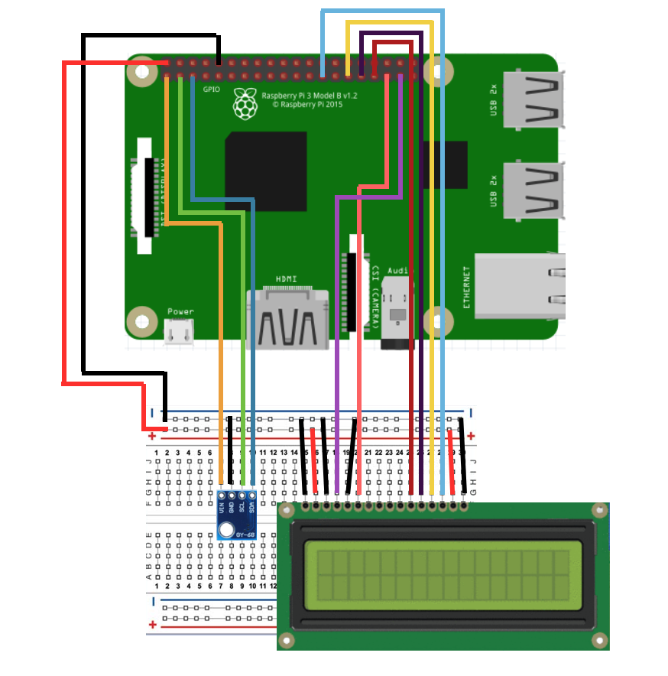
Hardware Design
Hardware Components:
Pressure and temperature sensor
SCL for the clock signal
SDA for the data transfers.
LCD Display
Register Select
Write/Read
Enable
Data Pin
Raspberry Pi
Breadboard
Jumper wires

Slide 4
I2C/SMbus Connection
I2C is a multi-device bus used to connect low-speed peripherals to computers and embedded systems. The Raspberry Pi supports this interface on its GPIO header and it is a great way to connect sensors and devices.
Each I2C device uses a unique 7-bit address, meaning you can have more than 120 unique I2C devices sharing the bus, and you can freely communicate with them one at a time on an as-needed basis.

Slide 5
Software Design
Program is written in mixed python and assembly language on Linux operating system.
pi@raspberrypi:~ $ uname –a
Linux raspberrypi 4.4.26-v7+ #915 SMP Thu Oct 20 17:08:44 BST 2016 armv7l GNU/Linux
RaspberryPi
I2C/SMBus
Other devices
LCD
BMP180 Sensor
Notes:
The system info is as following

Slide 6
Software Design
The steps of implementing weather stations in terms of software part
Initialize LCD screen
Initialize System Management Bus (SMBus) driver
Read calibration data from sensor via SMBus
Read raw temperature and press data from sensor via SMBus
Refine temperature and press data according to calibration data.
Print date to computer screen
Print temperature and press data to computer screen
Print info in Step 6 and 7 to LCD screen
Notes:
In the software part, we use 8 steps to implement the weather stations

Slide 7
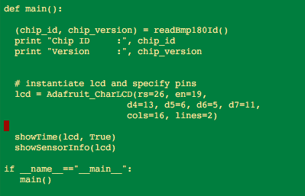
Software Design
The main function code in python is shown as following:
Notes:
First we call readBmp180Id function to get the chip ID and chip version and print them on the computer screen. Then initialize the LCD.
Call showTime function to get the current date and time. Call showSensor function to read the temperature and pressure from sensor and display them on the LCD

Slide 8
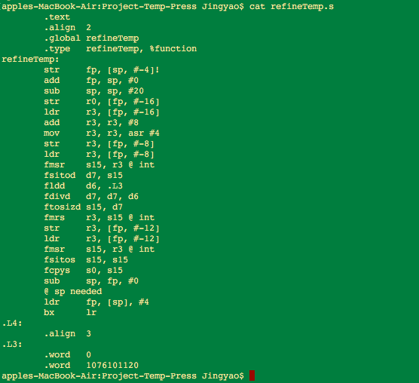
Software Design
refineTemp.s
Components in software
We implemented two functions caculateB5() and refineTemp() in assembly code.
Call assembly functions in python script
gcc -shared -I/usr/include/python2.7/ -lpython2.7 myModule.c caculateB5.s refineTemp.s -o myModule.so
Notes:
In this program, we implemented two functions calculateB5 and refineTemp in assembly code.
This pic shows the refineTemp code. In fact, python can not call assembly function directly.
In this program, myModule.c call the two assembly function as its external functions, and then we compile myModule.c and
the two assembly functions to generate a so file which can be
recognized by python. Then python can call this myModule.so file to run.

Slide 9
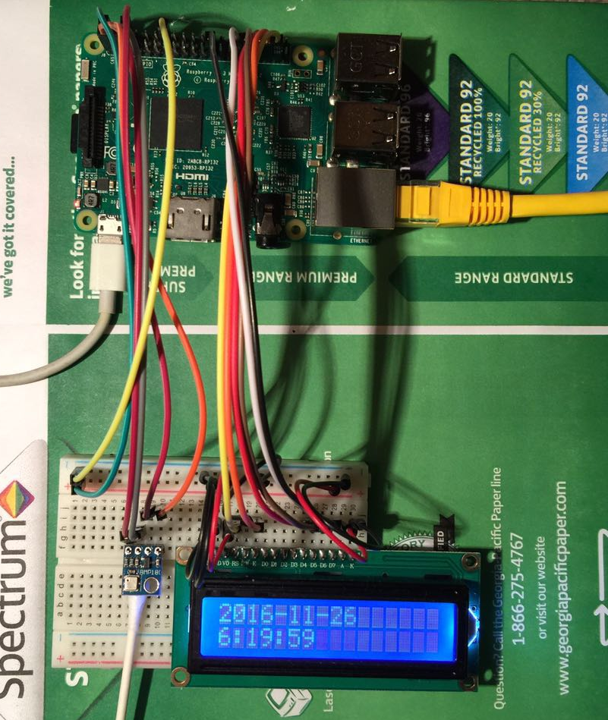
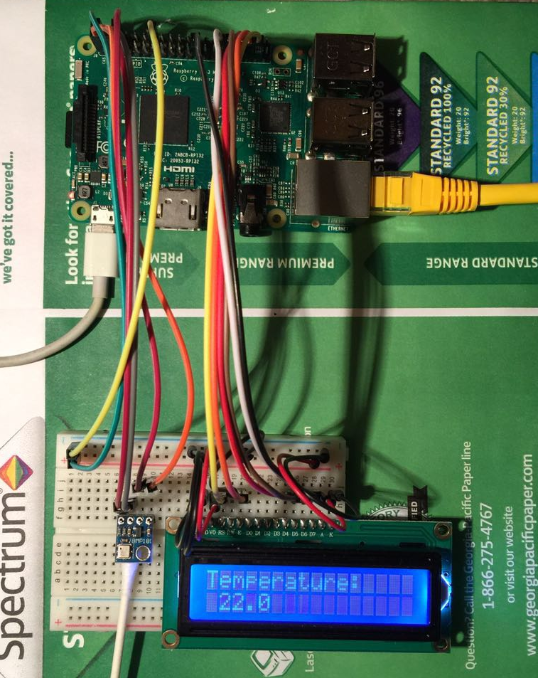
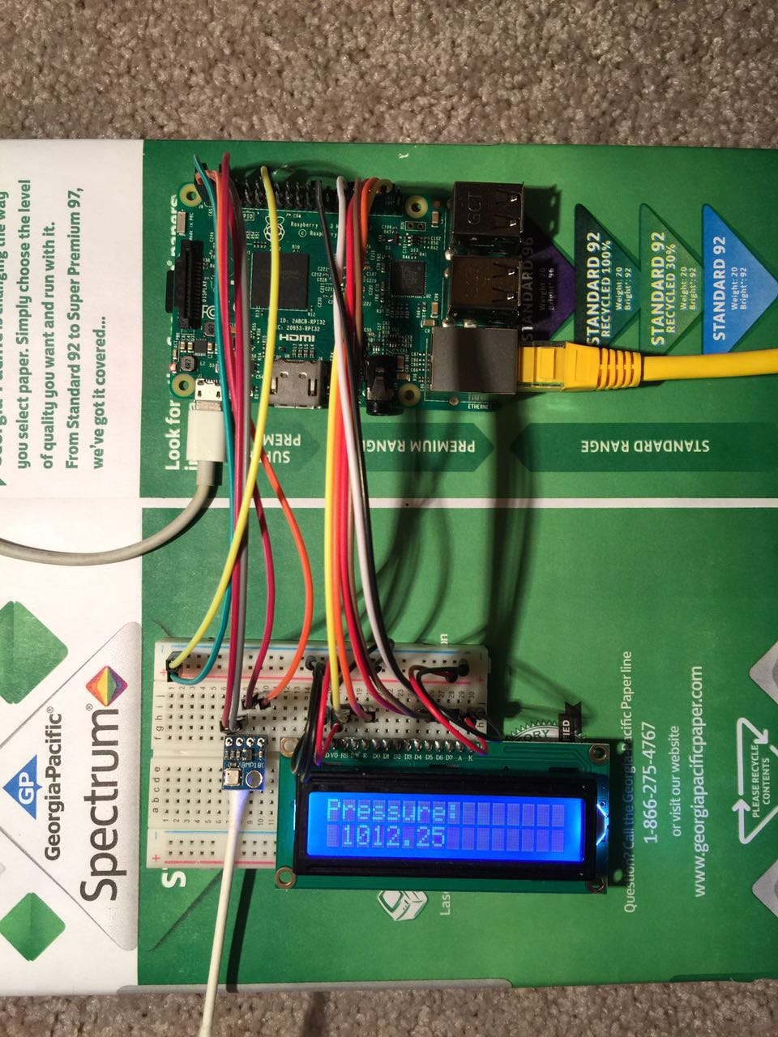
Result
Sample result from LCD screen:
One-time display (temperature and pressure)
1.show date
2.show temperature
3.show pressure
Notes:
In result part, we first show a one-time temperature and pressure display at LCD and computer screen.
After that, a 5-hour data collection with 2-minute sampled rate is conducted in time period [11:12 pm - 4:27 am]
in the indoor environment with AC off condition.

Slide 10
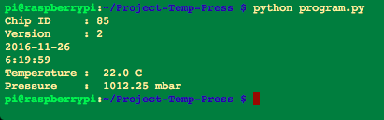
Result
Sample result from computer screen:
One-time display (temperature and pressure)
Notes:
In result part, we first show a one-time temperature and pressure display at LCD and computer screen.
After that, a 5-hour data collection with 2-minute sampled rate is conducted in time period [11:12 pm - 4:27 am]
in the indoor environment with AC off condition.

Slide 11
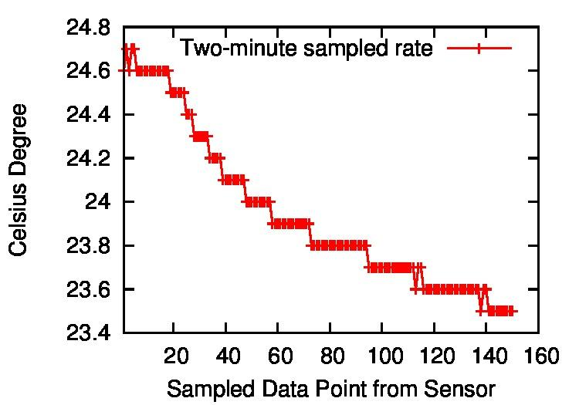
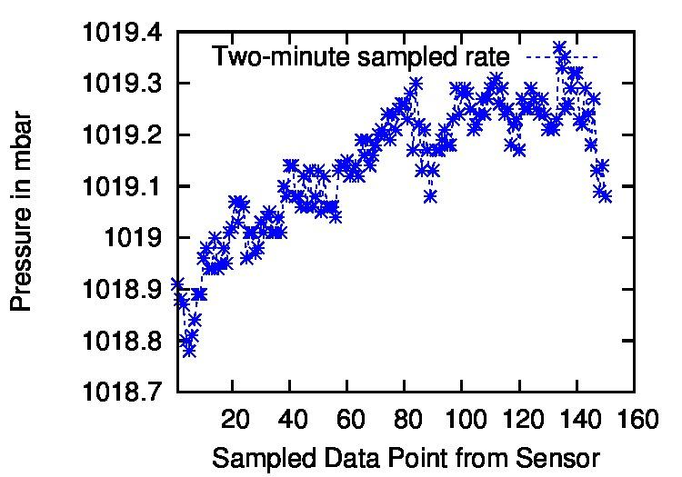
Result
5 hour data collection( 2-minute sampled rate is conducted):
Indoor environment with AC off condition.
Notes:
In result part, we first show a one-time temperature and pressure display at LCD and computer screen.
After that, a 5-hour data collection with 2-minute sampled rate is conducted in time period [11:12 pm - 4:27 am]
in the indoor environment with AC off condition.

Slide 12
Future Work
For the future work we have thought of adding few sensor like humidity, alarm and some led lights for some extra functionality like when the temperature go higher or lower than a limit than different kind of light will so different kind of warning and for higher limit alarm and sound sensors can be used.

Slide 13
Challege and Experience
-No one of had any past experience with the hardware so all the things using a raspberrypi and using sensors was all the first time thing for all the team members.
- From what to buy for project and what kind of sensors what kind of wires we will need and all was were confusing in the starting after few hours of discussion and searching on google we finally came across the basics about all the things. Than how to use the breadboard and how to assemble and how to manage.
- Other challenge we face is due to time problem some time 2 of the team member has to work on the pi and for that we came up with the vncviewer and it helped a lot in managing time.
-One other great challenge was to call assembly code from the python program.

Slide 14
Q & A

