Slide 1
Fine Grained Sentiment Classification Explainer App Group-7
Manzar Shajiuddin Ahmed
Mayur Sandipkumar Patel
Rutvik Trivedi
Nisarg Prashantbhai Zaveri

Slide 2
Introduction
In this project, we have developed a Fine Grained Sentiment Classification Explainer App.
Sentiment classification is crucial for understanding the nuances in customer feedback, social media interactions, and more.
This application uses the Stanford Sentiment Treebank (SST-5) dataset to classify sentiments from very negative to very positive.

Slide 3
Project Overview
Our aims to provide insights into sentiment predictions using multiple classifiers.
The app explains these predictions using LIME (Local Interpretable Model-agnostic Explanations) and is designed to help users understand why a particular sentiment was predicted.

Slide 4
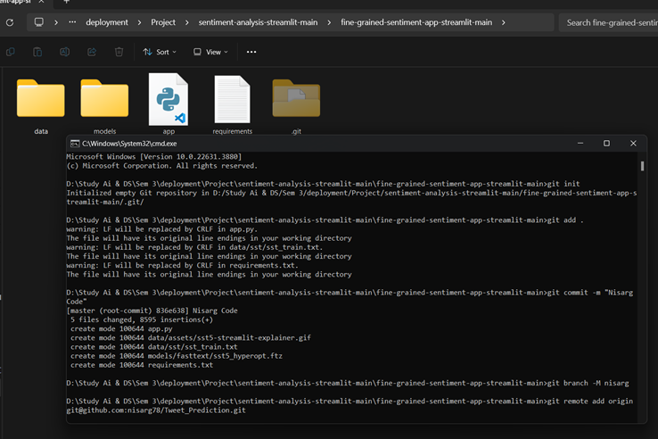

Slide 5
Why Streamlit?
Streamlit was chosen for its lightweight and minimalist framework, which is ideal for quickly prototyping UI designs with minimal code.
It simplifies the deployment of web applications by abstracting away complex backend configurations, making it easier for us to focus on the core functionalities of the app.

Slide 6
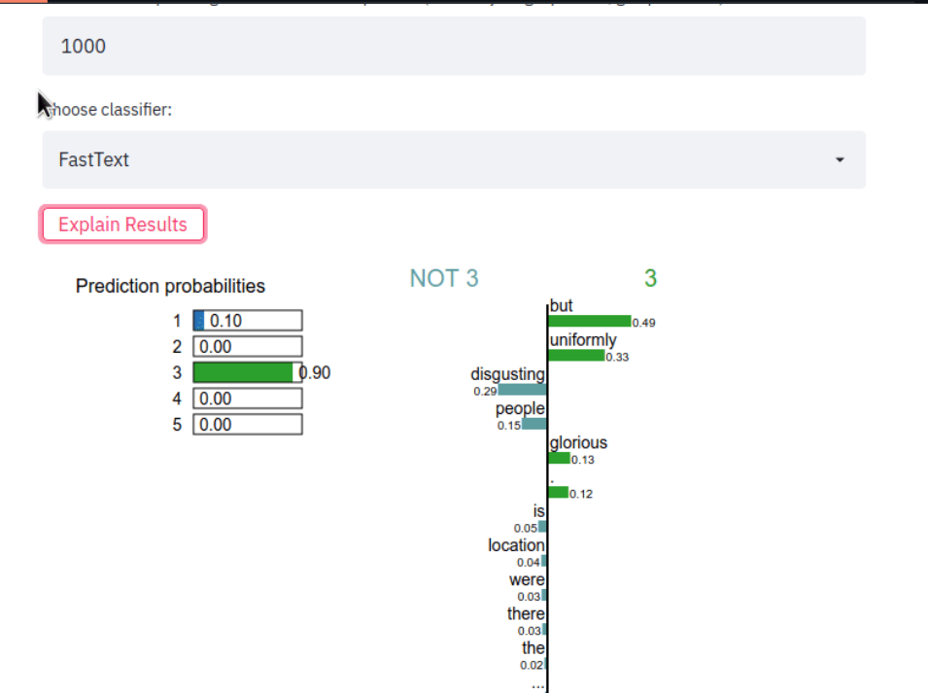
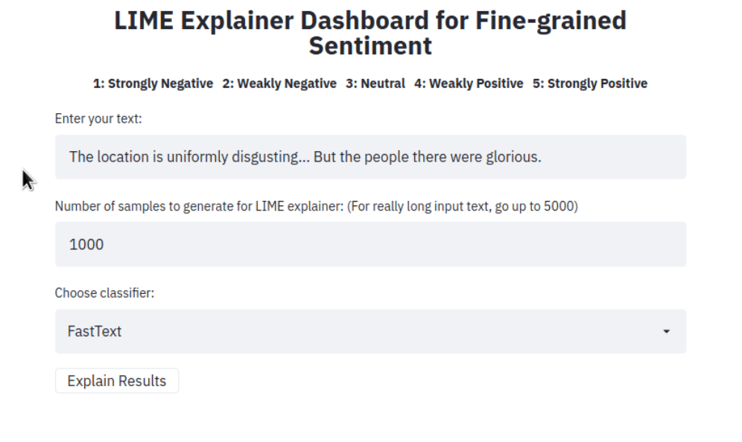
Streamlit

Slide 7

Installation and Setup
Set up a virtual environment:
1
`python3 -m venv venv`
`source venv/bin/activate`
Install dependencies:
2
`pip3 install -r requirements.txt`
Activate the virtual environment for further development:
3
`source venv/bin/activate`

Slide 8

Usage Instructions
Run the app using the command:
`streamlit run app.py`
Enter a sentence, choose a type of classifier, and click on the button 'Explain results'.
Observe the features (words or tokens) that contributed to the classifier predicting a particular class label.

Slide 9
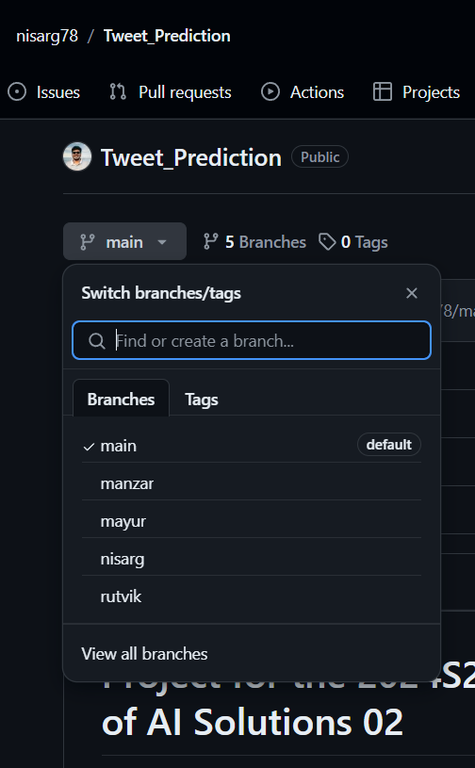
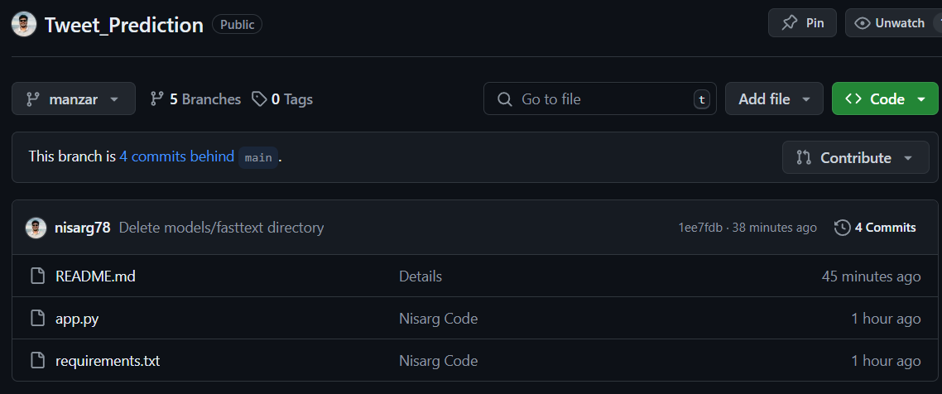
GIT Collaboration Process

Slide 10
Live Demo

Slide 11
Conclusion
The effective use of GIT for collaboration and the deployment of an AI solution using Streamlit.
By leveraging multiple classifiers and LIME for explanations, we provide a comprehensive tool for fine-grained sentiment analysis.
This project has enhanced our understanding of collaborative development, continuous integration, and deployment strategies.

Slide 12
Thank You
Link: - https://drive.google.com/drive/folders/1cXaETCBkIipwZtLEY9dZXJgeCIiDW4Z6?usp=sharing
Github: - https://github.com/nisarg78/Tweet_Prediction/tree/main

