Slide 1
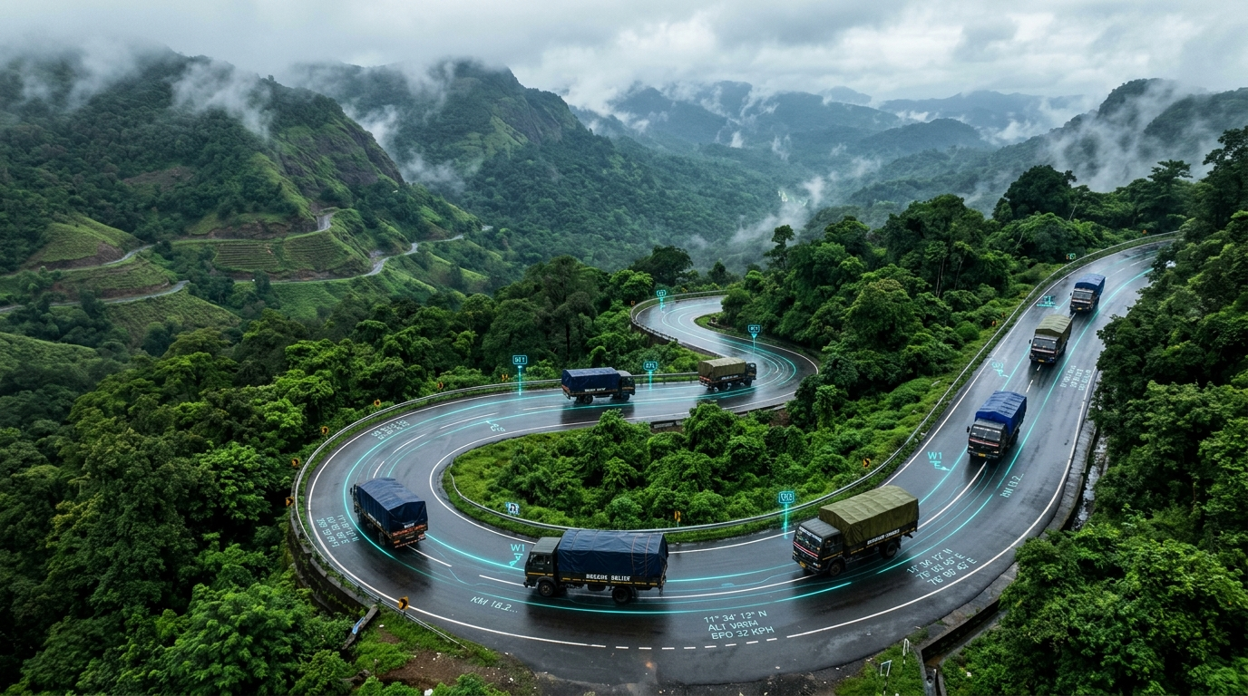
ACADEMIC MINI PROJECT • DISASTER RELIEF LOGISTICS
ReliefRoute India v2
Smart & Safe Truck Routing
During Disasters in India
An easy-to-use map dashboard that guides emergency relief trucks safely around flooded roads, landslides, and storm zones across India.
Created by: Nisarga Devaraj (github.com/nisargad1)
Built with: R, Shiny, Leaflet & OpenStreetMap
November 2026 • Free & Open Source (MIT License)
Smart Navigation in Action: Helping emergency supply trucks steer clear of flooded roads and mountain landslides during heavy monsoon storms.

Slide 2
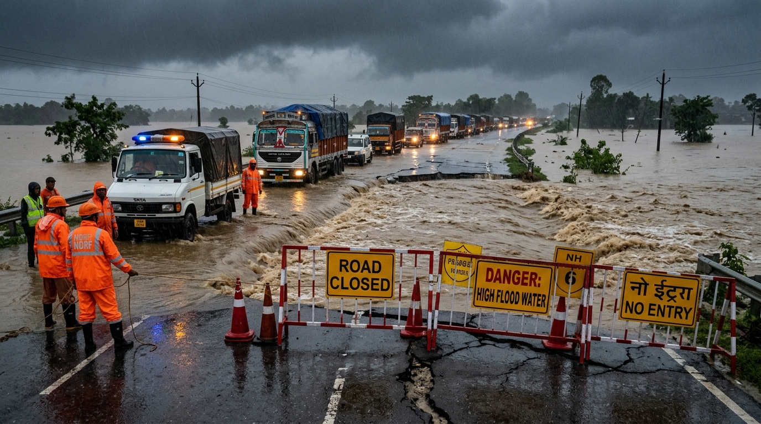
THE REAL-WORLD PROBLEM
Why Regular GPS Apps Fail During Emergencies
Everyday navigation apps like Google Maps are made for normal traffic, not disaster zones.
1. Fastest Route is Not Always Safe
Normal map apps always pick the shortest or quickest road. But during heavy floods (like in Kerala or Assam), that 'fastest' highway is often washed out or underwater, leaving trucks trapped.
2. Warning Updates Are Scattered & Slow
Government weather and flood warnings usually come as news updates, PDF circulars, or radio bulletins. Drivers and managers cannot easily plug these alerts into a map to see safe routes.
Real Challenge: Blocked and flooded highway during Indian monsoons.
3. Huge Costs and High Stakes
Up to 80% of all disaster spending goes into transporting goods. When trucks take wrong, blocked roads, relief items get ruined and help arrives too late for people in need.
60% – 80%
Of all disaster relief funding is spent on transportation and fuel. When roads are blocked, essential food, water, and medicines get delayed.

Slide 3
TARGET AUDIENCE & STAKEHOLDERS
Who Are the Users of ReliefRoute India?
Designed for government agencies, emergency responders, fleet operators, and aid workers.
1. Disaster Management Authorities
NDMA, STATE (SDMA) & DISTRICT (DDMA) TEAMS
• Monitors the national supply-demand picture in real time.
• Sees which districts are cut off by floods or landslides.
• Downloads one-click Situation Reports (HTML/PDF) for executive briefings and state emergency meetings.
2. Fleet Dispatchers & Convoy Leaders
NDRF, ARMED FORCES & TRUCK OPERATORS
• Plans safe turn-by-turn driving routes for emergency lorry drivers.
• Uses the Safety Slider to balance convoy speed vs hazard detour.
• Automatically groups trucks into 10-tonne convoys to save fuel and ensure drivers travel in safe escorted teams.
3. Relief Camp Managers & District Officers
LOCAL EMERGENCY RELIEF CAMPS & SHELTERS
• Enters camp population numbers to calculate exact food/water tonnes needed.
• Draws live red 'No-Go' circles or boxes directly on the map over flooded bridges.
• Requests supplies from multiple central warehouses with clear shortage warnings.
4. NGOs & Humanitarian Volunteers
RED CROSS, GOONJ, LOCAL VOLUNTEER NETWORKS
• Needs an affordable, free tool to coordinate independent aid trucks.
• Avoids expensive commercial mapping subscription fees.
• Uses open-source data to direct donated clothes, food, and medicine to where need is highest.

Slide 4
COMPARISON WITH EXISTING TOOLS
What Exists Today vs. ReliefRoute India
How our solution solves the key missing pieces in current apps.
Regular Map Apps
(Google Maps)
City Driving
Open-Source Routers
(OSRM / ORS)
Standard Routing
Government Sites
(NDMA / IMD)
Weather Alerts
ReliefRoute India
(Our Solution)
Disaster Relief
AVOIDS DISASTERS?
✗ No (only traffic jams and tolls)
CUSTOM DANGER ZONES?
✗ Cannot draw flood zones
SAFETY RISK SCORE?
✗ Only checks travel time/distance
WAREHOUSE BALANCING?
✗ Only 1 car/trip at a time
ACCESS & PRICE
✗ Proprietary, commercial service
AVOIDS DISASTERS?
✗ Basic roadblocks only
CUSTOM DANGER ZONES?
✗ Slow and clunky to update
SAFETY RISK SCORE?
✗ Limited risk adjustments
WAREHOUSE BALANCING?
✗ Cannot plan supply sharing
ACCESS & PRICE
✗ Complex server configuration
AVOIDS DISASTERS?
✗ Shows warnings on static web maps
CUSTOM DANGER ZONES?
✗ Informational only, not for GPS
SAFETY RISK SCORE?
✗ Color codes (Yellow/Orange/Red)
WAREHOUSE BALANCING?
✗ Managed manually by phone calls
ACCESS & PRICE
✗ Government internal systems
AVOIDS DISASTERS?
✔ Live rain, flood, and quake feeds
CUSTOM DANGER ZONES?
✔ 1-Click tool to draw no-go zones
SAFETY RISK SCORE?
✔ Smart Risk Index with safety slider
WAREHOUSE BALANCING?
✔ Automatically balances stocks & camps
ACCESS & PRICE
✔ 100% Free, open-source R code

Slide 5
FORMULAS USED: PART 1
How We Calculate Safe Routes & Road Risk Scores
The exact equations used by the app to score danger and reroute trucks.
Formula 1: The Weighted Risk Index (WRI)
WRI = 100 × ( wH·H + wR·V + wS·S ) / ( wH + wR + wS )
• Meaning: Calculates a single Risk Score from 0 (Safe) to 100 (Deadly) for every highway.
• H (Hazard): Live weather danger (0 to 1) from rain forecast, flood signals, or earthquakes.
• V (Vulnerability): Road fragility (0 to 1) based on mountain terrain slope or flood plains.
• S (Security): Checkpoints, difficult passes, or border security constraints (0 to 1).
• wH, wR, wS: Importance weights chosen by user (default: 8 for weather, 4 for road, 3 for security).
Formula 2: Hazard Slowdown (Real Travel Time)
Travel_Time = Base_Time / ( 1 - 0.45 · H )
• Meaning: Floods, water-logging, and storms slow down heavy trucks automatically.
• If Hazard H = 0 (dry weather): Travel_Time = Base_Time (normal truck speed: 55 km/h on highways).
• As Hazard H increases toward 1: Truck speed slows down by up to ~45% due to rain and standing water.
Formula 3: Risk-Penalised Routing Cost (Dijkstra Shortest Path)
Route_Cost = Travel_Time × [ 1 + λ × ( WRI / 100 ) × 2 ]
• Meaning: Adds an extra penalty to dangerous roads so the map chooses safe detours.
• λ (Lambda Slider, 0 to 10): Lets the manager set their risk tolerance.
• At λ = 0: Behaves like normal GPS (fastest route, ignores danger).
• At λ > 0: Happily takes a small detour if it avoids dangerous flood corridors.
• Hard Rule: If a road touches a drawn danger polygon or H ≥ 0.85, the road is closed completely.

Slide 6
FORMULAS USED: PART 2
How We Calculate Camp Needs, Warehouse Sharing & Convoys
Equations for population relief rations, linear programming, and vehicle routing.
Formula 4: Dynamic Relief Camp Demand (Tonnes of Food/Water)
Demand = [ Population × Affected% × ( 1 + 1.5·H ) × Ration_kg × Days ] / 1000
• Meaning: Calculates exactly how many tonnes of supplies each disaster camp needs.
• Population: Census of India 2011 district numbers.
• Affected%: Percentage of district displaced or stranded (e.g. 5% to 25%).
• (1 + 1.5·H): Disaster multiplier — camps in severe flood areas (high H) receive up to 2.5× extra aid.
• Ration_kg: Standard disaster ration per person per day (default: 2.5 kg food and water).
Formula 5: Warehouse Supply Balancing (Linear Programming Simplex)
Minimize Total Cost = ∑ ∑ ( Shipment_ij × Route_Cost_ij ) subject to Warehouse Stock & Camp Need
• Meaning: Solves the mathematical puzzle of which central warehouse supplies which relief camp.
• Shipment_ij: Number of tonnes sent from Warehouse i to Camp j.
• Route_Cost_ij: Safe risk-weighted rupee delivery cost between the two cities.
• Constraint: A warehouse cannot ship more than its stored stock. Every camp's demand must be met.
• Virtual Dummy Hub: If total stock across India is short, unmet demand is flagged with exact missing tonnes.
Formula 6: Clarke-Wright Convoy Savings (Grouping Deliveries)
Savings(A, B) = Cost(Hub to A) + Cost(Hub to B) - Cost(A to B)
• Meaning: Checks if delivering to Camp A and Camp B in ONE combined round trip saves fuel.
• Instead of sending 2 separate round trips (Hub→A→Hub and Hub→B→Hub), trucks travel Hub→A→B→Hub.
• Capacity Constraint: Total tonnes combined must fit within the 10-tonne truck payload limit.
• Result: Saves up to 35% in fuel and ensures relief trucks travel in safe, escorted groups.

Slide 7
SMART LOGISTICS FEATURES
Two Smart Tools: Sharing Supplies & Grouping Trucks
Deciding who gets what supplies, and how trucks travel together safely.
TOOL 1: Fair Supply Sharing
Which warehouse sends food to which relief camp?
• Lowest Overall Cost: Automatically matches multiple warehouses with relief camps across India at the lowest delivery cost and risk.
• Based on Real Population: Camps with more people or heavier disaster damage automatically get more supplies.
• Clear Shortage Warnings: If total food or trucks are not enough, the app clearly shows exactly how many tonnes are still missing.
TOOL 2: Multi-Stop Truck Convoys
Grouping trucks into safe, shared journeys
• Multi-Stop Deliveries: Instead of sending separate trucks back and forth to each village, it creates one round-trip route that delivers to several camps in a row.
• Packed to Capacity: Ensures every 10-tonne relief truck is fully loaded before leaving, avoiding wasted trips.
• Saves Fuel & Keeps Drivers Safe: Saves up to 35% in total driving distance and fuel, while keeping trucks traveling together in safe groups.

Slide 8
HOW THE SYSTEM WORKS
System Architecture in 3 Simple Steps
From live public data to smart map directions for relief teams.
STEP 1: LIVE DATA FEEDS
Pulls Free Public Data
• Open-Meteo: Live 3-day rainfall forecasts & flood signals
• USGS: Real-time earthquake alerts
• NASA: Natural hazard events (floods, storms, fires)
• OpenStreetMap: Real road distances and driving times
• Census of India: Population numbers for every district
STEP 2: THE ROUTING BRAIN
Calculates Safe Paths
• Connects 48 major Indian cities across 69 main highways
• Checks which roads fall inside drawn flood danger zones
• Calculates the Risk Score for every highway segment
• Finds the best detour around storms using shortest-path math
• Solves supply matching so every camp gets fair rations
STEP 3: EASY DASHBOARD
Interactive Web App
• Color-coded map showing safe routes, warnings, and trucks
• Heatmaps showing where relief supplies are needed most
• Simple slider to choose speed vs. extra safety
• 1-Click download of printable summary reports (HTML/PDF)
• Bilingual labels in both English and Hindi for field teams

Slide 9
TECHNOLOGIES USED
Simple Tech Stack Overview
Built using standard, reliable, and completely free open-source tools.
DASHBOARD & APP
R & Shiny Dashboard
Builds the interactive web interface with buttons, map layers, tabs, and real-time screen updates.
MAPS & GEOGRAPHY
Leaflet & sf Package
Draws interactive maps of India, road polylines, flood circles, and lets users draw shapes on the map.
ROUTING MATH
igraph & lpSolve
Crunches the numbers to find the safest routes and solves warehouse supply sharing in seconds.
LIVE INTERNET FEEDS
Weather & Satellite APIs
Pulls live weather and earthquake information automatically from Open-Meteo, USGS, NASA, and OSM.
TESTING & QUALITY
testthat & GitHub Actions
Automatically runs test checks on every update to guarantee the routes and math are 100% correct.
REPORTS & CHARTS
Plotly & HTML Export
Shows risk trade-off graphs and generates clear summary reports ready to print or save as PDF.

Slide 10
KEY PROJECT FEATURES
Helpful Features Built for Relief Teams
Practical tools designed for both live emergency responses and training drills.
EASY 1-CLICK TOOL
Draw Danger Zones on the Map
Emergency workers can simply draw a box or circle over flooded areas on the map. The app immediately closes those roads and finds a safe detour in seconds.
TESTED WITH REAL DATA
Replay Past Indian Disasters
Test the system against real historical storms: Kerala Floods (2018), Chennai Floods (2015), Uttarakhand Landslides (2013), Cyclone Fani (2019), and Assam (2024).
TRANSPARENT CHOICES
Compare Routes Side-by-Side
View 3 choices at once: (1) Normal GPS path, (2) Avoid Roadblocks path, and (3) Our Safe Route. Clearly see the small extra travel time needed to stay safe.
READY FOR MEETINGS
Printable Situation Report (SitRep)
Download a clean summary sheet with total food delivered, truck trip schedules, and any unmet camp needs — ready to print or save as a PDF for commanders.

Slide 11
HONEST SELF-EVALUATION
Current Limitations of the Project
Honest points to mention during viva, defense, or project presentations.
1. Highway Corridors Only (Not Village Streets)
The app currently maps 48 major Indian cities and 69 highway routes. It does not yet cover every small village street or unpaved rural mud road.
2. Estimated Warehouse Stock & Bridge Data
Warehouse stock levels, bridge strength scores, and security ratings currently use estimated figures. Real government use will require live warehouse database connections.
3. Weather Block Size (25 km Grid)
Satellite rain data comes in 25-kilometer blocks. While great for regional monsoon storms, it can smooth out sudden, tiny flash floods in narrow mountain valleys.
4. Internet Needed for Live Updates
Pulling live weather and earthquake data needs internet access. Saved historical scenarios work completely offline, but real-time mode needs a data connection.

Slide 12
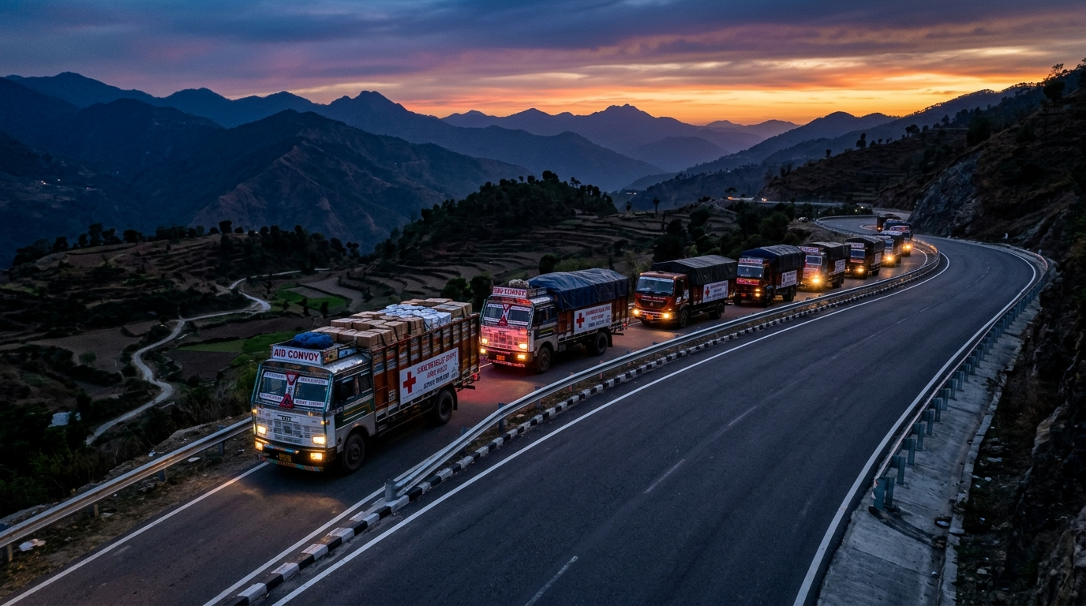
FUTURE IMPROVEMENTS
What We Plan to Build Next
Roadmap to turn this student project into a field-ready emergency platform.
1. Connect to Live River Flood Sensors
Link directly with Central Water Commission (CWC) river gauges and IMD radar for early flash flood warnings.
2. Offline Phone App for Truck Drivers
Build a lightweight driver app that works even when phone networks are down, using satellite or walkie-talkie mesh.
3. Drone Photos to Spot Road Damage
Use quick drone photos after a flood or landslide to automatically detect broken bridges and update the map instantly.
4. Separate Relief Supplies by Urgency
Separate trucks for cold-chain medicines, clean drinking water, and dry food so life-saving medicines get priority.
Ultimate Goal: Relief trucks traveling together safely on clear roads, delivering urgent supplies without getting delayed by floods.

Slide 13
SUMMARY & CONCLUSION
ReliefRoute India: Key Takeaways
1. Solves a Real Problem: Regular GPS leads trucks into floods. Our tool routes around shifting danger zones.
2. Balances Speed & Safety: Lets emergency teams decide how much extra time they are willing to take to stay 100% safe.
3. Fair Supply Sharing: Automatically coordinates warehouse stocks so no relief camp is left empty-handed.
4. Saves Money & Fuel: Groups trucks into shared convoys, cutting fuel costs by up to 35%.
5. Free & Tested: Fully working dashboard, tested code, and open source under the MIT License.
GitHub Repository: https://github.com/nisargad1/ReliefRoute-India
Created by: Nisarga Devaraj • Built with R & Shiny • Thank You!

