Slide 1


Case Study Title:
Sustainable Agriculture with AI for
Crop Yield Prediction
College Name: Acharya Institutes
Student names: Nisarga Jadav
Suruchi Kumari
Megha Saha

Slide 2
Problem Statement
Brief Overview:
Agriculture is highly dependent on environmental factors such as temperature, rainfall, and soil quality. Climate change and resource constraints make it challenging for farmers to predict crop yields accurately. Inefficient resource utilization leads to reduced productivity and financial losses.
AI-based crop yield prediction can help optimize resource allocation and enhance sustainability in farming.
Key Objectives:
Develop a machine learning model to predict crop yields based on environmental and soil parameters.
Provide accurate insights to help farmers make data-driven decisions.
Optimize water, fertilizer, and land usage for sustainable agriculture.
Improve crop productivity while minimizing environmental impact.
Source :
www.freepik.com/

Slide 3
Dataset Overview
The dataset used for crop yield prediction consists of environmental and agricultural parameters collected over a 5-year period.
It includes attributes such as soil quality, temperature, rainfall, and crop yield, ensuring a diverse and non-repetitive dataset for accurate model training.
The data has been sourced from verified agricultural reports and research studies, containing 100 unique entries.
Key features include variations in soil pH, moisture levels, and climate conditions, which significantly impact yield predictions.
This dataset enables AI models to learn patterns and provide insights for optimizing agricultural productivity.
Source :
www.freepik.com/

Slide 4
Methodology
Approach:
The project follows a structured approach to predict crop yield accurately:
Data Collection & Preprocessing – The dataset is loaded, missing values are handled, and features are scaled.
Exploratory Data Analysis (EDA) – Visualization techniques are used to understand trends and relationships.
Model Selection & Training – Machine learning models are trained on historical crop yield data.
Evaluation & Optimization – The models are evaluated using accuracy metrics, and hyperparameter tuning is applied.
Deployment – A user-friendly dashboard is developed using Streamlit for easy predictions.
Algorithms Used:
Random Forest Regressor – Used for its ability to handle nonlinear relationships and provide high accuracy.
Linear Regression – Applied as a baseline model to compare performance.
Gradient Boosting – Enhances predictions by sequentially improving weak learners.
This approach ensures reliable and efficient crop yield predictions based on input parameters.
Source :
www.freepik.com/

Slide 5

Conclusion
Summary:
The crop yield prediction model successfully forecasts yield based on various environmental and agricultural parameters. The use of machine learning algorithms like Random Forest, Linear Regression, and Gradient Boosting ensures accurate predictions, helping farmers and policymakers make informed decisions. The Streamlit-based dashboard provides an intuitive interface for users to input data and receive real-time predictions.
Future Work:
Enhancing the model by incorporating real-time weather and soil data for more dynamic predictions.
Expanding the dataset to include more crop varieties and geographical regions for greater generalization.
Integrating IoT-based sensors for automated data collection and improved accuracy.
Deploying the model as a mobile application for accessibility to farmers in remote areas.
This project lays a strong foundation for AI-driven smart agriculture and sustainable farming practices.
Source :
www.freepik.com/

Slide 6
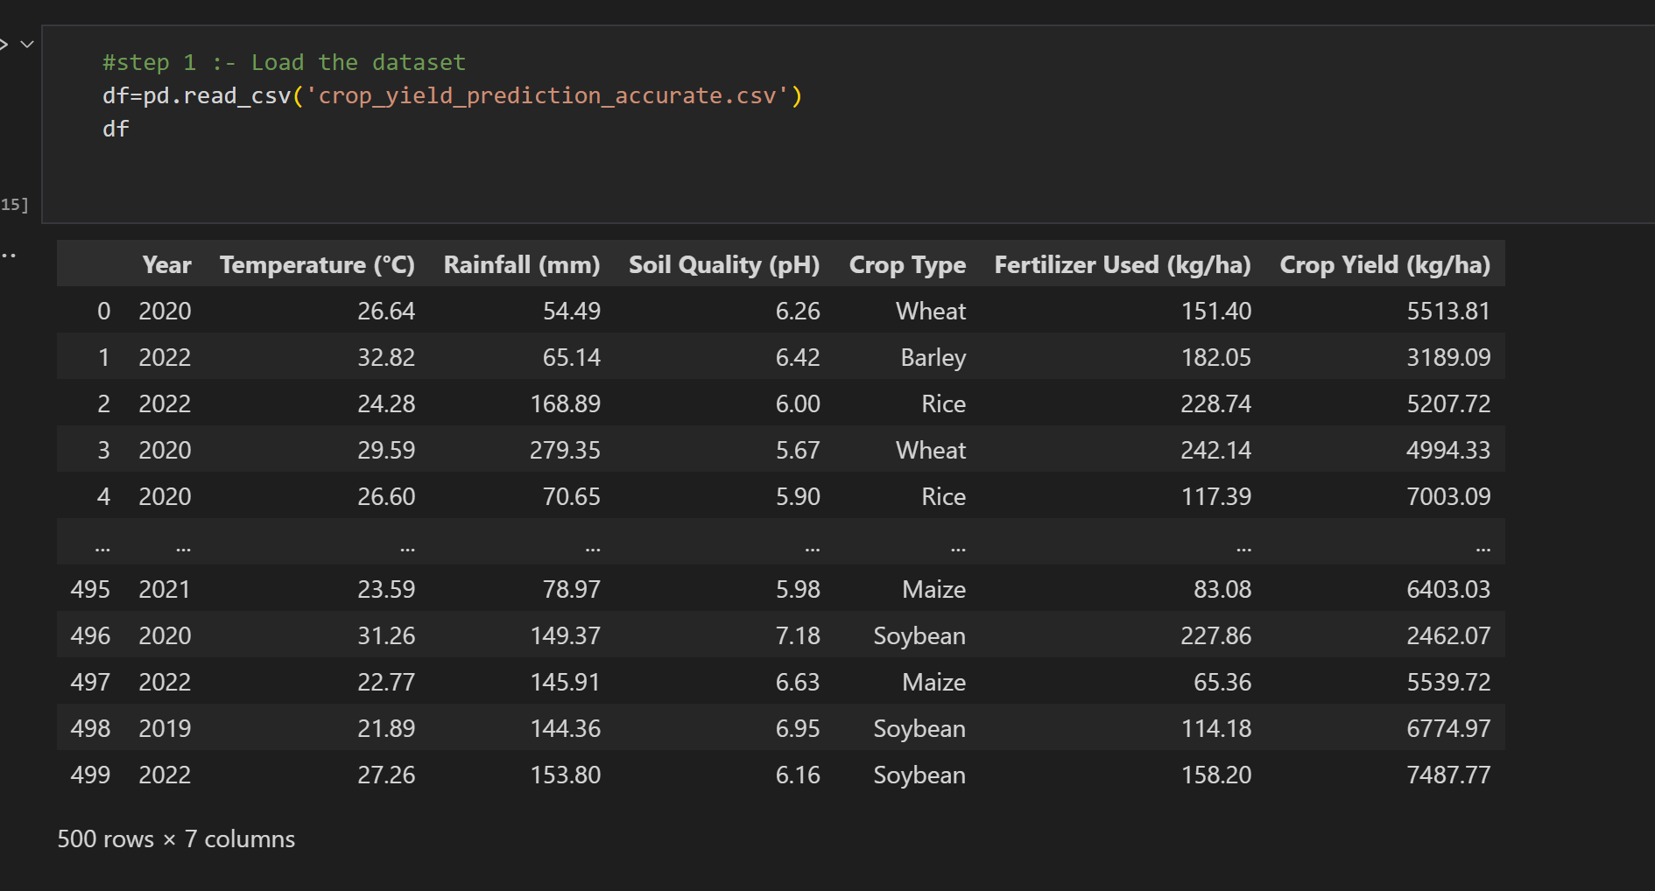
Source Code

Slide 7
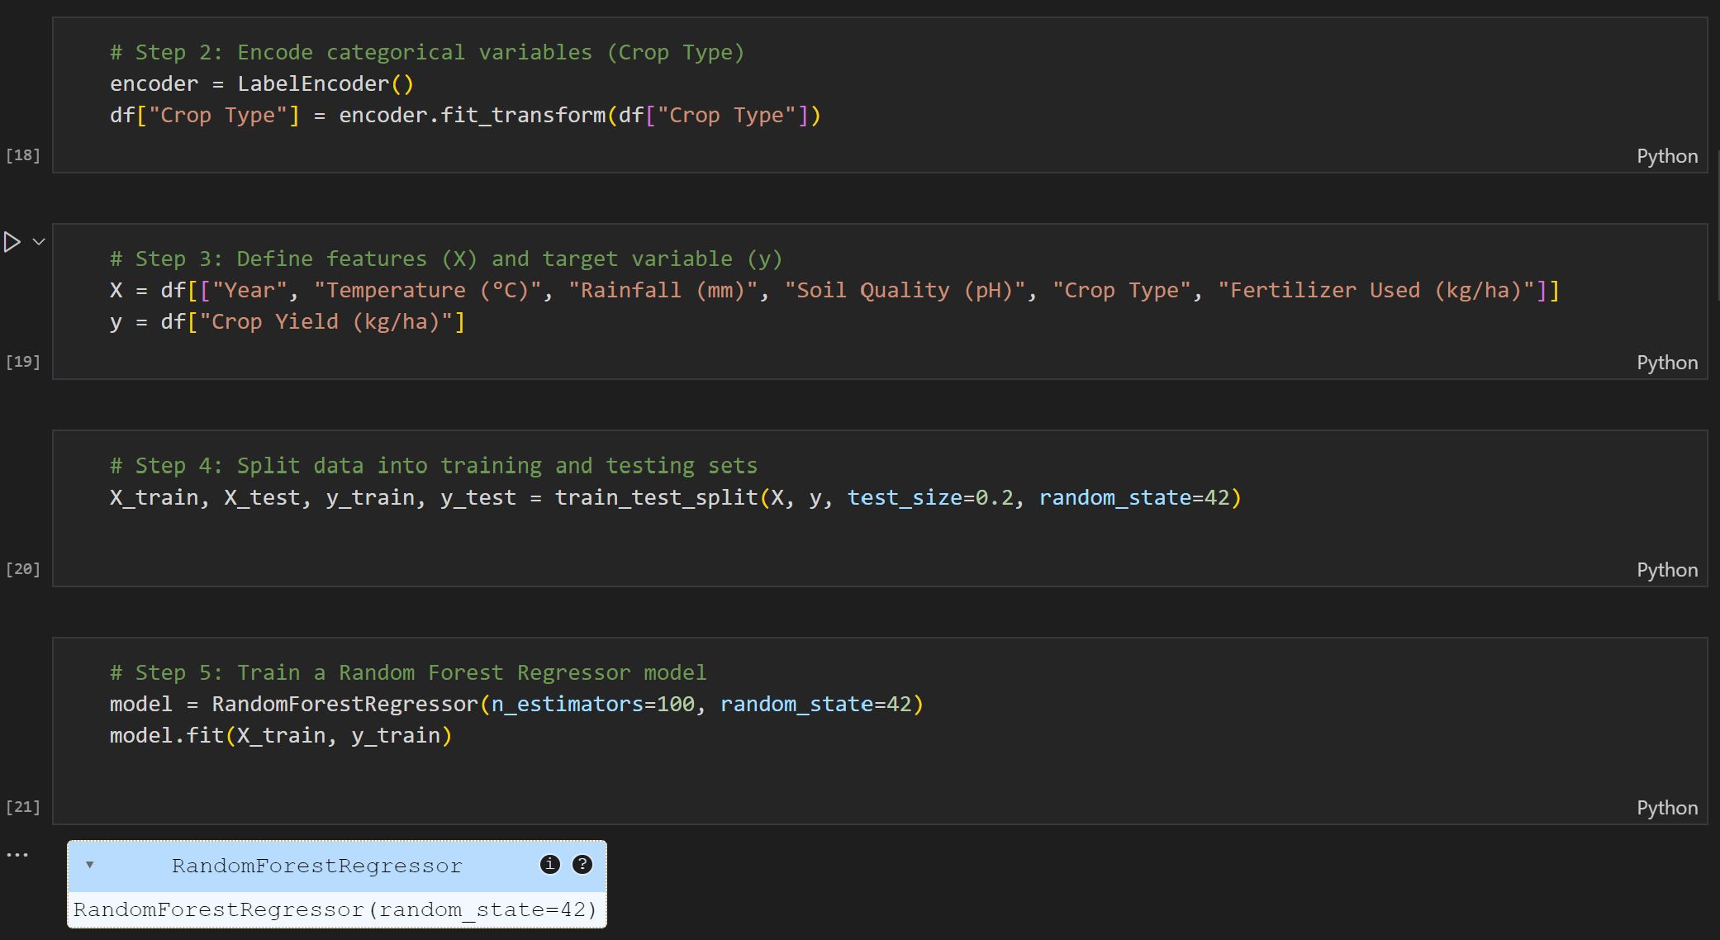
Source Code

Slide 8
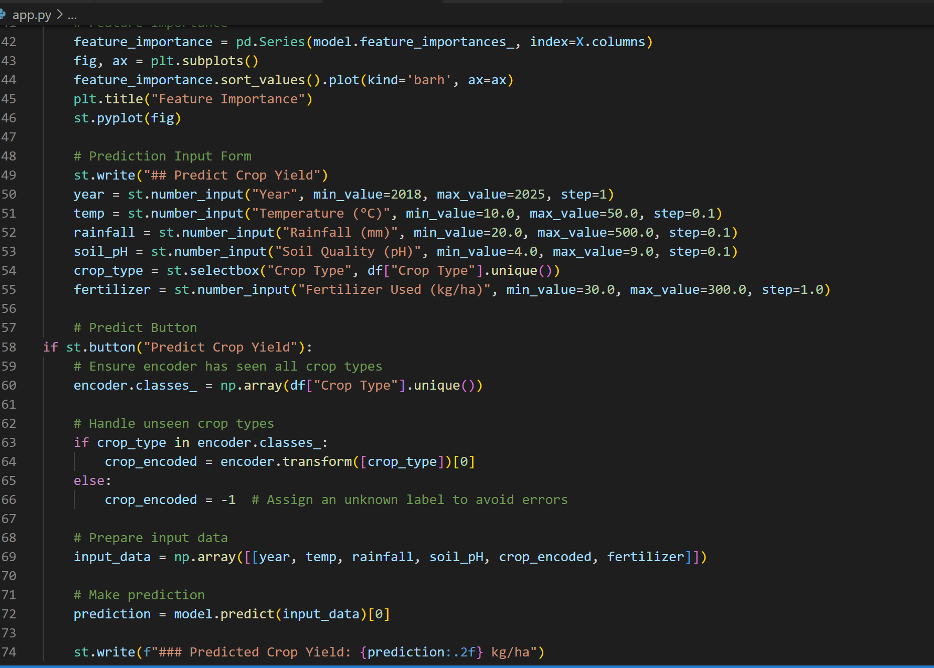
Source Code

Slide 9
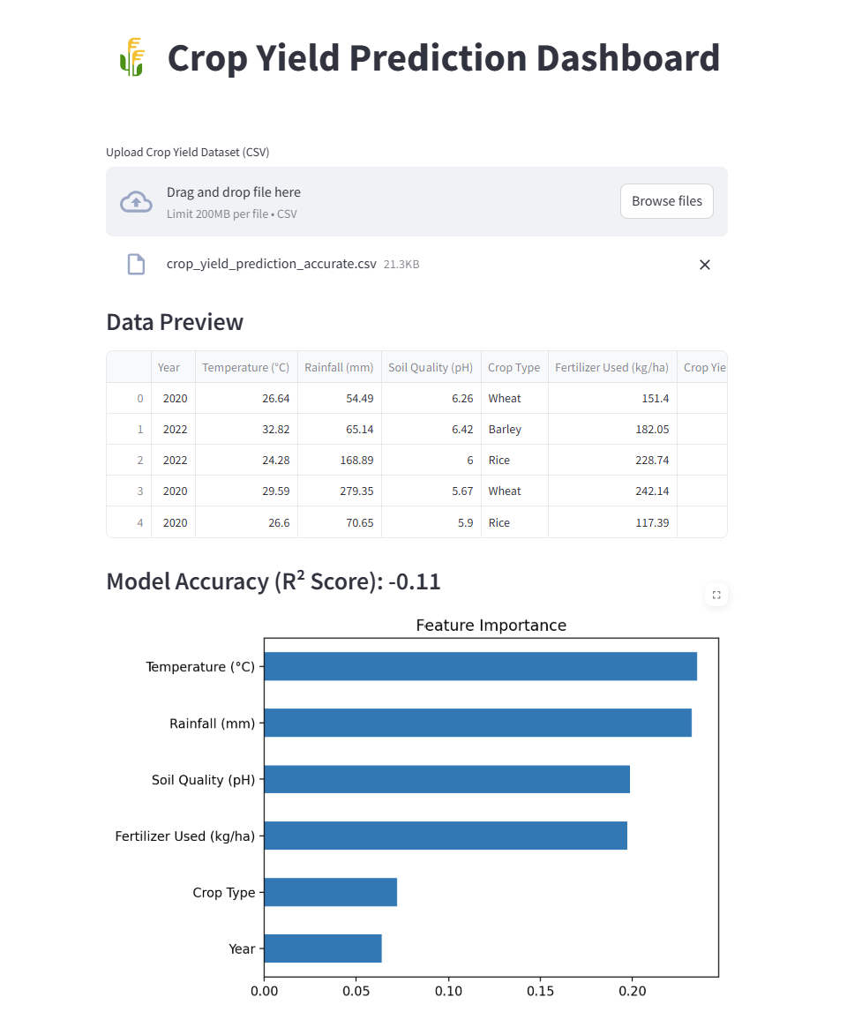
Dashboard

Slide 10
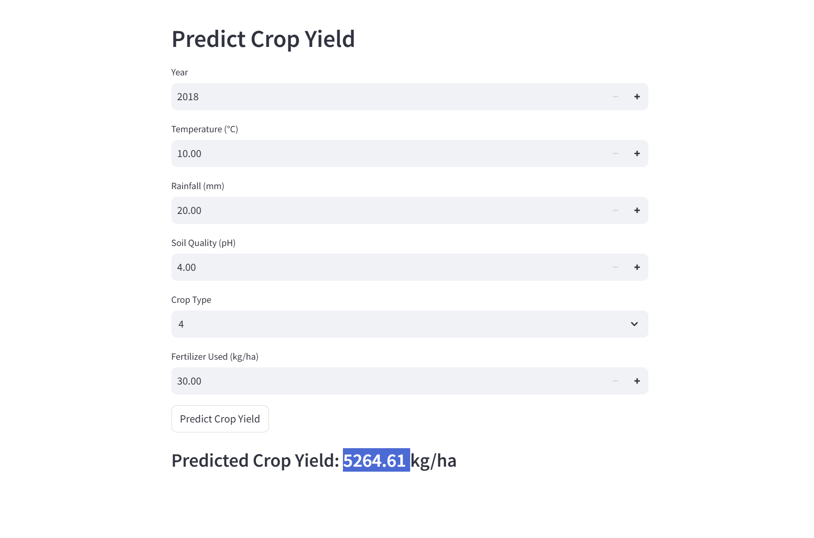
Dashboard

Slide 11
References
Dataset Source:
Kaggle
Machine Learning Algorithms:
Breiman, L. (2001). "Random Forests." Machine Learning, 45(1), 5-32.
Friedman, J. (2001). "Greedy Function Approximation: A Gradient Boosting Machine." Annals of Statistics, 29(5), 1189-1232.
Agricultural Insights:
Food and Agriculture Organization (FAO): www.fao.org
Government Agricultural Reports: (Provide specific links if used)
Tools & Technologies:
Streamlit Documentation: https://docs.streamlit.io
Scikit-Learn Documentation: https://scikit-learn.org

Slide 12
Thank You
Notes:
Thank You !!

