Slide 1

Lean Supply Chain Management in the Automotive Aftermarket Industry
Notes:
Welcome! Today, we’ll dive into a story of transformation—a journey that takes us through the automotive aftermarket industry's challenges and triumphs, as Lean principles help it evolve into a leaner, faster, and more responsive system.

Slide 2
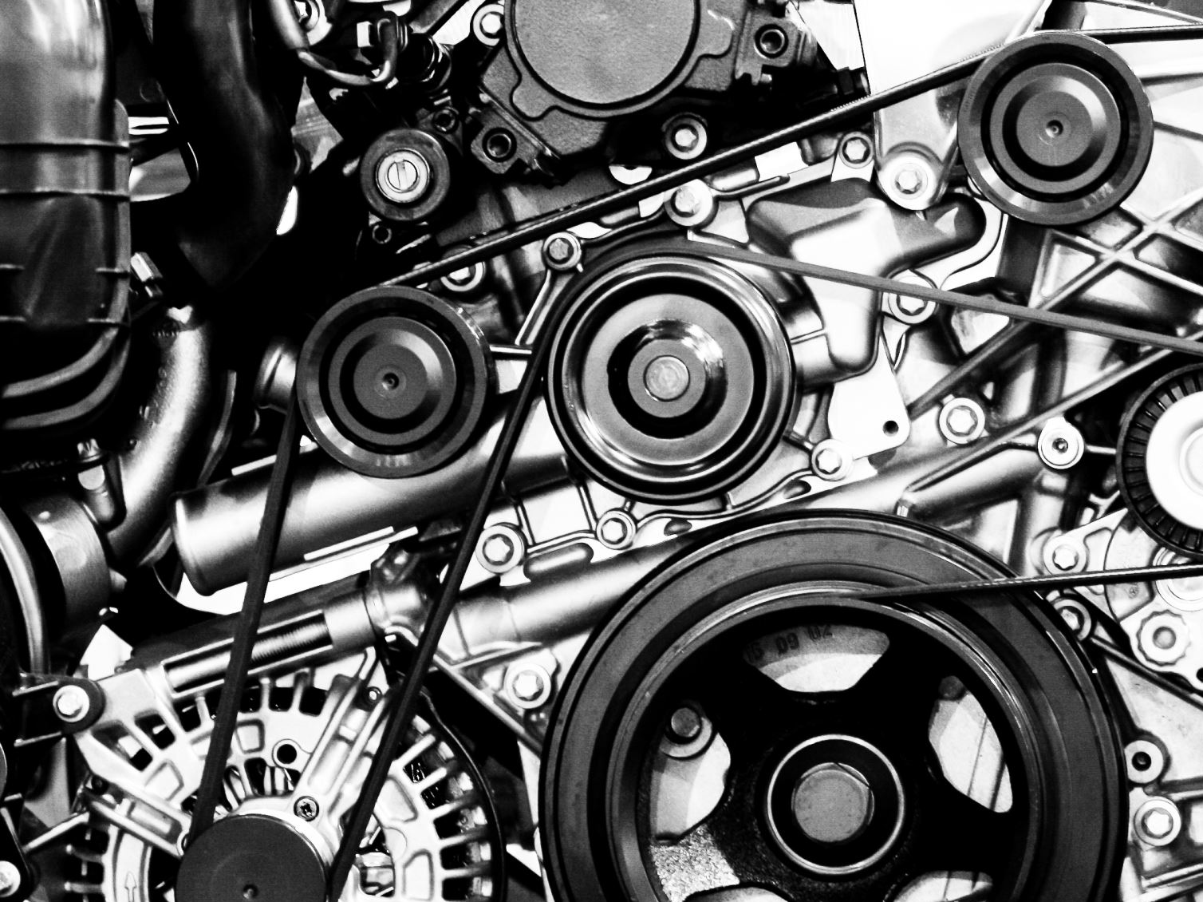
Overview of the Automotive Aftermarket Industry
Definition: The aftermarket industry includes all products, services, and parts used after the original sale of a vehicle.
Scope: Replacement parts, accessories, and repair services.
Importance: Critical for customer satisfaction, vehicle longevity, and fast, reliable service.
Notes:
Imagine a world where every part of a car, from brakes to engines, has a story of its own. Once a vehicle rolls off the assembly line, these parts need regular care, replacements, and upgrades—this is where the aftermarket industry steps in, providing essential services that keep vehicles safe, efficient, and enjoyable to drive.

Slide 3
Challenges in the Automotive Aftermarket Supply Chain
Inventory Management: Managing a vast variety of parts with unpredictable demand.
High Holding Costs: The cost of storing large inventories and the risk of parts becoming obsolete.
Demand Fluctuations: Demand varies based on vehicle age, usage, and seasonal needs.
Time Sensitivity: Customers expect fast delivery and repair services.
Notes:
But like every story, the aftermarket industry faces its own set of challenges. Picture this: a vast warehouse filled with spare parts for every make and model, from vintage classics to the latest electric vehicles. Managing this complex inventory is no easy feat. Parts demand fluctuates wildly, storage costs rise, and yet, customers expect these parts to be available on demand. These challenges demand a smarter, more responsive solution.

Slide 4
Introduction to Lean Supply Chain Management
Core Principles of Lean: Waste reduction, continuous improvement, and maximizing customer value.
Goal in Supply Chains: Streamline processes, reduce costs, and improve responsiveness to demand.
Notes:
Enter Lean—a philosophy born from the manufacturing world that teaches us to eliminate waste, improve continuously, and deliver maximum value. Lean helps us take control of our processes, streamline operations, and meet customer needs with precision and efficiency. Lean is not just a tool; it’s a mindset, one that has the power to transform even the most complex supply chains.

Slide 5
Key Lean Techniques for Supply Chain Optimization
Just-in-Time (JIT): Ensures that inventory levels are aligned closely with demand.
Value Stream Mapping (VSM): Helps visualize processes to identify inefficiencies and waste.
Kanban: Uses visual cues to regulate inventory flow, preventing overproduction.
Kaizen (Continuous Improvement): Encourages regular small improvements rather than waiting for large-scale changes.
Notes:
Lean brings with it a toolkit that reads like a superhero's arsenal. There’s Just-in-Time (JIT), which minimizes storage by synchronizing parts arrival with demand. Value Stream Mapping (VSM) helps us visualize every step in a process, spotting bottlenecks and inefficiencies along the way. Kanban, with its simple visual cues, ensures we produce only what’s needed, when it’s needed. And finally, Kaizen fosters a culture of continuous improvement, where small changes make a big impact over time.

Slide 6
Applying Lean Techniques in the Automotive Aftermarket Industry
Inventory Management with JIT: Reduces excess stock and aligns inventory levels with actual demand.
Streamlined Order Processing with VSM and Kanban: Minimizes lead times by reducing bottlenecks in the ordering process.
Supplier Collaboration: Lean encourages closer collaboration to ensure timely delivery and better demand forecasting.
Kaizen for Incremental Improvements: Enables constant improvements to processes and customer service.
Notes:
Let’s see these techniques come to life in the aftermarket world. Imagine JIT helping us reduce the clutter of excess stock by aligning inventory levels perfectly with demand. VSM maps the path of every part, from supplier to customer, so we can cut delays. Kanban cards signal when it’s time to restock, while Kaizen encourages everyone, from technicians to managers, to suggest improvements. This is Lean in action, making the aftermarket supply chain more agile and responsive.

Slide 7

Benefits of Lean in the Aftermarket
Supply Chain
Cost Savings: Reduced inventory holding costs and minimized waste.
Increased Efficiency: Faster lead times and streamlined processes.
Enhanced Customer Satisfaction: Quicker turnaround times and improved availability of parts.
Competitive Advantage: Greater agility in responding to demand and supply chain challenges.
Notes:
So, what happens when Lean becomes part of the aftermarket’s DNA? Costs go down, as we no longer need massive storage spaces for unused parts. Efficiency rises, with parts arriving exactly when needed. Customers are happier because they get their parts quickly, and in turn, companies become more competitive, ready to meet market demands head-on.

Slide 8
Challenges of Implementing Lean in the Aftermarket
Demand Variability: Difficulty in predicting demand for specific parts, which challenges JIT.
Initial Investment: Implementation of Lean requires process changes, training, and initial setup costs.
Cultural Shift: Lean success requires a culture of continuous improvement, which may require organizational change.
Balancing Speed with Lean: Lean emphasizes efficiency, but customers often expect instant availability of certain parts.
Notes:
But Lean, like any journey, isn’t without its hurdles. Demand can be unpredictable, making it hard to balance JIT with part availability. Implementing Lean requires investment, and it’s not just about changing processes—it’s about changing mindsets. Lean asks us to look at supply chain speed differently, balancing the need for efficiency with the need for readiness.

Slide 9
The Future of Lean in Automotive Aftermarket Supply Chains
Digital Tools Integration: Use of IoT, AI, and predictive analytics for real-time data and demand forecasting.
Sustainability Focus: Lean’s emphasis on waste reduction aligns with sustainability goals.
Greater Collaboration with Suppliers: Lean encourages ongoing partnerships that adapt to industry trends.
Continuous Improvement: Kaizen mindset helps companies stay competitive as market demands evolve.
Notes:
The future of Lean in the aftermarket looks bright and high-tech. Imagine a world where digital tools—IoT, AI, predictive analytics—allow us to monitor demand in real-time, forecast needs accurately, and reduce waste. Lean aligns perfectly with a sustainable future, reducing waste and optimizing every resource. As supply chains become more interconnected, Lean principles pave the way for resilient, adaptive, and sustainable practices.

Slide 10
Conclusion
Recap: Lean principles can greatly optimize supply chains in the aftermarket industry, addressing key challenges and improving responsiveness.
Key Takeaways: Highlight benefits such as cost savings, improved efficiency, and competitive advantage.
Final Thought: Adopting Lean is an ongoing journey, requiring commitment to continuous improvement and adaptation.
Notes:
As we wrap up, we see that Lean is more than a solution; it’s a way forward, guiding the aftermarket industry toward reduced costs, improved efficiency, and enhanced customer satisfaction. Lean’s journey is one of ongoing transformation, where each step brings new insights and lasting improvements.

Slide 11
THANK YOU

