Slide 1
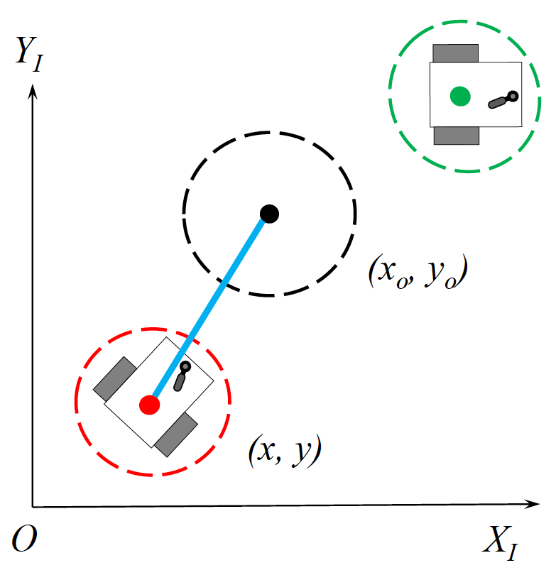
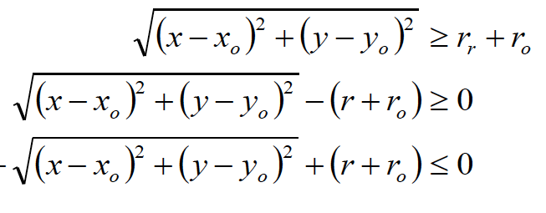
Adding Obstacle constraint
Euclidean distance between the predicted robot position
And the obstacle position is upper bounded by summation
of radius of two.
g(x) =
Point stabilisation of non-holonomic robot using MPC

Slide 2
Parameters for result analysis
General Parameters:
Prediction horizon length: N = 20 to 30
Sampling time: T = 0.2 s
Robot diameter = Obstacle diameter = 0.2 m
Constraints parameters:
-2 < x < 2
-2 < y < 2
-inf < theta < inf
v_max < v <v_min
Pi/4 < w < pi/4
Loop parameters:
Max iterations: 100
MPC iterations run: mpciter
Error = norm( (x0-xs), 2 )
Point stabilisation of non-holonomic robot using MPC

Slide 3
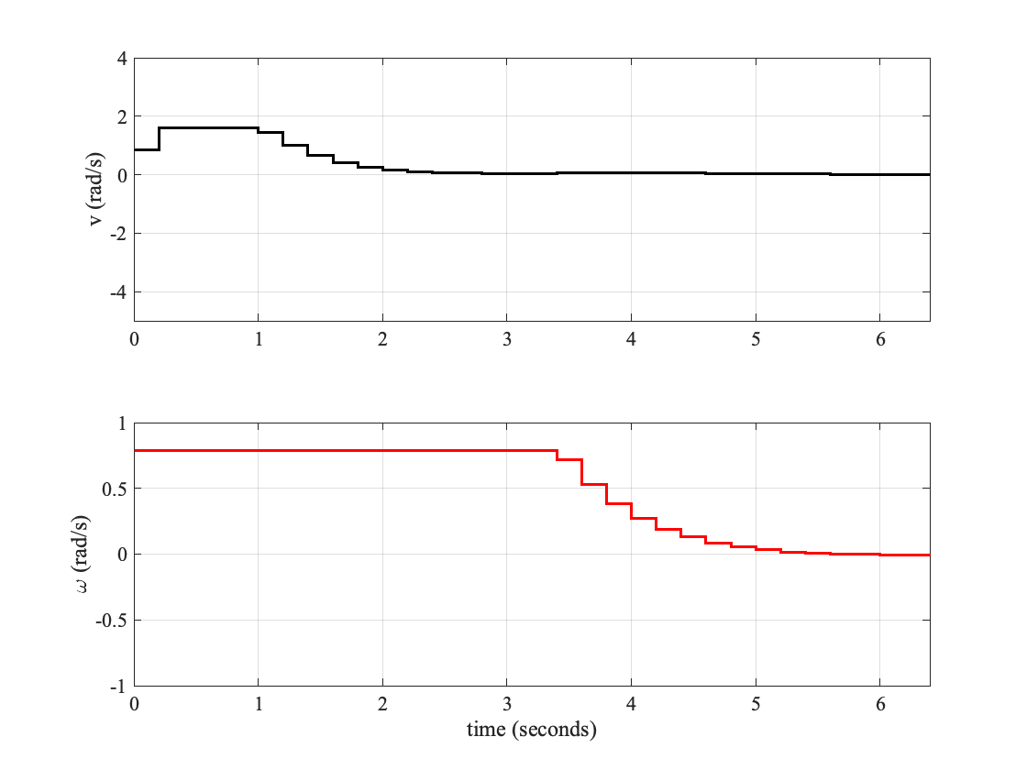

Result analysis: without obstacle
Fig2: Single shooting control actions
Convergence iterations with 35 iterations
Fig1: Same trajectory for Single shooting and multiple
Shooting with- 1.6 < v < 1.6 and (theta)ref = pi
Fig3: Multiple shotting control actions
Slightly faster convergence with 32 iterations
Point stabilisation of non-holonomic robot using MPC

Slide 4
Result analysis: velocity constraint
Fig4: multiple shooting with -1.6 < v < 1.6 for (theta)ref = 0
Iterations: 32
Error: 0.01
Fig5: multiple shooting with -0.6 < v < 0.6 for (theta)ref = 0
Iterations: 30
Error: 0.008
Point stabilisation of non-holonomic robot using MPC

Slide 5
Result analysis: with obstacle
Fig6: Single shooting with -1.6 < v < 1.6 for (theta)ref = pi/2
Fig7: Multiple shooting with -1.6 < v < 1.6 for (theta)ref = pi/2
Point stabilisation of non-holonomic robot using MPC

