Slide 1
Agentic AI Hackathon: AI –Based Preventive Health Risk Assessment System

Slide 2


Name of the team: AEVIA
Details of Team members
TEAM MEMBER NAME | Recent Passport Photo | Email ID | Phone number [WhatsApp]
NISARGA S |  | nisargasgowda95@gmail.com | 8050788307
RAMYA S |  | ramyas2005ramyas@gmail.com | 9036762783

Slide 3
Problem statement
AI-Based Preventive Health Risk Assessment System
Problem statement under
Data Accessibility: AI models require large datasets to be effective. However, health data is often fragmented, siloed, or not easily accessible due to privacy concerns, regulations (like HIPAA), and inconsistent data standards across different healthcare providers.
Data Quality: Poor-quality or incomplete data can lead to inaccurate predictions. For example, if the dataset contains noisy or biased data, the AI model might generate misleading risk assessments.
Bias in Data: If the data used to train the AI system is not representative of diverse populations (e.g., underrepresentation of certain ethnic groups, genders, or age groups), the AI system may fail to provide accurate or equitable predictions for all patients

Slide 4
Proposed solution
Proposed solution under:
System Architecture
The proposed system follows a modular and scalable architecture consisting of data acquisition, preprocessing, risk prediction, explainability, and decision-support modules. The architecture enables seamless integration with existing healthcare systems and supports continuous learning.
Data Acquisition and Integration
Health data are collected from multiple heterogeneous sources, including electronic health records (EHRs), laboratory reports, wearable devices, and patient-reported lifestyle information. Standard interoperability protocols such as HL7 and FHIR are employed to ensure compatibility with hospital information systems. Data encryption and anonymization techniques are applied at the collection stage to preserve patient privacy.

Slide 5
Need of project
The growing complexity of healthcare, increasing prevalence of chronic diseases, and rapid expansion of health-related data have highlighted the need for intelligent preventive healthcare solutions. An AI-Based Preventive Health Risk Assessment System enables early identification of potential health risks and supports proactive medical intervention.
Firstly, most traditional healthcare systems follow a reactive approach, where diseases are diagnosed only after symptoms appear. This often results in delayed treatment, higher medical costs, and poor patient outcomes. AI-based preventive systems shift healthcare from treatment-centric to prevention-centric by predicting risks before disease onset.
Secondly, chronic diseases such as cardiovascular disorders, diabetes, and cancer contribute significantly to global mortality. These conditions typically develop over long periods and can be effectively managed or prevented if detected early. AI models can analyze historical and real-time patient data to identify early warning signs that are difficult for humans to detect

Slide 6
End user of project
Patients and General Public
Patients are primary end users of the system. They utilize the platform to monitor their health status, receive personalized risk assessments, and obtain preventive recommendations. The system empowers individuals to take proactive control of their health through early risk awareness and lifestyle guidance.
Healthcare Professionals
Healthcare professionals, including physicians, nurses, and specialists, use the system as a clinical decision-support tool. The system assists in identifying high-risk patients, prioritizing preventive interventions, and improving diagnostic accuracy while maintaining human oversight in clinical decision-makin
Health Insurance Providers
Insurance companies use risk assessment insights to support preventive care initiatives, optimize health plans, and reduce long-term claim costs. The system enables insurers to promote early interventions and wellness programs for high-risk individuals.

Slide 7
Technology Used
Langflow platform
Langflow component name – Agent , Chat input , Chat output
IBM Grainte model - for eg – ibm-granite-3-2-8b
IBM Cloud
IBM Watsonx.ai
Watsonx

Slide 8
Novelty and Uniqueness
· First platform merging micro‑climate sensing, GenAI, and policy
retrieval for urban adaptation.
· Uses non‑wearable, rooftop nodes—cheaper and easier to deploy
city‑wide.
· Granite‑guarded outputs ensure bias‑free, regulation‑compliant
advice.

Slide 9
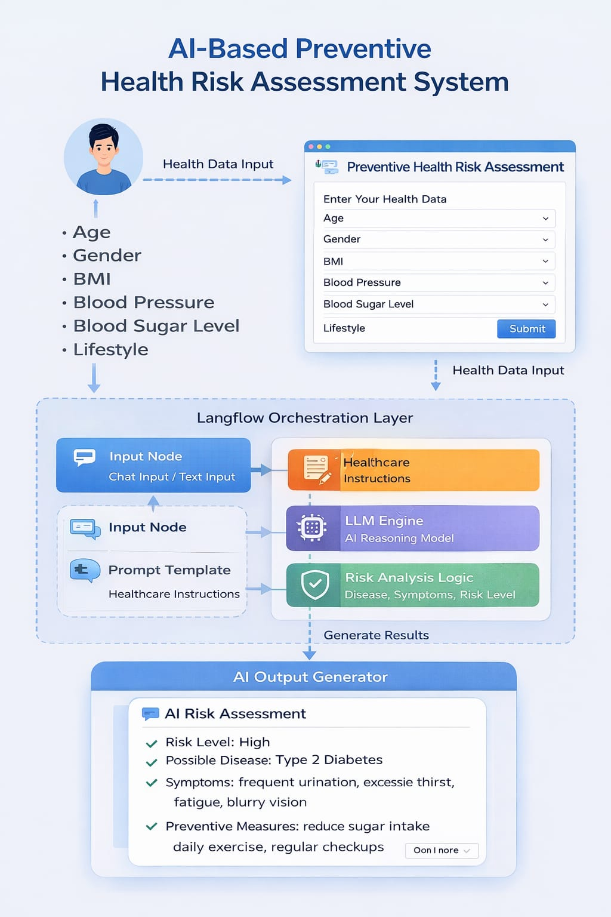
Technical flow diagram - Architecture blueprint

Slide 10
Langflow component Used
Explain the use of each langflow component used into you project
1)Chat Input – Text input and prompt template., IBM Watsonx.ai
2) IBM Watsonx AI Agent
File component
Chat output

Slide 11
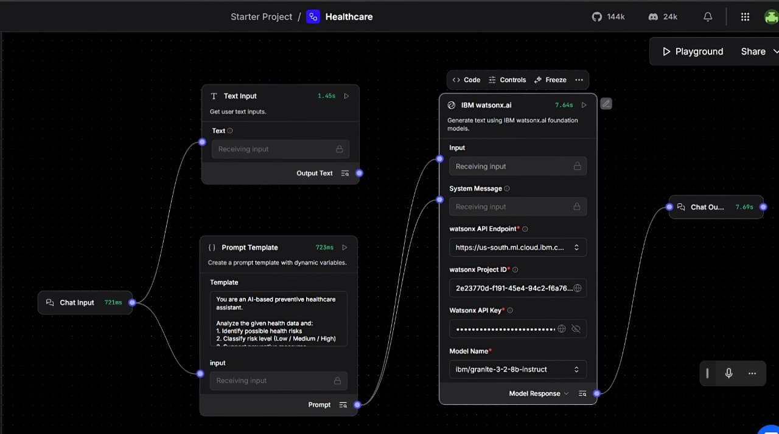
Input Screenshot

Slide 12
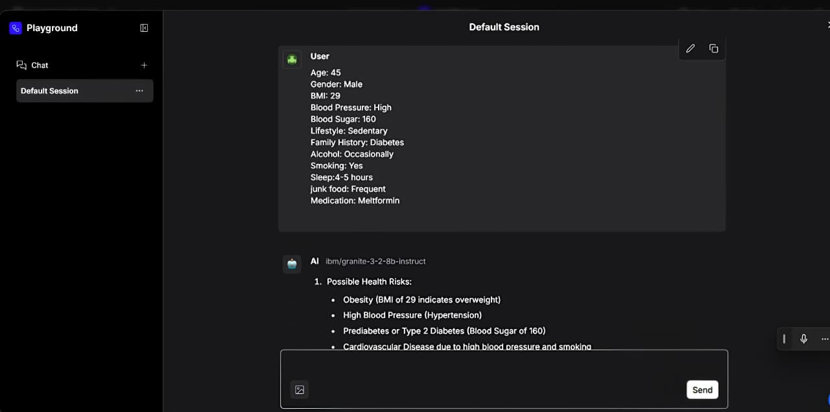
Output Screenshot 1

Slide 13
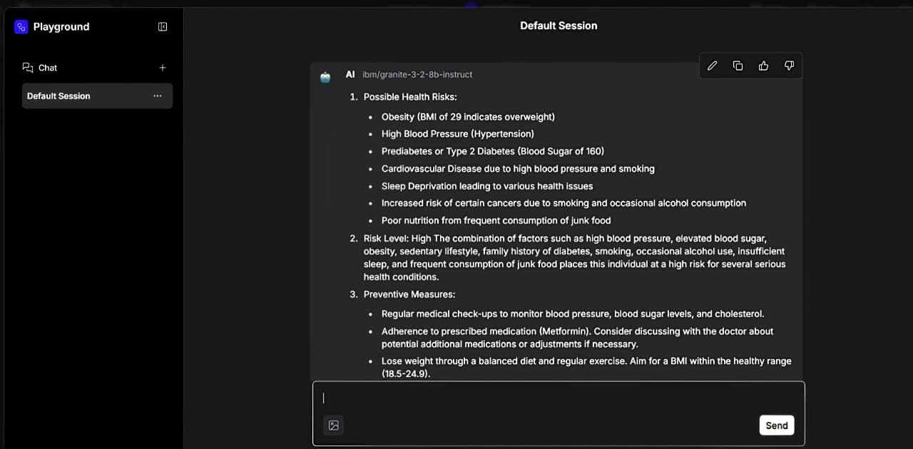
Output Screenshot 1

Slide 14
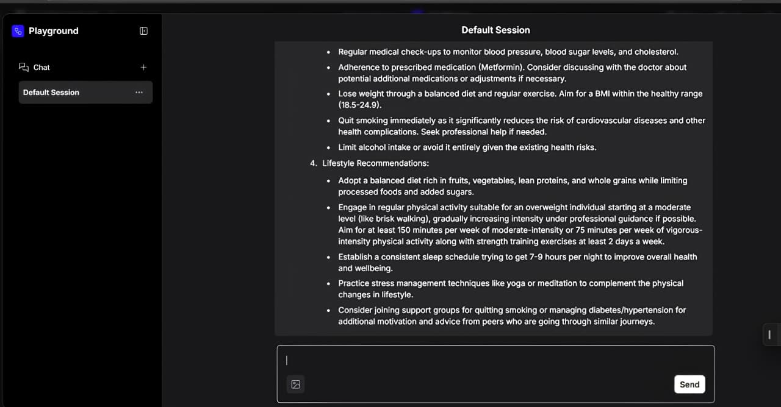
Output Screenshot 2

Slide 15
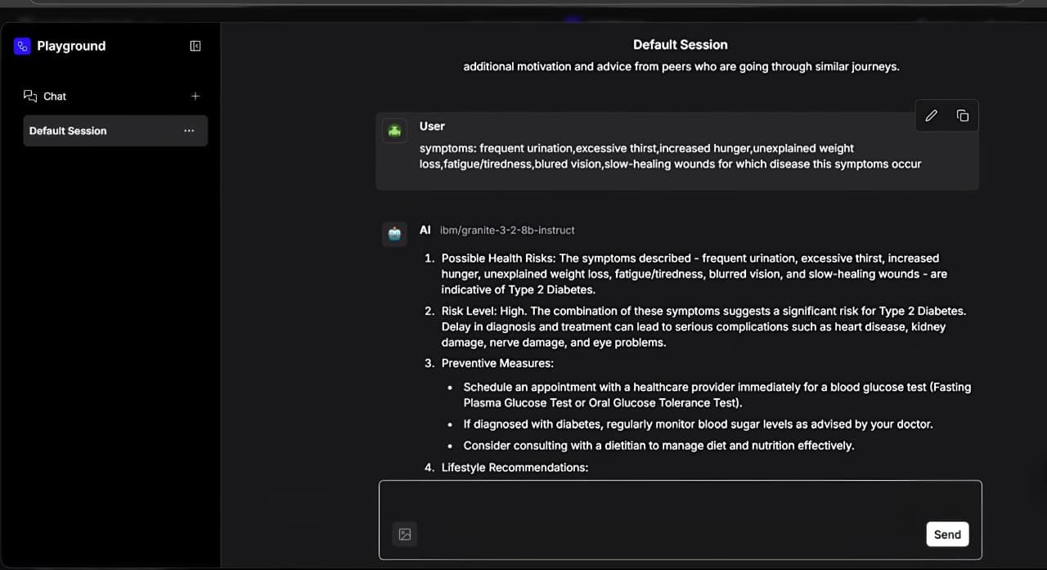
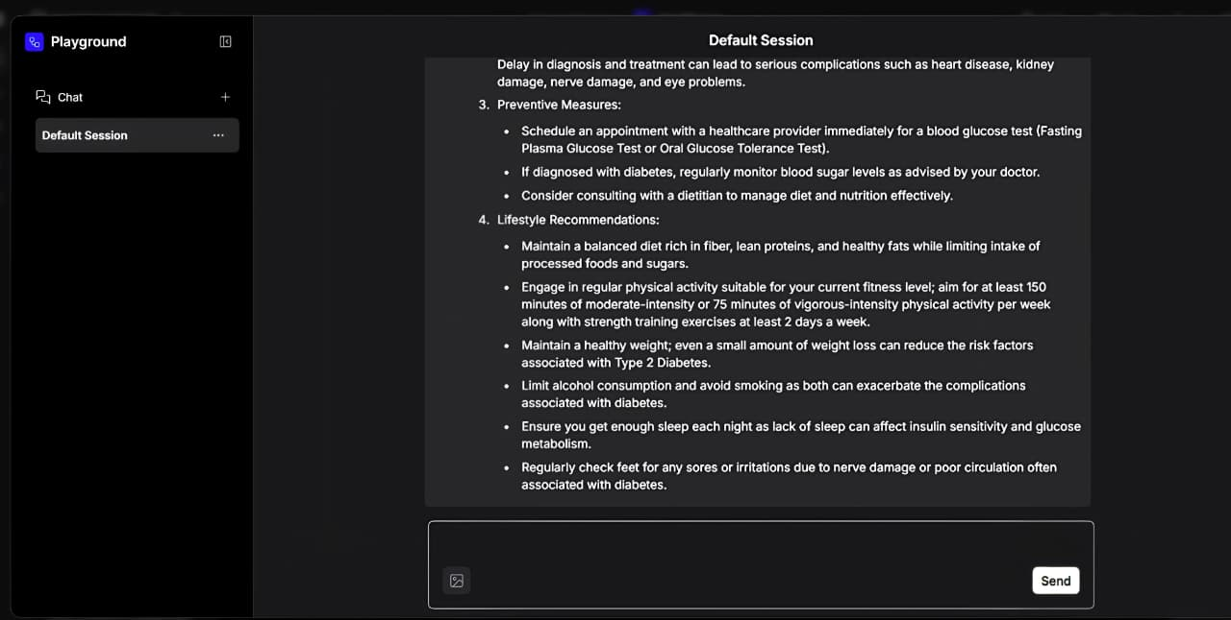
Output Screenshot 2

Slide 16
Future Scope
1.Integration with Genomic and Multi-Omics Data
Future systems will incorporate genomic, proteomic, and metabolomic data to enable highly precise risk predictions. This integration will allow early identification of genetic predispositions to diseases, leading to more personalized preventive strategies and precision medicine.
2.Advanced Predictive and Prescriptive Analytics
Next-generation models will move beyond risk prediction to prescriptive analytics, recommending optimized preventive actions and treatment pathways. Reinforcement learning and causal AI techniques will enable systems to learn optimal intervention strategies over time.
3.Population-Level and Public Health Applications
AI-based preventive systems will be increasingly used for population health management. Large-scale risk analytics will support public health surveillance, early outbreak detection, and targeted preventive programs at regional and national levels.
4.Regulatory Acceptance and Clinical Standardization
As regulatory frameworks mature, AI-based preventive health systems are expected to become standardized components of clinical practice. Regulatory approval and clinical guidelines will further accelerate adoption in mainstream healthcare
·
·
·

Slide 17
Git Hub Link
https://github.com/nisargasgowda95-lang/Healthcare
.

Slide 18
References
Technology used
​IBM Granite 3.0 Model Family: Official documentation for enterprise-grade LLMs and reasoning capabilities. ibm.com/granite
​LangFlow Orchestration: Low-code platform for building multi-agent AI workflows. docs.langflow.org
​IBM WatsonX.ai: Enterprise studio for AI builders to train, validate, and deploy models. ibm.com/watsonx
​Domain Research (Traffic Analysis)
​Intelligent Traffic Management: Research on reducing CO2 emissions and fuel consumption via predictive flow analysis. (Source: NIH/PMC12552707)
​Agentic AI in Transportation: Exploring the transition from static traffic signals to dynamic, autonomous reasoning agents. (Source: IEEE Xplore / MDPI)
​Open Source
​LangChain Components: Standard library for enhancing LLM utility with context-aware tools.

Slide 19


