Slide 1
Updates for Cargill 4/30/20

Slide 2
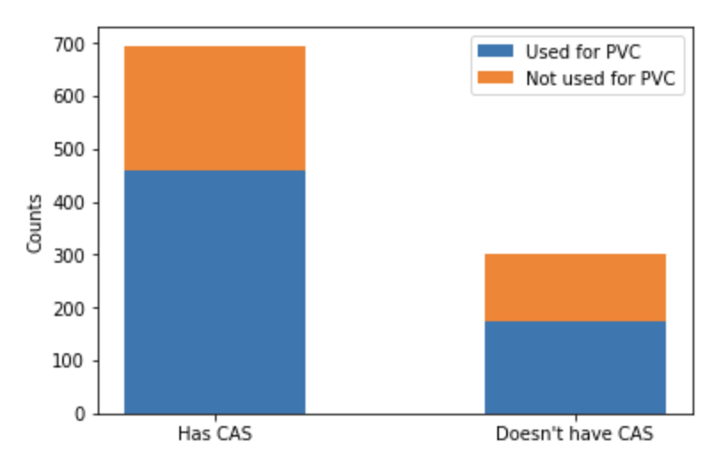
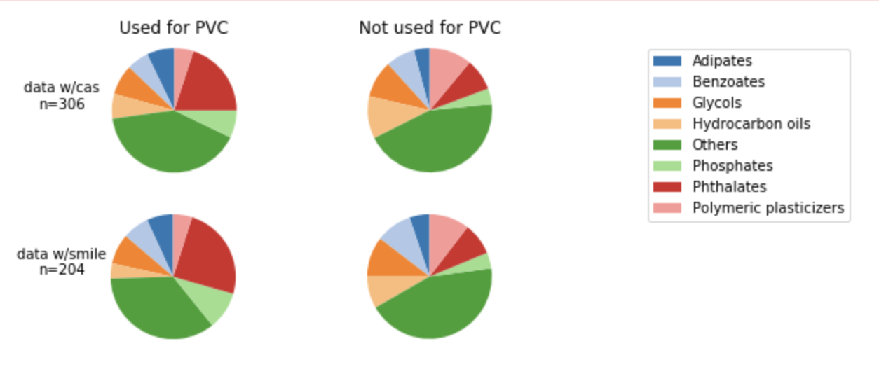
What data are we working with?
All plasticizer samples from Knovel sources
Samples with CAS No.
Removing duplicates
Samples with SMILES
n=1257
n=845
n=306
n=204

Slide 3
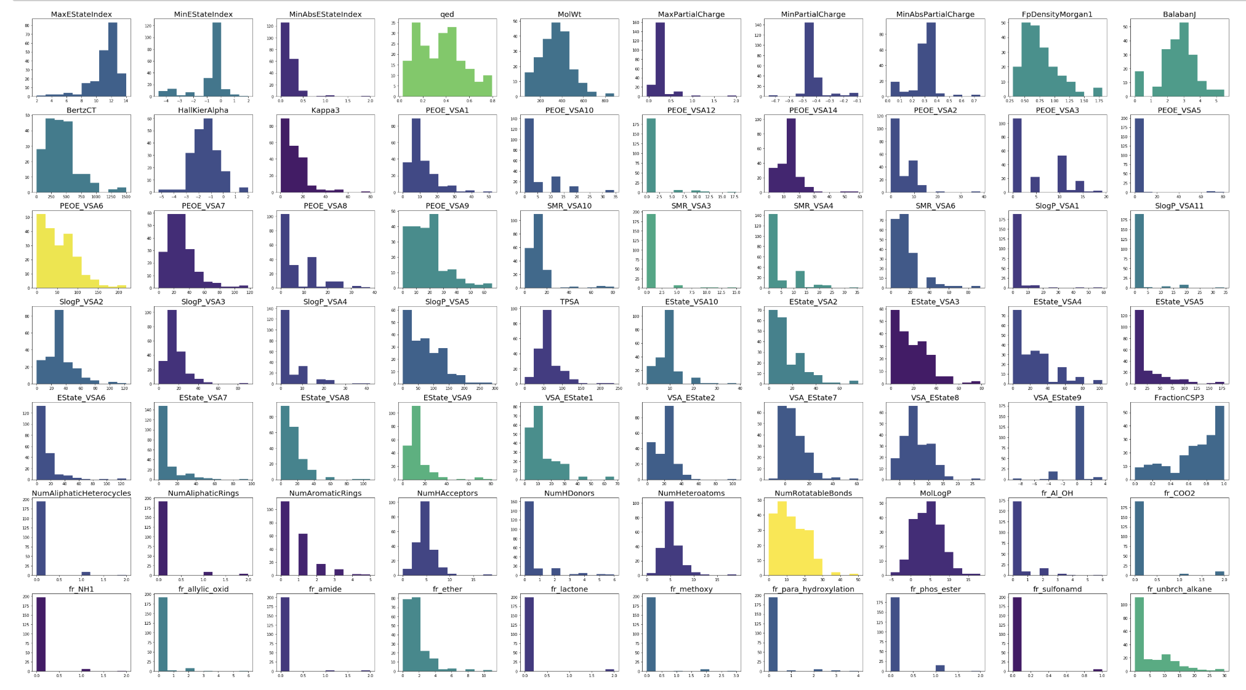
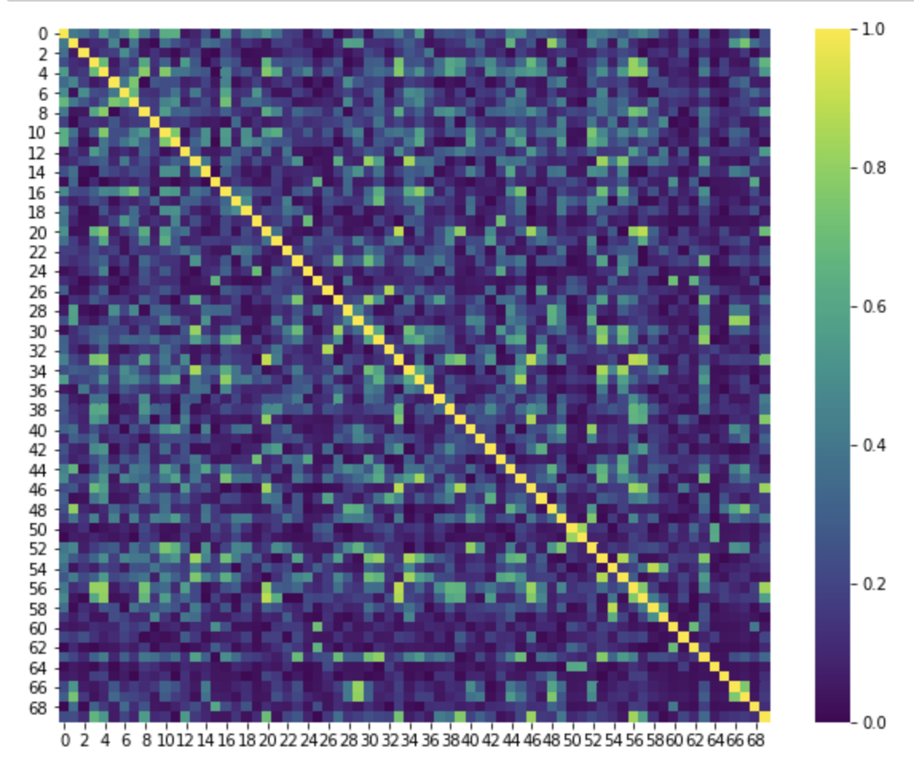
RDKit Descriptor Analysis
Correlation Matrix
200 descriptors calculated from rdkit (python)
70 with highest variance and lowest interdependence

Slide 4
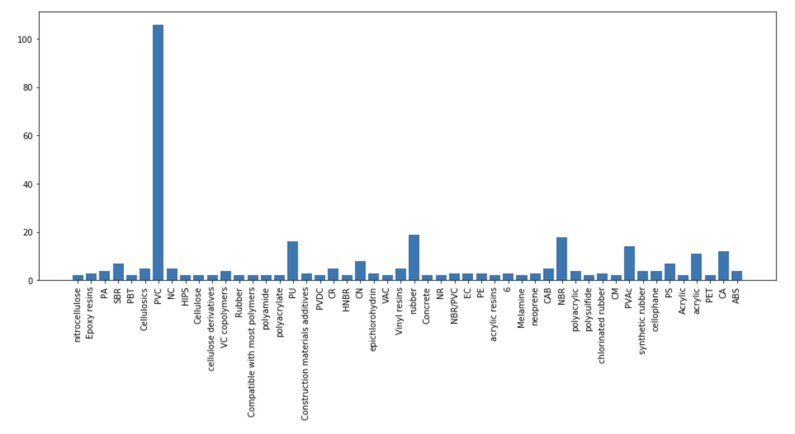
Types of Polymers
Preliminary logistic regression predicted plasticizers used for PVC vs. not with 82% accuracy (85% training accuracy)

Slide 5
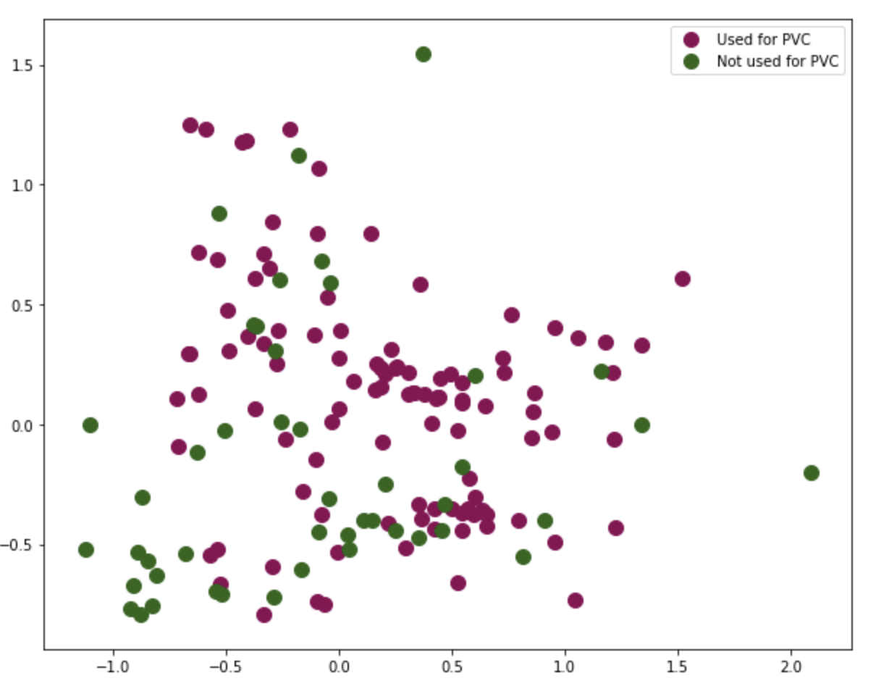
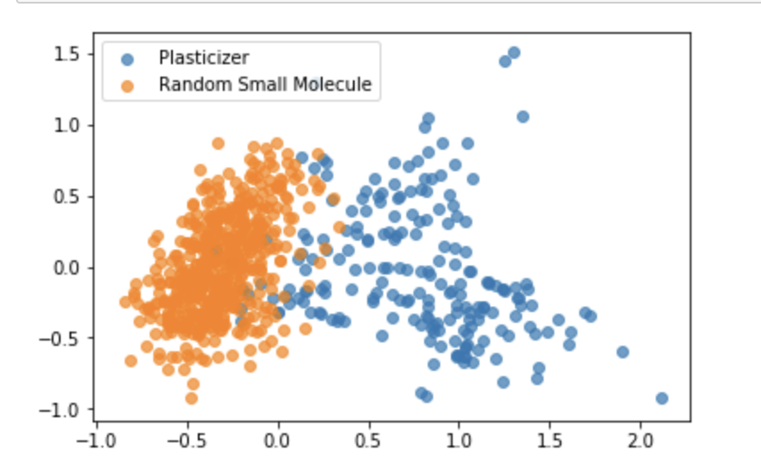
Initial PCA
70 features reduced to 2 with PCA
PCA components not good enough to distinguish between plasticizers used for PVC vs. other polymers
Features are good enough to distinguish between all plasticizers and a randomly selected subset of GDB-17 small molecules database
Need to make sure it’s not caused by single non-overlapping variable (e.g. molecular weight)

