Slide 1
L01: Interactive Data Visualization with plotly in R
EAS 509: Statistical Learning and Data Mining II
Instructor: Dr. Nikolay Simakov

Slide 2
Initial Survey
31 Submissions
Homework is important for my learning style:
Strongly Agree 58.064%
Agree 35.483%
Neither Agree nor Disagree 6.451%
Final group project will help in better understanding of the course topics (lets' do it).
Strongly Agree 41.935%
Agree 45.161%
Neither Agree nor Disagree 6.451%
Disagree 3.225%
Strongly Disagree 3.225%
Final group project is on!

Slide 3
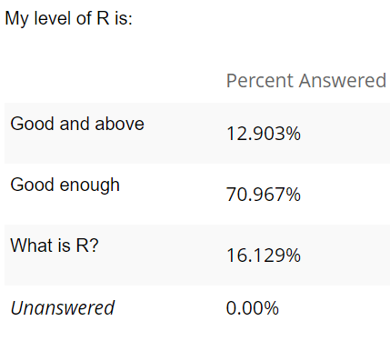
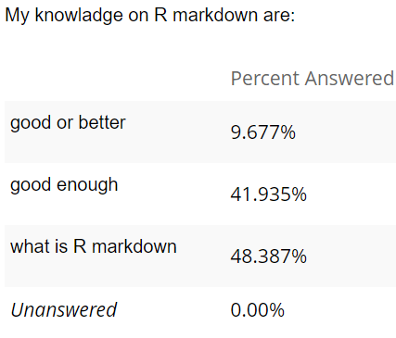
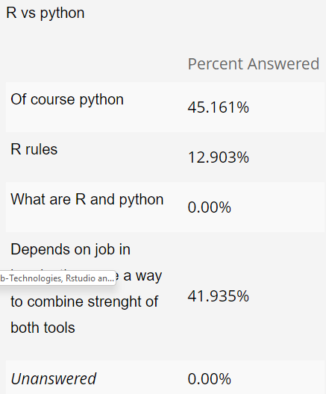
Initial Survey
This course uses R
Homeworks and exams should be done in R
Final project should be done in R too, with few exceptions:
Data cleaning (typically final project data is already clean)
Method of interest is not available in R (typically additional method to R)
Why to Learn R?

Slide 4
Initial Survey
This course uses R
Homeworks and exams should be done in R
Final project should be done in R too, with few exceptions:
Data cleaning (typically final project data is already clean)
Method of interest is not available in R (typically additional method to R)
Why to Learn R?

Slide 5
How to learn R
Learn R the statistician way. Check out:
Data Science Specialization by John Hopkins University
https://www.coursera.org/specializations/jhu-data-science
Complete at least Course 1 and 2.
“The Data Scientist’s Toolbox” covers: version control, markdown, git, GitHub, R, and Rstudio
“R Programming”

Slide 6
Outline
Motivation recap
Low-level details on plotly.R
Web-technologies
High-level details on plotly.R
2d plots
3d plots
Maps
Animation
Statistical/Machine learning plots

Slide 7
plotly in R - Learning Material
Documentation: https://plotly.com/r/
Online book: https://plotly-r.com/
This lectures are largely adopted from these material.

Slide 8
What is plotly? Why to use it?
Plotly R Open Source Graphing Library (plotly.R) – interactive and publication quality visualization library
Decrease turn-around time
Get more out of your plots faster
Get insight from your data faster and more easily

Slide 9
What is plotly? How does it work with R?
Plotly R Open Source Graphing Library (plotly.R) – interactive and publication quality visualization library
For visualization and interactivity, it uses plotly.js, a JavaScript library for web-browsers
The R part of Plotly.R converts data for visualization to json objects for visualization by plotly.js
Provides wide range of routines (functions) to provide familiar feel of other R tools from tydiverse
Converts ggplots and so on

Slide 10
Web-Technologies, Rstudio and Plotly
Web-Technologies are key element in R interactive data visulasation
Server
Client
Back-end software stack
Web server (with front end source code for download by client)
Back-end programs
Written on different programming languages like python, perl, php, javascript, c and and anything you want
Databases
Internet Browser
User type in server address
Browser:
Load code from server
Run downloaded code
Internet / network

Slide 11
Web-Technologies, Rstudio and Plotly
R-plotty library generates plotly json object and send it to plotly java-script library for visualisation
Rstudio Server
Client
Rstudio Server Back-end
Web server (with front end source code for download by client)
Back-end programs
Written on different programming languages to facilitate web needs
R running at the very bottom
Databases?
Internet Browser
User type in rstudio server address
Browser:
Load code from server
Run downloaded code
The code include all rstudio GUI
And plotly JavaScipt library if you use it in R
Internet / network
plotly json
R + r-plotly
plotly js

Slide 12
Web-Technologies, Rstudio and Plotly
Same physical computer
Rstudio Server
Client
Rstudio Server Back-end
Web server (with front end source code for download by client)
Back-end programs
Written on different programming languages to facilitate web needs
R running at the very bottom
Databases?
Internet Browser
User type in rstudio server address
Browser:
Load code from server
Run downloaded code
The code include all rstudio GUI
And plotly JavaScipt library if you use it in R
Loopback network
plotly json
R + r-plotly
plotly js

Slide 13
Web-Technologies, Rstudio and Plotly
Same physical computer
Rstudio (roughly)
Rstudio Back-end
Web server ?
Back-end programs
Written on different programming languages to facilitate web needs
R running at the very bottom
Databases?
Build-in Browser
Automatically connected
Browser:
Load code from server
Run downloaded code
The code include all rstudio GUI
And plotly JavaScipt library if you use it in R
plotly json
R + r-plotly
plotly js

Slide 14
Web-Technologies, Rstudio and Plotly
Earlier slides was for interactive session
As soon as you knit your r-markdown to html file everything is inside that file including JavaScript libraries which provide the interactivity.

