Slide 1
Unsupervised Methods

Slide 2
Adopted from slide from Introduction to Statistical Learning, with applications in R (2nd edition) by Gareth James, Daniela Witten, Trevor Hastie and Robert Tibshirani:
https://web.stanford.edu/~hastie/MOOC-Slides/unsupervised.pdf
See also videos from the book authors:
https://www.youtube.com/playlist?list=PL5-da3qGB5IBC-MneTc9oBZz0C6kNJ-f2

Slide 3
Unsupervised Learning
Unsupervised vs Supervised Learning:
Supervised learning methods includes regression and classification.
In that setting we observe both a set of features
X₁, X₂, . . . , X_{p} for each object, as well as a response or outcome variable Y . The goal is then to predict Y using X₁, X₂, . . . , X_{p}.
Here we instead focus on unsupervised learning, we where observe only the features X₁, X₂, . . . , X_{p}. We are not interested in prediction, because we do not have an associated response variable Y .

Slide 4
The Goals of Unsupervised Learning
The goal is to discover interesting things about the measurements: is there an informative way to visualize the data? Can we discover subgroups among the variables or among the observations?
We discuss two methods:
principal components analysis, a tool used for data visualization or data pre-processing before supervised techniques are applied, and
clustering, a broad class of methods for discovering unknown subgroups in data.

Slide 5
The Challenge of Unsupervised Learning
Unsupervised learning is more subjective than supervised learning, as there is no simple goal for the analysis, such as prediction of a response.
But techniques for unsupervised learning are of growing importance in a number of fields:
subgroups of breast cancer patients grouped by their gene expression measurements,
groups of shoppers characterized by their browsing and purchase histories,
movies grouped by the ratings assigned by movie viewers.

Slide 6
Another advantage
It is often easier to obtain unlabeled data — from a lab instrument or a computer — than labeled data, which can require human intervention.
For example it is difficult to automatically assess the overall sentiment of a movie review: is it favorable or not?

Slide 7
Principal Components Analysis
PCA produces a low-dimensional representation of a dataset. It finds a sequence of linear combinations of the variables that have maximal variance, and are mutually uncorrelated.
Apart from producing derived variables for use in supervised learning problems, PCA also serves as a tool for data visualization.

Slide 8
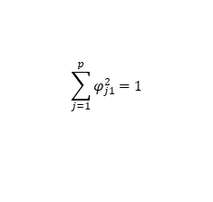
Principal Components Analysis: details
The first principal component of a set of features
X₁, X₂, . . . , X_{p} is the normalized linear combination of the features
Z₁ = φ₁₁X₁ + φ₂₁X₂ + . . . + φ_{p1}X_{p}
$$\sum_{j=1}^{p}{φ_{j1}^{2}}=1$$
that has the largest variance. By normalized, we mean that
We refer to the elements φ₁₁, . . . , φ_{p1} as the loadings of the first principal component; together, the loadings make up the principal component loading vector,
φ₁ = (φ₁₁ φ₂₁ . . . φ_{p1})^{T} .
We constrain the loadings so that their sum of squares is equal to one, since otherwise setting these elements to be arbitrarily large in absolute value could result in an arbitrarily large variance.

Slide 9
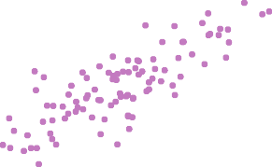
PCA: example
Ad Spending
0 5 10 15 20 25 30 35
10
20
30 40 50
60
70
Population
The population size (pop) and ad spending (ad) for 100 different cities are shown as purple circles. The green solid line indicates the first principal component direction, and the blue dashed line indicates the second principal component direction.

Slide 10
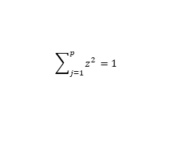
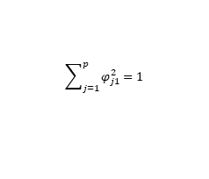
Computation of Principal Components
Suppose we have a n × p data set X. Since we are only interested in variance, we assume that each of the variables in X has been centered to have mean zero (that is, the column means of X are zero).
We then look for the linear combination of the sample feature values of the form
(1)
z_{i1} = φ₁₁x_{i1} + φ₂₁x_{i2} + . . . + φ_{p1}x_{ip}
for i = 1, . . . , n that has largest sample variance, subject to
the constraint that
$$\sum_{j=1}^{p}{φ_{j1}^{2}}=1$$
Since each of the x_{ij} has mean zero, then so does z_{i1} (for
any values of φ_{j1}). Hence the sample variance of the z_{i1}
can be written as
$$\sum_{j=1}^{p}{z_{}^{2}}=1$$

Slide 11

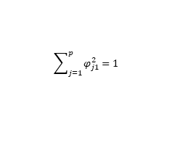
Computation: continued
Plugging in (1) the first principal component loading vector solves the optimization problem
$$\underset{\text{φ}\text{11} \text{,}\text{φ}\text{21},…,\text{φ}\text{p}\text{1}}{maximize}{\frac{1}{n}\sum_{i=1}^{n}{{\left(\sum_{j=1}^{p}{φ_{j1}x_{ij}}\right)}^{2}}}$$
$$\sum_{j=1}^{p}{φ_{j1}^{2}}=1$$
subject to
This problem can be solved via a singular-value decomposition of the matrix X, a standard technique in linear algebra.
We refer to Z₁ as the first principal component, with realized values z₁₁, . . . , z_{n1}

Slide 12
Geometry of PCA
The loading vector φ₁ with elements φ₁₁, φ₂₁, . . . , φ_{p1} defines a direction in feature space along which the data vary the most.
If we project the n data points x₁, . . . , x_{n} onto this direction, the projected values are the principal component scores z₁₁, . . . , z_{n1} themselves.

Slide 13
Further principal components
The second principal component is the linear combination of X₁, . . . , X_{p} that has maximal variance among all linear combinations that are uncorrelated with Z₁.
The second principal component scores z₁₂, z₂₂, . . . , z_{n2}
take the form
z_{i2} = φ₁₂x_{i1} + φ₂₂x_{i2} + . . . + φ_{p2}x_{ip},
where φ₂ is the second principal component loading vector, with elements φ₁₂, φ₂₂, . . . , φ_{p2}.

Slide 14
Further principal components: continued
It turns out that constraining Z₂ to be uncorrelated with Z₁ is equivalent to constraining the direction φ₂ to be orthogonal (perpendicular) to the direction φ₁. And so on.
The principal component directions φ₁, φ₂, φ₃, . . . are the ordered sequence of right singular vectors of the matrix X,
and the variances of the components are 1/n times the
squares of the singular values. There are at most
min(n − 1, p) principal components.

Slide 15
Illustration
USAarrests data: For each of the fifty states in the United States, the data set contains the number of arrests per
100, 000 residents for each of three crimes: Assault, Murder, and Rape. We also record UrbanPop (the percent of the population in each state living in urban areas).
The principal component score vectors have length n = 50, and the principal component loading vectors have length
p = 4.
PCA was performed after standardizing each variable to have mean zero and standard deviation one.

Slide 16
USAarrests data: PCA plot
−0.5
0.0
0.5
UrbanPop
biplot
3
2
Hawaii
0.5
RhodMe aIslUsaatnacdhuseNttesw Jersey
California
Second Principal Component
1
Connecticut
Washington
Colorado
Ohio WiscoMnsininnesota Pennsylvania _{Oregon}
New York
Nevada
Illinois^{Arizona}
Texas
Rape
KansaOs klaho^{D}m^{el}a^{aware} Missouri
New Ha^{I}m^{ow}pªshire
Nebraska _{Indiana}
Michigan
0.0
0
Idaho
Virginia
New Mexico Maryland
Assault
TennesseLeouisiana
Florida
Maine
Wyoming
rth Dakota
Montana
−1
South Dakota
Kentucky
Arkansas
Alabama
Alaska Georgia
Murder
VermontWest Virginia
−0.5
−2
South Carolina
North Carolina Mississippi
−3
−3
−2
−1 0 1
First Principal Component
2
3

Slide 17
Figure details
The first two principal components for the USArrests data.
The blue state names represent the scores for the first two principal components.
The orange arrows indicate the first two principal component loading vectors (with axes on the top and right). For example, the loading for Rape on the first component is 0.54, and its loading on the second principal component 0.17 [the word Rape is centered at the point (0.54, 0.17)].
This figure is known as a biplot, because it displays both the principal component scores and the principal component loadings.

Slide 18
PCA loadings
 | PC1 | PC2
Murder | 0.5358995 | -0.4181809
Assault | 0.5831836 | -0.1879856
UrbanPop | 0.2781909 | 0.8728062
Rape | 0.5434321 | 0.1673186
z_{i1} = φ₁₁x_{i1} + φ₂₁x_{i2} + . . . + φ_{p1}x_{ip}

Slide 19
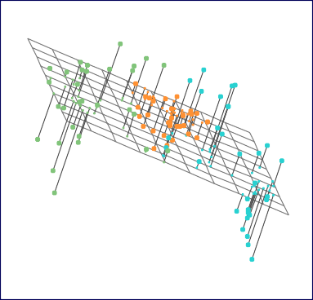
Another Interpretation of Principal Components
•
•
•
•
1.0
• • ••
• • •
•
• • • • • • ••
•
•
Second principal component
0.5
• •
• •
•
•
•
•
•
• •
•
0.0
• • ••
•
•
•••
•
•
•
• • • •
••• •• •
•
• •
• •
• •
•
−0.5
••
•
•
•
•
•
•• •••
•
•
• • •• •
−1.0
−1.0
−0.5
0.0 0.5
First principal component
1.0

Slide 20
PCA find the hyperplane closest to the observations
The first principal component loading vector has a very special property: it defines the line in p-dimensional space that is closest to the n observations (using average squared Euclidean distance as a measure of closeness)
The notion of principal components as the dimensions that are closest to the n observations extends beyond just the first principal component.
For instance, the first two principal components of a data set span the plane that is closest to the n observations, in terms of average squared Euclidean distance.

Slide 21
Scaling of the variables matters
If the variables are in different units, scaling each to have standard deviation equal to one is recommended.
If they are in the same units, you might or might not scale the variables.
Scaled
−0.5 0.0
Unscaled
0.0
0.5
−0.5
0.5
1.0
3
UrbanPop
150
UrbanPop
1.0
Second Principal Component
2
0.5
Second Principal Component
−100 −50 0 50 100
** ** *
*
0.5
1
*
*
* *
*
* *
*
* *
* R*ape
*
* * * * * *
*
*
0.0
*
*
Rape
0
*
*
*
* * * * **
** *
*
* * *
* *
**
** * * * *
* * *
* Assa
0.0
*
*
A*ssault
* * ** *
*M* urd*er * * *
*
* *
* **
* * *
−2 −1
*
*
*
*
*
*
*
* *
M*urder
−0.5
*
**
−0.5
−3
−3 −2 −1 0
1
2
3
−100 −50 0 50 100 150
First Principal Component
First Principal Component

Slide 22
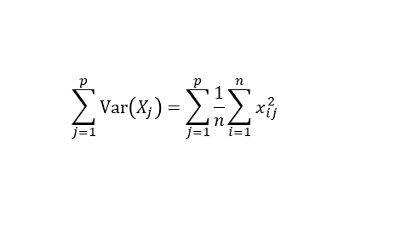
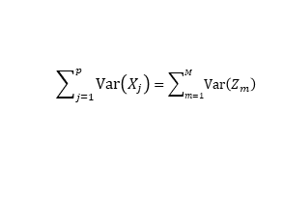
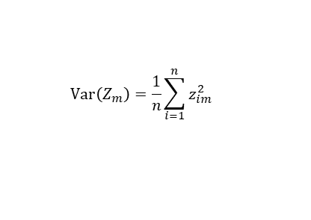
Proportion Variance Explained
To understand the strength of each component, we are interested in knowing the proportion of variance explained (PVE) by each one.
The total variance present in a data set (assuming that the variables have been centered to have mean zero) is defined
as
$$\sum_{j=1}^{p}{Var\left(X_{j}\right)}=\sum_{j=1}^{p}{\frac{1}{n}\sum_{i=1}^{n}{x_{ij}^{2}}}$$
and the variance explained by the mth principal component is
$$Var\left(Z_{m}\right)=\frac{1}{n}\sum_{i=1}^{n}{z_{im}^{2}}$$
It can be shown that
$$\sum_{j=1}^{p}{Var\left(X_{j}\right)}=\sum_{m=1}^{M}{Var\left(Z_{m}\right)}$$
with M = min(n − 1, p).

Slide 23
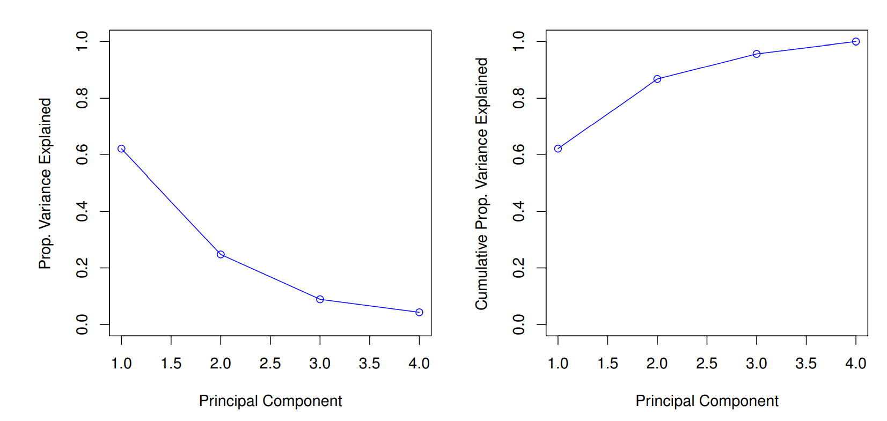
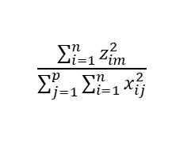
Proportion Variance Explained: continued
Therefore, the PVE of the mth principal component is
given by the positive quantity between 0 and 1
$$\frac{\sum_{i=1}^{n}{z_{im}^{2}}}{\sum_{j=1}^{p}{\sum_{i=1}^{n}{x_{ij}^{2}}}}$$
The PVEs sum to one. We sometimes display the cumulative PVEs.
scree plot

Slide 24
How many principal components should we use?
If we use principal components as a summary of our data, how many components are sufficient?
No simple answer to this question, as cross-validation is not available for this purpose.
Why not?
When could we use cross-validation to select the number of components?
the “scree plot” on the previous slide can be used as a guide: we look for an “elbow”.

Slide 25
Conclusions
Unsupervised learning is important for understanding the variation and grouping structure of a set of unlabeled data, and can be a useful pre-processor for supervised learning
It is intrinsically more difficult than supervised learning because there is no gold standard (like an outcome variable) and no single objective (like test set accuracy).
It is an active field of research, with many recently developed tools such as self-organizing maps, independent components analysis and spectral clustering.
See The Elements of Statistical Learning, chapter 14.

