Slide 1
Unsupervised Methods, Principal Component Analysis, Kernel PCA. Part 4.
EAS 509: Statistical Learning and Data Mining II

Slide 2
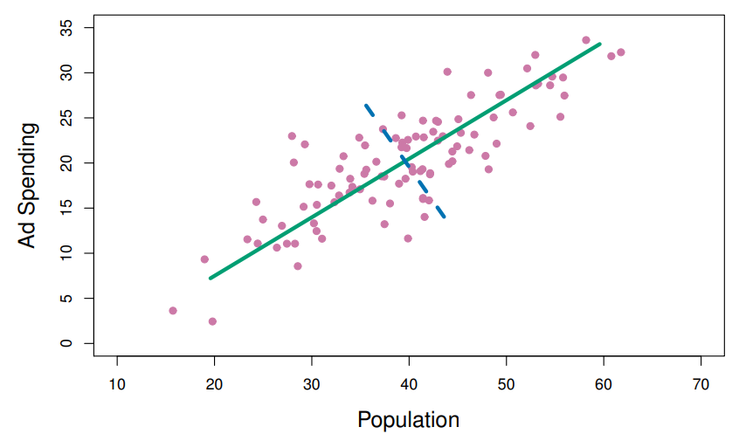
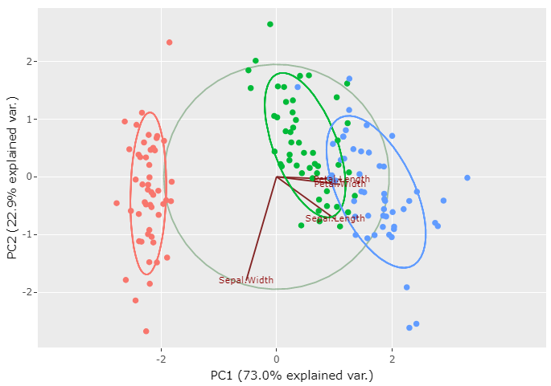
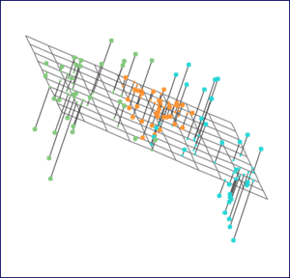
Principal Component Analysis
Second
Principal Component
PCA produces a low-dimensional representation of a dataset. It finds a sequence of linear combinations of the variables that have maximal variance, and are mutually uncorrelated.
Apart from producing derived variables for use in supervised learning problems, PCA also serves as a tool for data visualization.
First Principal Component
(Vary the Most)
Second
Principal Component
biplot
PCA can also be viewed as incremental data approximation
First Principal Component
(Vary the Most)

Slide 3
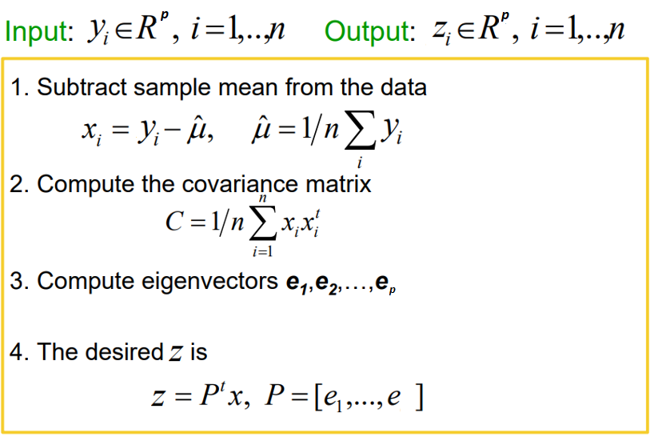
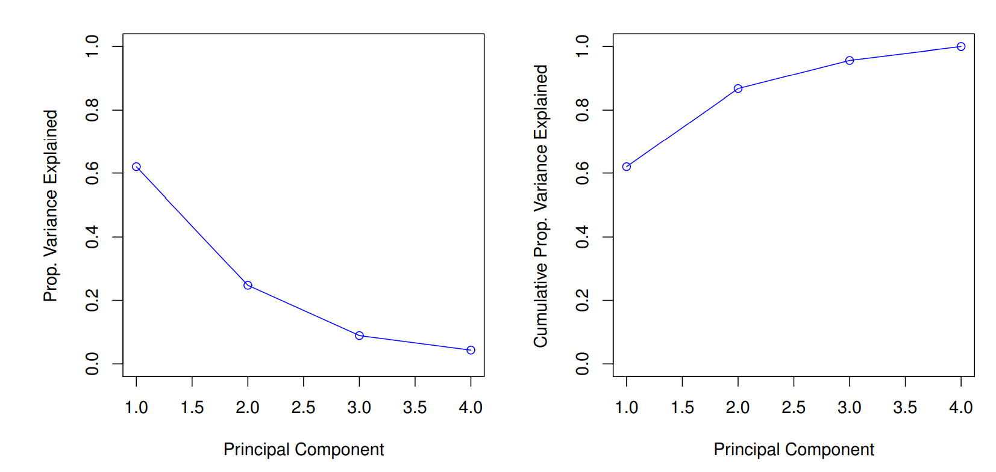
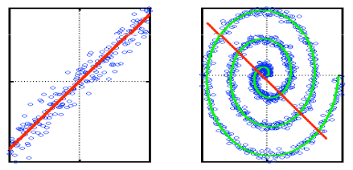


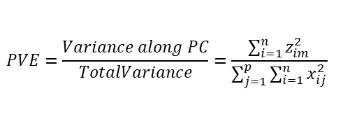
Principal Component Analysis - 2
Loadings of First Principal Component
$$zi1 = φ11xi1 + φ21xi2 + . . . + φp1xip$$
$$zi2 = φ12xi2 + φ22xi2 + . . . + φ2pxip$$
$$. . .$$
1.2 Scale x if needed
Loadings of Second Principal Component
Proportion Variance Explained
$$PVE=\frac{Variance along PC}{TotalVariance}=\frac{\sum_{i=1}^{n}{z_{im}^{2}}}{\sum_{j=1}^{p}{\sum_{i=1}^{n}{x_{ij}^{2}}}}$$
scree plot
Elbow?
$$z2$$
$$x2$$
Strengths:
Eigenvector method
No tuning parameters
Non -iterative
No local optima
Weaknesses:
Limited to linear projections
$$x1$$
$$z1$$

Slide 4
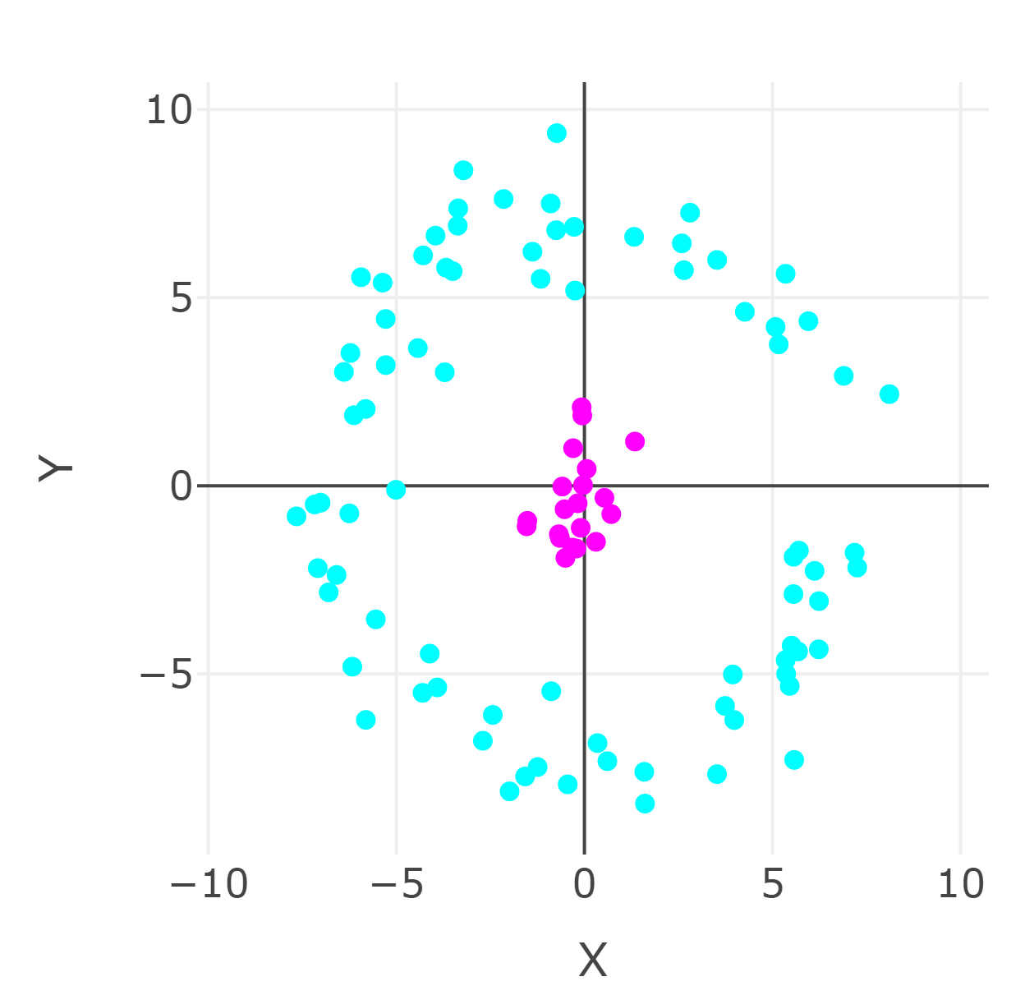
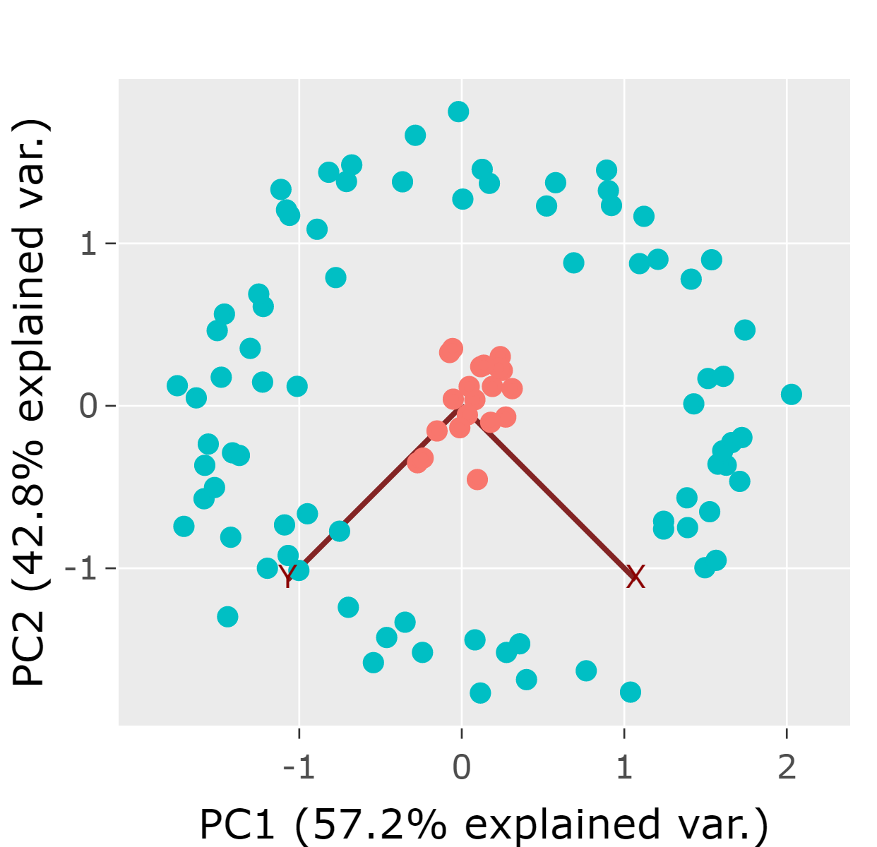
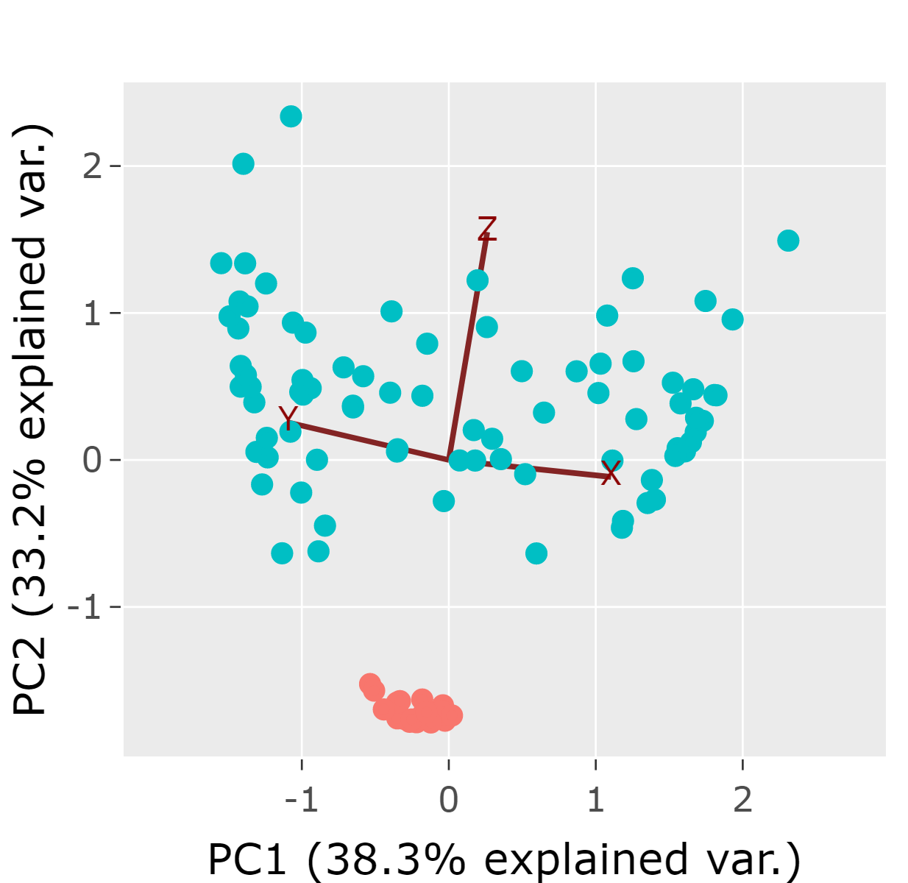
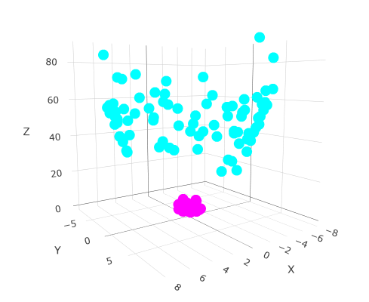
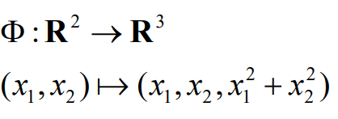
Kernel PCA Motivation: Going to Higher Dimentional Space Helps with Linear Separation
PCA
Adding distance from origin:
PCA on R³

Slide 5


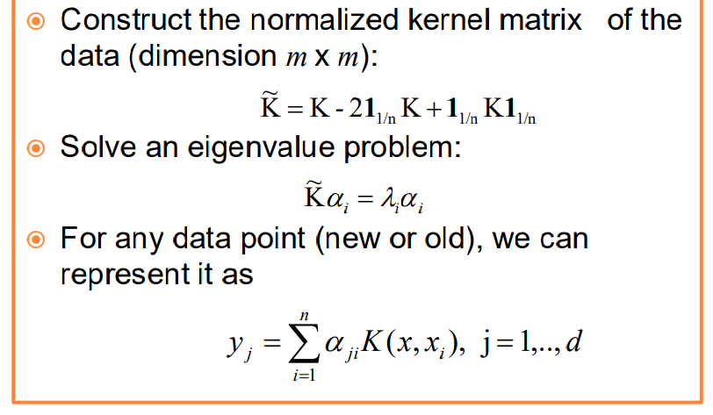
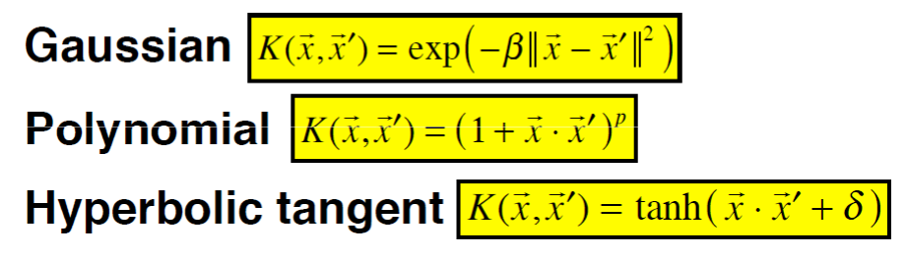
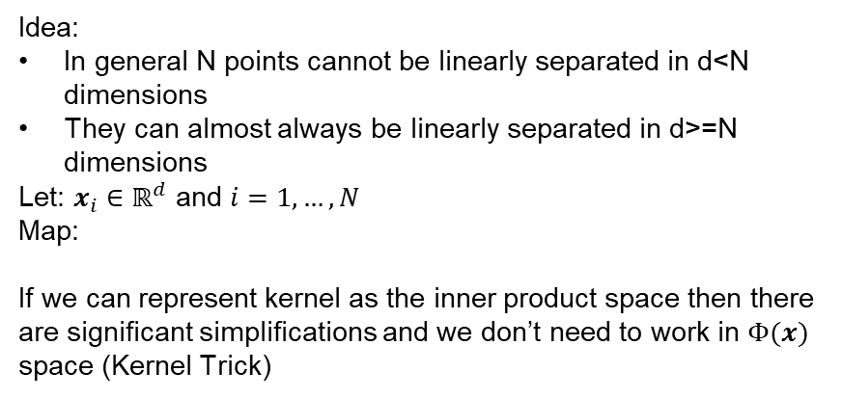

Kernel PCA
Idea:
In general N points cannot be linearly separated in d<N dimensions
They can almost always be linearly separated in d>=N dimensions
Let: $x_{i}∈ℝ^{d}$ and $i=1, …,N$
Map:
If we can represent kernel as the inner product space then there are significant simplifications and we don’t need to work in $Φ(x)$ space (Kernel Trick)
Calculate Kernel Matrix K
The consequence of Kernel Trick is that we don’t need to do $Φ(x)$ transformation and do PCA on it.
Instead, PC is calculated from eigenvectors of K

Slide 6
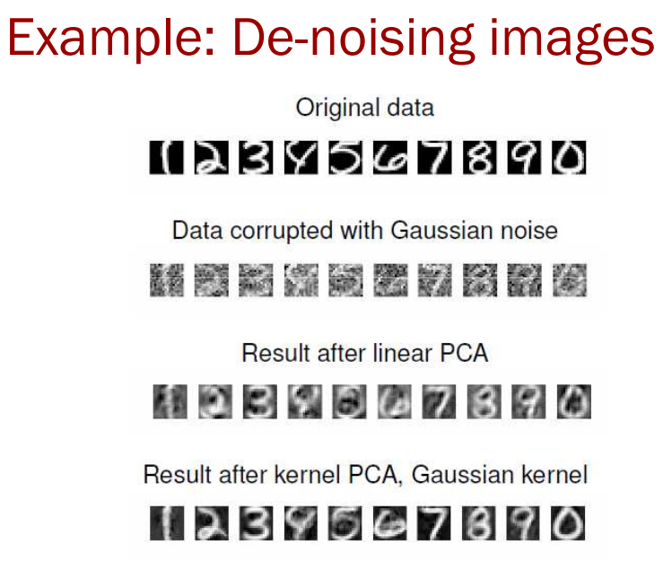
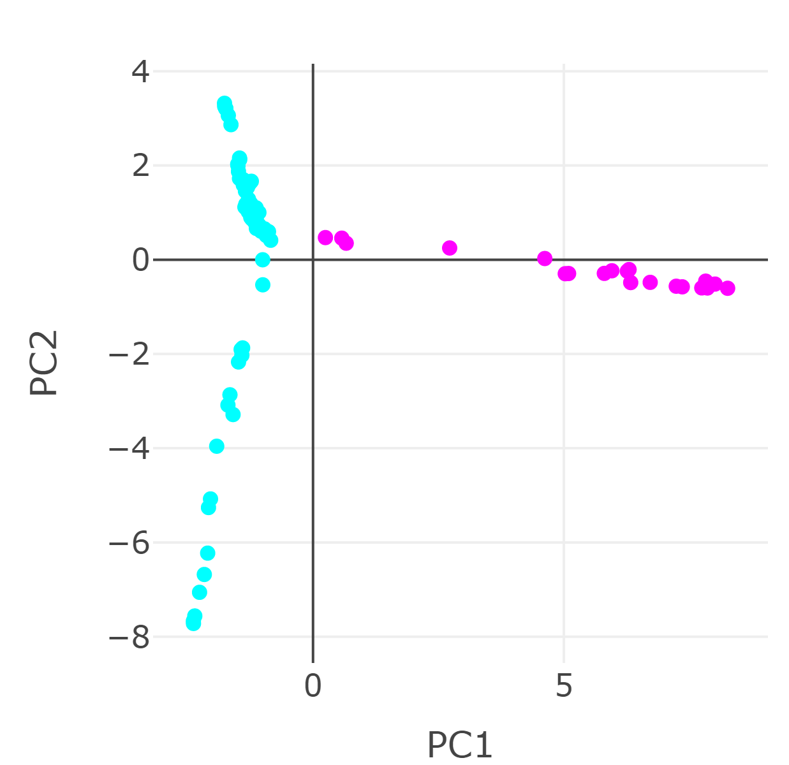
Kernel PCA: Examples
Kernel
PCA

Slide 7
Kernel PCA
Kernel PCA can give a good reencoding of the data when it lies along a non-linear manifold.
The kernel matrix is The kernel matrix is n x n, so kernel PCA will have difficulties if we have lots of data points.

