Slide 1
Unsupervised Methods: Clustering
EAS 509: Statistical Learning and Data Mining II
Slides due to Introduction to Statistical Learning, with applications in R (2nd edition):
https://web.stanford.edu/~hastie/MOOC-Slides/unsupervised.pdf
See also videos from the book authors:
https://www.youtube.com/playlist?list=PL5-da3qGB5IBC-MneTc9oBZz0C6kNJ-f2

Slide 2
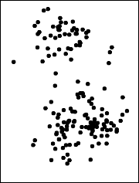
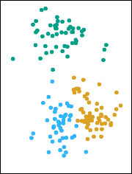
Clustering Recap
Clustering refers to a very broad set of techniques for finding subgroups, or clusters, in a data set.
We seek a partition of the data into distinct groups so that the observations within each group are quite similar to each other,
We must define what it means for two or more observations to be similar or different.
Indeed, this is often a domain-specific consideration that must be made based on knowledge of the data being studied.

Slide 3
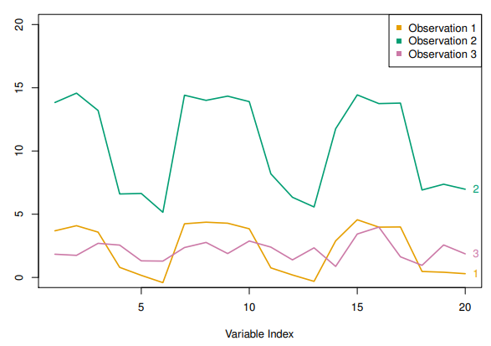
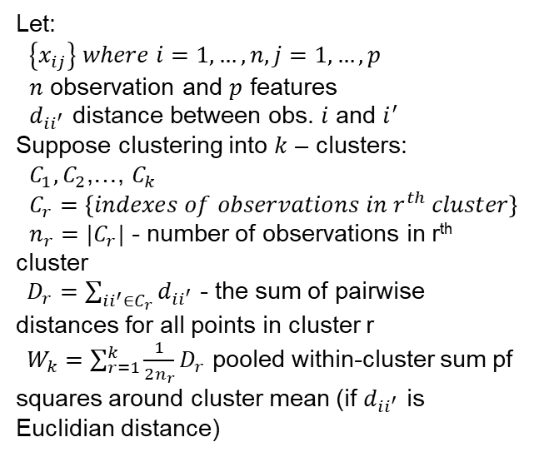
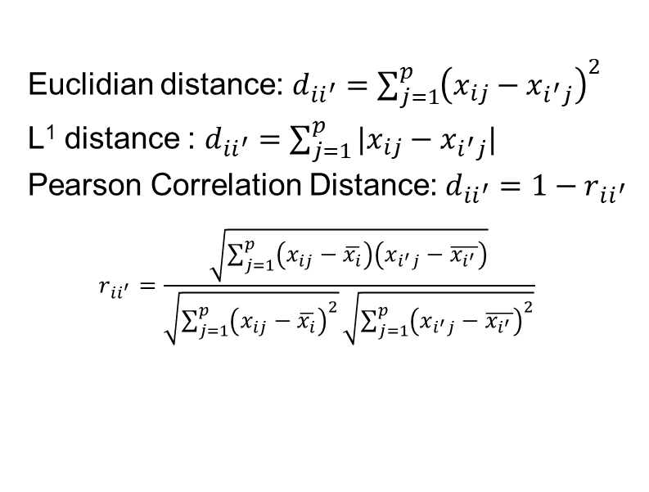
Dissimilarity Recap
Let:
$\left\{x_{ij}\right\} where i=1,…,n, j=1,…,p$
$n$ observation and $p$ features
$d_{ii^{′}}$ distance between obs. $i$ and $i^{′}$
Suppose clustering into $k$ – clusters:
$C_{1},C_{2}$,…, $C_{k}$
$C_{r}=\left\{indexes of observations in r^{th} cluster\right\}$
${n_{r}=|C}_{r}|$ - number of observations in r^{th} cluster
$D_{r}=\sum_{ii^{′}∈C_{r}}{d_{ii^{′}}}$ - the sum of pairwise distances for all points in cluster r
$W_{k}=\sum_{r=1}^{k}{\frac{1}{2n_{r}}D_{r}}$ pooled within-cluster sum pf squares around cluster mean (if $d_{ii^{′}}$ is Euclidian distance)
2?
Euclidian distance: $d_{ii^{′}}=\sum_{j=1}^{p}{{\left(x_{ij}−x_{i^{′}j}\right)}^{2}}$
L¹ distance : $d_{ii^{′}}=\sum_{j=1}^{p}{{|x}_{ij}−x_{i^{′}j}|}$
Pearson Correlation Distance: $d_{ii^{′}}=1−r_{ii^{′}}$
$$r_{ii^{′}}=\frac{\sqrt{\sum_{j=1}^{p}{\left(x_{ij}−\overline{x_{i}}\right)\left(x_{i^{′}j}−\overline{x_{i^{′}}}\right)}}}{\sqrt{\sum_{j=1}^{p}{{\left(x_{ij}−\overline{x_{i}}\right)}^{2}}}\sqrt{\sum_{j=1}^{p}{{\left(x_{i^{′}j}−\overline{x_{i^{′}}}\right)}^{2}}}}$$
Correlation Distance Similar
Euclidian/L1 Distance Similar

Slide 4
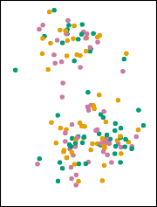
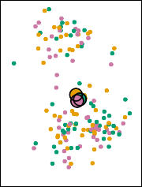
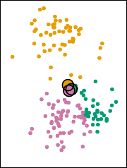
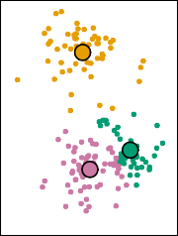
K-Means Clustering Recap: Algorithm
Randomly assign a number, from 1 to K, to each of the observations. These serve as initial cluster assignments for the observations. (Random Partition).
Alternatively (Forgy): choose k-observation to be ‘centroids’ and perform 2.b
Iterate until the cluster assignments stop changing:
For each of the K clusters, compute the cluster centroid. The k-th cluster centroid is the vector of the p feature means for the observations in the kth cluster.
Assign each observation to the cluster whose centroid is closest (where closest is defined using Euclidean distance).
Step 1
Iteration 1,
Step 2a
Iteration 1,
Step 2b
Iteration 2,
Step 2a

Slide 5







Scaling Matters
Scaling of the variables matters!
Dimensions with larger variance will dominate the dissimilarity.
Typically, if the units are different, we do standardization
If the units are same, we still can do standardization
$$x_{1}$$
$$x_{2}$$
$$d$$
$$vs$$
$$x_{1}^{′}$$
$$x_{2}^{′}$$
$$d$$

Slide 6
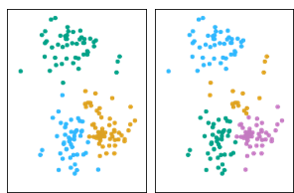
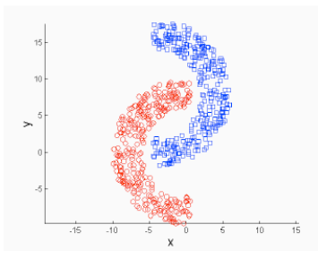
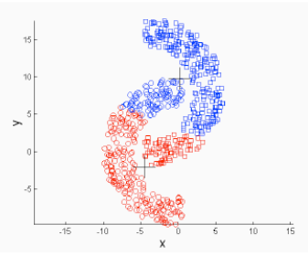
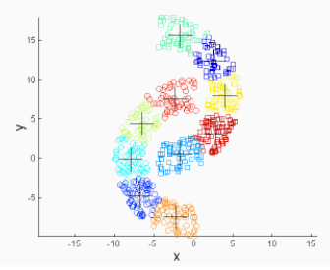
K-Means Clustering Limitations
K=3
K=4
It is not guaranteed to converge the global minimum
When moving to higher number of clusters, it does not split the existing clusters but create a new groupings
Favor globular clusters
K-means (2 Clusters)
K-means (10 Clusters)

Slide 7
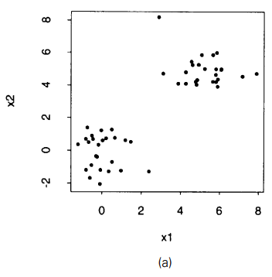
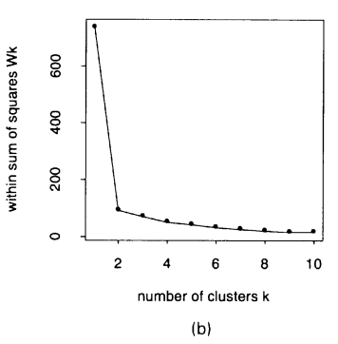
Choosing Number of Clusters
There is no consensus on this
“Elbow”
Gap Statistics
Silhouettes
Tibshirani, Walther, G., & Hastie, T. (2001).

Slide 8
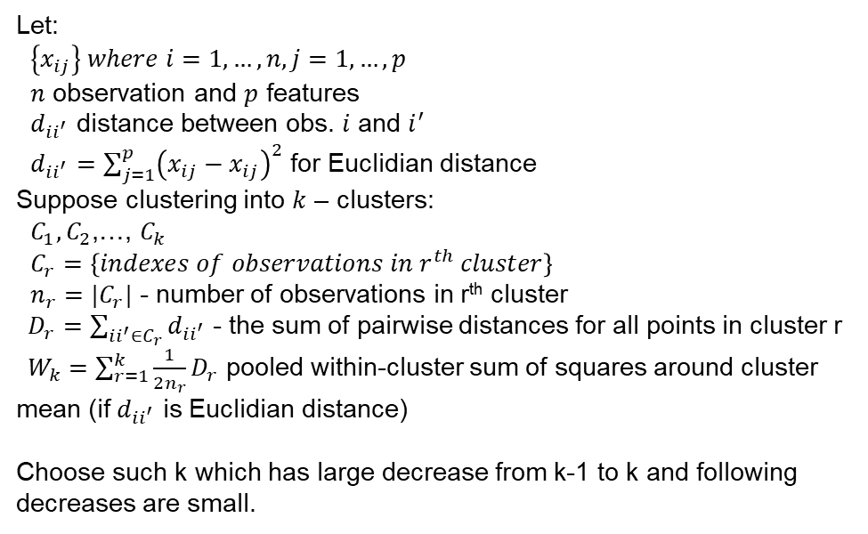
Choosing Number of Clusters: “Elbow” Method
Let:
$\left\{x_{ij}\right\} where i=1,…,n, j=1,…,p$
$n$ observation and $p$ features
$d_{ii^{′}}$ distance between obs. $i$ and $i^{′}$
$d_{ii^{′}}=\sum_{j=1}^{p}{{\left(x_{ij}−x_{ij}\right)}^{2}}$ for Euclidian distance
Suppose clustering into $k$ – clusters:
$C_{1},C_{2}$,…, $C_{k}$
$C_{r}=\left\{indexes of observations in r^{th} cluster\right\}$
${n_{r}=|C}_{r}|$ - number of observations in r^{th} cluster
$D_{r}=\sum_{ii^{′}∈C_{r}}{d_{ii^{′}}}$ - the sum of pairwise distances for all points in cluster r
$W_{k}=\sum_{r=1}^{k}{\frac{1}{2n_{r}}D_{r}}$ pooled within-cluster sum of squares around cluster mean (if $d_{ii^{′}}$ is Euclidian distance)
Choose such k which has large decrease from k-1 to k and following decreases are small.
Elbow
Tibshirani, Walther, G., & Hastie, T. (2001).

Slide 9
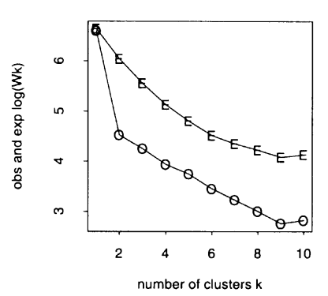
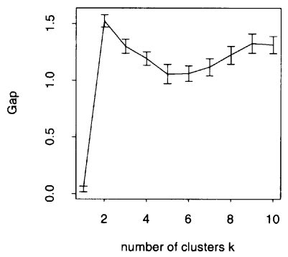
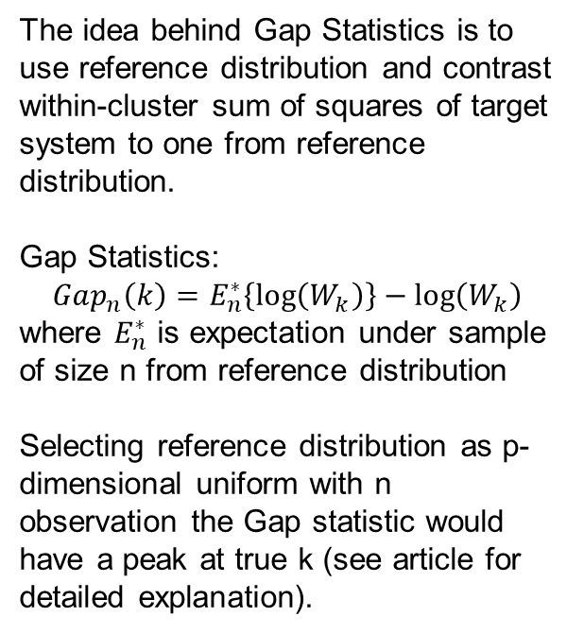
Choosing Number of Clusters: Gap Statistics
The idea behind Gap Statistics is to use reference distribution and contrast within-cluster sum of squares of target system to one from reference distribution.
Gap Statistics:
$$Gap_{n}\left(k\right)=E_{n}^{∗}\left\{\log\left(W_{k}\right)\right\}−\log\left(W_{k}\right)$$
where $E_{n}^{∗}$ is expectation under sample of size n from reference distribution
Selecting reference distribution as p-dimensional uniform with n observation the Gap statistic would have a peak at true k (see article for detailed explanation).
Gap has max
Tibshirani, Walther, G., & Hastie, T. (2001).

Slide 10
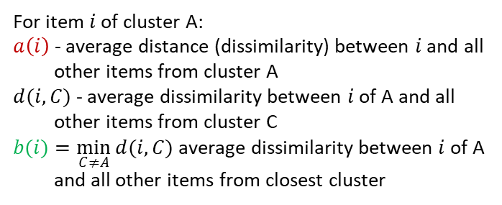
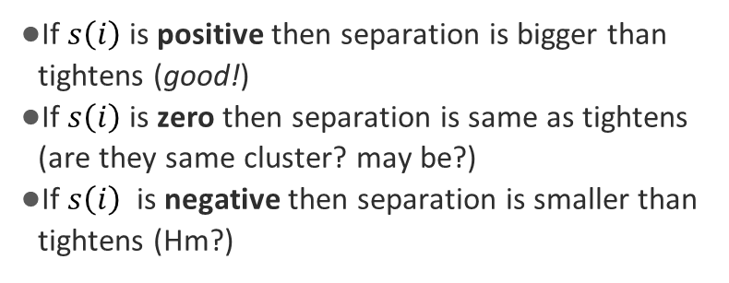
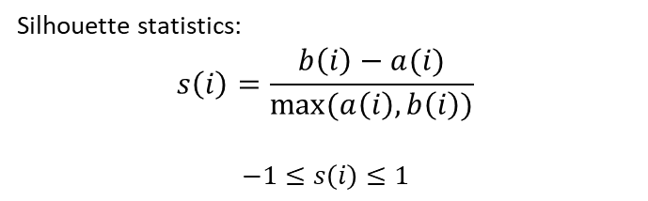
Silhouettes: A graphical aid to the interpretation and validation of cluster analysis
Silhouette statistics is based on comparison of cluster tightness and inter-cluster separation
B
Silhouette statistics:
$$s\left(i\right)=\frac{b\left(i\right)−a(i)}{max⁡(a\left(i\right),b\left(i\right))}$$
$$−1≤s\left(i\right)≤1$$
A
$$i$$
C
For item 𝑖 of cluster A:
$a\left(i\right)$ - average distance (dissimilarity) between $i$ and all other items from cluster A
$d(i,C)$ - average dissimilarity between $i$ of A and all other items from cluster C
$b(i)=\min_{C≠A}{d(i,C)}$ average dissimilarity between $i$ of A and all other items from closest cluster
If $s\left(i\right)$ is positive then separation is bigger than tightens (good!)
If $s\left(i\right)$ is zero then separation is same as tightens (are they same cluster? may be?)
If $s\left(i\right)$ is negative then separation is smaller than tightens (Hm?)

Slide 11
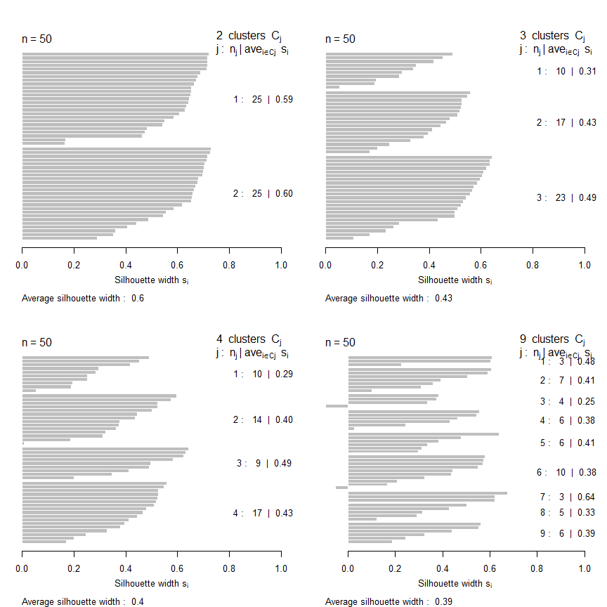
Silhouettes: A graphical aid to the interpretation and validation of cluster analysis
Silhouette plot

Slide 12
Silhouettes
Choose k with larger width and no negative items (are they outliers?)

Slide 13
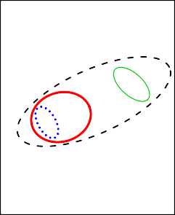
Hierarchical Clustering
K-means clustering requires us to pre-specify the number of clusters K. This can be a disadvantage (later we discuss strategies for choosing K)
Hierarchical clustering is an alternative approach which does not require that we commit to a particular choice of K.
In hierarchical clustering a dendrogram is built starting from the leaves and combining clusters up to the trunk.
Clustering methods can be grouped in:
bottom-up (agglomerative) methods (Hierarchical clustering )
top-down methods
D
E
A
B
C
4
3
2
1
0
D
E B A C

Slide 14
Hierarchical Clustering Algorithm
Start with each point in its own cluster.
Identify the closest two clusters and merge them.
Repeat.
Ends when all points are in a single cluster.
4
D
3
E
B
Distance
A
2
C
1
0
D E B A C

Slide 15
Hierarchical Clustering Algorithm
Start with each point in its own cluster.
Identify the closest two clusters and merge them.
Repeat.
Ends when all points are in a single cluster.
4
D
3
E
B
Distance
A
2
C
1
0
D E B A C

Slide 16
Hierarchical Clustering Algorithm
Start with each point in its own cluster.
Identify the closest two clusters and merge them.
Repeat.
Ends when all points are in a single cluster.
4
D
3
E
B
Distance
A
2
C
1
0
D E B A C

Slide 17
Hierarchical Clustering Algorithm
Start with each point in its own cluster.
Identify the closest two clusters and merge them.
Repeat.
Ends when all points are in a single cluster.
4
D
3
E
B
Distance
A
2
C
1
0
D E B A C

Slide 18
Hierarchical Clustering Algorithm
Start with each point in its own cluster.
Identify the closest two clusters and merge them.
Repeat.
Ends when all points are in a single cluster.
4
D
3
E
B
Distance
A
2
C
1
0
D E B A C
Linkage – defines how to calculate distance between clusters containing multiple items:
Complete – largest distance
Single – smallest distance
Average – average dissimilarity between all elements of two clusters
Centroid - Dissimilarity between the centroids

Slide 19
Hierarchical Clustering Algorithm
Start with each point in its own cluster.
Identify the closest two clusters and merge them.
Repeat.
Ends when all points are in a single cluster.
Average – average dissimilarity between all elements of two clusters
Centroid - Dissimilarity between the centroids
4
D
3
E
B
Distance
A
2
C
1
0
D E B A C
Linkage – defines how to calculate distance between clusters containing multiple items:
Complete – largest distance
Single – smallest distance
Average – average dissimilarity between all elements of two clusters
Centroid - Dissimilarity between the centroids

Slide 20
Hierarchical Clustering: Getting K-Clusters
K=1
Cut at proper height to get desired number of clusters
4
K=2
D
3
E
B
K=3
Distance
A
2
K=4
C
1
K=5
0
D E B A C

Slide 21
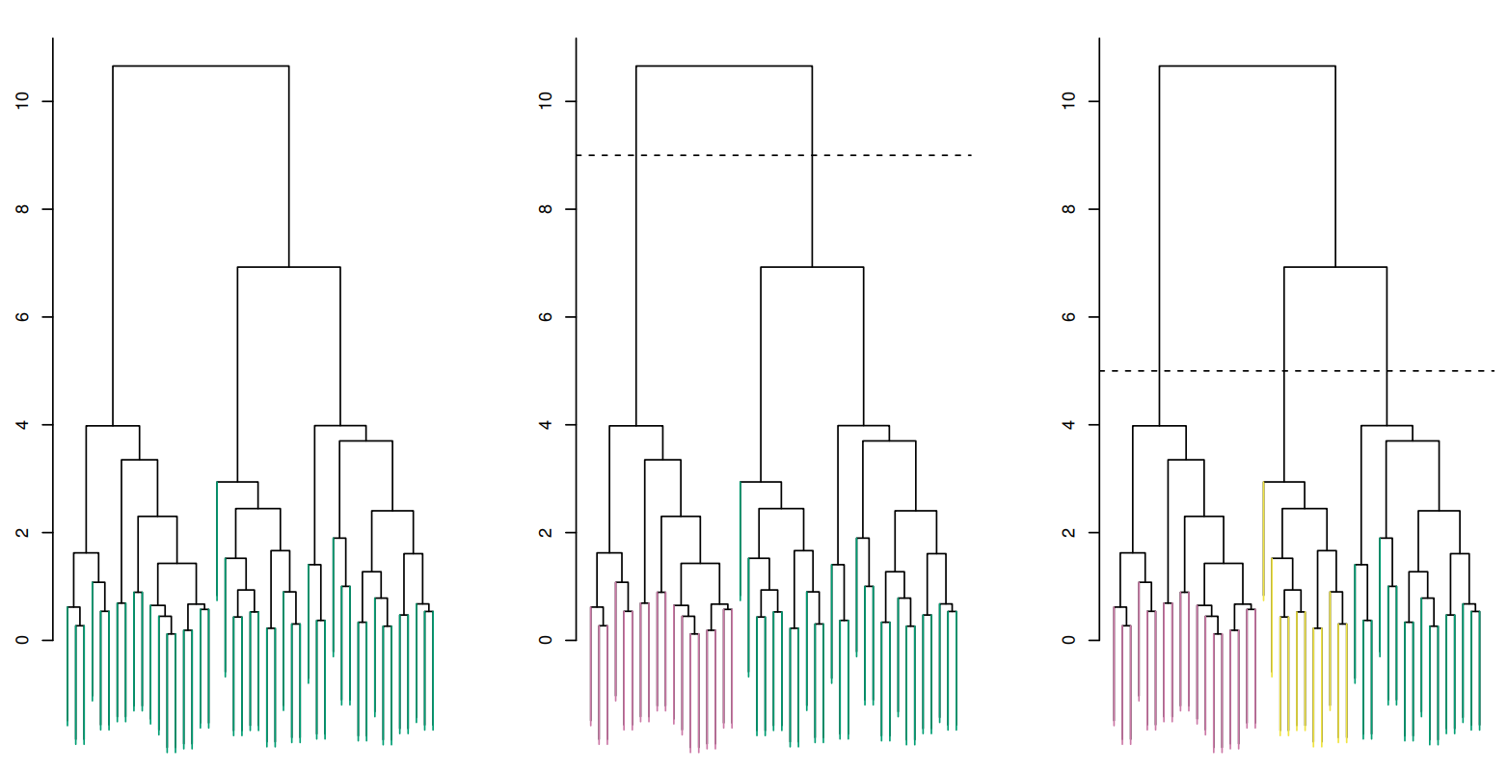
Hierarchical Clustering: Getting K-Clusters, Example
K=1
K=2
K=3
Illustration on selecting different number of cluster

Slide 22
Hierarchical Clustering: Linkage
Single Linkage
Complete Linkage
Linkage – defines how to calculate distance between clusters containing multiple items:
Complete – largest distance between elements of two clusters
Single – smallest distance between elements of two clusters
Average – average dissimilarity between all elements of two clusters
Centroid - Dissimilarity between the centroids
D
E
D
E
B
B
A
A
C
C
Average Linkage
Centroid Linkage
D
E
D
E
B
B
A
A
C
C

Slide 23
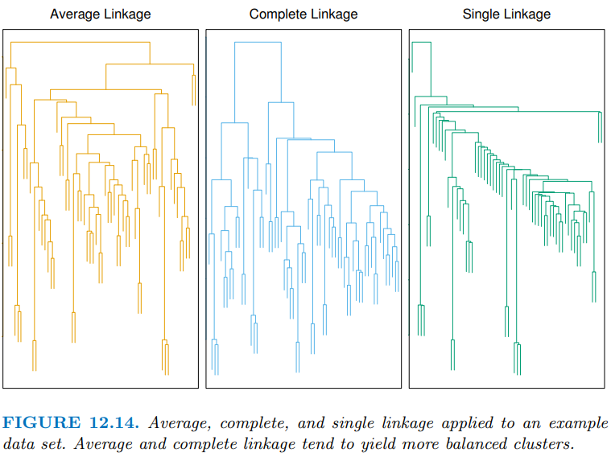
Hierarchical Clustering: Linkage
Average and Complete Linkages are most often used
Single linkage often produce long, stringy, clusters, i.e. one element at a time. Not balanced clusters
Centroid are often used in genomics

Slide 24
Practical issues
Scaling of the variables matters!. Should the observations or features first be standardized in some way? For instance, maybe the variables should be centered to have mean zero and scaled to have standard deviation one.
In the case of hierarchical clustering,
What dissimilarity measure should be used?
What type of linkage should be used?
How many clusters to choose? (in both K-means or hierarchical clustering). Difficult problem. No agreed-upon method.
Too many?
Too few?
Which features should we use to drive the clustering?

Slide 25
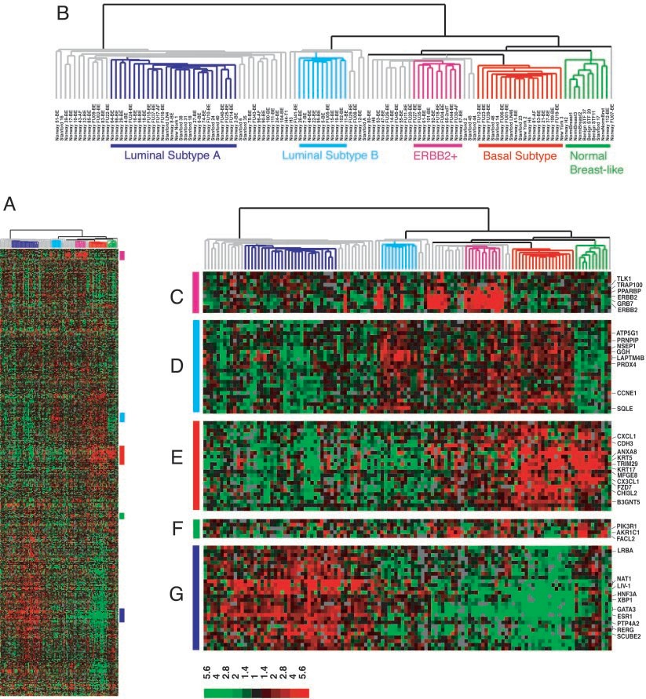
Example: breast cancer microarray study
“Repeated observation of breast tumor subtypes in independent gene expression data sets;” Sorlie at el, PNAS 2003
Gene expression measurements for about ∼ 8000 genes, for each of 88 breast cancer patients.
Average linkage, correlation metric
Clustered samples using 500 intrinsic genes: each woman was measured before and after chemotherapy. Intrinsic genes have smallest within/between variation.

Slide 26
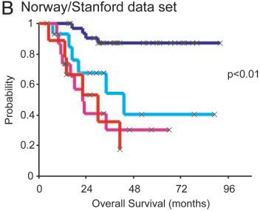
Example: breast cancer microarray study

Slide 27
Summary
Unsupervised learning is important for understanding the variation and grouping structure of a set of unlabeled data, and can be a useful pre-processor for supervised learning
It is intrinsically more difficult than supervised learning because there is no gold standard (like an outcome variable) and no single objective (like test set accuracy).
It is an active field of research, with many recently developed tools such as self-organizing maps, independent components analysis and spectral clustering.
See The Elements of Statistical Learning, chapter 14.

