Slide 1
Unsupervised Methods: Clustering
EAS 509: Statistical Learning and Data Mining II
Slides due to Introduction to Statistical Learning, with applications in R (2nd edition):
https://web.stanford.edu/~hastie/MOOC-Slides/unsupervised.pdf
See also videos from the book authors:
https://www.youtube.com/playlist?list=PL5-da3qGB5IBC-MneTc9oBZz0C6kNJ-f2

Slide 2
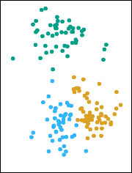
Clustering
Clustering refers to a very broad set of techniques for finding subgroups, or clusters, in a data set.
We seek a partition of the data into distinct groups so that the observations within each group are quite similar to each other,
It make this concrete, we must define what it means for two or more observations to be similar or different.
Indeed, this is often a domain-specific consideration that must be made based on knowledge of the data being studied.

Slide 3
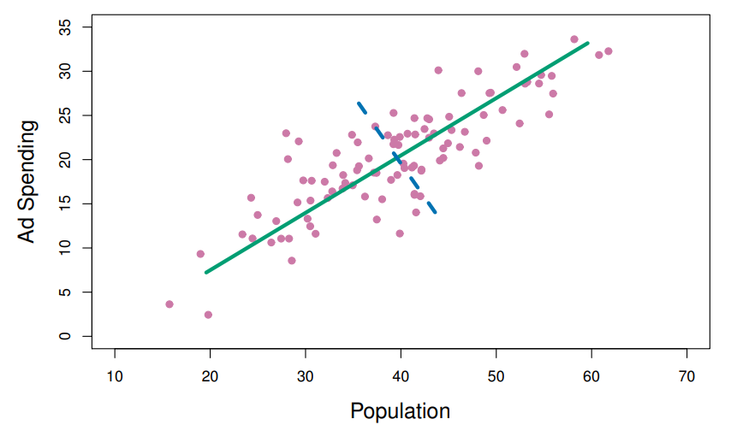
PCA vs Clustering
PCA looks for a low-dimensional representation of the observations that explains a good fraction of the variance.
Second
Principal Component
First Principal Component
(Vary the Most)
Clustering looks for homogeneous subgroups among the observations.

Slide 4
Example:
Clustering for Market Segmentation:
Suppose we have access to a large number of measurements (e.g. median household income, occupation, distance from nearest urban area, and so forth) for a large number of people.
Our goal is to perform market segmentation by identifying subgroups of people who might be more receptive to a particular form of advertising, or more likely to purchase a particular product.
The task of performing market segmentation amounts to clustering the people in the data set.

Slide 5
Two clustering methods in this Section
In K-means clustering, we seek to partition the observations into a pre-specified number of clusters.
In hierarchical clustering, we do not know in advance how many clusters we want; in fact, we end up with a tree-like visual representation of the observations, called a dendrogram, that allows us to view at once the clusterings obtained for each possible number of clusters, from 1 to n.
There are many other clustering

Slide 6
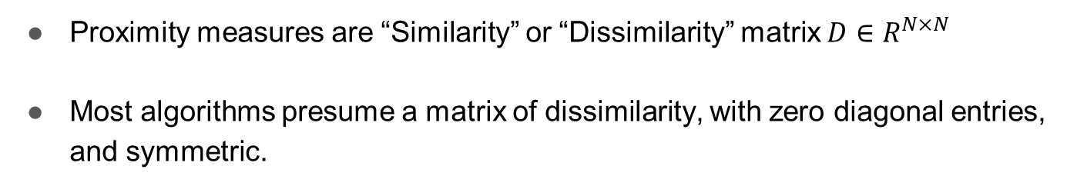
Proximity Measures: Similarity/Dissimilarity/Distance Calculations
Proximity measures are “Similarity” or “Dissimilarity” matrix $D∈R^{N×N}$
Most algorithms presume a matrix of dissimilarity, with zero diagonal entries, and symmetric.

Slide 7
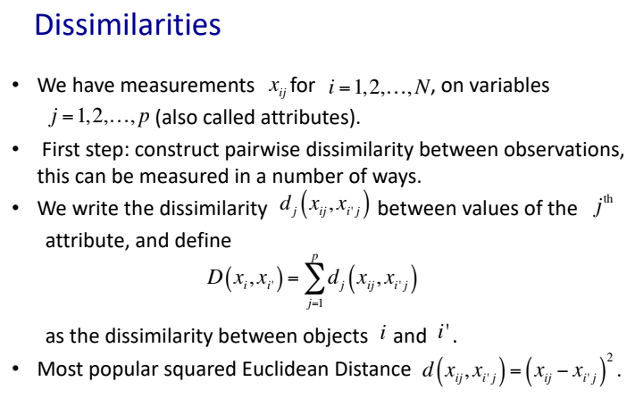

Slide 8
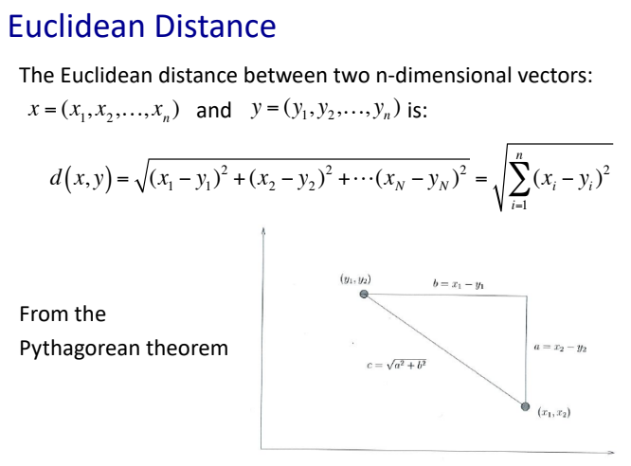

Slide 9
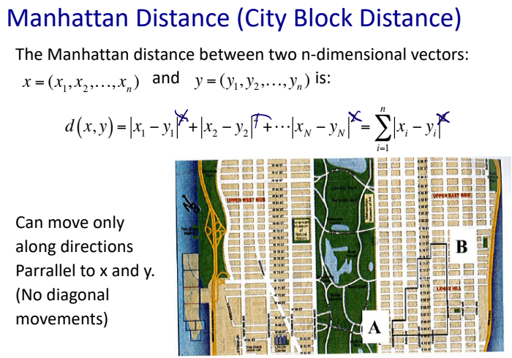
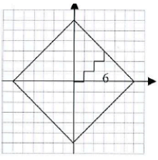
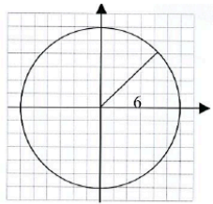
also known as rectilinear distance, L¹ distance or l₁ norm

Slide 10
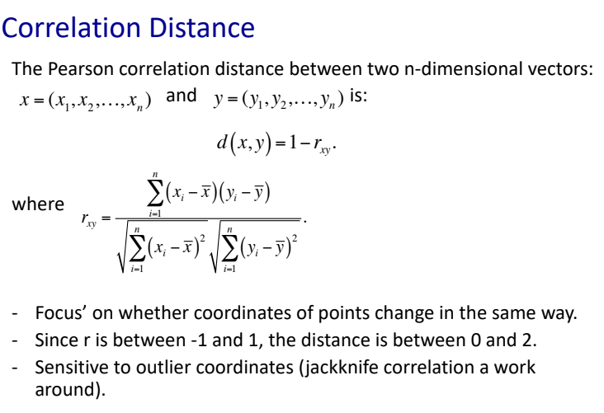

Slide 11
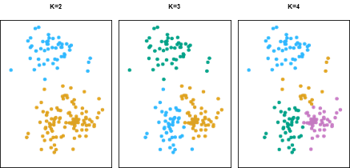
K-means clustering
In K-means clustering, we seek to partition the observations into a pre-specified number of clusters.
Clustering of A data set with 150 2-d simulated observations into 2, 3 and 4 clusters

Slide 12
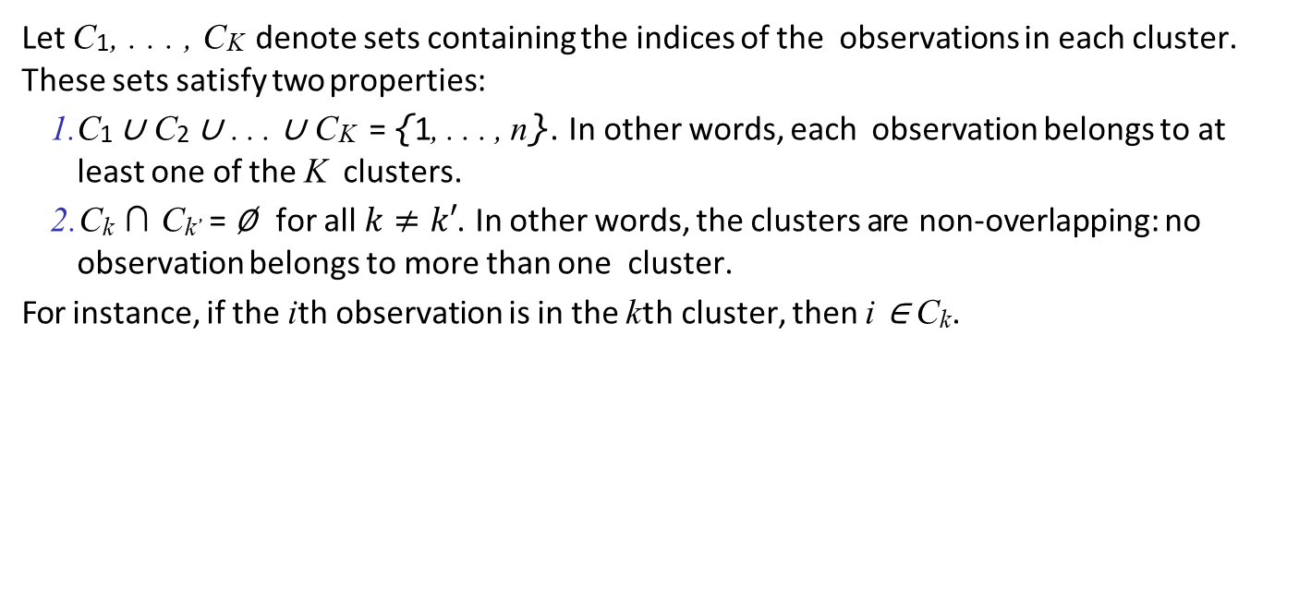
Details of K-means clustering
Let C₁, . . . , C_{K} denote sets containing the indices of the observations in each cluster. These sets satisfy two properties:
C₁ ∪ C₂ ∪ . . . ∪ C_{K} = {1, . . . , n}. In other words, each observation belongs to at least one of the K clusters.
C_{k} ∩ C_{k}’ = ∅ for all $k≠k′$. In other words, the clusters are non-overlapping: no observation belongs to more than one cluster.
For instance, if the ith observation is in the kth cluster, then i ∈ C_{k}.

Slide 13
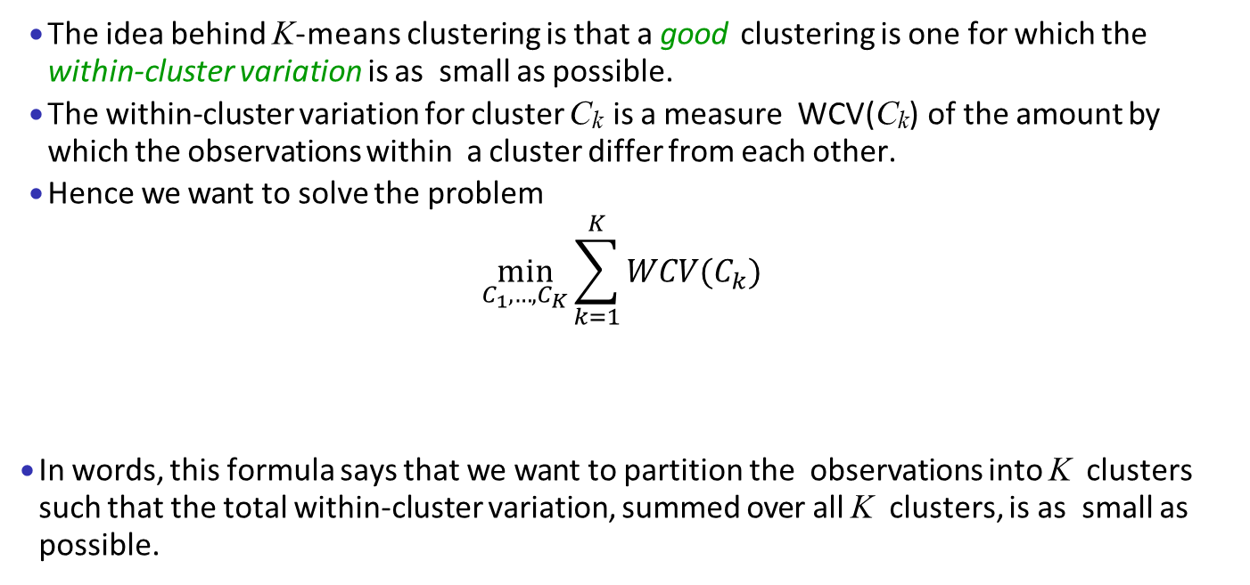
Details of K-means clustering: continued
The idea behind K-means clustering is that a good clustering is one for which the within-cluster variation is as small as possible.
The within-cluster variation for cluster C_{k} is a measure WCV(C_{k}) of the amount by which the observations within a cluster differ from each other.
Hence we want to solve the problem
$$\min_{C_{1},…,C_{K}}{\sum_{k=1}^{K}{WCV(C_{k})}}$$
In words, this formula says that we want to partition the observations into K clusters such that the total within-cluster variation, summed over all K clusters, is as small as possible.

Slide 14
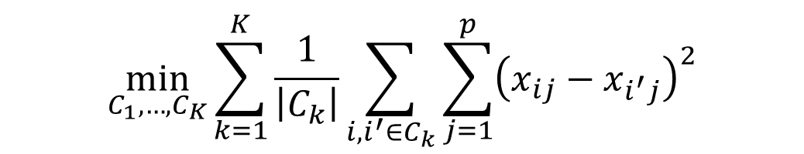
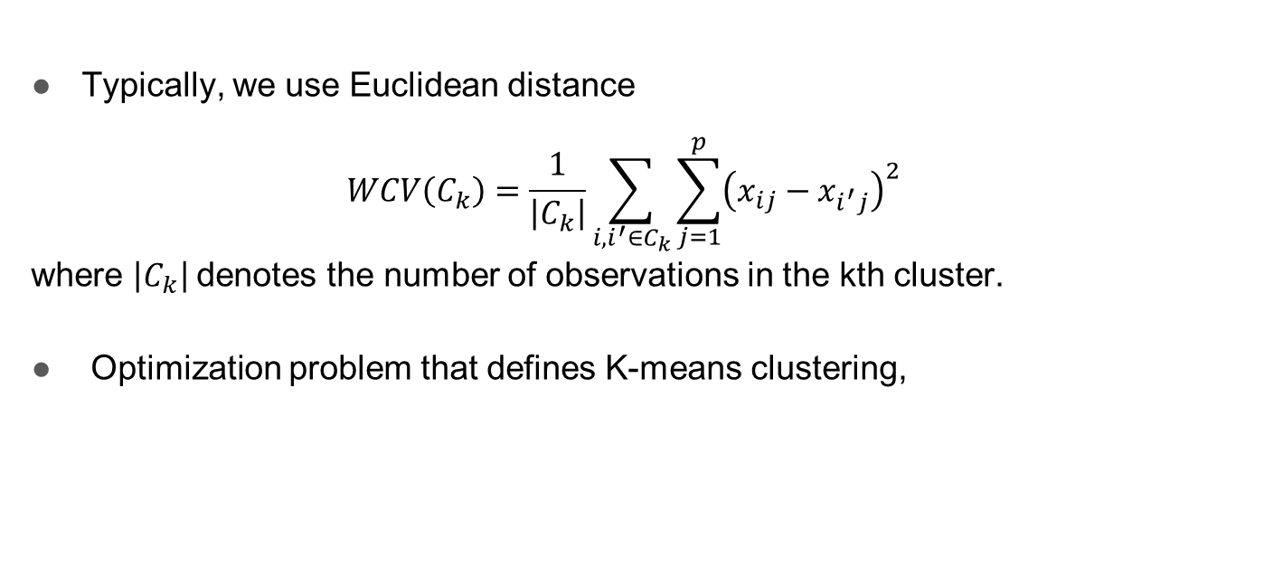
How to define within-cluster variation?
Typically, we use Euclidean distance
$$WCV\left(C_{k}\right)=\frac{1}{\left|C_{k}\right|}\sum_{i,i^{′}∈C_{k}}{\sum_{j=1}^{p}{{\left(x_{ij}−x_{i^{′}j}\right)}^{2}}}$$
where $\left|C_{k}\right|$denotes the number of observations in the kth cluster.
Optimization problem that defines K-means clustering,
$$\min_{C_{1},…,C_{K}}{\sum_{k=1}^{K}{\frac{1}{\left|C_{k}\right|}\sum_{i,i^{′}∈C_{k}}{\sum_{j=1}^{p}{{\left(x_{ij}−x_{i^{′}j}\right)}^{2}}}}}$$

Slide 15
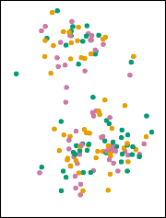
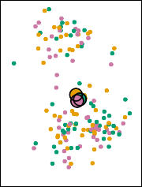
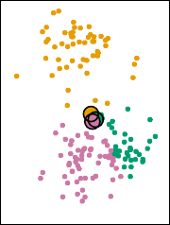
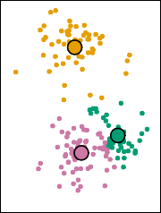
K-Means Clustering Algorithm
Randomly assign a number, from 1 to K, to each of the observations. These serve as initial cluster assignments for the observations. (Random Partition).
Alternatively (Forgy): choose k-observation to be ‘centroids’ and perform 2.b
Iterate until the cluster assignments stop changing:
For each of the K clusters, compute the cluster centroid. The k-th cluster centroid is the vector of the p feature means for the observations in the kth cluster.
Assign each observation to the cluster whose centroid is closest (where closest is defined using Euclidean distance).
Step 1
Iteration 1,
Step 2a
Iteration 1,
Step 2b
Iteration 2,
Step 2a

Slide 16
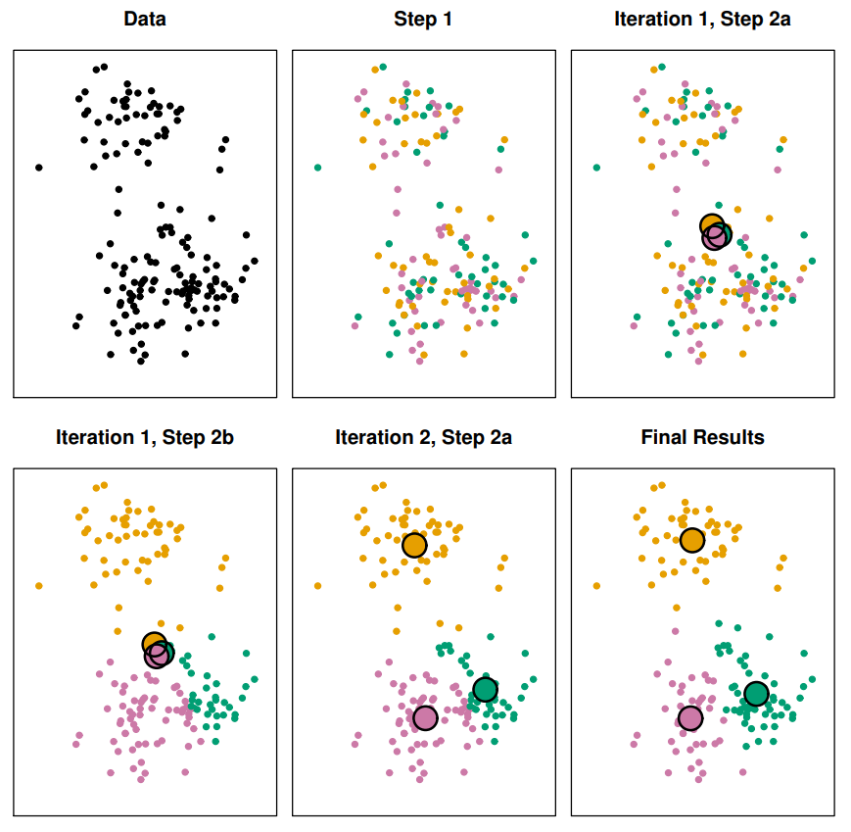
Example

Slide 17
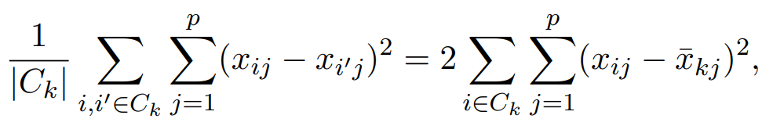
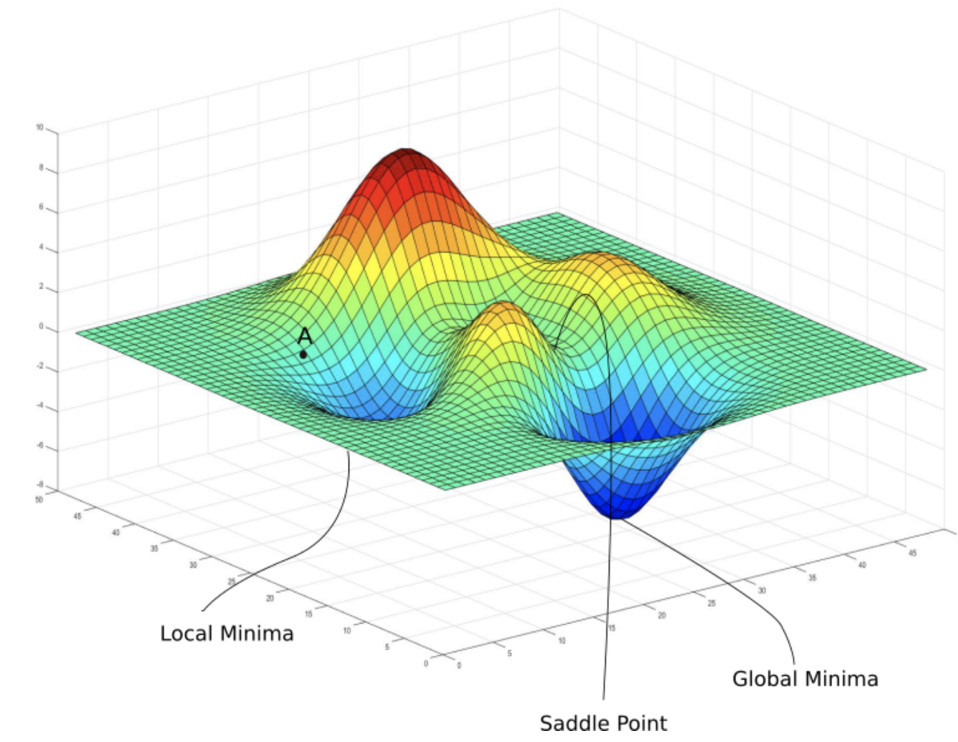
Properties of the Algorithm
This algorithm is guaranteed to decrease the value of the objective at each step.
however it is not guaranteed to give the global minimum

Slide 18
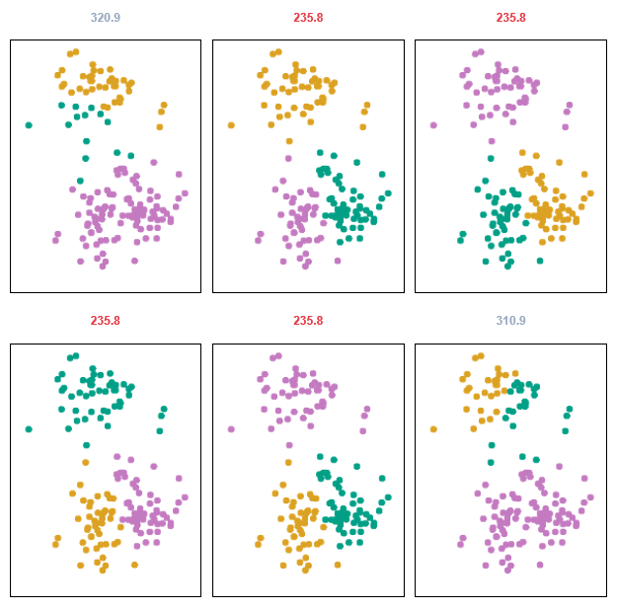
Example: different starting values
K-means clustering performed six times on the data from previous figure with K = 3, each time with a different random initial assignment
Three different local optima were obtained,
Those labeled in red all achieved the same best solution,

Slide 19
K-means clustering
Checkout some visualization of K-means clustering
https://www.youtube.com/watch?v=nXY6PxAaOk0&ab_channel=JohanHagelb%C3%A4ck
https://www.youtube.com/watch?v=5I3Ei69I40s&ab_channel=bitLectures

