Slide 1
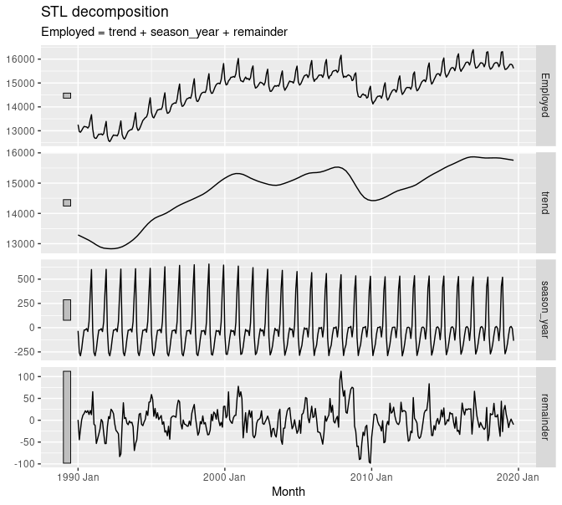
Time Series Analysis and Forecasting
Ch3. Time series decomposition and transformations

Slide 2
Transformations and adjustments

Slide 3
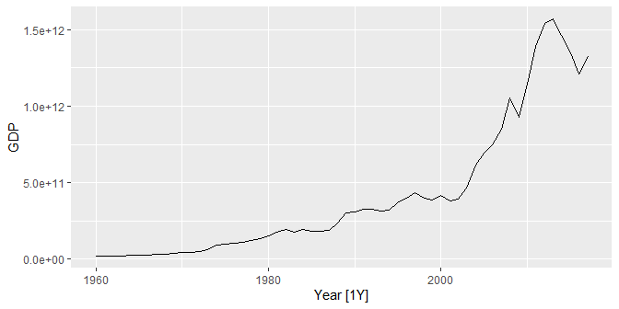
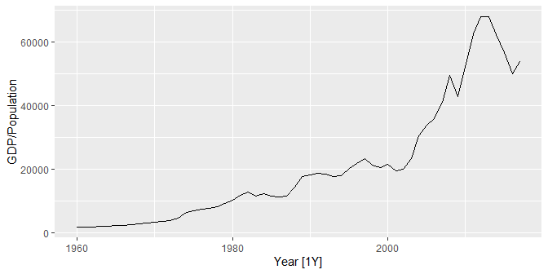
Per capita adjustments
global_economy %>% filter(Country == "Australia") %>% autoplot(GDP)
Adjusting the historical data can often lead to a simpler time series.
Calendar adjustments
Population adjustments
Inflation adjustments
Mathematical transformations
The purpose of these adjustments and transformations is to simplify the patterns in the historical data by removing known sources of variation, or by making the pattern more consistent across the whole data set.
global_economy %>% filter(Country == "Australia") %>% autoplot(GDP / Population)

Slide 4
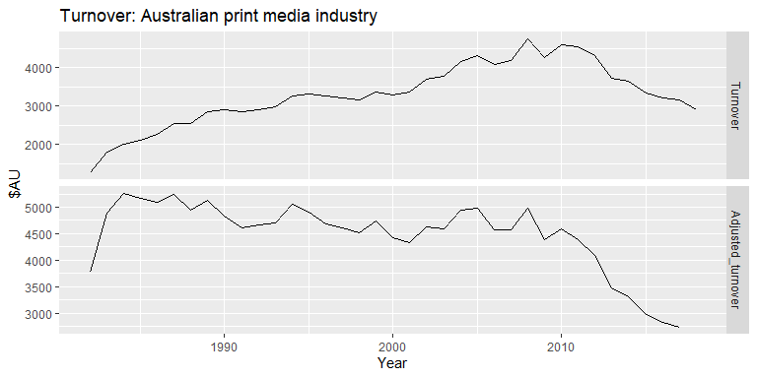
Inflation adjustments
urnover for the Australian print media industry in Australian dollars. The “Adjusted” turnover has been adjusted for inflation using the CPI.

Slide 5
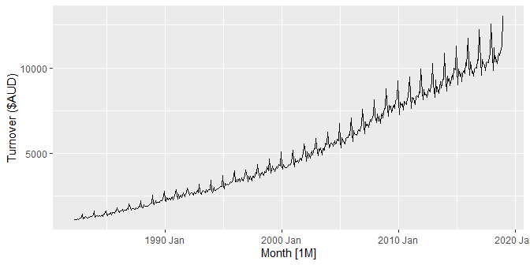
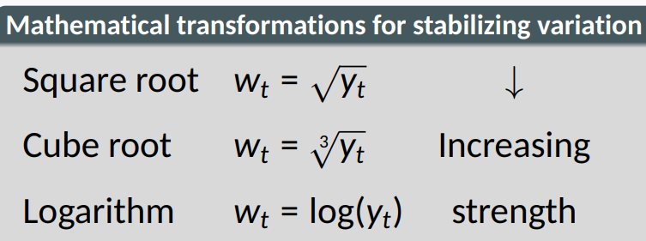
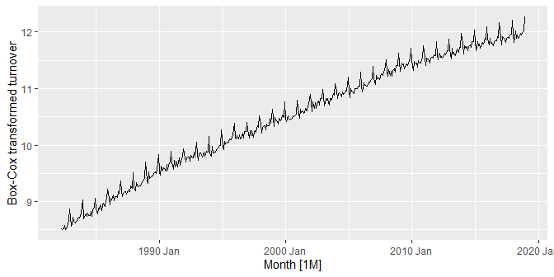
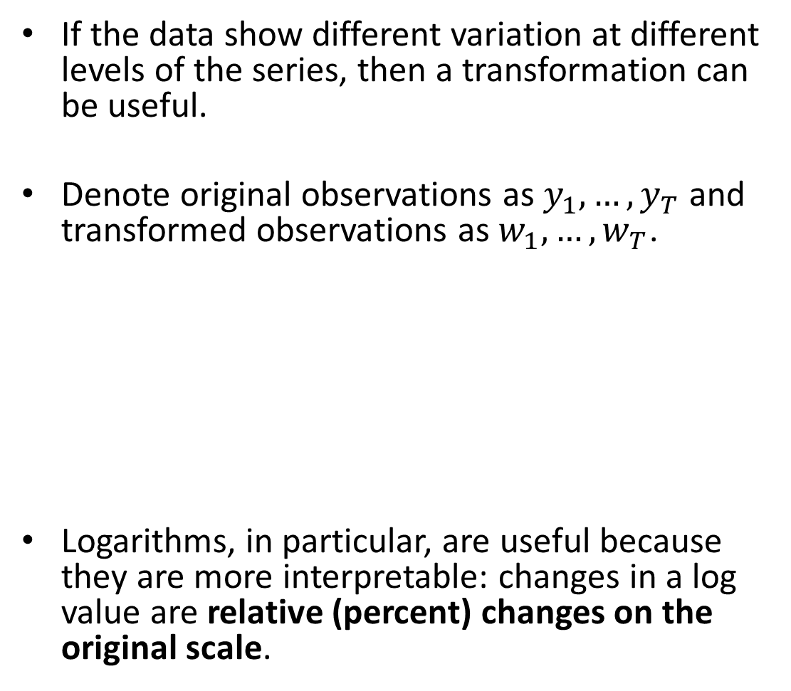
Mathematical transformations
If the data show different variation at different levels of the series, then a transformation can be useful.
Denote original observations as $y_{1},…,y_{T}$ and transformed observations as $w_{1},…,w_{T}$.
Logarithms, in particular, are useful because they are more interpretable: changes in a log value are relative (percent) changes on the original scale.

Slide 6
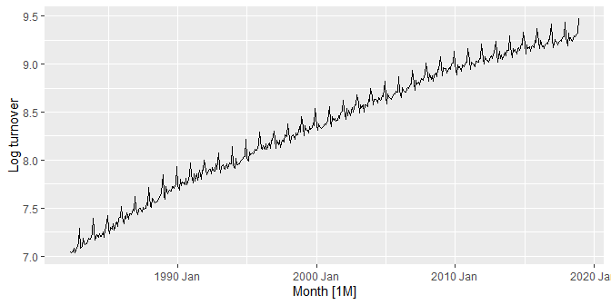
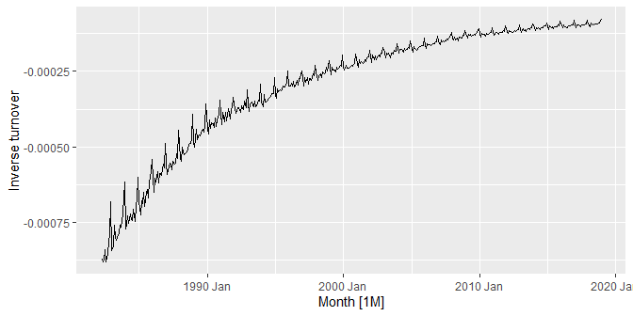
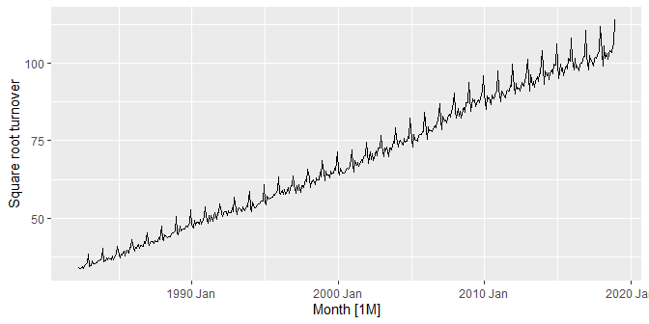
Mathematical transformations
food <- aus_retail %>% filter(Industry == "Food retailing") %>% summarise(Turnover = sum(Turnover))
food %>% autoplot(log(Turnover))
food %>% autoplot(-1/Turnover)
food %>% autoplot(sqrt(Turnover))

Slide 7
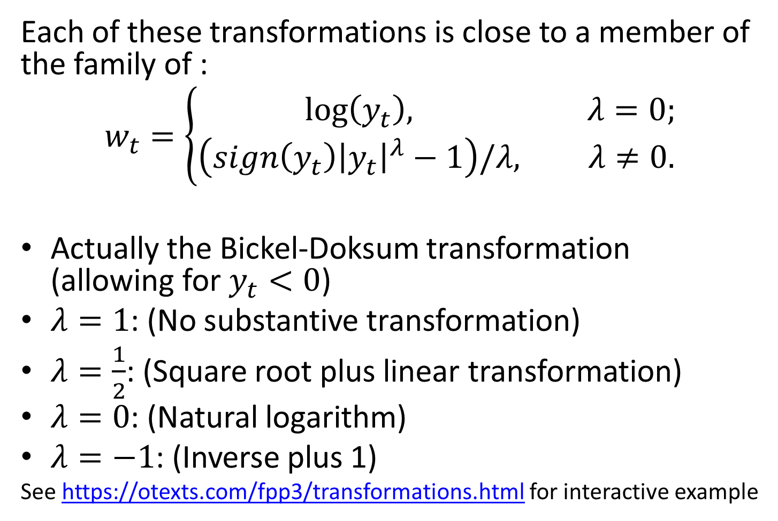
Box-Cox transformations
Each of these transformations is close to a member of the family of :
$$w_{t}=\left\{\begin{matrix}log\left(y_{t}\right), & λ=0; \\ \left(sign\left(y_{t}\right){\left|y_{t}\right|}^{λ}−1\right)/λ, & λ≠0.\end{matrix}\right.$$
Actually the Bickel-Doksum transformation (allowing for $y_{t}<0$)
$λ=1$: (No substantive transformation)
$λ=\frac{1}{2}$: (Square root plus linear transformation)
$λ=0$: (Natural logarithm)
$λ=−1$: (Inverse plus 1)
See https://otexts.com/fpp3/transformations.html for interactive example

Slide 8
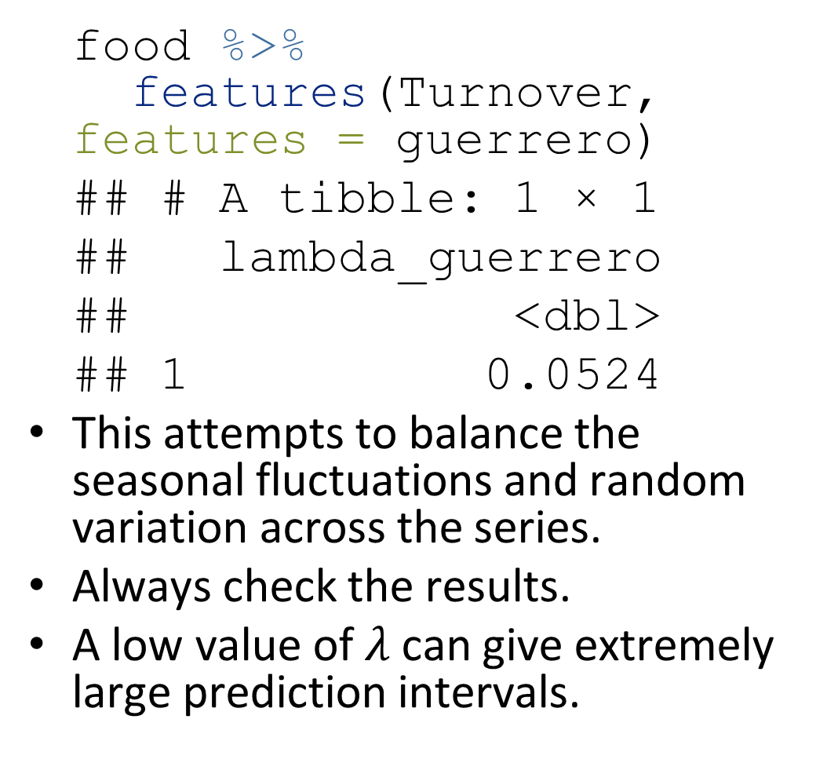
Box-Cox transformations
food %>% features(Turnover, features = guerrero)
## # A tibble: 1 × 1 ## lambda_guerrero ## <dbl> ## 1 0.0524
This attempts to balance the seasonal fluctuations and random variation across the series.
Always check the results.
A low value of $λ$ can give extremely large prediction intervals.
food %>% autoplot(box_cox(Turnover, 0.0524))

Slide 9
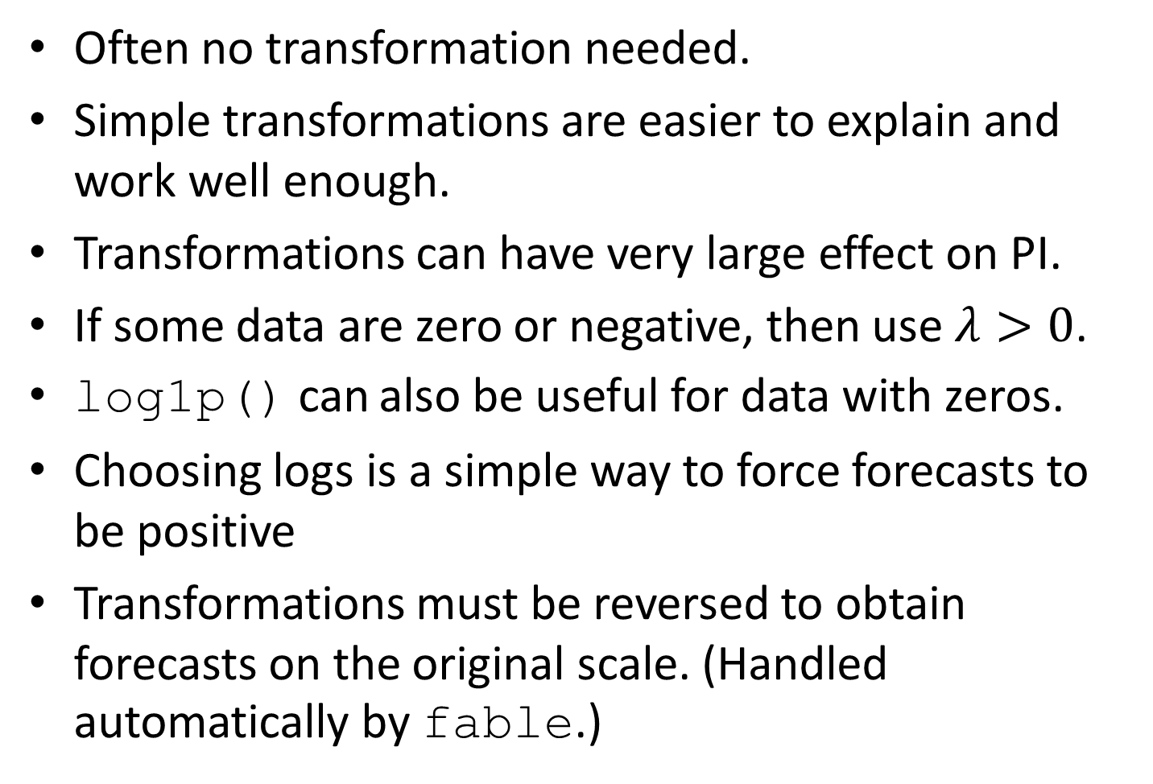
Transformations
Often no transformation needed.
Simple transformations are easier to explain and work well enough.
Transformations can have very large effect on PI.
If some data are zero or negative, then use $λ>0$.
log1p() can also be useful for data with zeros.
Choosing logs is a simple way to force forecasts to be positive
Transformations must be reversed to obtain forecasts on the original scale. (Handled automatically by fable.)

Slide 10
Time series components

Slide 11
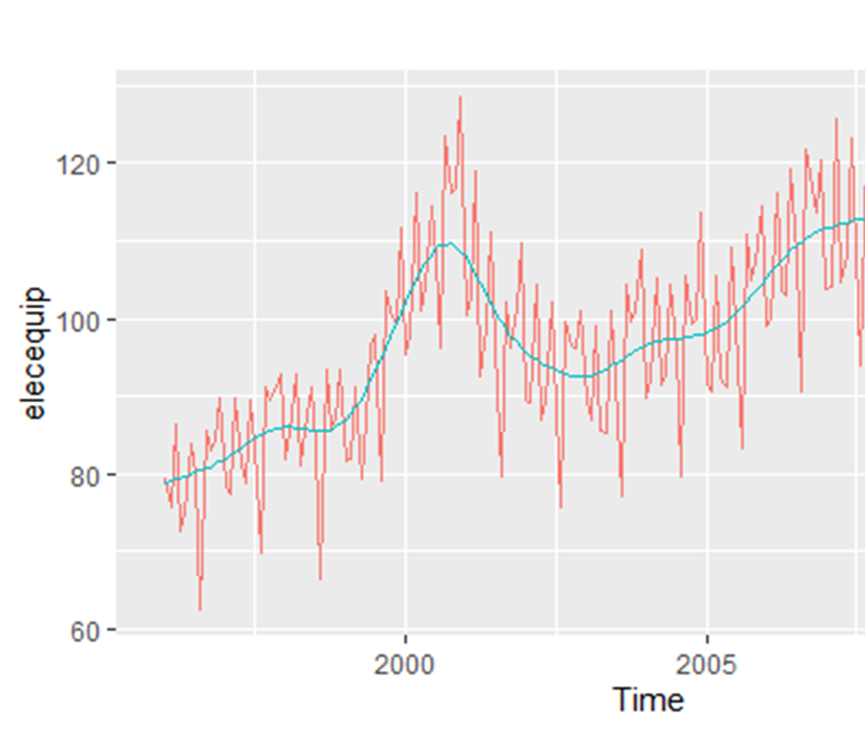
Time series patterns
Recall…
Trend
pattern exists when there is a long-term increase or decrease in the data.
Cyclic
pattern exists when data exhibit rises and falls that are not of fixed period (duration usually of at least 2 years).
Seasonal
pattern exists when a series is influenced by seasonal factors (e.g., the quarter of the year, the month, or day of the week).

Slide 12
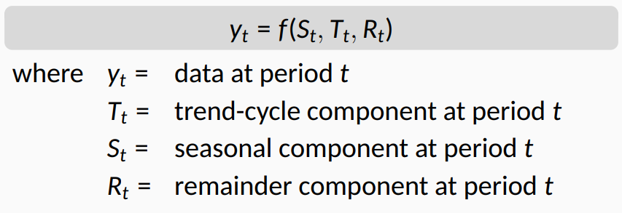

Time series decomposition
Additive decomposition: $y_{t}=S_{t}+T_{t}+R_{t}.$
Multiplicative decomposition: $y_{t}=S_{t}×T_{t}×R_{t}.$

Slide 13
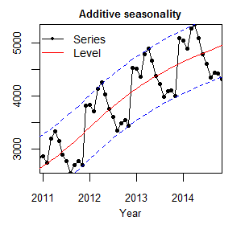
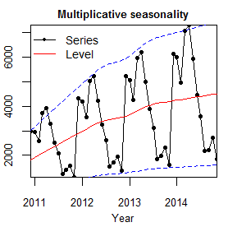
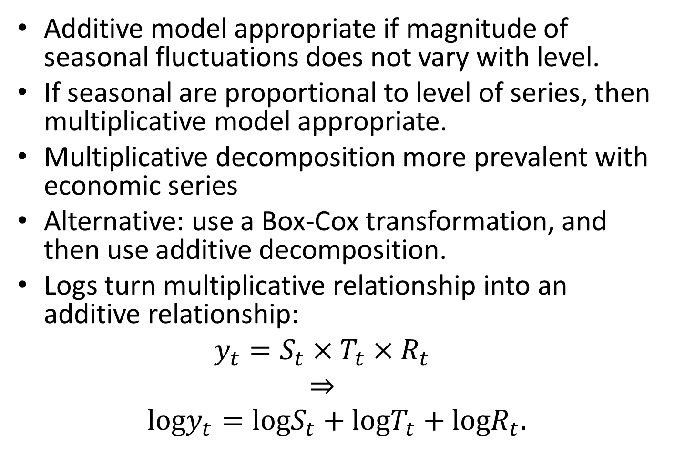
Time series decomposition
Additive model appropriate if magnitude of seasonal fluctuations does not vary with level.
If seasonal are proportional to level of series, then multiplicative model appropriate.
Multiplicative decomposition more prevalent with economic series
Alternative: use a Box-Cox transformation, and then use additive decomposition.
Logs turn multiplicative relationship into an additive relationship:
$$y_{t}=S_{t}×T_{t}×R_{t}$$
$$⇒$$
$$logy_{t}=logS_{t}+logT_{t}+logR_{t}.$$

Slide 14
US Retail Employment
us_retail_employment <- us_employment %>% filter(year(Month) >= 1990, Title == "Retail Trade") %>% select(-Series_ID) us_retail_employment
## # A tsibble: 357 x 3 [1M] ## Month Title Employed ## <mth> <chr> <dbl> ## 1 1990 Jan Retail Trade 13256. ## 2 1990 Feb Retail Trade 12966. ## 3 1990 Mar Retail Trade 12938. ## 4 1990 Apr Retail Trade 13012. ## 5 1990 May Retail Trade 13108. ## 6 1990 Jun Retail Trade 13183. ## 7 1990 Jul Retail Trade 13170. ## 8 1990 Aug Retail Trade 13160. ## 9 1990 Sep Retail Trade 13113. ## 10 1990 Oct Retail Trade 13185. ## # … with 347 more rows

Slide 15
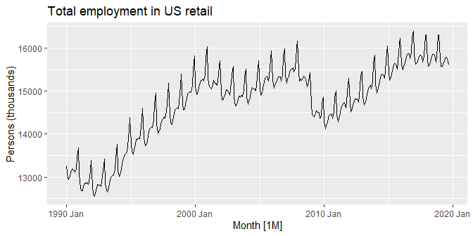
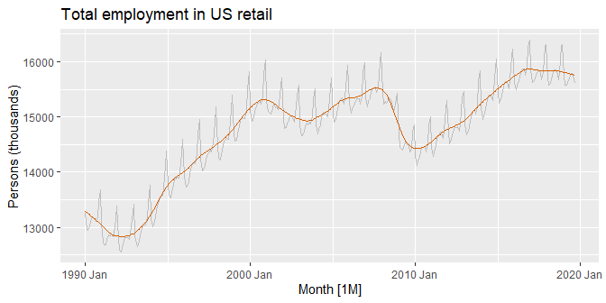
US Retail Employment
An example: We will decompose the number of persons employed in retail
us_retail_employment %>% autoplot(Employed) + labs(y="Persons (thousands)", title="Total employment in US retail")

Slide 16
US Retail Employment
dcmp <- us_retail_employment %>% model(stl = STL(Employed)) components(dcmp)
## # A dable: 357 x 7 [1M] ## # Key: .model [1] ## # : Employed = trend + season_year + remainder ## .model Month Employed trend season_year remainder season_adjust ## <chr> <mth> <dbl> <dbl> <dbl> <dbl> <dbl> ## 1 stl 1990 Jan 13256. 13288. -33.0 0.836 13289. ## 2 stl 1990 Feb 12966. 13269. -258. -44.6 13224. ## 3 stl 1990 Mar 12938. 13250. -290. -22.1 13228. ## 4 stl 1990 Apr 13012. 13231. -220. 1.05 13232. ## 5 stl 1990 May 13108. 13211. -114. 11.3 13223. ## 6 stl 1990 Jun 13183. 13192. -24.3 15.5 13207. ## 7 stl 1990 Jul 13170. 13172. -23.2 21.6 13193. ## 8 stl 1990 Aug 13160. 13151. -9.52 17.8 13169. ## 9 stl 1990 Sep 13113. 13131. -39.5 22.0 13153. ## 10 stl 1990 Oct 13185. 13110. 61.6 13.2 13124. ## # … with 347 more rows

Slide 17
US Retail Employment
us_retail_employment %>% autoplot(Employed, color='gray') + autolayer(components(dcmp), trend, color='#D55E00') + labs(y="Persons (thousands)", title="Total employment in US retail")

Slide 18
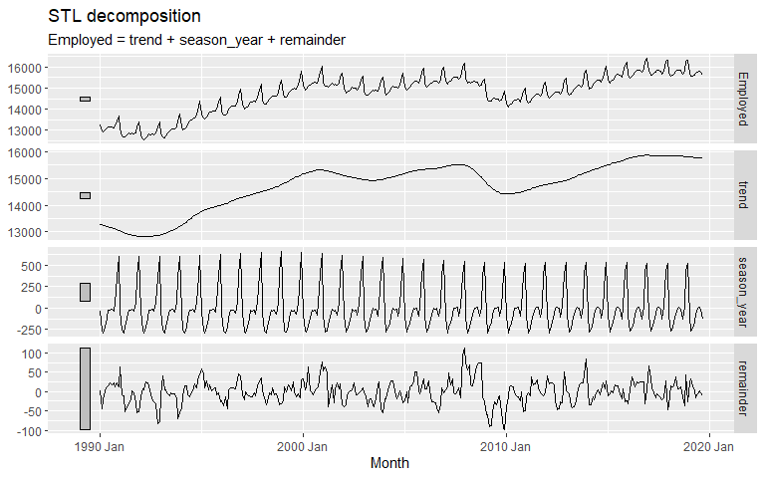
US Retail Employment
components(dcmp) %>% autoplot()

Slide 19
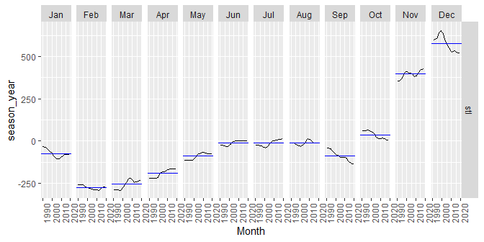
US Retail Employment
components(dcmp) %>% gg_subseries(season_year)

Slide 20
Seasonal adjustment

Slide 21
Seasonal adjustment
Useful by-product of decomposition: an easy way to calculate seasonally adjusted data.
Additive decomposition: seasonally adjusted data given by
$y_{t}−S_{t}=T_{t}+R_{t}$
Multiplicative decomposition: seasonally adjusted data given by
$y_{t}/S_{t}=T_{t}×R_{t}$

Slide 22
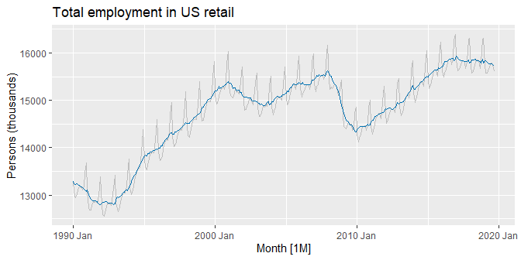
US Retail Employment
us_retail_employment %>% autoplot(Employed, color='gray') + autolayer(components(dcmp), season_adjust, color='#0072B2') + labs(y="Persons (thousands)", title="Total employment in US retail")

Slide 23
Seasonal adjustment
We use estimates of $S$ based on past values to seasonally adjust a current value.
Seasonally adjusted series reflect remainders as well as trend. Therefore they are not “smooth” and “downturns” or “upturns” can be misleading.
It is better to use the trend-cycle component to look for turning points.

Slide 24
time series decomposition classical method

Slide 25
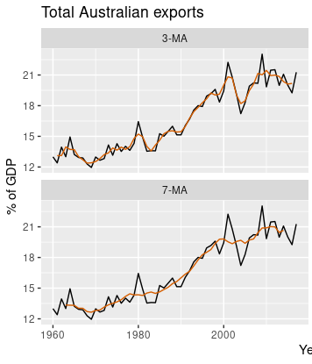

Moving averages
The classical method of time series decomposition originated in the 1920s and was widely used until the 1950s.
It still forms the basis of many time series decomposition methods, so it is important to understand how it works.
The first step in a classical decomposition is to use a moving average method to estimate the trend-cycle, so we begin by discussing moving averages.
where m=2k+1. That is, the estimate of the trend-cycle at time t is obtained by averaging values of the time series within k periods of t .

Slide 26
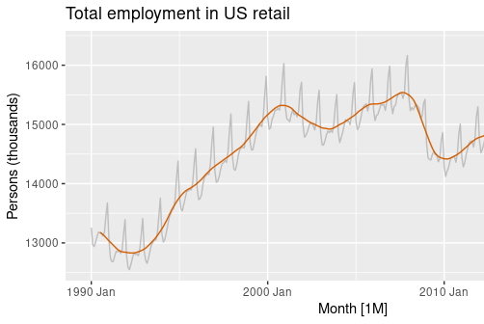
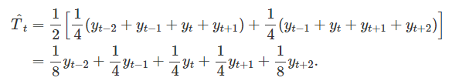
Moving averages of moving averages
It is possible to apply a moving average to a moving average.
One reason for doing this is to make an even-order moving average symmetric.
Another is Estimating the trend-cycle with seasonal data
Consider 2×4-MA (see how seasonal variation is averaged out in case of quarterly data):
A 2x12-MA applied to the US retail employment series.

Slide 27
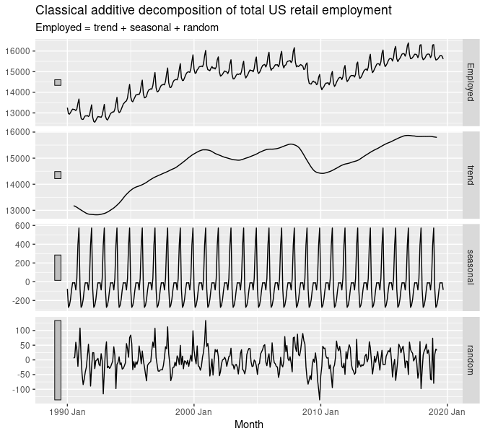
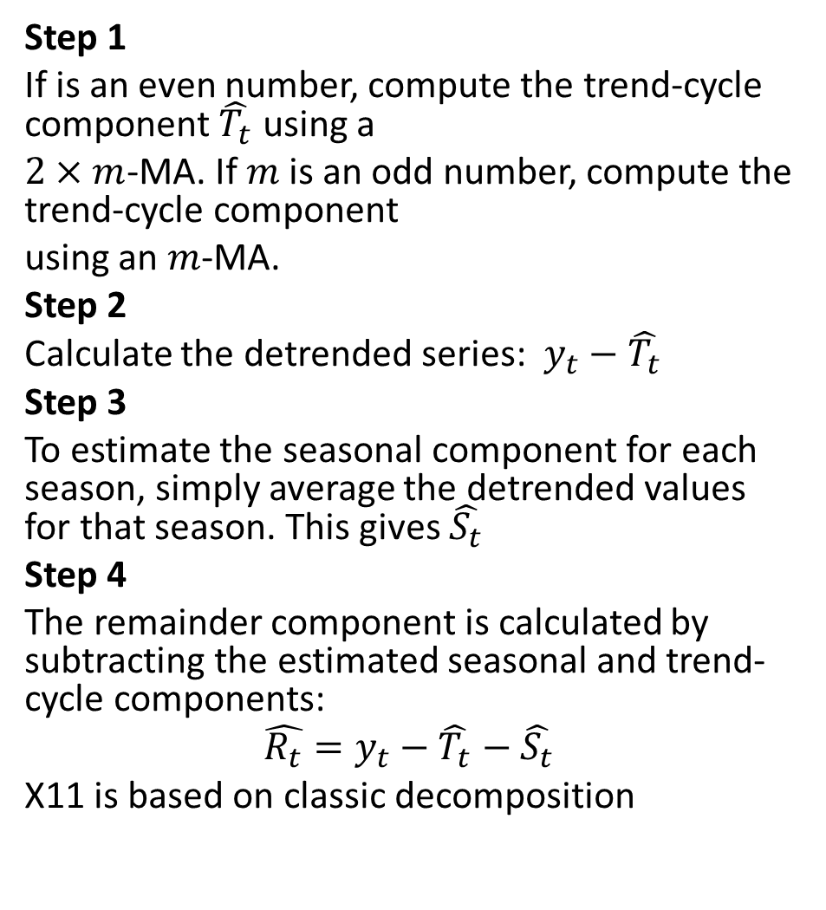
Classical Additive Decomposition
Step 1
If is an even number, compute the trend-cycle component $\hat{T_{t}}$ using a
$2×m$-MA. If $m$ is an odd number, compute the trend-cycle component
using an $m$-MA.
Step 2
Calculate the detrended series: $y_{t}−\hat{T_{t}}$
Step 3
To estimate the seasonal component for each season, simply average the detrended values for that season. This gives $\hat{S_{t}}$
Step 4
The remainder component is calculated by subtracting the estimated seasonal and trend-cycle components:
$$\hat{R_{t}}=y_{t}−\hat{T_{t}}−\hat{S_{t}}$$
X11 is based on classic decomposition

Slide 28
STL decomposition

Slide 29
STL decomposition
STL: “Seasonal and Trend decomposition using Loess”
Very versatile and robust.
Unlike X-12-ARIMA, STL will handle any type of seasonality.
Seasonal component allowed to change over time, and rate of change controlled by user.
Smoothness of trend-cycle also controlled by user.
Robust to outliers
Not trading day or calendar adjustments.
Only additive.
Take logs to get multiplicative decomposition.
Use Box-Cox transformations to get other decompositions.

Slide 30
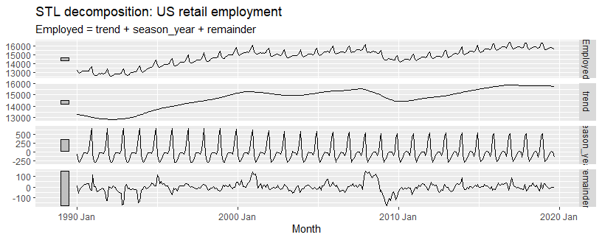
STL decomposition
us_retail_employment %>% model(STL(Employed ~ season(window=9), robust=TRUE)) %>% components() %>% autoplot() + labs(title = "STL decomposition: US retail employment")

Slide 31
STL decomposition
us_retail_employment %>% model(STL(Employed ~ season(window=5))) %>% components() us_retail_employment %>% model(STL(Employed ~ trend(window=15) + season(window="periodic"), robust = TRUE) ) %>% components()
trend(window = ?) controls wiggliness of trend component.
season(window = ?) controls variation on seasonal component.
season(window = 'periodic') is equivalent to an infinite window.

Slide 32
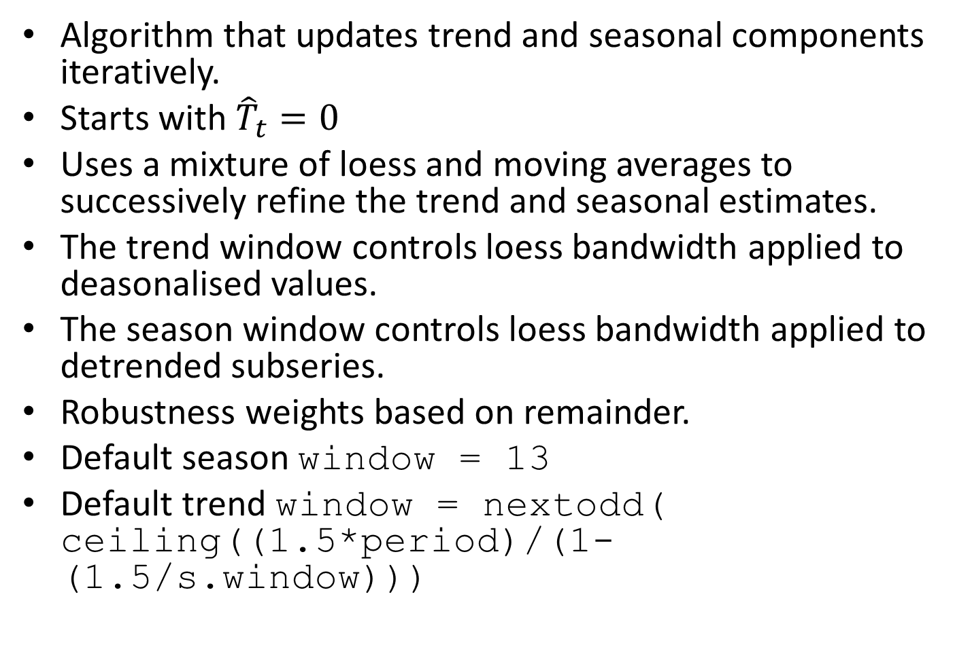
STL decomposition
Algorithm that updates trend and seasonal components iteratively.
Starts with ${\hat{T}}_{t}=0$
Uses a mixture of loess and moving averages to successively refine the trend and seasonal estimates.
The trend window controls loess bandwidth applied to deasonalised values.
The season window controls loess bandwidth applied to detrended subseries.
Robustness weights based on remainder.
Default season window = 13
Default trend window = nextodd( ceiling((1.5*period)/(1-(1.5/s.window)))

Slide 33
History of time series decomposition

Slide 34
History of time series decomposition
Classical method originated in 1920s.
Census II method introduced in 1957. Basis for X-11 method and variants (including X-12-ARIMA, X-13-ARIMA)
STL method introduced in 1983
TRAMO/SEATS introduced in 1990s.
National Statistics Offices
ABS uses X-12-ARIMA
US Census Bureau uses X-13ARIMA-SEATS
Statistics Canada uses X-12-ARIMA
ONS (UK) uses X-12-ARIMA
EuroStat use X-13ARIMA-SEATS

Slide 35
X-11 decomposition
Advantages
Relatively robust to outliers
Completely automated choices for trend and seasonal changes
Very widely tested on economic data over a long period of time.
Disadvantages
No prediction/confidence intervals
Ad hoc method with no underlying model
Only developed for quarterly and monthly data

Slide 36
Extensions: X-12-ARIMA and X-13-ARIMA
The X-11, X-12-ARIMA and X-13-ARIMA methods are based on Census II decomposition.
These allow adjustments for trading days and other explanatory variables.
Known outliers can be omitted.
Level shifts and ramp effects can be modelled.
Missing values estimated and replaced.
Holiday factors (e.g., Easter, Labour Day) can be estimated.

Slide 37
X-13ARIMA-SEATS
Advantages
Model-based
Smooth trend estimate
Allows estimates at end points
Allows changing seasonality
Developed for economic data
Disadvantages
Only developed for quarterly and monthly data

