Slide 1
Time Series Analysis and Forecasting
Ch5. The forecasters’ toolbox

Slide 2
A tidy forecasting workflow

Slide 3
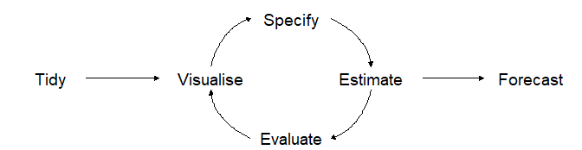
A tidy forecasting workflow
The process of producing forecasts can be split up into a few fundamental steps.
Preparing data
Data visualization
Specifying a model
Model estimation
Accuracy & performance evaluation
Producing forecasts

Slide 4
Data preparation (tidy)
gdppc <- global_economy %>% mutate(GDP_per_capita = GDP/Population) %>% select(Year, Country, GDP, Population, GDP_per_capita) gdppc
## # A tsibble: 15,150 x 5 [1Y] ## # Key: Country [263] ## Year Country GDP Population GDP_per_capita ## <dbl> <fct> <dbl> <dbl> <dbl> ## 1 1960 Afghanistan 537777811. 8996351 59.8 ## 2 1961 Afghanistan 548888896. 9166764 59.9 ## 3 1962 Afghanistan 546666678. 9345868 58.5 ## 4 1963 Afghanistan 751111191. 9533954 78.8 ## 5 1964 Afghanistan 800000044. 9731361 82.2 ## 6 1965 Afghanistan 1006666638. 9938414 101. ## 7 1966 Afghanistan 1399999967. 10152331 138. ## 8 1967 Afghanistan 1673333418. 10372630 161. ## 9 1968 Afghanistan 1373333367. 10604346 130. ## 10 1969 Afghanistan 1408888922. 10854428 130. ## # … with 15,140 more rows

Slide 5
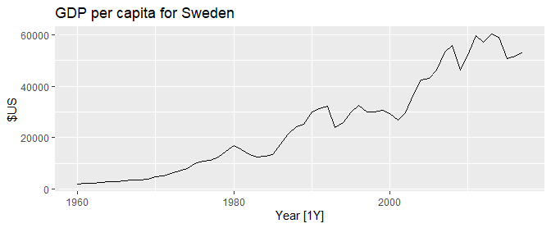
Data visualisation
gdppc %>% filter(Country=="Sweden") %>% autoplot(GDP_per_capita) + labs(title = "GDP per capita for Sweden", y = "$US")

Slide 6
Model estimation
The model() function trains models to data.
fit <- gdppc %>% model(trend_model = TSLM(GDP_per_capita ~ trend())) fit
## # A mable: 263 x 2 ## # Key: Country [263] ## Country trend_model ## <fct> <model> ## 1 Afghanistan <TSLM> ## 2 Albania <TSLM> ## 3 Algeria <TSLM> ## 4 American Samoa <TSLM> ## 5 Andorra <TSLM> ## 6 Angola <TSLM> ## 7 Antigua and Barbuda <TSLM> ## 8 Arab World <TSLM> ## 9 Argentina <TSLM> ## 10 Armenia <TSLM> ## # … with 253 more rows
A mable is a model table, each cell corresponds to a fitted model.

Slide 7
Producing forecasts
fit %>% forecast(h = "3 years")
## # A fable: 789 x 5 [1Y] ## # Key: Country, .model [263] ## Country .model Year GDP_per_capita .mean ## <fct> <chr> <dbl> <dist> <dbl> ## 1 Afghanistan trend_model 2018 N(526, 9653) 526. ## 2 Afghanistan trend_model 2019 N(534, 9689) 534. ## 3 Afghanistan trend_model 2020 N(542, 9727) 542. ## 4 Albania trend_model 2018 N(4716, 476419) 4716. ## 5 Albania trend_model 2019 N(4867, 481086) 4867. ## 6 Albania trend_model 2020 N(5018, 486012) 5018. ## 7 Algeria trend_model 2018 N(4410, 643094) 4410. ## 8 Algeria trend_model 2019 N(4489, 645311) 4489. ## 9 Algeria trend_model 2020 N(4568, 647602) 4568. ## 10 American Samoa trend_model 2018 N(12491, 652926) 12491. ## # … with 779 more rows
A fable is a forecast table with point forecasts and distributions

Slide 8
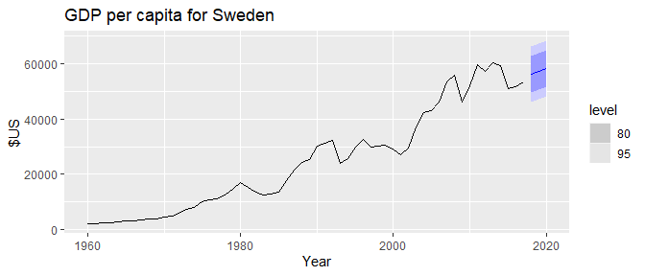
Visualising forecasts
fit %>% forecast(h = "3 years") %>% filter(Country=="Sweden") %>% autoplot(gdppc) + labs(title = "GDP per capita for Sweden", y = "$US")

Slide 9
Simple forecasting methods

Slide 10
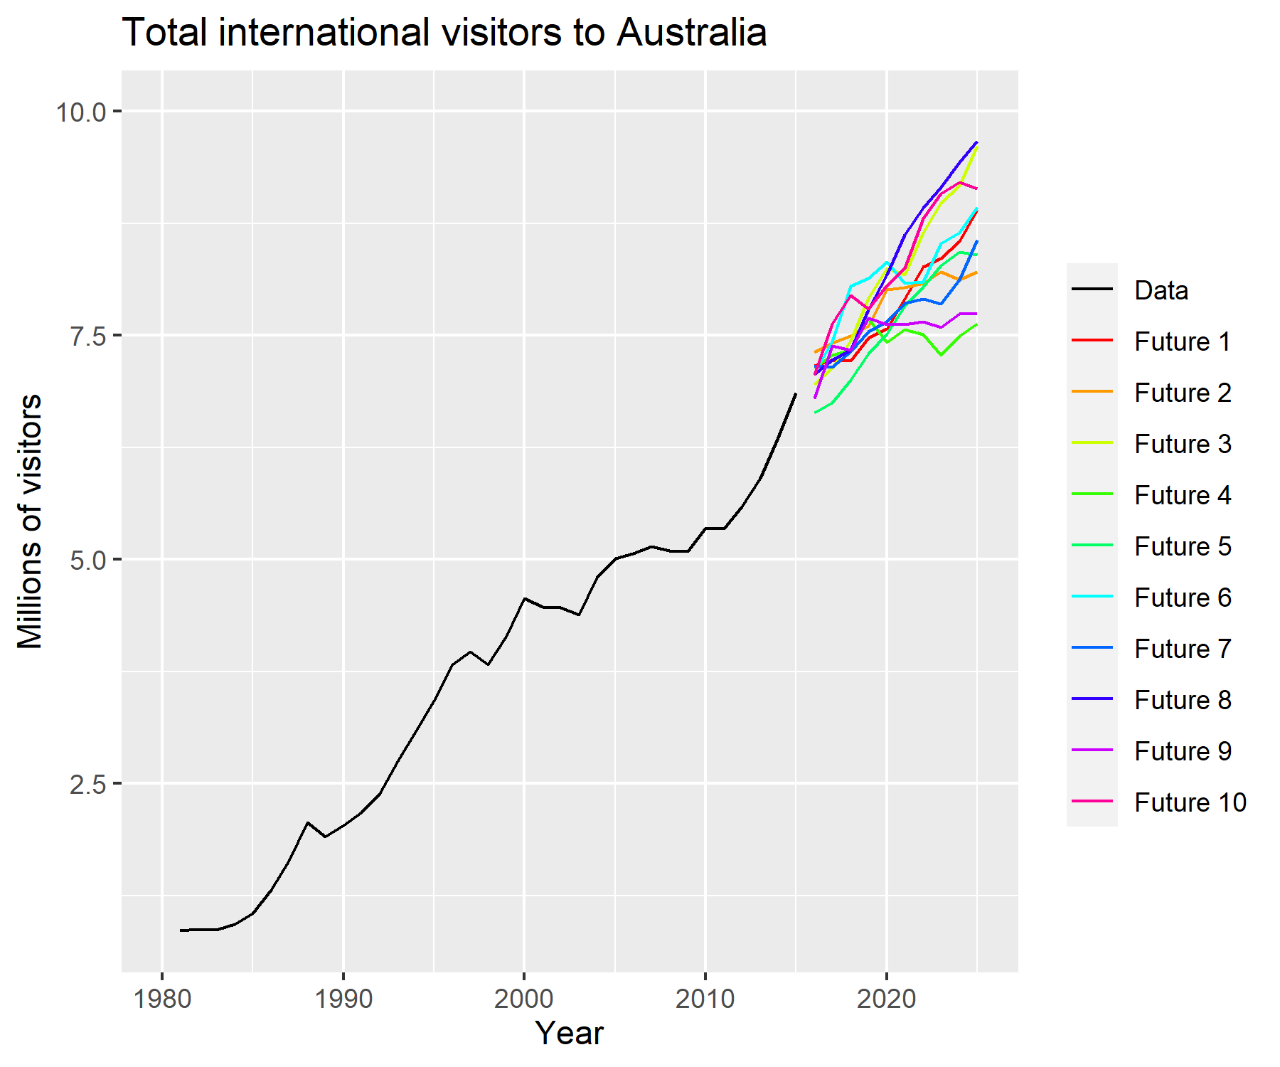
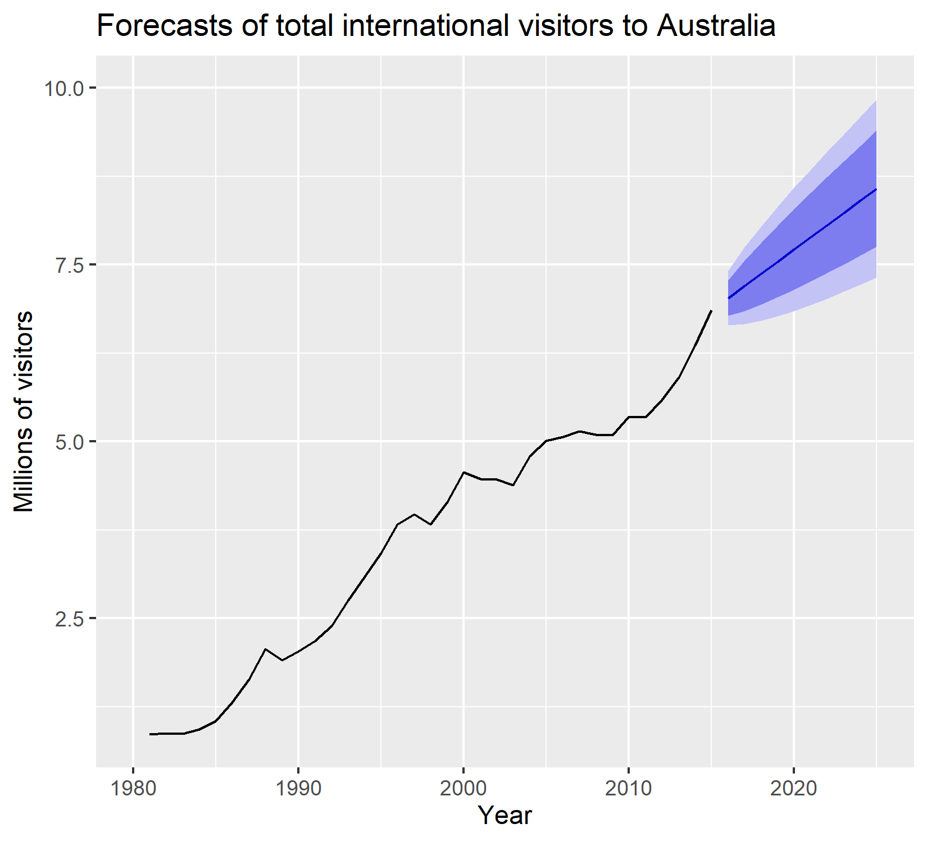
Forecasting
Possible Futures
Point Forecasts –
the average what is possible
Historic Data
80% forecast intervals should contain 80% of future observation
90% forecast intervals should contain 90% of future observation

Slide 11
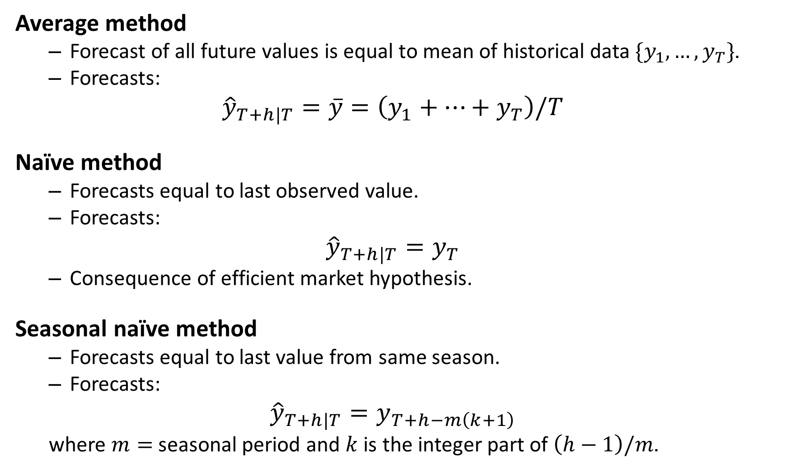
Some simple forecasting methods
Average method
Forecast of all future values is equal to mean of historical data $\{y_{1},…,y_{T}\}$.
Forecasts:
$${\hat{y}}_{T+h|T}=\overset{‾}{y}=\left(y_{1}+…+y_{T}\right)/T$$
Naïve method
Forecasts equal to last observed value.
Forecasts:
$${\hat{y}}_{T+h|T}=y_{T}$$
Consequence of efficient market hypothesis.
Seasonal naïve method
Forecasts equal to last value from same season.
Forecasts:
$${\hat{y}}_{T+h|T}=y_{T+h−m\left(k+1\right)}$$
where $m=$ seasonal period and $k$ is the integer part of $\left(h−1\right)/m$.

Slide 12
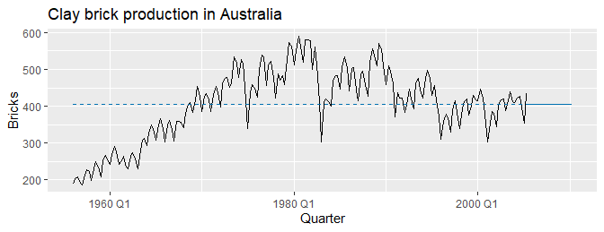
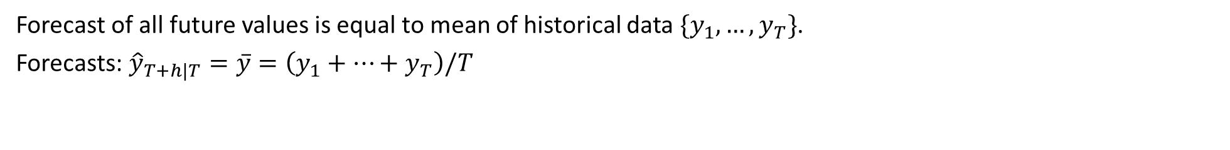
MEAN(y): Average method
Forecast of all future values is equal to mean of historical data $\{y_{1},…,y_{T}\}$.
Forecasts: ${\hat{y}}_{T+h|T}=\overset{‾}{y}=\left(y_{1}+…+y_{T}\right)/T$

Slide 13
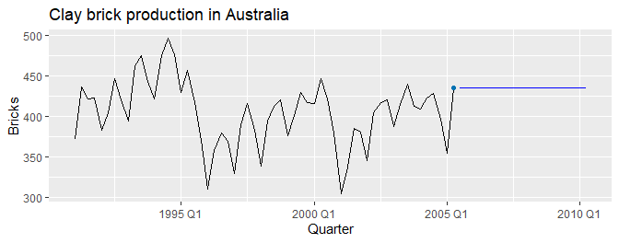
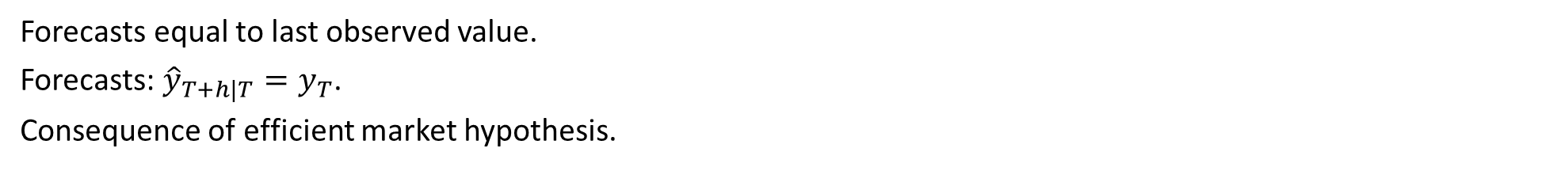
NAIVE(y): Naïve method
Forecasts equal to last observed value.
Forecasts: ${\hat{y}}_{T+h|T}=y_{T}$.
Consequence of efficient market hypothesis.

Slide 14
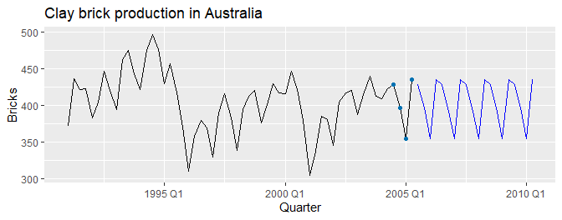
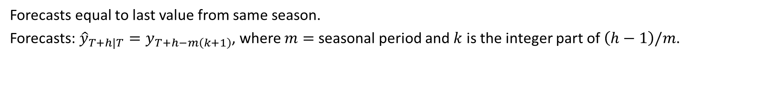
SNAIVE(y~lag(m)): Seasonal naïve method
Forecasts equal to last value from same season.
Forecasts: ${\hat{y}}_{T+h|T}=y_{T+h−m\left(k+1\right)}$, where $m=$ seasonal period and $k$ is the integer part of $\left(h−1\right)/m$.

Slide 15
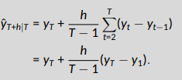
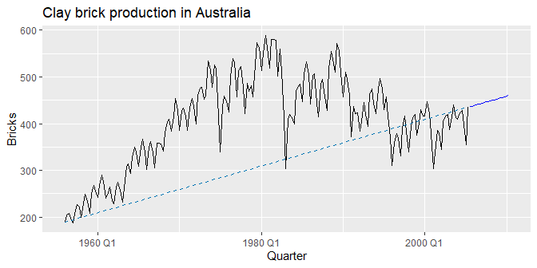
RW(y~drift()): Drift method
Forecasts equal to last value plus average change.
Forecasts:
Equivalent to extrapolating a line drawn between first and last observations.

Slide 16
Model fitting
The model() function trains models to data.
brick_fit <- aus_production %>% filter(!is.na(Bricks)) %>% model( Seasonal_naive = SNAIVE(Bricks), Naive = NAIVE(Bricks), Drift = RW(Bricks ~ drift()), Mean = MEAN(Bricks) )
## # A mable: 1 x 4 ## Seasonal_naive Naive Drift Mean ## <model> <model> <model> <model> ## 1 <SNAIVE> <NAIVE> <RW w/ drift> <MEAN>

Slide 17
Producing forecasts
brick_fc <- brick_fit %>% forecast(h = "5 years")
## # A fable: 80 x 4 [1Q] ## # Key: .model [4] ## .model Quarter Bricks .mean ## <chr> <qtr> <dist> <dbl> ## 1 Seasonal_naive 2005 Q3 N(428, 2336) 428 ## 2 Seasonal_naive 2005 Q4 N(397, 2336) 397 ## 3 Seasonal_naive 2006 Q1 N(355, 2336) 355 ## 4 Seasonal_naive 2006 Q2 N(435, 2336) 435 ## # … with 76 more rows

Slide 18
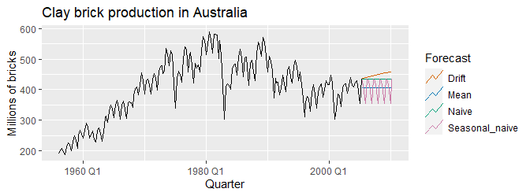
Visualising forecasts
brick_fc %>% autoplot(aus_production, level = NULL) + labs(title = "Clay brick production in Australia", y = "Millions of bricks") + guides(colour = guide_legend(title = "Forecast"))

Slide 19
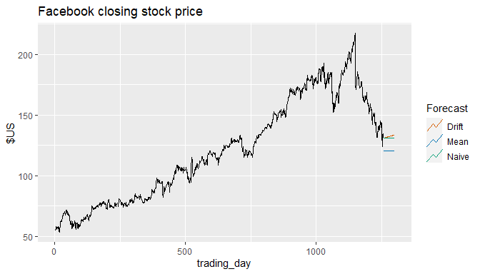
Facebook closing stock price
# Extract training data fb_stock <- gafa_stock %>% filter(Symbol == "FB") %>% mutate(trading_day = row_number()) %>% update_tsibble(index=trading_day, regular=TRUE) # Specify, estimate and forecast fb_stock %>% model( Mean = MEAN(Close), Naive = NAIVE(Close), Drift = RW(Close ~ drift()) ) %>% forecast(h=42) %>% autoplot(fb_stock, level = NULL) + labs(title = "Facebook closing stock price", y="$US") + guides(colour=guide_legend(title="Forecast"))

Slide 20
Residual diagnostics

Slide 21
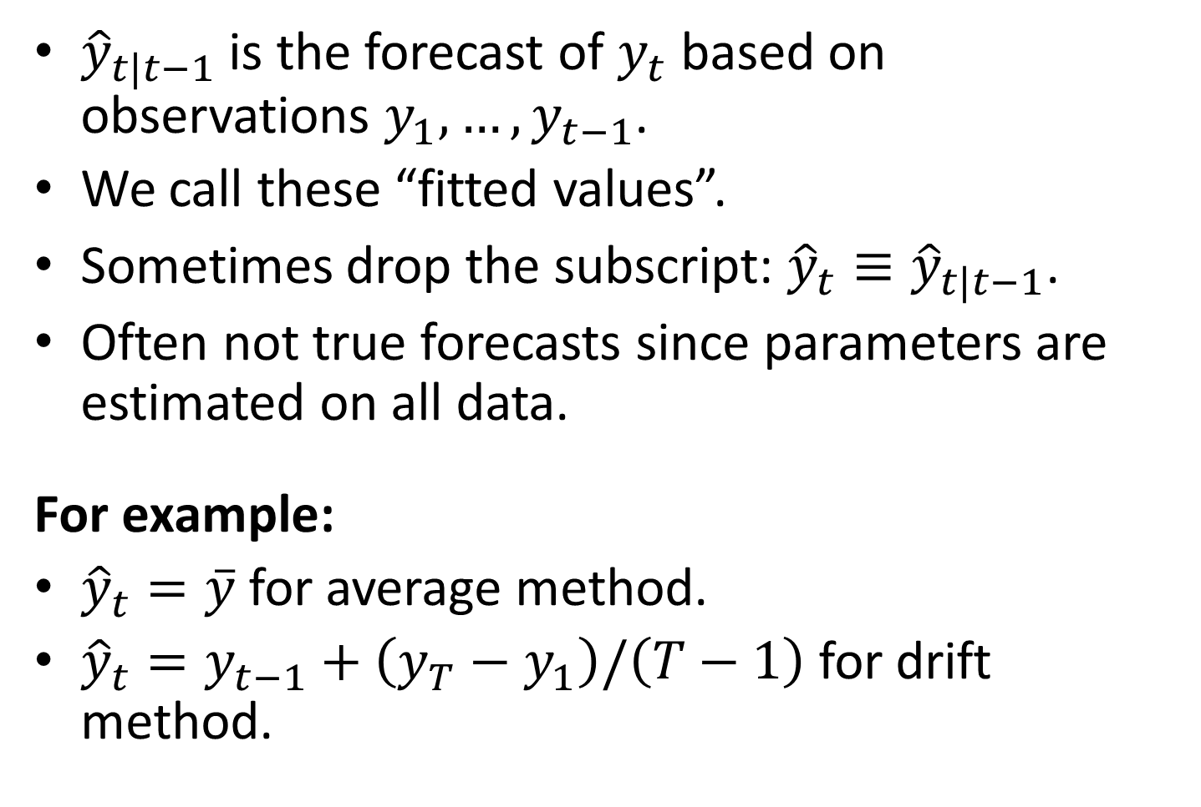
Fitted values
${\hat{y}}_{t|t−1}$ is the forecast of $y_{t}$ based on observations $y_{1},…,y_{t−1}$.
We call these “fitted values”.
Sometimes drop the subscript: ${\hat{y}}_{t}≡{\hat{y}}_{t|t−1}$.
Often not true forecasts since parameters are estimated on all data.
For example:
${\hat{y}}_{t}=\overset{‾}{y}$ for average method.
${\hat{y}}_{t}=y_{t−1}+\left(y_{T}−y_{1}\right)/\left(T−1\right)$ for drift method.

Slide 22
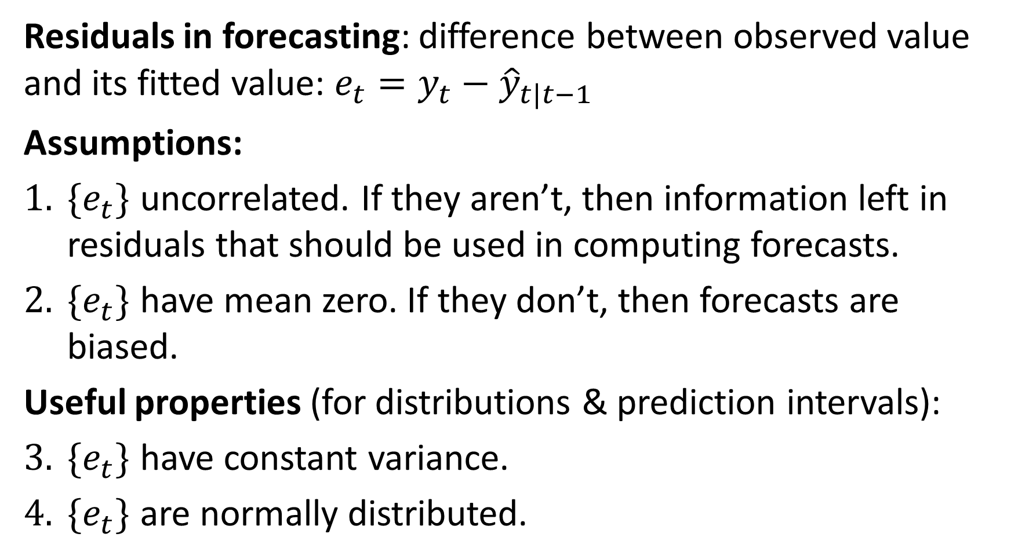
Forecasting residuals
Residuals in forecasting: difference between observed value and its fitted value: $e_{t}=y_{t}−{\hat{y}}_{t|t−1}$
Assumptions:
$\{e_{t}\}$ uncorrelated. If they aren’t, then information left in residuals that should be used in computing forecasts.
$\{e_{t}\}$ have mean zero. If they don’t, then forecasts are biased.
Useful properties (for distributions & prediction intervals):
$\{e_{t}\}$ have constant variance.
$\{e_{t}\}$ are normally distributed.

Slide 23
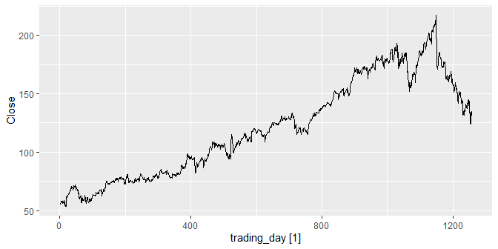
Facebook closing stock price
fb_stock %>% autoplot(Close)

Slide 24



Facebook closing stock price
fit <- fb_stock %>% model(NAIVE(Close)) augment(fit)
## # A tsibble: 1,258 x 7 [1] ## # Key: Symbol, .model [1] ## Symbol .model trading_day Close .fitted .resid .innov ## <chr> <chr> <int> <dbl> <dbl> <dbl> <dbl> ## 1 FB NAIVE(Close) 1 54.7 NA NA NA ## 2 FB NAIVE(Close) 2 54.6 54.7 -0.150 -0.150 ## 3 FB NAIVE(Close) 3 57.2 54.6 2.64 2.64 ## 4 FB NAIVE(Close) 4 57.9 57.2 0.720 0.720 ## 5 FB NAIVE(Close) 5 58.2 57.9 0.310 0.310 ## 6 FB NAIVE(Close) 6 57.2 58.2 -1.01 -1.01 ## 7 FB NAIVE(Close) 7 57.9 57.2 0.720 0.720 ## 8 FB NAIVE(Close) 8 55.9 57.9 -2.03 -2.03 ## 9 FB NAIVE(Close) 9 57.7 55.9 1.83 1.83 ## 10 FB NAIVE(Close) 10 57.6 57.7 -0.140 -0.140 ## # … with 1,248 more rows

Slide 25
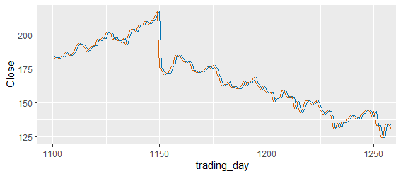
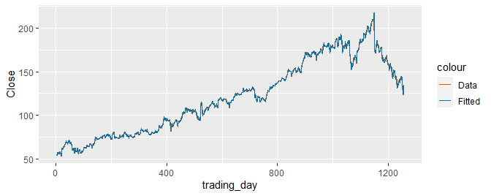
Facebook closing stock price
augment(fit) %>% ggplot(aes(x = trading_day)) + geom_line(aes(y = Close, colour = "Data")) + geom_line(aes(y = .fitted, colour = "Fitted"))

Slide 26
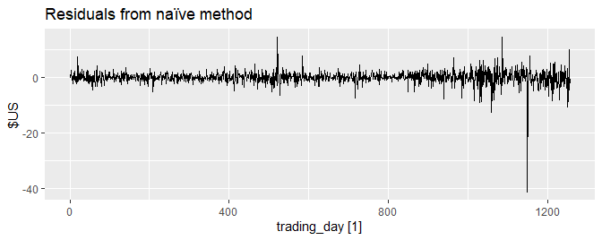
Facebook closing stock price
augment(fit) %>% autoplot(.resid) + labs(y = "$US", title = "Residuals from naïve method")

Slide 27
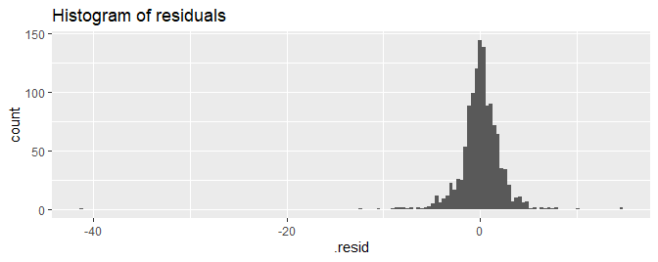
Facebook closing stock price
augment(fit) %>% ggplot(aes(x = .resid)) + geom_histogram(bins = 150) + labs(title = "Histogram of residuals")

Slide 28
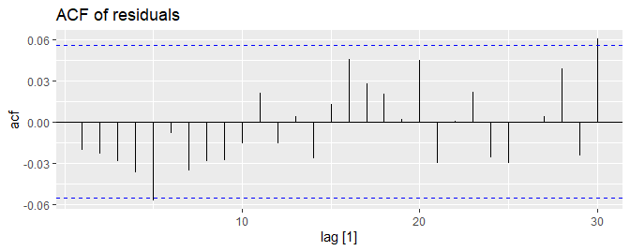
Facebook closing stock price
augment(fit) %>% ACF(.resid) %>% autoplot() + labs(title = "ACF of residuals")

Slide 29
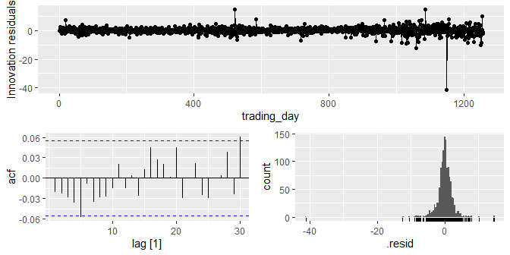
gg_tsresiduals() function
gg_tsresiduals(fit)

Slide 30
ACF of residuals
We assume that the residuals are white noise (uncorrelated, mean zero, constant variance). If they aren’t, then there is information left in the residuals that should be used in computing forecasts.
So a standard residual diagnostic is to check the ACF of the residuals of a forecasting method.
We expect these to look like white noise.

Slide 31
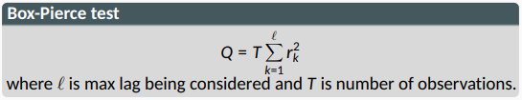
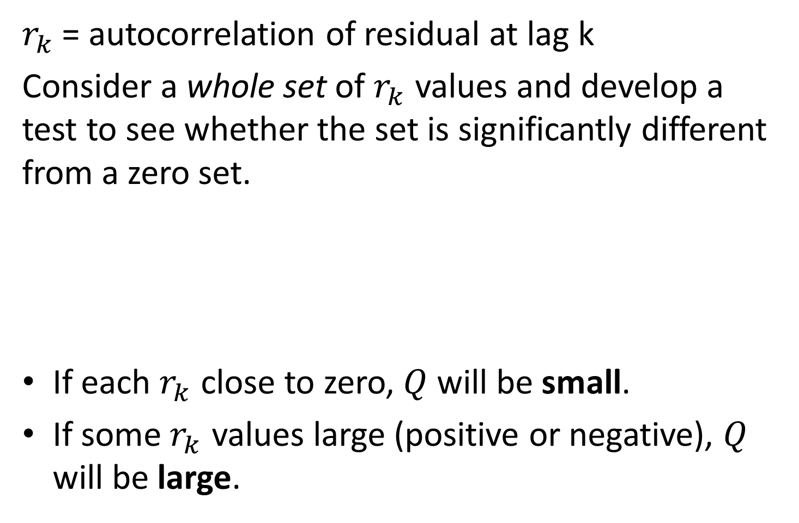
Portmanteau tests
$r_{k}$ = autocorrelation of residual at lag k
Consider a whole set of $r_{k}$ values and develop a test to see whether the set is significantly different from a zero set.
If each $r_{k}$ close to zero, $Q$ will be small.
If some $r_{k}$ values large (positive or negative), $Q$ will be large.

Slide 32
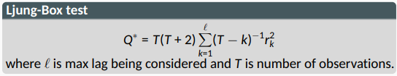
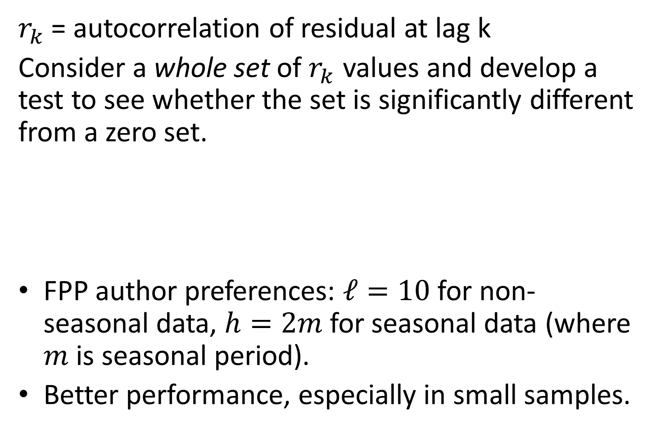
Portmanteau tests
$r_{k}$ = autocorrelation of residual at lag k
Consider a whole set of $r_{k}$ values and develop a test to see whether the set is significantly different from a zero set.
FPP author preferences: $ℓ=10$ for non-seasonal data, $h=2m$ for seasonal data (where $m$ is seasonal period).
Better performance, especially in small samples.

Slide 33
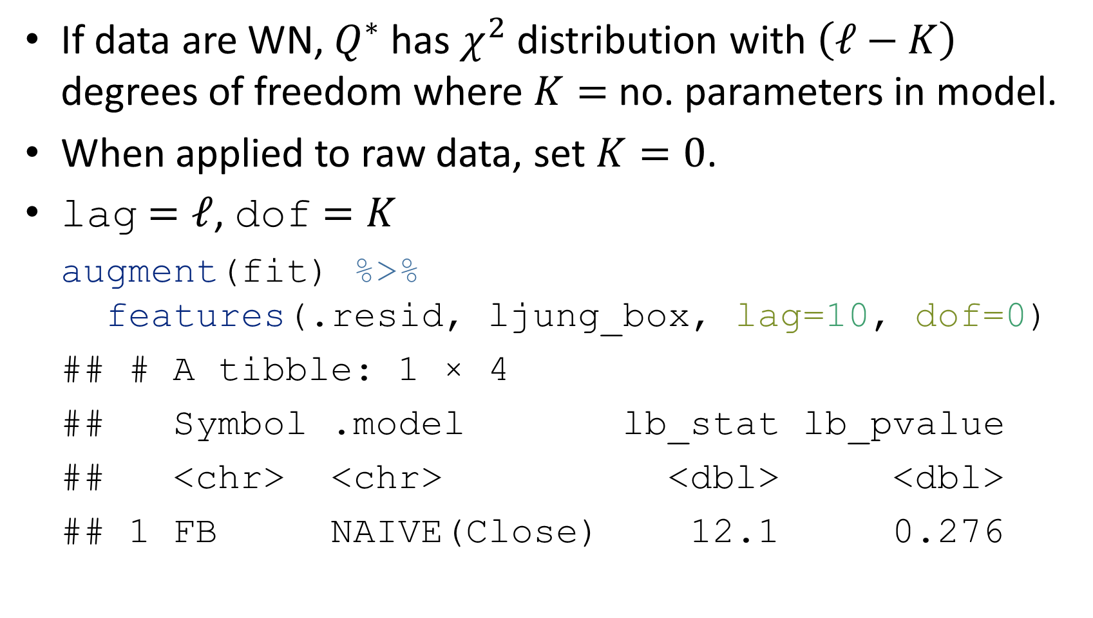
Portmanteau tests
If data are WN, $Q^{∗}$ has $χ^{2}$ distribution with $\left(ℓ−K\right)$ degrees of freedom where $K=$ no. parameters in model.
When applied to raw data, set $K=0$.
lag $=ℓ$, dof $=K$
augment(fit) %>% features(.resid, ljung_box, lag=10, dof=0)
## # A tibble: 1 × 4 ## Symbol .model lb_stat lb_pvalue ## <chr> <chr> <dbl> <dbl> ## 1 FB NAIVE(Close) 12.1 0.276

Slide 34
Distributional forecasts and prediction intervals

Slide 35
Forecast distributions
A forecast ${\hat{y}}_{T+h|T}$ is (usually) the mean of the conditional distribution $y_{T+h}∣y_{1},…,y_{T}$.
Most time series models produce normally distributed forecasts.
The forecast distribution describes the probability of observing any future value.

Slide 36
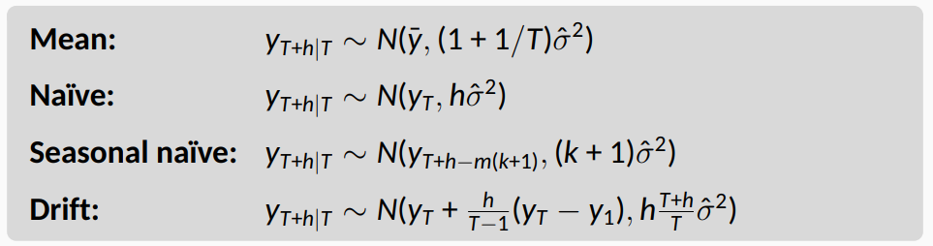

Forecast distributions
Assuming residuals are normal, uncorrelated, sd = $\hat{σ}$:
where $k$ is the integer part of $\left(h−1\right)/m$.
Note that when $h=1$ and $T$ is large, these all give the same approximate forecast variance: ${\hat{σ}}^{2}$.

Slide 37
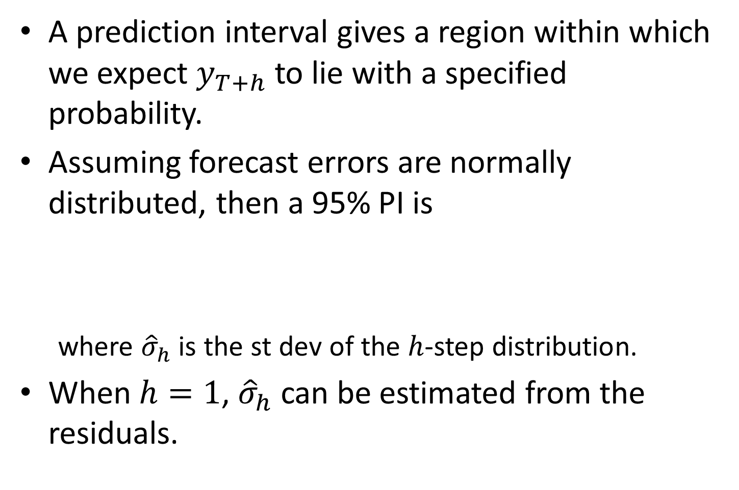
Prediction intervals
A prediction interval gives a region within which we expect $y_{T+h}$ to lie with a specified probability.
Assuming forecast errors are normally distributed, then a 95% PI is
where ${\hat{σ}}_{h}$ is the st dev of the $h$-step distribution.
When $h=1$, ${\hat{σ}}_{h}$ can be estimated from the residuals.

Slide 38
Prediction intervals
brick_fc %>% hilo(level = 95)
## # A tsibble: 80 x 5 [1Q] ## # Key: .model [4] ## .model Quarter Bricks .mean `95%` ## <chr> <qtr> <dist> <dbl> <hilo> ## 1 Seasonal_naive 2005 Q3 N(428, 2336) 428 [333, 523]95 ## 2 Seasonal_naive 2005 Q4 N(397, 2336) 397 [302, 492]95 ## 3 Seasonal_naive 2006 Q1 N(355, 2336) 355 [260, 450]95 ## 4 Seasonal_naive 2006 Q2 N(435, 2336) 435 [340, 530]95 ## 5 Seasonal_naive 2006 Q3 N(428, 4672) 428 [294, 562]95 ## 6 Seasonal_naive 2006 Q4 N(397, 4672) 397 [263, 531]95 ## 7 Seasonal_naive 2007 Q1 N(355, 4672) 355 [221, 489]95 ## 8 Seasonal_naive 2007 Q2 N(435, 4672) 435 [301, 569]95 ## 9 Seasonal_naive 2007 Q3 N(428, 7008) 428 [264, 592]95 ## 10 Seasonal_naive 2007 Q4 N(397, 7008) 397 [233, 561]95 ## # … with 70 more rows

Slide 39
Prediction intervals
Point forecasts often useless without a measure of uncertainty (such as prediction intervals).
Prediction intervals require a stochastic model (with random errors, etc).
For most models, prediction intervals get wider as the forecast horizon increases.
Use level argument to control coverage.
Check residual assumptions before believing them.
Usually too narrow due to unaccounted uncertainty.

Slide 40
Forecasting with transformations

Slide 41
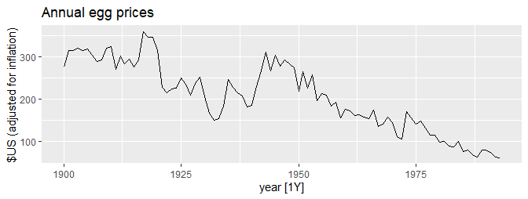
Modelling with transformations
eggs <- prices %>% filter(!is.na(eggs)) %>% select(eggs) eggs %>% autoplot() + labs(title="Annual egg prices", y="$US (adjusted for inflation)")

Slide 42
Modelling with transformations
Transformations used in the left of the formula will be automatically back-transformed. To model log-transformed egg prices, you could use:
fit <- eggs %>% model(RW(log(eggs) ~ drift())) fit
## # A mable: 1 x 1 ## `RW(log(eggs) ~ drift())` ## <model> ## 1 <RW w/ drift>

Slide 43
Forecasting with transformations
fc <- fit %>% forecast(h = 50) fc
## # A fable: 50 x 4 [1Y] ## # Key: .model [1] ## .model year eggs .mean ## <chr> <dbl> <dist> <dbl> ## 1 RW(log(eggs) ~ drift()) 1994 t(N(4.1, 0.018)) 61.8 ## 2 RW(log(eggs) ~ drift()) 1995 t(N(4.1, 0.036)) 61.4 ## 3 RW(log(eggs) ~ drift()) 1996 t(N(4.1, 0.055)) 61.0 ## 4 RW(log(eggs) ~ drift()) 1997 t(N(4.1, 0.074)) 60.6 ## 5 RW(log(eggs) ~ drift()) 1998 t(N(4.1, 0.093)) 60.2 ## 6 RW(log(eggs) ~ drift()) 1999 t(N(4, 0.11)) 59.8 ## 7 RW(log(eggs) ~ drift()) 2000 t(N(4, 0.13)) 59.4 ## 8 RW(log(eggs) ~ drift()) 2001 t(N(4, 0.15)) 59.0 ## 9 RW(log(eggs) ~ drift()) 2002 t(N(4, 0.18)) 58.6 ## 10 RW(log(eggs) ~ drift()) 2003 t(N(4, 0.2)) 58.3 ## # … with 40 more rows

Slide 44
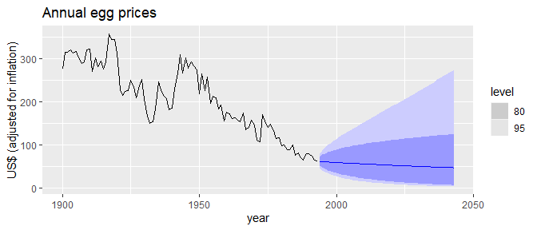
Forecasting with transformations
fc %>% autoplot(eggs) + labs(title="Annual egg prices", y="US$ (adjusted for inflation)")

Slide 45
Bias adjustment
Back-transformed point forecasts are medians.
Back-transformed PI have the correct coverage.
Back-transformed means
Let $X$ be have mean $μ$ and variance $σ^{2}$.
Let $f\left(x\right)$ be back-transformation function, and $Y=f\left(X\right)$.
Taylor series expansion about $μ$:
$$f\left(X\right)=f\left(μ\right)+\left(X−μ\right)f′\left(μ\right)+\frac{1}{2}{\left(X−μ\right)}^{2}f″\left(μ\right).$$

Slide 46
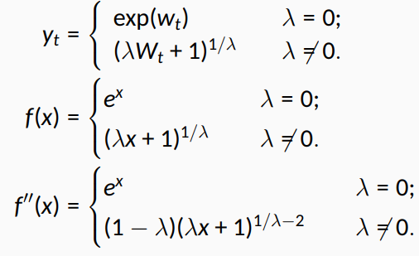

Bias adjustment
Box-Cox back-transformation:

Slide 47
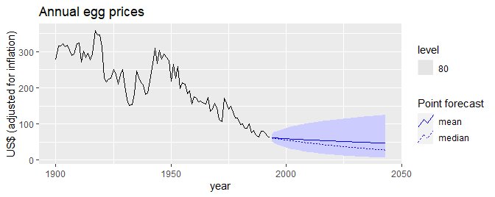
Bias adjustment
fc %>% autoplot(eggs, level = 80, point_forecast = lst(mean, median)) + labs(title="Annual egg prices", y="US$ (adjusted for inflation)")

Slide 48
Forecasting and decomposition

Slide 49
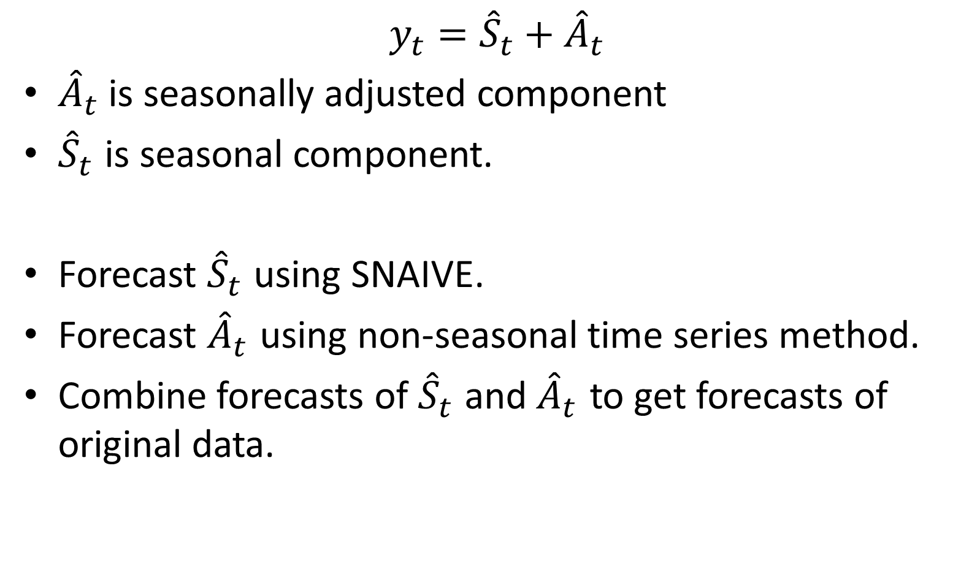
Forecasting and decomposition
$${y_{t}={\hat{S}}_{t}+\hat{A}}_{t}$$
${\hat{A}}_{t}$is seasonally adjusted component
${\hat{S}}_{t}$ is seasonal component.
Forecast ${\hat{S}}_{t}$ using SNAIVE.
Forecast ${\hat{A}}_{t}$ using non-seasonal time series method.
Combine forecasts of ${\hat{S}}_{t}$ and ${\hat{A}}_{t}$ to get forecasts of original data.

Slide 50
US Retail Employment
us_retail_employment <- us_employment %>% filter(year(Month) >= 1990, Title == "Retail Trade") %>% select(-Series_ID) us_retail_employment
## # A tsibble: 357 x 3 [1M] ## Month Title Employed ## <mth> <chr> <dbl> ## 1 1990 Jan Retail Trade 13256. ## 2 1990 Feb Retail Trade 12966. ## 3 1990 Mar Retail Trade 12938. ## 4 1990 Apr Retail Trade 13012. ## 5 1990 May Retail Trade 13108. ## 6 1990 Jun Retail Trade 13183. ## 7 1990 Jul Retail Trade 13170. ## 8 1990 Aug Retail Trade 13160. ## 9 1990 Sep Retail Trade 13113. ## 10 1990 Oct Retail Trade 13185. ## # … with 347 more rows

Slide 51
US Retail Employment
dcmp <- us_retail_employment %>% model(STL(Employed)) %>% components() %>% select(-.model) dcmp
## # A tsibble: 357 x 6 [1M] ## Month Employed trend season_year remainder season_adjust ## <mth> <dbl> <dbl> <dbl> <dbl> <dbl> ## 1 1990 Jan 13256. 13288. -33.0 0.836 13289. ## 2 1990 Feb 12966. 13269. -258. -44.6 13224. ## 3 1990 Mar 12938. 13250. -290. -22.1 13228. ## 4 1990 Apr 13012. 13231. -220. 1.05 13232. ## 5 1990 May 13108. 13211. -114. 11.3 13223. ## 6 1990 Jun 13183. 13192. -24.3 15.5 13207. ## 7 1990 Jul 13170. 13172. -23.2 21.6 13193. ## 8 1990 Aug 13160. 13151. -9.52 17.8 13169. ## 9 1990 Sep 13113. 13131. -39.5 22.0 13153. ## 10 1990 Oct 13185. 13110. 61.6 13.2 13124. ## # … with 347 more rows

Slide 52
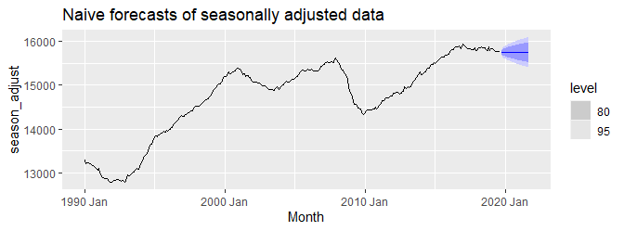
US Retail Employment
dcmp %>% model(NAIVE(season_adjust)) %>% forecast() %>% autoplot(dcmp) + labs(title = "Naive forecasts of seasonally adjusted data")

Slide 53
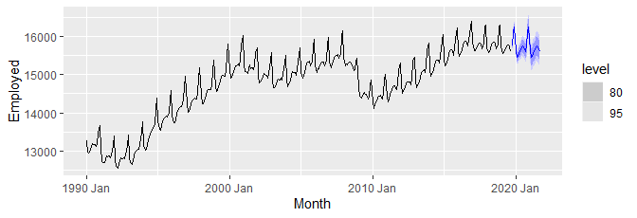
US Retail Employment
us_retail_employment %>% model(stlf = decomposition_model( STL(Employed ~ trend(window = 7), robust = TRUE), NAIVE(season_adjust) )) %>% forecast() %>% autoplot(us_retail_employment)

Slide 54
Decomposition models
decomposition_model() creates a decomposition model
You must provide a method for forecasting the season_adjust series.
A seasonal naive method is used by default for the seasonal components.
The variances from both the seasonally adjusted and seasonal forecasts are combined.

Slide 55
Evaluating forecast accuracy

Slide 56

Training and test sets
A model which fits the training data well will not necessarily forecast well.
A perfect fit can always be obtained by using a model with enough parameters.
Over-fitting a model to data is just as bad as failing to identify a systematic pattern in the data.
The test set must not be used for any aspect of model development or calculation of forecasts.
Forecast accuracy is based only on the test set.

Slide 57
Forecast errors
Forecast “error”: the difference between an observed value and its forecast.
$$e_{T+h}=y_{T+h}−{\hat{y}}_{T+h|T},$$
where the training data is given by $\{y_{1},…,y_{T}\}$
Unlike residuals, forecast errors on the test set involve multi-step forecasts.
These are true forecast errors as the test data is not used in computing ${\hat{y}}_{T+h|T}$.

Slide 58
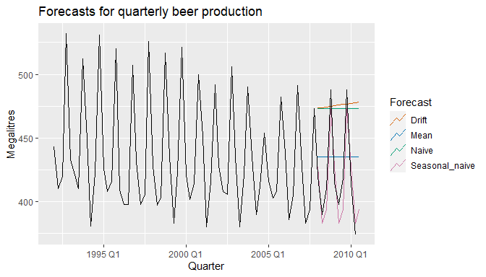
Measures of forecast accuracy

Slide 59
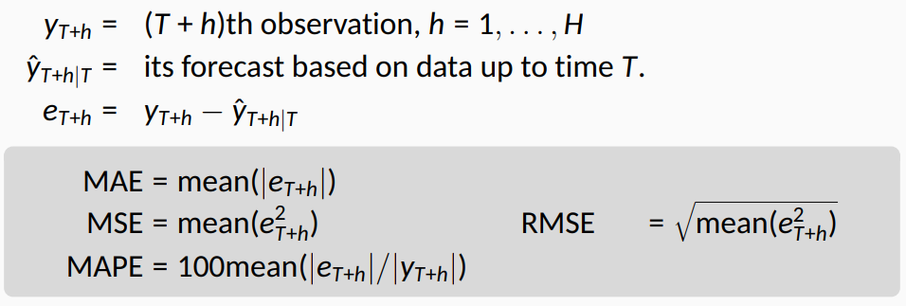
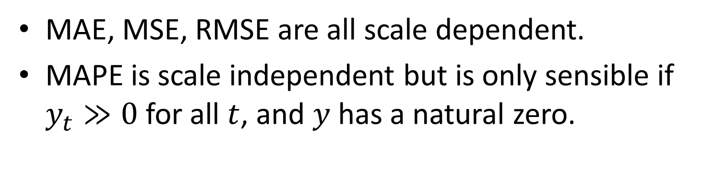
Measures of forecast accuracy
MAE, MSE, RMSE are all scale dependent.
MAPE is scale independent but is only sensible if $y_{t}≫0$ for all $t$, and $y$ has a natural zero.

Slide 60
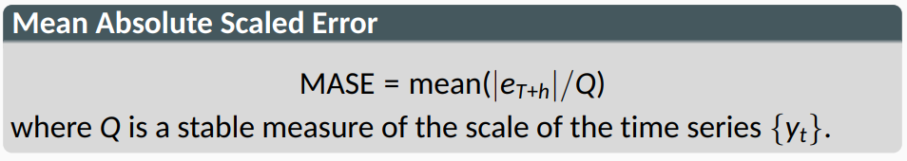
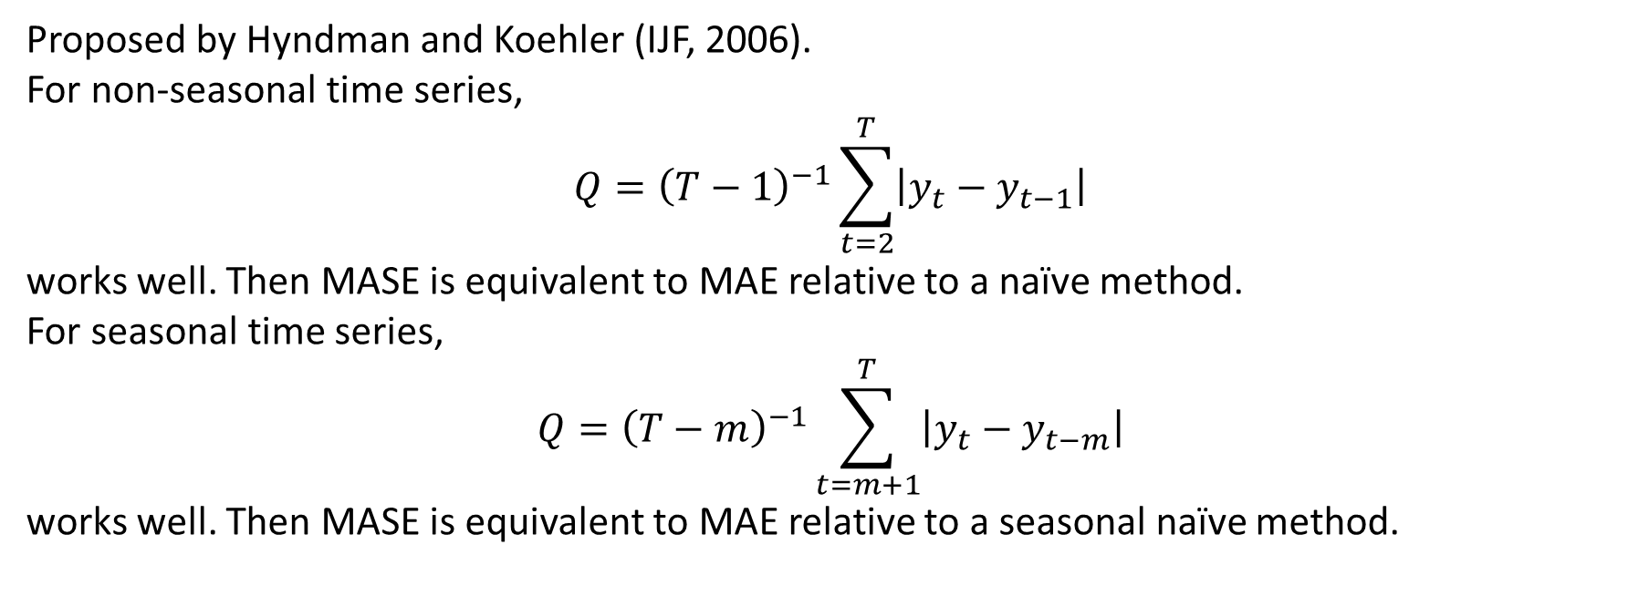
Measures of forecast accuracy
Proposed by Hyndman and Koehler (IJF, 2006).
For non-seasonal time series,
$$Q={\left(T−1\right)}^{−1}\sum_{t=2}^{T}{\left|y_{t}−y_{t−1}\right|}$$
works well. Then MASE is equivalent to MAE relative to a naïve method.
For seasonal time series,
$$Q={\left(T−m\right)}^{−1}\sum_{t=m+1}^{T}{\left|y_{t}−y_{t−m}\right|}$$
works well. Then MASE is equivalent to MAE relative to a seasonal naïve method.

Slide 61
Measures of forecast accuracy

Slide 62
Measures of forecast accuracy
recent_production <- aus_production %>% filter(year(Quarter) >= 1992) train <- recent_production %>% filter(year(Quarter) <= 2007) beer_fit <- train %>% model( Mean = MEAN(Beer), Naive = NAIVE(Beer), Seasonal_naive = SNAIVE(Beer), Drift = RW(Beer ~ drift()) ) beer_fc <- beer_fit %>% forecast(h = 10)

Slide 63
Measures of forecast accuracy
accuracy(beer_fit)
## # A tibble: 4 × 6 ## .model .type RMSE MAE MAPE MASE ## <chr> <chr> <dbl> <dbl> <dbl> <dbl> ## 1 Drift Training 65.3 54.8 12.2 3.83 ## 2 Mean Training 43.6 35.2 7.89 2.46 ## 3 Naive Training 65.3 54.7 12.2 3.83 ## 4 Seasonal_naive Training 16.8 14.3 3.31 1
accuracy(beer_fc, recent_production)
## # A tibble: 4 × 6 ## .model .type RMSE MAE MAPE MASE ## <chr> <chr> <dbl> <dbl> <dbl> <dbl> ## 1 Drift Test 64.9 58.9 14.6 4.12 ## 2 Mean Test 38.4 34.8 8.28 2.44 ## 3 Naive Test 62.7 57.4 14.2 4.01 ## 4 Seasonal_naive Test 14.3 13.4 3.17 0.937

Slide 64
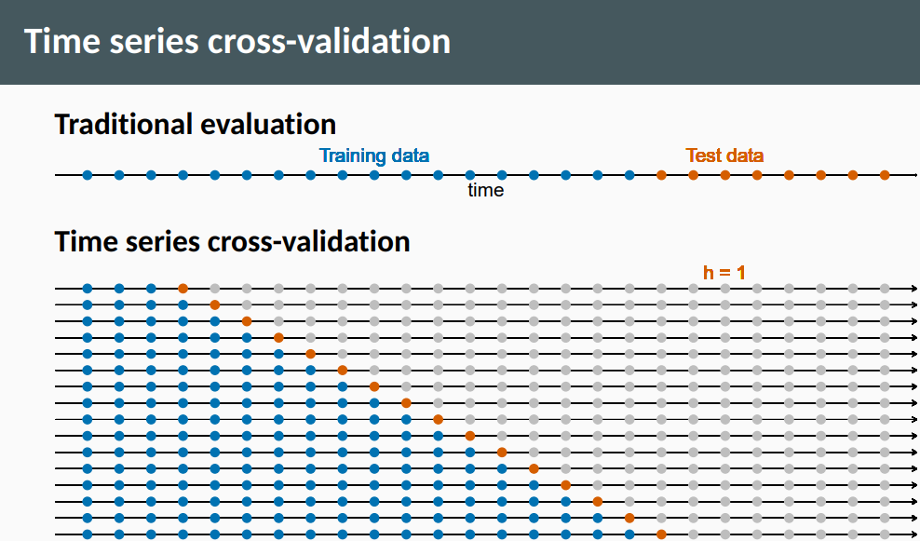

Slide 65


Slide 66
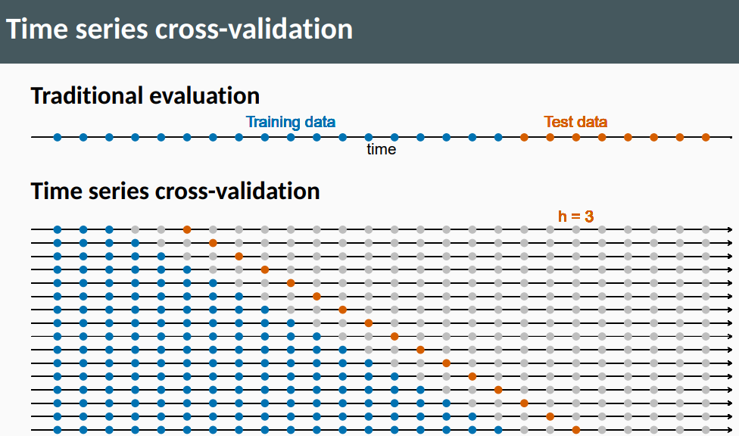

Slide 67
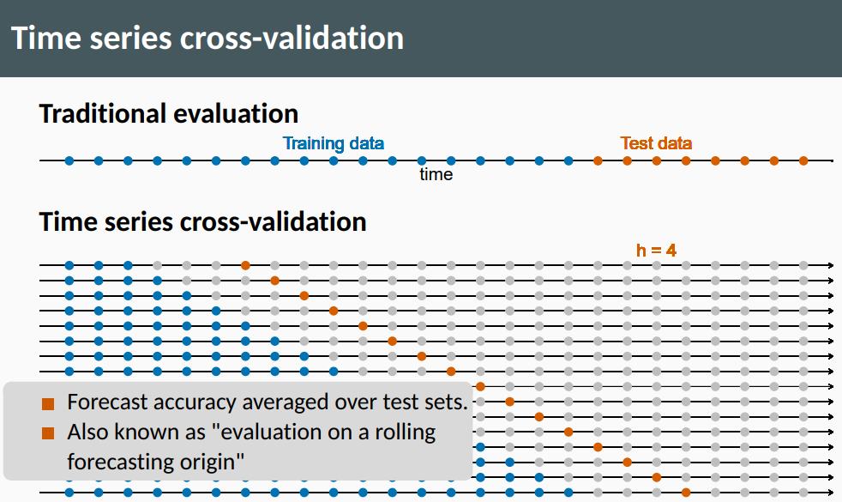

Slide 68
Time series cross-validation
Stretch with a minimum length of 3, growing by 1 each step.
fb_stretch <- fb_stock %>% stretch_tsibble(.init = 3, .step = 1) %>% filter(.id != max(.id))
## # A tsibble: 790,650 x 4 [1] ## # Key: .id [1,255] ## Date Close trading_day .id ## <date> <dbl> <int> <int> ## 1 2014-01-02 54.7 1 1 ## 2 2014-01-03 54.6 2 1 ## 3 2014-01-06 57.2 3 1 ## 4 2014-01-02 54.7 1 2 ## 5 2014-01-03 54.6 2 2 ## 6 2014-01-06 57.2 3 2 ## 7 2014-01-07 57.9 4 2 ## # … with 790,643 more rows

Slide 69
Time series cross-validation
Estimate RW w/ drift models for each window.
fit_cv <- fb_stretch %>% model(RW(Close ~ drift()))
## # A mable: 1,255 x 3 ## # Key: .id, Symbol [1,255] ## .id Symbol `RW(Close ~ drift())` ## <int> <chr> <model> ## 1 1 FB <RW w/ drift> ## 2 2 FB <RW w/ drift> ## 3 3 FB <RW w/ drift> ## 4 4 FB <RW w/ drift> ## # … with 1,251 more rows

Slide 70
Time series cross-validation
Produce one step ahead forecasts from all models.
fc_cv <- fit_cv %>% forecast(h=1)
## # A fable: 1,255 x 5 [1] ## # Key: .id, Symbol [1,255] ## .id Symbol trading_day Close .mean ## <int> <chr> <dbl> <dist> <dbl> ## 1 1 FB 4 N(58, 5.8) 58.4 ## 2 2 FB 5 N(59, 2.7) 59.0 ## 3 3 FB 6 N(59, 1.9) 59.1 ## 4 4 FB 7 N(58, 2.2) 57.7 ## # … with 1,251 more rows

Slide 71
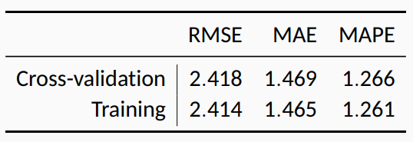
Time series cross-validation
# Cross-validated fc_cv %>% accuracy(fb_stock) # Training set fb_stock %>% model(RW(Close ~ drift())) %>% accuracy()
A good way to choose the best forecasting model is to find the model with the smallest RMSE computed using time series cross-validation.

