Slide 1
Time Series Analysis and Forecasting
Ch7. Regression models

Slide 2
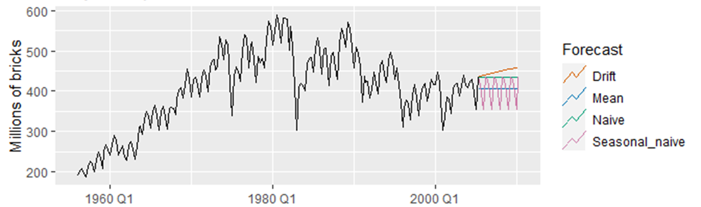
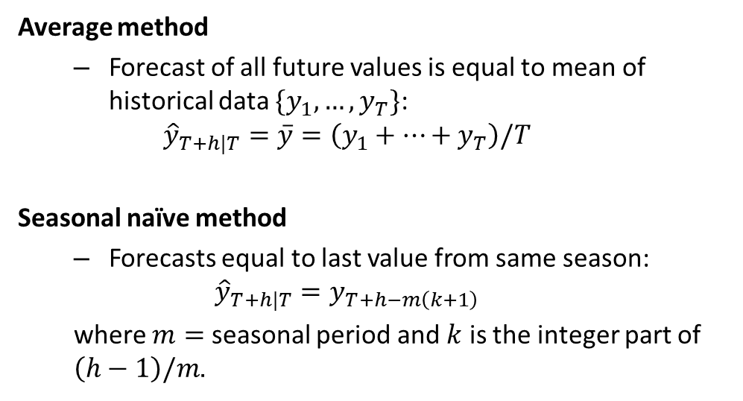
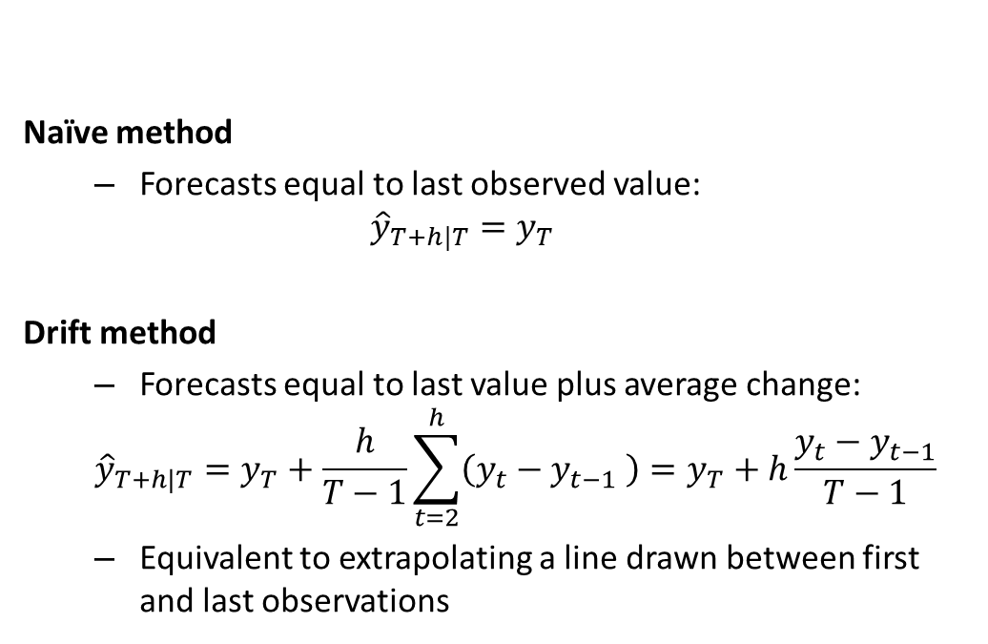
Some simple forecasting methods
Naïve method
Forecasts equal to last observed value:
$${\hat{y}}_{T+h|T}=y_{T}$$
Drift method
Forecasts equal to last value plus average change:
$${\hat{y}}_{T+h|T}=y_{T}+\frac{h}{T−1}\sum_{t=2}^{h}{\left(y_{t}−y_{t−1} \right)}=y_{T}+h\frac{y_{t}−y_{t−1}}{T−1}$$
Equivalent to extrapolating a line drawn between first and last observations
Average method
Forecast of all future values is equal to mean of historical data $\{y_{1},…,y_{T}\}$:
$${\hat{y}}_{T+h|T}=\overset{‾}{y}=\left(y_{1}+…+y_{T}\right)/T$$
Seasonal naïve method
Forecasts equal to last value from same season:
$${\hat{y}}_{T+h|T}=y_{T+h−m\left(k+1\right)}$$
where $m=$ seasonal period and $k$ is the integer part of $\left(h−1\right)/m$.

Slide 3
The linear model with time series

Slide 4
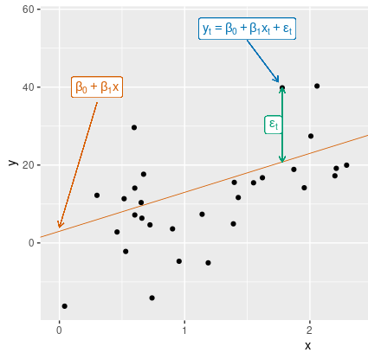
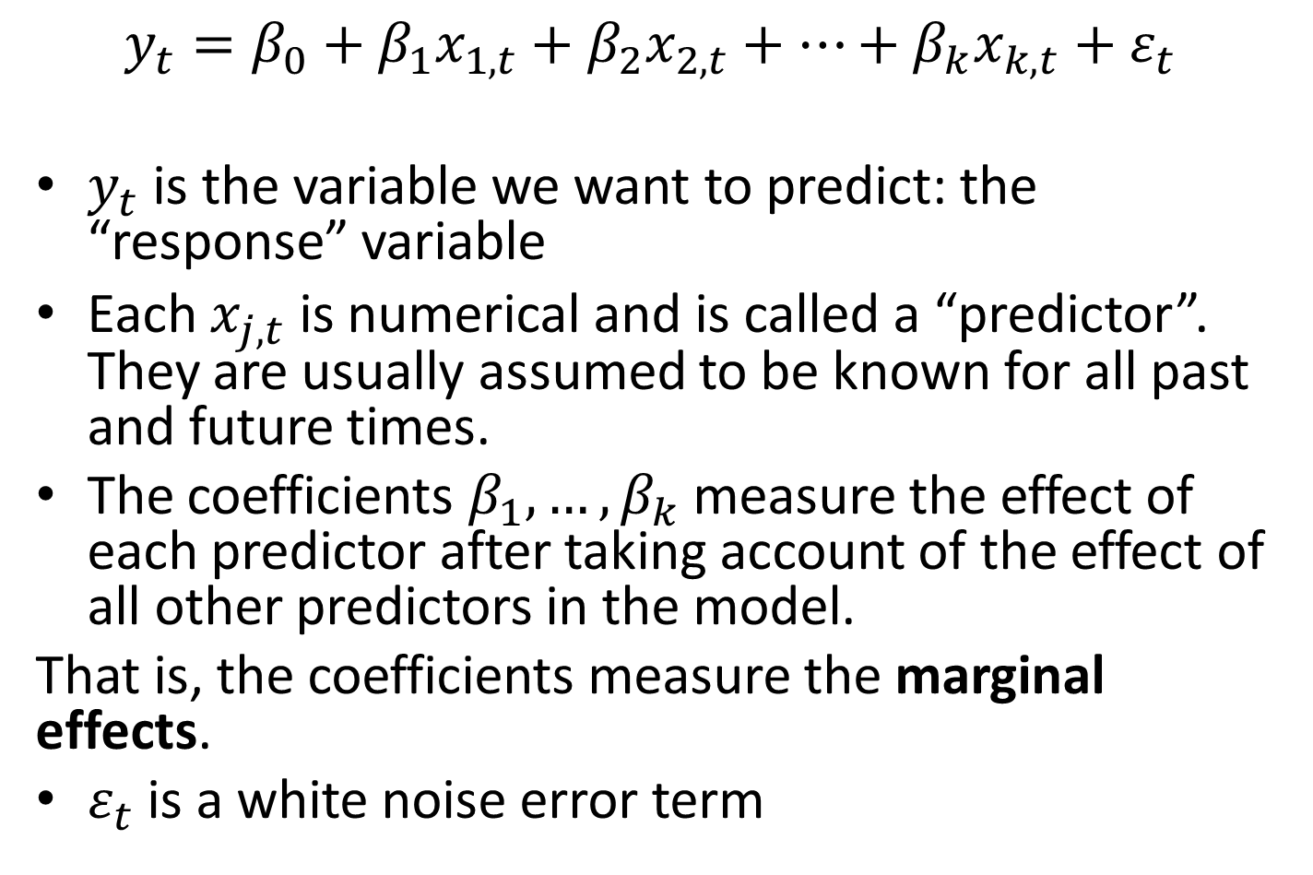
Multiple regression and forecasting
$$y_{t}=β_{0}+β_{1}x_{1,t}+β_{2}x_{2,t}+⋯+β_{k}x_{k,t}+ε_{t}$$
$y_{t}$ is the variable we want to predict: the “response” variable
Each $x_{j,t}$ is numerical and is called a “predictor”. They are usually assumed to be known for all past and future times.
The coefficients $β_{1},…,β_{k}$ measure the effect of each predictor after taking account of the effect of all other predictors in the model.
That is, the coefficients measure the marginal effects.
$ε_{t}$ is a white noise error term

Slide 5
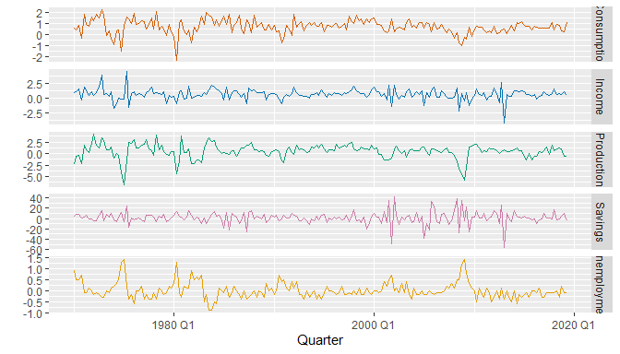
Example: US consumption expenditure

Slide 6
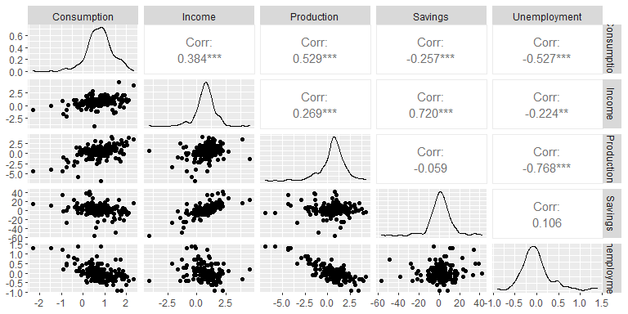
Example: US consumption expenditure

Slide 7
Example: US consumption expenditure
fit_consMR <- us_change %>% model(lm = TSLM(Consumption ~ Income + Production + Unemployment + Savings)) report(fit_consMR)
## Series: Consumption ## Model: TSLM ## ## Residuals: ## Min 1Q Median 3Q Max ## -0.906 -0.158 -0.036 0.136 1.155 ## ## Coefficients: ## Estimate Std. Error t value Pr(>|t|) ## (Intercept) 0.25311 0.03447 7.34 5.7e-12 *** ## Income 0.74058 0.04012 18.46 < 2e-16 *** ## Production 0.04717 0.02314 2.04 0.043 * ## Unemployment -0.17469 0.09551 -1.83 0.069 . ## Savings -0.05289 0.00292 -18.09 < 2e-16 *** ## --- ## Signif. codes: 0 '***' 0.001 '**' 0.01 '*' 0.05 '.' 0.1 ' ' 1 ## ## Residual standard error: 0.31 on 193 degrees of freedom ## Multiple R-squared: 0.768, Adjusted R-squared: 0.763 ## F-statistic: 160 on 4 and 193 DF, p-value: <2e-16

Slide 8
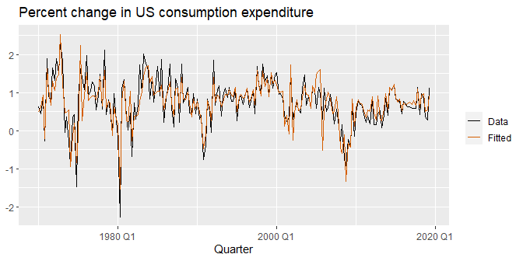
Example: US consumption expenditure

Slide 9
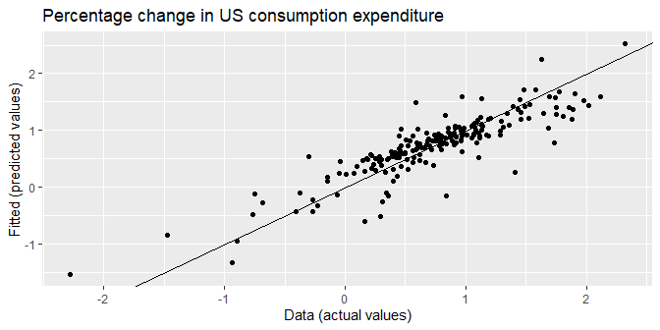
Example: US consumption expenditure

Slide 10
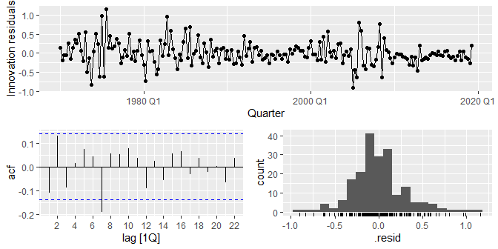
Example: US consumption expenditure
fit_consMR %>% gg_tsresiduals()
augment(fit_consMR) %>% features(.innov, ljung_box, lag = 10, dof = 5)
#>
# A tibble: 1 × 3
#> .model lb_stat lb_pvalue
#> <chr> <dbl> <dbl>
#> 1 tslm 18.9 0.00204

Slide 11
Some useful predictors for linear models

Slide 12

Trend
Linear trend
$$x_{t}=t$$
$t=1,2,…,T$
Strong assumption that trend will continue.

Slide 13
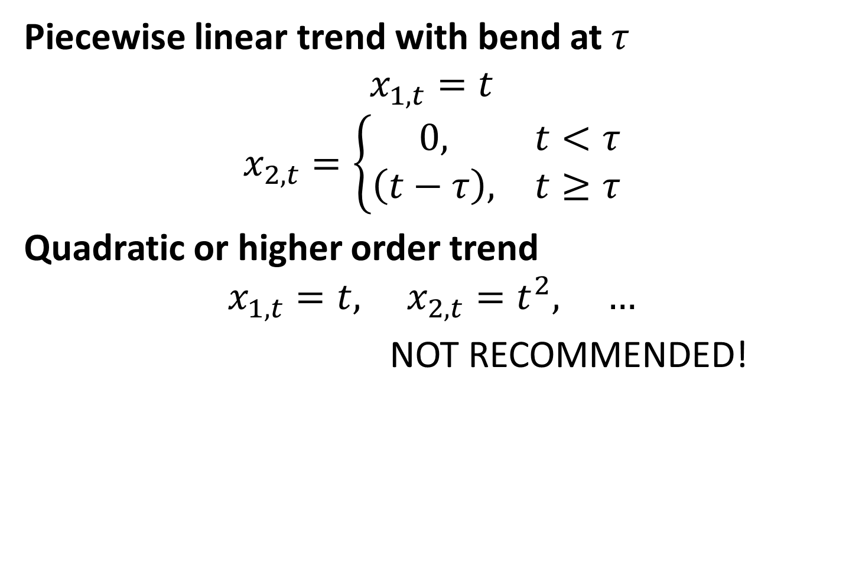
Nonlinear trend
Piecewise linear trend with bend at $τ$
$$x_{1,t}=t$$
$$x_{2,t}=\left\{\begin{matrix}0, & t<τ \\ \left(t−τ\right), & t≥τ\end{matrix}\right.$$
Quadratic or higher order trend
$$x_{1,t}=t, x_{2,t}=t^{2}, …$$
NOT RECOMMENDED!

Slide 14
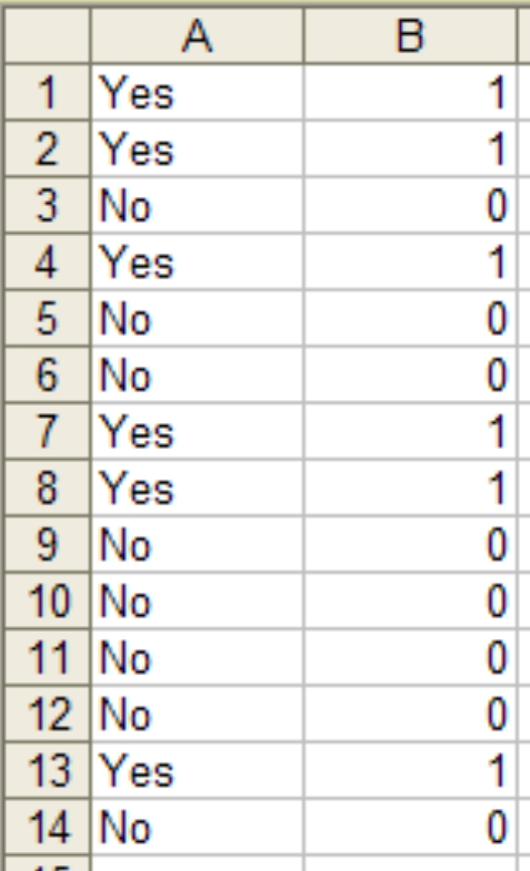
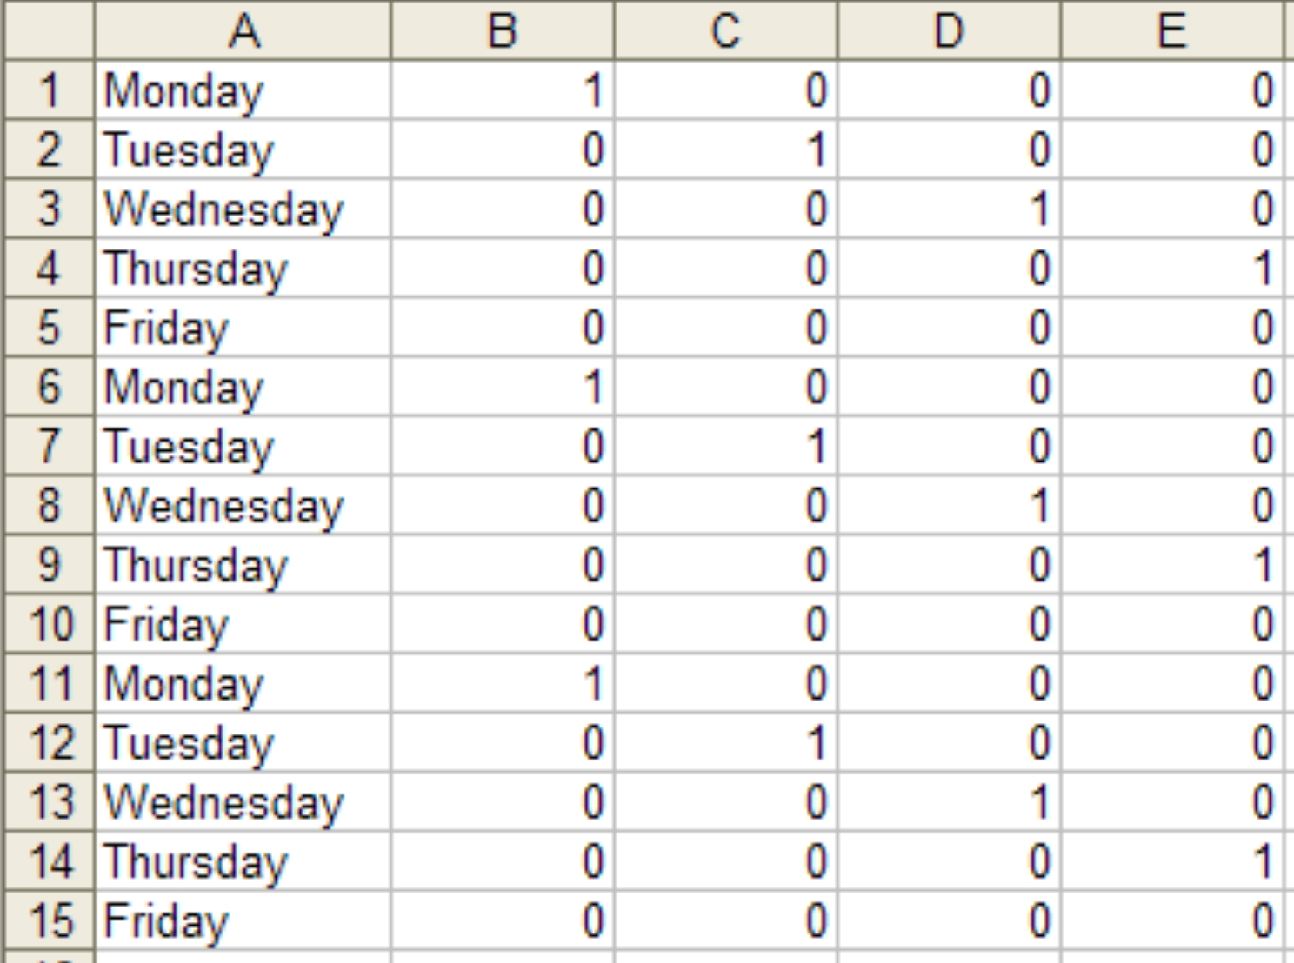
Dummy variables
If a categorical variable takes only two values (e.g., Yes' or No’), then an equivalent numerical variable can be constructed taking value 1 if yes and 0 if no. This is called a dummy variable.
If there are more than two categories, then the variable can be coded using several dummy variables (one fewer than the total number of categories).
Is Wednesday?
Is Monday?
Is Tuesday?
Is Thursday?

Slide 15
Beware of the dummy variable trap!
Using one dummy for each category gives too many dummy variables!
The regression will then be singular and inestimable.
Either omit the constant, or omit the dummy for one category.
The coefficients of the dummies are relative to the omitted category.

Slide 16
Uses of dummy variables
Seasonal dummies
For quarterly data: use 3 dummies
For monthly data: use 11 dummies
For daily data: use 6 dummies
What to do with weekly data?
Outliers
If there is an outlier, you can use a dummy variable to remove its effect.
Public holidays
For daily data: if it is a public holiday, dummy=1, otherwise dummy=0.

Slide 17
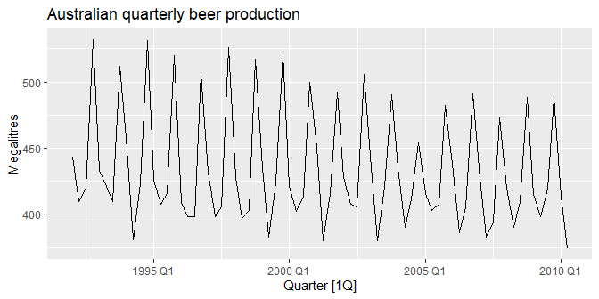
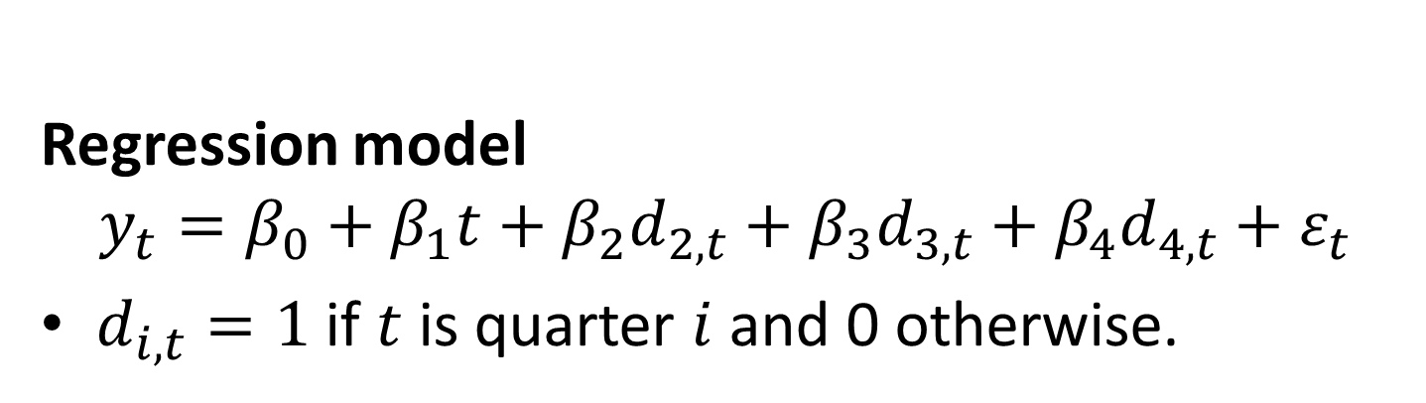
Beer production revisited
Regression model
$$y_{t}=β_{0}+β_{1}t+β_{2}d_{2,t}+β_{3}d_{3,t}+β_{4}d_{4,t}+ε_{t}$$
$d_{i,t}=1$ if $t$ is quarter $i$ and 0 otherwise.

Slide 18
Beer production revisited
fit_beer <- recent_production %>%
model(TSLM(Beer ~ trend() + season())) report(fit_beer)
## Series: Beer ## Model: TSLM ## ## Residuals: ## Min 1Q Median 3Q Max ## -42.9 -7.6 -0.5 8.0 21.8 ## ## Coefficients: ## Estimate Std. Error t value Pr(>|t|) ## (Intercept) 441.8004 3.7335 118.33 < 2e-16 *** ## trend() -0.3403 0.0666 -5.11 2.7e-06 *** ## season()year2 -34.6597 3.9683 -8.73 9.1e-13 *** ## season()year3 -17.8216 4.0225 -4.43 3.4e-05 *** ## season()year4 72.7964 4.0230 18.09 < 2e-16 *** ## --- ## Signif. codes: 0 '***' 0.001 '**' 0.01 '*' 0.05 '.' 0.1 ' ' 1 ## ## Residual standard error: 12.2 on 69 degrees of freedom ## Multiple R-squared: 0.924, Adjusted R-squared: 0.92 ## F-statistic: 211 on 4 and 69 DF, p-value: <2e-16

Slide 19
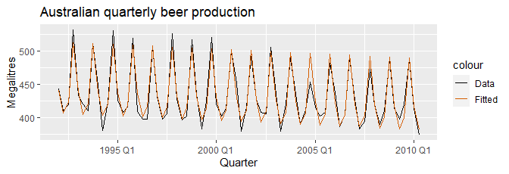
Beer production revisited
augment(fit_beer) %>% ggplot(aes(x = Quarter)) + geom_line(aes(y = Beer, colour = "Data")) + geom_line(aes(y = .fitted, colour = "Fitted")) + labs(y="Megalitres",title ="Australian quarterly beer production") + scale_colour_manual(values = c(Data = "black", Fitted = "#D55E00"))

Slide 20
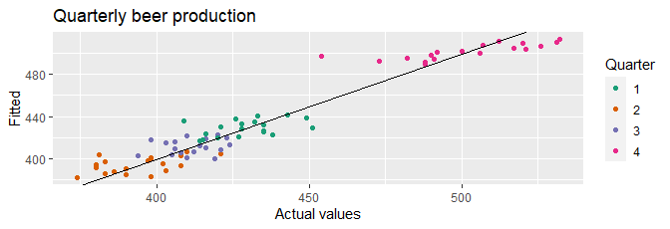
Beer production revisited
augment(fit_beer) %>% ggplot(aes(x=Beer, y=.fitted, colour=factor(quarter(Quarter)))) + geom_point() + labs(y="Fitted", x="Actual values", title = "Quarterly beer production") + scale_colour_brewer(palette="Dark2", name="Quarter") + geom_abline(intercept=0, slope=1)

Slide 21
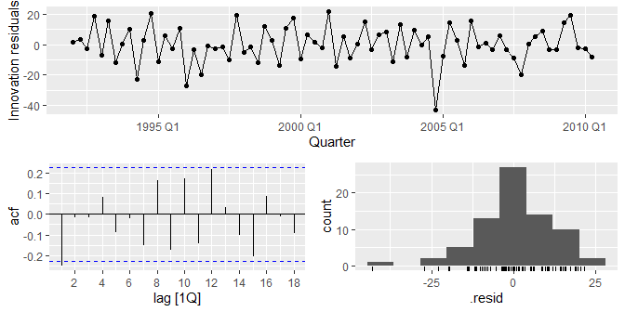
Beer production revisited
fit_beer %>% gg_tsresiduals()

Slide 22
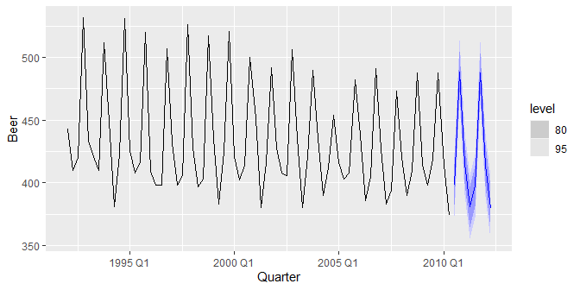
Beer production revisited
fit_beer %>% forecast %>% autoplot(recent_production)

Slide 23
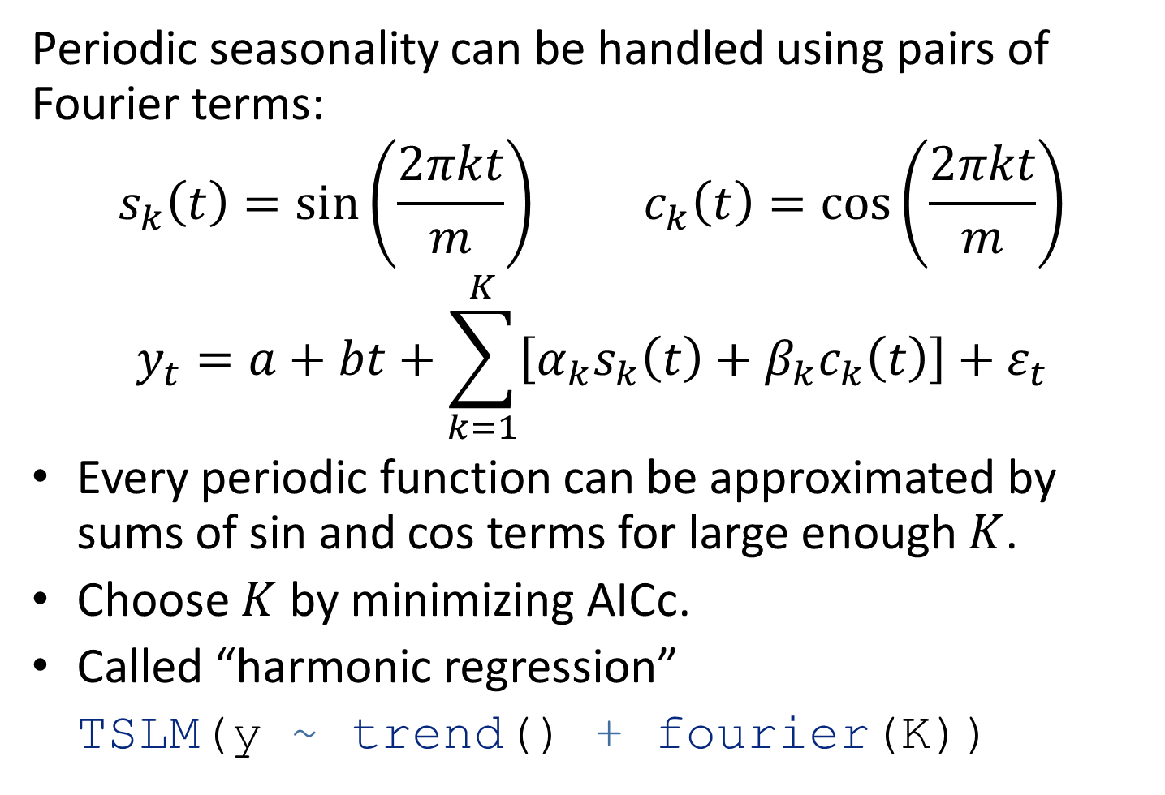
Fourier series
Periodic seasonality can be handled using pairs of Fourier terms:
$$s_{k}\left(t\right)=sin\left(\frac{2πkt}{m}\right) c_{k}\left(t\right)=cos\left(\frac{2πkt}{m}\right)$$
$$y_{t}=a+bt+\sum_{k=1}^{K}{\left[α_{k}s_{k}\left(t\right)+β_{k}c_{k}\left(t\right)\right]}+ε_{t}$$
Every periodic function can be approximated by sums of sin and cos terms for large enough $K$.
Choose $K$ by minimizing AICc.
Called “harmonic regression”
TSLM(y ~ trend() + fourier(K))

Slide 24
Harmonic regression: beer production
fourier_beer <- recent_production %>% model(TSLM(Beer ~ trend() + fourier(K=2))) report(fourier_beer)
## Series: Beer ## Model: TSLM ## ## Residuals: ## Min 1Q Median 3Q Max ## -42.9 -7.6 -0.5 8.0 21.8 ## ## Coefficients: ## Estimate Std. Error t value Pr(>|t|) ## (Intercept) 446.8792 2.8732 155.53 < 2e-16 *** ## trend() -0.3403 0.0666 -5.11 2.7e-06 *** ## fourier(K = 2)C1_4 8.9108 2.0112 4.43 3.4e-05 *** ## fourier(K = 2)S1_4 -53.7281 2.0112 -26.71 < 2e-16 *** ## fourier(K = 2)C2_4 -13.9896 1.4226 -9.83 9.3e-15 *** ## --- ## Signif. codes: 0 '***' 0.001 '**' 0.01 '*' 0.05 '.' 0.1 ' ' 1 ## ## Residual standard error: 12.2 on 69 degrees of freedom ## Multiple R-squared: 0.924, Adjusted R-squared: 0.92 ## F-statistic: 211 on 4 and 69 DF, p-value: <2e-16

Slide 25
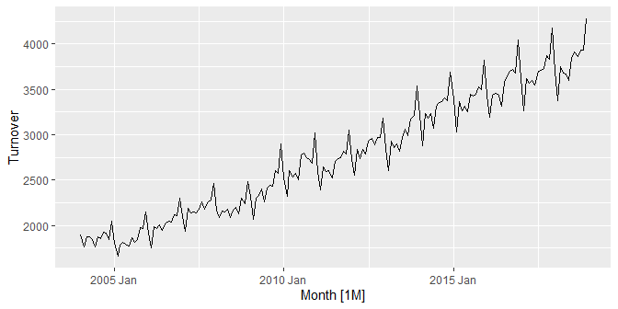
Harmonic regression: eating-out expenditure
aus_cafe <- aus_retail %>% filter( Industry == "Cafes, restaurants and takeaway food services", year(Month) %in% 2004:2018 ) %>% summarise(Turnover = sum(Turnover)) aus_cafe %>% autoplot(Turnover)

Slide 26
Harmonic regression: eating-out expenditure
fit <- aus_cafe %>% model(K1 = TSLM(log(Turnover) ~ trend() + fourier(K = 1)), K2 = TSLM(log(Turnover) ~ trend() + fourier(K = 2)), K3 = TSLM(log(Turnover) ~ trend() + fourier(K = 3)), K4 = TSLM(log(Turnover) ~ trend() + fourier(K = 4)), K5 = TSLM(log(Turnover) ~ trend() + fourier(K = 5)), K6 = TSLM(log(Turnover) ~ trend() + fourier(K = 6))) glance(fit) %>% select(.model, r_squared, adj_r_squared, AICc)
## # A tibble: 6 × 4 ## .model r_squared adj_r_squared AICc ## <chr> <dbl> <dbl> <dbl> ## 1 K1 0.962 0.962 -1085. ## 2 K2 0.966 0.965 -1099. ## 3 K3 0.976 0.975 -1160. ## 4 K4 0.980 0.979 -1183. ## 5 K5 0.985 0.984 -1234. ## 6 K6 0.985 0.984 -1232.

Slide 27
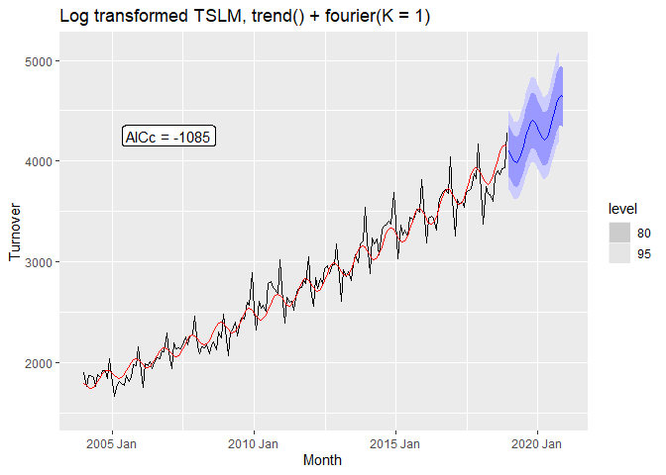
Harmonic regression: eating-out expenditure

Slide 28
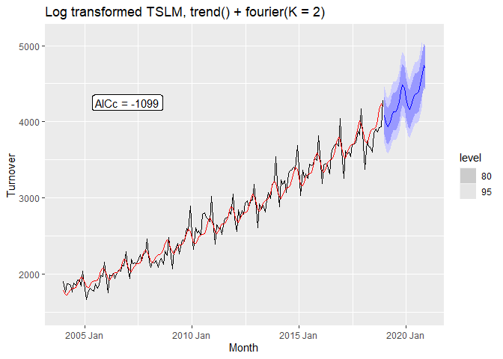
Harmonic regression: eating-out expenditure

Slide 29
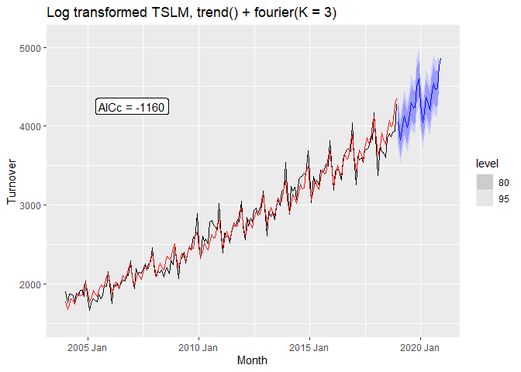
Harmonic regression: eating-out expenditure

Slide 30

Harmonic regression: eating-out expenditure

Slide 31
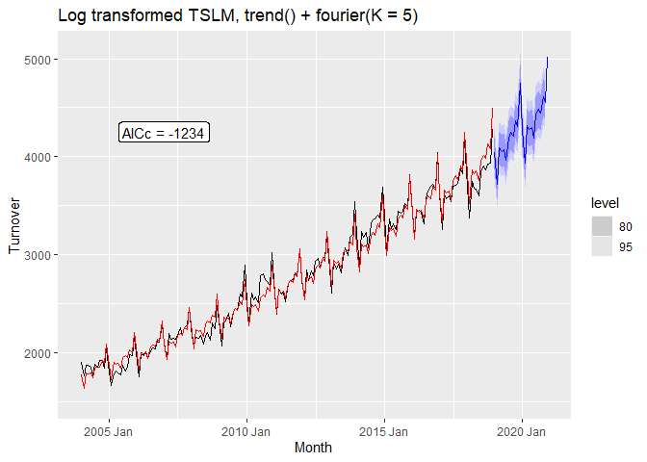
Harmonic regression: eating-out expenditure

Slide 32

Harmonic regression: eating-out expenditure

Slide 33
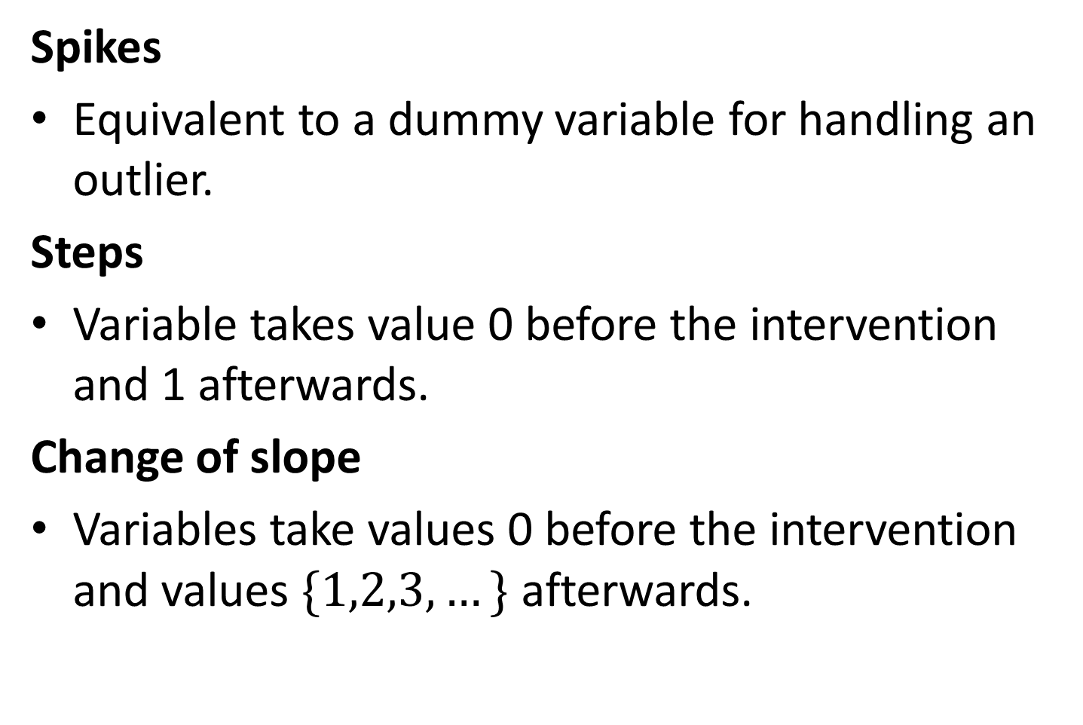
Intervention variables
Spikes
Equivalent to a dummy variable for handling an outlier.
Steps
Variable takes value 0 before the intervention and 1 afterwards.
Change of slope
Variables take values 0 before the intervention and values $\{1,2,3,…\}$ afterwards.

Slide 34
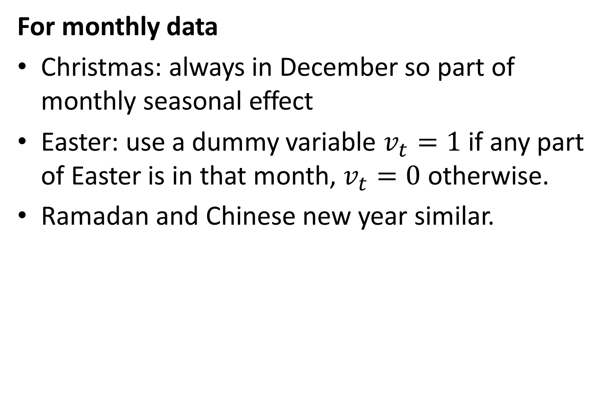
Holidays
For monthly data
Christmas: always in December so part of monthly seasonal effect
Easter: use a dummy variable $v_{t}=1$ if any part of Easter is in that month, $v_{t}=0$ otherwise.
Ramadan and Chinese new year similar.

Slide 35
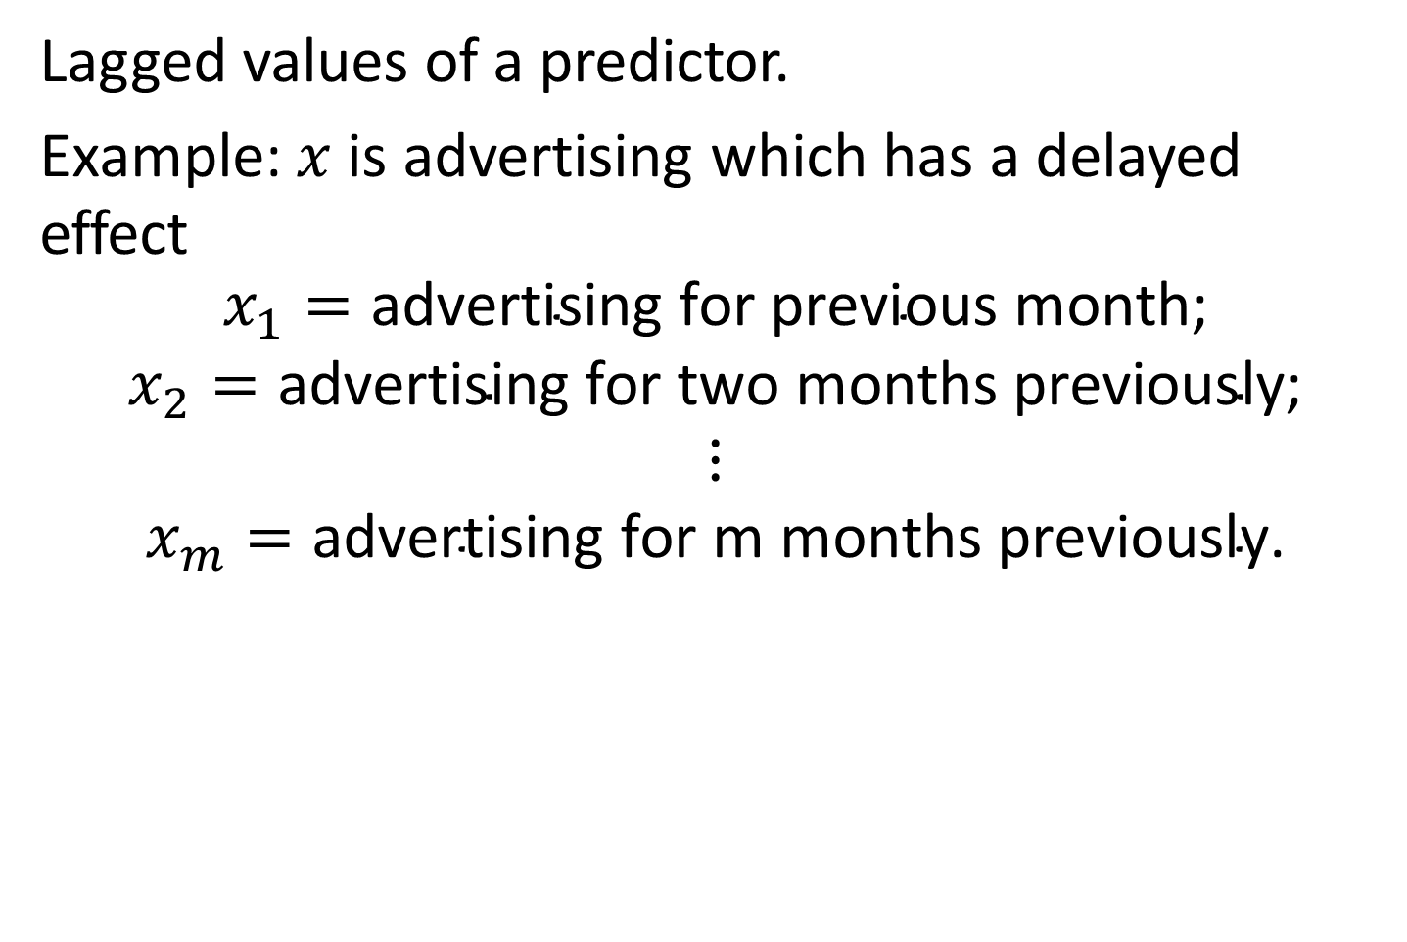
Distributed lags
Lagged values of a predictor.
Example: $x$ is advertising which has a delayed effect
$$\begin{matrix}x_{1}=\text{advertising} \text{for} \text{previous} \text{month}\text{;} \\ x_{2}=\text{advertising} \text{for} \text{two} \text{months} \text{previously}\text{;} \\ ⋮ \\ x_{m}=\text{advertising} \text{for} \text{m} \text{months} \text{previously}\text{.}\end{matrix}$$

Slide 36
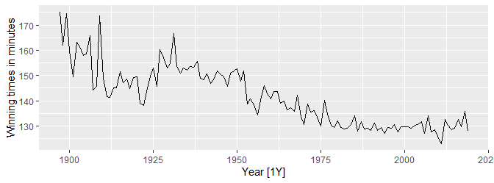
Example: Boston marathon winning times
marathon <- boston_marathon %>% filter(Event == "Men's open division") %>% select(-Event) %>% mutate(Minutes = as.numeric(Time)/60) marathon %>% autoplot(Minutes) + labs(y="Winning times in minutes")

Slide 37
Example: Boston marathon winning times
fit_trends <- marathon %>% model( # Linear trend linear = TSLM(Minutes ~ trend()), # Exponential trend exponential = TSLM(log(Minutes) ~ trend()), # Piecewise linear trend piecewise = TSLM(Minutes ~ trend(knots = c(1940, 1980))) )
fit_trends
## # A mable: 1 x 3 ## linear exponential piecewise ## <model> <model> <model> ## 1 <TSLM> <TSLM> <TSLM>

Slide 38
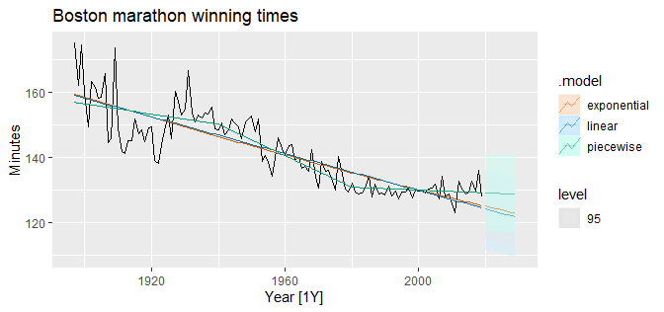
Example: Boston marathon winning times
fit_trends %>% forecast(h=10) %>% autoplot(marathon)

Slide 39
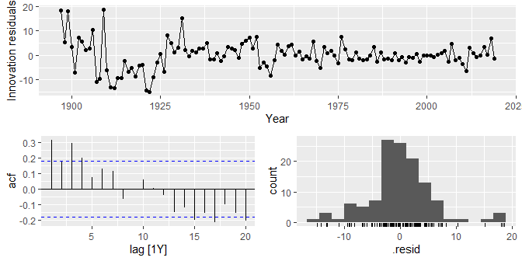
Example: Boston marathon winning times
fit_trends %>% select(piecewise) %>% gg_tsresiduals()

Slide 40
Residual diagnostics

Slide 41
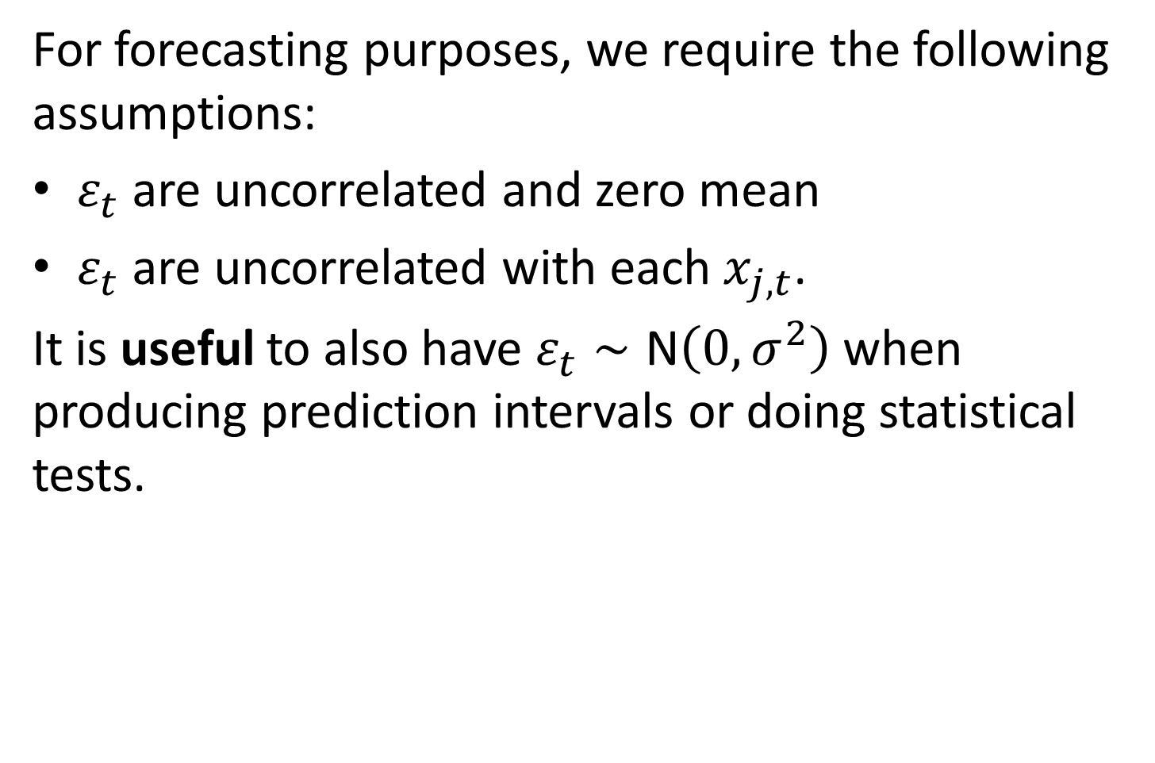
Multiple regression and forecasting
For forecasting purposes, we require the following assumptions:
$ε_{t}$ are uncorrelated and zero mean
$ε_{t}$ are uncorrelated with each $x_{j,t}$.
It is useful to also have $ε_{t}∼\text{N}\left(0,σ^{2}\right)$ when producing prediction intervals or doing statistical tests.

Slide 42
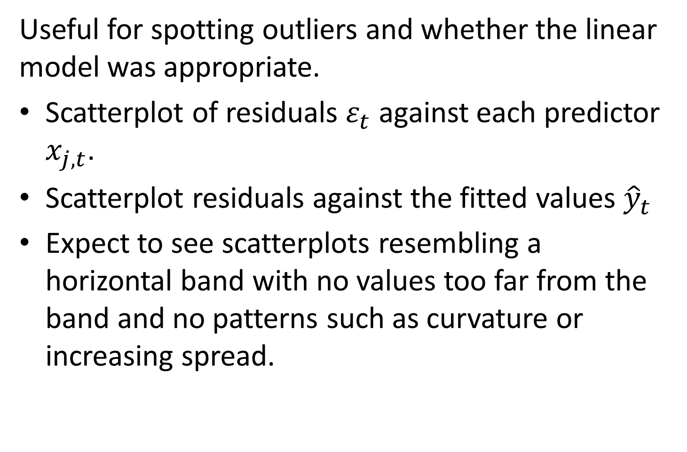
Residual plots
Useful for spotting outliers and whether the linear model was appropriate.
Scatterplot of residuals $ε_{t}$ against each predictor $x_{j,t}$.
Scatterplot residuals against the fitted values ${\hat{y}}_{t}$
Expect to see scatterplots resembling a horizontal band with no values too far from the band and no patterns such as curvature or increasing spread.

Slide 43
Residual patterns
If a plot of the residuals vs any predictor in the model shows a pattern, then the relationship is nonlinear.
If a plot of the residuals vs any predictor not in the model shows a pattern, then the predictor should be added to the model.
If a plot of the residuals vs fitted values shows a pattern, then there is heteroscedasticity in the errors. (Could try a transformation.)

Slide 44
Selecting predictors and forecast evaluation

Slide 45
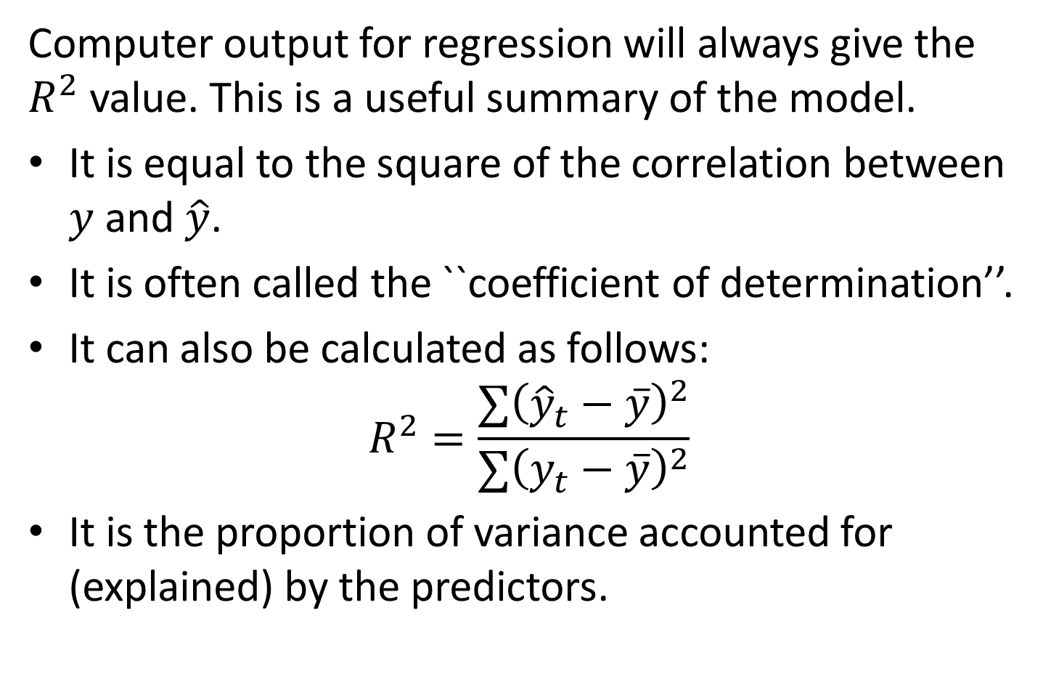
Comparing regression models
Computer output for regression will always give the $R^{2}$ value. This is a useful summary of the model.
It is equal to the square of the correlation between $y$ and $\hat{y}$.
It is often called the ``coefficient of determination’’.
It can also be calculated as follows:
$$R^{2}=\frac{∑{\left({\hat{y}}_{t}−\overset{‾}{y}\right)}^{2}}{∑{\left(y_{t}−\overset{‾}{y}\right)}^{2}}$$
It is the proportion of variance accounted for (explained) by the predictors.

Slide 46
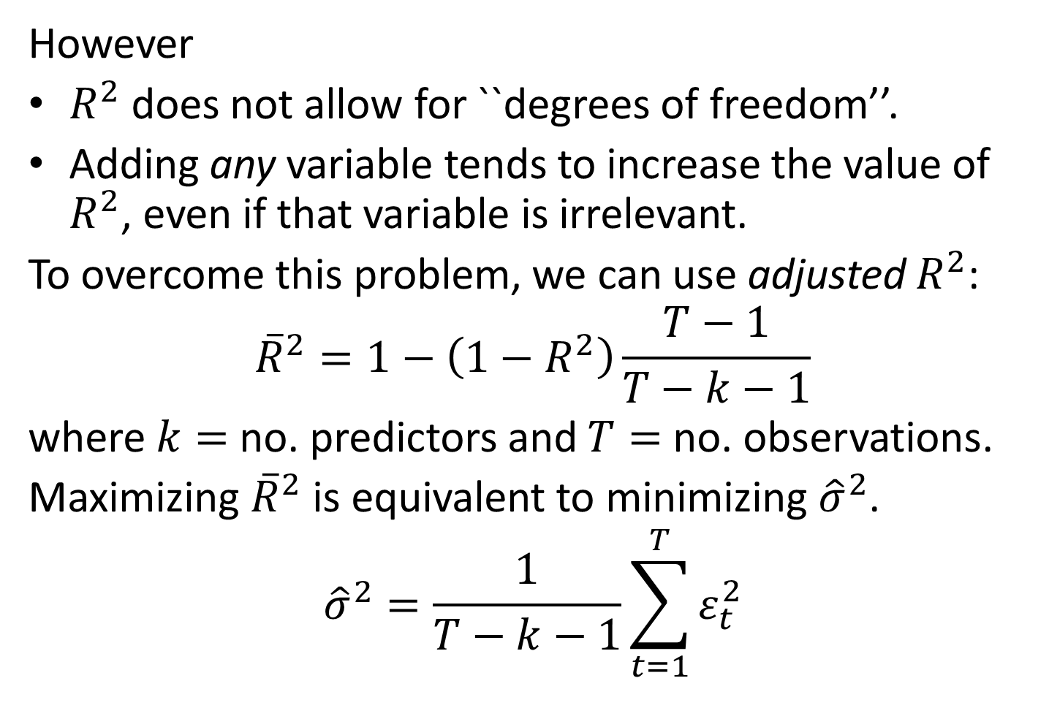
Comparing regression models
However
$R^{2}$ does not allow for ``degrees of freedom’’.
Adding any variable tends to increase the value of $R^{2}$, even if that variable is irrelevant.
To overcome this problem, we can use adjusted $R^{2}$:
$${\overset{‾}{R}}^{2}=1−\left(1−R^{2}\right)\frac{T−1}{T−k−1}$$
where $k=$ no. predictors and $T=$ no. observations.
Maximizing ${\overset{‾}{R}}^{2}$ is equivalent to minimizing ${\hat{σ}}^{2}$.
$${\hat{σ}}^{2}=\frac{1}{T−k−1}\sum_{t=1}^{T}{ε_{t}^{2}}$$

Slide 47
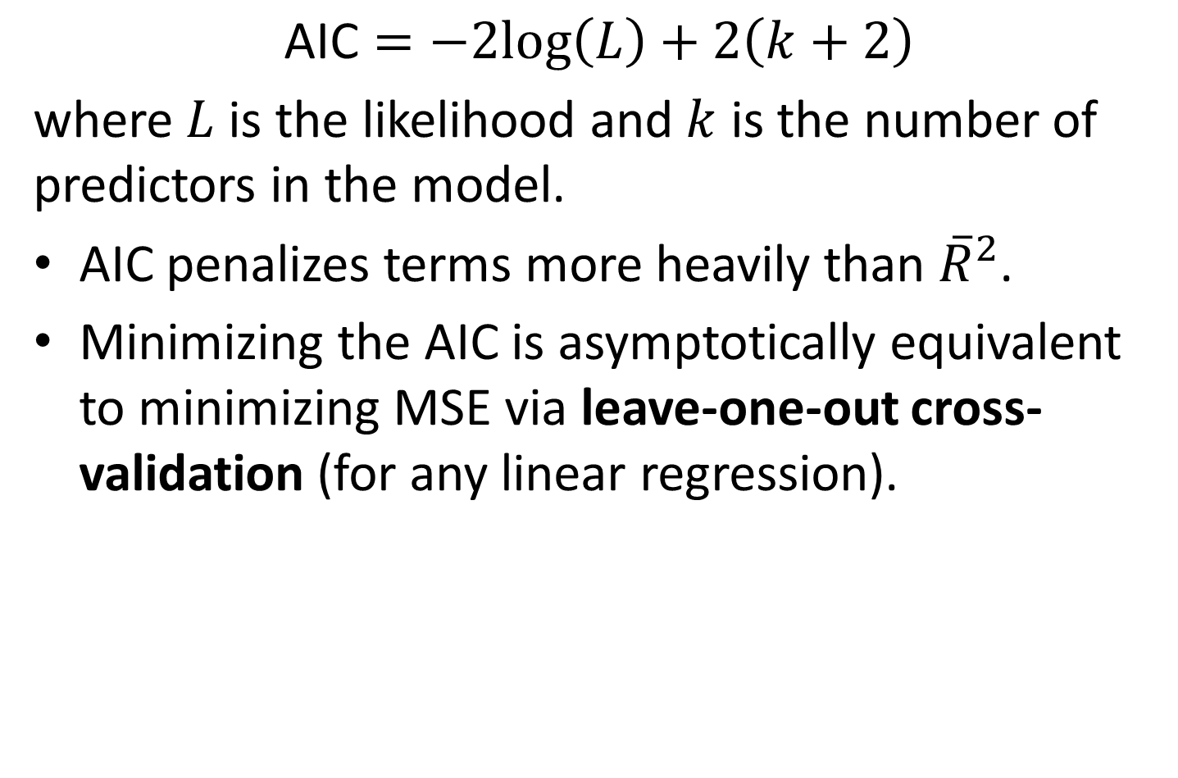
Akaike’s Information Criterion
$$\text{AIC}=−2log\left(L\right)+2\left(k+2\right)$$
where $L$ is the likelihood and $k$ is the number of predictors in the model.
AIC penalizes terms more heavily than ${\overset{‾}{R}}^{2}$.
Minimizing the AIC is asymptotically equivalent to minimizing MSE via leave-one-out cross-validation (for any linear regression).

Slide 48
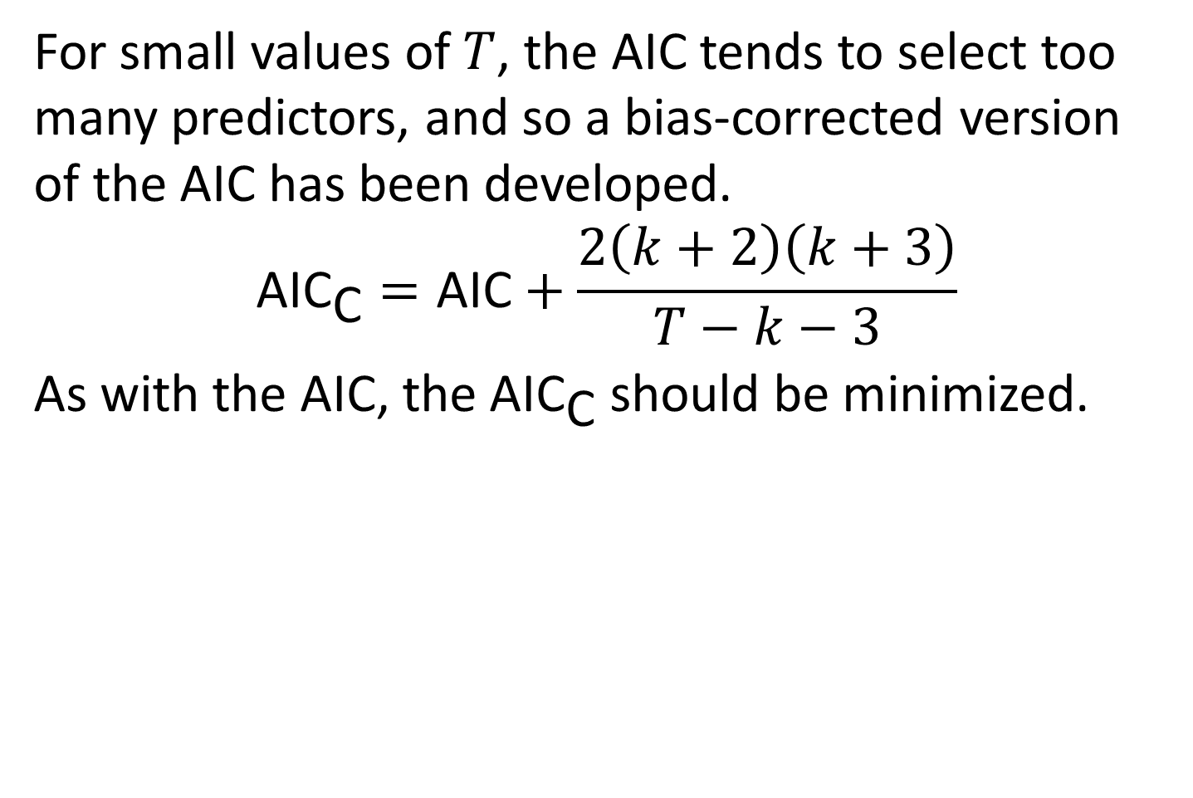
Corrected AIC
For small values of $T$, the AIC tends to select too many predictors, and so a bias-corrected version of the AIC has been developed.
$${\text{AIC}}_{\text{C}}=\text{AIC}+\frac{2\left(k+2\right)\left(k+3\right)}{T−k−3}$$
As with the AIC, the AIC$​_{\text{C}}$ should be minimized.

Slide 49
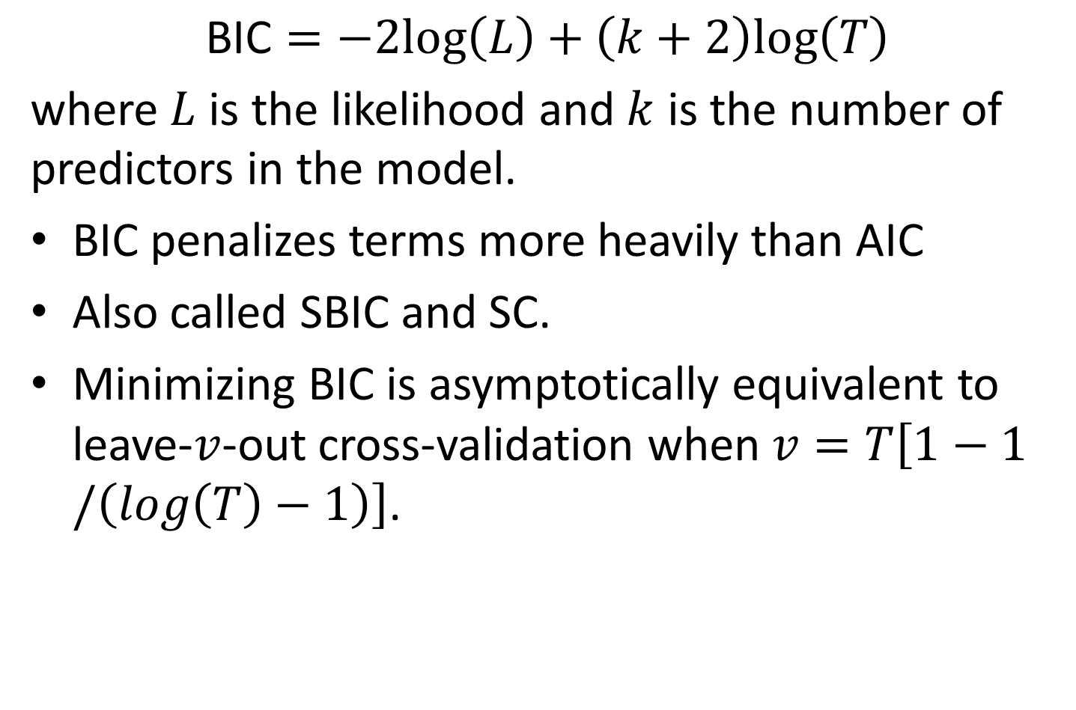
Bayesian Information Criterion
$$\text{BIC}=−2log\left(L\right)+\left(k+2\right)log\left(T\right)$$
where $L$ is the likelihood and $k$ is the number of predictors in the model.
BIC penalizes terms more heavily than AIC
Also called SBIC and SC.
Minimizing BIC is asymptotically equivalent to leave-$v$-out cross-validation when $v=T\left[1−1/\left(log\left(T\right)−1\right)\right]$.

Slide 50
Leave-one-out cross-validation
For regression, leave-one-out cross-validation is faster and more efficient than time-series cross-validation.
Select one observation for test set, and use remaining observations in training set. Compute error on test observation.
Repeat using each possible observation as the test set.
Compute accuracy measure over all errors.

Slide 51
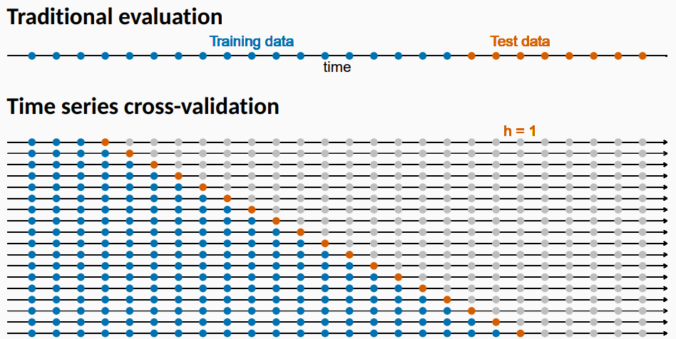
Cross-validation

Slide 52
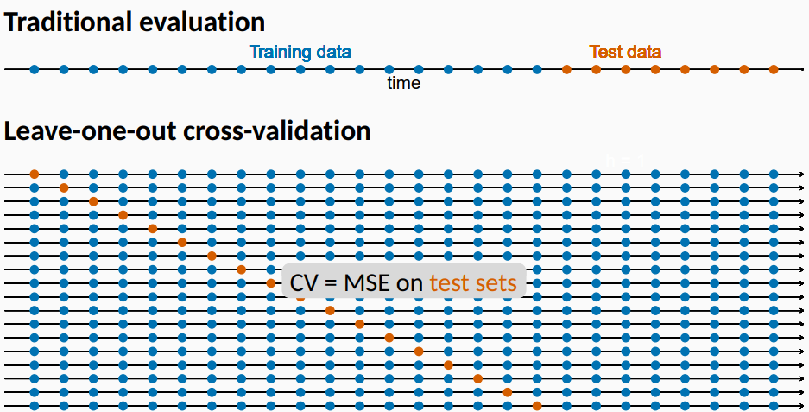
Cross-validation

Slide 53
Choosing regression variables
Best subsets regression
Fit all possible regression models using one or more of the predictors.
Choose the best model based on one of the measures of predictive ability (CV, AIC, AICc).
Warning!
If there are a large number of predictors, this is not possible.
For example, 44 predictors leads to 18 trillion possible models!

Slide 54
Choosing regression variables
Backwards stepwise regression
Start with a model containing all variables.
Try subtracting one variable at a time. Keep the model if it has lower CV or AICc.
Iterate until no further improvement.
Notes
Stepwise regression is not guaranteed to lead to the best possible model.
Inference on coefficients of final model will be wrong.

Slide 55
Forecasting with regression

Slide 56
Ex-ante versus ex-post forecasts
Ex ante forecasts are made using only information available in advance.
require forecasts of predictors
Ex post forecasts are made using later information on the predictors.
useful for studying behaviour of forecasting models.
trend, seasonal and calendar variables are all known in advance, so these don’t need to be forecast.

Slide 57
Scenario based forecasting
Assumes possible scenarios for the predictor variables
Prediction intervals for scenario based forecasts do not include the uncertainty associated with the future values of the predictor variables.

Slide 58

Building a predictive regression model
If getting forecasts of predictors is difficult, you can use lagged predictors instead.
$$y_{t}=β_{0}+β_{1}x_{1,t−h}+…+β_{k}x_{k,t−h}+ε_{t}$$
A different model for each forecast horizon $h$.

Slide 59
US Consumption
fit_consBest <- us_change %>% model( TSLM(Consumption ~ Income + Savings + Unemployment) ) future_scenarios <- scenarios( Increase = new_data(us_change, 4) %>% mutate(Income=1, Savings=0.5, Unemployment=0), Decrease = new_data(us_change, 4) %>% mutate(Income=-1, Savings=-0.5, Unemployment=0), names_to = "Scenario") fc <- forecast(fit_consBest, new_data = future_scenarios)

Slide 60
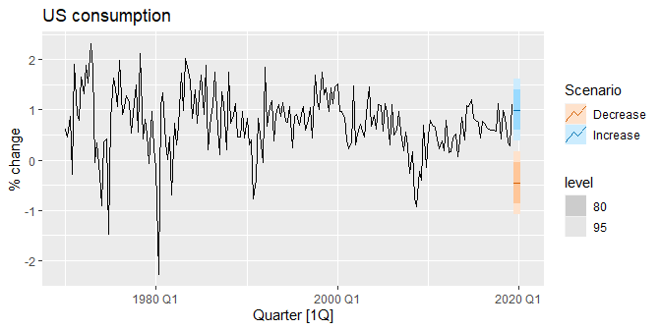
US Consumption
us_change %>% autoplot(Consumption) + labs(y="% change in US consumption") + autolayer(fc) + labs(title = "US consumption", y = "% change")

Slide 61
Matrix formulation

Slide 62
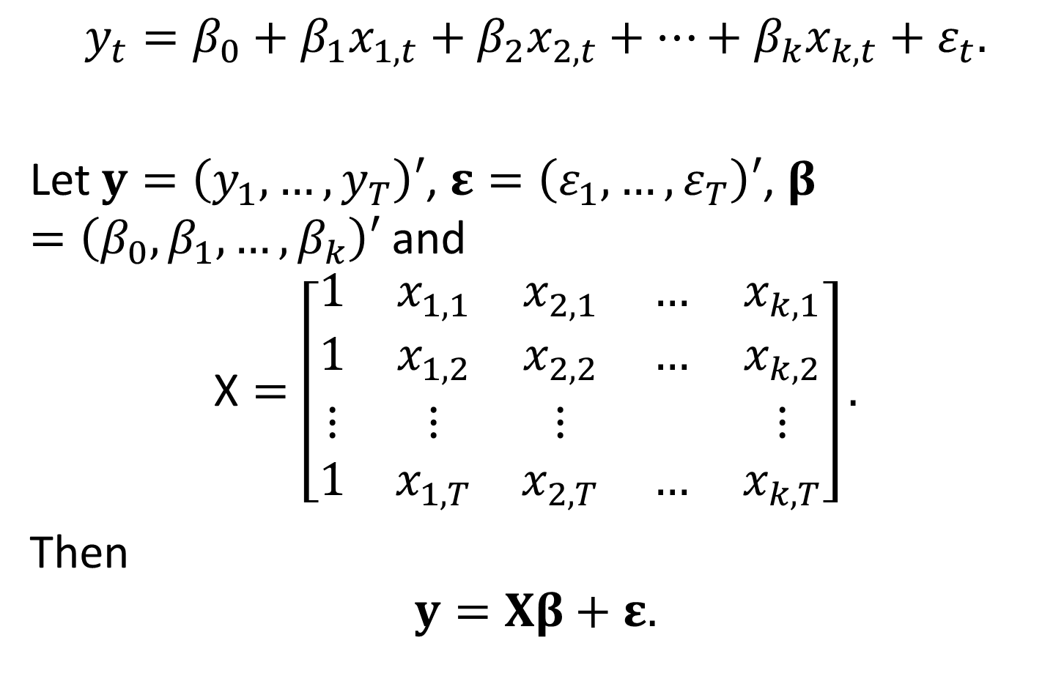
Matrix formulation
$$y_{t}=β_{0}+β_{1}x_{1,t}+β_{2}x_{2,t}+⋯+β_{k}x_{k,t}+ε_{t}.$$
Let $y=\left(y_{1},…,y_{T}\right)′$, $ε=\left(ε_{1},…,ε_{T}\right)′$, $β=\left(β_{0},β_{1},…,β_{k}\right)′$ and
$$\text{X}=\left[\begin{matrix}1 & x_{1,1} & x_{2,1} & … & x_{k,1} \\ 1 & x_{1,2} & x_{2,2} & … & x_{k,2} \\ ⋮ & ⋮ & ⋮ & & ⋮ \\ 1 & x_{1,T} & x_{2,T} & … & x_{k,T}\end{matrix}\right].$$
Then
$$y=Xβ+ε.$$

Slide 63
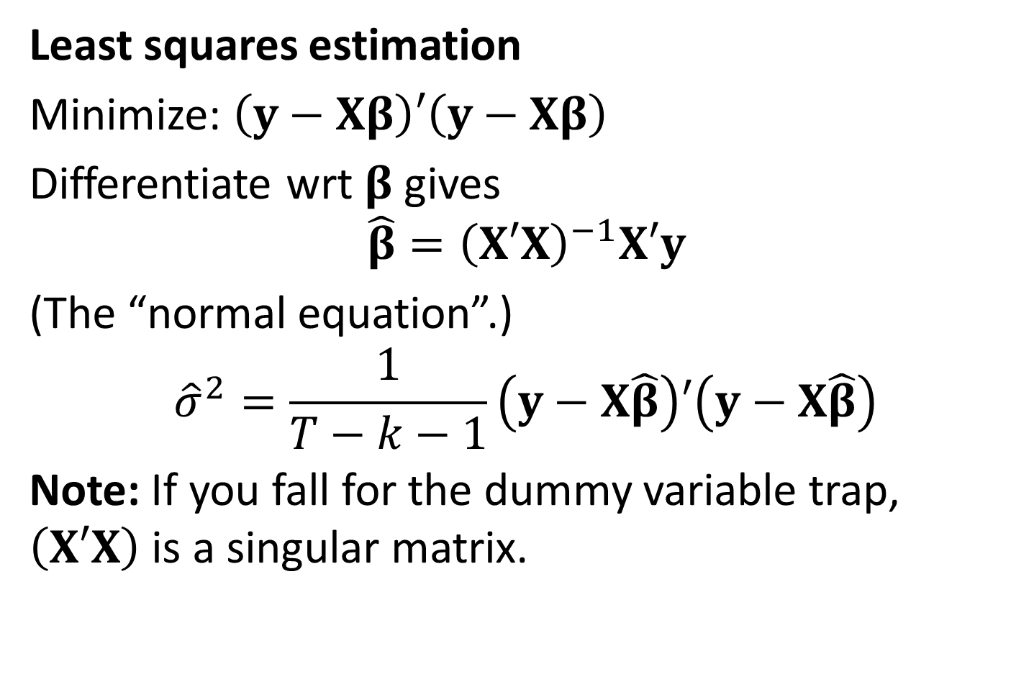
Matrix formulation
Least squares estimation
Minimize: $\left(y−Xβ\right)′\left(y−Xβ\right)$
Differentiate wrt $β$ gives
$$\hat{β}={\left(X′X\right)}^{−1}X′y$$
(The “normal equation”.)
$${\hat{σ}}^{2}=\frac{1}{T−k−1}\left(y−X\hat{β}\right)′\left(y−X\hat{β}\right)$$
Note: If you fall for the dummy variable trap, $\left(X′X\right)$ is a singular matrix.

Slide 64
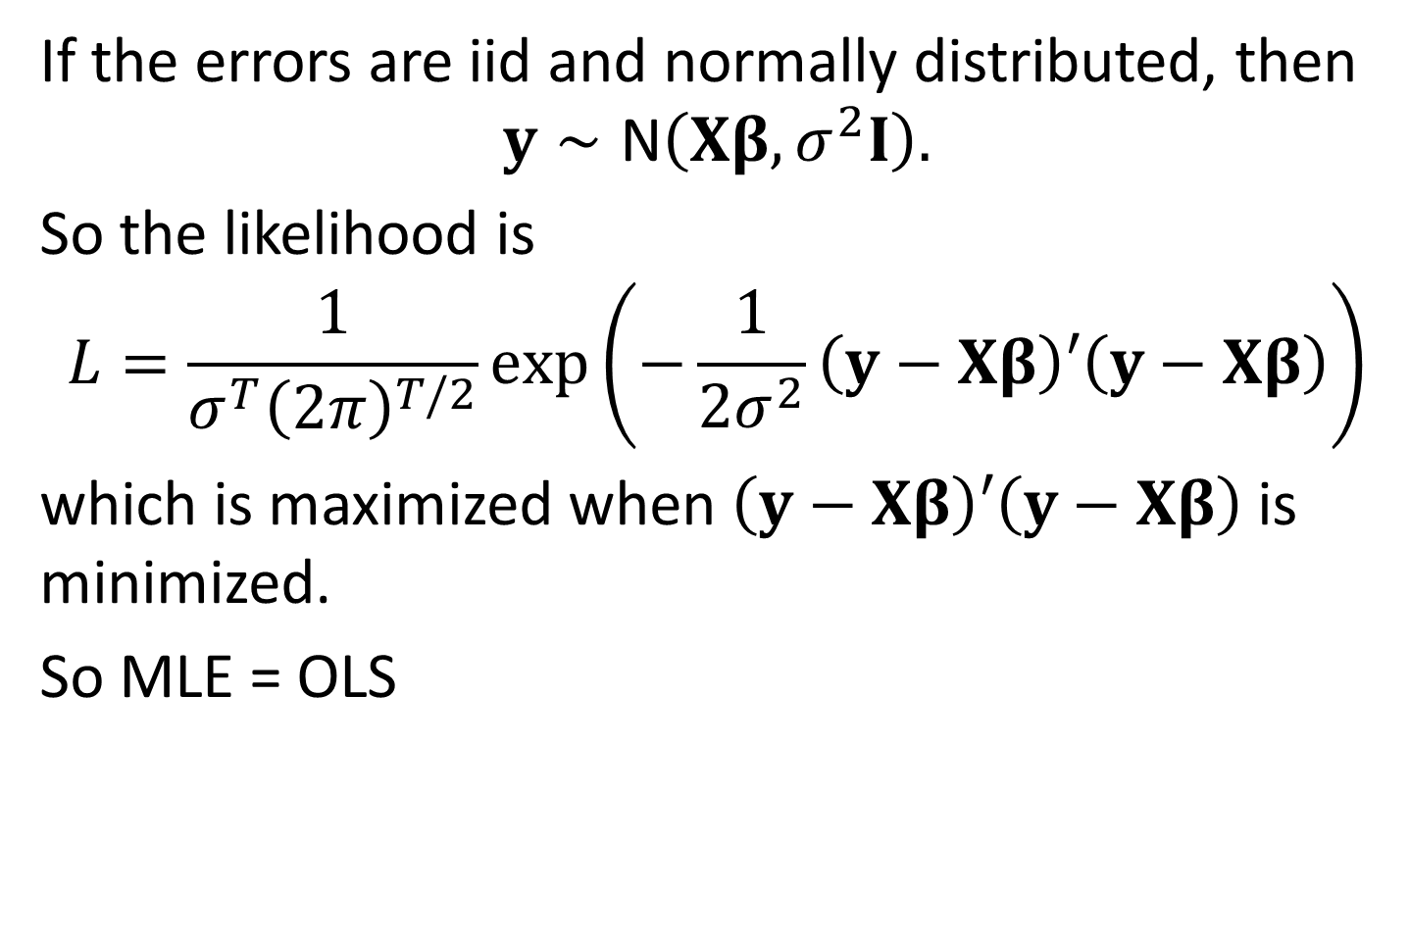
Likelihood
If the errors are iid and normally distributed, then
$$y∼\text{N}\left(Xβ,σ^{2}I\right).$$
So the likelihood is
$$L=\frac{1}{σ^{T}{\left(2π\right)}^{T/2}}exp\left(−\frac{1}{2σ^{2}}\left(y−Xβ\right)′\left(y−Xβ\right)\right)$$
which is maximized when $\left(y−Xβ\right)′\left(y−Xβ\right)$ is minimized.
So $\text{MLE} \text{= }\text{OLS}$

Slide 65
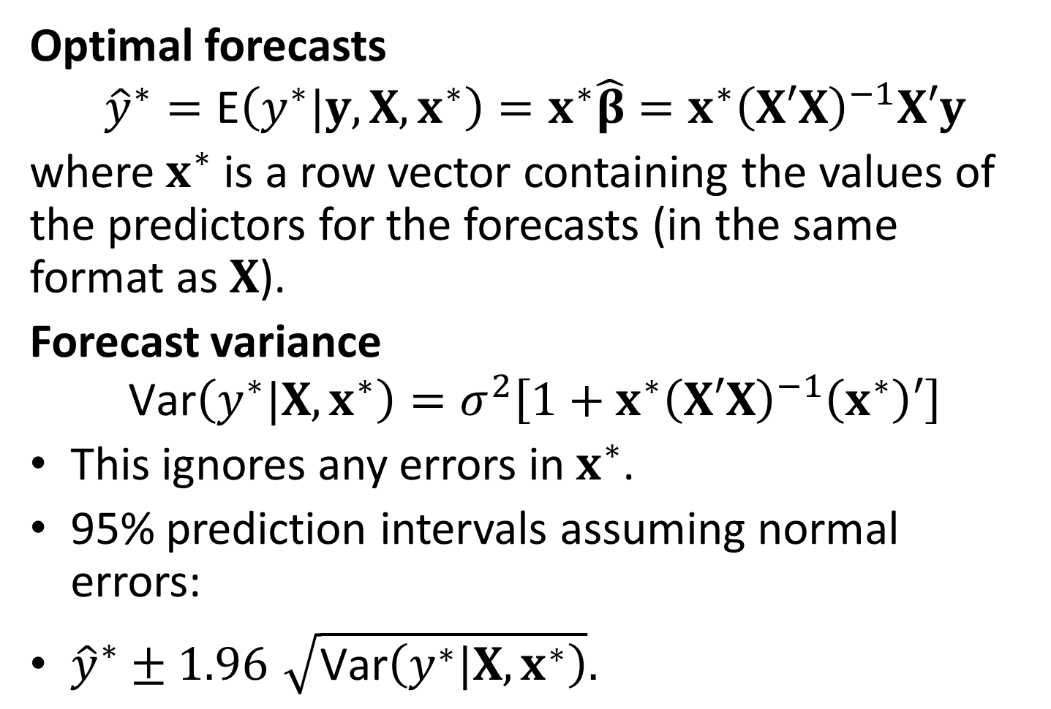
Multiple regression forecasts
Optimal forecasts
$${\hat{y}}^{∗}=\text{E}\left(y^{∗}|y,X,x^{∗}\right)=x^{∗}\hat{β}=x^{∗}{\left(X′X\right)}^{−1}X′y$$
where $x^{∗}$ is a row vector containing the values of the predictors for the forecasts (in the same format as $X$).
Forecast variance
$$\text{Var}\left(y^{∗}|X,x^{∗}\right)=σ^{2}\left[1+x^{∗}{\left(X′X\right)}^{−1}\left(x^{∗}\right)′\right]$$
This ignores any errors in $x^{∗}$.
95% prediction intervals assuming normal errors:
${\hat{y}}^{∗}±1.96\sqrt{\text{Var}\left(y^{∗}|X,x^{∗}\right)}.$

Slide 66
Correlation, causation and forecasting

Slide 67
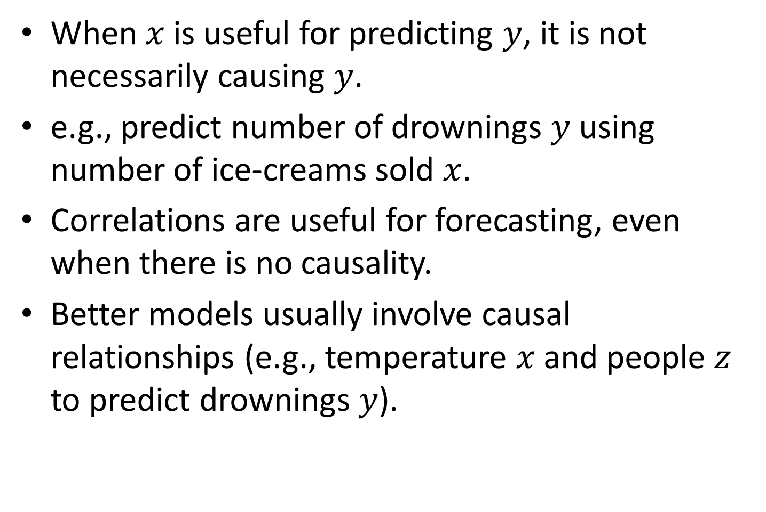
Correlation is not causation
When $x$ is useful for predicting $y$, it is not necessarily causing $y$.
e.g., predict number of drownings $y$ using number of ice-creams sold $x$.
Correlations are useful for forecasting, even when there is no causality.
Better models usually involve causal relationships (e.g., temperature $x$ and people $z$ to predict drownings $y$).

Slide 68
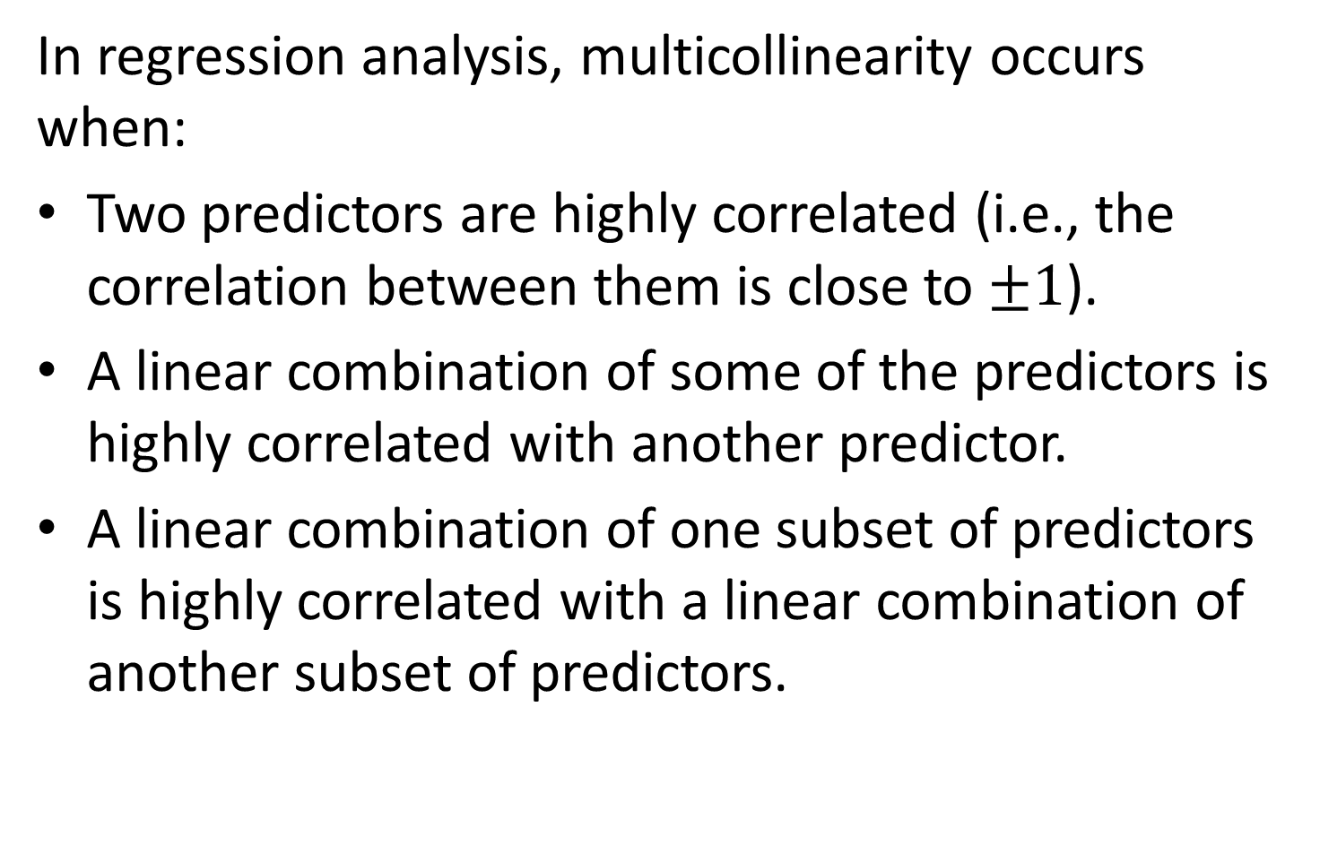
Multicollinearity
In regression analysis, multicollinearity occurs when:
Two predictors are highly correlated (i.e., the correlation between them is close to $±1$).
A linear combination of some of the predictors is highly correlated with another predictor.
A linear combination of one subset of predictors is highly correlated with a linear combination of another subset of predictors.

Slide 69
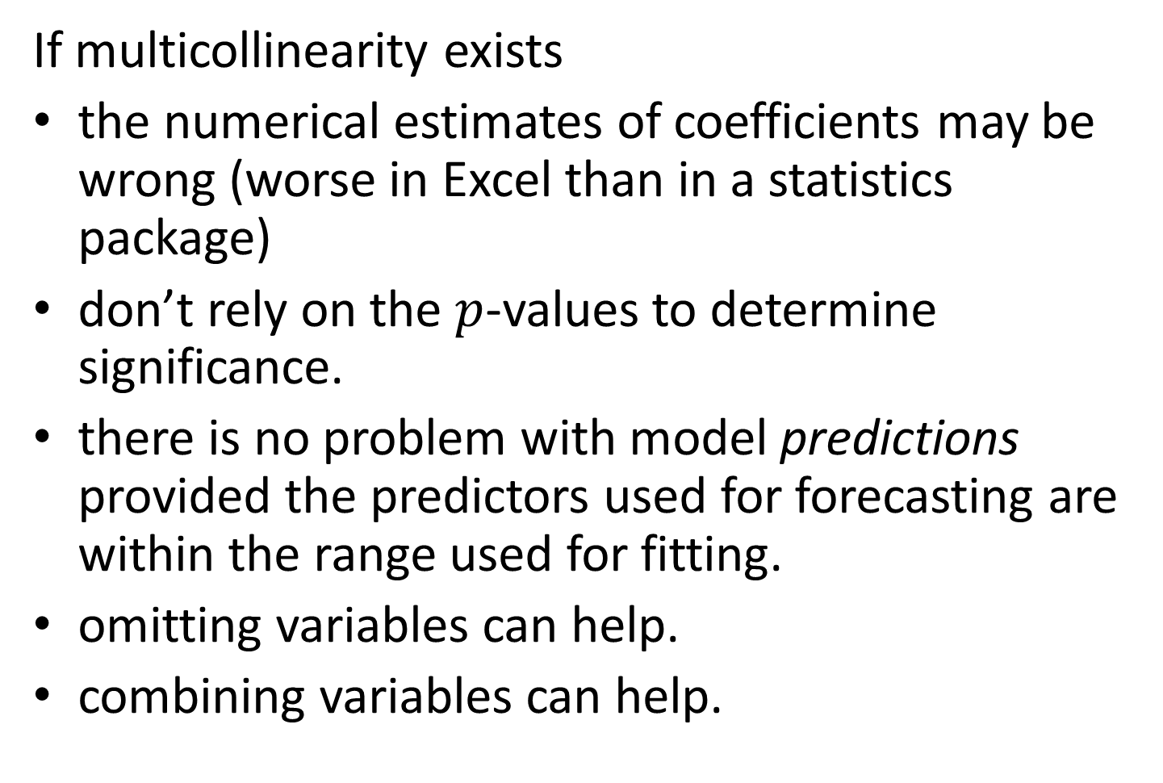
Multicollinearity
If multicollinearity exists
the numerical estimates of coefficients may be wrong (worse in Excel than in a statistics package)
don’t rely on the $p$-values to determine significance.
there is no problem with model predictions provided the predictors used for forecasting are within the range used for fitting.
omitting variables can help.
combining variables can help.

