Slide 1
Time Series Analysis and Forecasting
Ch8. Exponential smoothing

Slide 2
Exponential smoothing

Slide 3
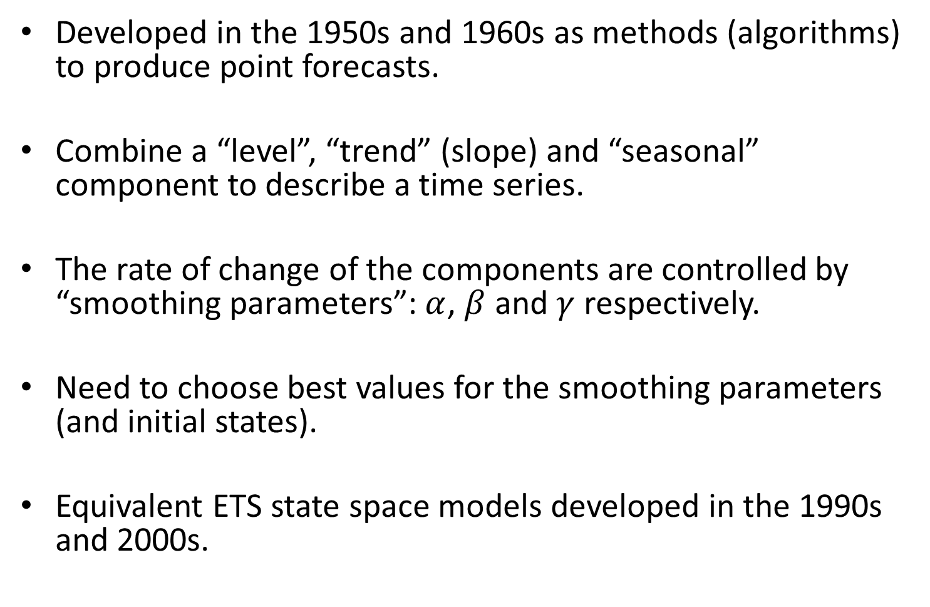
Historical perspective
Developed in the 1950s and 1960s as methods (algorithms) to produce point forecasts.
Combine a “level”, “trend” (slope) and “seasonal” component to describe a time series.
The rate of change of the components are controlled by “smoothing parameters”: $α$, $β$ and $γ$ respectively.
Need to choose best values for the smoothing parameters (and initial states).
Equivalent ETS state space models developed in the 1990s and 2000s.

Slide 4
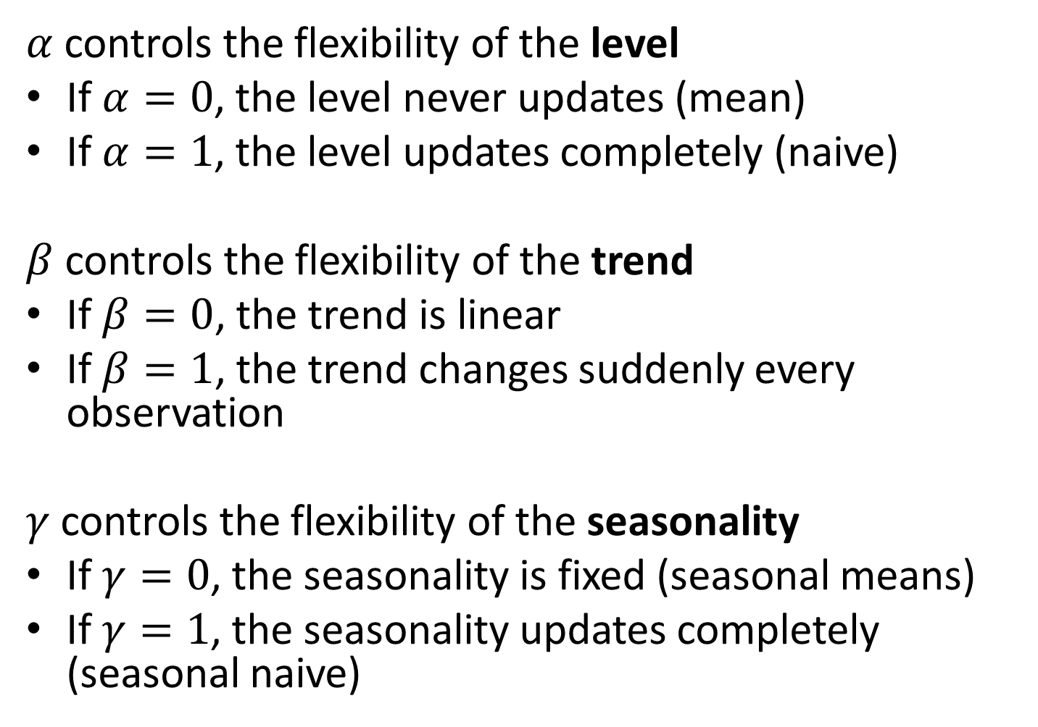
Big idea: control the rate of change
$α$ controls the flexibility of the level
If $α=0$, the level never updates (mean)
If $α=1$, the level updates completely (naive)
$β$ controls the flexibility of the trend
If $β=0$, the trend is linear
If $β=1$, the trend changes suddenly every observation
$γ$ controls the flexibility of the seasonality
If $γ=0$, the seasonality is fixed (seasonal means)
If $γ=1$, the seasonality updates completely (seasonal naive)

Slide 5
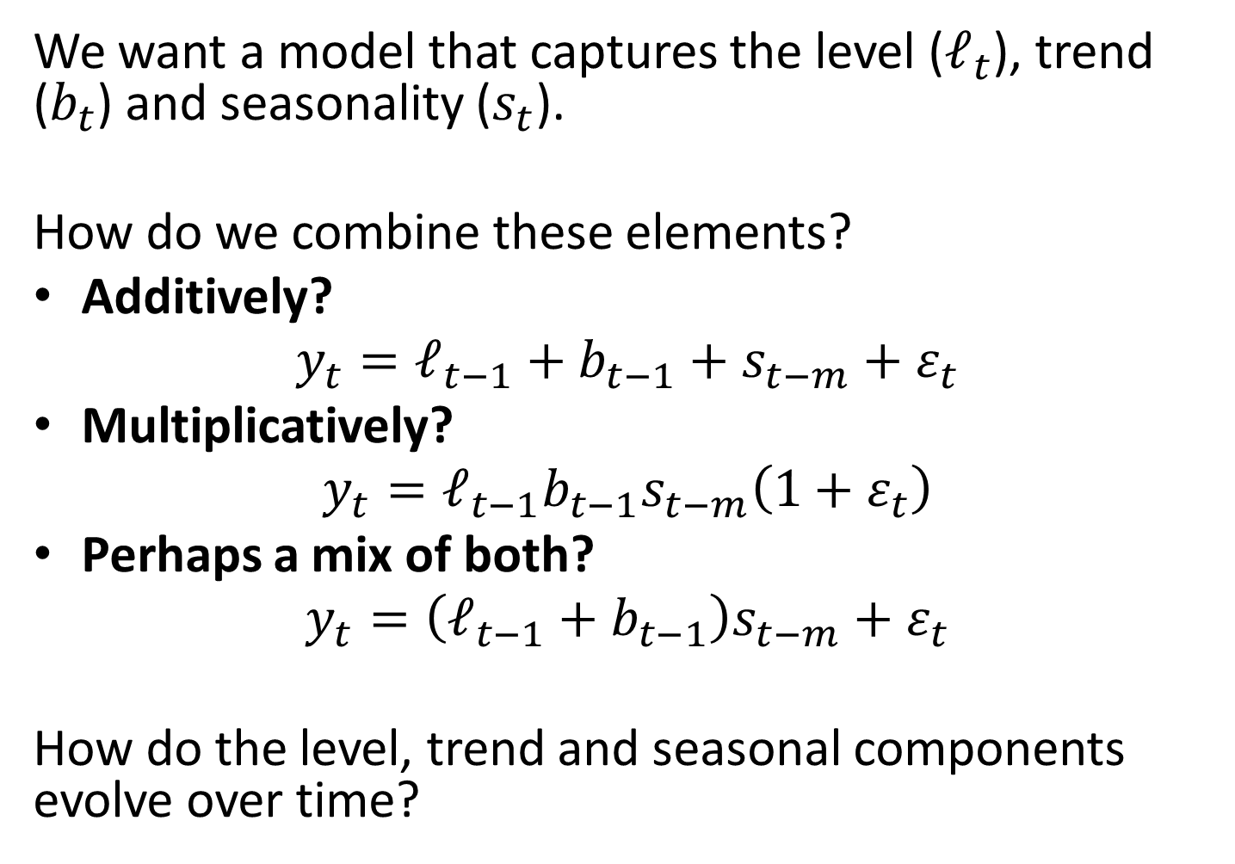
A model for levels, trends, and seasonalities
We want a model that captures the level ($ℓ_{t}$), trend ($b_{t}$) and seasonality ($s_{t}$).
How do we combine these elements?
Additively?
$$y_{t}=ℓ_{t−1}+b_{t−1}+s_{t−m}+ε_{t}$$
Multiplicatively?
$$y_{t}=ℓ_{t−1}b_{t−1}s_{t−m}\left(1+ε_{t}\right)$$
Perhaps a mix of both?
$$y_{t}=\left(ℓ_{t−1}+b_{t−1}\right)s_{t−m}+ε_{t}$$
How do the level, trend and seasonal components evolve over time?

Slide 6
ETS models
Error:
Additive ("A")
Multiplicative ("M")
Trend:
None ("N")
Additive ("A"),
Multiplicative ("M"),
Damped ("Ad" or "Md").
Seasonality:
None ("N"),
Additive ("A")
Multiplicative ("M")
General notation:
E T S : ExponenTial Smoothing
Error Trend Season

Slide 7
Simple exponential smoothing

Slide 8
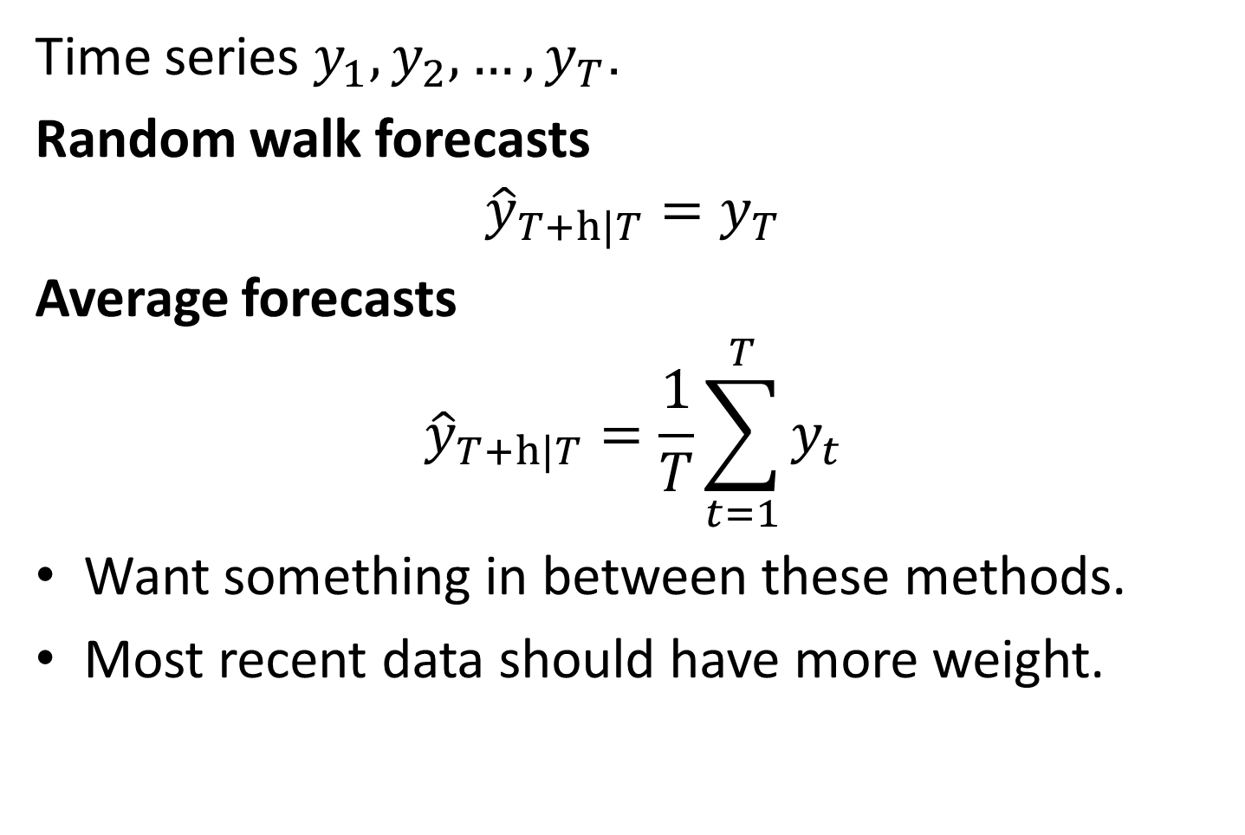
Simple methods
Time series $y_{1},y_{2},…,y_{T}$.
Random walk forecasts
$${\hat{y}}_{T+h|T}=y_{T}$$
Average forecasts
$${\hat{y}}_{T+h|T}=\frac{1}{T}\sum_{t=1}^{T}{y_{t}}$$
Want something in between these methods.
Most recent data should have more weight.

Slide 9
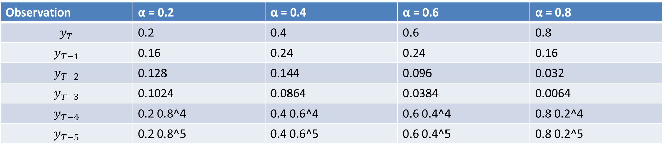
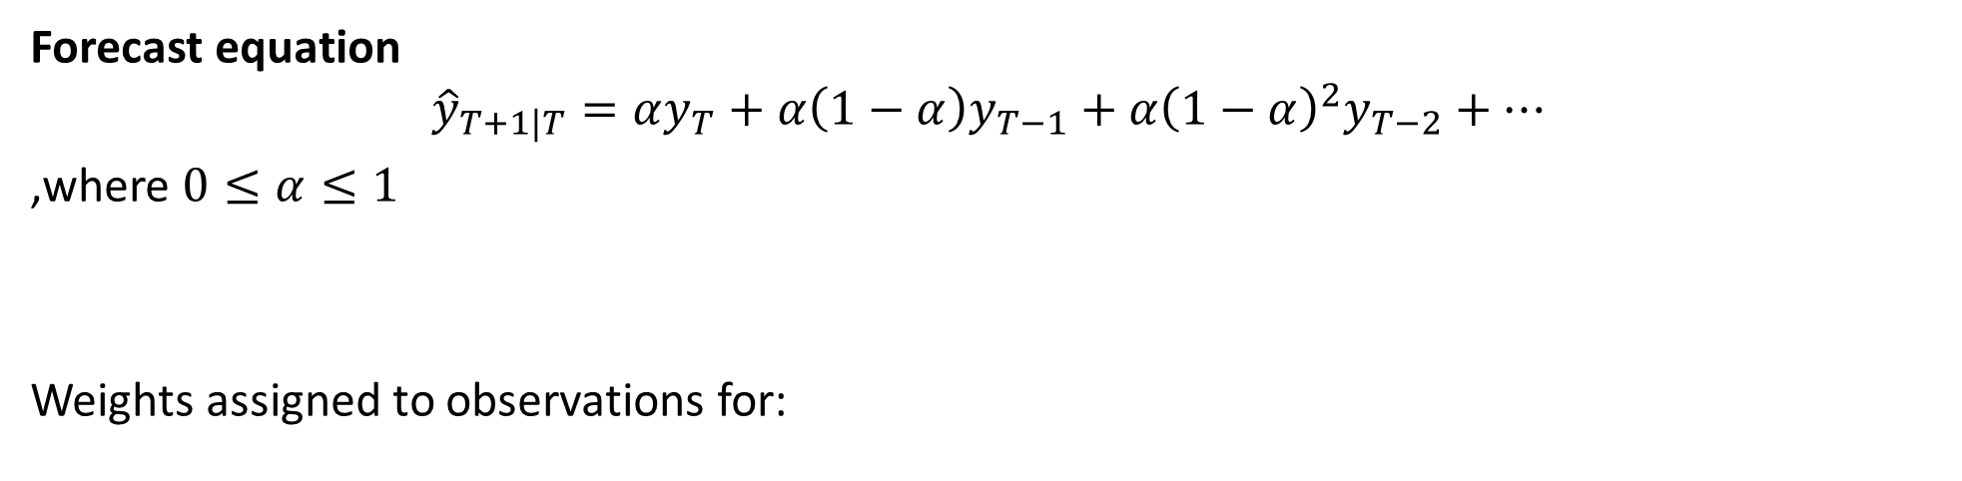
Simple Exponential Smoothing
Forecast equation
$${\hat{y}}_{T+1|T}=αy_{T}+α\left(1−α\right)y_{T−1}+α{\left(1−α\right)}^{2}y_{T−2}+⋯$$
,where $0≤α≤1$
Weights assigned to observations for:
Observation | α = 0.2 | α = 0.4 | α = 0.6 | α = 0.8
$$y_{T}$$ | 0.2 | 0.4 | 0.6 | 0.8
$$y_{T−1}$$ | 0.16 | 0.24 | 0.24 | 0.16
$$y_{T−2}$$ | 0.128 | 0.144 | 0.096 | 0.032
$$y_{T−3}$$ | 0.1024 | 0.0864 | 0.0384 | 0.0064
$$y_{T−4}$$ | 0.2 0.8^4 | 0.4 0.6^4 | 0.6 0.4^4 | 0.8 0.2^4
$$y_{T−5}$$ | 0.2 0.8^5 | 0.4 0.6^5 | 0.6 0.4^5 | 0.8 0.2^5

Slide 10
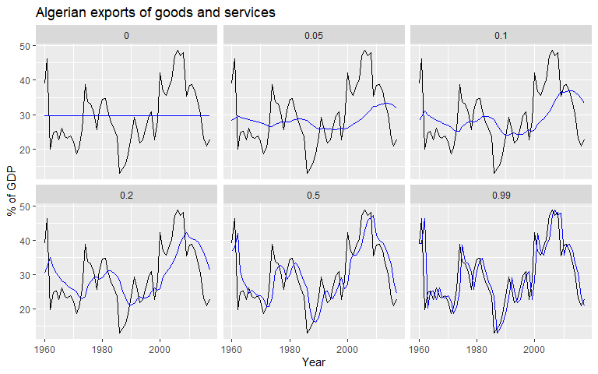
Simple Exponential Smoothing

Slide 11
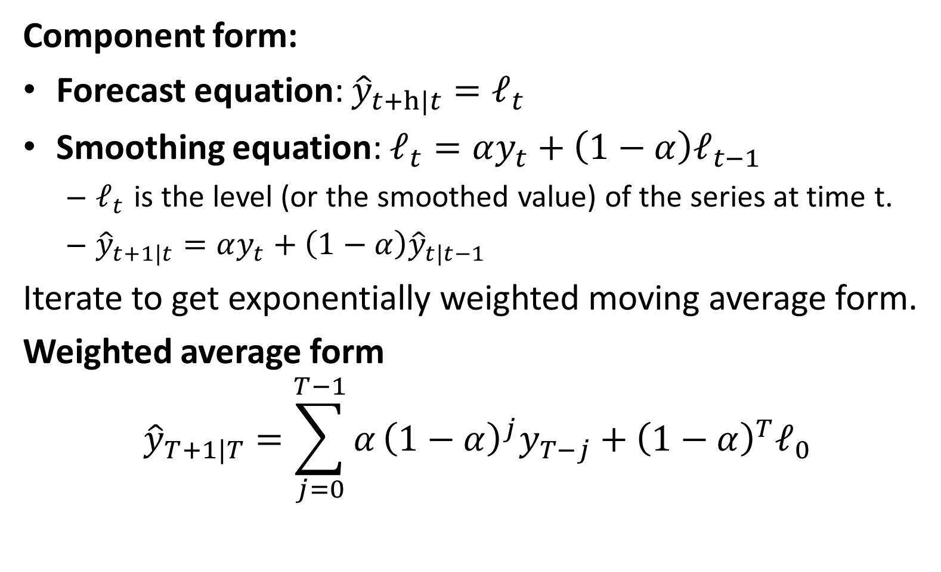
Simple Exponential Smoothing
Component form:
Forecast equation: ${\hat{y}}_{t+h|t}=ℓ_{t}$
Smoothing equation: $ℓ_{t}=αy_{t}+\left(1−α\right)ℓ_{t−1}$
$ℓ_{t}$ is the level (or the smoothed value) of the series at time t.
${\hat{y}}_{t+1|t}=αy_{t}+\left(1−α\right){\hat{y}}_{t|t−1}$
Iterate to get exponentially weighted moving average form.
Weighted average form
$${\hat{y}}_{T+1|T}=\sum_{j=0}^{T−1}{α}{\left(1−α\right)}^{j}y_{T−j}+{\left(1−α\right)}^{T}ℓ_{0}$$

Slide 12
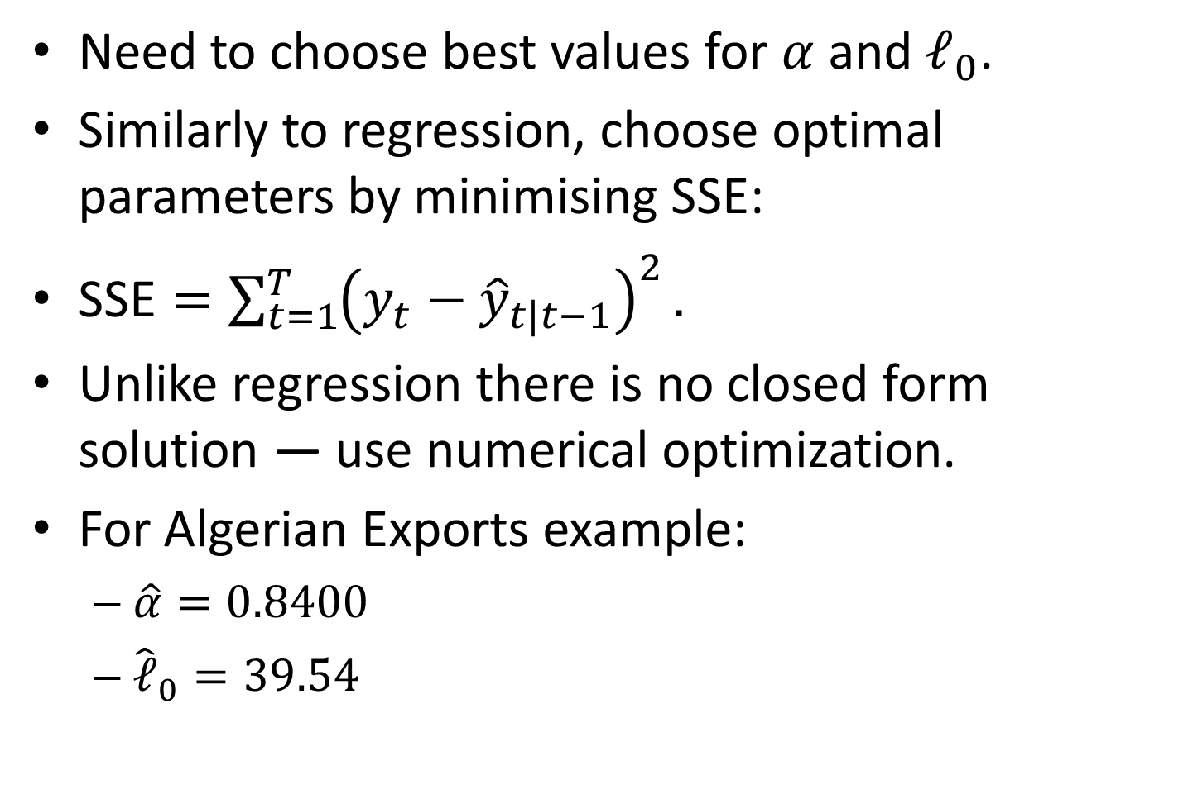
Optimising smoothing parameters
Need to choose best values for $α$ and $ℓ_{0}$.
Similarly to regression, choose optimal parameters by minimising SSE:
$\text{SSE}=\sum_{t=1}^{T}{{\left(y_{t}−{\hat{y}}_{t|t−1}\right)}^{2}}.$
Unlike regression there is no closed form solution — use numerical optimization.
For Algerian Exports example:
$\hat{α}=0.8400$
${\hat{ℓ}}_{0}=39.54$

Slide 13
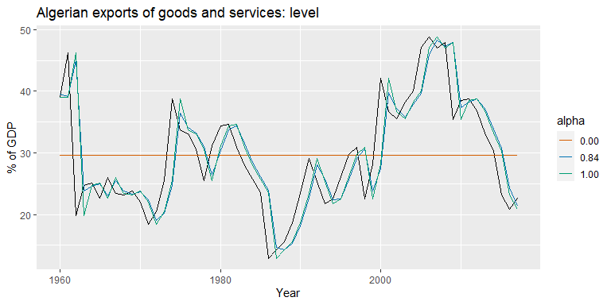
Simple Exponential Smoothing

Slide 14
Models and methods
Methods
Algorithms that return point forecasts.
Models
Generate same point forecasts but can also generate forecast distributions.
A stochastic (or random) data generating process that can generate an entire forecast distribution.
Allow for “proper” model selection.

Slide 15
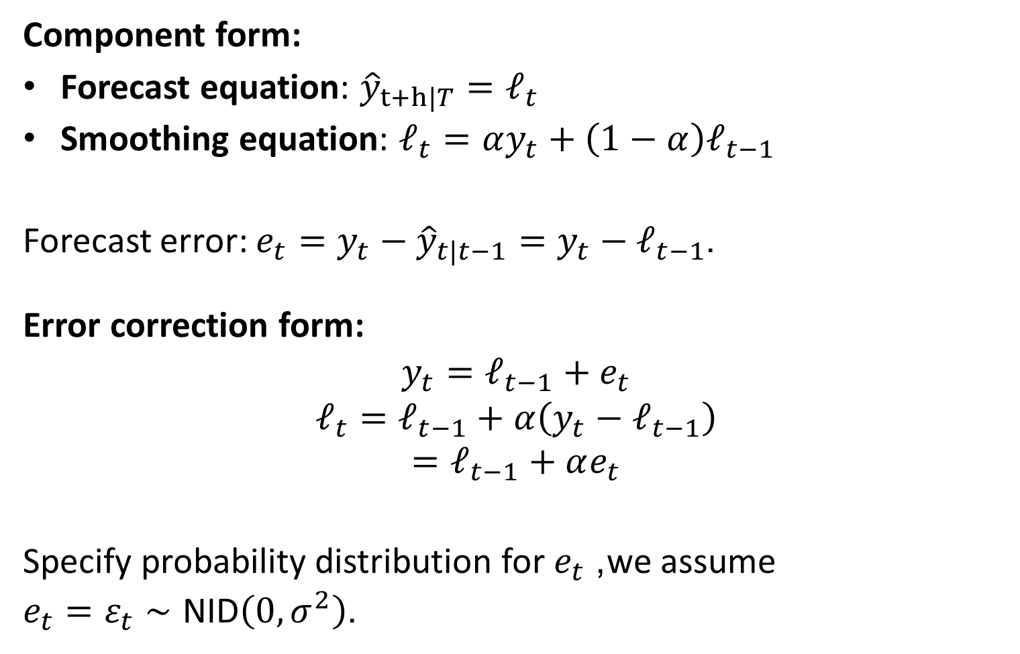
ETS(A,N,N): SES with additive errors
Component form:
Forecast equation: ${\hat{y}}_{t+h|T}=ℓ_{t}$
Smoothing equation: $ℓ_{t}=αy_{t}+\left(1−α\right)ℓ_{t−1}$
Forecast error: $e_{t}=y_{t}−{\hat{y}}_{t|t−1}=y_{t}−ℓ_{t−1}$.
Error correction form:
$$y_{t}=ℓ_{t−1}+e_{t}$$
$$ℓ_{t}=ℓ_{t−1}+α\left(y_{t}−ℓ_{t−1}\right)$$
$$=ℓ_{t−1}+αe_{t}$$
Specify probability distribution for $e_{t}$, we assume
$e_{t}=ε_{t}∼\text{NID}\left(0,σ^{2}\right)$.

Slide 16
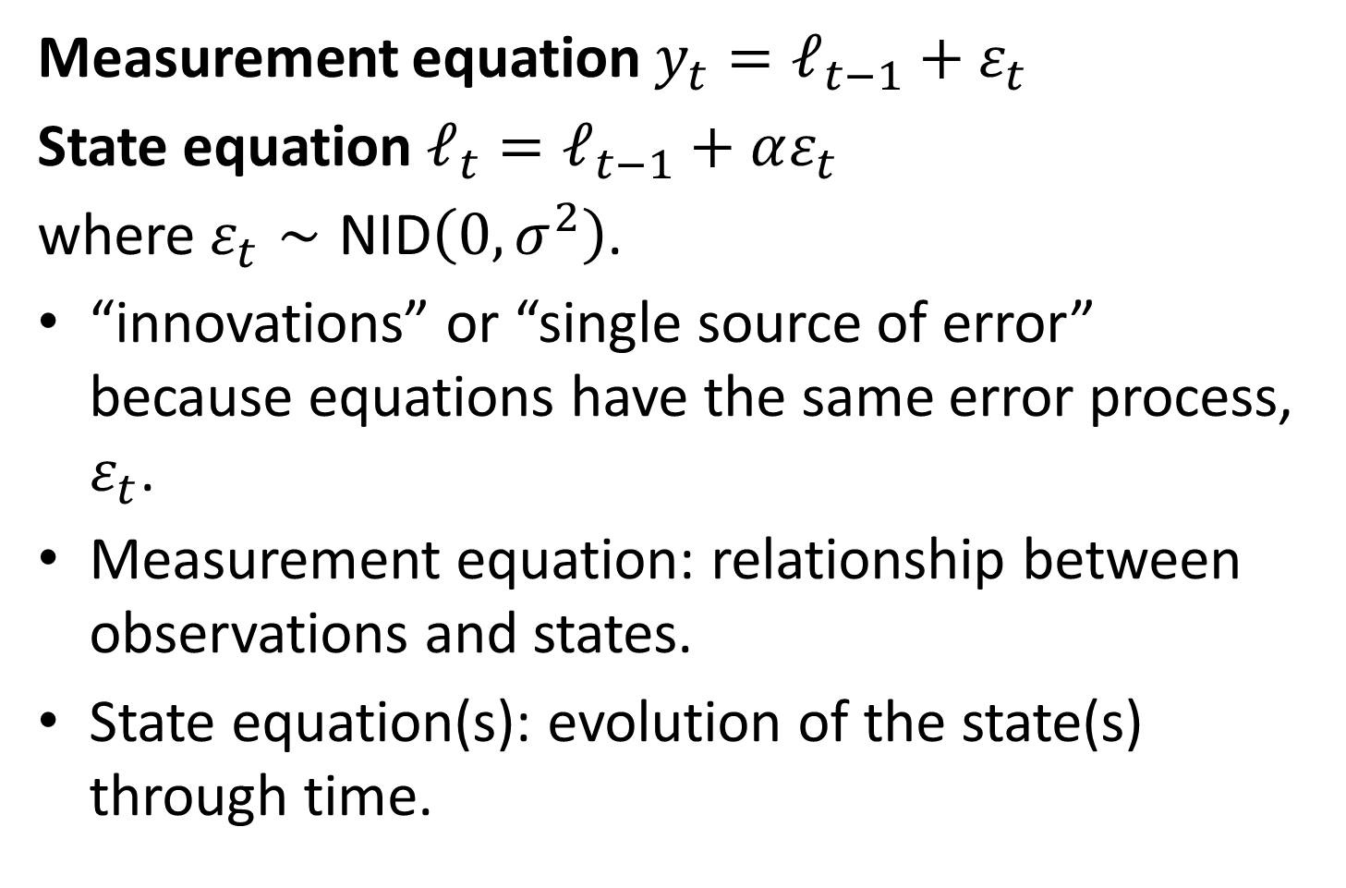
ETS(A,N,N): SES with additive errors
Measurement equation $y_{t}=ℓ_{t−1}+ε_{t}$
State equation $ℓ_{t}=ℓ_{t−1}+αε_{t}$
where $ε_{t}∼\text{NID}\left(0,σ^{2}\right)$.
“innovations” or “single source of error” because equations have the same error process, $ε_{t}$.
Measurement equation: relationship between observations and states.
State equation(s): evolution of the state(s) through time.

Slide 17
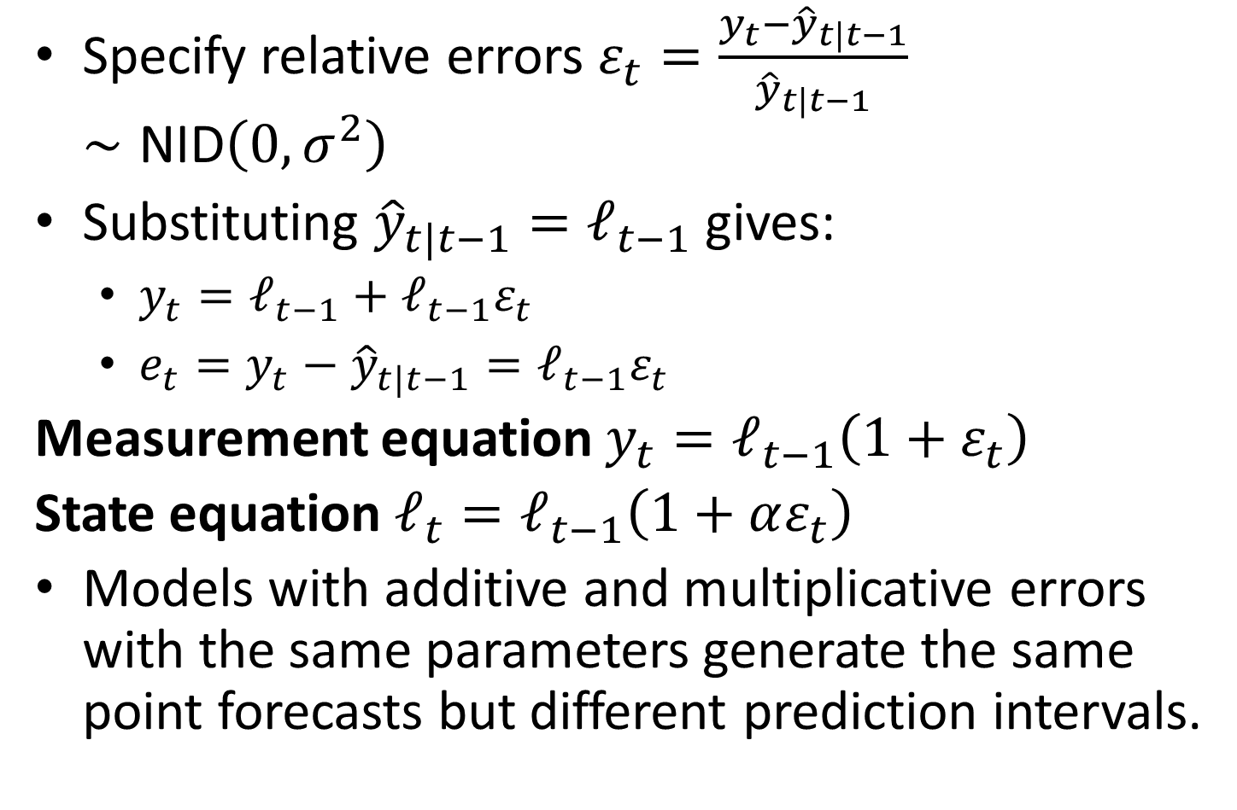
ETS(M,N,N): SES with multiplicative errors.
Specify relative errors $ε_{t}=\frac{y_{t}−{\hat{y}}_{t|t−1}}{{\hat{y}}_{t|t−1}}∼\text{NID}\left(0,σ^{2}\right)$
Substituting ${\hat{y}}_{t|t−1}=ℓ_{t−1}$ gives:
$y_{t}=ℓ_{t−1}+ℓ_{t−1}ε_{t}$
$e_{t}=y_{t}−{\hat{y}}_{t|t−1}=ℓ_{t−1}ε_{t}$
Measurement equation $y_{t}=ℓ_{t−1}\left(1+ε_{t}\right)$
State equation $ℓ_{t}=ℓ_{t−1}\left(1+αε_{t}\right)$
Models with additive and multiplicative errors with the same parameters generate the same point forecasts but different prediction intervals.

Slide 18
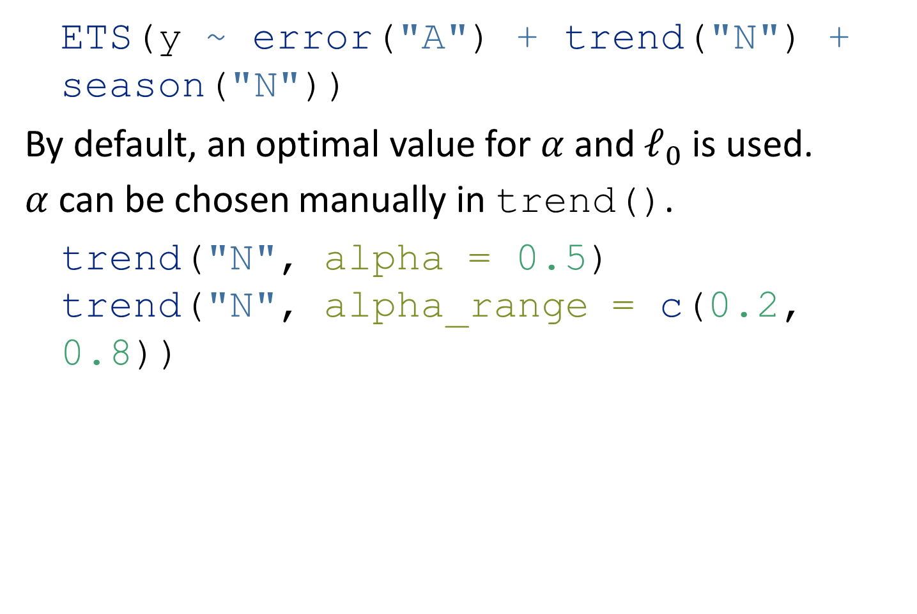
ETS(A,N,N): Specifying the model
ETS(y ~ error("A") + trend("N") + season("N"))
By default, an optimal value for $α$ and $ℓ_{0}$ is used.
$α$ can be chosen manually in trend().
trend("N", alpha = 0.5) trend("N", alpha_range = c(0.2, 0.8))

Slide 19
Example: Algerian Exports
algeria_economy <- global_economy %>% filter(Country == "Algeria") fit <- algeria_economy %>% model(ANN = ETS(Exports ~ error("A") + trend("N") + season("N"))) report(fit)
## Series: Exports ## Model: ETS(A,N,N) ## Smoothing parameters: ## alpha = 0.84 ## ## Initial states: ## l[0] ## 39.5 ## ## sigma^2: 35.6 ## ## AIC AICc BIC ## 447 447 453

Slide 20
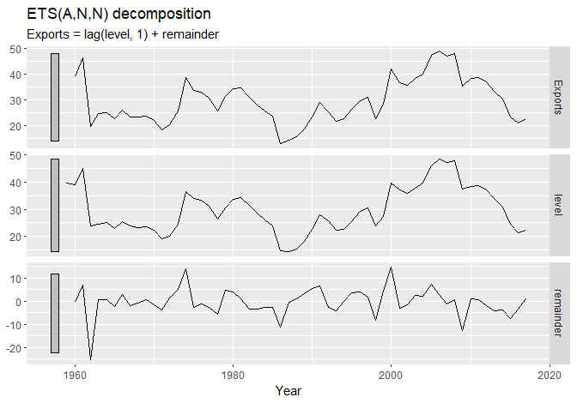
Example: Algerian Exports
components(fit) %>% autoplot()

Slide 21
Example: Algerian Exports
components(fit) %>% left_join(fitted(fit), by = c("Country", ".model", "Year"))
## # A dable: 59 x 7 [1Y] ## # Key: Country, .model [1] ## # : Exports = lag(level, 1) + remainder ## Country .model Year Exports level remainder .fitted ## <fct> <chr> <dbl> <dbl> <dbl> <dbl> <dbl> ## 1 Algeria ANN 1959 NA 39.5 NA NA ## 2 Algeria ANN 1960 39.0 39.1 -0.496 39.5 ## 3 Algeria ANN 1961 46.2 45.1 7.12 39.1 ## 4 Algeria ANN 1962 19.8 23.8 -25.3 45.1 ## 5 Algeria ANN 1963 24.7 24.6 0.841 23.8 ## 6 Algeria ANN 1964 25.1 25.0 0.534 24.6 ## 7 Algeria ANN 1965 22.6 23.0 -2.39 25.0 ## 8 Algeria ANN 1966 26.0 25.5 3.00 23.0 ## 9 Algeria ANN 1967 23.4 23.8 -2.07 25.5 ## 10 Algeria ANN 1968 23.1 23.2 -0.630 23.8 ## # … with 49 more rows

Slide 22
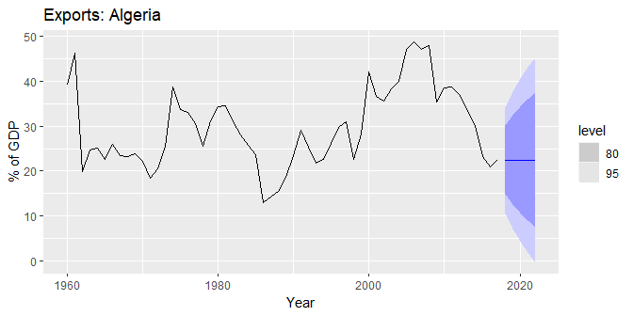
Example: Algerian Exports
fit %>% forecast(h = 5) %>% autoplot(algeria_economy) + labs(y = "% of GDP", title = "Exports: Algeria")

Slide 23
Models with trend

Slide 24
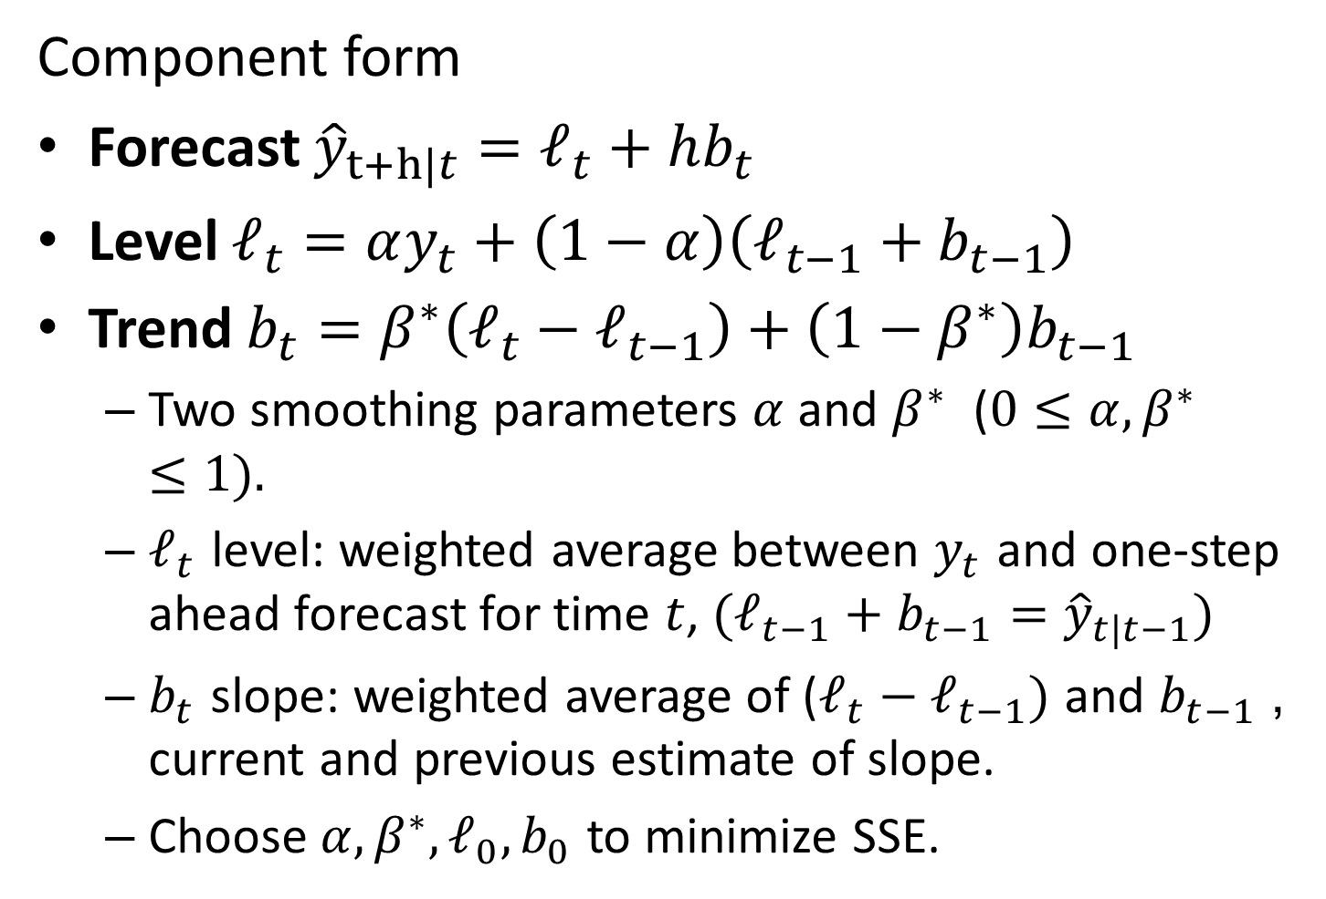
Holt’s linear trend
Component form
Forecast ${\hat{y}}_{t+h|t}=ℓ_{t}+hb_{t}$
Level $ℓ_{t}=αy_{t}+\left(1−α\right)\left(ℓ_{t−1}+b_{t−1}\right)$
Trend $b_{t}=β^{∗}\left(ℓ_{t}−ℓ_{t−1}\right)+\left(1−β^{∗}\right)b_{t−1}$
Two smoothing parameters $α$ and $β^{∗}$ ($0≤α,β^{∗}≤1)$.
$ℓ_{t}$ level: weighted average between $y_{t}$ and one-step ahead forecast for time $t$, $(ℓ_{t−1}+b_{t−1}={\hat{y}}_{t|t−1})$
$b_{t}$ slope: weighted average of ($ℓ_{t}−ℓ_{t−1})$ and $b_{t−1}$, current and previous estimate of slope.
Choose $α,β^{∗},ℓ_{0},b_{0}$ to minimize SSE.

Slide 25
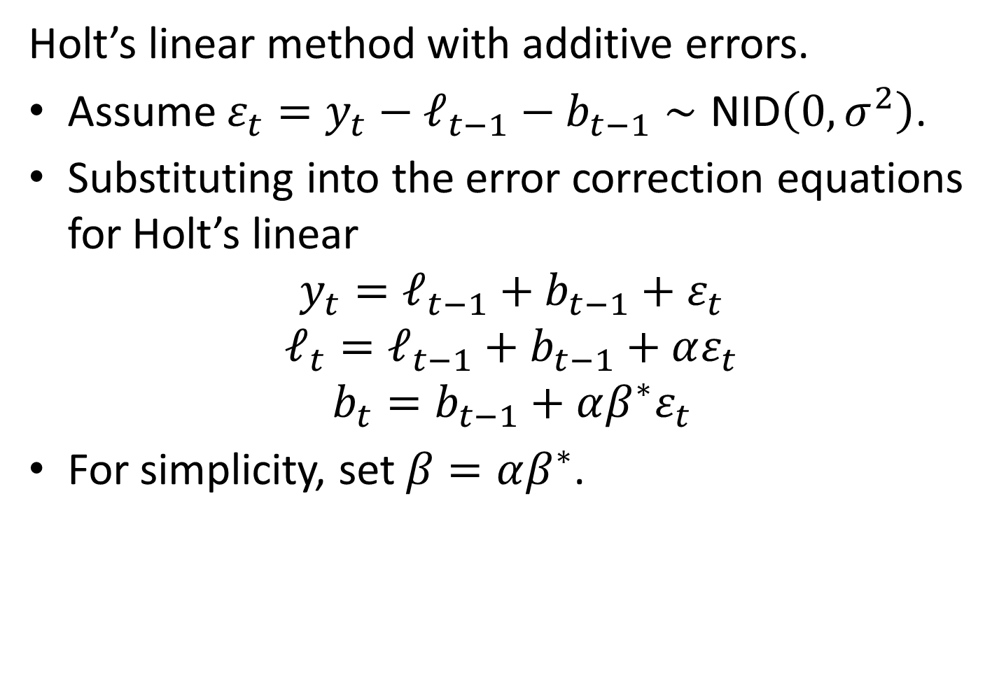
ETS(A,A,N)
Holt’s linear method with additive errors.
Assume $ε_{t}=y_{t}−ℓ_{t−1}−b_{t−1}∼\text{NID}\left(0,σ^{2}\right)$.
Substituting into the error correction equations for Holt’s linear
$$y_{t}=ℓ_{t−1}+b_{t−1}+ε_{t}$$
$$ℓ_{t}=ℓ_{t−1}+b_{t−1}+αε_{t}$$
$$b_{t}=b_{t−1}+αβ^{∗}ε_{t}$$
For simplicity, set $β=αβ^{∗}$.

Slide 26
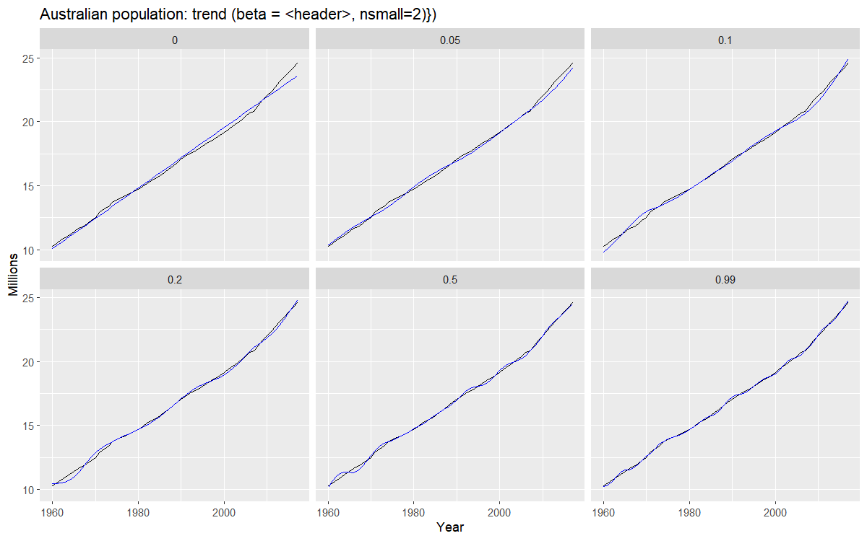
Exponential smoothing: trend/slope

Slide 27
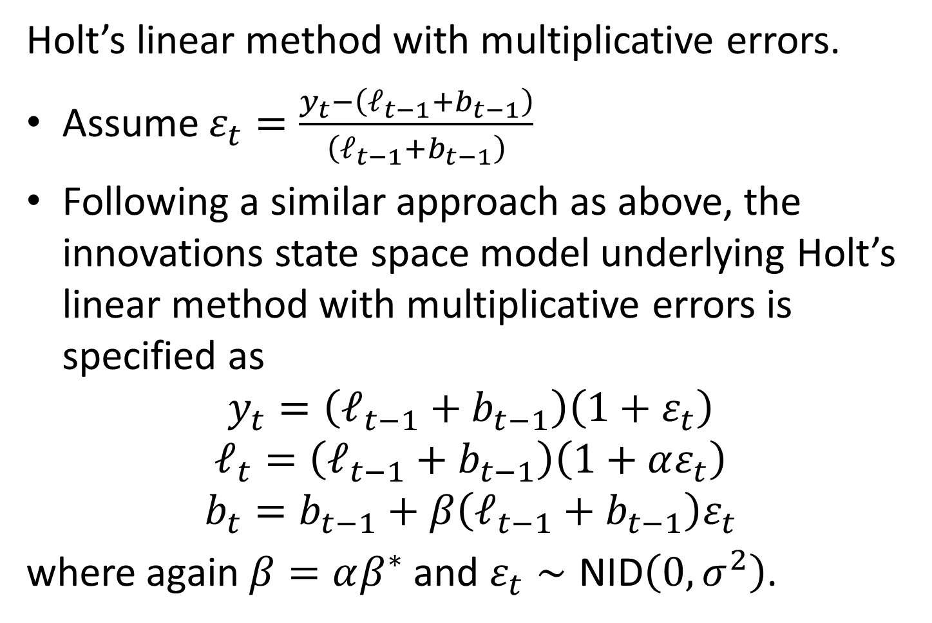
ETS(M,A,N)
Holt’s linear method with multiplicative errors.
Assume $ε_{t}=\frac{y_{t}−\left(ℓ_{t−1}+b_{t−1}\right)}{\left(ℓ_{t−1}+b_{t−1}\right)}$
Following a similar approach as above, the innovations state space model underlying Holt’s linear method with multiplicative errors is specified as
$$y_{t}=\left(ℓ_{t−1}+b_{t−1}\right)\left(1+ε_{t}\right)$$
$$ℓ_{t}=\left(ℓ_{t−1}+b_{t−1}\right)\left(1+αε_{t}\right)$$
$$b_{t}=b_{t−1}+β\left(ℓ_{t−1}+b_{t−1}\right)ε_{t}$$
where again $β=αβ^{∗}$ and $ε_{t}∼\text{NID}\left(0,σ^{2}\right)$.

Slide 28
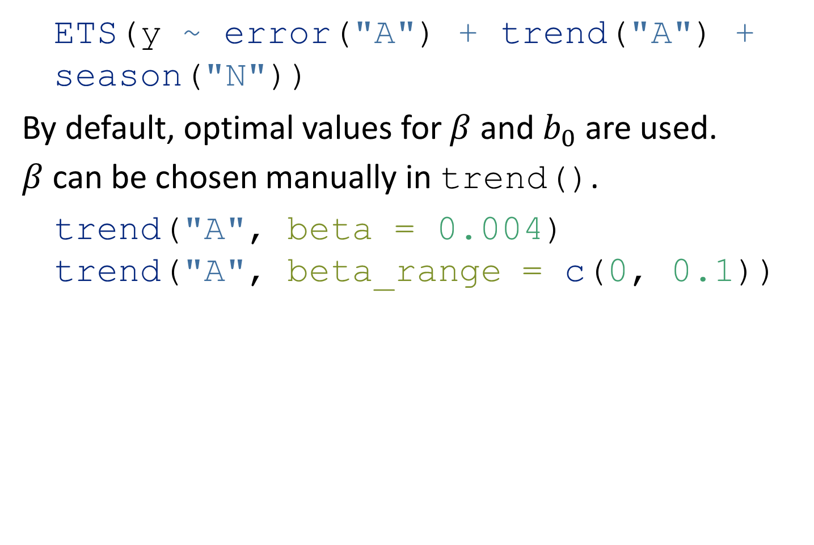
ETS(A,A,N): Specifying the model
ETS(y ~ error("A") + trend("A") + season("N"))
By default, optimal values for $β$ and $b_{0}$ are used.
$β$ can be chosen manually in trend().
trend("A", beta = 0.004) trend("A", beta_range = c(0, 0.1))

Slide 29
Example: Australian population
aus_economy <- global_economy %>% filter(Code == "AUS") %>% mutate(Pop = Population / 1e6) fit <- aus_economy %>% model(AAN = ETS(Pop ~ error("A") + trend("A") + season("N"))) report(fit)
## Series: Pop ## Model: ETS(A,A,N) ## Smoothing parameters: ## alpha = 1 ## beta = 0.327 ## ## Initial states: ## l[0] b[0] ## 10.1 0.222 ## ## sigma^2: 0.0041 ## ## AIC AICc BIC ## -77.0 -75.8 -66.7

Slide 30
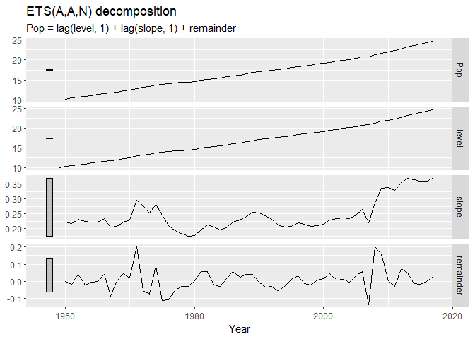
Example: Australian population
components(fit) %>% autoplot()

Slide 31
Example: Australian population
components(fit) %>% left_join(fitted(fit), by = c("Country", ".model", "Year"))
## # A dable: 59 x 8 [1Y] ## # Key: Country, .model [1] ## # : Pop = lag(level, 1) + lag(slope, 1) + remainder ## Country .model Year Pop level slope remainder .fitted ## <fct> <chr> <dbl> <dbl> <dbl> <dbl> <dbl> <dbl> ## 1 Australia AAN 1959 NA 10.1 0.222 NA NA ## 2 Australia AAN 1960 10.3 10.3 0.222 -0.000145 10.3 ## 3 Australia AAN 1961 10.5 10.5 0.217 -0.0159 10.5 ## 4 Australia AAN 1962 10.7 10.7 0.231 0.0418 10.7 ## 5 Australia AAN 1963 11.0 11.0 0.223 -0.0229 11.0 ## 6 Australia AAN 1964 11.2 11.2 0.221 -0.00641 11.2 ## 7 Australia AAN 1965 11.4 11.4 0.221 -0.000314 11.4 ## 8 Australia AAN 1966 11.7 11.7 0.235 0.0418 11.6 ## 9 Australia AAN 1967 11.8 11.8 0.206 -0.0869 11.9 ## 10 Australia AAN 1968 12.0 12.0 0.208 0.00350 12.0 ## # … with 49 more rows

Slide 32
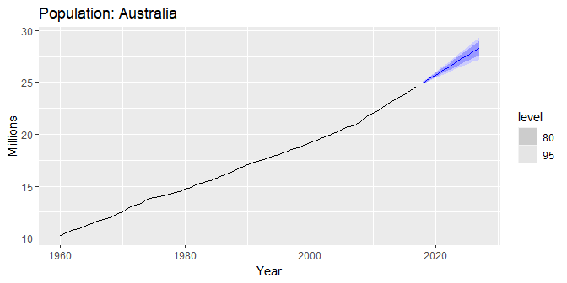
Example: Australian population
fit %>% forecast(h = 10) %>% autoplot(aus_economy) + labs(y = "Millions", title = "Population: Australia")

Slide 33
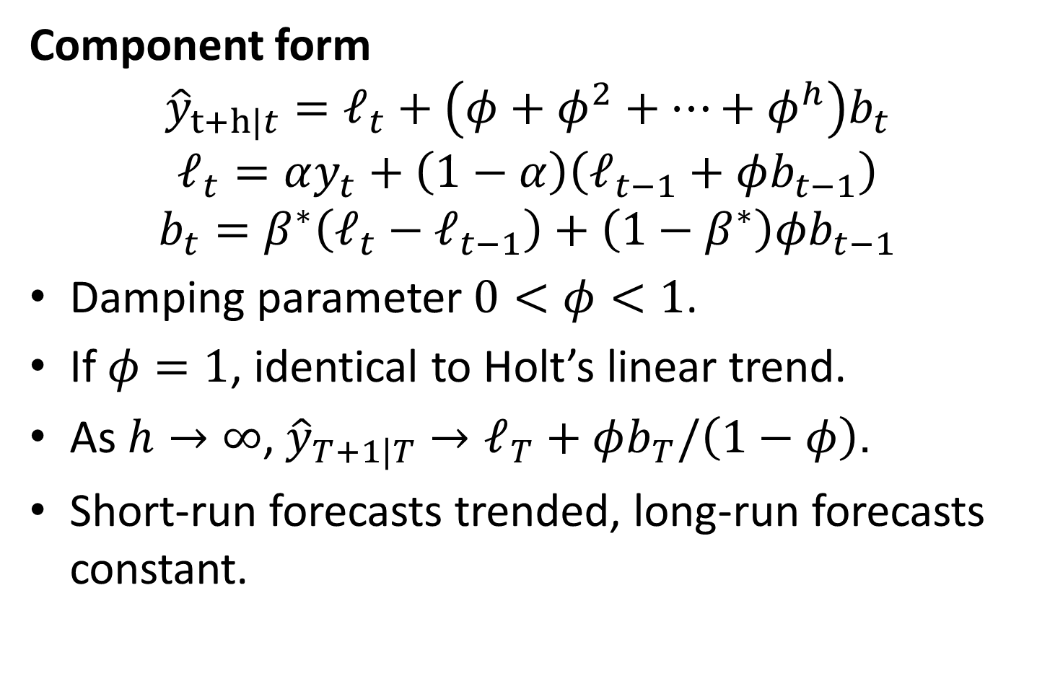
Damped trend method
Component form
$${\hat{y}}_{t+h|t}=ℓ_{t}+\left(φ+φ^{2}+…+φ^{h}\right)b_{t}$$
$$ℓ_{t}=αy_{t}+\left(1−α\right)\left(ℓ_{t−1}+φb_{t−1}\right)$$
$$b_{t}=β^{∗}\left(ℓ_{t}−ℓ_{t−1}\right)+\left(1−β^{∗}\right)φb_{t−1}$$
Damping parameter $0<φ<1$.
If $φ=1$, identical to Holt’s linear trend.
As $h→∞$, ${\hat{y}}_{T+1|T}→ℓ_{T}+φb_{T}/\left(1−φ\right)$.
Short-run forecasts trended, long-run forecasts constant.

Slide 34
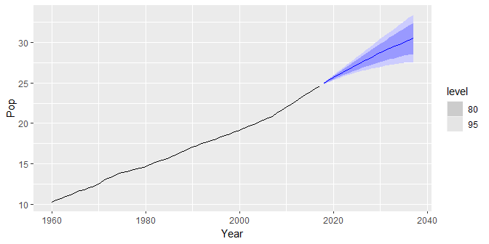
Example: Australian population
aus_economy %>% model(holt = ETS(Pop ~ error("A") + trend("Ad") + season("N"))) %>% forecast(h = 20) %>% autoplot(aus_economy)

Slide 35
Example: Australian population
fit <- aus_economy %>% filter(Year <= 2010) %>% model( ses = ETS(Pop ~ error("A") + trend("N") + season("N")), holt = ETS(Pop ~ error("A") + trend("A") + season("N")), damped = ETS(Pop ~ error("A") + trend("Ad") + season("N")) )
tidy(fit) accuracy(fit)

Slide 36
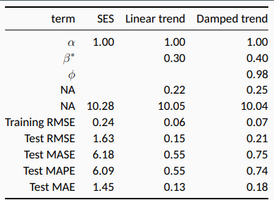

Slide 37
Models with seasonality

Slide 38
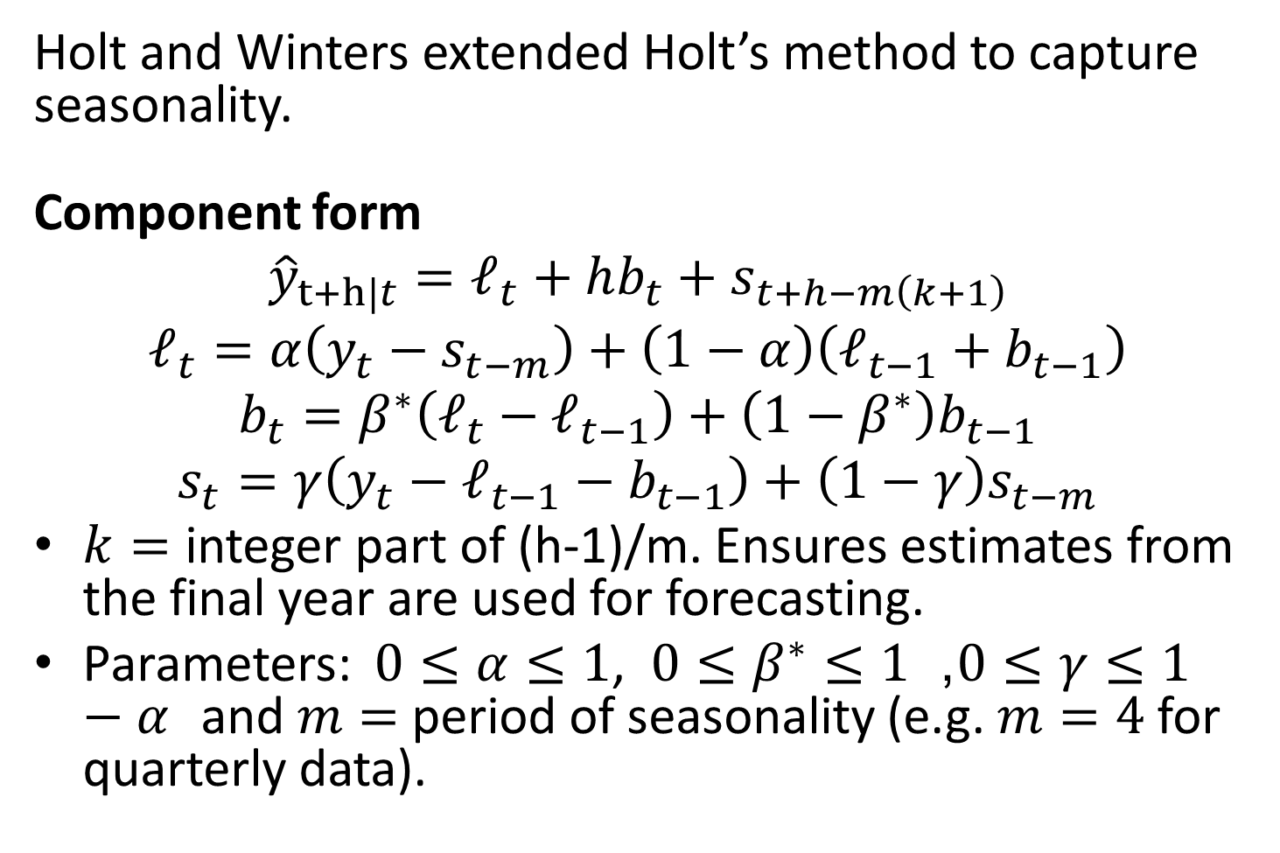
Holt-Winters additive method
Holt and Winters extended Holt’s method to capture seasonality.
Component form
$${\hat{y}}_{t+h|t}=ℓ_{t}+hb_{t}+s_{t+h−m\left(k+1\right)}$$
$$ℓ_{t}=α\left(y_{t}−s_{t−m}\right)+\left(1−α\right)\left(ℓ_{t−1}+b_{t−1}\right)$$
$$b_{t}=β^{∗}\left(ℓ_{t}−ℓ_{t−1}\right)+\left(1−β^{∗}\right)b_{t−1}$$
$$s_{t}=γ\left(y_{t}−ℓ_{t−1}−b_{t−1}\right)+\left(1−γ\right)s_{t−m}$$
$k=$ integer part of (h-1)/m. Ensures estimates from the final year are used for forecasting.
Parameters: $0≤α≤1$, $0≤β^{∗}≤1$, $0≤γ≤1−α$ and $m=$ period of seasonality (e.g. $m=4$ for quarterly data).

Slide 39
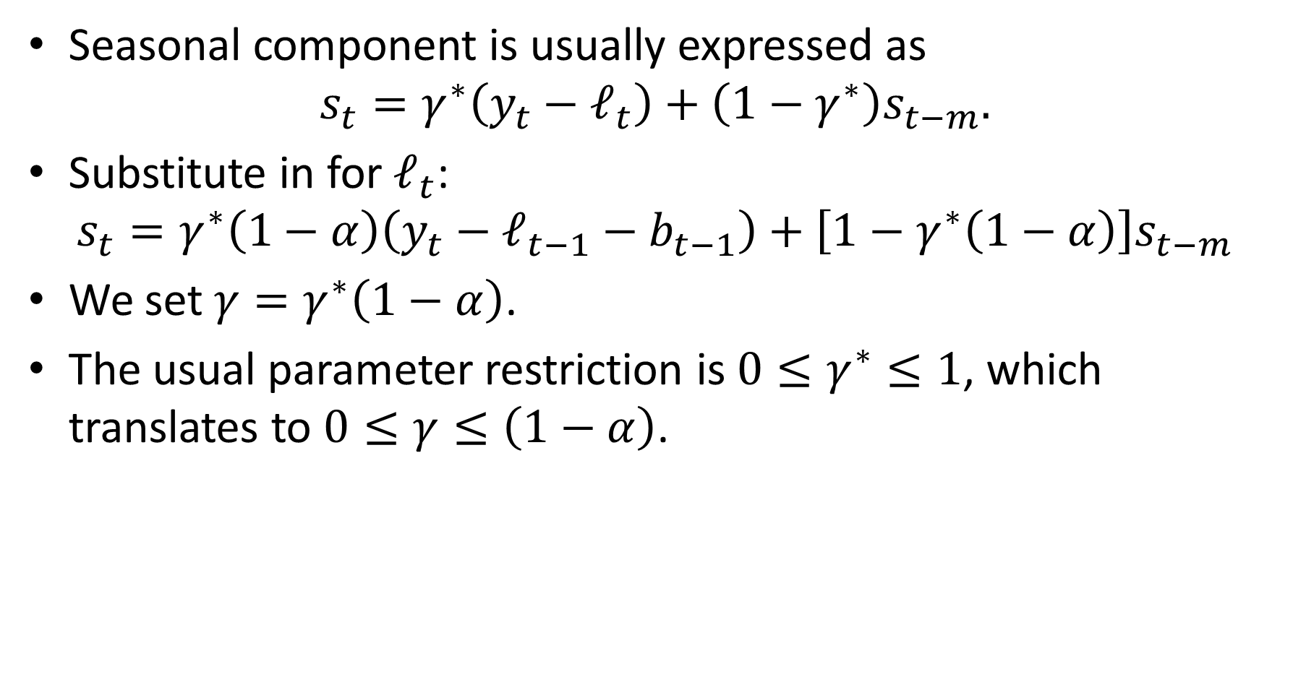
Holt-Winters additive method
Seasonal component is usually expressed as
$$s_{t}=γ^{∗}\left(y_{t}−ℓ_{t}\right)+\left(1−γ^{∗}\right)s_{t−m}.$$
Substitute in for $ℓ_{t}$:
$$s_{t}=γ^{∗}\left(1−α\right)\left(y_{t}−ℓ_{t−1}−b_{t−1}\right)+\left[1−γ^{∗}\left(1−α\right)\right]s_{t−m}$$
We set $γ=γ^{∗}\left(1−α\right)$.
The usual parameter restriction is $0≤γ^{∗}≤1$, which translates to $0≤γ≤\left(1−α\right)$.

Slide 40
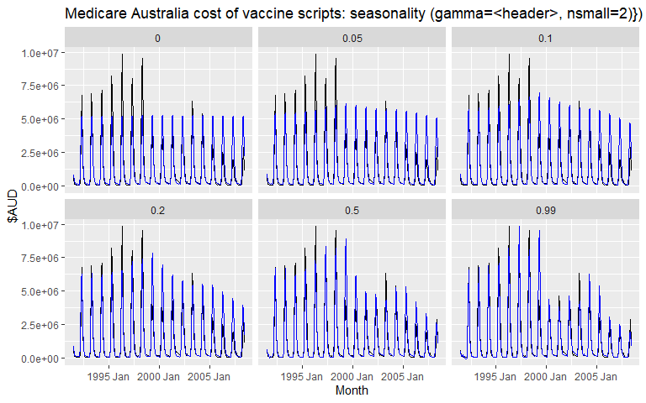
Exponential smoothing: seasonality

Slide 41
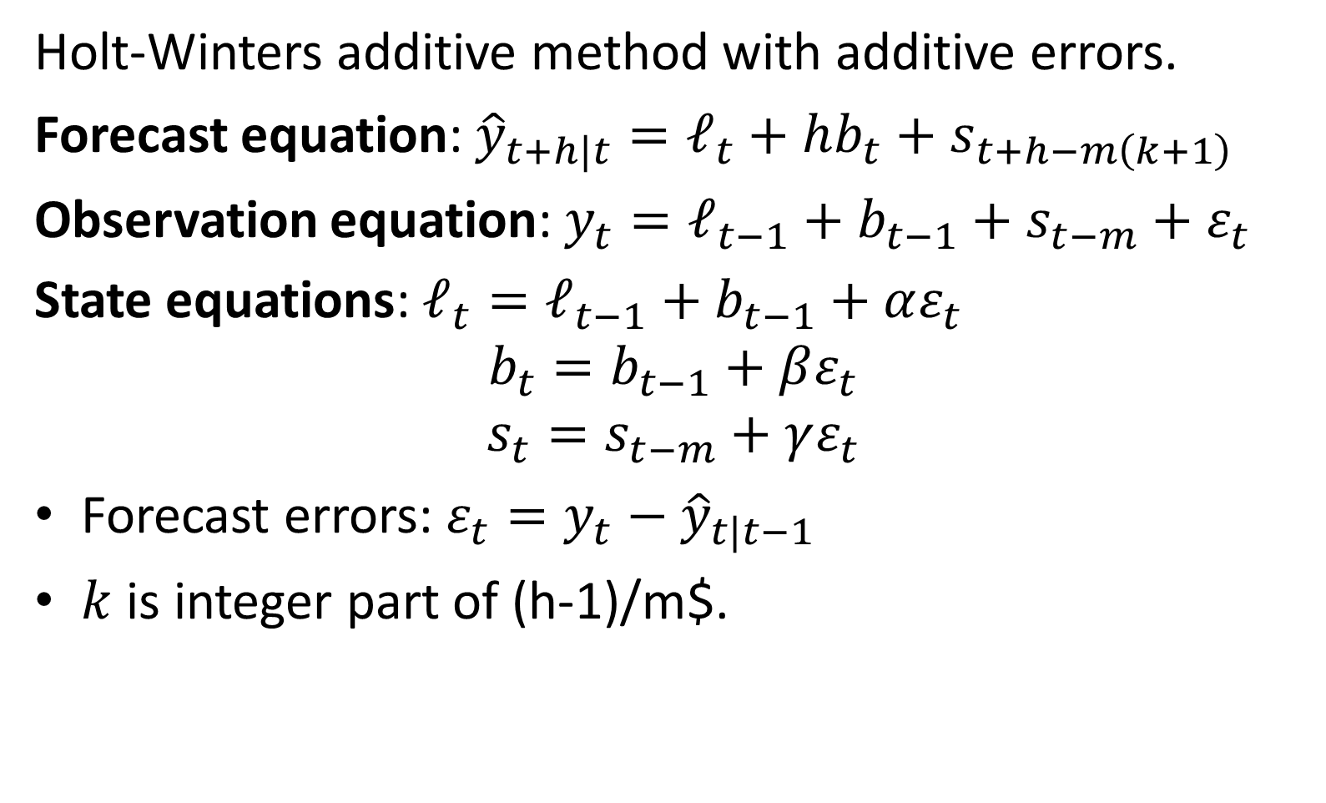
ETS(A,A,A)
Holt-Winters additive method with additive errors.
Forecast equation: ${\hat{y}}_{t+h|t}=ℓ_{t}+hb_{t}+s_{t+h−m\left(k+1\right)}$
Observation equation: $y_{t}=ℓ_{t−1}+b_{t−1}+s_{t−m}+ε_{t}$
State equations: $ℓ_{t}=ℓ_{t−1}+b_{t−1}+αε_{t}$
$$b_{t}=b_{t−1}+βε_{t}$$
$$s_{t}=s_{t−m}+γε_{t}$$
Forecast errors: $ε_{t}=y_{t}−{\hat{y}}_{t|t−1}$
$k$ is integer part of (h-1)/m$.

Slide 42
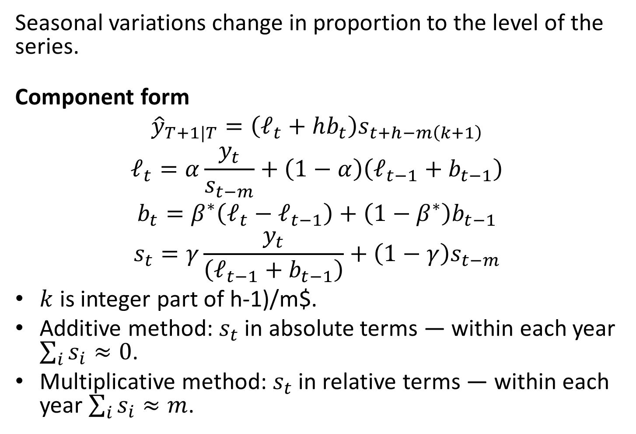
Holt-Winters multiplicative method
Seasonal variations change in proportion to the level of the series.
Component form
$${\hat{y}}_{T+1|T}=\left(ℓ_{t}+hb_{t}\right)s_{t+h−m\left(k+1\right)}$$
$$ℓ_{t}=α\frac{y_{t}}{s_{t−m}}+\left(1−α\right)\left(ℓ_{t−1}+b_{t−1}\right)$$
$$b_{t}=β^{∗}\left(ℓ_{t}−ℓ_{t−1}\right)+\left(1−β^{∗}\right)b_{t−1}$$
$$s_{t}=γ\frac{y_{t}}{\left(ℓ_{t−1}+b_{t−1}\right)}+\left(1−γ\right)s_{t−m}$$
$k$ is integer part of h-1)/m$.
Additive method: $s_{t}$ in absolute terms — within each year $\sum_{i}^{​}{s_{i}}≈0$.
Multiplicative method: $s_{t}$ in relative terms — within each year $\sum_{i}^{​}{s_{i}}≈m$.

Slide 43
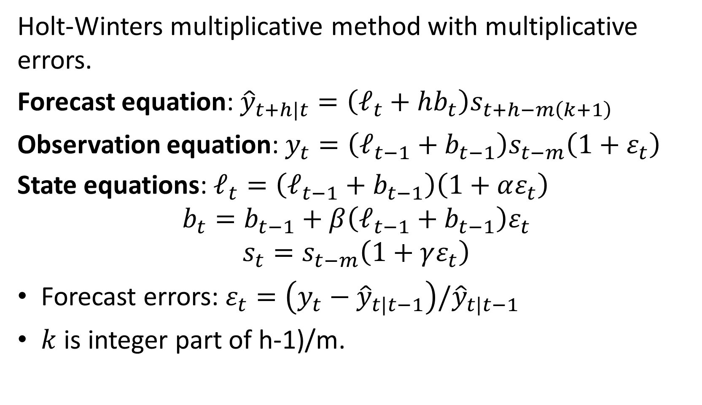
ETS(M,A,M)
Holt-Winters multiplicative method with multiplicative errors.
Forecast equation: ${\hat{y}}_{t+h|t}=\left(ℓ_{t}+hb_{t}\right)s_{t+h−m\left(k+1\right)}$
Observation equation: $y_{t}=\left(ℓ_{t−1}+b_{t−1}\right)s_{t−m}\left(1+ε_{t}\right)$
State equations: $ℓ_{t}=\left(ℓ_{t−1}+b_{t−1}\right)\left(1+αε_{t}\right)$
$$b_{t}=b_{t−1}+β\left(ℓ_{t−1}+b_{t−1}\right)ε_{t}$$
$$s_{t}=s_{t−m}\left(1+γε_{t}\right)$$
Forecast errors: $ε_{t}=\left(y_{t}−{\hat{y}}_{t|t−1}\right)/{\hat{y}}_{t|t−1}$
$k$ is integer part of h-1)/m.

Slide 44
Example: Australian holiday tourism
aus_holidays <- tourism %>% filter(Purpose == "Holiday") %>% summarise(Trips = sum(Trips)) fit <- aus_holidays %>% model( additive = ETS(Trips ~ error("A") + trend("A") + season("A")), multiplicative = ETS(Trips ~ error("M") + trend("A") + season("M")) ) fc <- fit %>% forecast()

Slide 45
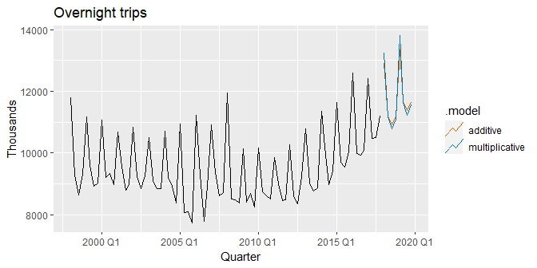
Example: Australian holiday tourism
fc %>% autoplot(aus_holidays, level = NULL) + labs(y = "Thousands", title = "Overnight trips")

Slide 46
Estimated components
components(fit)
## # A dable: 168 x 7 [1Q] ## # Key: .model [2] ## # : Trips = lag(level, 1) + lag(slope, 1) + lag(season, 4) + ## # remainder ## .model Quarter Trips level slope season remainder ## <chr> <qtr> <dbl> <dbl> <dbl> <dbl> <dbl> ## 1 additive 1997 Q1 NA NA NA 1512. NA ## 2 additive 1997 Q2 NA NA NA -290. NA ## 3 additive 1997 Q3 NA NA NA -684. NA ## 4 additive 1997 Q4 NA 9899. -37.4 -538. NA ## 5 additive 1998 Q1 11806. 9964. -24.5 1512. 433. ## 6 additive 1998 Q2 9276. 9851. -35.6 -290. -374. ## 7 additive 1998 Q3 8642. 9700. -50.2 -684. -489. ## 8 additive 1998 Q4 9300. 9694. -44.6 -538. 188. ## 9 additive 1999 Q1 11172. 9652. -44.3 1512. 10.7 ## 10 additive 1999 Q2 9608. 9676. -35.6 -290. 290. ## # … with 158 more rows

Slide 47
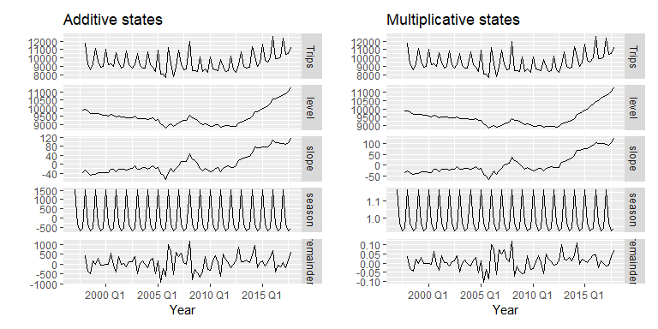
Estimated components

Slide 48
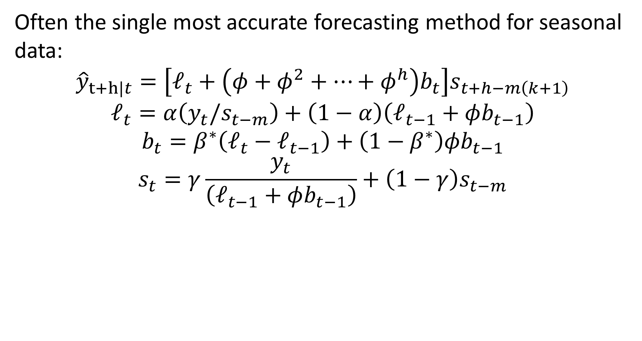
Holt-Winters damped method
Often the single most accurate forecasting method for seasonal data:
$${\hat{y}}_{t+h|t}=\left[ℓ_{t}+\left(φ+φ^{2}+…+φ^{h}\right)b_{t}\right]s_{t+h−m\left(k+1\right)}$$
$$ℓ_{t}=α\left(y_{t}/s_{t−m}\right)+\left(1−α\right)\left(ℓ_{t−1}+φb_{t−1}\right)$$
$$b_{t}=β^{∗}\left(ℓ_{t}−ℓ_{t−1}\right)+\left(1−β^{∗}\right)φb_{t−1}$$
$$s_{t}=γ\frac{y_{t}}{\left(ℓ_{t−1}+φb_{t−1}\right)}+\left(1−γ\right)s_{t−m}$$

Slide 49
Holt-Winters with daily data
sth_cross_ped <- pedestrian %>% filter( Date >= "2016-07-01", Sensor == "Southern Cross Station" ) %>% index_by(Date) %>% summarise(Count = sum(Count) / 1000) sth_cross_ped %>% filter(Date <= "2016-07-31") %>% model( hw = ETS(Count ~ error("M") + trend("Ad") + season("M")) ) %>% forecast(h = "2 weeks") %>% autoplot(sth_cross_ped %>% filter(Date <= "2016-08-14")) + labs( title = "Daily traffic: Southern Cross", y = "Pedestrians ('000)" )

Slide 50
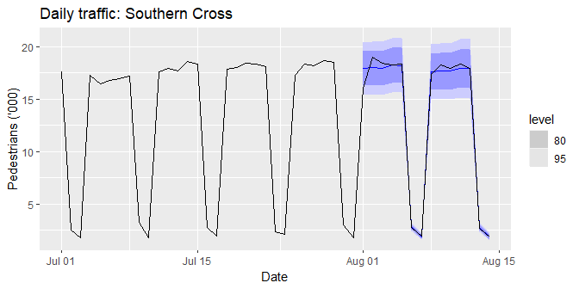
Holt-Winters with daily data

Slide 51
Innovations state space models

Slide 52
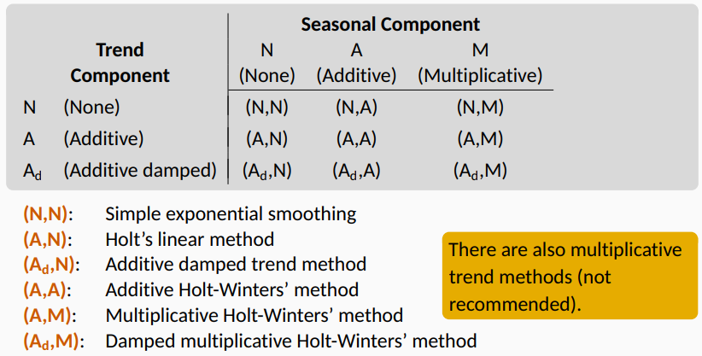
Exponential smoothing methods

Slide 53
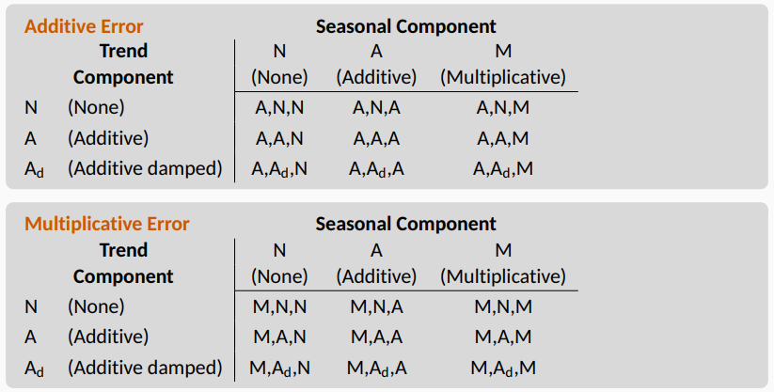
ETS models

Slide 54
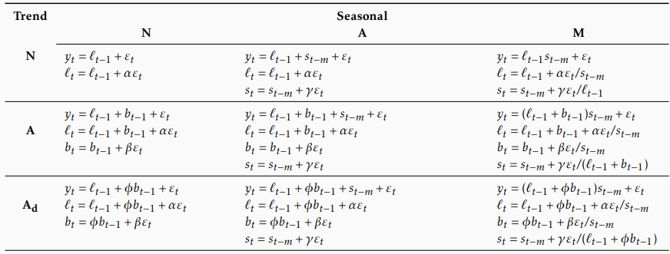
Additive error models

Slide 55
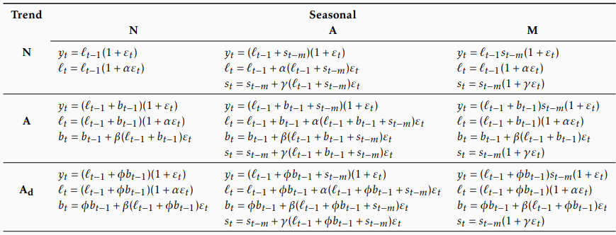
Multiplicative error models

Slide 56
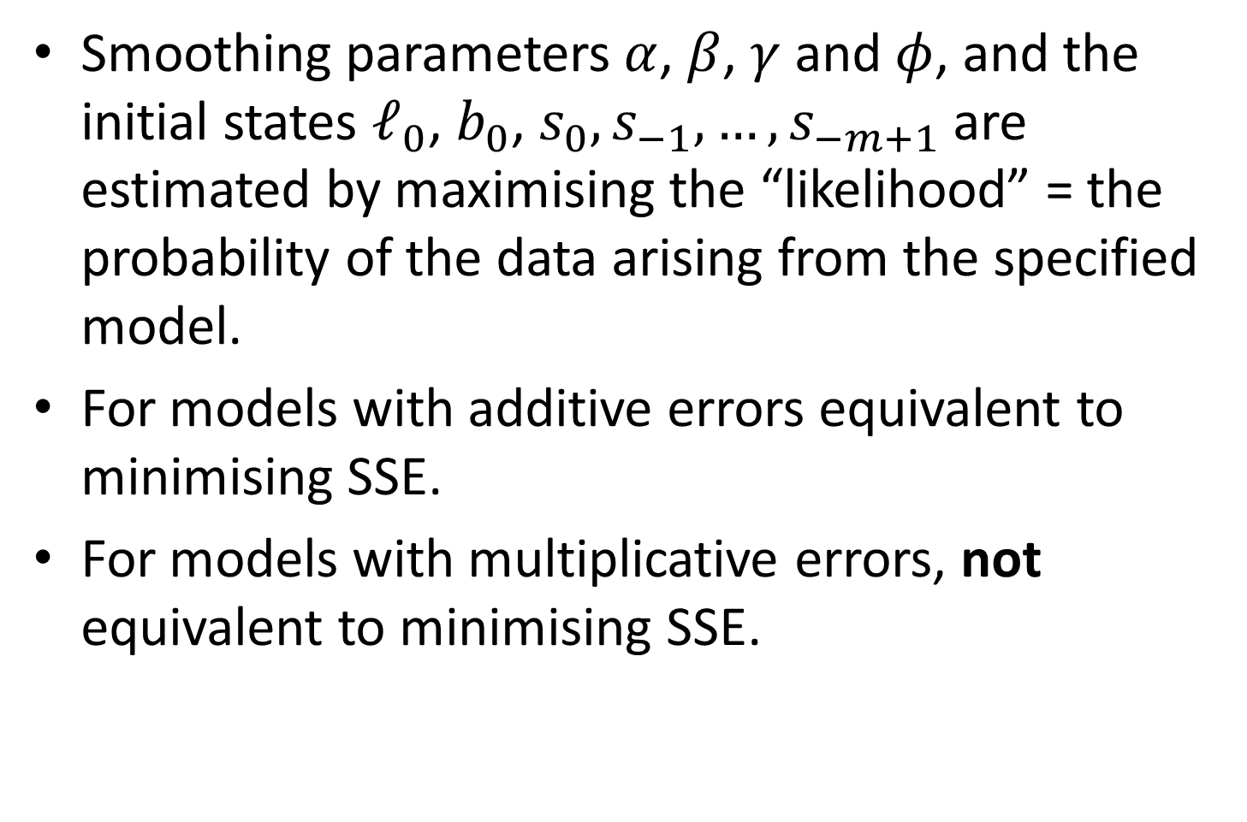
Estimating ETS models
Smoothing parameters $α$, $β$, $γ$ and $φ$, and the initial states $ℓ_{0}$, $b_{0}$, $s_{0},s_{−1},…,s_{−m+1}$ are estimated by maximising the “likelihood” = the probability of the data arising from the specified model.
For models with additive errors equivalent to minimising SSE.
For models with multiplicative errors, not equivalent to minimising SSE.

Slide 57
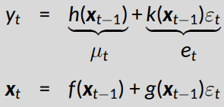

Innovations state space models
Let $x_{t}=\left(ℓ_{t},b_{t},s_{t},s_{t−1},…,s_{t−m+1}\right)$ and $ε_{t}\overset{\text{iid}}{∼}\text{N}\left(0,σ^{2}\right)$.
Additive errors
$k\left(x\right)=1$. $y_{t}=μ_{t}+ε_{t}$.
Multiplicative errors
$k\left(x_{t−1}\right)=μ_{t}$. $y_{t}=μ_{t}\left(1+ε_{t}\right)$
$ε_{t}=\left(y_{t}−μ_{t}\right)/μ_{t}$ is relative error.

Slide 58
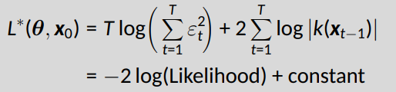

Innovations state space models
Estimation
Estimate parameters $θ=\left(α,β,γ,φ\right)$ and initial states $x_{0}=\left(ℓ_{0},b_{0},s_{0},s_{−1},…,s_{−m+1}\right)$ by minimizing $L^{∗}$.

Slide 59
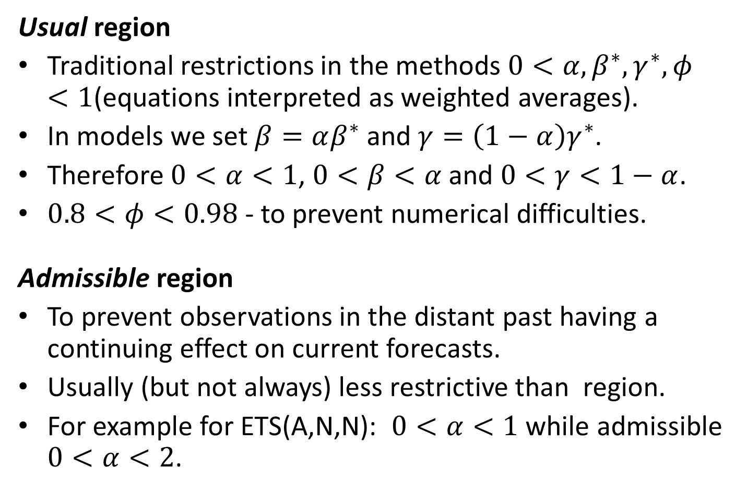
Parameter restrictions
Usual region
Traditional restrictions in the methods $0<α,β^{∗},γ^{∗},φ<1$(equations interpreted as weighted averages).
In models we set $β=αβ^{∗}$ and $γ=\left(1−α\right)γ^{∗}$.
Therefore $0<α<1$, $0<β<α$ and $0<γ<1−α$.
$0.8<φ<0.98$ - to prevent numerical difficulties.
Admissible region
To prevent observations in the distant past having a continuing effect on current forecasts.
Usually (but not always) less restrictive than region.
For example for ETS(A,N,N): $0<α<1$ while admissible $0<α<2$.

Slide 60
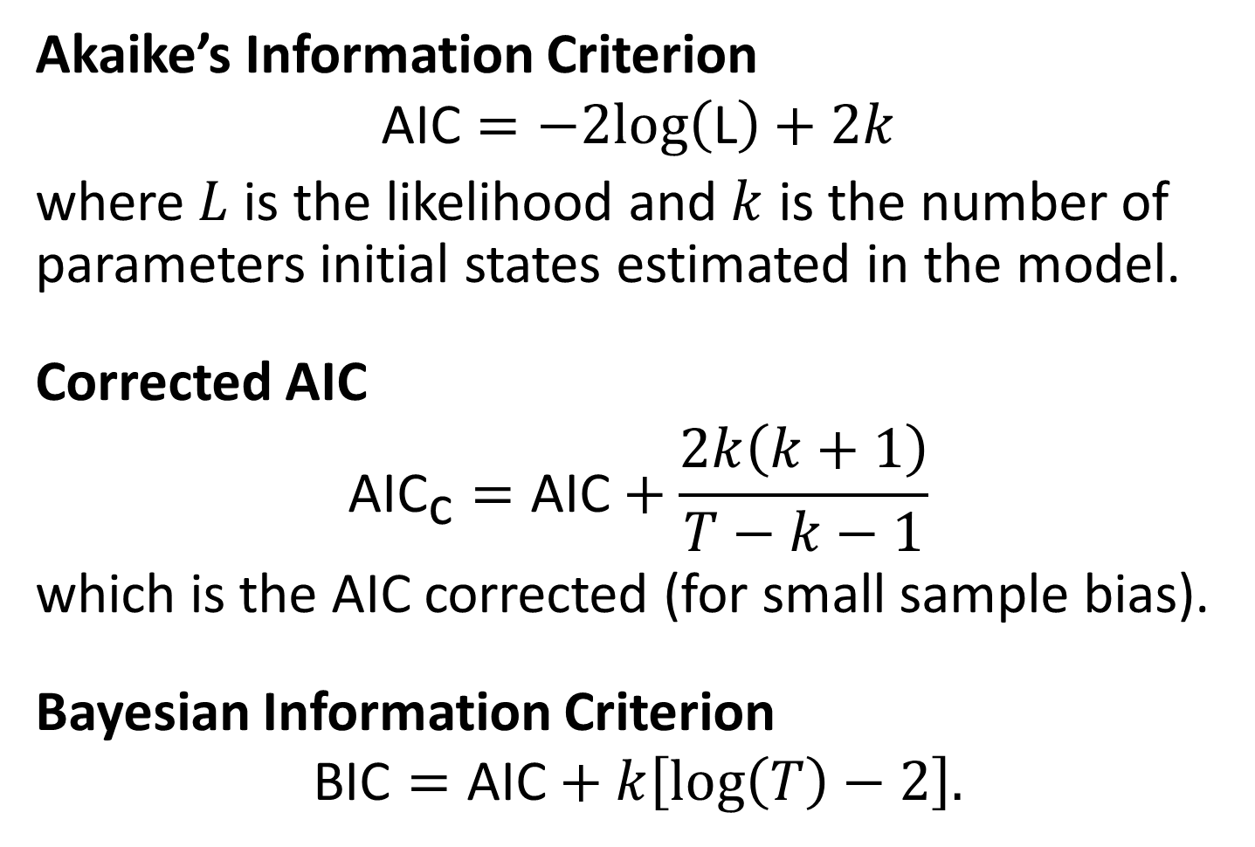
Model selection
Akaike’s Information Criterion
$$\text{AIC}=−2log\left(\text{L}\right)+2k$$
where $L$ is the likelihood and $k$ is the number of parameters initial states estimated in the model.
Corrected AIC
$${\text{AIC}}_{\text{c}}=\text{AIC}+\frac{2k\left(k+1\right)}{T−k−1}$$
which is the AIC corrected (for small sample bias).
Bayesian Information Criterion
$$\text{BIC}=\text{AIC}+k\left[log\left(T\right)−2\right].$$

Slide 61
AIC and cross-validation
Minimizing the AIC assuming Gaussian residuals is asymptotically equivalent to minimizing one-step time series cross validation MSE.

Slide 62
Automatic forecasting
From Hyndman et al. (IJF, 2002):
Apply each model that is appropriate to the data. Optimize parameters and initial values using MLE (or some other criterion).
Select best method using AICc:
Produce forecasts using best method.
Obtain forecast intervals using underlying state space model.
Method performed very well in M3 competition.

Slide 63
Example: National populations
fit <- global_economy %>% mutate(Pop = Population / 1e6) %>% model(ets = ETS(Pop)) fit
## # A mable: 263 x 2 ## # Key: Country [263] ## Country ets ## <fct> <model> ## 1 Afghanistan <ETS(A,A,N)> ## 2 Albania <ETS(M,A,N)> ## 3 Algeria <ETS(M,A,N)> ## 4 American Samoa <ETS(M,A,N)> ## 5 Andorra <ETS(M,A,N)> ## 6 Angola <ETS(M,A,N)> ## 7 Antigua and Barbuda <ETS(M,A,N)> ## 8 Arab World <ETS(M,A,N)> ## 9 Argentina <ETS(A,A,N)> ## 10 Armenia <ETS(M,A,N)> ## # … with 253 more rows

Slide 64
Example: National populations
fit %>% forecast(h = 5)
## # A fable: 1,315 x 5 [1Y] ## # Key: Country, .model [263] ## Country .model Year Pop .mean ## <fct> <chr> <dbl> <dist> <dbl> ## 1 Afghanistan ets 2018 N(36, 0.012) 36.4 ## 2 Afghanistan ets 2019 N(37, 0.059) 37.3 ## 3 Afghanistan ets 2020 N(38, 0.16) 38.2 ## 4 Afghanistan ets 2021 N(39, 0.35) 39.0 ## 5 Afghanistan ets 2022 N(40, 0.64) 39.9 ## 6 Albania ets 2018 N(2.9, 0.00012) 2.87 ## 7 Albania ets 2019 N(2.9, 6e-04) 2.87 ## 8 Albania ets 2020 N(2.9, 0.0017) 2.87 ## 9 Albania ets 2021 N(2.9, 0.0036) 2.86 ## 10 Albania ets 2022 N(2.9, 0.0066) 2.86 ## # … with 1,305 more rows

Slide 65
Example: Australian holiday tourism
holidays <- tourism %>% filter(Purpose == "Holiday") fit <- holidays %>% model(ets = ETS(Trips)) fit
## # A mable: 76 x 4 ## # Key: Region, State, Purpose [76] ## Region State Purpose ets ## <chr> <chr> <chr> <model> ## 1 Adelaide South Australia Holiday <ETS(A,N,A)> ## 2 Adelaide Hills South Australia Holiday <ETS(A,A,N)> ## 3 Alice Springs Northern Territory Holiday <ETS(M,N,A)> ## 4 Australia's Coral Coast Western Australia Holiday <ETS(M,N,A)> ## 5 Australia's Golden Outback Western Australia Holiday <ETS(M,N,M)> ## 6 Australia's North West Western Australia Holiday <ETS(A,N,A)> ## 7 Australia's South West Western Australia Holiday <ETS(M,N,M)> ## 8 Ballarat Victoria Holiday <ETS(M,N,A)> ## 9 Barkly Northern Territory Holiday <ETS(A,N,A)> ## 10 Barossa South Australia Holiday <ETS(A,N,N)> ## # … with 66 more rows

Slide 66
Example: Australian holiday tourism
fit %>% filter(Region == "Snowy Mountains") %>% report()
## Series: Trips ## Model: ETS(M,N,A) ## Smoothing parameters: ## alpha = 0.157 ## gamma = 1e-04 ## ## Initial states: ## l[0] s[0] s[-1] s[-2] s[-3] ## 142 -61 131 -42.2 -27.7 ## ## sigma^2: 0.0388 ## ## AIC AICc BIC ## 852 854 869

Slide 67
Example: Australian holiday tourism
fit %>% filter(Region == "Snowy Mountains") %>% components(fit)
## # A dable: 84 x 9 [1Q] ## # Key: Region, State, Purpose, .model [1] ## # : Trips = (lag(level, 1) + lag(season, 4)) * (1 + remainder) ## Region State Purpose .model Quarter Trips level season remai…¹ ## <chr> <chr> <chr> <chr> <qtr> <dbl> <dbl> <dbl> <dbl> ## 1 Snowy Mountains New S… Holiday ets 1997 Q1 NA NA -27.7 NA ## 2 Snowy Mountains New S… Holiday ets 1997 Q2 NA NA -42.2 NA ## 3 Snowy Mountains New S… Holiday ets 1997 Q3 NA NA 131. NA ## 4 Snowy Mountains New S… Holiday ets 1997 Q4 NA 142. -61.0 NA ## 5 Snowy Mountains New S… Holiday ets 1998 Q1 101. 140. -27.7 -0.113 ## 6 Snowy Mountains New S… Holiday ets 1998 Q2 112. 142. -42.2 0.154 ## 7 Snowy Mountains New S… Holiday ets 1998 Q3 310. 148. 131. 0.137 ## 8 Snowy Mountains New S… Holiday ets 1998 Q4 89.8 148. -61.0 0.0335 ## 9 Snowy Mountains New S… Holiday ets 1999 Q1 112. 147. -27.7 -0.0687 ## 10 Snowy Mountains New S… Holiday ets 1999 Q2 103. 147. -42.2 -0.0199 ## # … with 74 more rows, and abbreviated variable name ¹​remainder

Slide 68
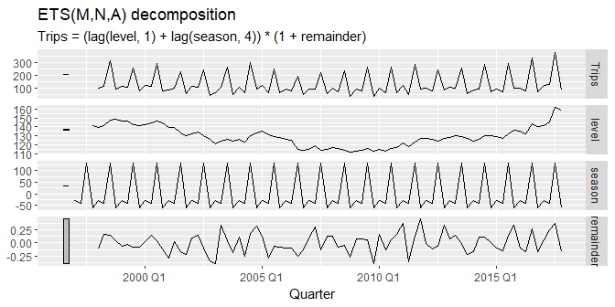
Example: Australian holiday tourism
fit %>% filter(Region == "Snowy Mountains") %>% components(fit) %>% autoplot()

Slide 69
Example: Australian holiday tourism
fit %>% forecast()
## # A fable: 608 x 7 [1Q] ## # Key: Region, State, Purpose, .model [76] ## Region State Purpose .model Quarter Trips .mean ## <chr> <chr> <chr> <chr> <qtr> <dist> <dbl> ## 1 Adelaide South Australia Holiday ets 2018 Q1 N(210, 457) 210. ## 2 Adelaide South Australia Holiday ets 2018 Q2 N(173, 473) 173. ## 3 Adelaide South Australia Holiday ets 2018 Q3 N(169, 489) 169. ## 4 Adelaide South Australia Holiday ets 2018 Q4 N(186, 505) 186. ## 5 Adelaide South Australia Holiday ets 2019 Q1 N(210, 521) 210. ## 6 Adelaide South Australia Holiday ets 2019 Q2 N(173, 537) 173. ## 7 Adelaide South Australia Holiday ets 2019 Q3 N(169, 553) 169. ## 8 Adelaide South Australia Holiday ets 2019 Q4 N(186, 569) 186. ## 9 Adelaide Hills South Australia Holiday ets 2018 Q1 N(19, 36) 19.4 ## 10 Adelaide Hills South Australia Holiday ets 2018 Q2 N(20, 36) 19.6 ## # … with 598 more rows

Slide 70
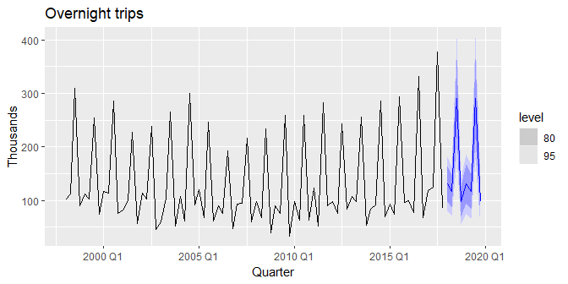
Example: Australian holiday tourism
fit %>% forecast() %>% filter(Region == "Snowy Mountains") %>% autoplot(holidays) + labs(y = "Thousands", title = "Overnight trips")

Slide 71
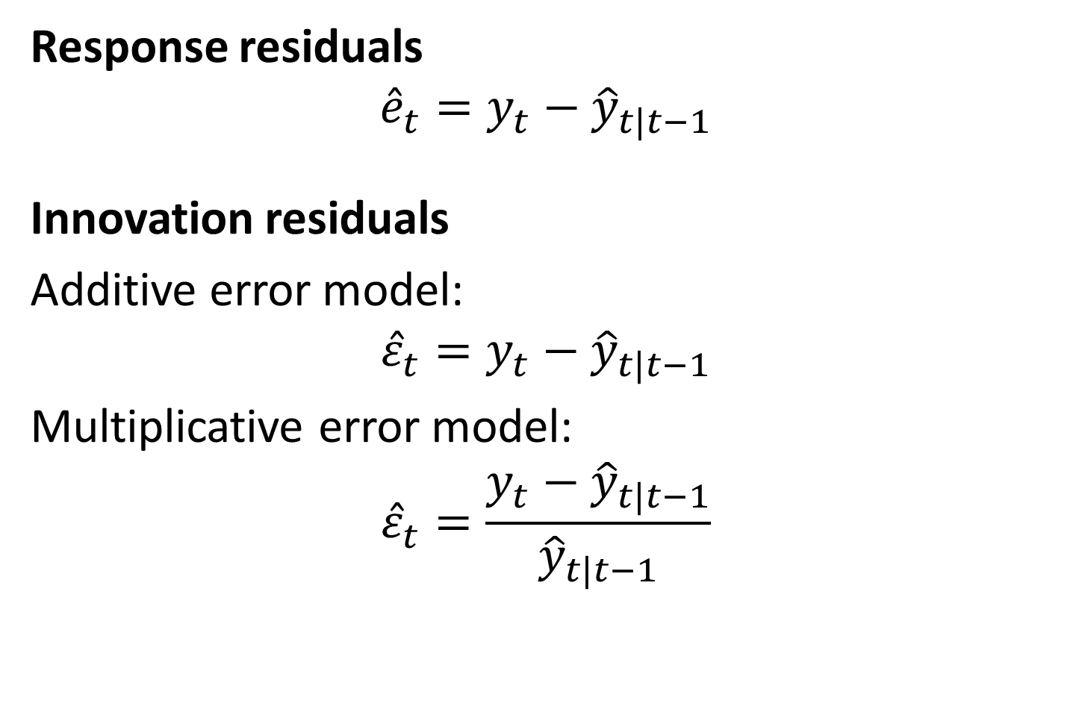
Residuals
Response residuals
$${\hat{e}}_{t}=y_{t}−{\hat{y}}_{t|t−1}$$
Innovation residuals
Additive error model:
$${\hat{ε}}_{t}=y_{t}−{\hat{y}}_{t|t−1}$$
Multiplicative error model:
$${\hat{ε}}_{t}=\frac{y_{t}−{\hat{y}}_{t|t−1}}{{\hat{y}}_{t|t−1}}$$

Slide 72
Example: Australian holiday tourism
aus_holidays <- tourism %>% filter(Purpose == "Holiday") %>% summarise(Trips = sum(Trips)) fit <- aus_holidays %>% model(ets = ETS(Trips)) %>% report()
## Series: Trips ## Model: ETS(M,N,M) ## Smoothing parameters: ## alpha = 0.358 ## gamma = 0.000969 ## ## Initial states: ## l[0] s[0] s[-1] s[-2] s[-3] ## 9667 0.943 0.927 0.968 1.16 ## ## sigma^2: 0.0022 ## ## AIC AICc BIC ## 1331 1333 1348

Slide 73

Example: Australian holiday tourism
residuals(fit) residuals(fit, type = "response")

Slide 74

Example: Australian holiday tourism
fit %>% augment()
## # A tsibble: 80 x 6 [1Q] ## # Key: .model [1] ## .model Quarter Trips .fitted .resid .innov ## <chr> <qtr> <dbl> <dbl> <dbl> <dbl> ## 1 ets 1998 Q1 11806. 11230. 576. 0.0513 ## 2 ets 1998 Q2 9276. 9532. -257. -0.0269 ## 3 ets 1998 Q3 8642. 9036. -393. -0.0435 ## 4 ets 1998 Q4 9300. 9050. 249. 0.0275 ## 5 ets 1999 Q1 11172. 11260. -88.0 -0.00781 ## 6 ets 1999 Q2 9608. 9358. 249. 0.0266 ## 7 ets 1999 Q3 8914. 9042. -129. -0.0142 ## 8 ets 1999 Q4 9026. 9154. -129. -0.0140 ## 9 ets 2000 Q1 11071. 11221. -150. -0.0134 ## 10 ets 2000 Q2 9196. 9308. -111. -0.0120 ## # … with 70 more rows
Innovation residuals (.innov) are given by ${\hat{ε}}_{t}$ while regular residuals (.resid) are $y_{t}−{\hat{y}}_{t−1}$. They are different when the model has multiplicative errors.

Slide 75
Some unstable models
Some of the combinations of (Error, Trend, Seasonal) can lead to numerical difficulties; see equations with division by a state.
These are: ETS(A,N,M), ETS(A,A,M), ETS(A,A,M).
Models with multiplicative errors are useful for strictly positive data, but are not numerically stable with data containing zeros or negative values. In that case only the six fully additive models will be applied.

Slide 76

Exponential smoothing models

Slide 77
Forecasting with exponential smoothing

Slide 78

Forecasting with ETS models
Traditional point forecasts: iterate the equations for $t=T+1,T+2,…,T+h$ and set all $ε_{t}=0$ for $t>T$.
Not the same as $\text{E}\left(y_{t+h}|x_{t}\right)$ unless seasonality is additive.
fable uses $\text{E}\left(y_{t+h}|x_{t}\right)$.
Point forecasts for ETS(A,*,*) are identical to ETS(M,*,*) if the parameters are the same.

Slide 79

Example: ETS(A,A,N)
$$y_{T+1}=ℓ_{T}+b_{T}+ε_{T+1}$$
$${\hat{y}}_{T+1|T}=ℓ_{T}+b_{T}$$
$$y_{T+2}=ℓ_{T+1}+b_{T+1}+ε_{T+2}$$
$$=\left(ℓ_{T}+b_{T}+αε_{T+1}\right)+\left(b_{T}+βε_{T+1}\right)+ε_{T+2}$$
$${\hat{y}}_{T+2|T}=ℓ_{T}+2b_{T}$$
etc.

Slide 80

Example: ETS(M,A,N)
$$y_{T+1}=\left(ℓ_{T}+b_{T}\right)\left(1+ε_{T+1}\right)$$
$${\hat{y}}_{T+1|T}=ℓ_{T}+b_{T}.$$
$$y_{T+2}=\left(ℓ_{T+1}+b_{T+1}\right)\left(1+ε_{T+2}\right)$$
$$=\{\left(ℓ_{T}+b_{T}\right)\left(1+αε_{T+1}\right)+\left[b_{T}+β\left(ℓ_{T}+b_{T}\right)ε_{T+1}\right]\}\left(1+ε_{T+2}\right)$$
$${\hat{y}}_{T+2|T}=ℓ_{T}+2b_{T}$$
etc.

Slide 81
Forecasting with ETS models
Prediction intervals: can only be generated using the models.
The prediction intervals will differ between models with additive and multiplicative errors.
Exact formulae for some models.
More general to simulate future sample paths, conditional on the last estimate of the states, and to obtain prediction intervals from the percentiles of these simulated future paths.

Slide 82

Prediction intervals
PI for most ETS models: ${\hat{y}}_{T+h|T}±cσ_{h}$, where $c$ depends on coverage probability and $σ_{h}$ is forecast standard deviation.
(A,N,N): $σ_{h}=σ^{2}\left[1+α^{2}\left(h−1\right)\right]$
(A,A,N): $σ_{h}=σ^{2}\left[1+\left(h−1\right)\left\{α^{2}+αβh+\frac{1}{6}β^{2}h\left(2h−1\right)\right\}\right]$
(A,A$​_{d}$,N): $σ_{h}=σ^{2}\left[1+α^{2}\left(h−1\right)+\frac{βφh}{{\left(1−φ\right)}^{2}}\left\{2α\left(1−φ\right)+βφ\right\}−\frac{βφ\left(1−φ^{h}\right)}{{\left(1−φ\right)}^{2}\left(1−φ^{2}\right)}\left\{2α\left(1−φ^{2}\right)+βφ\left(1+2φ−φ^{h}\right)\right\}\right]$
(A,N,A): $σ_{h}=σ^{2}\left[1+α^{2}\left(h−1\right)+γk\left(2α+γ\right)\right]$
(A,A,A): $σ_{h}=σ^{2}\left[1+\left(h−1\right)\left\{α^{2}+αβh+\frac{1}{6}β^{2}h\left(2h−1\right)\right\}+γk\left\{2α+γ+βm\left(k+1\right)\right\}\right]$
(A,A$​_{d}$,A): $σ_{h}=σ^{2}[1+α^{2}\left(h−1\right)+\frac{βφh}{{\left(1−φ\right)}^{2}}\left\{2α\left(1−φ\right)+βφ\right\}−\frac{βφ\left(1−φ^{h}\right)}{{\left(1−φ\right)}^{2}\left(1−φ^{2}\right)}\left\{2α\left(1−φ^{2}\right)+βφ\left(1+2φ−φ^{h}\right)\right\}$
$$+γk\left(2α+γ\right)+\frac{2βγφ}{\left(1−φ\right)\left(1−φ^{m}\right)}\left\{k\left(1−φ^{m}\right)−φ^{m}\left(1−φ^{mk}\right)\right\}]$$

Slide 83

Example: Corticosteroid drug sales
h02 <- PBS %>% filter(ATC2 == "H02") %>% summarise(Cost = sum(Cost)) h02 %>% autoplot(Cost)

Slide 84
Example: Corticosteroid drug sales
h02 %>% model(ETS(Cost)) %>% report()
## Series: Cost ## Model: ETS(M,Ad,M) ## Smoothing parameters: ## alpha = 0.307 ## beta = 0.000101 ## gamma = 0.000101 ## phi = 0.978 ## ## Initial states: ## l[0] b[0] s[0] s[-1] s[-2] s[-3] s[-4] s[-5] s[-6] s[-7] s[-8] s[-9] ## 417269 8206 0.872 0.826 0.756 0.773 0.687 1.28 1.32 1.18 1.16 1.1 ## s[-10] s[-11] ## 1.05 0.981 ## ## sigma^2: 0.0046 ## ## AIC AICc BIC ## 5515 5519 5575

Slide 85
Example: Corticosteroid drug sales
h02 %>% model(ETS(Cost ~ error("A") + trend("A") + season("A"))) %>% report()
## Series: Cost ## Model: ETS(A,A,A) ## Smoothing parameters: ## alpha = 0.17 ## beta = 0.00631 ## gamma = 0.455 ## ## Initial states: ## l[0] b[0] s[0] s[-1] s[-2] s[-3] s[-4] s[-5] s[-6] s[-7] ## 409706 9097 -99075 -136602 -191496 -174531 -241437 210644 244644 145368 ## s[-8] s[-9] s[-10] s[-11] ## 130570 84458 39132 -11674 ## ## sigma^2: 3.5e+09 ## ## AIC AICc BIC ## 5585 5589 5642

Slide 86

Example: Corticosteroid drug sales
h02 %>% model(ETS(Cost)) %>% forecast() %>% autoplot(h02)

Slide 87
Example: Corticosteroid drug sales
h02 %>% model( auto = ETS(Cost), AAA = ETS(Cost ~ error("A") + trend("A") + season("A")) ) %>% accuracy()
Model | MAE | RMSE | MAPE | MASE | RMSSE
auto | 38649 | 51102 | 4.99 | 0.638 | 0.689
AAA | 43378 | 56784 | 6.05 | 0.716 | 0.766

