Slide 1
EAS509 Section 3 : Survival Analysis and Censored Data
ISL: Ch11. Survival Analysis and Censored Data

Slide 2
Survival Analysis
Survival analysis concerns a special kind of outcome variable: the time until an event occurs.
Examples:
a five-year medical study, in which patients have been treated for cancer
We would like to fit a model to predict patient survival time, using features such as baseline health measurements or type of treatment
Sounds like a regression problem. But some of the patients have survived until the end of the study or drop out earlier. Such a patient’s survival time is said to be censored.
We do not want to discard this subset of surviving patients, since the fact that they survived at least five years (or less) amounts to valuable information.

Slide 3
Examples
Time-to-event data that consist of a distinct start time and end time.
Time from surgery to death
Time from start of treatment to progression
Time from response to recurrence
Time from HIV infection to development of AIDS
Time to heart attack
Time to onset of substance abus

Slide 4
Non-medical Examples
Company that wishes to model customers’ time to cancel subscription (churn).
presumably not all customers will have cancelled their subscription by the end of this time period; for such customers, the time to cancellation is censored.
Aliases for survival analysis
Reliability analysis
Duration analysis
Event history analysis
Time-to-event analysis

Slide 5
References/Used Material
Gareth James, Daniela Witten, Trevor Hastie, Robert Tibshirani. An Introduction to Statistical Learning : with Applications in R. New York :Springer, 2013. https://www.statlearning.com/
Chapter 11
Survival Analysis Videos: http://www.zstatistics.com/videos#/survival-analysis
R tutorial: https://www.emilyzabor.com/tutorials/survival_analysis_in_r_tutorial.html

Slide 6
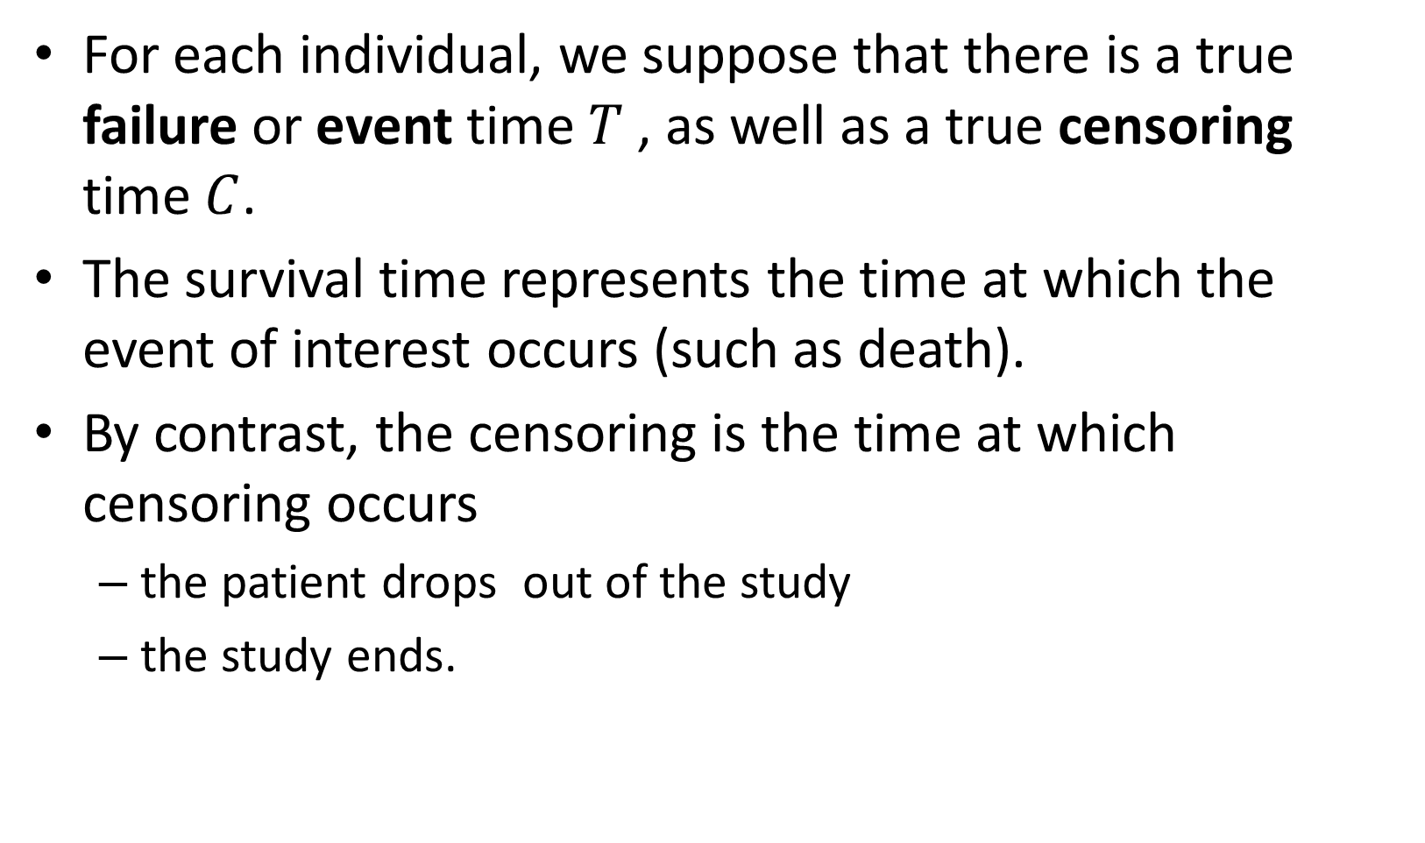
Survival and Censoring Times
For each individual, we suppose that there is a true failure or event time $T$ , as well as a true censoring time $C$.
The survival time represents the time at which the event of interest occurs (such as death).
By contrast, the censoring is the time at which censoring occurs
the patient drops out of the study
the study ends.

Slide 7
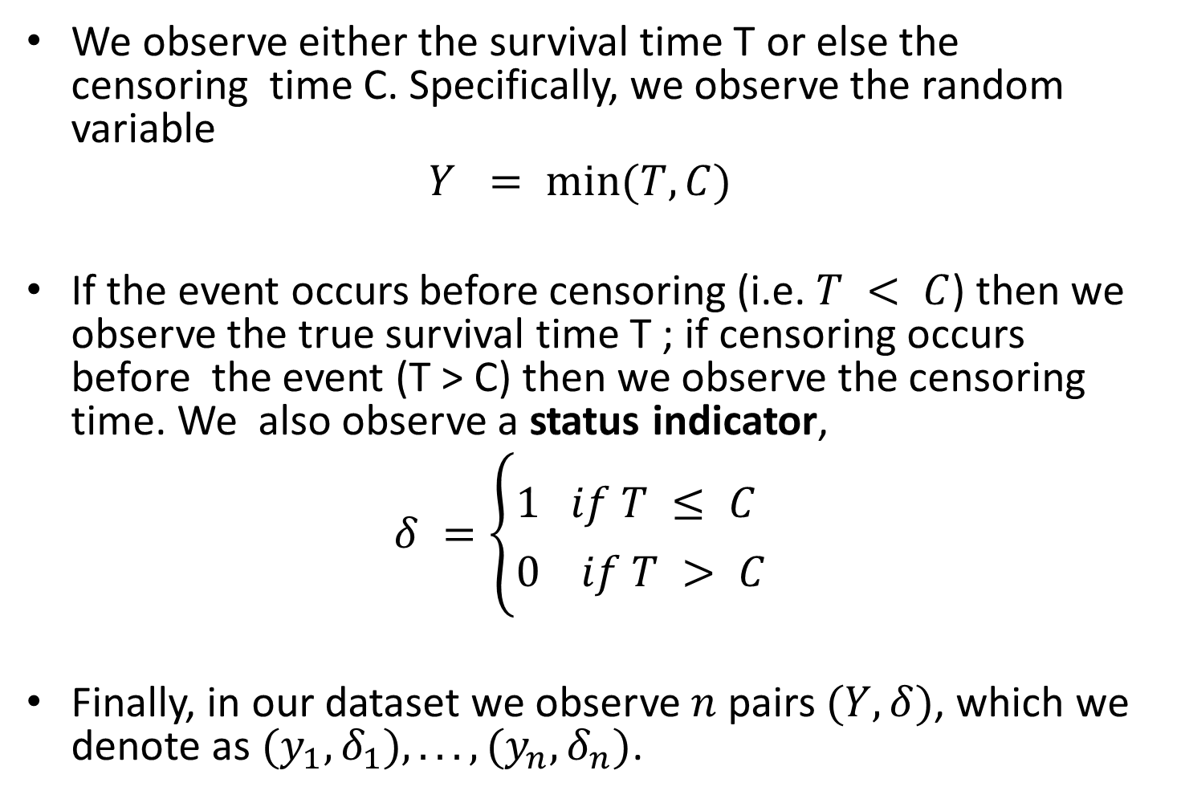
Survival and Censoring Times — Continued
We observe either the survival time T or else the censoring time C. Specifically, we observe the random variable
$$Y = min⁡(T, C)$$
If the event occurs before censoring (i.e. $T < C$) then we observe the true survival time T ; if censoring occurs before the event (T > C) then we observe the censoring time. We also observe a status indicator,
$$δ =\left\{\begin{matrix}1 if T ≤ C \\ 0 if T > C\end{matrix}\right.$$
Finally, in our dataset we observe $n$ pairs $(Y, δ)$, which we denote as $(y_{1}, δ_{1}), . . . , (y_{n}, δ_{n})$.

Slide 8
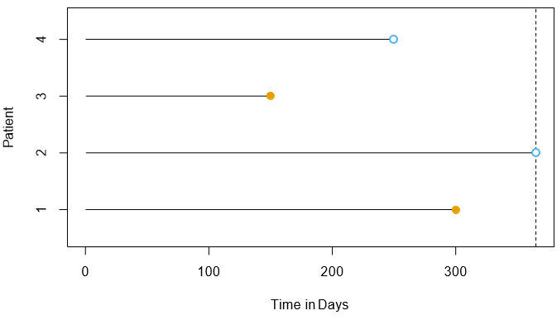




Illustration of censored survival data
Censoring Occur
$$y_{4} =c_{4},δ_{4}=0$$
$$y_{3}=t_{3},δ_{3}=1$$
Event Occur
$$y_{2} =c_{2},δ_{2}=0$$
$$y_{1}=t_{1},δ_{1}=1$$
For patient $i$ time to event $T=t_{i}$ or censoring time $C=c_{i}$

Slide 9
A Closer Look at Censoring
Why subject drop out is important:
Suppose that a number of patients drop out of a cancer study early because they are very sick.
An analysis that does not take into consideration the reason why the patients dropped out will likely overestimate the true average survival time.
Similarly, suppose that males who are very sick are more likely to drop out of the study than females who are very sick. Then a comparison of male and female survival times may wrongly suggest that males survive longer than females.
In general, we need to assume that, conditional on the features, the event time T is independent of the censoring time C. The two examples above violate the assumption of independent censoring.

Slide 10
A Closer Look at Censoring (Optional)
Here we talk about right censoring i.e. event happens on right from censoring time
Other possibilities:
Left censoring
Interval censoring

Slide 11
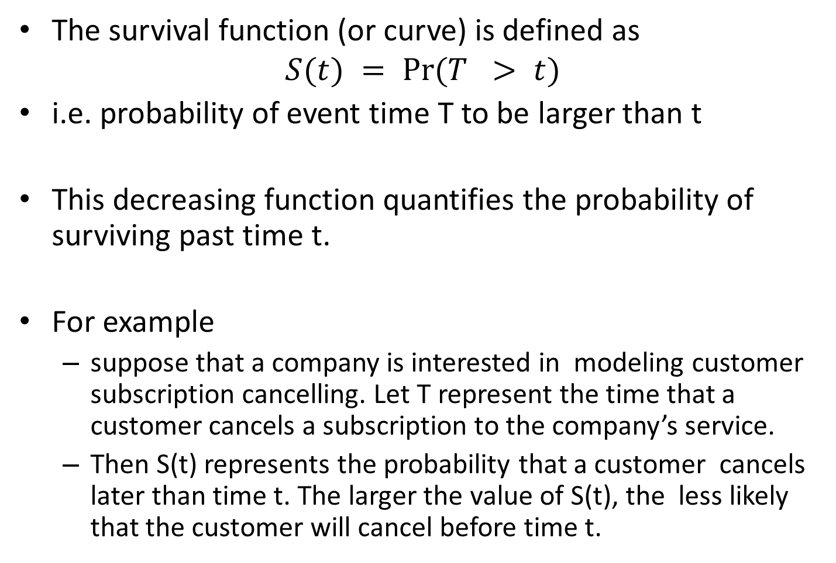
The Survival Curve
The survival function (or curve) is defined as
$$S(t) = Pr⁡(T > t)$$
i.e. probability of event time T to be larger than t
This decreasing function quantifies the probability of surviving past time t.
For example
suppose that a company is interested in modeling customer subscription cancelling. Let T represent the time that a customer cancels a subscription to the company’s service.
Then S(t) represents the probability that a customer cancels later than time t. The larger the value of S(t), the less likely that the customer will cancel before time t.

Slide 12
Estimating the Survival Curve
BrainCancer dataset
Survival times for patients with primary brain tumors undergoing treatment with stereotactic radiation methods.
The predictors:
gtv (gross tumor volume, in cubic centimeters);
sex (male or female);
diagnosis (meningioma, LG glioma, HG glioma, or other);
loc (the tumor location: either infratentorial or supratentorial);
ki (Karnofsky index)
stereo (stereotactic treatment method)
53 of the 88 patients were still alive at the end of the study.

Slide 13
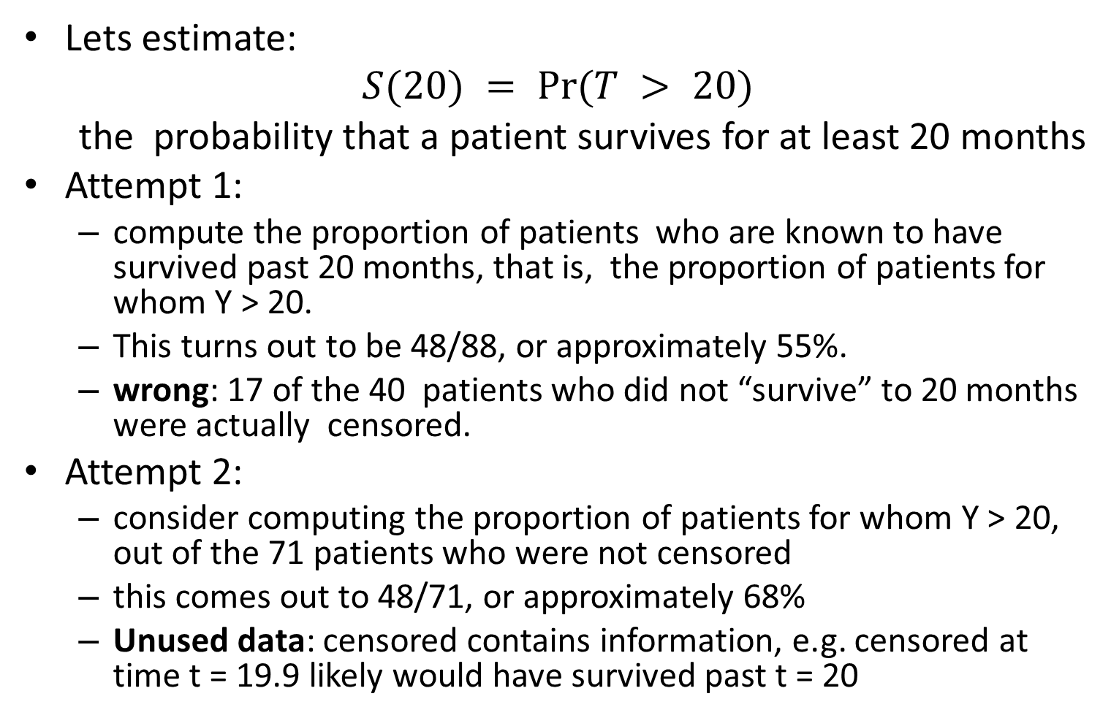
Estimating the Survival Curve — Continued
Lets estimate:
$$S(20) = Pr⁡(T > 20)$$
the probability that a patient survives for at least 20 months
Attempt 1:
compute the proportion of patients who are known to have survived past 20 months, that is, the proportion of patients for whom Y > 20.
This turns out to be 48/88, or approximately 55%.
wrong: 17 of the 40 patients who did not “survive” to 20 months were actually censored.
Attempt 2:
consider computing the proportion of patients for whom Y > 20, out of the 71 patients who were not censored
this comes out to 48/71, or approximately 68%
Unused data: censored contains information, e.g. censored at time t = 19.9 likely would have survived past t = 20

Slide 14


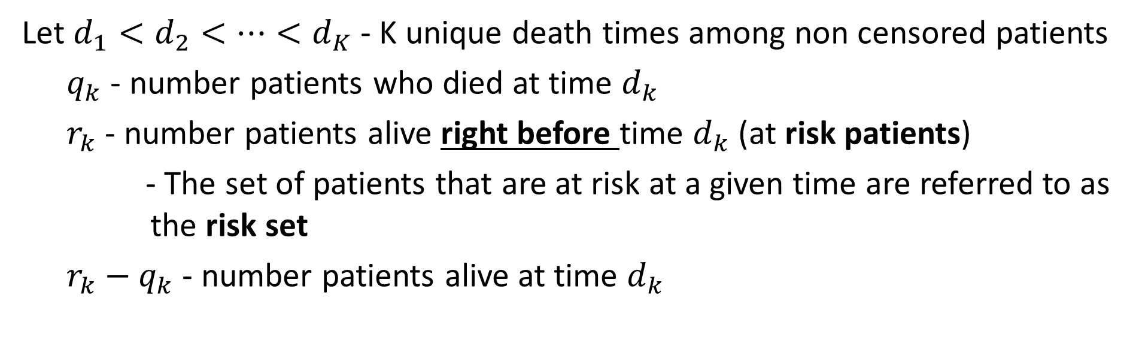
Kaplan-Meier estimator
Let $d_{1}<d_{2}<…<d_{K}$ - K unique death times among non censored patients
$q_{k}$ - number patients who died at time $d_{k}$
$r_{k}$ - number patients alive right before time $d_{k}$ (at risk patients)
- The set of patients that are at risk at a given time are referred to as the risk set
$r_{k}−q_{k}$ - number patients alive at time $d_{k}$
Recall $Pr⁡(A) = Pr⁡(A|B) Pr⁡(B) + Pr⁡(A|B^{c}) Pr⁡(B^{c})$

Slide 15

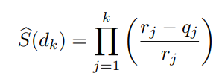

Kaplan-Meier estimator
Kaplan-Meier estimator of the survival curve:
For times t between d_{k} and d_{k+1}, we set $\hat{S}(t) =\hat{S}(d_{k})$

Slide 16
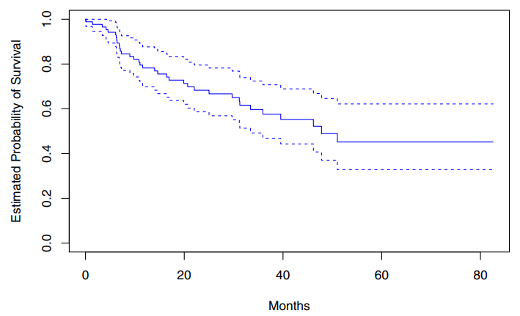
BrainCancer dataset
The estimated probability of survival past 20 months is 71%, which is quite a bit higher than the naive estimates of 55% and 68% presented earlier.

Slide 17
First Failure
1
4/5
2
Patients
3
4
5
4/5
y₁
y₂ y₃ y₄
y₅
Time

Slide 18
Second Failure
1
2
Patients
3
2/3
4
5
4/5 x 2/3
y₁
y₂ y₃ y₄
y₅
Time

Slide 19
Third Failure
1
2
Patients
3
4
0/1
5
4/5 x 2/3 x 0
y₁
y₂ y₃ y₄
y₅
Time

Slide 20
Resulting KM Survival Curve
1.0
0.8
4/5
0.6
(4/5)x(2/3)
S(t)
0.4
0.2
0.0
0
40
50
60
70
80
90
100
Time

Slide 21
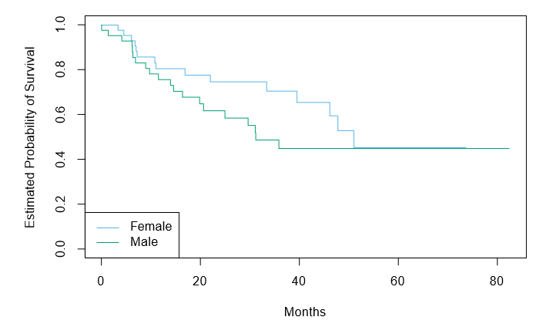
The Log-Rank Test
Females seem to fare a little better up to about 50 months, but then the two curves both level off to about 50%. How can we carry out a formal test of equality of the two survival curves?
At first glance, a two-sample t-test seems like an obvious choice: but the presence of censoring again creates a complication.
To overcome this challenge, we will conduct a log-rank test.
We wish to compare the survival of males to that of females. Shown are the Kaplan-Meier survival curves for the two groups.

Slide 22
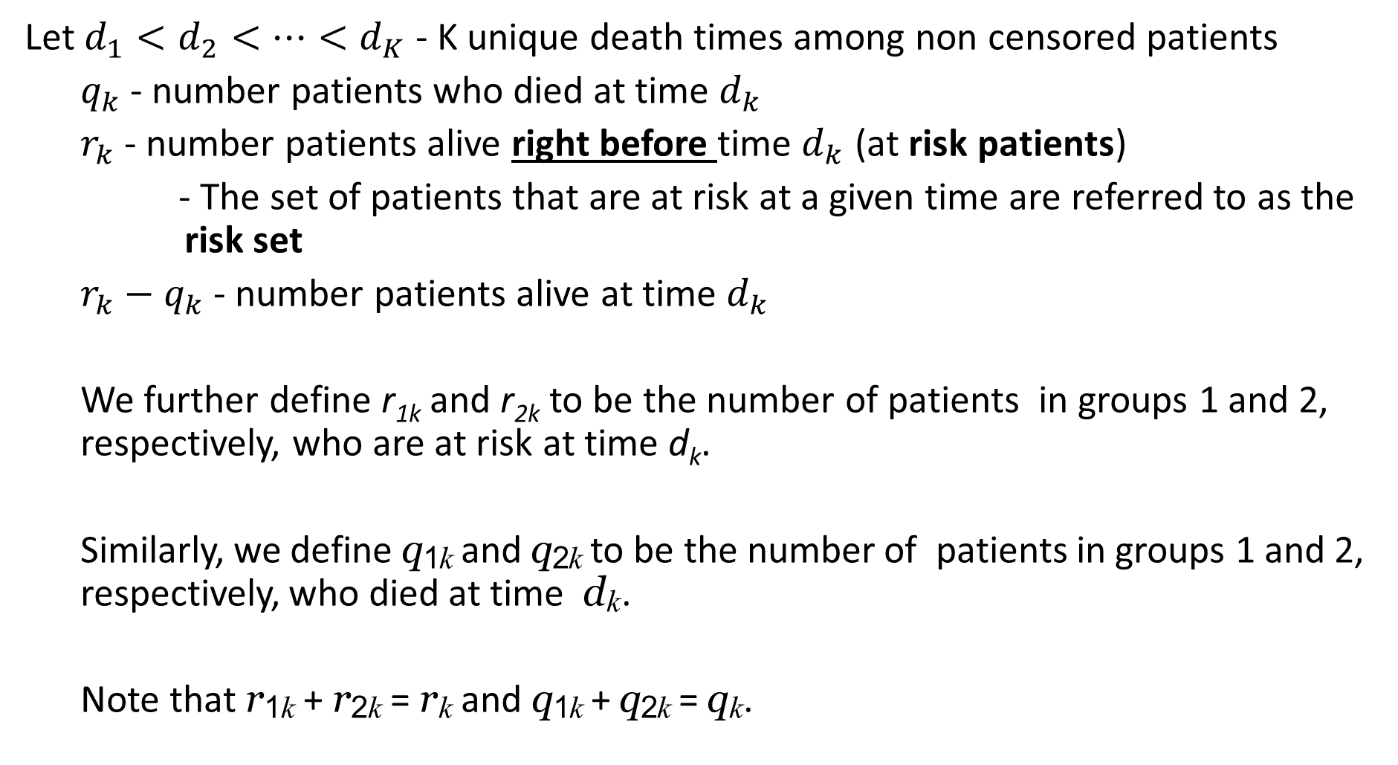
The Log-Rank Test — Continued
Let $d_{1}<d_{2}<…<d_{K}$ - K unique death times among non censored patients
$q_{k}$ - number patients who died at time $d_{k}$
$r_{k}$ - number patients alive right before time $d_{k}$ (at risk patients)
- The set of patients that are at risk at a given time are referred to as the risk set
$r_{k}−q_{k}$ - number patients alive at time $d_{k}$
We further define r_{1k} and r_{2k} to be the number of patients in groups 1 and 2, respectively, who are at risk at time d_{k}.
Similarly, we define q_{1k} and q_{2k} to be the number of patients in groups 1 and 2, respectively, who died at time d_{k}.
Note that r_{1k} + r_{2k} = r_{k} and q_{1k} + q_{2k} = q_{k}.

Slide 23
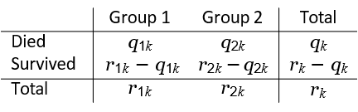
Details of the Test Statistic
At each death time d_{k}, we construct a 2 × 2 table of counts of the form shown above.
Note that if the death times are unique (i.e. no two individuals die at the same time), then one of q_{1k} and q_{2k} equals one, and the other equals zero.

Slide 24
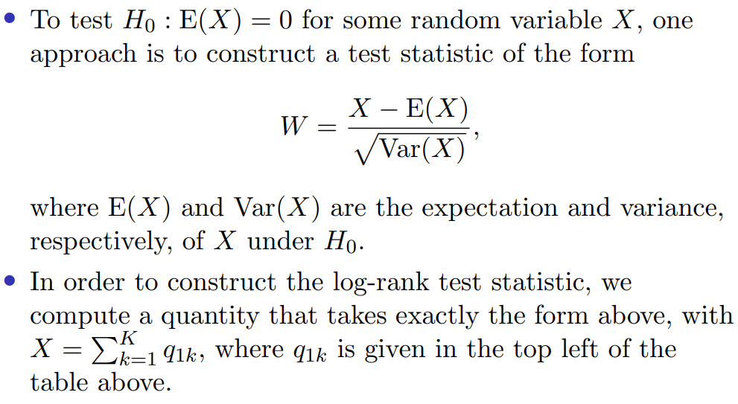
Log Rank Test: the Main Idea

Slide 25
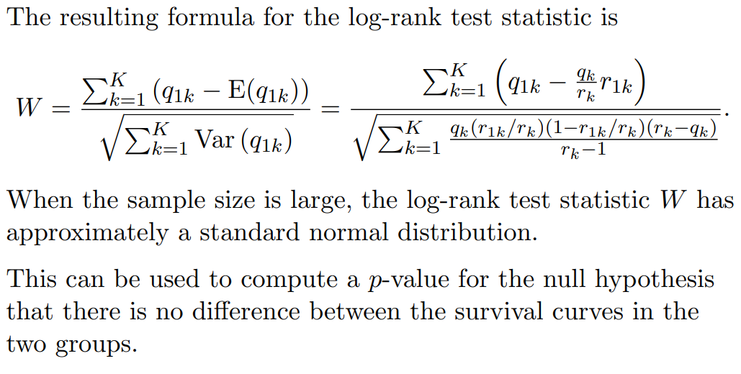
The Final Result

Slide 26
Application to the Brain Cancer Dataset
Comparing the survival times of females and males on the BrainCancer data gives a log-rank test statistic of W = 1.2, which corresponds to a two-sided p-value of 0.2.
Thus, we cannot reject the null hypothesis of no difference in survival curves between females and males.
The log-rank test is closely related to Cox’s proportional hazards model, which we discuss next.

Slide 27
Regression Models with a Survival Response
We now consider the task of fitting a regression model to survival data.
We wish to predict the true survival time T .
Since the observed quantity Y = min(T, C) is positive and may have a long right tail, we might be tempted to fit a linear regression of log(Y ) on X. But censoring again creates a problem.
To overcome this difficulty, we instead make use of a sequential construction, similar to the idea used for the Kaplan-Meier survival curve.

Slide 28
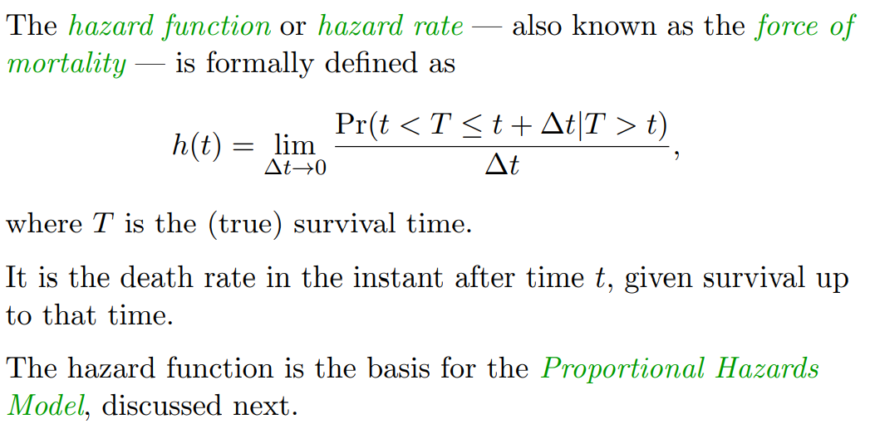
The Hazard Function

Slide 29
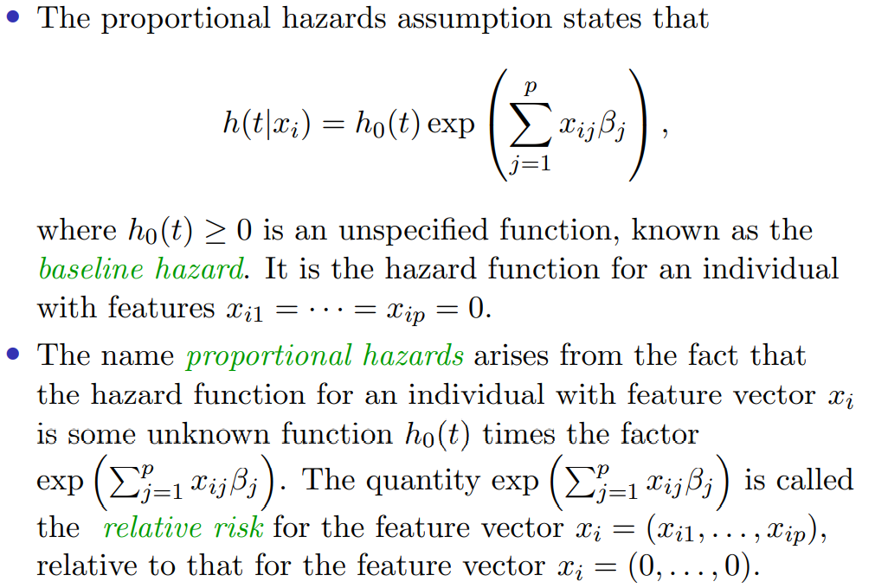
The Proportional Hazards Model

Slide 30
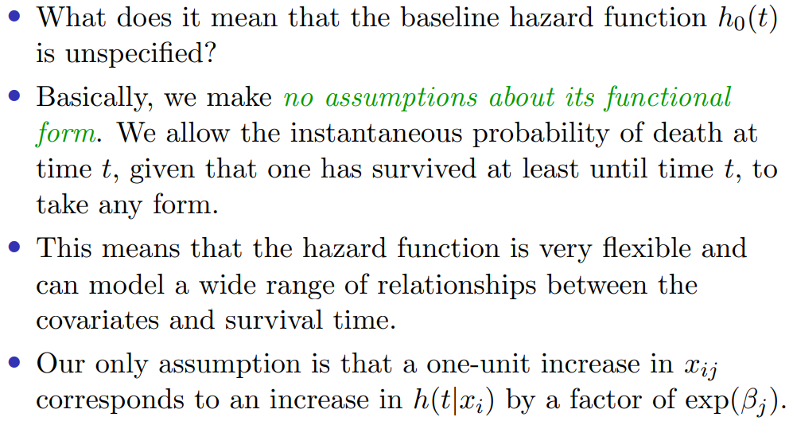
Proportional Hazards Model— Continued

Slide 31
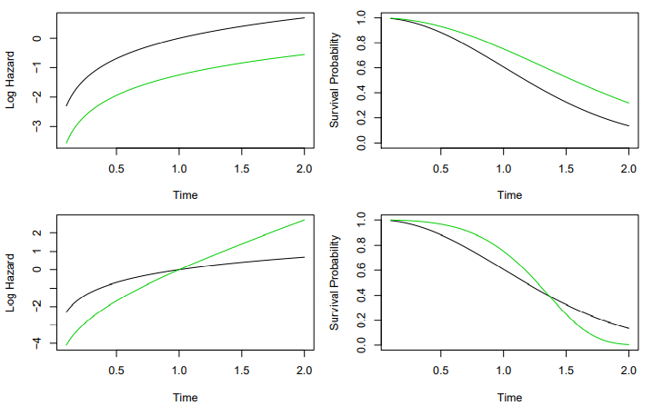
Proportional Hazards Model— Example

Slide 32
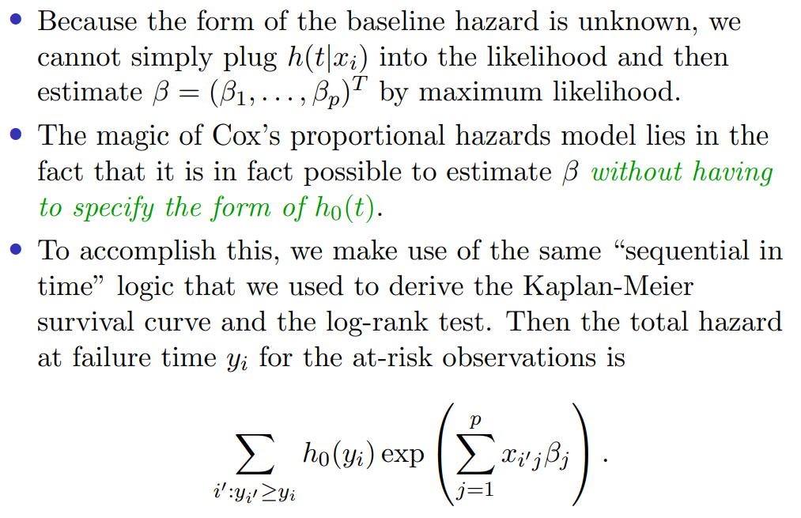
Partial Likelihood

Slide 33
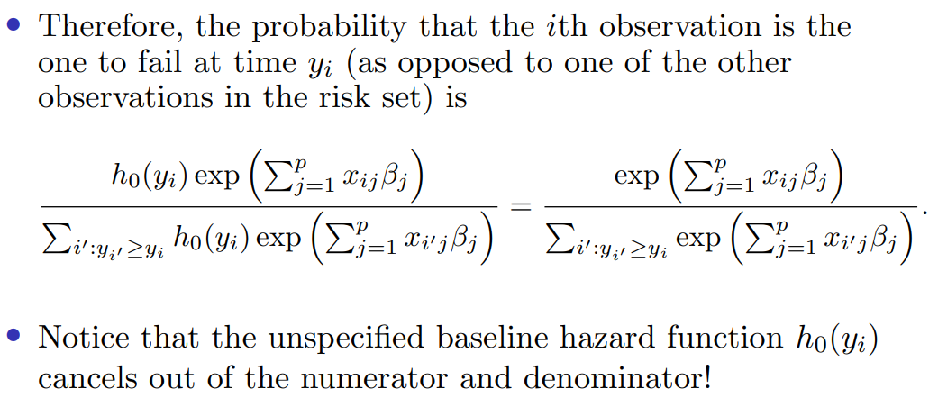
Partial Likelihood — Continued

Slide 34
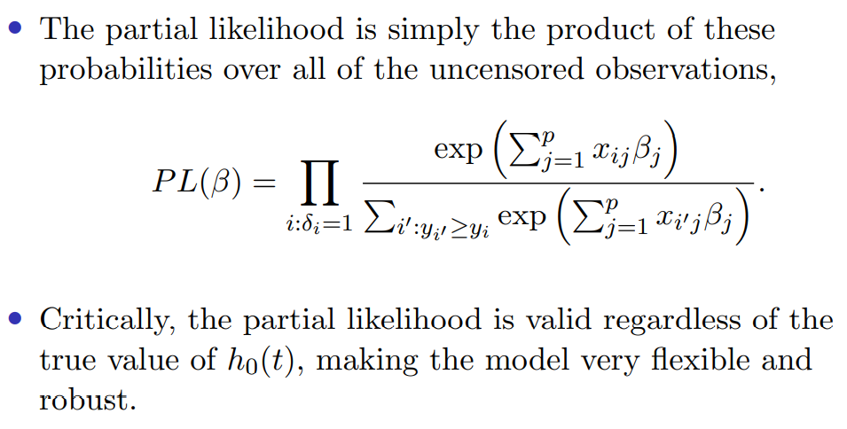
Partial Likelihood — Continued

Slide 35
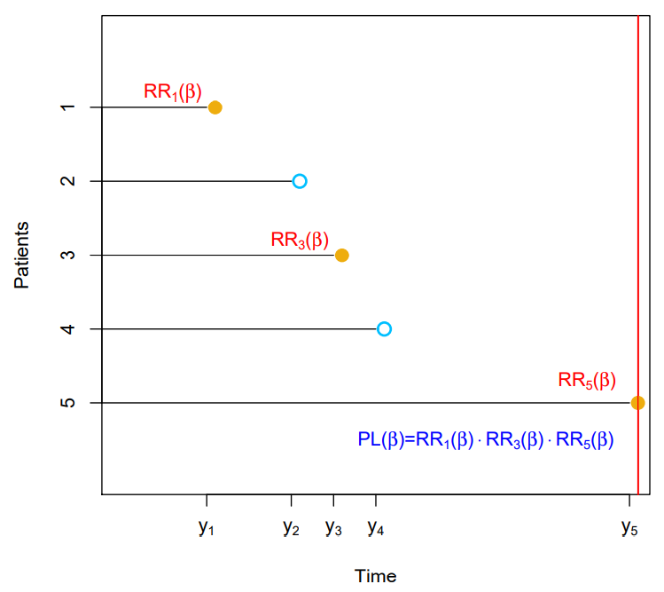
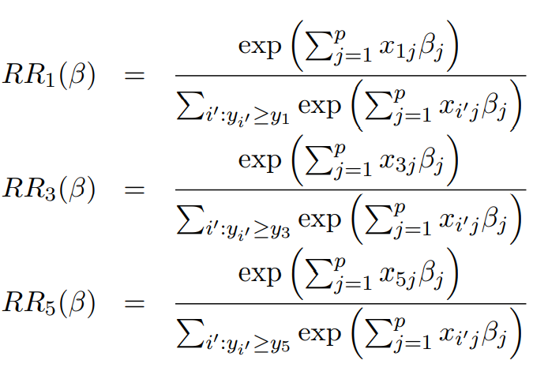
Partial Likelihood — Example

Slide 36
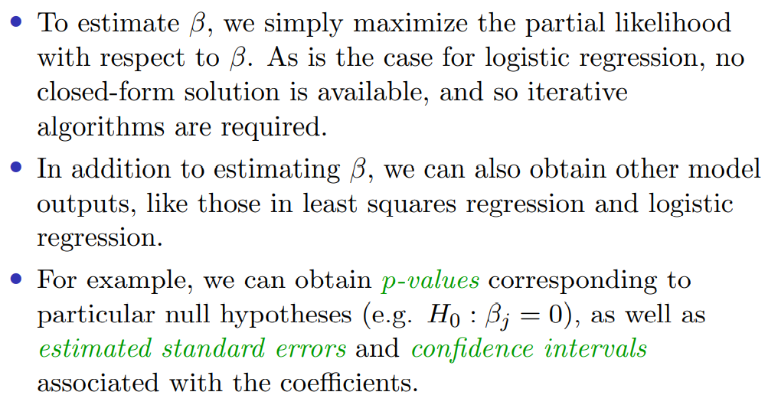
Partial Likelihood — Computation

